Slide 1


Chesapeake Bay Trust
Workgroup 8: Landscape Analysis
Chesapeake Bay Program Education Workgroup Meeting
Monday, April 8 2024 10:00 AM

Slide 2
Purpose
Provide an update on initial results of career and workforce landscape analysis.

Slide 3

Landscape Analysis
Discussion Group Findings

Slide 4
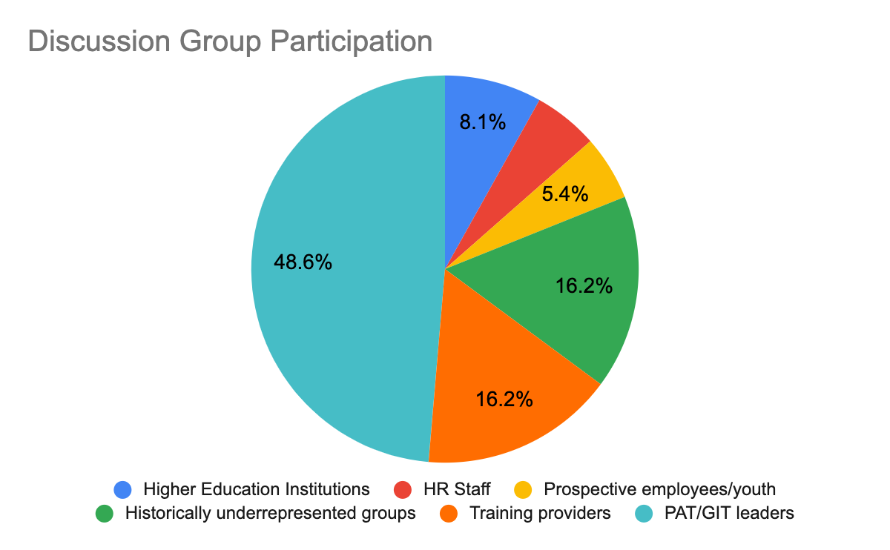
Participants
Group | Total
HR Staff | 2
Government Agency Representatives | 6
Prospective Employees/Youth | 2
Historically Underrepresented Groups | 6
Training Providers | 6
Higher Education Institutions | 3
Project Advisory & Goal Implementation Team Members | 18
Total | 43
Notes:
Project Advisory and Goal Implementation Team Members (PAT/GIT)
Human Resources staff
Prospective and existing employees (including students)
Federal, state, and local government agency representatives
Historically underrepresented groups (BIPOC, LGBTQ+, low income, etc.)
Higher education institutions (sciences faculty, career services staff)
Training providers

Slide 5

Facilitator Protocols
Moderator protocols - reviewed and approved
Candor and confidentiality
Strategies
Discussion questions (open-ended)
Poll questions (close-ended)
Flexibility to go off-book as needed
Submitted report to lead investigator within 48 hours of the discussion group
Notes:
Ex. Every HR staff that participated mentioned a robust internship opportunities. If we repeat this process, the results will be repeated.
Training providers are selected with such criteria that each of them are rich in information about the parameters that we are trying to study in the provider group in the Ches Bay.
"There are some cases where we might need an inquiry on certain items that fulfill specific criteria. This is where purposive sampling is useful."

Slide 6
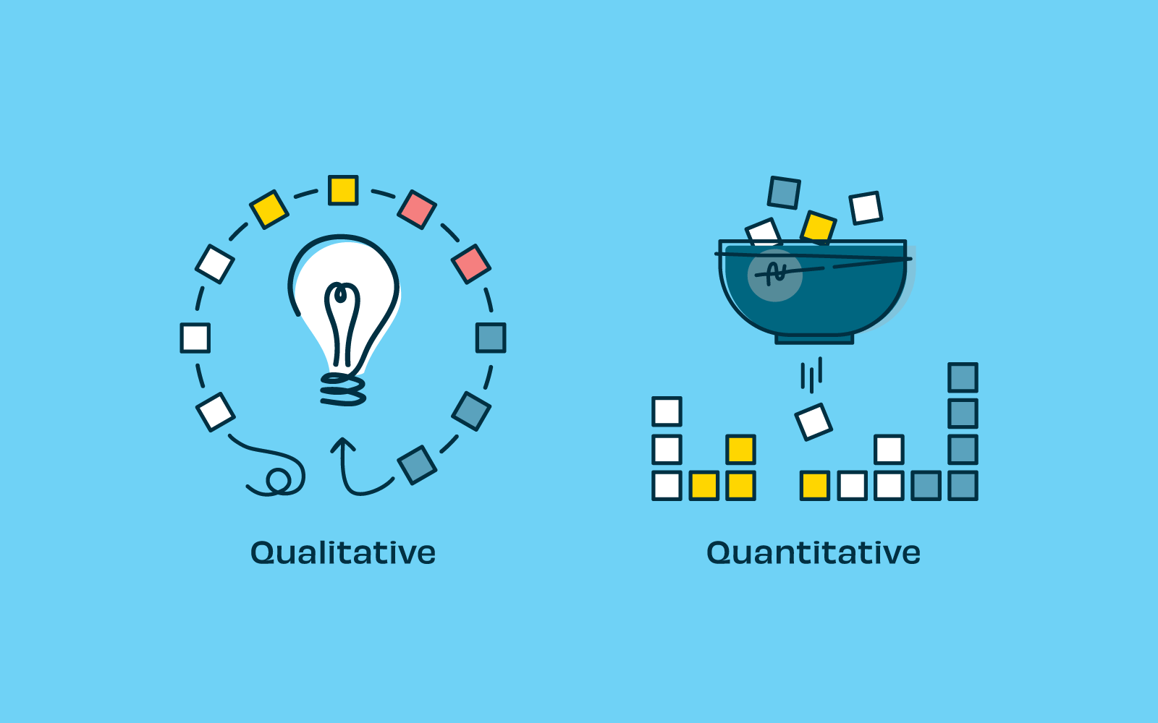
Methodology: Analysis in Quantitative Research
Qualitative research is not generalizable
High-quality qualitative research is defined by
Category | Questions to Consider
Credibility | Do members of the community being researched feel that the findings represent their experience?
Transferability | Can findings be applied to other contexts?
Dependability | Would another researcher identify similar findings?
Confirmability | Do findings reflect the participants’ responses and not the researcher’s perspectives and interests?
Authenticity | Does the research represent a range of viewpoints on the topic? (Treharne & Riggs, 2014)
Anney, V. N. (2014). Ensuring the quality of the findings of qualitative research: Looking at trustworthiness criteria. Journal of Emerging Trends in Educational Research and Policy Studies, 5(2), 272-281
Notes:
Ex. Every HR staff that participated mentioned a robust internship opportunities. If we repeat this process, the results will be repeated.
Training providers are selected with such criteria that each of them are rich in information about the parameters that we are trying to study in the provider group in the Ches Bay.
"There are some cases where we might need an inquiry on certain items that fulfill specific criteria. This is where purposive sampling is useful."

Slide 7
Highlights
Defining green jobs
Related to science
Outdoors-related, agriculture/land-related
Environmental policy, conservation
Jobs that do not cause harm
Reasons/benefits to green jobs
Passion for environment and clean energy
Cultural/familial connections to the environment
Partnerships with district agencies
Learning about emerging jobs and acquiring skills to access them
Restricted funding
Not knowing how to access jobs
Conflicting findings on requirements and expectations
Notes:
Ex. Every HR staff that participated mentioned a robust internship opportunities. If we repeat this process, the results will be repeated.
Training providers are selected with such criteria that each of them are rich in information about the parameters that we are trying to study in the provider group in the Ches Bay.
"There are some cases where we might need an inquiry on certain items that fulfill specific criteria. This is where purposive sampling is useful."

Slide 8
Information Gathering: Training Providers
Conducted Outreach to over 50 Providers across the Chesapeake Bay
2. 12 Training Provider Responses w/DEIJ outcome data
3. Added information for 60+ training providers using publicly identifiable lists
Now: Analyzing Data
Notes:
Box 3: We sent the form to 70 people (Wanted to thank Beth for lending your aid in outreach)
12 training providers completed the form including their outcome data, which is important as this information that is not publicly available
Added publicly available data from training providers (68 additions): types of training, where they're located, and if the training aligns with GIT needs.

Slide 9

Questions +
Feedback

