Slide 1
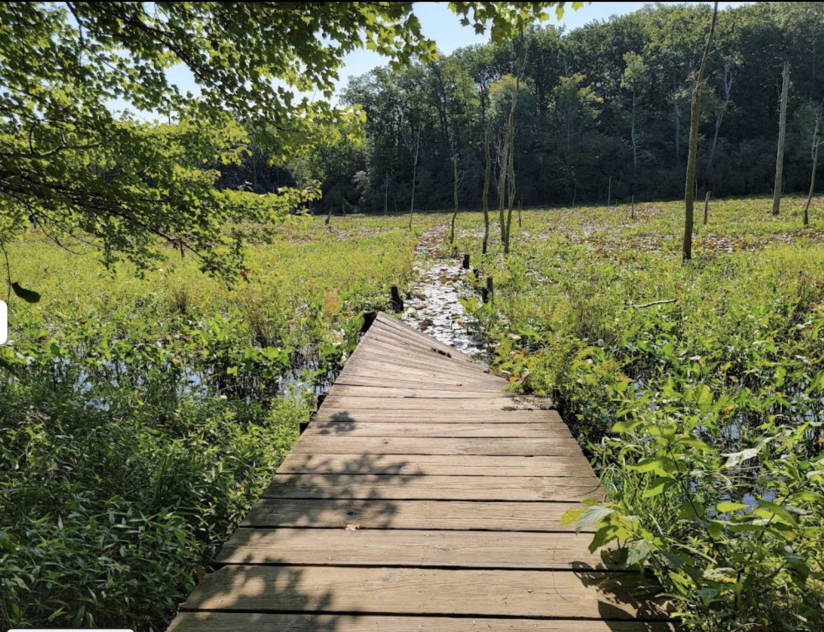

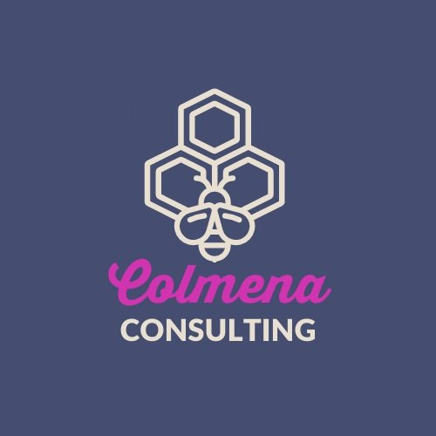
Chesapeake Bay Program GIT: Diversity Workgroup
Scope Of Work 3:
Equitable Grant Funding In The Chesapeake Bay Watershed
November 18, 2022
Landscape Analysis Findings

Slide 2
Interviewees
Under-Represented Organizations
Funders
Black Oak Collective
Charles Village Community Benefits District
EcoLatinos
Eastern PA Coalition for Abandoned Mine Reclamation
Green Muslims
Harder Street Urban Ag Center
Interfaith Partners for the Chesapeake
Northeast Farmers of Color Land Trust
Pamunkey Indian Tribal
Southeast Rural Community Assistance Project
Virginia Community Voice
Chesapeake Bay Funders Network
Chesapeake Bay Trust
DOEE - DC Chesapeake Bay Program
FFAR
LGAC
Maryland DNR
Maryland Philanthropy Network Green Funders Affinity Group
National Fish and Wildlife Foundation
National Park Service
NOAA
US Fish and Wildlife Service
Virginia Chesapeake Bay Program
Virginia DEQ
Virginia Environmental Endowment

Slide 3
What We Were Listening For
Under-Represented Organizations
Funders
Access to funding (e.g. priorities, process, supports)
Sources of funding
Key funding needs
Role of community and collaboration
Examples of effective grantmaking practices
Perceived challenges in accessing funding
URO Role in setting funder priorities
Relationship building with community
Equitable outcomes
Data collection and utilization
internal challenges and barriers

Slide 4
Asks to Funders from Organizations
Improved Communications
A Desire for Deep Engagement
An Improved Application Process
Better Access to Funders
Specific Funding Needs (engagement, startup support, collaboration)

Slide 5
Key Findings
Build Trust With Community
Make Equity a Priority
Agree on Clear and Shared Language
Come Out of the Black Box
Expand Ecosystem Awareness

Slide 6
Workshop Ideas
Building Trust
Make Equity a Leadership Priority and Commitment
Develop a Shared Language, Definitions, and Set of Data
Simplify and Streamline Processes
Build Awareness Across the Ecosystem
Notes:
Topic 1: Building Trust:
Trust-Based Philanthropy: Trust-based values function as a north star across four key dimensions of a grantmaking organization’s work: culture, structures, leadership, and practices.” In the workshops, we would explore what it means to embed trust in the culture, structure, leadership, and practices of private and public funders.
Community Engagement: Authentic community engagement requires capacity and resources as we democratize the work we do and shift power and resources to disadvantaged communities. In the workshops, we would explore a spectrum of community engagement developed in partnership with municipalities engaged in place-based work to reflect on what engagement means, and to what extent a shift of power from funder to community is appropriate and welcome.
Topic 2: Make Equity a Leadership Priority and Commitment
Participatory Strategy & Grantmaking: Clear alignment existed between funders and UROs in the belief that under-represented and under-resourced communities are included in grantmaking strategy and decision-making. In the workshops, we would introduce the principles of participatory grantmaking strategy and processes and provide take-aways for grantmaking staff to build upon.
Legal Briefing: Grantmaking staff need clear guidance on implementing priorities related to equity, Justice40, and supporting under-represented and under-resourced communities. In the workshops, we would bring in legal staff to provide the most up-to-date guidance and answer questions and consider recommendations for identifying and sharing best practices.
Grantmaker Communities of Practice: Grantmaking staff are eager to share and learn from each other as they are tackling these complex challenges. In the workshops, we would share information related to best practices for communities that private and public funders can implement.
Topic 3: Develop a Shared Language, Definitions, and Set of Data
Shared Definitions and Concepts: Across the network, it was apparent that grantmaking staff and UROs were struggling to understand shared concepts around environmental justice. In the workshops we would focus in on the evolving nature of the language in this space and provide resources to help make the connection between science, community priorities, and equity. This would also address key questions and concepts from Section 3.4, including metrics to capture interactions between social systems, ecosystems and health such as Natural Capital’s InVEST, the Human Well Being Index, Eco Health Framework, and Social Indicator Planning and Evaluation System for Nonpoint Source Management
Shared Data: Funders collect a lot of data from their applicants and grantees, but often fail to analyze or share that data across the network. In the workshop, we would share local efforts among funders to align their data collection and reporting strategies and help participants build on this work. This would include walking through efforts by Foundations and agencies to create a more open and transparent grantmaking system.
Equitable Evaluation: Many traditional practices in evaluation and reporting do not consider questions around who owns the data or stories, who defines success, whose voices may be missing, or the work that takes place beyond quantitative outcomes. In the workshops, we would introduce concepts related to centering community in evaluation that does not leave behind rigor, validity, or equity.
Topic 4: Simplify and Streamline Processes
Streamlining for Equity: The burden of paperwork and the density of technical information can actively work against equity goals. In the workshops, we would outline ways to shift internal capacity from paperwork to people-centered processes.
Identifying Equitable Fiscal Sponsors and Intermediaries: Funding intermediaries and fiscal sponsors can present a lot of pitfalls, especially when these organizations are also struggling to implement more equitable practices. In the workshops, we would talk about ways to identify intermediaries and fiscal sponsors that center community, while also understanding barriers for funders in supporting these organizations.
Topic 5: Build Awareness Across the Ecosystem
Asset Mapping: Increasing capacity and resources to better support community assets and needs mapping will support both funders and UROs. In the workshops, we would highlight some existing efforts and help participants consider ways to ensure that the data collection and sharing are disaggregated in ways that highlight funding disparities. We could also work to go through exercises that include approaches and steps to community asset mapping.

Slide 7
For questions or additional information reach out to
Marcus Griswold at mgriswold@calmwatersgroup.com

