Slide 1
GIT 6: Beyond 2025 Phase II
April 30, 2025

Slide 2
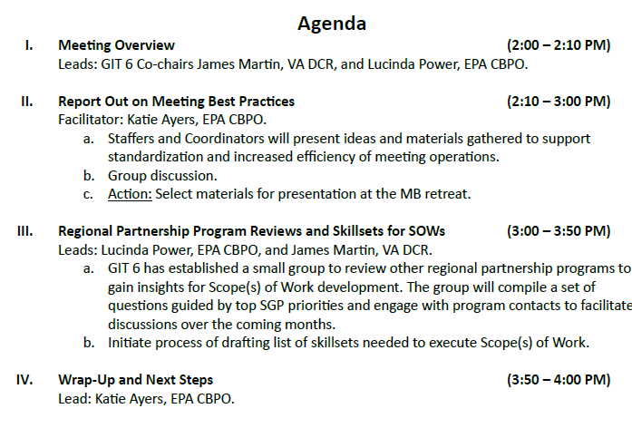
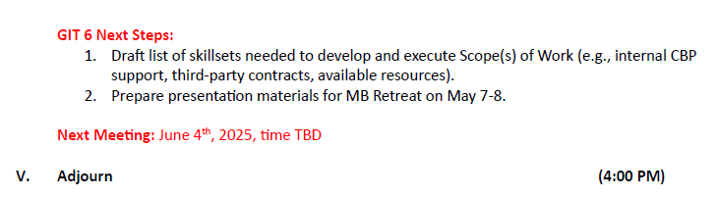
Notes:
Purpose: To discuss meeting operations and best practices; identify next steps for small group to conduct regional partnership program reviews; and determine skillsets needed to draft and execute Scope(s) of Work for GIT 6. The group will utilize top Structure/Governance/Process (SGP) priorities identified by GIT 6 to prepare deliverables and proposed plans for the Management Board Retreat on May 7-8, 2025.

Slide 3
Report out on
Meeting Best Practices
(50 minutes)
Facilitator: Katie Ayers

Slide 4
Example Guiding Questions
Existing SOPs, templates, or best practices that are used successfully for planning and running meetings?
How are agendas developed and who contributes?
Roles and responsibilities of Chairs, Coordinators, Staffers, Members, and Interested Parties?
How are decisions/actions captured and shared?
Where and how to incorporate public feedback?
Standards for website materials?
What platforms are used for hosting meetings and collaborating?

Slide 5
Deliverables from Coordinators and Staffers
List of existing resources (documents, SOPs, tools, templates).
Summary of best practices organized by topic (agenda setting, facilitation, etc.).
List of gaps or areas needing new SOPs or guidance.
Staffer Feedback Document

Slide 6
Meeting Best Practices
Standardization at appropriate tiers (GITs, workgroups, teams, etc.), but maintain some flexibility
  Material distribution 1-2 weeks in advance
  Agendas, venue information, minutes, record of attendees
  Actions/decisions - follow up timelines
Distribution lists could be stored in central location and updated regularly
Define roles and responsibilities of Chairs, Coordinators, Staffers, Members, and Interested Parties; voting/non-voting
  Consider structure of group membership that is most effective; what to do when missing positions
  Staffers are helpful in cross-GIT collaboration

Slide 7
Meeting Best Practices
Methods to ensure engagement in virtual, hybrid, and in-person environments?
  Best platform for hosting meetings (MS Teams, Zoom)
  Best platform for file sharing (Google Drive)
  Interactive discussions (Mentimeter, Miro board, Google Forms, raise hand, chat, consensus)
  Establish recommended frequency and duration for different tiers
  Need guidance on AI use and sharing recordings
Where and how to incorporate public feedback? (during or after meetings; GIT, workgroup, action team level?)
Question for Management Board/PSC:
What practices should be required as standards in CBP Governance document?

Slide 8
Web Content
The Chesapeake Bay Program's online Meetings Calendar is the home for public meetings hosted by GITs, Workgroups, Action Teams, and other Chesapeake Bay Program groups. The Meetings Calendar supports the program’s commitment to hosting open meetings, with advance notification of the date, time, location, agenda, and materials, and—after the meeting has occurred—a summary of actions and decisions. Ensuring staffers follow existing instructions for adding events to this calendar (e.g., including the relevant details, uploading the relevant materials, and making sure an event's title, URL, description, and supporting files are clear and concise) will facilitate collaboration, foster transparency, and make our vast meetings archive easier to search.
CBP Governance document states function of website
Web Team working on improvements for collaboration and revised guidance for website
  Accessibility Best Practices
Upload agendas and actions/decisions to group meeting pages, keep minutes and running notes as internal documents
  Create 3 templates for minutes based on level of detail needed by groups
  Ensure group pages are updated with scope, purpose, workplan, governance, membership, etc.

Slide 9
Group Discussion
Notes:
Until 3:00 PM.

Slide 10
Notes

Slide 11
Geographic Partnership Program Reviews
(20 minutes)
Lead: Lucinda Power

Slide 12
Objective: Review other geographic programs to gain insights for developing Scope(s) of Work focused on structure/governance/process.
Develop targeted discussion questions
Identify specific programs and points of contact
Engage tribal partners and other stakeholders
Small group of volunteers for this task met on April 28th.
Notes:
Small group will select programs to contact for discussions and materials review, assign staff to gather documents or schedule conversations, and develop a reporting format or slide deck template to capture insights.

Slide 13
Example Guiding Questions and Products
Is there an Agreement and/or Strategic Plan that guides the work of the Program?
How does the Program evaluate progress? Does it have an adaptive management framework?
What is the budget formulation process?
What is the level of political support for the program?
What communication tools or strategies have been most effective?
Products:
Organizational charts from other programs to compare structural features
Inventory of vision and mission statements and programmatic priorities
Political support map or timeline of key funding milestones
Examples of decision-making protocols or flowcharts
Compilation of accountability and reporting tools used by other programs
Case studies of adaptive management in action
Sample outreach materials, meeting formats, etc.

Slide 14
Geographic Program Reviews
Identified Programs: Puget Sound Partnership, South Florida Ecosystem Restoration Task Force (Everglades), San Francisco Estuary Partnership, Lake Champlain Basin Program, International Joint Commission (Great Lakes)
Develop template with 5-6 questions and assign Programs to individuals
  How was the Program formally established? (e.g., statutes)
  Organizational structure? What guides the Program?
  Funding mechanisms; deployment and prioritization of resources?
  How are you measuring success?
  Lessons learned?
Review Program materials (e.g., strategic plan, org chart) and schedule one-hour discussions
Notes:
Opportunity for more in-depth reviews: further discussion with specific questions for Programs? Are there NGO coalitions to support the Program? Best practices to engage external partners/stakeholders and areas for improvement?

Slide 15
Identifying Skillsets Needed to Address Structure, Governance, and Process Priorities
(30 minutes)
Lead: James Martin

Slide 16
Top Priorities
Clarifying membership roles, responsibilities, and definitions of Chesapeake Bay Program groups
Revising the Strategy Review System (SRS)
Refining decision-making processes
Strengthening communication, engagement, and trust
Establishing a logical framework and governance structure that supports the Chesapeake Bay Watershed Agreement

Slide 17
Existing Expertise and Resources Needed
Feedback document

Slide 18
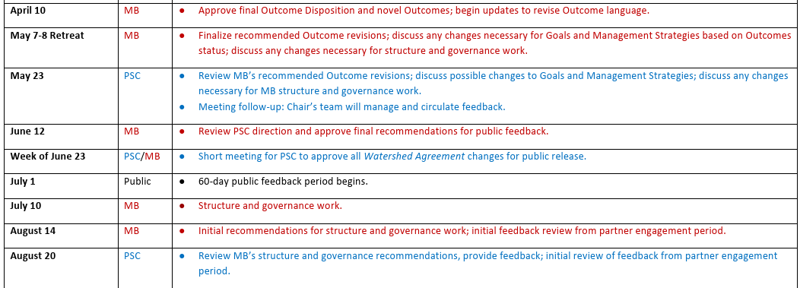
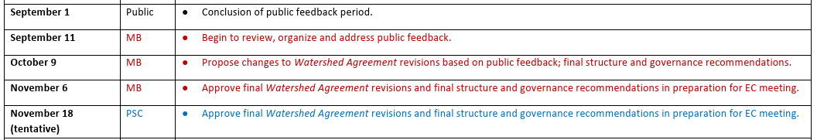
Process for Implementing the Dec 10, 2024 Charting a Course Beyond 2025 Charge

Slide 19
Next Steps
GIT 6 members continue to review and organize meeting best practices with goal to produce single document and templates.
Small team will develop guiding questions, identify geographic programs to review, and reach out to contacts.
Finalize list of skillsets needed and existing expertise/resources for Scope of Work development.
Resources in SharePoint Group
GIT 6 providing progress update at Management Board Retreat, Day 2 on May 8, 2025.

