Slide 1

Next Steps for
Changing Our Mindsets: Thinking Like a Network
Habitat Goal Implementation Team Meeting
April 28, 2025
Gina Hunt

Slide 2
Thinking Like a Network Recap
When we met last Spring, we had a presentation from USFWS that described this thinking, and there was an evaluation on where we are and where we would like to be across the “Continuum of Collaboration” in the Habitat GIT.
When we met in the Fall, we had participants provide suggestions on how to get there on the spectrum.
Today we are going to briefly revisit those details and then discuss next steps. Putting suggestions to actions, and prioritizing.

Slide 3
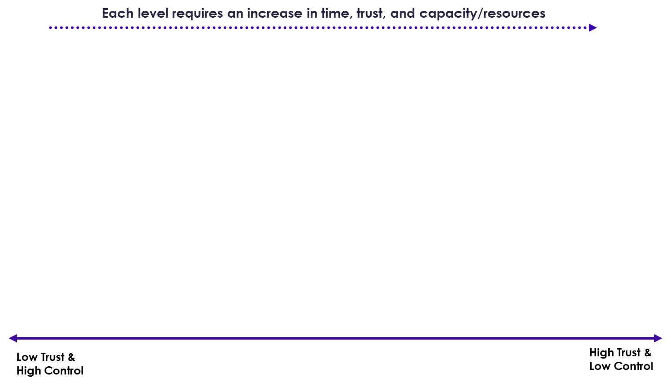
Compete | Coexist | Inform or Consult (1-way Comms) | Coordinate (2-way Comms) | Cooperate (2-way Comms) | Collaborate (Multi-way Comms) | Empower or Integrate
Competition between or among partners for clients, resources, partners, Board members, and/or public attention and credit. | Neutral relationship or connections with partners, aware of their work but no systematic connection between or among partners | Partners share information for mutual benefit – to improve understanding of and awareness about issues, alternatives, and/or decisions made | Partners agree to adjust and align organizational strategic priorities and work with each other for greater outcomes | Partners interact (formally and informally) on discrete projects or activities (time bound) | Partners engage in collective impact to achieve jointly identified issues, co-develop outcomes and alternatives, and implement solutions. Work is based on shared mission, goals, and decision making, share funding, staff, and expertise | Completely merging operations, administrative structures, and budgets to form new entity. The individual partners/orgs involved are not discernable – decision making lies entirely with new entity
Adapted from: Himmelman, A.T., Collaboration for a Change: Definitions, Decision‐making Models, Roles, and Collaboration Process Guide. January 2002, Himmelman Consulting, Minneapolis, MN; International Association of Public Participation (IAP2) Spectrum of Public Participation; Partnerships and Community Collaboration Academy, Community Collaboration Toolbox: Continuum of Collaboration
Notes:
NOTE: his diagram is a synthesis of research (cited on slide), practitioner experiences and case studies – UPDATED 9/24 (single color, combined trust/control arrows, and added increasing capacity arrow)

Slide 4
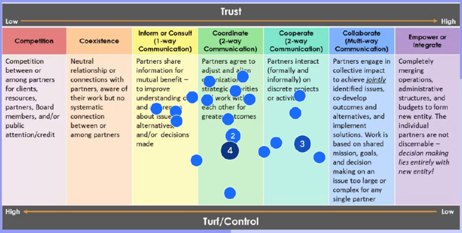
Habitat GIT *currently* operates
Notes:
Spring 2024 exercise results

Slide 5
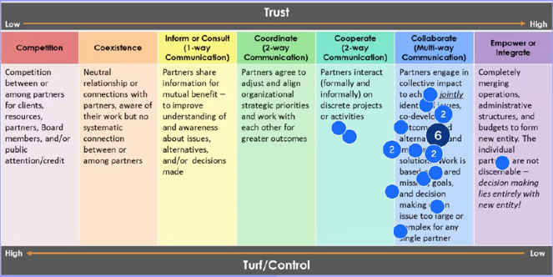
Habitat GIT *currently* operates
*Would like* Habitat GIT to operate
Notes:
Spring 2024 exercise results

Slide 6
What is needed
These are the characteristics of operating on this end of the continuum.
Coordinate (2-way Comms) | Cooperate (2-way Comms) | Collaborate (Multi-way Comms) | Empower or Integrate
Minimal time commitment, limited levels of trust, no need to share turf. Focus is on information exchange. | Moderate time commitments, moderate levels of trust, no need to share turf. Focus is making it easy to share resources and services. | Substantial time commitments, high level of trust, and significant access to each other’s turf. Focus is sharing resources for a common purpose. | Extensive time commitments, high levels of trust and extensive areas of common turf, Focus is on enhancing each other’s capacity to meet the common purpose.

Slide 7
Improving Collaboration – Fall Results
Key Challenges
Siloed Work: Limited cross-GIT communication and collaboration; updates often lack depth.
Infrequent Interaction: Too few joint meetings and opportunities for real-time exchange. Large meetings lack interaction.
Low Engagement: Limited in-person participation, unclear collaborative roles, and inconsistent commitment.
Communication Gaps: Minimal info sharing, lack of shared liaisons, and inaccessible updates.
Structural Barriers: Decisions often top-down, jurisdictional disparities, and resource overlap.
Remote Work Impact: Harder to build trust, relationships, and collective momentum.
Opportunities for Action
Enhance Communication: Appoint liaisons, increase summary updates, and foster regular informal check-ins.
Foster Cross-GIT Collaboration: Thematic think tanks, co-benefit projects, and targeted workshops. Focus on concrete cross-cutting challenges
Build Community: Prioritize in-person engagement, shared events, and social connection (e.g., lunch & learns, annual conferences).
Support Collaboration: Align goals, provide recognition and funding support.
Increase Visibility & Access: Share agendas, outputs, and meeting outcomes broadly; utilize reminders and shared calendars.

Slide 8
WE WANT TO MOVE SUGGESTIONS
TO ACTIONS
Opportunities for Action
Enhance Communication: Appoint liaisons, increase summary updates, and foster regular informal check-ins.
Foster Cross-GIT Collaboration: Thematic think tanks, co-benefit projects, and targeted workshops. Focus on concrete cross-cutting challenges
Build Community: Prioritize in-person engagement, shared events, and social connection (e.g., lunch & learns, annual conferences).
Support Collaboration: Align goals, provide recognition and funding support.
Increase Visibility & Access: Share agendas, outputs, and meeting outcomes broadly; utilize reminders and shared calendars.
Foster Cross GIT and Workgroup Collaboration:
How do we identify outcome/workgroup topics of overlap?
How do we identify co-benefits with on the ground projects?
Low Engagement: How do we strengthen engagement in the workgroups?
Support Collaboration/Funding Support: How do we strengthen the GIT membership’s ability to acquire funding resources?
We have heard the need for focused and actionable collaboration. Would it be helpful to have a designated time to discuss upcoming grant opportunities? Time to workshop problems and funding opportunities. IF yes, provide idea/action needed.
Considering the Opportunities for Action already provided, please let us know if you have an additional suggestion.

Slide 9
PRIORITIZE OUR ACTIONS
There are many great suggestions – but which category would be the most important place to focus.
Opportunities for Action
Enhance Communication: Appoint liaisons, increase summary updates, and foster regular informal check-ins.
Foster Cross-GIT Collaboration: Thematic think tanks, co-benefit projects, and targeted workshops.
Build Community: Prioritize in-person engagement, shared events, and social connection (e.g., lunch & learns, annual conferences).
Support Collaboration: Align goals, provide recognition and funding support.
Increase Visibility & Access: Share agendas, outputs, and meeting outcomes broadly; utilize reminders and shared calendars.

Slide 10
WE WANT TO MOVE SUGGESTIONS
TO ACTIONS
Opportunities for Action
Enhance Communication: Appoint liaisons, increase summary updates, and foster regular informal check-ins.
Foster Cross-GIT Collaboration: Thematic think tanks, co-benefit projects, and targeted workshops. Focus on concrete cross-cutting challenges
Build Community: Prioritize in-person engagement, shared events, and social connection (e.g., lunch & learns, annual conferences).
Support Collaboration: Align goals, provide recognition and funding support.
Increase Visibility & Access: Share agendas, outputs, and meeting outcomes broadly; utilize reminders and shared calendars.
Foster Cross GIT and Workgroup Collaboration:
How do we identify outcome/workgroup topics of overlap?
How do we identify co-benefits with on the ground projects?
Low Engagement: How do we strengthen engagement in the workgroups?
Support Collaboration/Funding Support: How do we strengthen the GIT membership’s ability to acquire funding resources?
We have heard the need for focused and actionable collaboration. Would it be helpful to have a designated time to discuss upcoming grant opportunities? Time to workshop problems and funding opportunities. IF yes, provide idea/action needed.
ie. Host a workshop before grant cycle to discuss possible proposals and discuss cross-workgroup/git opportunities to strengthen the proposals through collaboration and co-benefits of projects

Slide 11
Enhance Communication
Foster Cross GIT and Workgroup Collaboration
Build Community
Support Collaboration
Increase Visibility and access

Slide 12
Moving ForwarD
Actions:
Strengthen communication and connection across GITs and WGs
Focus on actionable collaboration, not just updates

