Slide 1
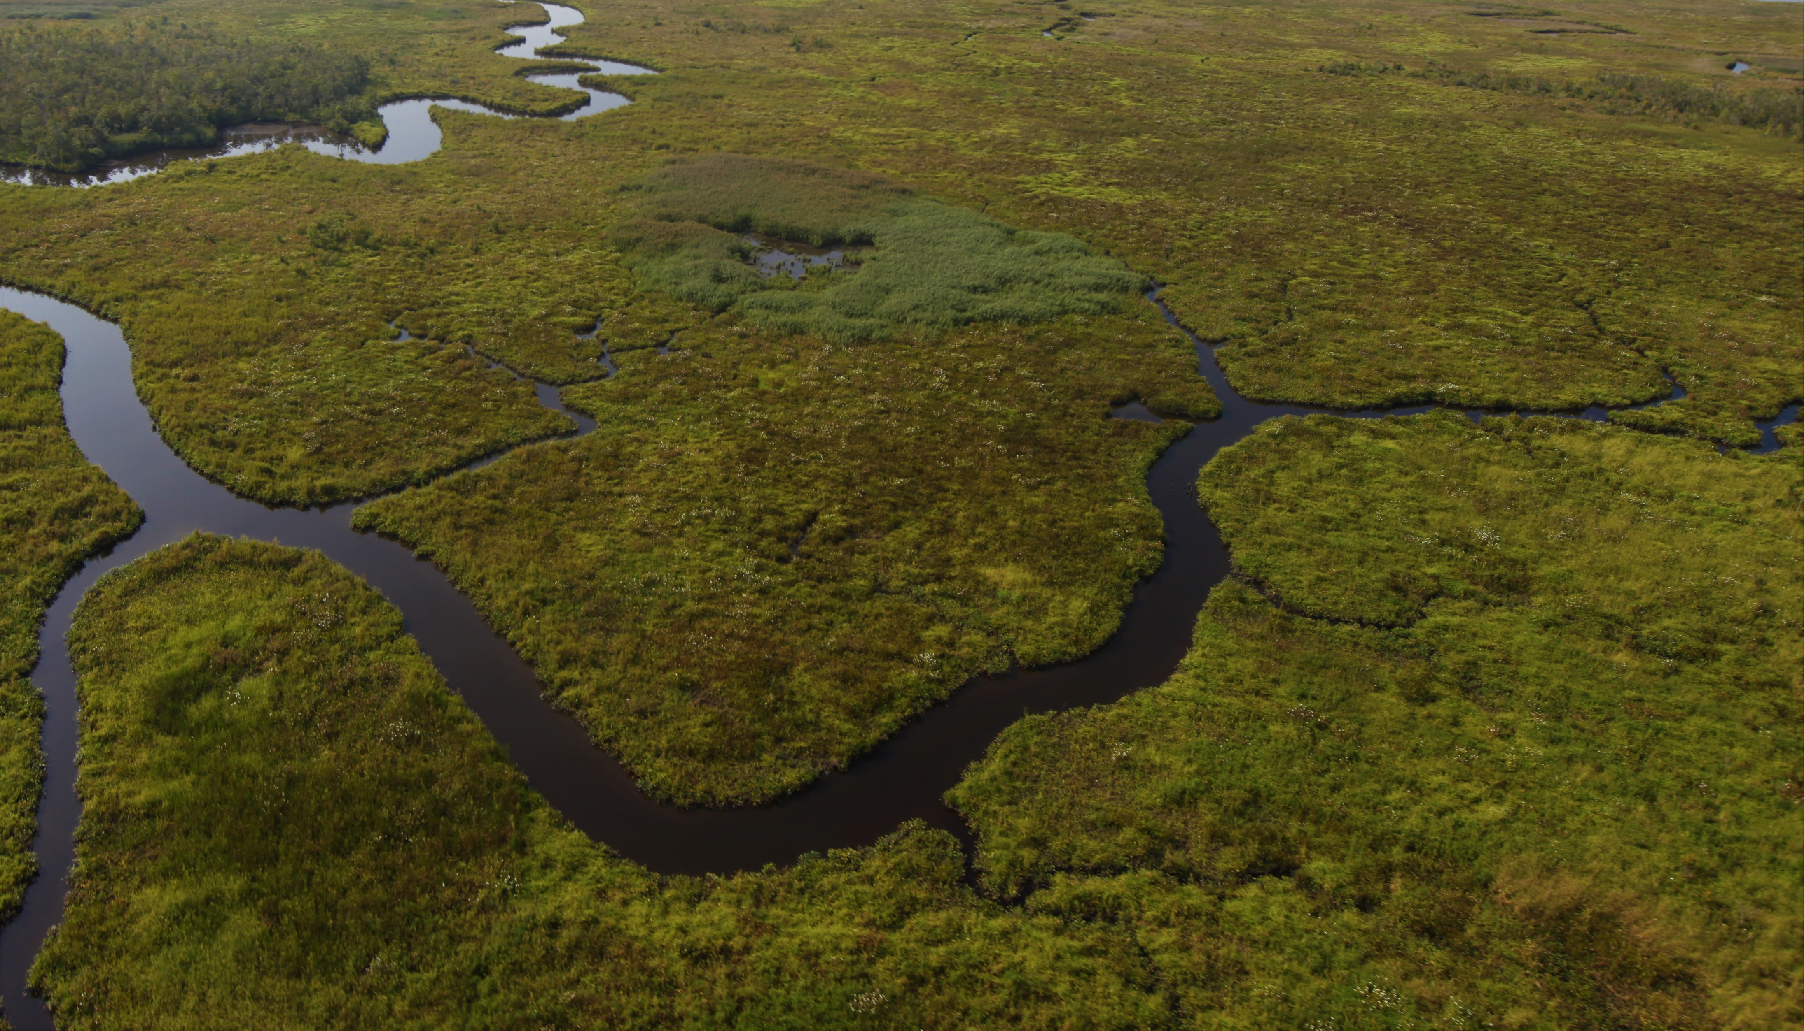

Wetland’s Habitat Tracker history
December
2020- Jan 2021
March2021-July
2021
August
2-3, 2022
November 23, 2022
December 2022-
January 2023
January
2024
Wetlands Workgroup briefs PSC in March. PSC suggests Bay program and supports need for Tracking mechanism for wetlands. PSC asks Pay Program evaluate all 31 outcomes. OAT is formed. In July OAT briefs MB/PSC on status of 31 outcomes.
MB/PSC directs the Bay Program to identify why wetlands are so far off course, what can be done about it and develop a plan to achieve the outcome by 2025.
Bay Program submits draft Restoring the Wetlands of the Chesapeake Watershed Workshop Action Plan for MB consideration That includes development of a new tool called the Habitat Tracker
Bay Program and Jurisdictions present wetland’s outcome attainment strategy(s) for MB/PSC discussion:
Meet expectations?
Path Forward?
Plan was final Jan 17, 2023 and included the expectation of the Habitat tracker
Habitat Tracker becomes Live.
Wetlands Workgroup enters SRS process and identifies wetlands as off track , asks MB for support to develop a tracking tool. MB asks for Costs and refers Wetlands workgroup to the PSC
Restoring Wetlands of the Chesapeake Bay Watershed Workshop identifies barriers, potential solutions and recommendations on moving forward. Discussion includes development of a new tool to track wetlands
Notes:
Time line experiment

