Slide 1

Building the New Stewardship Indicator
Working Document
May 16, 2024

Slide 2
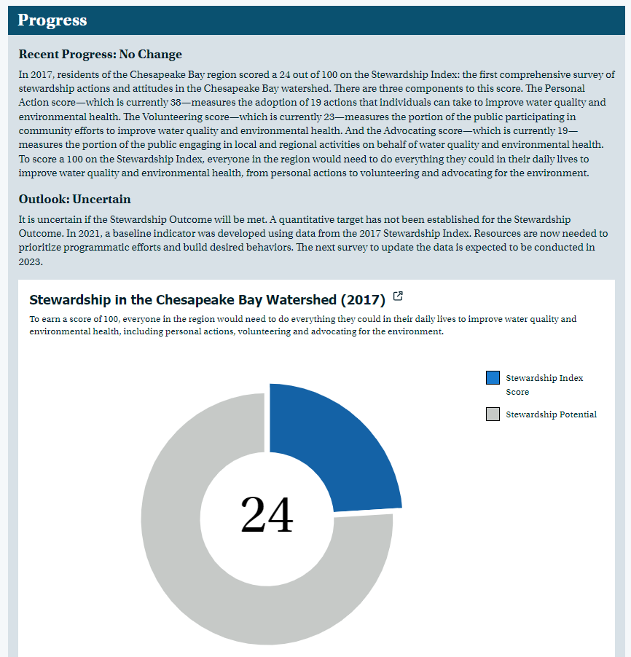
Current Indicator
Rolled up score that includes:
Behavior
Volunteerism
Civic Engagement

Slide 3

Changes in Stewardship Indicator Approach
 | 2017 | 2024
What to measure? | Measure “environmentally motivated” behaviors | Expand definition of stewardship and measure actions that stem from personal values and motivations, community priorities that are accessible to all.
Number of indicators? | Single score rollup of behavior adoption, volunteerism and civic engagement – not enable us to see trends | Several indicators that show trends and enable us to focus efforts more strategically
Success? | Everyone, everywhere, doing everything | Recognize where we are and take action to make forward progress
Notes:
With our new data in hand, and after some conversations we have been having as a team, we recognize we need to make several changes to the way we are thinking about measuring our progress.
First, what we measure? Before we were measuring against our 19 stewardship behaviors that I mentioned earlier, but we want to expand the definition of stewardship, to behaviors beyond those that are environmentally motivated to behaviors that stem from personal or community interests that may also have environmental impacts.
Second, in 2017, we had a rollup score that didn’t enable us to see trends, and so going forward we would like to think about a collection of indicators that show trends and enable us to focus efforts more strategically
Finally, in 2017 we measured success against everyone, everywhere, doing all of our predetermined measured behaviors. We know not everyone is interested or able perform these stewardship behaviors so we want to recognize where people are, and focus on actions that make forward progress.

Slide 4
Proposed Indicator
Four Components:
A. Stewardship Behaviors
What people are doing now, and what they are poised to do.
B. Public Expectations
Public support for restoration, and expectations for leadership.
C. Individual Attitudes
Personal factors and perceptions impacting Stewardship.
D. Expanding Stewardship
Acknowledge we need to learn more and do more

Slide 5
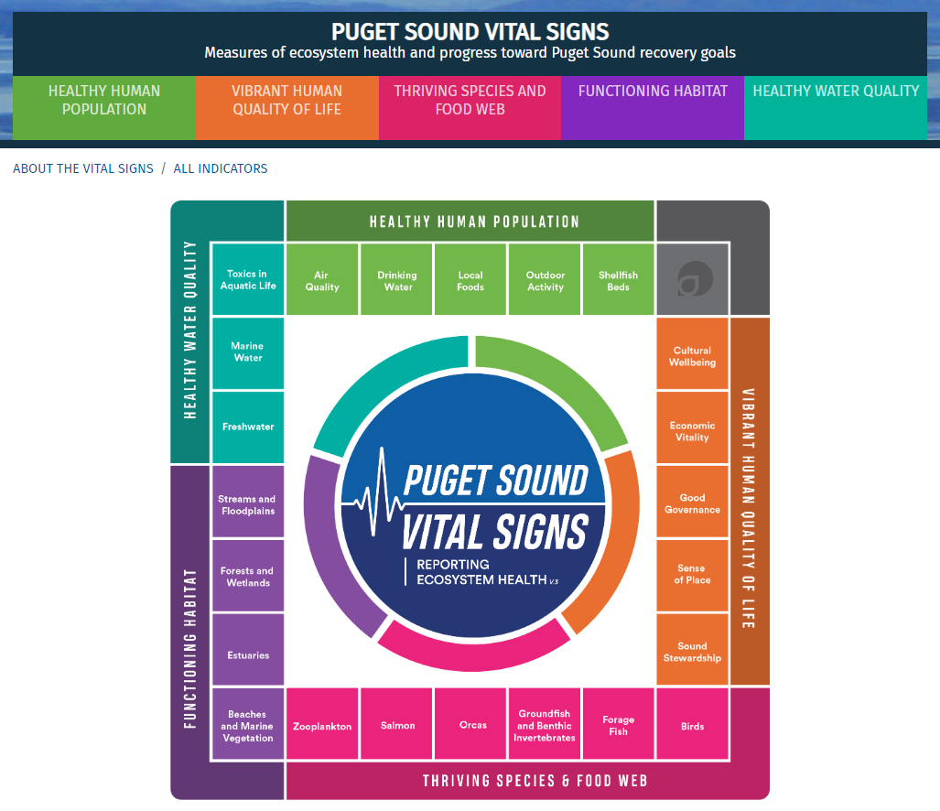
What We Like about This:
A wheel; no hierarchy
Focuses on connections among categories/factors
Can click into individual categories for deeper information

Slide 6


Stewardship Behaviors
Category 1
Expanding Stewardship
Category 2
Category 3
Take Action
Take Action
Category 4
About the indicator
Take Action
Take Action
Public Expectations
Individual Attitudes

Slide 7
Categories:
Improving
Conservation landscaping
Rain barrel connected
Dog waste
Rain garden
Poised to improve
Choosing native plants
Fewer disposable plastic water bottles
Fewer disposable plastic bags
Consider adding the impact of interventions (the “A” questions)
Holding steady (at a good level)
Septic serviced
Plant a tree
Worsening (moving in the wrong direction)
Use pesticides
Use herbicides
Medicine down the drain
Littering
Stewardship Behaviors
Category 1
Category 2
Category 3
Take Action
Category 4
Action:
Drive practitioners to ChesapeakeBehaviorChange.org
for best practices, data, case studies.

Slide 8
Category 1
Categories:
Personal responsibility & impact
My daily activities contribute to pollution. (E1)
Pollution around here affects me personally. (E2)
Intention
I want to do more to help make local creeks, rivers, and lakes healthier. (E3)
I know some things I can do to help reduce water pollution where I live. (E4)
If people work together, water pollution around here can be fixed. (E5)
If I wanted to volunteer to help the natural environment locally, I would know how to do that. (E6)
Government efficacy
I could see myself speaking out for the environment by posting to social media or talking with my neighbors. (E7)
Opportunity to volunteer
Can name an organization working on this (V5)
Category 2
Category 3
Take Action
Take Action
Category 4
Action:
Focus on audience segments.
About the indicator
Take Action
Take Action
Individual Attitudes

Slide 9
Action:
Decision makers to have sense of confidence/urgency around government action.
Encourage investment in the long-term sustainability of fed/state government, organizations, NGOs engaged in restoration effort at large. Align with the public sense of importance on this work.
Focus practitioners on civic action and getting people to speak out.
Category 1
Category 2
Category 3
Take Action
Categories:
Personal Priority
Chesapeake Bay health among region's highest priorities (E14)
Government Role
Strong government action is needed (E11)
Optimism
If people work together, water pollution can be fixed (E5)
Take Action
Category 4
About the indicator
Take Action
Take Action
Public Expectations

Slide 10
Category 1
Expanding Stewardship
Category 2
Categories:
Recognition of barriers to Stewardship
Acknowledgement of what we don’t know
Pathway to better understanding
Category 3
Take Action
Take Action
Category 4
About the indicator
Take Action
Take Action
Action:
Outline pathway to better understanding.

Slide 11
Feedback!
Handen.Amy@epa.gov

