Slide 1
Technical Assistance Programs for Flood Mitigation U.S. Army Corps of engineers
Tony Clark
Chief, Technical Assistance Branch, Planning Division
Karl Kerr
Planning Assistance to States (PAS) Program Manager
May 14, 2024

Slide 2
agenda
Cost-Sharing
Programs
Technical Assistance – no design or construction
Planning Assistance to States (PAS)
Floodplain Management Services (FPMS)
Silver Jackets (SJ)
(Small) Study, Design “AND” Construction
Continuing Authorities Program (CAP)
(Small) Study, Design “OR” Construction
Section 510, Chesapeake Bay Environmental Restoration and Protection
Section 219, Environmental Infrastructure
Section 313, Environmental Infrastructure

Slide 3
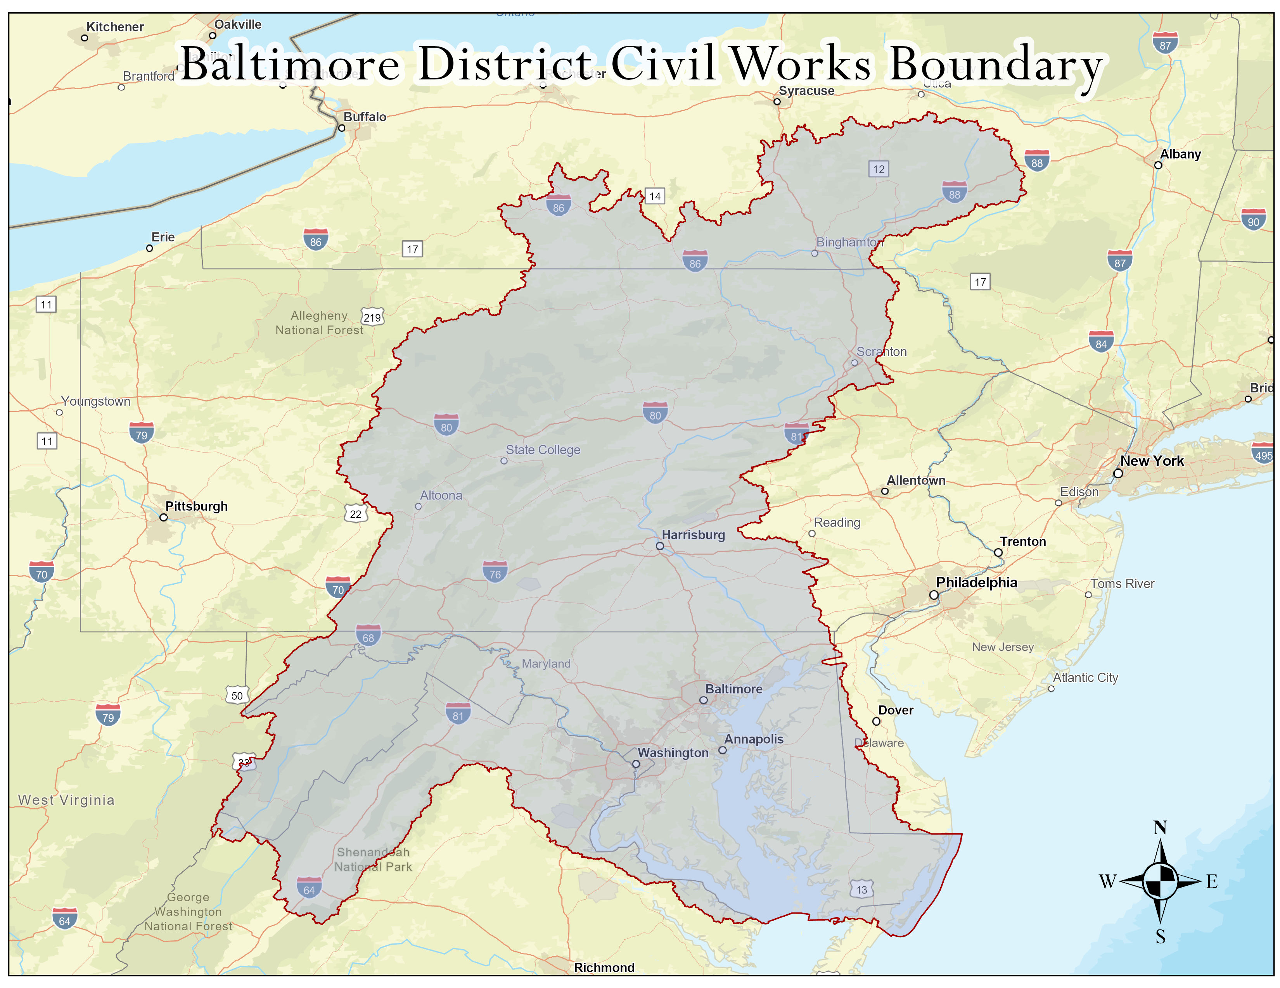

Slide 4
USACE programs – cost sharing
Federal Funding
NOT a grant
Annual appropriations to USACE
Budget process
Community project (named)
Programmatic (Technical Assistance, CAP, Section 510)
Non-Federal Funding
Cash or In-Kind Service from a non-federal Sponsor
Local municipality, County, State
Non-Governmental Organization (NGO)
Grants or funds from non-Federal sources to a non-federal sponsor
Process
Scope the tasks/costs
Sign an agreement
Begin when Federal and non-federal funds are in place

Slide 5
USACE programs
Planning Assistance to States (PAS)
All things water (flooding, drought, water supply, stormwater, comprehensive planning)
Floodplain Management Services (FPMS)
All things flooding (riverine, tidal, hurricane-driven, stormwater, compound; structural, non-structure, natural and nature-based solutions, etc.)
Silver Jackets (SJ)
All things flooding; interagency collaboration and annual proposals
Tribal Partnership Program (TPP)
All things water resources
Continuing Authorities Program (CAP)
All things water resources
Planning, design, & construction generally <$15M
Section 510 - Chesapeake Bay Environmental Restoration and Protection Program
Design & construction assistance for projects up to $15M
Section 219 and 313 – Environmental Infrastructure
Design & construction assistance for water and wastewater infrastructure
Technical Assistance
Design/Construction

Slide 6
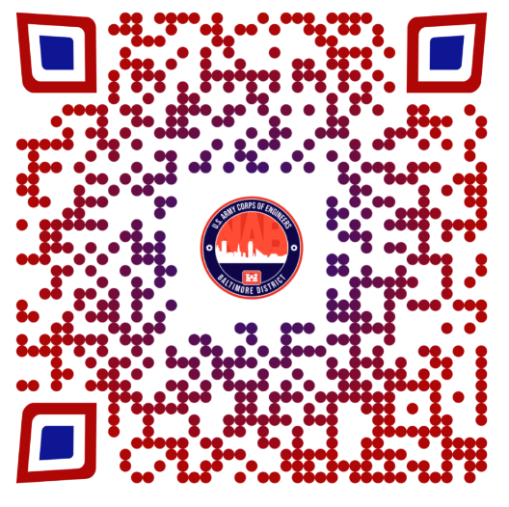
Planning assistance to states (PAS)
Purpose – “All things water”
Types of Projects
Stream and wetland assessments, sewer infrastructure inventories and databases, watershed planning, flood risk assessments and flood risk management studies, GIS mapping, water supply demands, etc.
Funding/Cost-Sharing
50% federal/50% non-federal
Non-federal voluntary contributions in excess of cost-share requirement
Opportunity for public-private partnerships; May include in-kind services
New Guidance!! Economically disadvantaged communities are exempt from the cost-share (100% USACE funded using the Climate and Economic Justice tool)
How to Get Started? What’s Required?
Contact the Program Manager
Federal and non-federal partners sign a Letter of Agreement
More Information
Karl Kerr, Program Manager, Baltimore District
410-962-4417
Karl.Kerr@usace.army.mil
http://www.nab.usace.army.mil/technical-services/

Slide 7
Floodplain management services (FPMS)
Purpose – “All things flood”
Types of Projects
Flood inundation tools and mapping, flood risk outreach, flood risk assessments, mitigation planning, post-flood documentation, emergency table-top exercises, flood preparedness, etc.
Funding/Cost-Sharing
100% Federal funds, with non-federal voluntary contributions allowed to expand the scope of the study
How to Get Started? What’s Required?
Contact the Program Manager
Federal and non-federal partners sign a Letter of Agreement, if non-federal contribution
More Information
Stacey Underwood, Program Manager, Baltimore District
410-962-4977
Stacey.m.underwood@usace.army.mil
http://www.nab.usace.army.mil/technical-services/

Slide 8
Typical tasks for FPMS/PAS Flood Risk Management Studies:
Task 1 - Field Survey
Riverine – Bridges and Channel Cross Sections
Stormwater – Inlets and Manholes
Task 2 - Hydrologic Analysis
Task 3 - Hydraulic Analysis
Task 4 - Floodplain Mapping
Task 5 - Flood Risk Management Measures

Slide 9
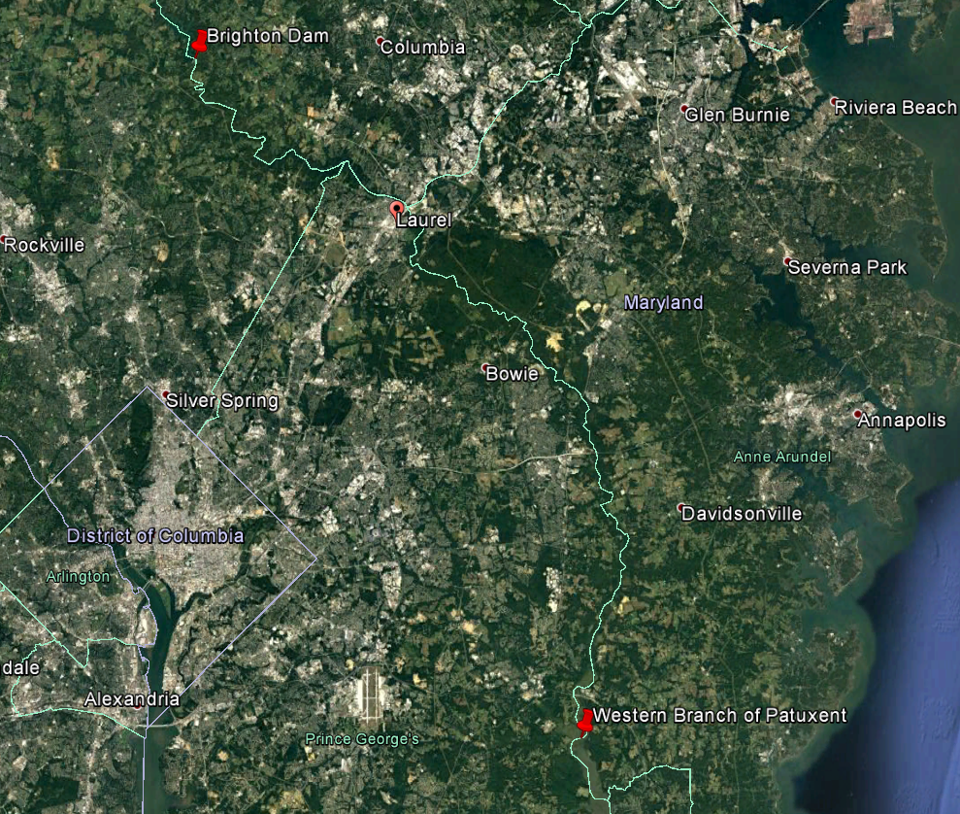
NAB – PATUXENT RIVER WATER RESOURCE Study
Agreement Type – Technical
Partners: City of Laurel, MD; FEMA;
Project Description: The City of Laurel and the Patuxent River Watershed Hazard Mitigation Partnership requested assistance in completing a flood evaluation for the riverine portion of the Patuxent River. This study would update the existing flood modeling and flood hazard mapping for the Patuxent River and develop flood risk reduction alternatives to assist the local communities in flood resiliency efforts.
Objectives:
Data collection
Hydrologic and hydraulic modeling
Develop alternatives to address riverine flooding
Economic analysis
Total project costs: $193K
Notes:
City of Laurel is leading the Patuxent River Watershed Hazard Mitigation Partnership which consists of members from the City of Laurel, Howard, Anne Arundel and Prince George’s Counties, USGS, MEMA, MDE, and MD Dept Planning, in completing a flood evaluation for the Patuxent river. The City and the Partnership reached to USACE to assist in updating the existing flood mapping and develop flood risk reduction alternatives. The City of Laurel lead partnering meeting with USACE and the Patuxent River Watershed Hazard Mitigation Partnership before and during the project. This partnership led to FEMA providing separate funding for the H&H portion of this study.
FEMA provided 93k to USACE to complete the hydrology and hydraulics, USACE completed the field work, data collection, modeling and development of alternatives.

Slide 10
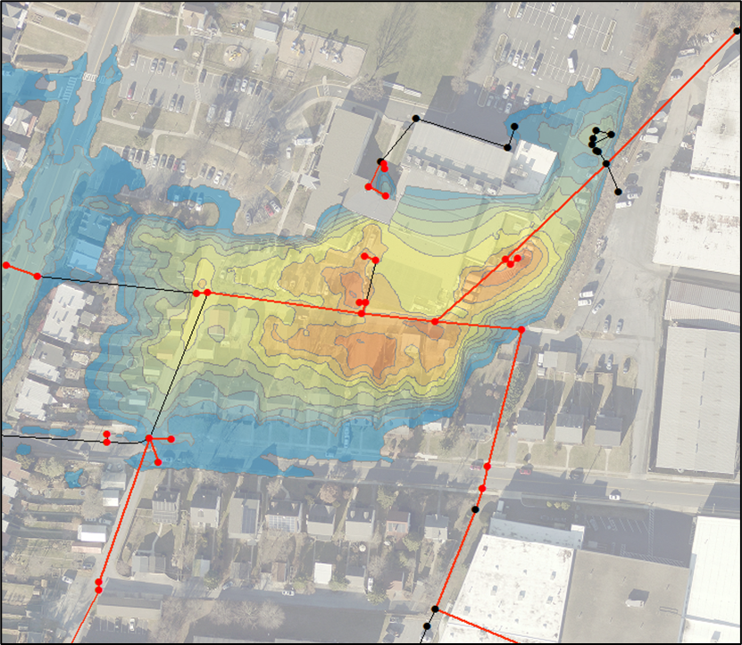
PAS – FLOOD RESILIENCY STUDY FOR THE CITY OF FREDERICK
Partner: City of Frederick, Maryland
Project Description: City of Frederick has experienced substantial flooding during larger storm events, like the event that occurred in May 2018, when extensive damages occurred as a result of inadequate stormwater infrastructure.
Objectives:
Complete field surveys of existing stormwater system.
Complete hydraulic and hydrologic, and stormwater modeling.
Develop conceptual alternatives to address riverine and stormwater flooding.
Total project costs: $730K
Federal funding: $365K
Non-Federal funding: $365K
Stoplog Panels

Slide 11
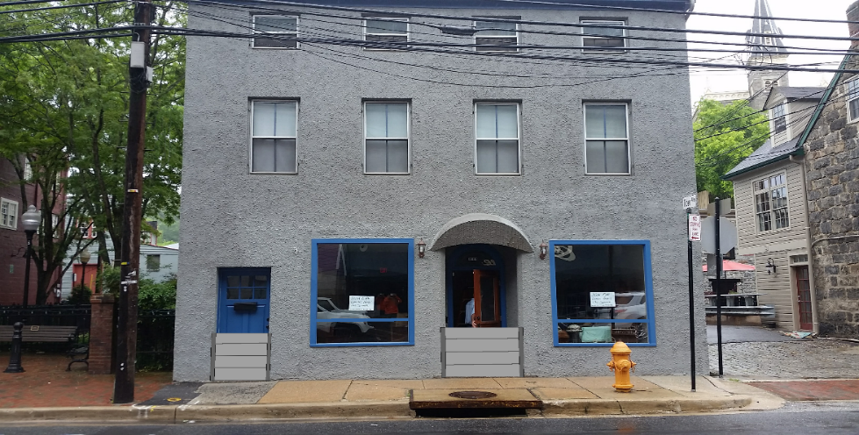
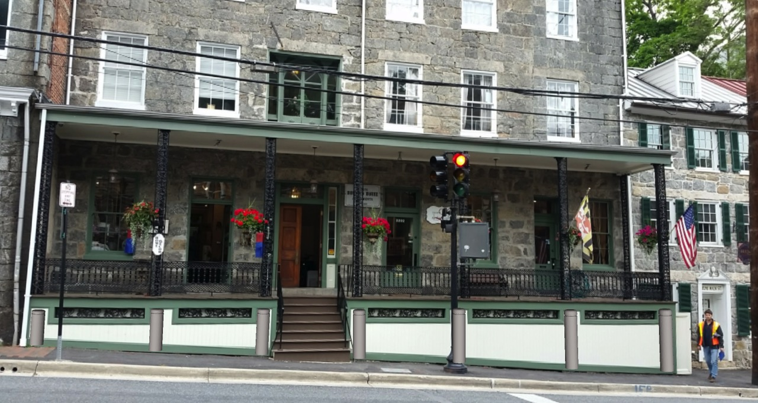
FPMS - Ellicott City, Maryland Non-Structural Flood Proofing
Partner: Ellicott City, MD
Project Description: After significant flooding in July 2016 and from Tropical Storm Lee in 2011, USACE partnered with Howard County, MD to explore non-structural flood proofing solutions.
Objectives:
Data collection and building surveys
Flood proofing assessment
Preliminary economic analysis
Nonstructural flood proofing measures recommendations and concept sheets with artistic renderings and historic preservation considerations
Public outreach and public meetings
Total project cost: $154K
Federal funding: $ 4K
Non-Federal funding: $150K
Structural Window
Stoplog Panels
Bollards Behind Porch
Flood Door

Slide 12

Silver jackets
Purpose – State-led, interagency federal, state and local stakeholders focused on sharing knowledge and collaborating on projects to reduce flood risk and enhance response and recovery
Types of Projects (Nonstructural)
Flood inundation tools and mapping, risk communication, flood risk assessments, mitigation planning, post-flood documentation, emergency table top exercises and more
Funding/Cost-Sharing
USACE accepts proposals annually; competitive; uses FPMS funding
Must be multi-agency effort
Agencies secure their own funds to participate in the project or to complete tasks
No signed agreements between participating parties
More Information
Stacey Underwood, Program Manager, Baltimore District
410-962-4977
Stacey.m.underwood@usace.army.mil
http://silverjackets.nfrmp.us/

Slide 13
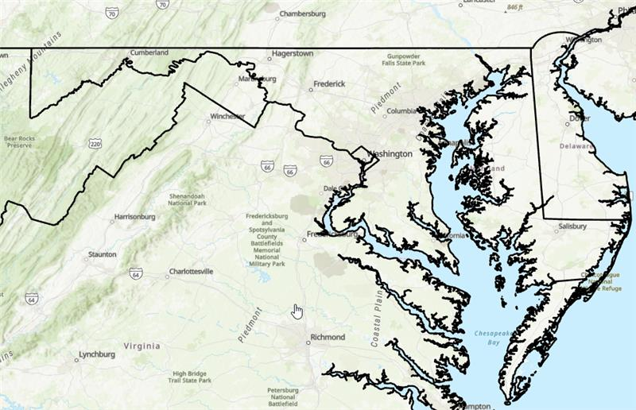
Silver jackets – Maryland Flood Risk outreach to underserved communities
Project Description: Current FY24 study. This study involves conducting an analysis across the state of Maryland using one or more EJ and equity screening tools, identifying vulnerable communities based on criteria selected by the team (to include high flood risk areas), and reaching out to selected communities to identify two who are interested in undertaking this flood risk outreach effort with us. The team will work with the communities to develop a plan that lays out their flood-related problems, needs and challenges, and recommended strategies and actions for making their community more flood resilient.
Agency Participation: FEMA; NOAA – National Ocean Service; NOAA – National Weather Service; EPA; MDE; DNR, MDEM; MDOT; MD Sea Grant Extension;
Total project cost: $135K (USACE) & $200K work in-kind

Slide 14
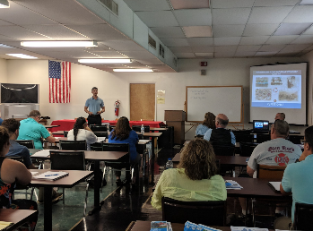
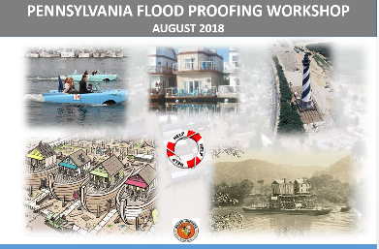
Silver jackets – non-structural flood proofing workshops in Pa and md
Project Description: Through the PA and MD SJ team, a series of non-structural flood proofing workshops were held in PA and MD. The workshops were help for local officials and the public to provide information on various types of federal and state programs available to assist communities and individuals with non-structural solutions to manage flood risk.
PA Silver Jackets Partners: USACE, FEMA, PA Emergency Management Agency, PA Dept of Environment Protection, PA Dept of Community and Economic Development, PA Historic and Museum Commission
MD Silver Jackets Partners: USACE, FEMA, MD Dept of Environment, MD Emergency Management Agency, MD State Highway Administration, MD Historic Trust, MD Dept of Natural Resources, and Eastern Shore Land Conservancy
PA Workshops - $32.2K USACE & $25K work in-kind
MD Workshops - $42K USACE & $35K work in-kind
Stoplog Panels

Slide 15
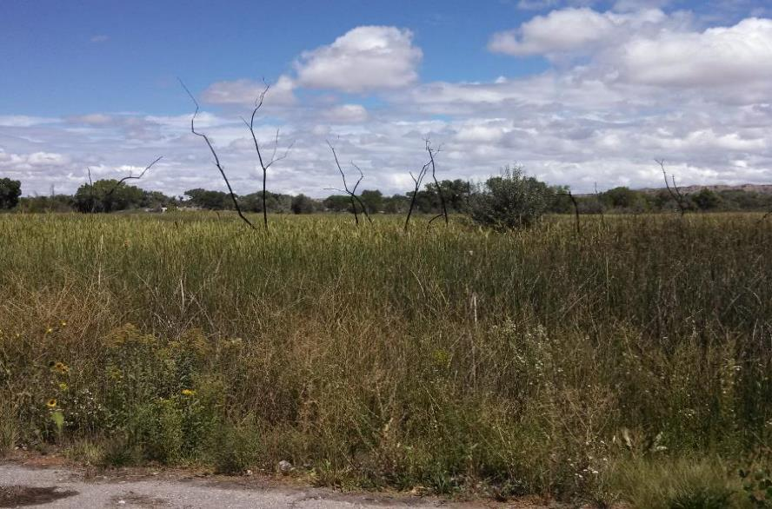
Cost-Share reduction FOR TERRITORIES AND TribAL NATIONS
Adjusted Waiver
Based on inflation
Applies to large feasibility studies or technical assistance
$530K federal contribution starting in FY22
Ability to Pay
Reduces cost-share to 10% (or 25% of a reduced project total) for EACH phase of the project
Based on Per Capita Income
Compare the Partner Per Capita to the rest of the Country
Partner’s Per Capita Income < 2/3 of US Per Capita Income

Slide 16
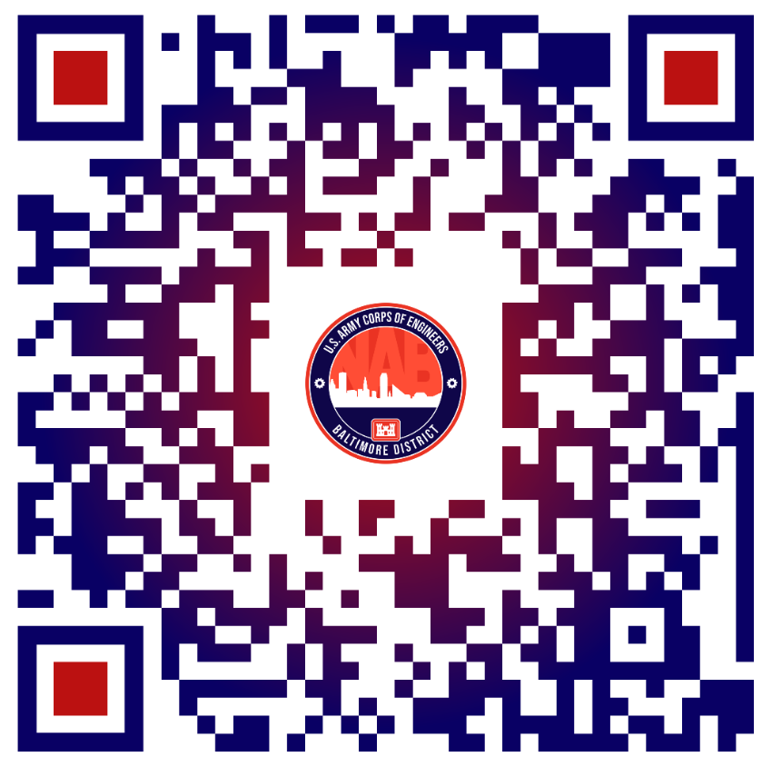
Continuing authorities program (CAP)
Purpose – planning, design and construction for projects generally less than $15M
Types of Projects
Section 14: Emergency Streambank and Shoreline Protection
Section 103: Beach Erosion and Hurricane and Storm Damage Reduction
Section 107: Navigation Improvements
Section 111: Mitigation of Shoreline Erosion Damage caused by Federal Navigation Work
Section 204: Regional Sediment Management & Beneficial Use of Dredged Material
Section 205: Flood Risk Management
Section 206: Aquatic Ecosystem Restoration
Section 208: Snagging & Clearing for Flood Risk Management
Section 1135: Project Modifications for Improvement to the Environment
Funding/Cost-Sharing
Varies
Non-federal share may include in-kind services
How to Get Started? What’s Required?
Contract the Program Manager, Andrew Roach (Andrew.a.roach@usace.army.mil)
Provide a Letter of Intent (examples located on CAP website below)
Sign a feasibility cost-sharing agreement (located on website)
More Information
http://www.nab.usace.army.mil/Missions/Civil-Works/cap/

Slide 17
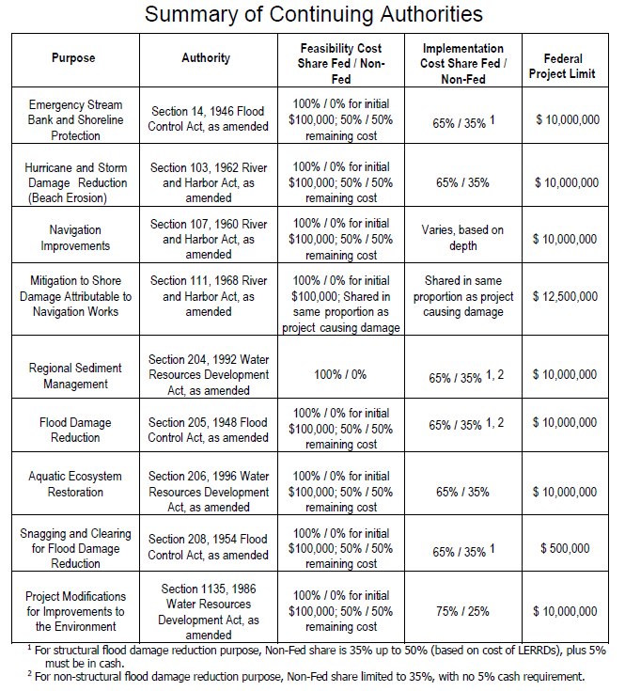
Notes:
Note that Section 205 can be used for early warning systems and such

Slide 18
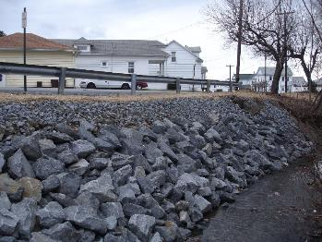
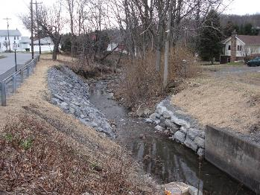
CAP, Section 14 – Lidy Creek, Luzerne County, PA
Partner: Dupont Borough, PA
Program: Emergency Streambank Stabilization, Section 14
Project Description:
Streambank stabilization of approximately 200 linear feet of Lidy Creek.
Riprap placed along 90 linear feet where the sewer line was exposed on the south bank and the road bed of Center Street that runs parallel to the creek.
Random placement of native rock and stone was placed for 200 linear feet, to create a stable stream system and improve habitat.

Slide 19
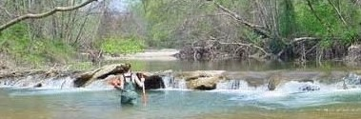
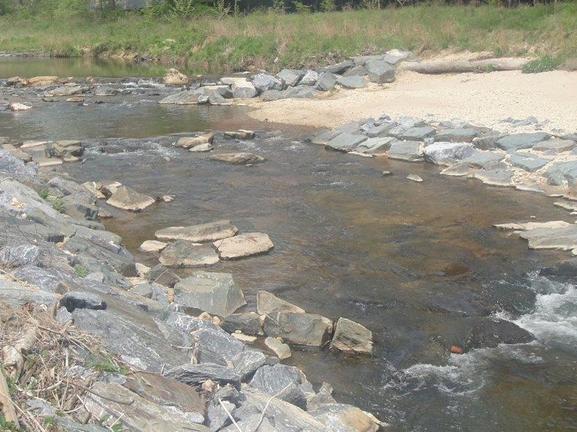
cAP, Section 206 – paint branch fish passage, md
Partner: Prince George’s County, Maryland
Program: Aquatic Ecosystem Restoration, Section 206
Project Description:
Self-sustaining dimension, pattern and profile
Increases/enhanced fish habitat
Improved sediment transport
Created migratory fish passage
Eliminated risk of sewer line failure
Stoplog Panels

Slide 20
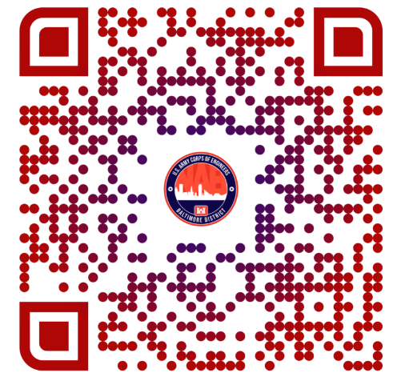
Section 510 PROGRAM CHESAPEAKE BAY environmental restoration and protection
Purpose – Design and Construction assistance for water-related projects within the Chesapeake Bay Watershed – up to $15M.
Types of Projects
Sediment and erosion control
Protection of eroding shorelines
Ecosystem restoration, including submerged aquatic vegetation
Protection of essential public works
Beneficial Uses of Dredged Material
Other related projects that may enhance the living resources of the estuary
Funding/Cost-Sharing
Scoping phase is 100% federally funded
Everything beyond Scoping phase is cost-shared at
75% federal and 25% non-federal
Planning (Feasibility) phase is paid for up-front with federal funds
Retroactively cost-shared once a Project Partnership agreement is signed
How to Get Started? What’s Required?
Contact the Program Manager, Chris Johnson (Christopher.a.johnson@usace.army.mil)
Provide a Letter of Intent to start Scoping phase
Sign a Project Partnership Agreement (after Scoping & Planning phases)
Prior to starting Implementation (Design and Construction) Phase.
More Information
Sample Letter of Request can be provided upon request

Slide 21
Section 510 PROGRAM CHESAPEAKE BAY environmental restoration and protection
Chesapeake Bay Comprehensive Plan
Sub-watersheds evaluated based on opportunity to contribute to each goal(s) = co-benefits
Stream Restoration
Fish Passage
Wetland Restoration
Riparian Buffers
…and More….
Comprehensive Plan products used by many stakeholders toward shared goals
Opportunities exist in EACH sub-watershed

Slide 22
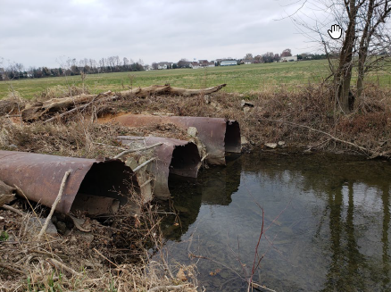
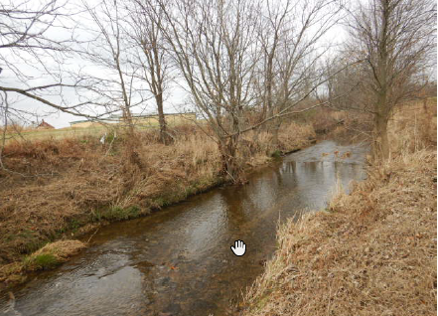
Sec 510 – plum Creek, Stream restorATION
Partner: Conewago Township, Adams County, PA
Program: Section 510, Chesapeake Bay Environmental Restoration and Protection Program
Project Description:
Daylight the creek
Restoring the stream to a more natural state
Restoring roughly 1,500 linear feet of stream
Reconnect the stream to the floodplain
Construct an environmentally friendly and sustainable traffic bridge

Slide 23
Environmental infrastructure programs
Section 219 – Environmental Infrastructure Program (400+)
Assist in technical planning, and/or design assistance for
Water Supply and Storage
Treatment and Distribution systems
Wastewater treatment systems including treatment plants
75% federal/25% non-federal
Section 313 – South Central PA Environmental Improvement Program (17 counties)
Provides design and construction assistance for wastewater treatment, water supply and water-related environmental infrastructure
75% federal (reimbursement)/25% non-federal
Program Manager: Justin Callahan (410) 962-6693
justin.callahan@usace,army.mil

Slide 24
Thank you!
Questions and Discussion

