Slide 1
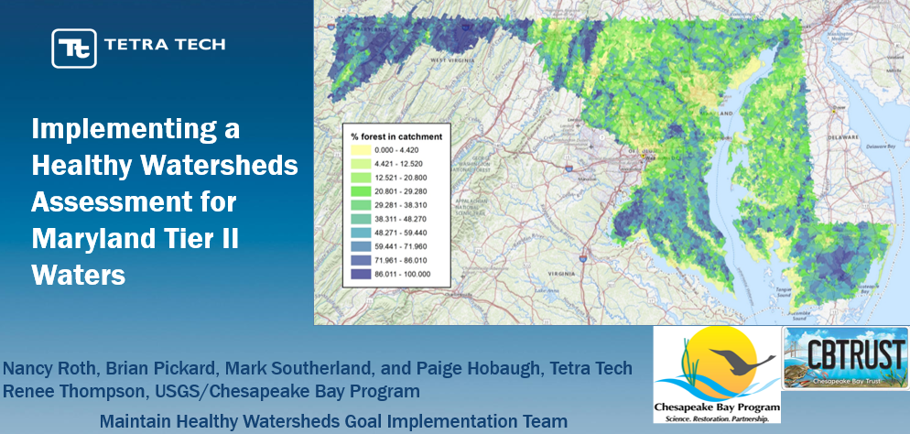
MDHWA Final Results and Next Steps - Renee Thompson, USGS – HWGIT
October 17, 2022

Slide 2
Testing Predictive Power of Metrics
Built Random Forest models to assess which watershed condition metrics were the best predictors of stream condition
Maryland Biological Stream Survey
>5,000 samples since 1990s
Monitoring of non-tidal stream communities – both benthic macroinvertebrate and fish Indices of Biotic Integrity (IBI)
IBIs as response variables

Slide 3
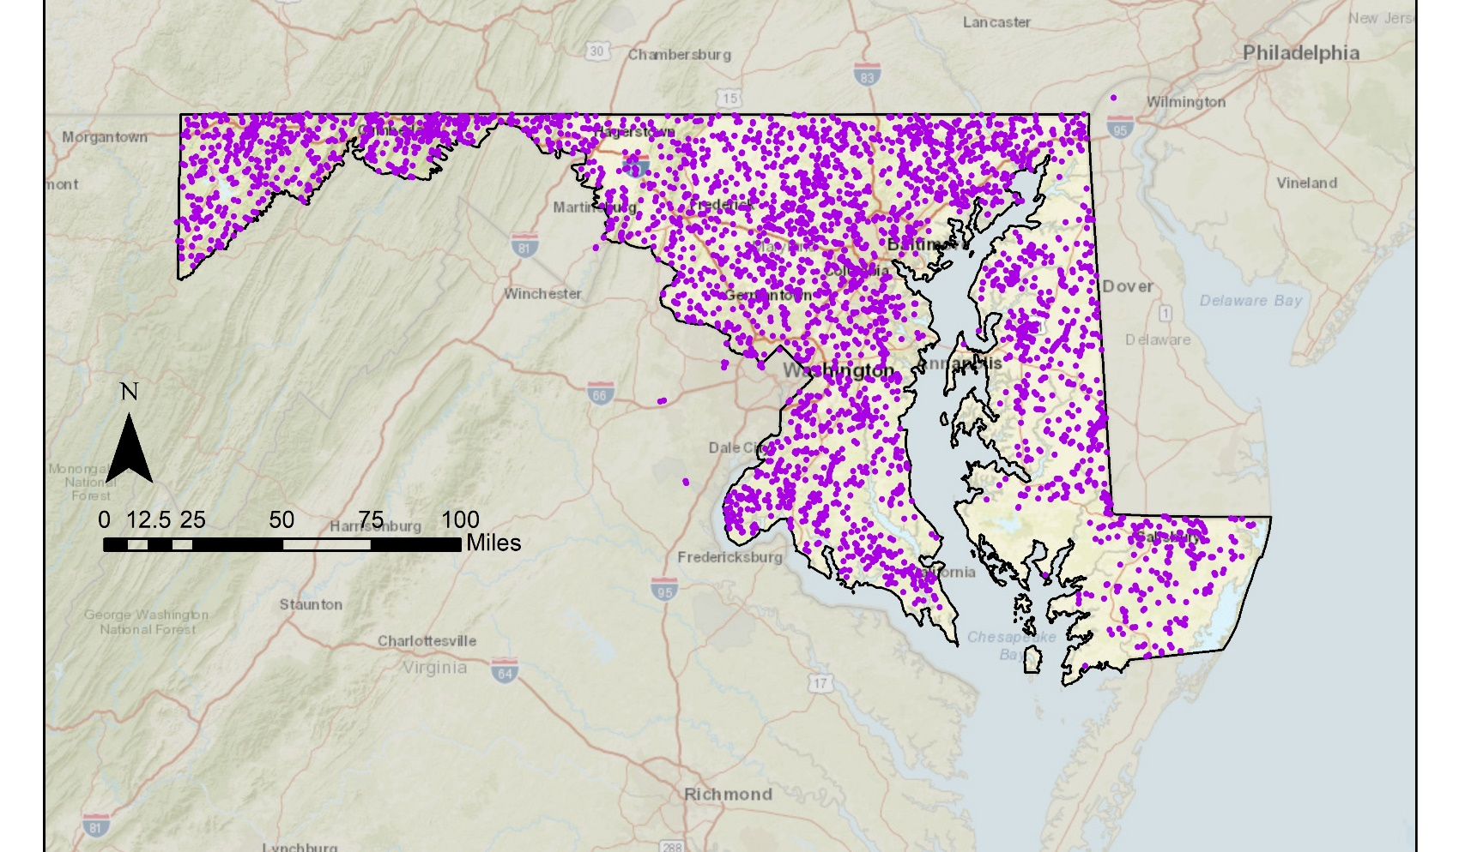
MBSS Sampling Locations
Notes:
MBSS data were available, the MDHWA analyses used these stream data to examine relationships between landscape variables and stream response (in terms of Fish Index of Biological Integrity [FIBI] and Benthic Index of Biological Integrity [BIBI]) to assess the predictive power of proposed metrics for use in modeling stream condition. These models can subsequently be used to predict (1) current stream condition for unsampled areas and (2) future stream condition under new predicted future landscape conditions.

Slide 4
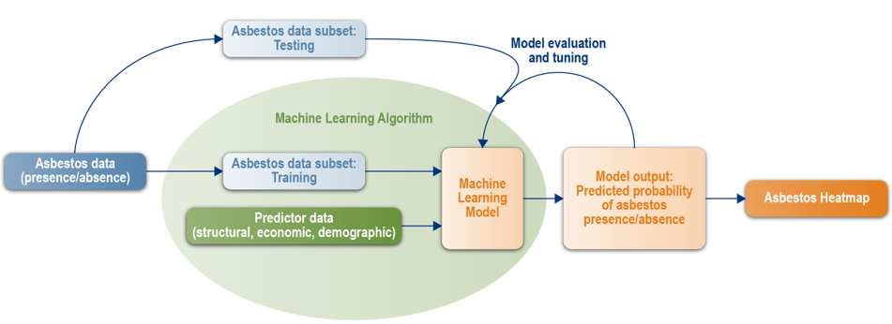
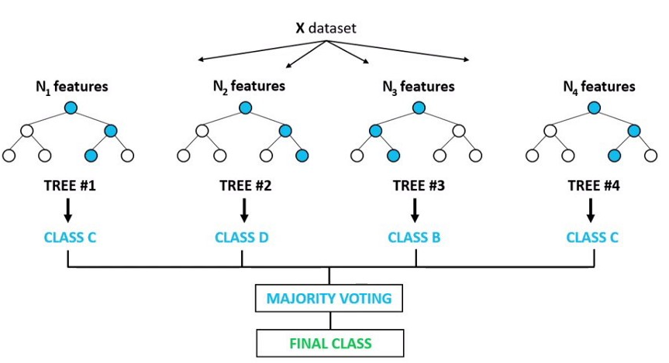
Random Forest Model
Testing Dataset
FIBI/BIBI
Training Dataset
Machine Learning Model
Model Output: Predicted Probability of BIBI/FIBI
Predictor data
Notes:
Test the predictive power of the metrics.
Built two random forest models
As our response we have MBSS data fortunate to have in MD and consistent and an index for both benthic and fish as a response variable.
The way the RF works in general we have your predictor, response variables, put them together with the training datasets, we used 80 per for the data and saved 20 percent as test data.
The machine learning used the predictors to make decisions and runs hundreds and hundreds of trees and the output of the model is predictive probability of the ibi scores.

Slide 5
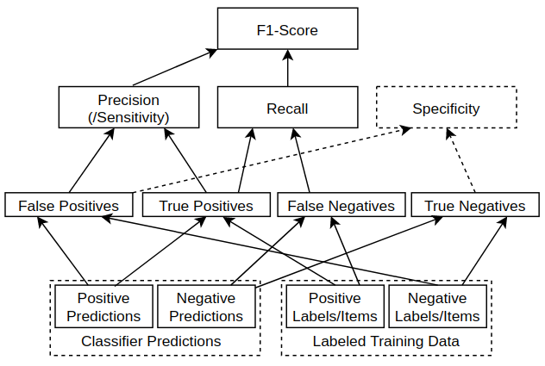
F1 score is the harmonic mean of precision and recall and is intended as a balanced indicator of model performance.
Recall is the ratio of correct classifications to the total number of classifications and is used to identify the sensitivity of classification
ratio of correct classifications to the total number of predicted classifications
Notes:
We used Random Forest (RF) modeling to predict FIBI and BIBI classification scores for each watershed within Maryland. RF modeling determines a set of individual decision trees that operate as an ensemble. Each individual tree in the RF predicts the class (good, fair, poor) by determining splits within each of the predictor variables.
Beyond overall accuracy, values for precision, recall, and F1 scores are provided for each model. Precision is the ratio of correct classifications to the total number of predicted classifications and is used to identify the correctness or classification. Recall is the ratio of correct classifications to the total number of classifications and is used to identify the sensitivity of classification. The F1 score is the harmonic mean of precision and recall and is intended as a balanced indicator of model performance.

Slide 6


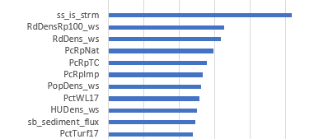

FIBI Results
Notes:
Fish IB .63 accuracy, precision and recall higher for poor and good
Doing well predicting the poor
“Poor”= Combination of poor and very poor
Do well with good/poor but the middle ground there is a lot more uncertainty predicting those categories.
Overall accuracy of the FIBI and BIBI models was 0.63 and 0.61 percent, respectively. Accuracy is determined by comparing the 20 percent withheld data for testing with the predicted classification of the model. Therefore, the RF correctly classified 63 percent and 62 percent of the FIBI and BIBI training data, respectively.

Slide 7



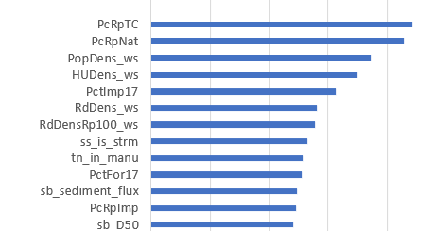
BIBI Results
BIBI feature importance plot
Notes:
It is important to note that this is a measure of each variable’s importance in determining various decision points within each of the random forest trees and does not necessarily reflect which variable is more important for determining watershed health. Nevertheless, the feature importance plots can provide a good relative indication of what metrics the model used to derive the highest accuracy.

Slide 8
Consistently Important Metrics
% tree canopy in riparian area
% natural in riparian area
Population and housing unit density
Road stream crossing density
% impervious within the riparian area.
Streambank and Streambed erosion metrics
Notes:
These hold constant with previous research and are intuitively the types of metrics typically associated with assessing watershed health.

Slide 9
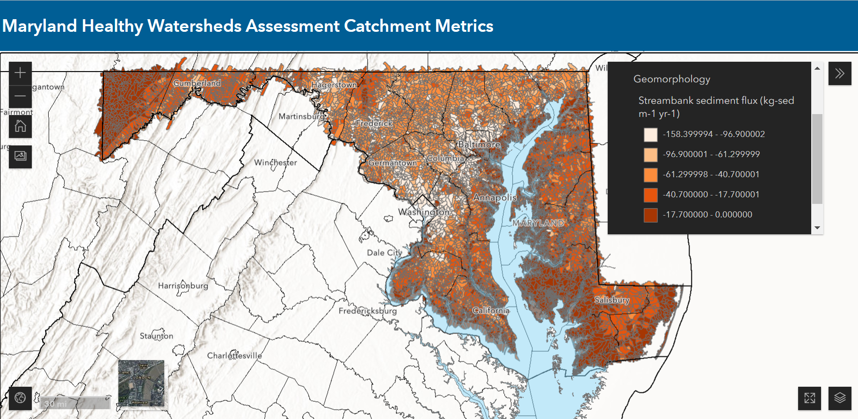
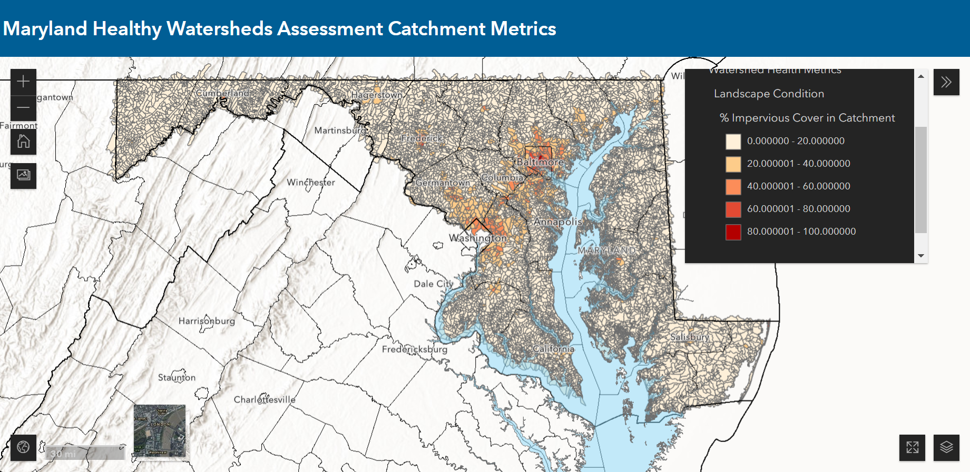
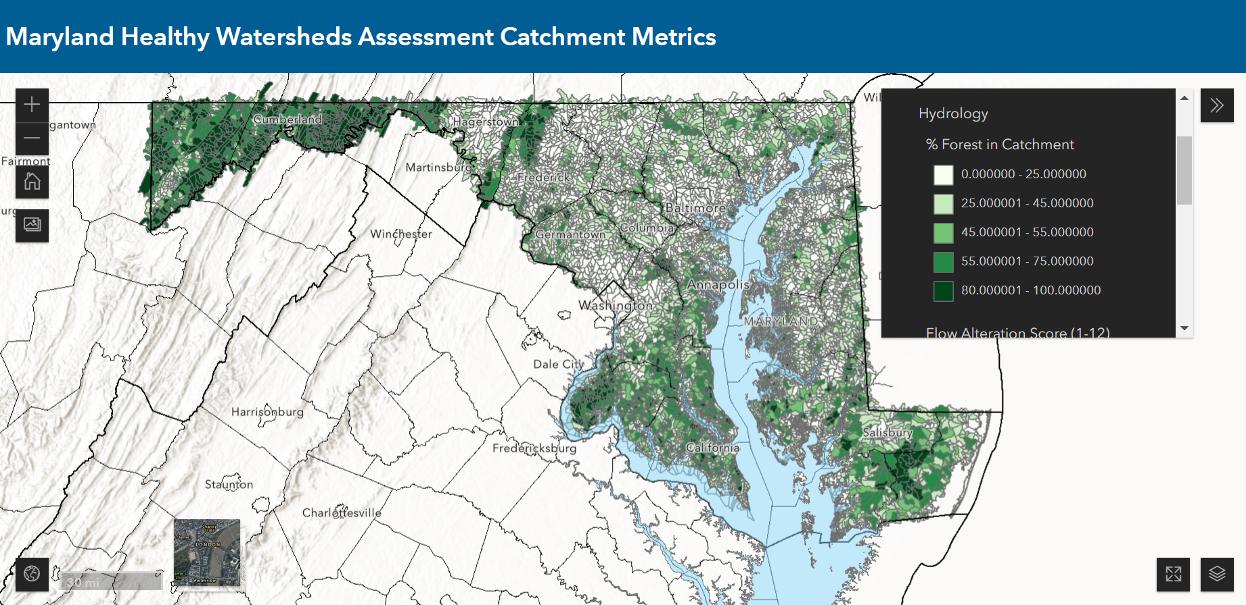
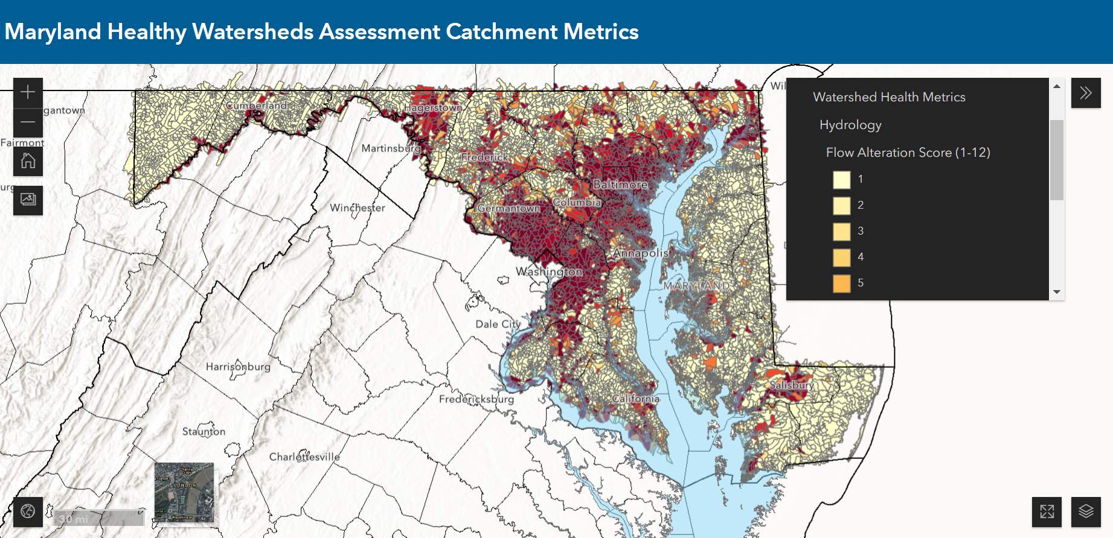
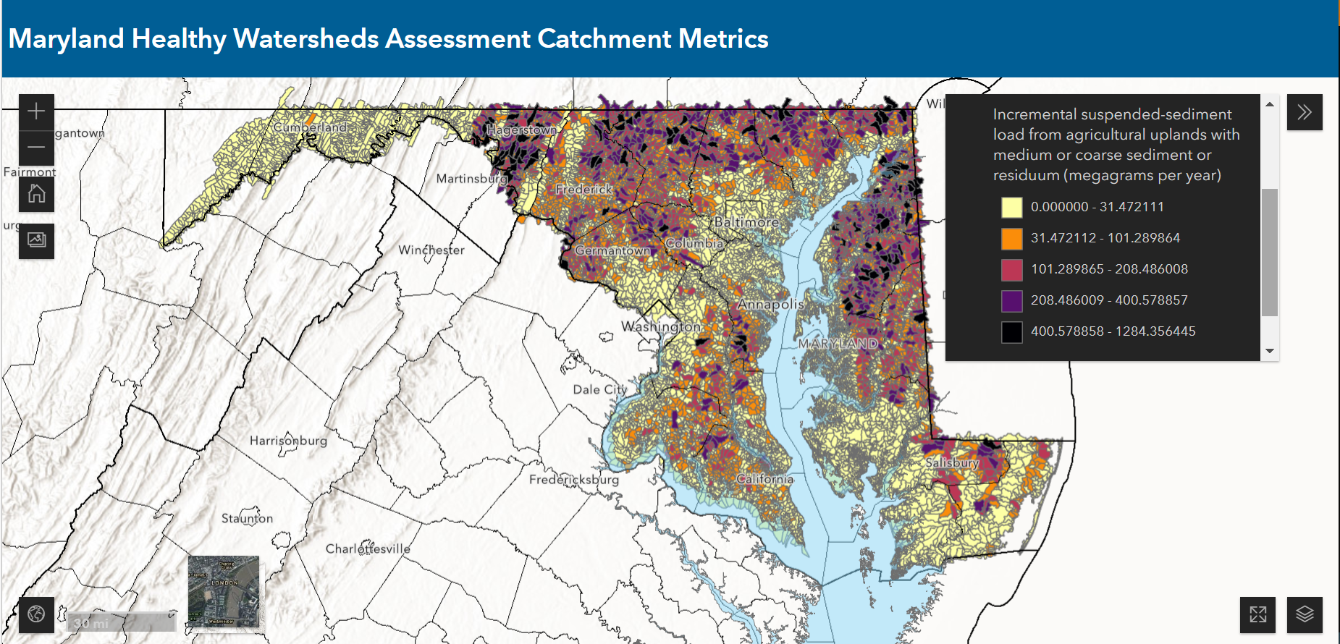
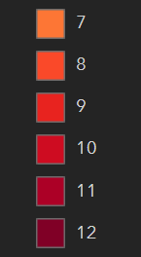

Slide 10
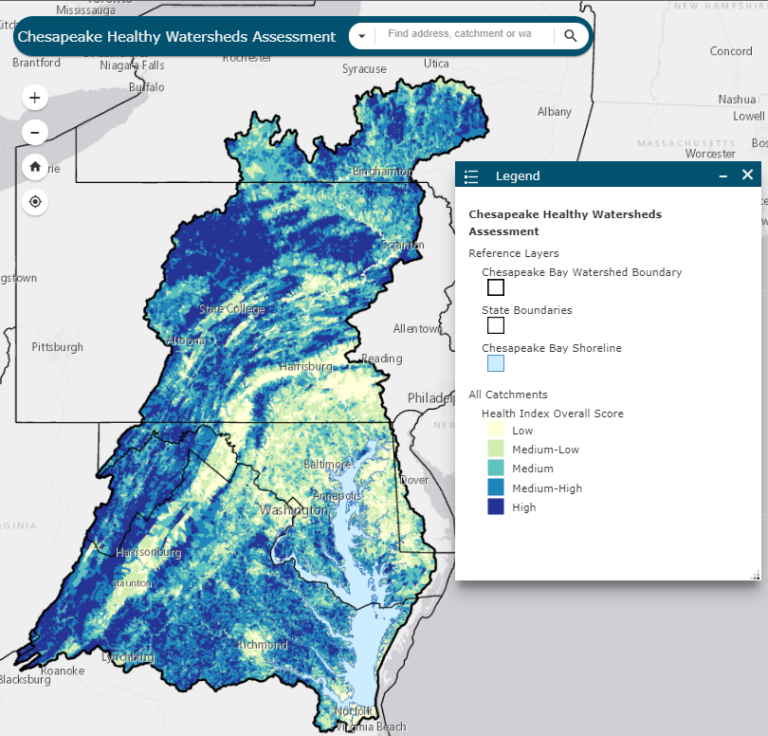
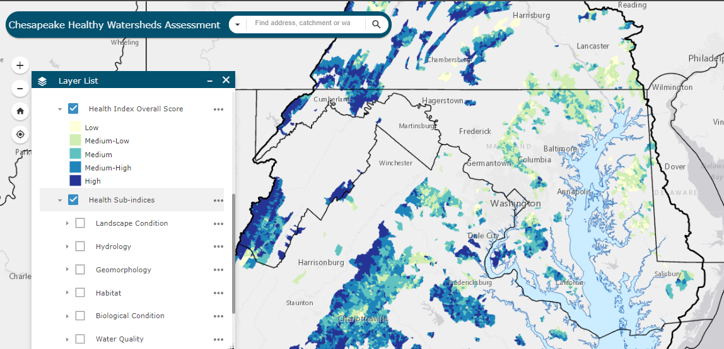
Previous efforts (e.g., PHWA and CHWA) relied on the development of sub-indices and an overall index of watershed health
Notes:
While these are attractive as they provide a single value to assess health, they are highly subjective and choices by the researcher can easily influence whether a watershed is deemed “healthy” or not.
This assessment demonstrates a fundamentally different way to approach assessing watershed health. First, the random forest removes researcher bias by allowing for all metrics determined to be potentially helpful in discerning watershed health to be included and evaluated equally. Second, using the MBSS data allows for field observations of healthy watersheds (or poor watershed health) to be used as the guide for the random forest model to select metrics of importance. This pairs real world observations with landscape data to determine what best explains these observations.

Slide 11
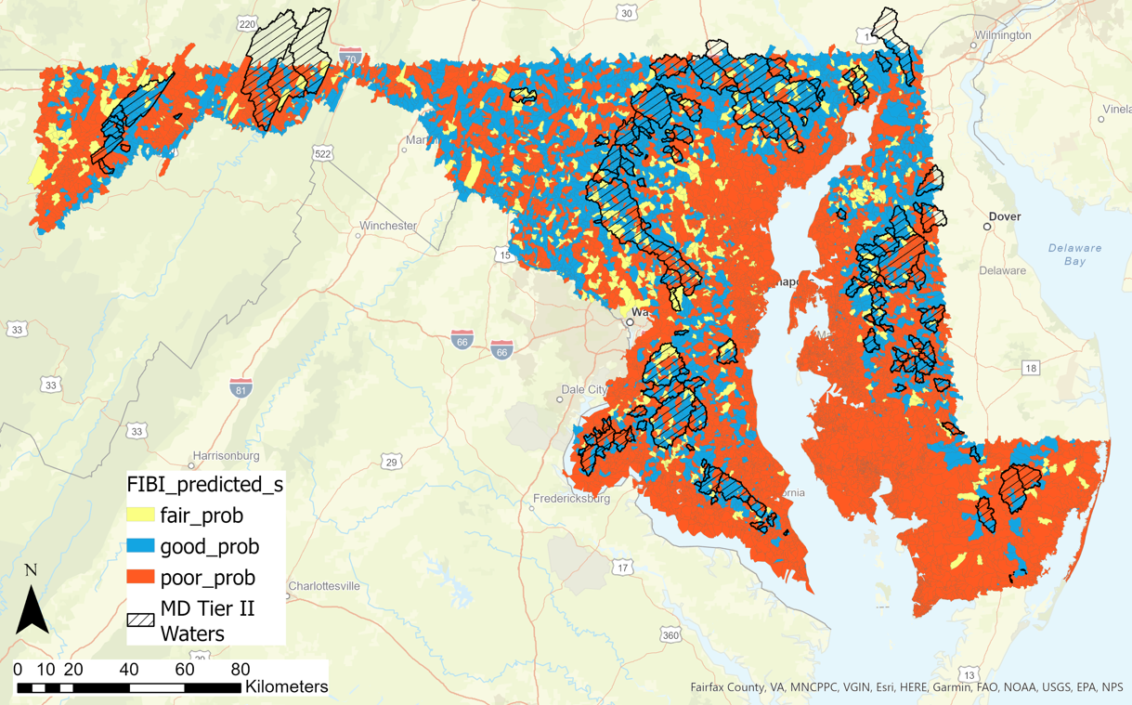
Notes:
show the predicted BIBI and FIBI scores with Maryland Tier II watersheds overlayed on top. Healthy watersheds identified by Maryland are also generally identified as good or fair within the predicted catchments.

Slide 12
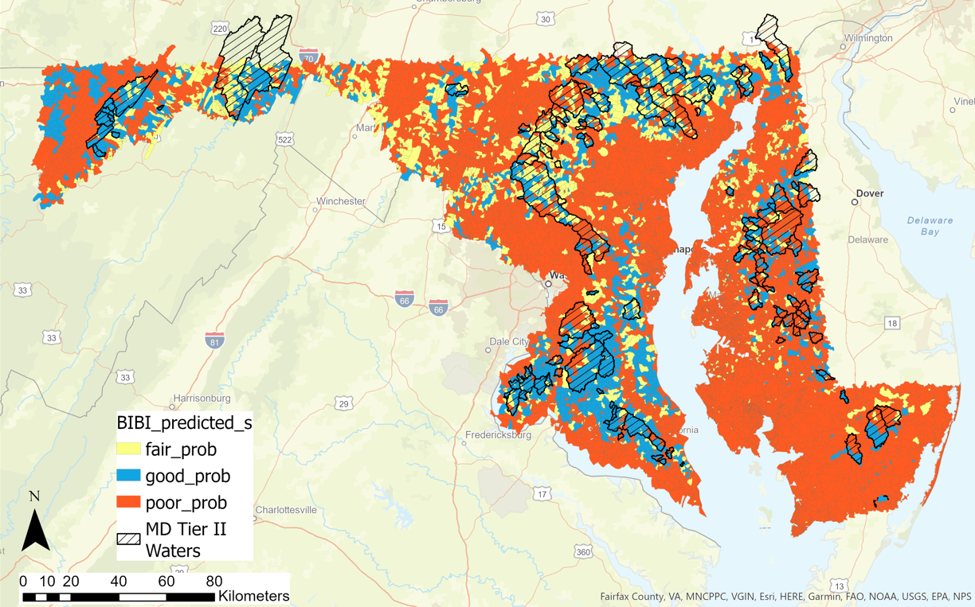
Notes:
The key point to take away from this type of modeling effort is that the BIBI and FIBI scores are proxies for watershed health.
Presumably, if you have benthic and fish indices of biologic integrity that are doing well, the catchment must also be quite healthy too. Previous efforts have created watershed health indices that are ambiguous, easily manipulated, and influenced by a high degree of researcher discretion. This approach provides an example of how to standardize and think about watershed health in a more objective manner.

Slide 13
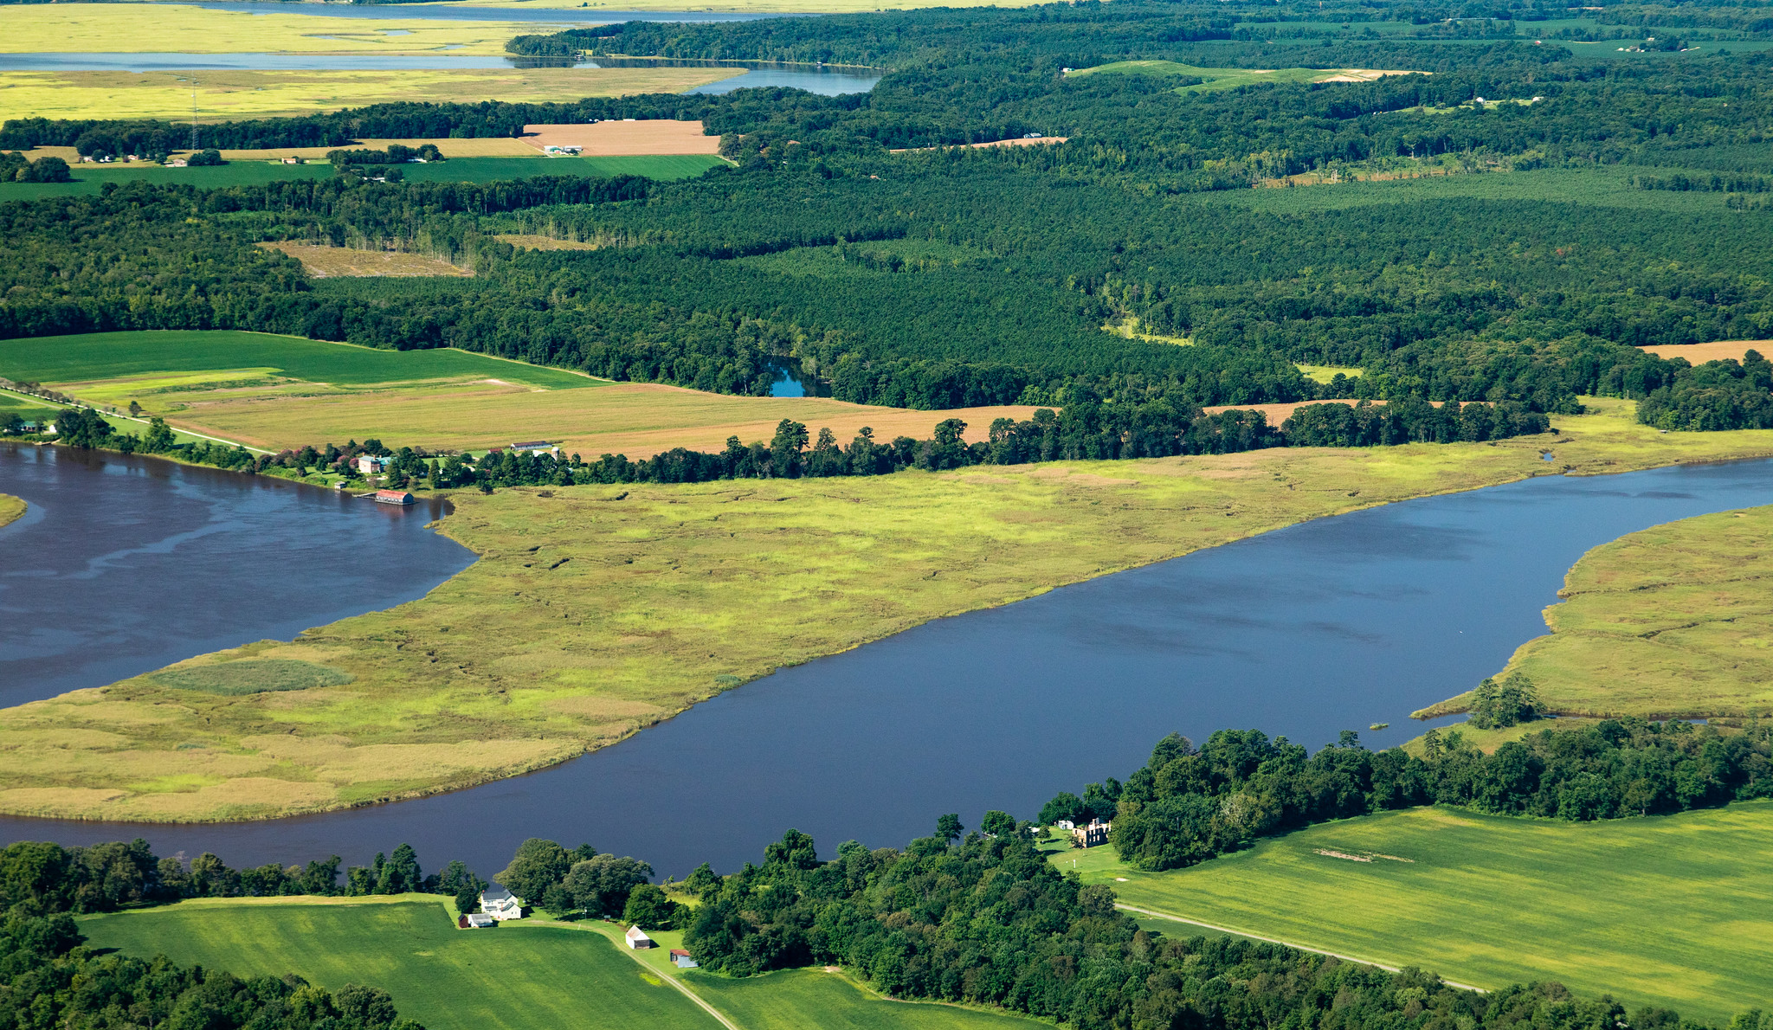
Applying the Healthy Watershed Assessments
Providing data to support management decision-making, particularly for maintaining the health of watersheds
Assess current watershed condition
Track condition over time
Provide early warning signs – vulnerability to degradation
Identify resiliency – ability to sustain good watershed health in spite of stressors
(Photo by Will Parson/Chesapeake Bay Program)

Slide 14
Next Steps
New data to explore and incorporate
Improvements to CHWA 2.0 (harnessing code and model developed for MDHWA)
Chart a course for development of an indicator to inform progress toward outcome.
Notes:
New data to explore
Improvements to CHWA 2.0
Chart a course for development of an indicator to inform progress toward outcome.

Slide 15
New Data to Explore
USGS Conductivity Research
Additional Forest Health Data
Accumulated watershed wide land use/land cover data
Effective Impervious Cover
Climate Vulnerability Index and Climate Change Likelihood datasets
Stream Temperature
Updated geomorphic metrics from FACET
Additional Brook Trout data
Toxic metrics
Fish health metrics

Slide 16
Additional Opportunities
Clarify relationship between CHWA and Stream Health Workgroup metrics
Clarify evidence expectations for states to claim success in maintaining their healthy watersheds by 2025
If the CHWA is refreshed regularly, can it be used directly to represent a “signal of change” in condition?

Slide 17

Renee Thompson, Geographer
Lower-Mississippi Gulf WSC, USGS,
Chesapeake Bay Program
Coordinator Maintain Healthy Watersheds
Goal Implementation Team
Rthompso@chesapeakebay.net

