Slide 1

Stewardship Workgroup
Quarter 2 Meeting – May 13, 2025

Slide 2
Agenda
2:30
Welcome/ Introductions
2:40
Beyond 2025 Outcome Development Discussion
3:10
Workforce Outcome Presentation
3:20
Implementing Stewardship Work in 2025 – Action Teams
3:35
Network Science Project – Local Concepts LLC
3:50
Closing Business & Announcements

Slide 3
What’s your favorite
thing about spring?
Do you have any
announcements
to share?
01
Icebreaker
in the Chat

Slide 4
Beyond 2025 Outcome Assessment Timeline
JAN-FEB | Workgroup and other meetings to collect input/feedback
FEB 27 | Presented recommendation to Update Stewardship Outcome to MB
APR 10 | MB approved disposition to Update Stewardship Outcome
MAY 7-8 | MB retreat to finalize recommended Outcome language revisions
MAY 23 | PSC Meeting – Discuss revised Outcome language recommendations
JULY 1 | 60 Day Public Feedback Period begins

Slide 5

Stewardship Goal: Increase the number and diversity of local stewards and local governments that actively support and carry out the conservation and restoration activities that achieve healthy local streams, rivers and a vibrant Chesapeake Bay.
Stewardship Outcome:
Increase the number and diversity of trained and mobilized volunteers who have the knowledge and skills needed to enhance the health of their local watersheds.
2014 Watershed Agreement Language

Slide 6
STEWARDSHIP OUTCOME
STEWARDSHIP GIT (GIT 5)
Stewardship Workgroup
Presenter: Britt Slattery
Note: This language was presented to the Management Board (MB) on May 8th. The slides titled “REVISED” have been updated to respond to the comments we received from MB.
PROPOSED DRAFT
OUTCOME LANGUAGE:
EXISTING 2014 AGREEMENT
OUTCOME LANGUAGE:
Equip partners and the regional network of practitioners with the social science data, technical assistance and support needed to develop and carry out programs that train and mobilize individuals and communities to improve the health of our land, water, living resources and people.
Increase the number and diversity of trained and mobilized volunteers who have the knowledge and skills needed to enhance the health of their local watersheds.

Slide 7
STEWARDSHIP OUTCOME
Note: This language was presented to the Management Board (MB) on May 8th. The slides titled “REVISED” have been updated to respond to the comments we received from MB.
STEWARDSHIP GIT (GIT 5)
Stewardship Workgroup
Presenter: Britt Slattery
PROPOSED TARGET Metrics to be determined; need baseline assessment. | New or Update | Estimate when target developed
1. Measure how well we are supporting partners Continually increase partners’ ability to develop and carry out programs that enable people and communities to participate in stewardship. | New target | Dec. 2025
2. Measure on the ground stewardship work. Through 2040, support achievement of the targets identified [SMART targets to be set**] that ultimately increase both individual and community level stewardship actions that advance certain Watershed Agreement outcomes, e.g., Healthy Forests and Trees, Workforce, Water Quality, etc. EXAMPLE: “By 2040, XXXX number of acres of urban or suburban forest will be stewarded by individuals or communities.” Assist the WG by connecting stewardship partners to help with implementation, and assist in the process to track the metric. | New target | Set SMART targets with other outcome teams by Dec. 2025

Slide 8
REVISED STEWARDSHIP OUTCOME
STEWARDSHIP GIT (GIT 5)
Stewardship Workgroup
REVISED DRAFT
OUTCOME LANGUAGE:
EXISTING 2014 AGREEMENT
OUTCOME LANGUAGE:
Increase public participation in regular actions that contribute positively to the health of the Bay, its watershed and communities.
Increase the number and diversity of trained and mobilized volunteers who have the knowledge and skills needed to enhance the health of their local watersheds.

Slide 9
REVISED STEWARDSHIP OUTCOME
STEWARDSHIP GIT (GIT 5)
Stewardship Workgroup
REVISED PROPOSED TARGET | New or Update | Estimate when target developed
Through 2040, better equip partners and regional practitioners with the social science data, technical assistance and support needed to develop, improve and carry out programs that advance certain Watershed Agreement outcomes through individual and community-level stewardship. | New target | Dec. 2025

Slide 10
Future Management Strategies and Potential Measures
(How to Get it Done)
Continue the Stewardship Survey, and use it to inform practitioners
along with other data/social science
Use additional datasets that demonstrate success – some things partners may already be tracking and reporting (for grants, other commitments):
# of volunteers that participate in projects
amount of pet waste kept out of the water through localities’ efforts
capture larger-scale, collective efforts / community-scale stewardship
Work with other Watershed Agreement outcomes
Identify targeted stewardship engagement that contributes to achieving outcomes
Help them plan “how to” promote those actions using social science practices (informed by the stewardship survey)
EXAMPLE: “By 2040, XX number of trees planted by individuals or communities in areas lacking tree canopy.”
Connect with the professional community (partners and regional practitioners) – self-assess their capacity to instigate and measure stewardship, and growth over time.

Slide 11
REVISED STEWARDSHIP OUTCOME
STEWARDSHIP GIT (GIT 5)
Stewardship Workgroup
Outcome’s ultimate intent:
Increase and normalize public participation in stewardship actions that contribute to achieving environmental results.
What’s new?
Build capacity: equip partners and stewardship practitioners with data, tools, technical assistance, support; work through the network to engage with the public.
Expand the scope of stewardship actions promoted to better align with and help achieve more of the outcomes in the Watershed Agreement.
More emphasis on collective, community-scale efforts as well as individual (greater impact).
Challenges:
Need more time to identify targets, numeric metrics and means to measure. Stewardship results take a long time to realize. We need small bites.
If the on the ground metrics live under other outcomes, then the Stewardship WG would assist the other WGs with data, tools, social science best practices guidance, and partnerships to support implementation; and help with tracking the metrics.
Effective stewardship methods and strategies for partners would be informed by data collected through an updated Stewardship Index (survey) and analysis.

Slide 12
Implementing Stewardship Work in 2025
Opportunities for engagement: Action Teams!
Steward Map Ambassadors (ongoing)
Stewardship Resource Library
Community-Level Stewardship

Slide 13
2025 Action Teams
Steward Map Ambassadors
Stewardship
Resource Library
Community-Level Stewardship
Assist with outreach and promotion of the map.
Help brainstorm new map uses and map design improvements.
View the map here.
Determine the key audience(s) and their resource needs/wants.
Help design, gather resources for, and eventually share an online stewardship resource hub for practitioners.
Develop a plan/methodology to identify what community-scale stewardship actions already exist across the watershed.
Help establish a baseline for future measurement.

Slide 14
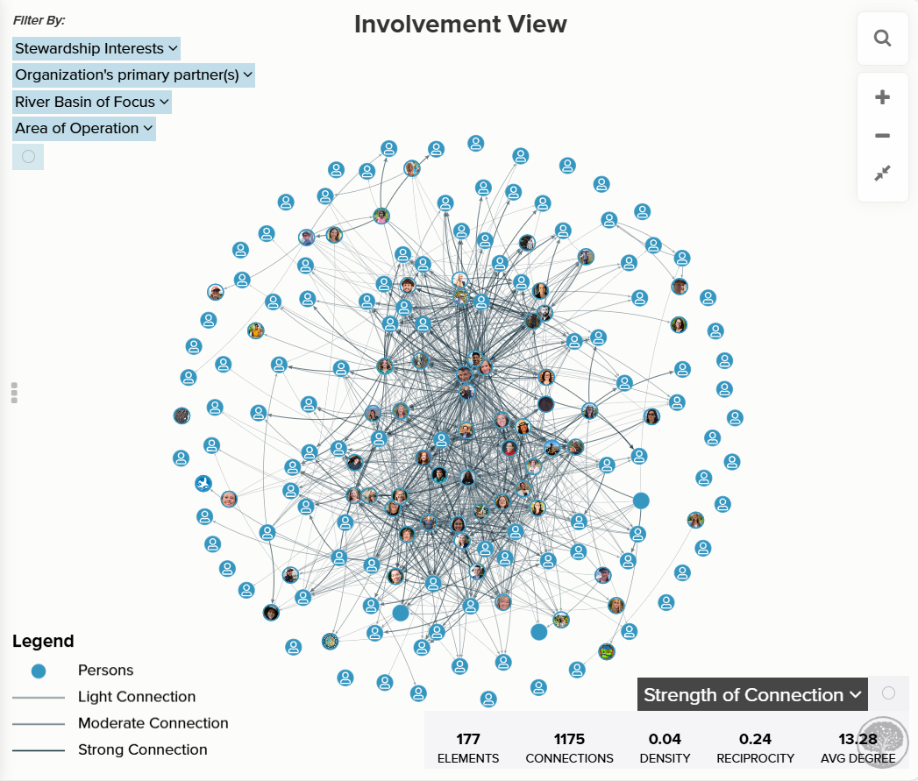
Implementing Stewardship Work in 2025
Ongoing Efforts:
Chesapeake Steward Map
Map Stewards: 191
150 added in 2024
11 added in 2025
1,444 Connections
Notes:
https://embed.kumu.io/8bee687ffdbfb36e078453bbe61838bd#home/involvement

Slide 15


Closing Announcements
Reach out to Meredith if you
are interested in guiding the work
of the Stewardship Workgroup in
an informal steering committee
or as a co-chair!
Let Meredith know if you’d like to join an Action Team!
Meredith Lemke, lemkem@chesapeake.org

Slide 16

Thank
You

