Slide 1
Chesapeake Bay Gateways and Watertrails Network
Grant Summary
November 18, 2022
"shall provide technical and financial assistance...to identify, conserve, restore, and interpret natural, recreational, historical, and cultural resources within the Chesapeake Bay Watershed."
-- Chesapeake Bay Initiative Act of 1998
“By advancing equity across the Federal Government, we can create opportunities for the improvement of communities that have been historically underserved, which benefits everyone.”
-- Executive Order 13895
Notes:
Welcome and thank you for joining us this afternoon. I am Wendy O'Sullivan, the superintendent of National Park Service Chesapeake Gateways Program.
With me today is Eddie Gonzalez, NPS Chesapeake Gateways Director of Partnerships and Grants and Bob Campbell, NPS Chesapeake Gateways Planning and Development Manager.
This afternoon we have a special announcement on the launch of a new NPS Chesapeake Gateways competitive network grants. (Next Slide)

Slide 2
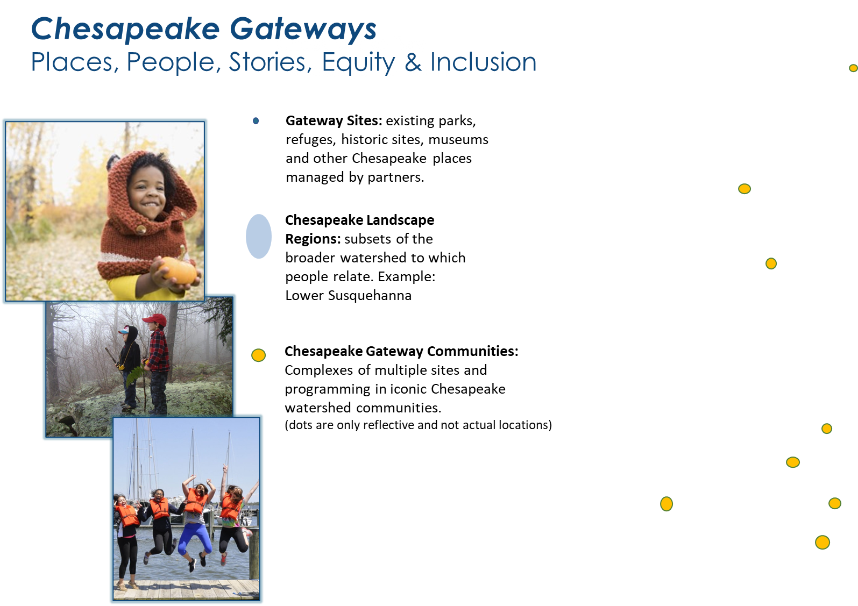
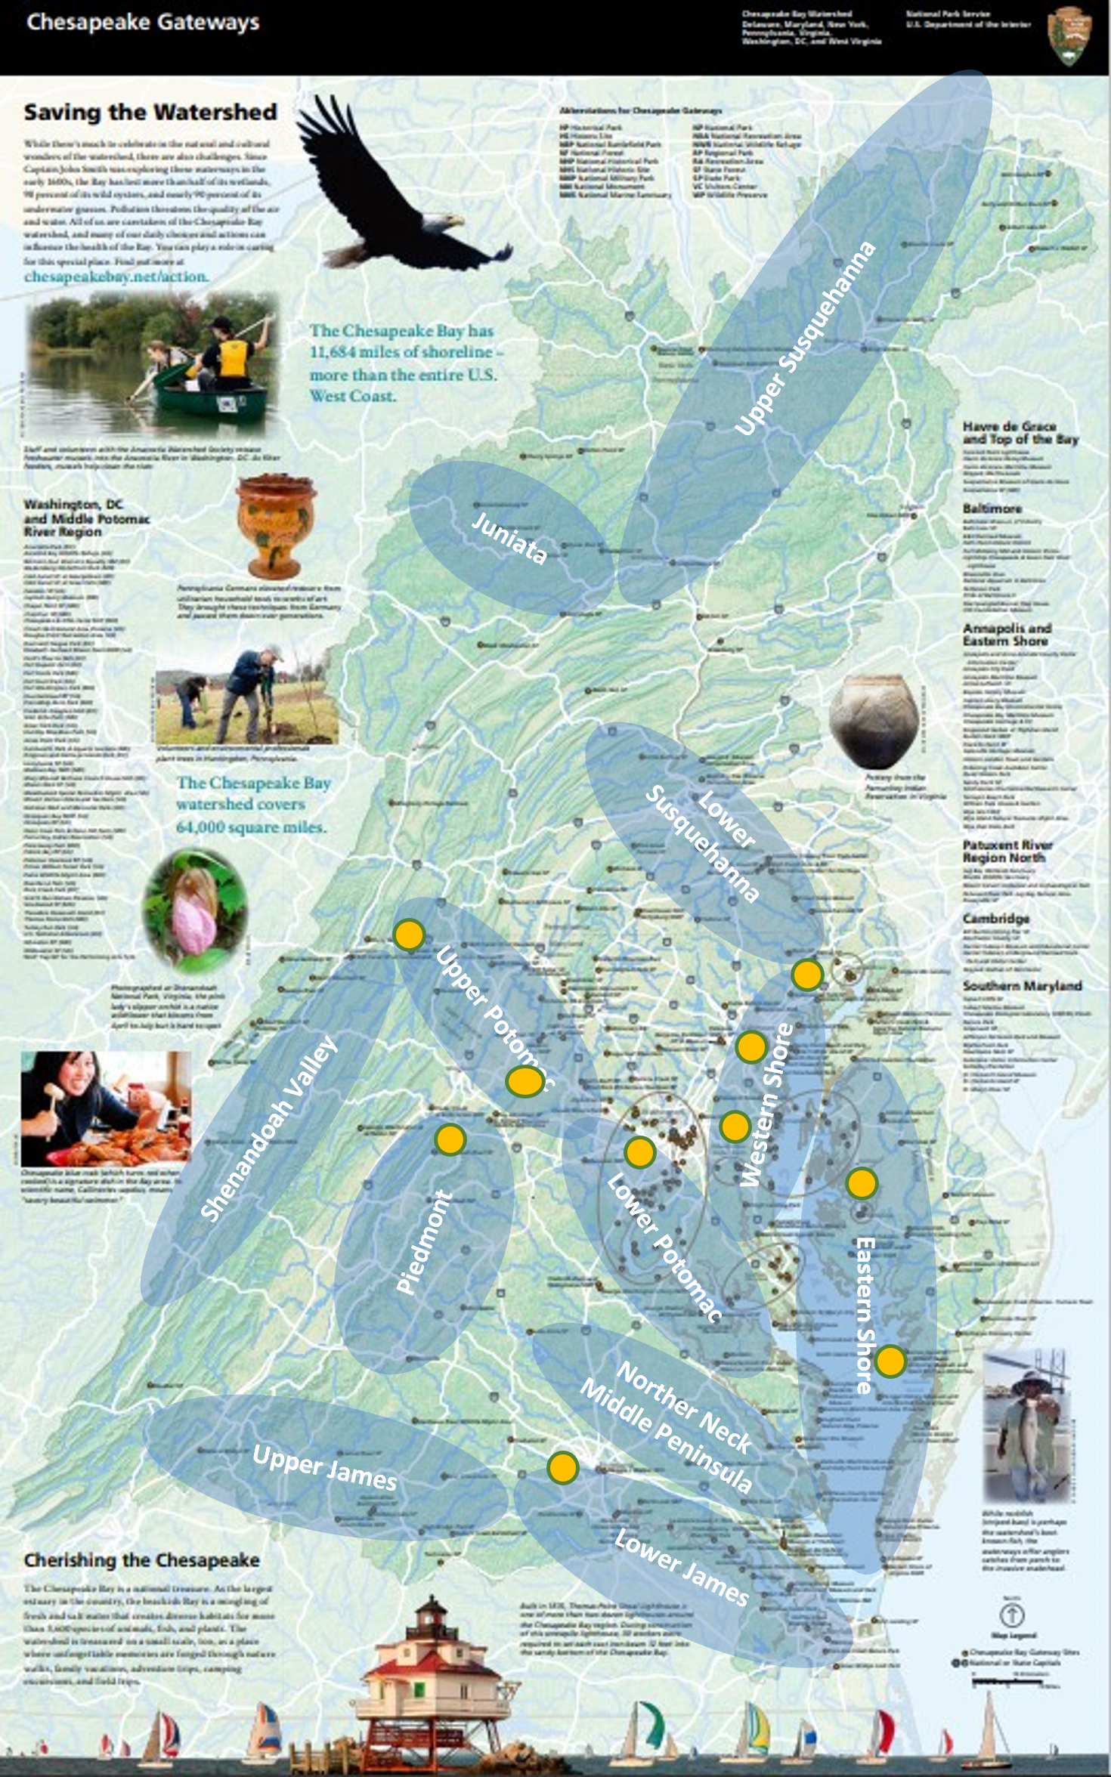

About Us
Notes:
Chesapeake Gateways Network is a system of places providing opportunities to enjoy, learn about and help conserve the Chesapeake Bay and its watershed. Included in the Network are diverse natural, cultural, historical and recreational sites, trails, museums, parks, refuges, interpretive and orientation facilities and associated programs.
For over 20 years NPS Chesapeake Gateways has supported successful and innovative projects and we remain focused on advancing dynamic partnerships, inclusive storytelling, equitable access and conservation, and
resilient communities for the Chesapeake.
We support partners and communities at three scales: at individual Chesapeake Gateway sites, at a regional and large landscape scale, and we are working to stand up an additional approach to also bring support at a local community scale.
At each level our work is focused on places, people, stories, equity and inclusion. We are striving for NPS Chesapeake Gateways to reflect and benefit our communities and to represent the future of the National Park Service, today.

Slide 3
Chesapeake Gateways Network Grant Submission Workshop
Approximately $1M $2M to award in two grant levels:
Small Grants ($25K-$50K)
Large Grants ($51K-$150K)
Two Grant Categories:
Inclusive Interpretive Initiative
Resilient Communities & Landscapes
Focus on Diversity, Equity, Inclusion, Accessibility, and Community Engagement
NO MATCH REQUIREMENT!!
Broad Eligible Entities, including the private sector (excluding Federal Agencies)
All projects must have a public purpose and occur in the Chesapeake watershed.
Extended application period (Deadline: January 30, 2023)
Find out more at: https://go.nps.gov/ChesapeakeGrants
Highlights
Notes:
Now, let me start with some highlights of these grants.
(Stay on this slide and walk through each bulleted highlight)
Approximately $1M to award in two grant levels:
Small Grants ($25K-$50K)
Large Grants ($51K-$150K)
Two Grant Categories:
Inclusive Interpretive Initiative
Resilient Communities & Landscapes
Focus on Diversity, Equity, Inclusion, Accessibility, and Community Engagement
NO MATCH REQUIREMENT
Broad Eligible Entities, including the private sector (excluding Federal Agencies)
All projects must have a public purpose and occur in the Chesapeake watershed.
Extended application period (Deadline: January 30, 2023)

Slide 4
Chesapeake Gateways Network Grant Submission Workshop
Approximately $1M $2M to award in two grant levels:
Small Grants ($25K-$50K)
Large Grants ($51K-$150K)
Two Grant Categories:
Inclusive Interpretive Initiative
Resilient Communities & Landscapes
Focus on Diversity, Equity, Inclusion, Accessibility, and Community Engagement
NO MATCH REQUIREMENT!!
Broad Eligible Entities, including the private sector (excluding Federal Agencies)
All projects must have a public purpose and occur in the Chesapeake watershed.
Extended application period (Deadline: January 30, 2023)
Find out more at: https://go.nps.gov/ChesapeakeGrants
Highlights
Notes:
Now, let me start with some highlights of these grants.
(Stay on this slide and walk through each bulleted highlight)
Approximately $1M to award in two grant levels:
Small Grants ($25K-$50K)
Large Grants ($51K-$150K)
Two Grant Categories:
Inclusive Interpretive Initiative
Resilient Communities & Landscapes
Focus on Diversity, Equity, Inclusion, Accessibility, and Community Engagement
NO MATCH REQUIREMENT
Broad Eligible Entities, including the private sector (excluding Federal Agencies)
All projects must have a public purpose and occur in the Chesapeake watershed.
Extended application period (Deadline: January 30, 2023)

Slide 5
Chesapeake Gateways Network Grant Application Overview
ELIGIBLE ENTITIES
00 – State governments
01 – County governments
02 – City or township governments
07 – Native American tribal governments (Federally recognized)
06 – Public and State controlled institutions of higher education
11 – Native American tribal organizations (other than Federally recognized tribal governments)
12 – Nonprofits having a 501(c)(3) status with the IRS, other than institutions of higher education
13 – Nonprofits without 501(c)(3) status with the IRS, other than institutions of higher education
20 – Private institutions of higher education
22 – For profit organization other than small businesses
23 – Small businesses
Projects must take place in the Chesapeake Watershed. See the Chesapeake Bay Program County Map to determine if your project site is eligible.
Who
Notes:
We are extremely pleased that this grant opportunity includes a broad list of eligible entities. I hope you see yourself on this list.
I do want to highlight about applying entities:
Neither national park units nor national park programs are not eligible to apply. In fact, federal agencies of any type are not eligible to apply. However, partners of federal agencies, including national park partners, are eligible but the proposal must be submitted by the partner and occur within the watershed.
For any applicant, the proposed project must convey a public benefit. The project cannot be of sole value to the proposing entity.
While the applicant may be located outside the watershed, only projects and programs conducted within the watershed will be considered. Projects that take place outside the watershed will not be considered. To find out if your proposed project is inside the watershed, compare your location to the list of Chesapeake Bay Counties.
Programs, projects, and non-federal entities that have received financial assistance from the NPS Chesapeake office in the past are still eligible to apply for funding through this notice.
PLEASE NOTE: While applicants can be from outside the Chesapeake watershed, only projects that take place in the watershed will be considered. Projects that take place outside the watershed will not be considered.

Slide 6




GRANT CATEGORIES
Advance a Major Inclusive Interpretive Initiative With an Equity Lens
Grant Categories
Promote Resilient Communities & Landscapes Through Tourism, Sustainability, Conservation & Local Economies
Notes:
Through these grants, NPS Chesapeake Gateways will support diversity, equity, inclusion, accessibility, and community engagement as defined in across two strategic themes:
Advance a Major Inclusive Interpretive Initiative with an Equity Lens
Promote Resilient Communities & Landscapes Through Tourism, Sustainability, Conservation & Local Economies
With more than 18 million people now living in the watershed, it is ever more apparent that regional, local, and individual actions influence every aspect of the Bay, its rivers, climate, the landscape, and our communities. Ecological health, human health, economic vigor, equity, access and quality of life are interdependent. NPS Chesapeake seeks to put people at the center of all our work.
In response to this, the new Chesapeake Gateways grants are focused on equity, inclusion, accessibility, and engagement to meet community and partner needs, advance the new Chesapeake Gateways Strategic Plan.

Slide 7
Chesapeake Gateways Network Grant Application Overview
Advance a Major Interpretative Initiative with an Equity Lens
ENGAGE underrepresented places
HELP tell underrepresented and full stories
FACILITATE galvanizing conservation and quality-of-life messaging
STRENGTHEN the ladder of engagement
Strategic Theme
Notes:
Chesapeake Gateways bring out more complete narratives of our storied landscape. The Chesapeake Watershed is rich with heritage, from the natural resources to the diverse peoples who have lived here through time— from pre-colonial history to today. Some stories are familiar, some untold or under-appreciated, and some are yet to be uncovered.
Through this strategic theme, NPS Chesapeake seeks to:
ENGAGE underrepresented places
HELP tell underrepresented and full stories
FACILITATE galvanizing conservation and quality-of-life messaging
STRENGTHEN the ladder of engagement

Slide 8
Chesapeake Gateways Network Grant Application Overview
Advance a Major Interpretative Initiative with an Equity Lens—Sample Actions
Develop meaningful relationships and engagement with underrepresented places and communities to listen, learn, and understand how the Chesapeake Gateways network can support community interests and needs, and help tell important stories.
Facilitate and support Chesapeake Gateways to assess and more fully understand their diverse communities and audiences and their needs and interests.
Link culture and nature through interpretation, education, messaging, and initiatives. Clearly combine cultural traditions and history with contemporary resource challenges, ecological sustainability, and resilience initiatives to convey a stewardship ethic.
Build ladders of youth engagement—from youth programs to internships to careers—to transform our collective workforce to reflect our communities’ demographics.
Strategic Theme
Notes:
These are sample actions that fall under this strategic theme. This is not a checklist, but meant to give you a sense of the types of projects included in this strategic theme.
Developing meaning relationships and engagement with the underrepresented.
Assessing and understanding your diverse communities
Linking culture and nature in ways not currently seen
Building ladders of youth engagement
What stories are being told? Who is telling them? AND, What stories are not being told? And who is missing from the storytellers?

Slide 9
Chesapeake Gateways Network Grant Application Overview
Strategic Theme
Promote Resilient Communities and Landscapes
PROMOTE and MARKET the Chesapeake Watershed experience
PROMOTE a stewardship ethic
FACILITATE collaboration for landscape and community conservation
ADVANCE equitable access to the outdoors
GROW landscape, heritage-based, sustainable economies
Notes:
Chesapeake Gateways recognize the Watershed’s heritage is a living history played out over a large landscape. Sustaining livelihoods while conserving resources is a core component of our work. Farming, fishing, heritage tourism, and access to nature are all things that make the Chesapeake special, and we must support them.
Through this strategic theme, NPS Chesapeake seeks to:
PROMOTE and MARKET the Chesapeake Watershed experience
PROMOTE a stewardship ethic
FACILITATE collaboration for landscape and community conservation
ADVANCE equitable access to the outdoors
GROW landscape, heritage-based, sustainable economies

Slide 10
Chesapeake Gateways Network Grant Application Overview
Promote Resilient Communities and Landscapes – Sample Actions
Make public lands and open spaces more welcoming and accessible to diverse communities. Share and advance standards for equitable access to parks, green space, water, etc. Expand access to green spaces in communities where they are needed.
Advance watershed-wide land conservation and public access collaborations.
Link Chesapeake Gateways and nature-based and cultural tourism of Gateways with economic initiatives for local resilience and community sustainability, especially tied with sectors closely linked with Chesapeake heritage, such as crafts, working lands and maritime activities.
Develop and encourage new and enhanced opportunities to connect with underrepresented communities through inclusive and welcoming events, festivals, places, and programming.
Deploy inclusive volunteer programs and campaigns to engage new audiences in Chesapeake stewardship.
Strategic Theme
Notes:
These are sample actions that fall under this strategic theme. Again, this is not a checklist, but meant to give you a sense of the types of projects under this theme.
Making public lands and open spaces more accessible
Advancing land conservation and public access
Linking nature and culture based tourism in the watershed
Connecting with underrepresented communities
Engaging new audiences
At a recent Park Service training on community engagement, I latched on to two quotes drive this work home for me: "Nothing about us, with us." And "The solution to community challenges are in the community."
Communities and the individuals they represent must be components of our work.

Slide 11
Chesapeake Gateways Network Grant Application Overview
PRIORITIES
Proposals that elevate the scope or audience of an existing program.
Proposals the expand inclusive programming to address barriers to stakeholder engagement.
Proposals the “kick-off” a new effort, strategy, or innovative design.
NPS Chesapeake Gateways encourages proposals that include and uplift partnerships. Final selections will also consider geographic distribution, diversity of awardees, and thematic distribution.
These grants are not designed to support annual maintenance and operations.
Prioritization
Notes:
Through these grants, NPS Chesapeake seeks to advance innovation in equity, inclusion, accessibility and engagement by Chesapeake Gateway network partners and communities. Each proposal must address at least one Chesapeake Gateways strategic theme.
Successful proposals will also:
Elevate the scope or audience of an existing program,
Expand inclusive programming to address barriers to stakeholder engagement, and or
“Kick off” a new effort, strategy, or innovative design.
NPS Chesapeake Gateways encourages proposals that include and uplift partnerships. Final selections will also consider geographic distribution, diversity of awardees, and thematic distribution.
These grants are not designed to support annual maintenance and operations.

Slide 12
Chesapeake Gateways Network Grant Application Overview
REVIEW CRITERIA
Connection to Chesapeake Gateways Strategic Themes (25%)
Connection to Equity, Inclusion, Accessibility, & Engagement Objectives (25%)
Innovation in Project Intent (20%)
Clarity of Project’s Operational Plan (15%)
Team’s Capacity to Implement Project (15%)
Review Criteria
Notes:
The review committee will evaluate and consider how well each proposal addresses the following criteria. Each criterion will be rated on a scale of 0 to 10 with its own weighting factor. To be competitive, the project narrative should provide detailed information related to each criterion.
We will walk through each one next.

Slide 13
Chesapeake Gateways Network Grant Application Overview
REVIEW CRITERIA
Connection to Chesapeake Gateways Strategic Themes (25%)
Connection to Equity, Inclusion, Accessibility, & Engagement Objectives (25%)
Innovation in Project Intent (20%)
Clarity of Project’s Operational Plan (15%)
Team’s Capacity to Implement Project (15%)
Review Criteria
Notes:
The review committee will evaluate and consider how well each proposal addresses the following criteria. Each criterion will be rated on a scale of 0 to 10 with its own weighting factor. To be competitive, the project narrative should provide detailed information related to each criterion.
We will walk through each one next.

Slide 14
Chesapeake Gateways Network Grant Application Overview
REVIEW CRITERIA
Connection to Chesapeake Gateways Strategic Themes (25%)
Chesapeake Gateways is about treasured resources and important stories, and about the people of the Chesapeake watershed, in all their splendid diversity. The Chesapeake Gateways Strategic Plan is structured into four strategic themes, representing a collective aspiration for near- and long-term impact across the watershed.
Review Criteria
Notes:
Chesapeake Gateways is about treasured resources and important stories, and about the people of the Chesapeake watershed, in all their splendid diversity. The Chesapeake Gateways Strategic Plan is structured into four strategic themes, representing a collective aspiration for near- and long-term impact across the watershed.
The reviewers will evaluate how successfully projects connect to one or more of the two target strategic themes.

Slide 15
Chesapeake Gateways Network Grant Application Overview
REVIEW CRITERIA
Connection to Equity, Inclusion, Accessibility, & Engagement Objectives (25%)
Chesapeake Gateways is a network of people, places, programs, and stories providing opportunities to enjoy, learn about, and help conserve the Chesapeake Bay watershed. Included in the network are assorted natural, cultural, historical, and recreational sites, trails, museums, parks, refuges, and interpretive and orientation facilities. The NPS Chesapeake strategic plan stems from a recognition that the benefits of the watershed have not been equally shared by all people or all communities.
Review Criteria
Notes:
Chesapeake Gateways is a network of people, places, programs, and stories providing opportunities to enjoy, learn about, and help conserve the Chesapeake Bay watershed. Included in the network are assorted natural, cultural, historical, and recreational sites, trails, museums, parks, refuges, and interpretive and orientation facilities. The NPS Chesapeake strategic plan stems from a recognition that the benefits of the watershed have not been equally shared by all people or all communities.
The reviewers will evaluate how well the proposal addresses equity, inclusion, accessibility, and engagement objectives. Does the project build long-term relationships with underrepresented communities to address community identified needs? How is the intended audience engaged in the project?

Slide 16
Chesapeake Gateways Network Grant Application Overview
REVIEW CRITERIA
Innovation in Project Intent (20%)
The vision for Chesapeake Gateways is a network that welcomes people to the Chesapeake watershed’s outstanding benefits and provides inclusive experiences that inspire a robust stewardship ethic. Innovative research, planning, programming, and projects in equitable public access, conservation, community engagement, education, and recreation are critical parts of the work to restore and protect the nation’s largest and most productive estuary. Innovations will be essential to expand storytelling to be inclusive of untold stories or under told stories. Innovation in community engagement will be essential to include all communities in project planning and implementation.
Review Criteria
Notes:
The vision for Chesapeake Gateways is a network that welcomes people to the Chesapeake watershed’s outstanding benefits and provides inclusive experiences that inspire a robust stewardship ethic. Innovative research, planning, programming, and projects in equitable public access, conservation, community engagement, education, and recreation are critical parts of the work to restore and protect the nation’s largest and most productive estuary. Innovations will be essential to expand storytelling to be inclusive of untold stories or under told stories. Innovation in community engagement will be essential to include all communities in project planning and implementation.
The reviewers will evaluate how innovative the proposed project is at addressing the chosen theme(s) and intended impact.

Slide 17
Chesapeake Gateways Network Grant Application Overview
REVIEW CRITERIA
Clarity of Project’s Operational Plan (15%)
Projects need to have well defined objectives, activities, costs, deliverables, and expected outcomes. A well-crafted budget and project narrative of your scope of work must clearly convey to reviewers your intent and your plan for accomplishing your objectives. Uncertainty about your fiscal and operational approach will undermine your proposal.
Review Criteria
Notes:
Projects need to have well defined objectives, activities, costs, deliverables, and expected outcomes. A well-crafted budget and project narrative of your scope of work must clearly convey to reviewers your intent and your plan for accomplishing your objectives. Uncertainty about your fiscal and operational approach will undermine your proposal.
The reviewers will evaluate how effectively the budget and project narrative convey the intent of the project.

Slide 18
Chesapeake Gateways Network Grant Application Overview
REVIEW CRITERIA
Team’s Capacity to Implement Project (15%)
Chesapeake Gateways depends on a network of people and partners to conserve and steward the special places in the watershed important to communities, visitors, and the nation, for this and future generations. Success of each project will depend on the capacity of each proposing organization and the team of volunteers, staff, partners and/or consultants assembled to plan and implement the project.
Review Criteria
Notes:
Chesapeake Gateways depends on a network of people and partners to conserve and steward the special places in the watershed important to communities, visitors, and the nation, for this and future generations. Success of each project will depend on the capacity of each proposing organization and the team of volunteers, staff, partners and/or consultants assembled to plan and implement the project.
The reviewers will evaluate whether each proposing organization has envisioned and assembled a team with the necessary skills to accomplish the project. Does the project team have the relevant subject matter expertise and experience? How well does the applicant demonstrate the ability to meet administrative and technical grant requirements?

Slide 19
Chesapeake Gateways Network Grant Application Overview
When
APPLICATION SCHEDULE
October, 2022 Notice Published in Grants.gov
October-November, 2022 Grant Overview and Workshop Sessions
January 30, 2023 Application Deadline
February-March 2023 Panel Review & Recommendations, Selection
April-May, 2023 Awards/Declinations prepared & communicated
Late-Summer, 2023 Project Period of Performance Begins
Notes:
Walk-through the schedule.
Notification of awards is expected in Spring of 2023. Awards are anticipated in Summer of 2023 with periods of performance starting in late summer.
Upon being selected for the award, successful applicants will receive a notification of the selection of their application for funding. NPS estimates it will notify the applicant selected for award by Spring 2023. A notice of selection is not an authorization to begin performance on an agreement. This notice will detail the next steps in the awarding process. Once all clearances and reviews have been conducted, a grant agreement will be sent for signature.

Slide 20

Chesapeake Gateways Network Grant Application Overview
Increasing Chances for Success
Success
Notes:
Walk-through the schedule.
Notification of awards is expected in Spring of 2023. Awards are anticipated in Summer of 2023 with periods of performance starting in late summer.
Upon being selected for the award, successful applicants will receive a notification of the selection of their application for funding. NPS estimates it will notify the applicant selected for award by Spring 2023. A notice of selection is not an authorization to begin performance on an agreement. This notice will detail the next steps in the awarding process. Once all clearances and reviews have been conducted, a grant agreement will be sent for signature.

Slide 21
Chesapeake Gateways Network Grant Application Overview
Challenges
Challenges
Utilizing Login.gov, SAM.gov., Grants.gov
New applicants
Lack of capacity/training (budgeting, project development)
Lack of one-on-one assistance/help
Notes:
Walk-through the schedule.
Notification of awards is expected in Spring of 2023. Awards are anticipated in Summer of 2023 with periods of performance starting in late summer.
Upon being selected for the award, successful applicants will receive a notification of the selection of their application for funding. NPS estimates it will notify the applicant selected for award by Spring 2023. A notice of selection is not an authorization to begin performance on an agreement. This notice will detail the next steps in the awarding process. Once all clearances and reviews have been conducted, a grant agreement will be sent for signature.

Slide 22
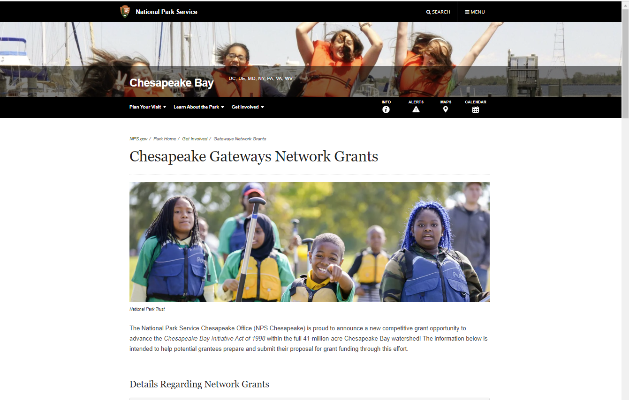
Chesapeake Gateways Network Grant Submission Workshop
Chesapeake Gateways Network Grants Webpage (go.nps.gov/chesapeakegrants)
To Start
Notes:
I also want to highlight that all this information is available on the network grants landing page. You can find more information about the application process, as well as links to the application on grants.gov, links to the NPS Chesapeake Gateways YouTube Channel, and very soon, a list of frequently asked questions.
Please spend some time going through the site to familiarize yourself with the program.
One thing to note, we've been contacted about providing guidance on project ideas. Unfortunately, we are not able to provide one-on-one advising on project ideas. If you are an eligible entity, your project/program will occur in the Chesapeake watershed, the project/program fits in one of the two strategic themes, and the project/program can be accomplished within the available funding and timeframe, then your proposal should be able to be considered.
Just remember, through these grants, NPS Chesapeake seeks to advance innovation in equity, inclusion, accessibility and engagement by Chesapeake Gateway network partners and communities. Each proposal must address at least one Chesapeake Gateways strategic theme.

Slide 23
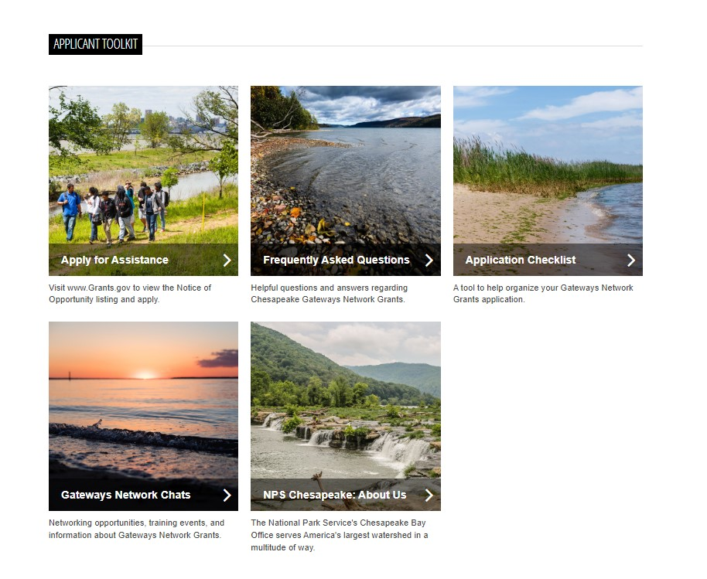
Chesapeake Gateways Network Grant Submission Workshop
Chesapeake Gateways Network Grants Webpage (go.nps.gov/chesapeakegrants)
To Start
Notes:
I also want to highlight that all this information is available on the network grants landing page. You can find more information about the application process, as well as links to the application on grants.gov, links to the NPS Chesapeake Gateways YouTube Channel, and very soon, a list of frequently asked questions.
Please spend some time going through the site to familiarize yourself with the program.
One thing to note, we've been contacted about providing guidance on project ideas. Unfortunately, we are not able to provide one-on-one advising on project ideas. If you are an eligible entity, your project/program will occur in the Chesapeake watershed, the project/program fits in one of the two strategic themes, and the project/program can be accomplished within the available funding and timeframe, then your proposal should be able to be considered.
Just remember, through these grants, NPS Chesapeake seeks to advance innovation in equity, inclusion, accessibility and engagement by Chesapeake Gateway network partners and communities. Each proposal must address at least one Chesapeake Gateways strategic theme.

Slide 24
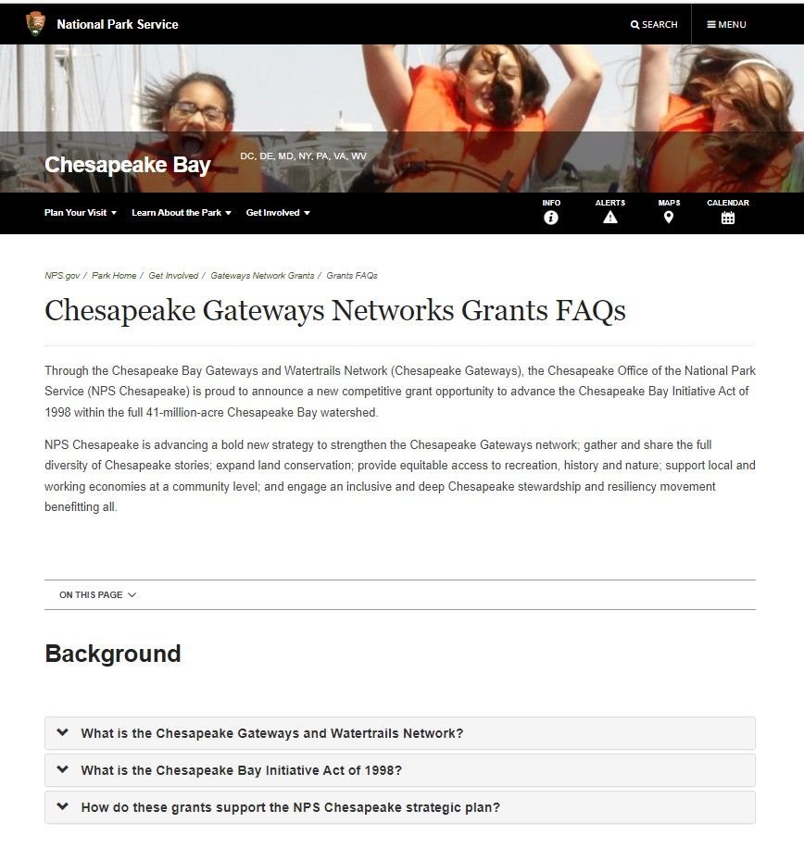
Chesapeake Gateways Network Grant Application Overview
Chesapeake Gateways Networks Grants FAQs - Chesapeake Bay (U.S. National Park Service) (nps.gov)
FAQ
Notes:
I also want to highlight that all this information is available on the network grants landing page. You can find more information about the application process, as well as links to the application on grants.gov, links to the NPS Chesapeake Gateways YouTube Channel, and very soon, a list of frequently asked questions.
Please spend some time going through the site to familiarize yourself with the program.
One thing to note, we've been contacted about providing guidance on project ideas. Unfortunately, we are not able to provide one-on-one advising on project ideas. If you are an eligible entity, your project/program will occur in the Chesapeake watershed, the project/program fits in one of the two strategic themes, and the project/program can be accomplished within the available funding and timeframe, then your proposal should be able to be considered.
Just remember, through these grants, NPS Chesapeake seeks to advance innovation in equity, inclusion, accessibility and engagement by Chesapeake Gateway network partners and communities. Each proposal must address at least one Chesapeake Gateways strategic theme.

Slide 25
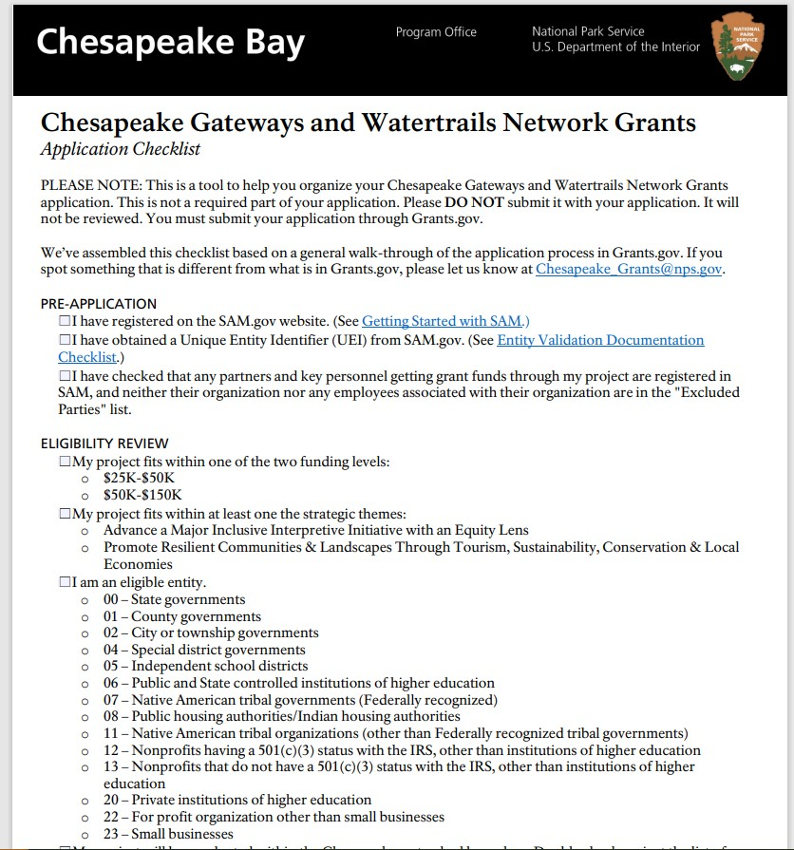
Chesapeake Gateways Network Grant Application Overview
Chesapeake Gateways and Watertrails Network Grants Application Checklist (nps.gov)
Checklist
Notes:
I also want to highlight that all this information is available on the network grants landing page. You can find more information about the application process, as well as links to the application on grants.gov, links to the NPS Chesapeake Gateways YouTube Channel, and very soon, a list of frequently asked questions.
Please spend some time going through the site to familiarize yourself with the program.
One thing to note, we've been contacted about providing guidance on project ideas. Unfortunately, we are not able to provide one-on-one advising on project ideas. If you are an eligible entity, your project/program will occur in the Chesapeake watershed, the project/program fits in one of the two strategic themes, and the project/program can be accomplished within the available funding and timeframe, then your proposal should be able to be considered.
Just remember, through these grants, NPS Chesapeake seeks to advance innovation in equity, inclusion, accessibility and engagement by Chesapeake Gateway network partners and communities. Each proposal must address at least one Chesapeake Gateways strategic theme.

Slide 26
Chesapeake Gateways Network Grant Application Overview
1. Register with the System for Award Management (SAM)
Applicants can register on the SAM.gov website. Grants.gov “Register with SAM” page also provides detailed instructions.
Once registered in SAM, entities must renew and revalidate their SAM registration at least once every 12 months from the date previously registered. Entities are strongly encouraged to revalidate their registration as often as needed to ensure their information is up to date and reflects changes that may have been made to the entity’s IRS information.
2. Obtain a Unique Entity Identifier (UEI) from SAM.gov which replaced Data Universal Numbering System (DUNS) number from Dun & Bradstreet in April 2022.
There is no cost to register with SAM.gov. There are third-party vendors who will charge a fee in exchange for registering entities with SAM.gov; please be aware you can register and request help for free.
Getting
Ready
Notes:
We will go over this in more detail during our grant writing workshop next month, but there are two things you can do to get ready to submit a proposal.
Applicants are required to register in SAM.gov prior to submitting a Federal award application and obtain a Unique Entity Identifier (UEI) which replaced Data Universal Numbering System (DUNS) number from Dun & Bradstreet in April 2022.
Applicants can register on the SAM.gov website. Grants.gov “Register with SAM” page also provides detailed instructions.
There is no cost to register with SAM.gov. There are third-party vendors who will charge a fee in exchange for registering entities with SAM.gov; please be aware you can register and request help for free. There is also more information in the “Submission Requirements” section of the grant application for more information on SAM.gov registration.
Subrecipents will also need to be registered in SAM.
Once registered in SAM, entities must renew and revalidate their SAM registration at least once every 12 months from the date previously registered. Entities are strongly encouraged to revalidate their registration as often as needed to ensure their information is up to date and reflects changes that may have been made to the entity’s IRS information.

Slide 27
Key Dates
August 23, 2022
Strategic Plan and Grants Listening Session
Professional Development
September 20, 2022
Introduction to Gateway Communities
October 6, 2022
Chesapeake Gateways Network Grant Announcement
October 18 & 20 2022
Grant Application Overview (repeated)
This Past Week
November 15 & 17, 2022
Grant Writing Workshop (repeated)
December 1 & 8, 2022
Becoming a Gateway Community (repeated)
January 30, 2023
Grant Application Deadline (target)
TBD 2023
Gateways Network Annual Conference
Notes:
In addition to these webinars focused on the Network grants, NPS Chesapeake has also been hosting a series of networks chats covering topics such as the NPS Chesapeake strategic plan, elements of gateway communities. We are also planning a Network-wide, Gateways annual conference in 2023.
All grant webinars and network chat recordings are posted to the Chesapeake Gateways YouTube Playlist. You can catch up any grant-related trainings you may have missed.
A link to the playlist can also be found on the grants landing page.

Slide 28
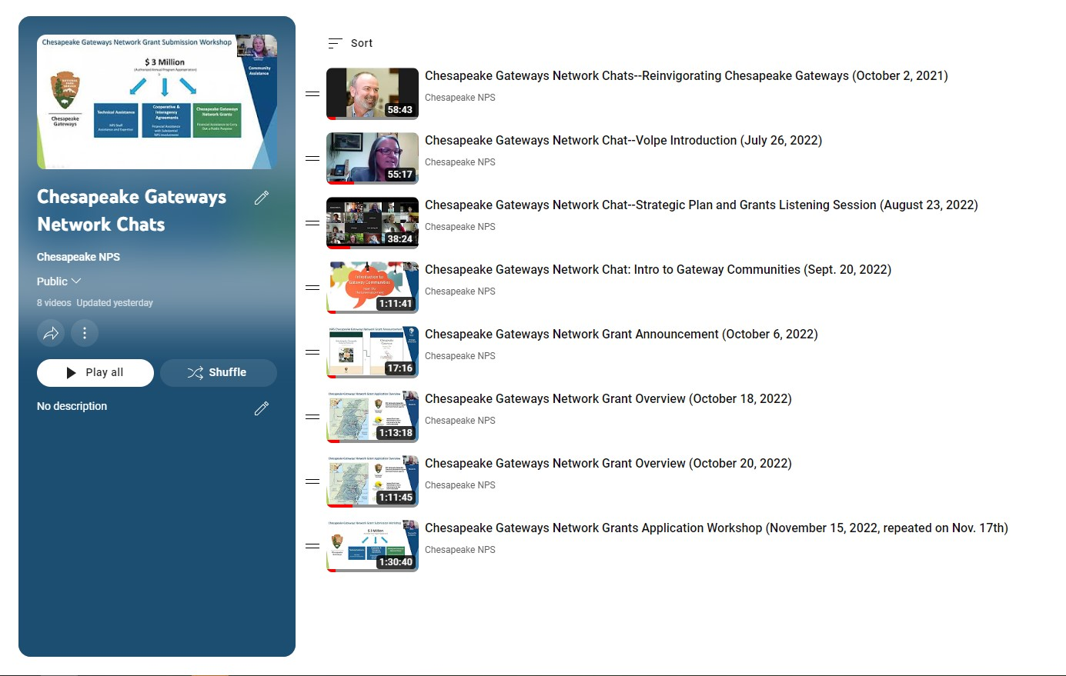
Chesapeake Gateways Network Grant Application Overview
Chesapeake Gateways Network Chats - YouTube
YouTube Training
Notes:
I also want to highlight that all this information is available on the network grants landing page. You can find more information about the application process, as well as links to the application on grants.gov, links to the NPS Chesapeake Gateways YouTube Channel, and very soon, a list of frequently asked questions.
Please spend some time going through the site to familiarize yourself with the program.
One thing to note, we've been contacted about providing guidance on project ideas. Unfortunately, we are not able to provide one-on-one advising on project ideas. If you are an eligible entity, your project/program will occur in the Chesapeake watershed, the project/program fits in one of the two strategic themes, and the project/program can be accomplished within the available funding and timeframe, then your proposal should be able to be considered.
Just remember, through these grants, NPS Chesapeake seeks to advance innovation in equity, inclusion, accessibility and engagement by Chesapeake Gateway network partners and communities. Each proposal must address at least one Chesapeake Gateways strategic theme.

Slide 29
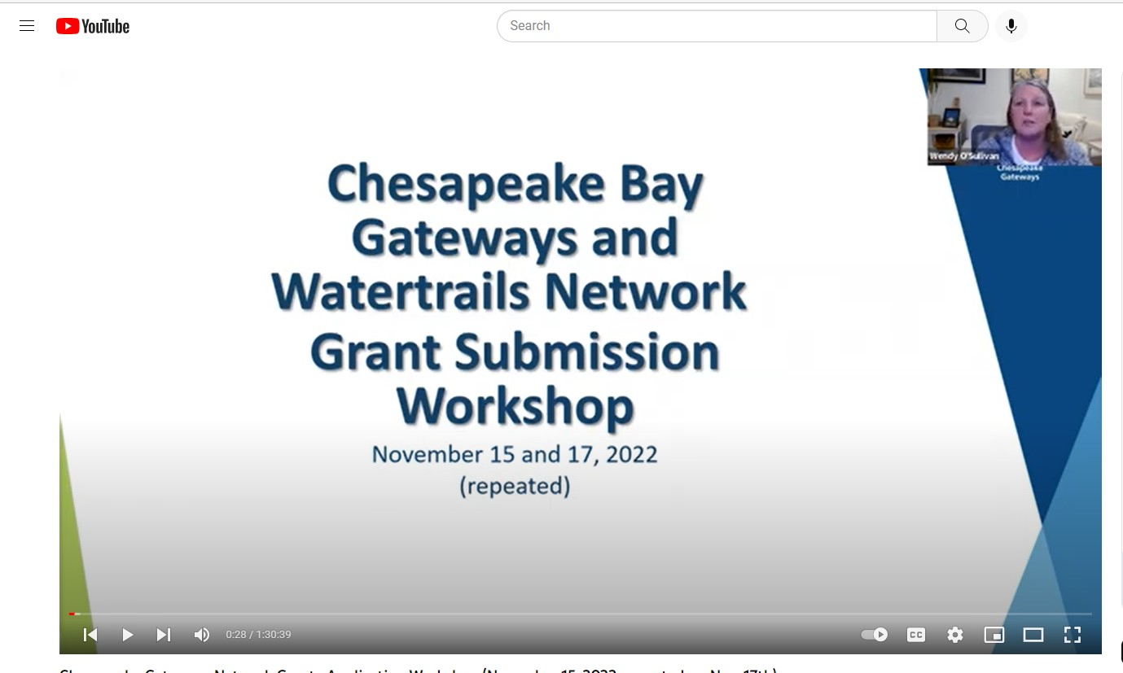
Chesapeake Gateways Network Grant Application Overview
Chesapeake Gateways Network Grants Application Workshop (Nov. 5th & 17th) - YouTube
Application Workshop
Notes:
I also want to highlight that all this information is available on the network grants landing page. You can find more information about the application process, as well as links to the application on grants.gov, links to the NPS Chesapeake Gateways YouTube Channel, and very soon, a list of frequently asked questions.
Please spend some time going through the site to familiarize yourself with the program.
One thing to note, we've been contacted about providing guidance on project ideas. Unfortunately, we are not able to provide one-on-one advising on project ideas. If you are an eligible entity, your project/program will occur in the Chesapeake watershed, the project/program fits in one of the two strategic themes, and the project/program can be accomplished within the available funding and timeframe, then your proposal should be able to be considered.
Just remember, through these grants, NPS Chesapeake seeks to advance innovation in equity, inclusion, accessibility and engagement by Chesapeake Gateway network partners and communities. Each proposal must address at least one Chesapeake Gateways strategic theme.

Slide 30
Chesapeake Gateways Network Grant Application Overview
Thank You!
To ask questions and to get future notices, please email:
Chesapeake_grants@nps.gov
For more details, go to:
go.nps.gov/ChesapeakeGrants
For More
Notes:
That concludes our orientation to the grants program. If you have any questions, please forward them to chesapeake_grants@nps.gov. We will be adding questions and answers to the frequently asked questions document as we go. We expect to have the FAQ go up on the grants landing page this week.
If you'd like to go through these slides again, we will be posting the recording on our YouTube channel. You can get a link on the grants landing page.
We will also be repeating this presentation on Thursday, October 20th, 4:00 – 5:30pm. You will need to register for that webinar separately to get that zoom link.
I'll know turn it back to Wendy for closing comments.

