Slide 1

Revisiting the Default Rate for Harvested Forest Acres in CAST
October 2023 THTF Meeting

Slide 2
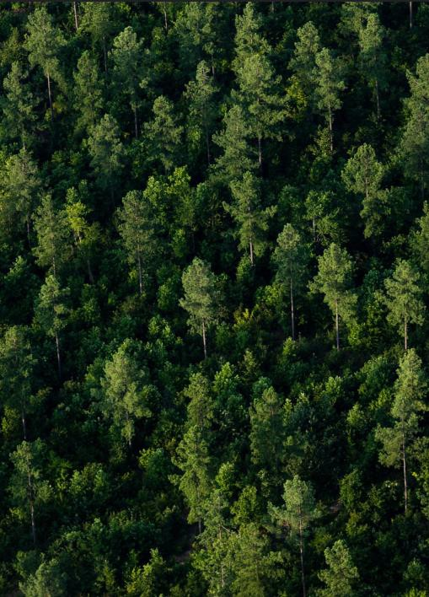
Harvested Forest Land Use
Harvested forest land use is defined as forests that have some amount of harvesting in a year. It is not broken down by type of harvest (e.g., clear cut, selective cut, etc.)
Harvested forest land use acres are reported annually by the CBWS states
Some states report this land use each year, while others are given a
default
  DC: no harvested forest acres, no default
  MD: 2002-2022 are reported, all other years are default
  VA: 1993-2022 are reported, all other years are default
  WV: 1985 – 2022 are reported, all other years are default
  NY, PA, and DE: all years are default
  The harvested forest default is 1.5 percent of true forest
Notes:
One of the main goals of this group is to improve the mapping and modeling of timber harvest in CAST. One of the guiding questions we established was to determine what % of forest should we assume is harvested for states that do not report- this is also known as the “default rate”.
Emphasize that this only applies for states that do not report. Improving reporting should be our first goal. All states have started reporting harvest data for the land use, we need to ensure that this is getting reported up for watershed model reporting as well.

Slide 3

State
Harv
HarvNat
HarvNatAg CAST_PreBMPAcres
2,463 8,289
CAST_PostBMPAcres
DE
701
1,369
8,289
Why are CAST reported acres so
much higher than LULC?
LULC does not map forest thinnings.
States report permitted acres, not acres of harvests.
DC
-
6
6 -
13,367 160,090
3,622 185,692
56,523 634,162
227,331 375,969
-
MD | 716 | 8,146 | 1.
NY | 8 | 1,830 | 2.
PA 14,273 45,992 |  |  | 3.
160,090
185,692
Some states' CAST acres are
634,162
1.5% of forests.
VA | 160,646 | 198,709 |  |  |  | 375,969
WV | 7 | 4,053 | 7,175 | 80,396 |  | 80,396
LULC vs CAST (Bay Portion of States)
Notes:
Don’t want to spend too much time on this, but as a recap- Over the last several meetings we have been looking at a number of data sources to get a better idea of the amount of timber harvesting. Started just comparing what we saw in the land use with what we saw in CAST and saw some pretty big discrepancies. Knowing that our mapping of timber harvesting wasn’t perfect (and that there was some misclassification of harvested areas as natural succession and as ag, we added in some additional classes for the comparison, but even when you compare harvested forest, natural succession and ag taken together, we are seeing less that the number of acres in CAST. And there are a number of good reasons for that – these are just some of the reasons.

Slide 4
FIA Timber Harvest data
Data provided here is clipped to watershed boundary
FIA distinguishes between different ownerships
Inventory identifies plots with “cutting” treatments
  “Cutting” is the removal of one or more trees from a stand
    “Treatments” should affect at least 1 acre
    Doesn’t distinguish between clear cuts and selective harvest, BUT can look at changes in basal area within cut treatments
FIA samples a subset of plots annually
  Most states in CBW are on a 7-year cycle
  VA is on a 5-year cycle
Notes:
Was a recommendation to look at FIA data as another point of comparison, so was able to get some FIA data clipped to the watershed boundary for us. Before looking at the data wanted to share some details and caveats about the data.
- Samplilng cycle means the 2018 data isn’t just from 2018- it is really a summary of 2012 or 2014-2018
In some states we may not have enough density of FIA plots to be overly confident in the results

Slide 5
Revisiting the default harvest rate (FIA)
 | total % cut/cycle length | annual % cut estimates (using remeasured plots)
CBW | 1.06% | 1.11%
DE | 0.76% | 0.89%
MD | 0.30% | 0.38%
NY | 1.41% | 1.90%
PA | 1.00% | 1.20%
VA | 0.89% | 1.09%
WV | 0.55% | 0.65%
Notes:
Looking first at the % of forests that are cut to revisit the default harvest rate that is applied in CAST. Did this using a couple of different methods.
This captures all harvest- public/private, clearcut and selective- suggests default rate is an overestimate. FIA data for harvested acres does line up decently well with what we have in CAST and when we try to disentangle clearcuts from the FIA data, it lines up relatively well with the land use data at the watershed scale.
Assuming we are trying to capture all harvest- there was a question of whether states would experience cutoff of reported BMP acres if we reduce the default rate to 1.1%

Slide 6
Delaware
Harvested Forest, 1% True Forest, & Forest Harvesting Practice Acres
1,600
1,400
1,389
1,383
1,354
1,382
1,380
1,378
1,345
1,377
1,376
1,376
1,330
1,375
1,375
1,374
1,200
1,201
1,159
1,000
912
908
908 918
909
912
907
906
905
907
908
Acres
800
731
739
613
600
400
200
0
2013
2014
2015
2016
2017 2018
2019
2020
2021
2022
All Years are Default
Harvested Forest Acres
1% of True Forest Credited Forest Harvesting Practice Acres
Notes:
These are Helen’s slides from last time as a refresher- we wanted to see if we reduced the default rate in CAST, if we would have issues with cutoff where there are more acres of BMPs being reported then there are acres to apply them to. Blue bars- current harvested forest acres in CAST, orange bars- 1% of true forest (if default rate was reduced) and grey bars are credited forest harvest acres. So Delaware would likely fall into this camp of running into issues with cutoff, but they are probably the only one

Slide 7
Maryland
Harvested Forest, 1% True Forest, & Forest Harvesting Practice Acres
35,000
30,000
25,000
30,047
30,022
29,999
29,977
29,985
29,993
30,003
21,294
21,147
21,130
21,115
21,121
21,130
21,164
21,340
21,365
21,100
20,000
Acres
15,626
16,103
15,000
13,073
12,864
13,589
12,019
10,000
10,060
8,991
9,053
8,120
6,543
5,000
2,766
0
0
2013
2014
2015
2016
2017 2018
All Years are Reported
2019
2020
2021
2022
Harvested Forest Acres
1% of True Forest Credited Forest Harvesting Practice Acres

Slide 8
New York
Harvested Forest, 1% True Forest, & Forest Harvesting Practice Acres
40,000
37,319
37,326
37,335
37,347
37,427
37,506
37,589
37,674
37,757
36,365
35,000
30,000
24,519
24,525
24,533
24,587
24,640
24,696
24,759
24,808
25,000
23,888
24,515
Acres
20,000
15,000
10,000
5,000
0
0
0
0
0
0
0
1,431
732
1,353
0
2013
2014
2015
2016
2017 2018
2019
2020
2021
2022
All Years are Default
Harvested Forest Acres
1% of True Forest Credited Forest Harvesting Practice Acres

Slide 9
Pennsylvania Harvested Forest, 1% True Forest,
& Forest Harvesting Practice Acres
140,000
126,556
126,938
126,912
126,889
126,867
126,898
126,930
126,965
127,001
127,038
120,000
100,000
83,912
83,907
83,944
83,992
84,038
83,636
83,895
83,880
83,866
83,886
80,000
60,000
40,000
Acres
16,346
16,713
16,245
21,731
20,000
13,631
13,893
15,239
16,183
14,113
712
0
2013
2014
2015
2016
2017 2018
2019
2020
2021
2022
All Years are Default
Harvested Forest Acres
1% of True Forest Credited Forest Harvesting Practice Acres

Slide 10
Virginia
Harvested Forest, 1% True Forest, & Forest Harvesting Practice Acres
160,000
140,000
136,677
120,000
117,064
100,000
89,460
89,201
85,121
85,250
86,705
85,314
85,376
85,308
85,231
85,214
84,956
85,625
85,041
85,058
Acres
80,000
78,018
72,390
72,000
76,462
72,981
67,074
69,418
66,199
68,381
69,412
68,475
60,658
62,296
57,177
60,000
40,000
20,000
0
2013
2014
2015
2016
2017 2018
All Years are Reported
2019
2020
2021
2022
Harvested Forest Acres
1% of True Forest Credited Forest Harvesting Practice Acres

Slide 11
West Virginia Harvested Forest, 1% True Forest, & Forest Harvesting Practice Acres
20,000
18,201
17,725
17,707
18,000
16,901
16,546
17,175
16,180
15,98146,057
_{15,75}1₁6,048
16,014
16,009
16,059
16,032
16,039
16,405
16,02115,910
16,048
16,000
15,355
15,030
15,383
14,918
14,725
14,247
13,653
14,000
12,753
13,238
12,365
12,000
10,000
8,000
6,000
4,000
2,000
0
Acres
2013
2014
2015
2016
2017 2018
All Years are Reported
2019
2020
2021
2022
Harvested Forest Acres
1% of True Forest Credited Forest Harvesting Practice Acres

Slide 12
Questions for the Group
Is there anything CBPO can do to help facilitate better reporting of harvested forest acres?
Should we reduce the default rate to align with the watershed-wide FIA data (1.1%)? Or have state-by-state harvest rates?
Should “harvested forest” acres in CAST include both clear cut and selectively harvested acres?

