Slide 1
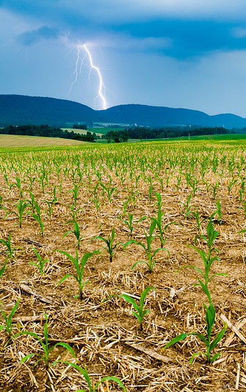
Protected Lands Workgroup
Quarterly Meeting
July 2024
Photo Credit: Chesapeake Bay Program

Slide 2
Agenda Overview
Review of 2024 Action Plan
GIS Community of Practice
Coordination Among Conservation Groups
Trust for Public Land’s Community Assessment Tool
Chesapeake Conservation Partnership

Slide 3
2024 PLWG Actions
1.1 Develop or improve communication materials and resources for public outreach.
1.1.a Create a map or language outlining excosystem services.
1.1.a.i Coordinate with WG members to compile outreach communication tools.
1.1.b. Spread awareness for CCP Narrative Toolkit.
1.1.b.i Utilize one jurisdiction as an example for CCP Narrative Toolkit.
1.1.b.ii Consult CBP Strategic Engagement Team to gain an understand of what themes would be most effective with landowners.
2.1 Collaborate with WG members to increase awareness for conservation programs and policies.
2.1.a Develop a shared doc to share information on programs and policies.
2.1.b Present on a specific land conservation program that exists within the Chesapeake Watershed.
3.1.a.i Coordinate presentations that will increase awareness for diversity, equity, and land conservation.
4.1 Coordinate data collection among jurisdictions and acquire missing numbers.
4.1.a Convene GIS experts from each jurisdiction.
4.1.b Identify and engage key stakeholders representing local land trusts, agencies, orgs.
4.1.c Consolidate new acquired numbers to update the number of protected lands.

Slide 4
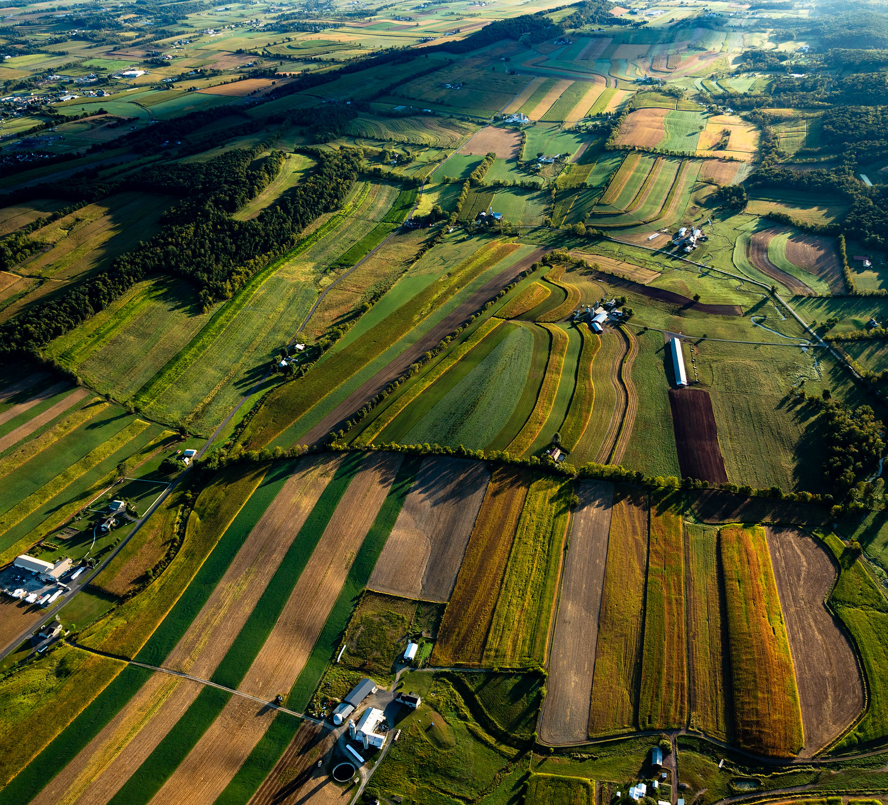
Presentation from
GIS Community of Practice

Slide 5
Coordination Among Conservation Groups
What can more strategic coordination look like across land conservation related groups in the Chesapeake Bay Program?
WHICH TOPICS?
Land Conservation/Protection (includes wetlands, forests)
Public Access to Waterways
Access to greenspace, parks, trails, etc. - natural, recreational, historical, cultural
Forest restoration, stewardship, conservation, including riparian buffers and tree canopy
Protecting Healthy Watersheds (those that are already healthy)
Stewardship, Education, Diversity/ DEIJ-A
GIS support for all
WHY?
  Shared vision for conservation on equal par w/ restoration
  Use data/maps on multiple benefits to drive decisions – more strategic, targeted, multidisciplinary approach to conservation
  Incorporate "people interests" into conservation (public access, health, equity, stewardship; local level concerns)
  Identify potential for alignment/ collaboration/ collective impact
  Protect investments long term (eg, healthy watersheds, forests)
  Find efficiencies (eg, restoration on already-conserved land, more functional habitats, etc.)
  Improve tracking and decision-support
  … some examples ...
Notes:
Protected Lands --
Land protection:
2M acres by 2025
Including 225K ac wetlands, 659K ac forest
Public Access --
Access to waterways:
300 new access sites by 2025
National Park Service (NPS) --
Chesapeake Gateways and Watertrails Network - network of water routes and land resources/sites and connections (parks, historic, natural, recreational sites, etc.) across the watershed.
NPS provides technical and financial assistance; resource conservation and interpretation; public education and access; aims to link Gateways sites with trails, scenic byways, etc.
Forestry Workgroup / US Forest Service (FS) --
Forest restoration, stewardship, conservation:
Riparian Forest Buffers – restore 900 miles/yr and conserve 70%;
Tree Canopy – expand by 2400 ac by 2025 (net gain)
Healthy Watersheds Goal Team --
Protecting/ maintaining intact natural watershed lands, and supporting the conservation targeting efforts at the Bay Program
Stewardship Goal Team --
“People" - stewardship, education, diversity, access, land conservation
CBP GIS Team (STAR) --
GIS support for CBWA activities

Slide 6
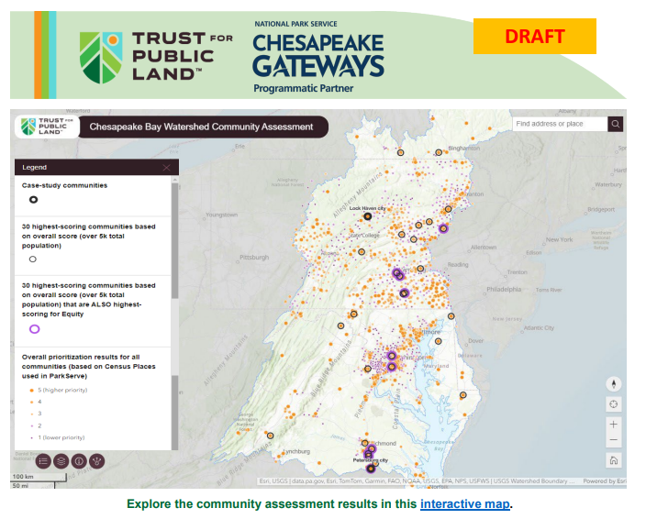
National Park Service & Trust for Public Land’s Community Assessment Tool
A mapping tool for the Chesapeake Bay Watershed and “Roadmap” reports for Maryland, Virginia, and Pennsylvania, show how parks can be used to address community needs.
Where parks and greenspace could drive the most systemic change in health, climate, equity, and economic opportunity.
A list of 22 criteria factors were used to explore impacts across the watershed and scoring was used to list communities on a scale of highest prioritiy to lowest.
Use the map to find your community and use the roadmaps reports to explore further community details.

Slide 7
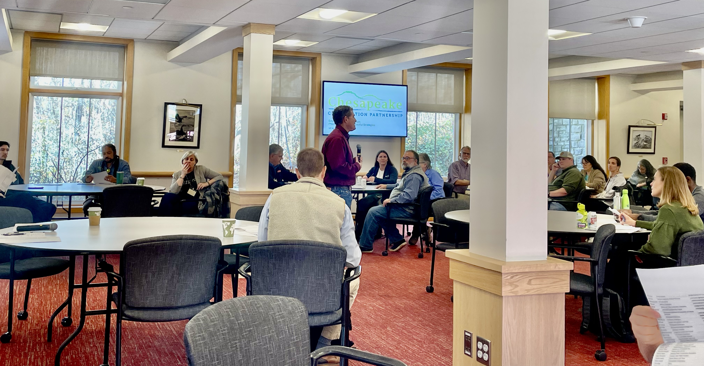
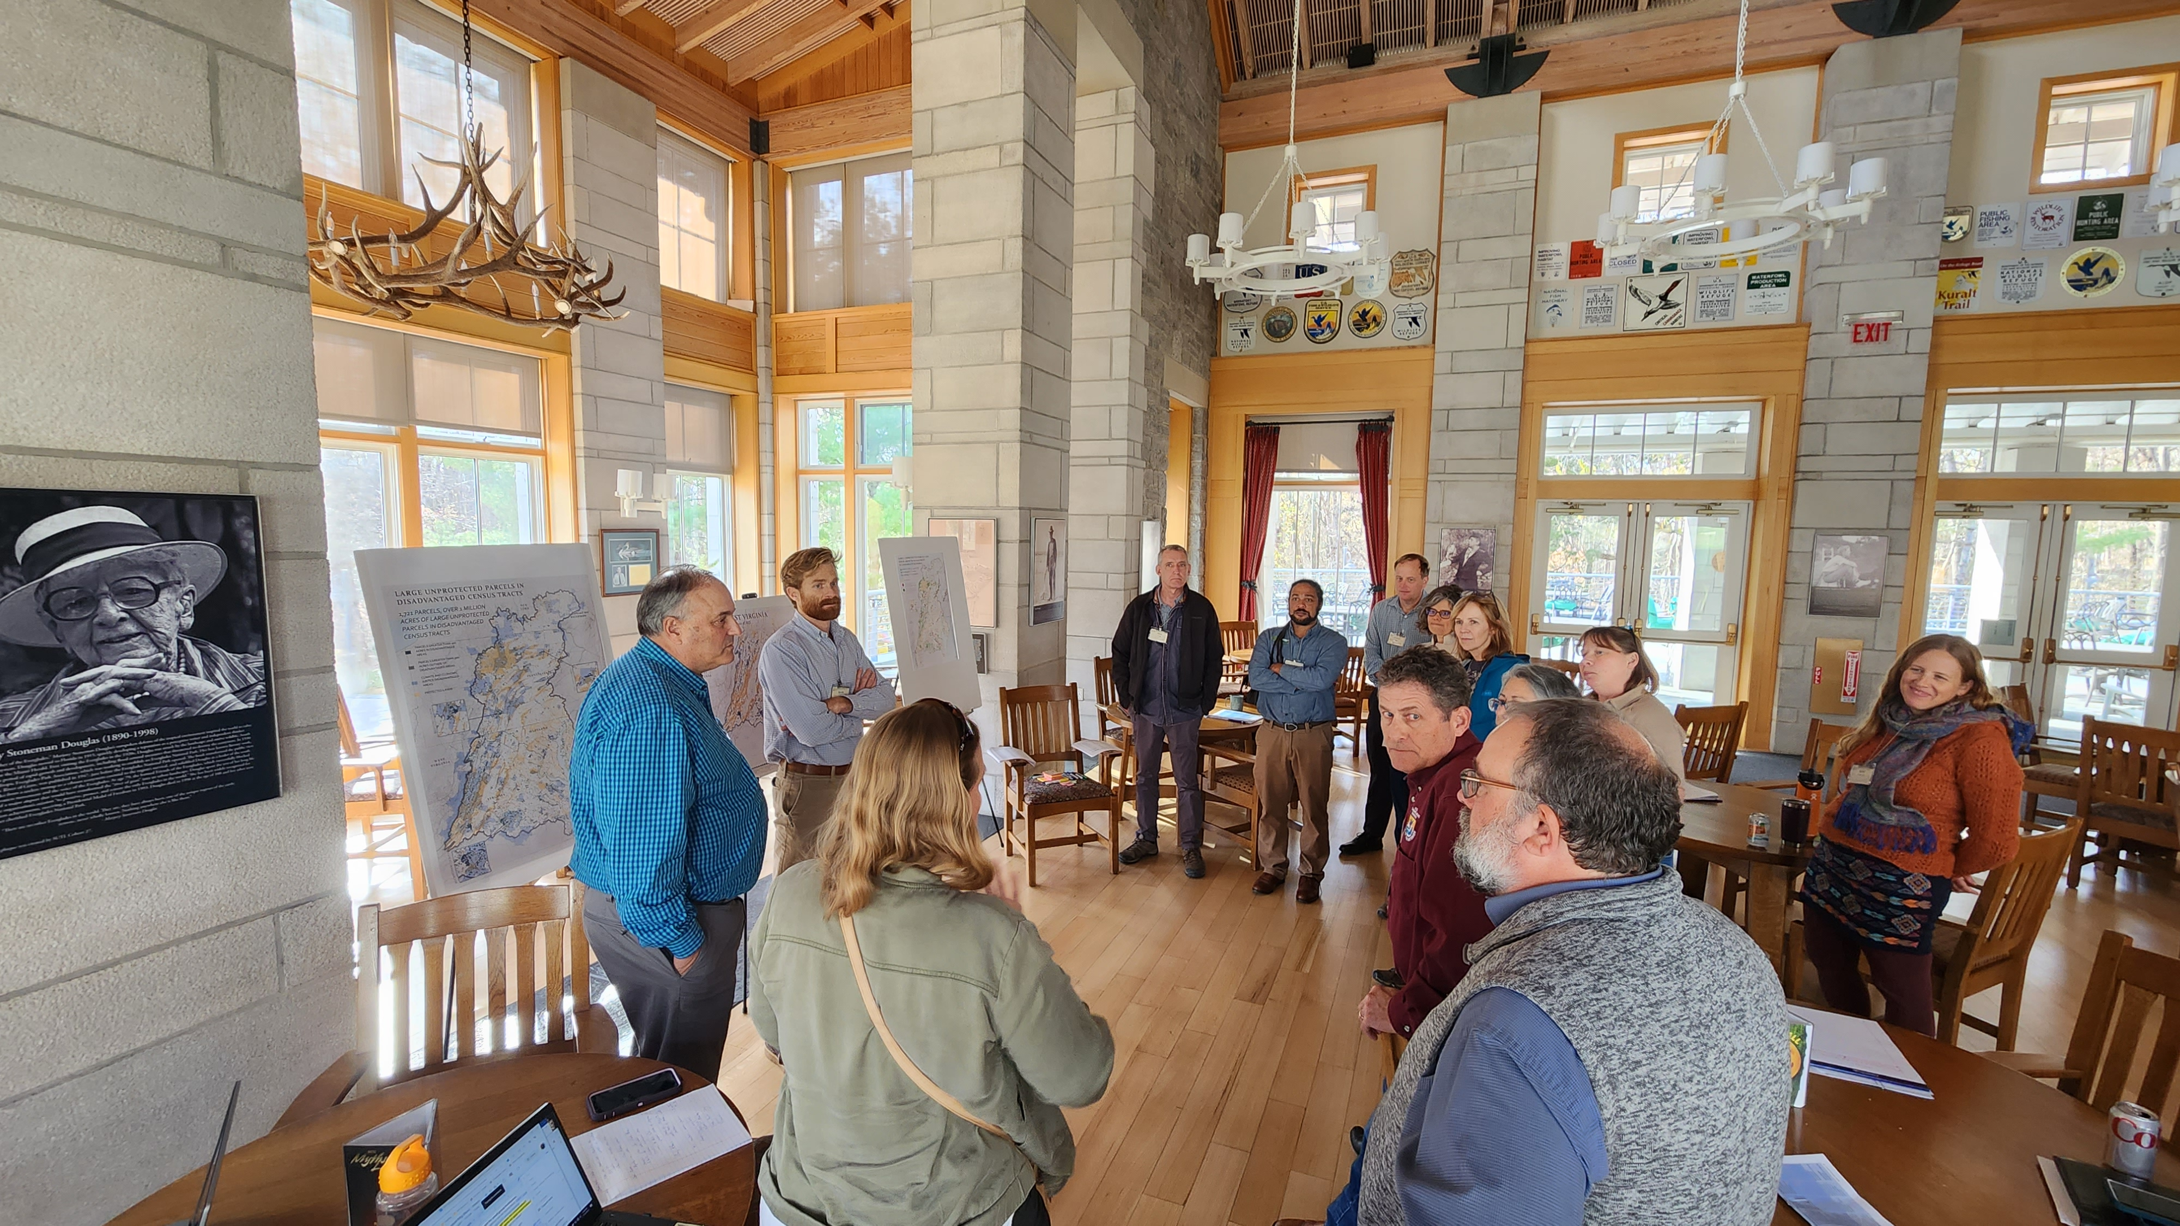
Chesapeake Conservation Partnership (CCP)
Chesapeake Conservation Partnership will be hosting its Fifteenth Annual Meeting, “Chesapeake United: Strategies for Cross Border Conservation”
Where: The Claggett Center, 3035 Buckeystown Pike, Adamstown, MD
When: 10:00AM November 19th to 3:00PM November 20th
Contact:
Ben Alexandro,
(balexandro@chesapeakeconservation.org)
Chase Douglas,
(cdouglas@chesapeakeconservancy.org)

Slide 8
Next Steps…
Upcoming Quarterly Meetings:
July 31th at 2:30PM
December 11th at 2:30PM
April 30th at 2:30PM

Slide 9
Thank you

