Slide 1
Recap of Pre-Meeting Webinars and Available Resources
Agricultural Advisory Committee Meeting
August 28, 2025

Slide 2
Onboarding New Members
Members of the newly-formed Agricultural Advisory Committee have a variety of experience with the Chesapeake Bay Program universe.
Members want to know if agriculture is accurately reflected in the Model:
Is the ag community getting credit for all the good work that they’re doing?
Where are the information gaps?
How can this group help?

Slide 3

“Onboarding Curriculum”
What do members need to know to inform their guidance to the Bay Program?
What resources are already available?
Where do gaps remain?
Given short time frame between June and August, what do members really need to know ASAP??

Slide 4
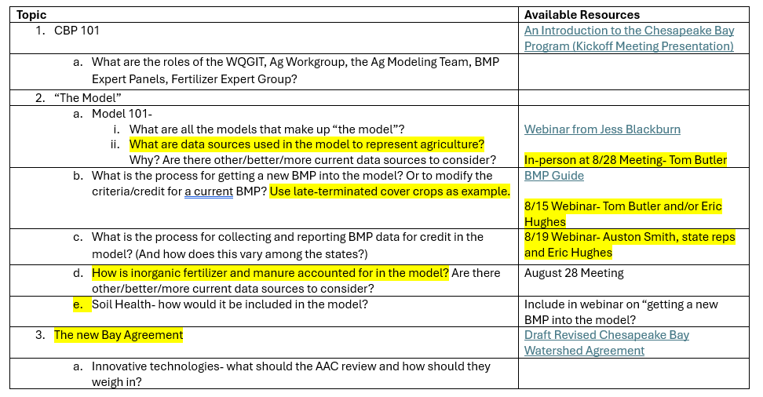
Onboarding Curriculum

Slide 5
Webinar #1- How a BMP gets into the Model*
There are 183 individual best management practices listed in the model, including 104 unique combinations of cover crop species, planting date & planting method
BMP Quick Reference Guide
New BMPs are incorporated in the model according to the “BMP Protocol”
  Expert Panel is convened to review available research and use best professional judgement
  Expert Panel decides if there’s sufficient information to support a nitrogen, phosphorus and/or sediment load reduction for the practice.
  The Panel also quantifies the load reduction that the practice receives and the technical details to describe the practice in the model.
Practices can also be re-evaluated through a similar process.
*There’s a lot more information in the webinar recording and presentation slides!

Slide 6
Webinar #2- Getting Credit for BMPs
Every Bay State and DC has their own unique set of BMP goals in the Chesapeake Bay Watershed Implementation Plan. Those include overall goals to meet by 2025, as well as “milestone goals” which break up the larger goal into 2-year increments.
Every year, each of the Bay States and DC report their progress towards meeting the Chesapeake Bay goals. States submit data according to a “Quality Assurance Protection Plan” that ensures that the data is relatively consistent and reliable.
States are also responsible for practice verification in the field, to ensure that BMPs conform to standards. States can also verify that a practice is still in use after it’s normal lifespan is completed and continue to receive credit for it.
*There’s a lot more information in the webinar recording and presentation slides!

Slide 7
Webinar #2- Getting Credit for BMPs (cont.)
Quality Assurance Protection Plans are updated every year.
  Some BMPs are prioritized because of their relative benefit to water quality and so these practices receive more extensive verification efforts that are outlined in the QAPP
  Examples include Forest/Grass Buffers, Tillage Practices and Cover Crop Practices
A lot of data is obtained by states through federal agencies like USDA-NRCS, but data is generally aggregated and reported on a county scale to protect individuals’ personal identifiable information.
*There’s a lot more information in the webinar recording and presentation slides!

Slide 8
