Slide 1

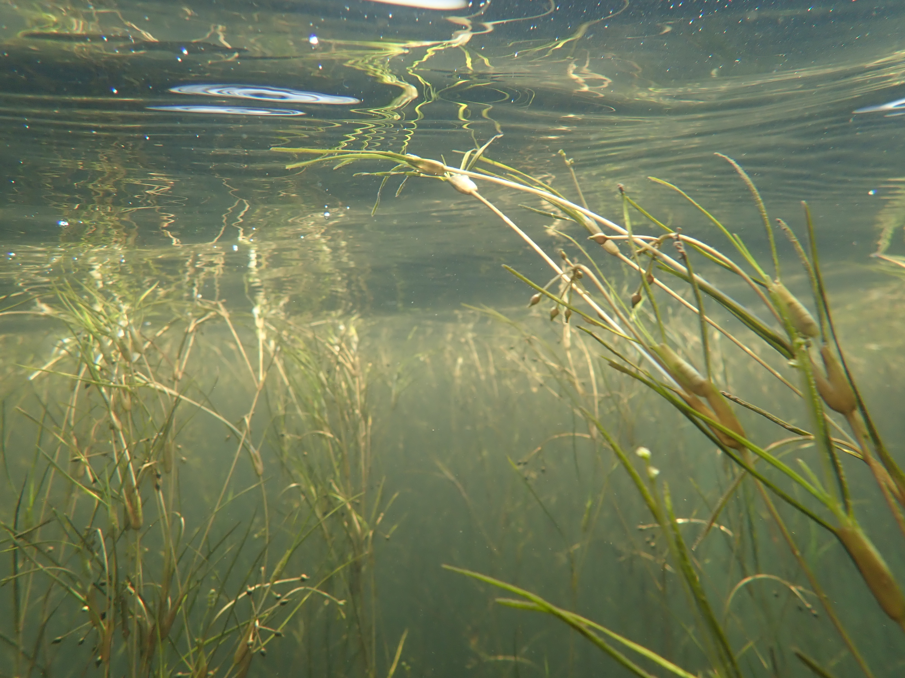
Spring HGIT MEETING – April 29th, 2025
Chesapeake Bay Program
Submerged Aquatic Vegetation Workgroup Updates
Brooke Landry
Maryland DNR and
Chair, SAV Workgroup

Slide 2
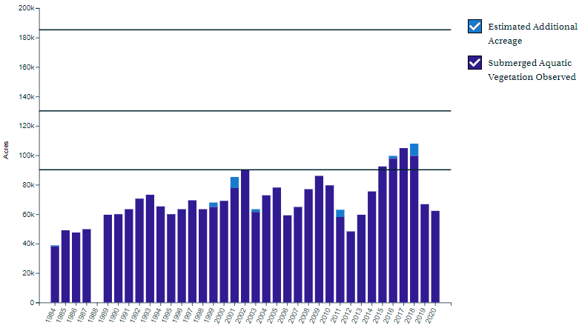
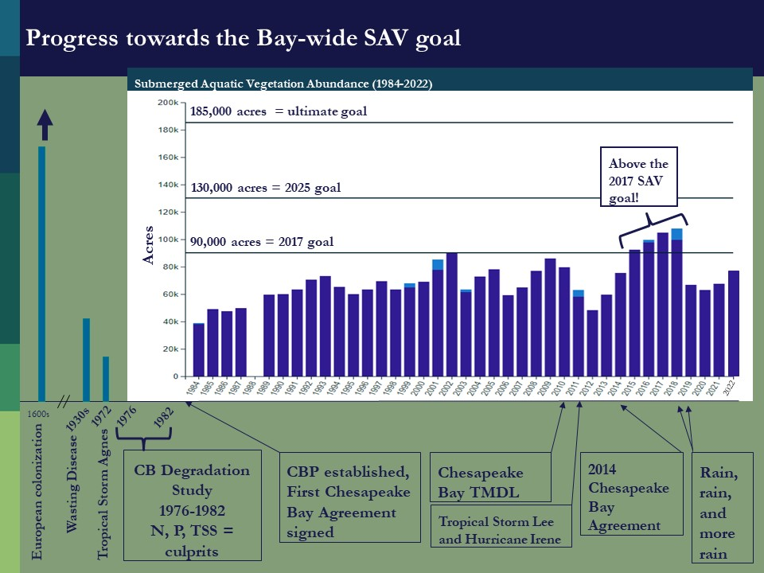
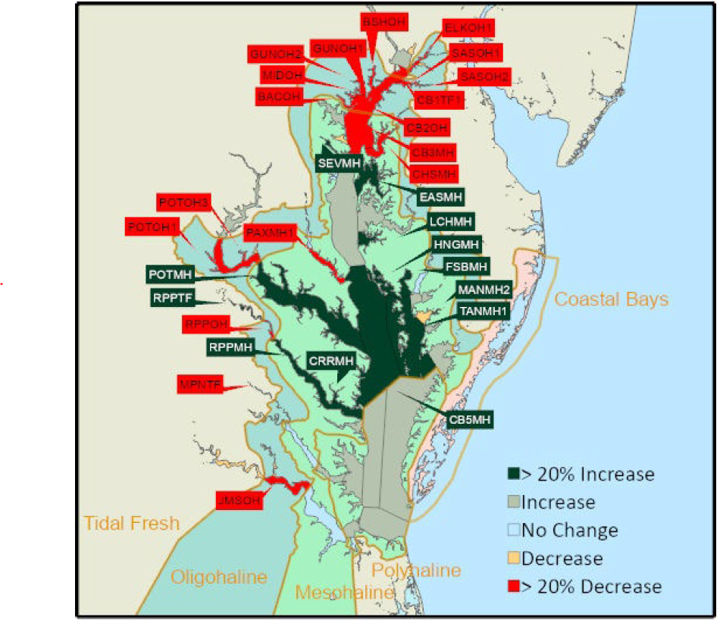
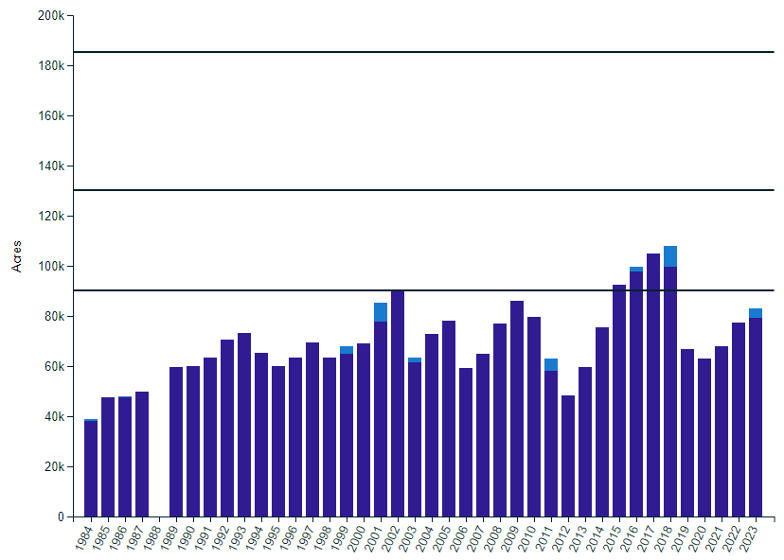
What is our Progress?
2023 SAV #s
FINAL SAV #s were up in 2023:
79,716 acres were mapped in 2023.
3,703 additional acres of SAV are estimated for a portion of the Potomac that was not mapped.
83,419 total acres of SAV estimated for 2023(+8%).
This is 61% of the 2025 target and 45% of the ultimate 185,000-acre outcome.
Ultimate goal = 185,000 acres
2025 goal = 130,000 acres
2017 goal = 90,000 acres
https://www.vims.edu/research/units/programs/sav/access/maps/index.php
https://www.chesapeakeprogress.com/abundant-life/sav

Slide 3
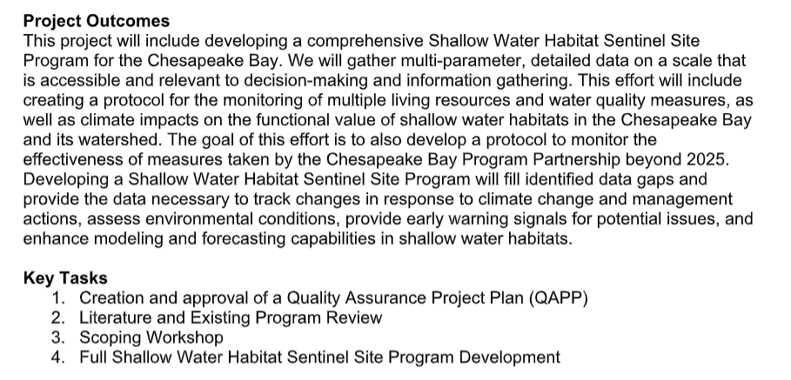
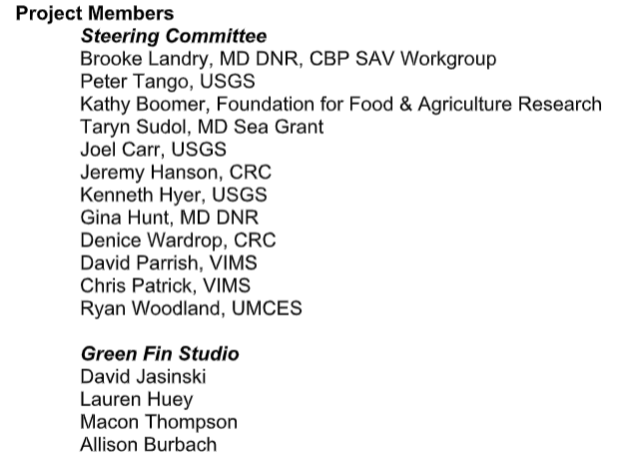
Shallow Water Habitat Sentinel Site Program Development ;
Contracted to Green Fin Studios!

Slide 4
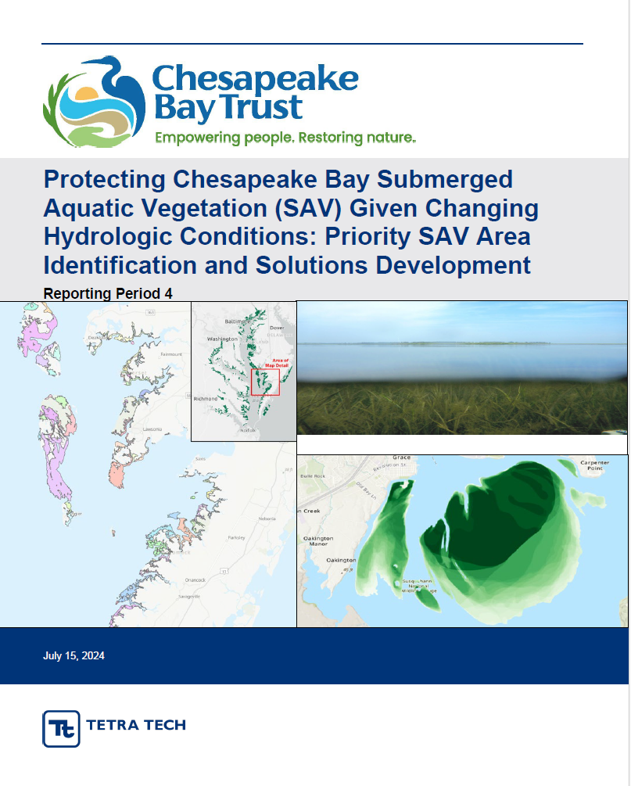
Protecting Chesapeake Bay SAV Given Changing Hydrologic Conditions: Priority SAV Area Identification and Solutions Development
2022 GIT-Funded Project
Lead: SAV Workgroup
Project Objective
This project will identify high-priority SAV areas within the Chesapeake Bay Watershed and determine which BMPs could be most effective in protecting those areas from loss during high-flow events/years using GIS spatial analysis/modeling and existing SAV, flow, land-use, and water quality data. With this information, steps can be taken to target high-priority SAV areas for implementation of BMPs and land management policies that will protect or restore those priority SAV habitats.
UPDATE: Tetra Tech presenting today!

Slide 5
Protecting Chesapeake Bay SAV Given Changing Hydrologic Conditions: Priority SAV Area Identification and Solutions Development
2022 GIT-Funded Project
Lead: SAV Workgroup
COMPLETE
Project Objective
This project will identify high-priority SAV areas within the Chesapeake Bay Watershed and determine which BMPs could be most effective in protecting those areas from loss during high-flow events/years using GIS spatial analysis/modeling and existing SAV, flow, land-use, and water quality data. With this information, steps can be taken to target high-priority SAV areas for implementation of BMPs and land management policies that will protect or restore those priority SAV habitats.
UPDATE: Tetra Tech presenting today!

Slide 6


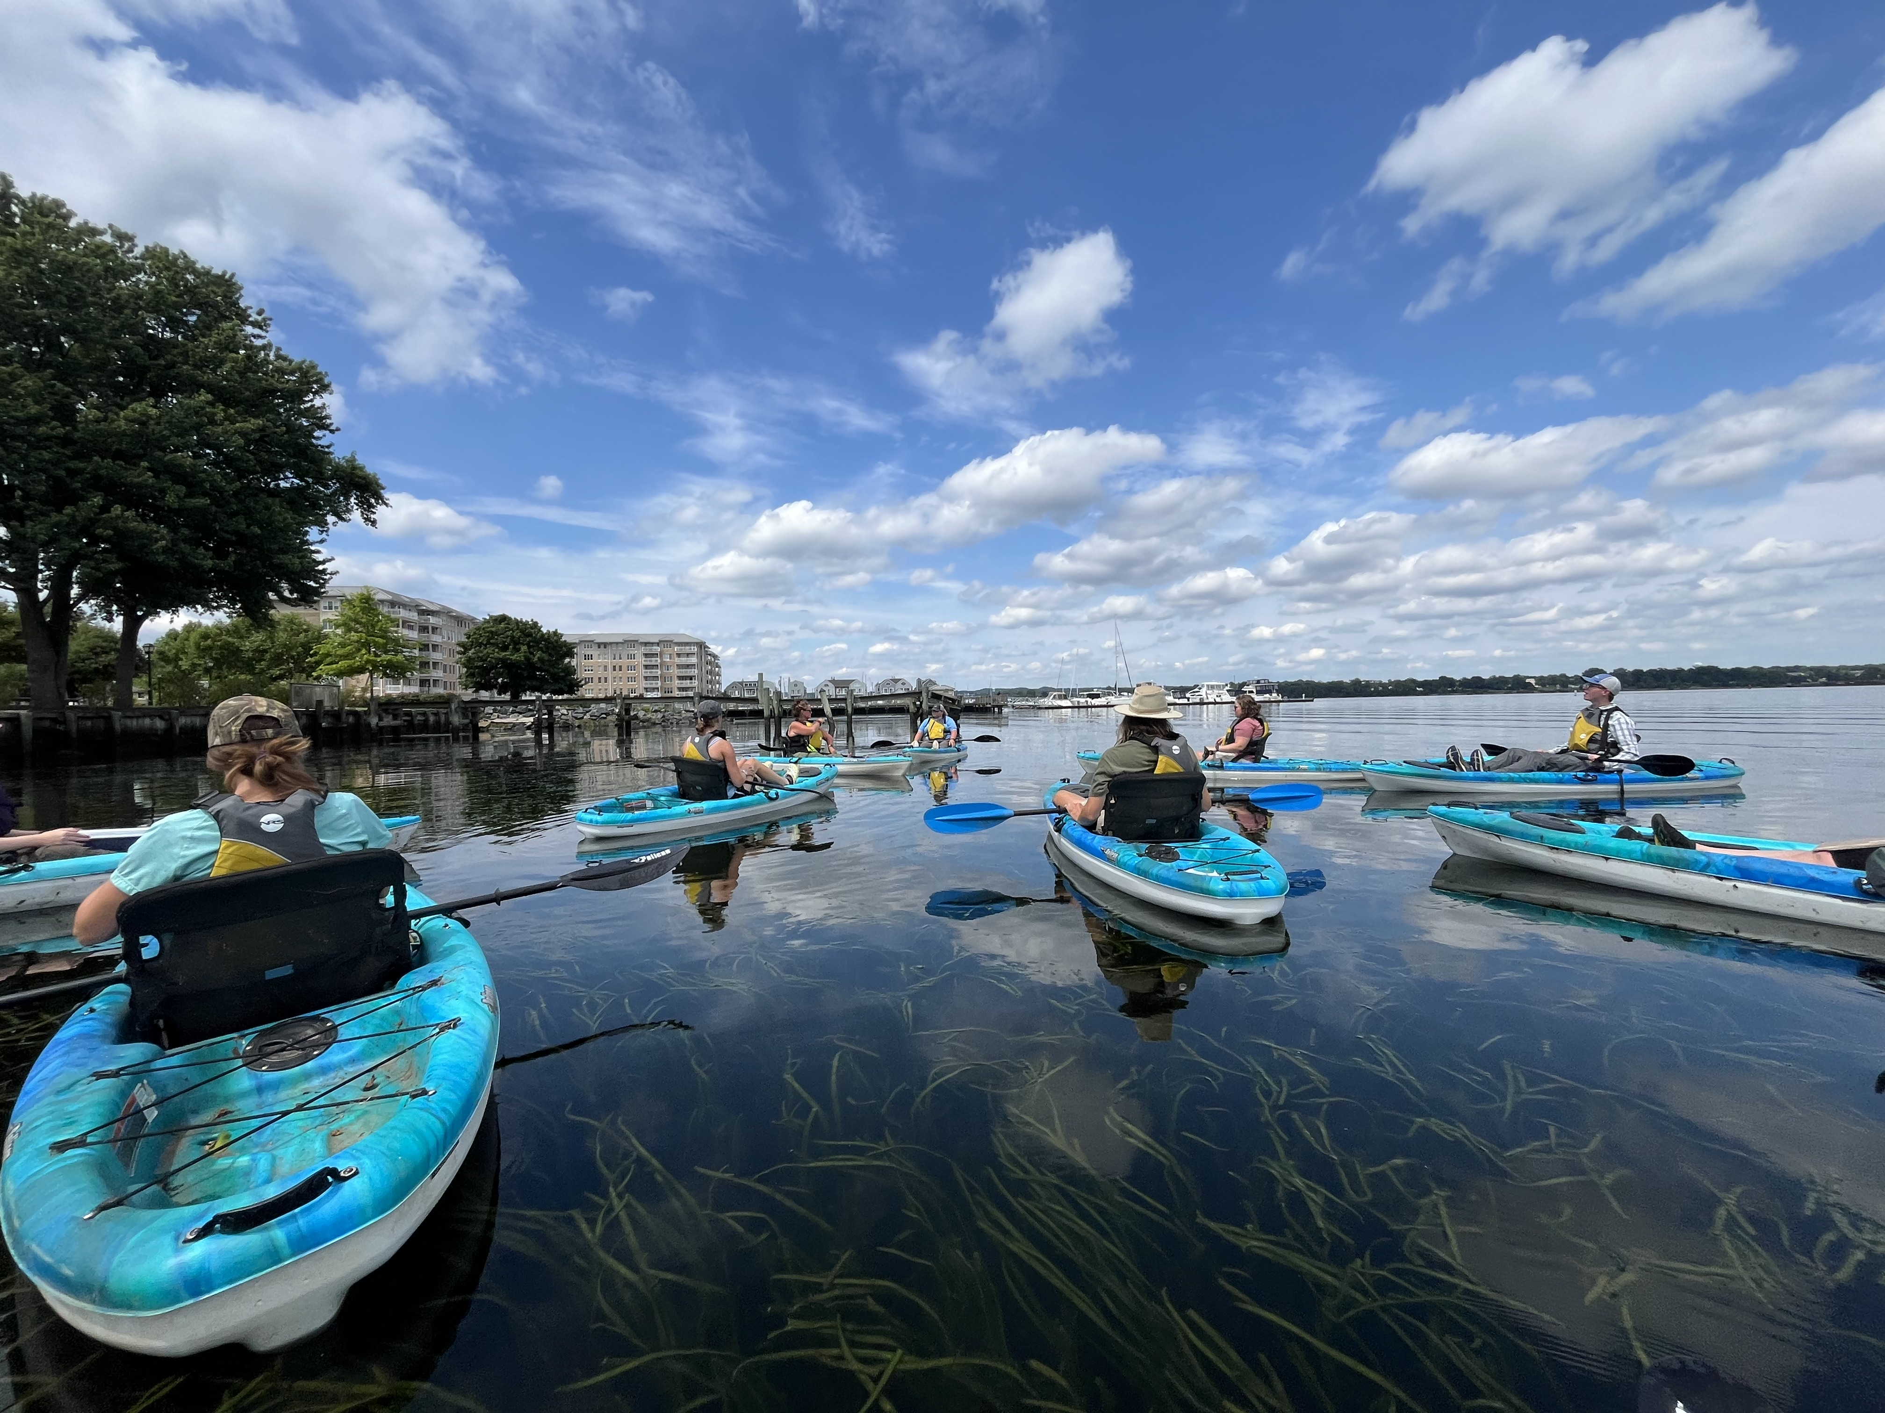
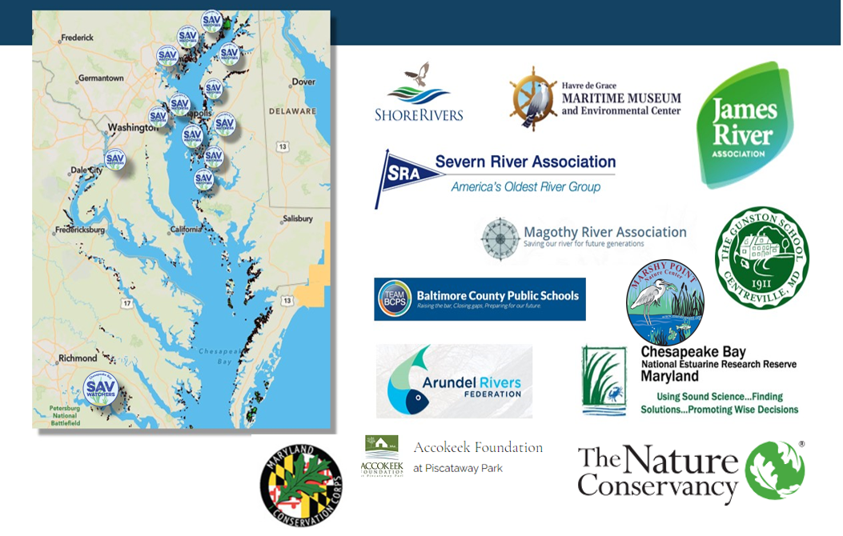
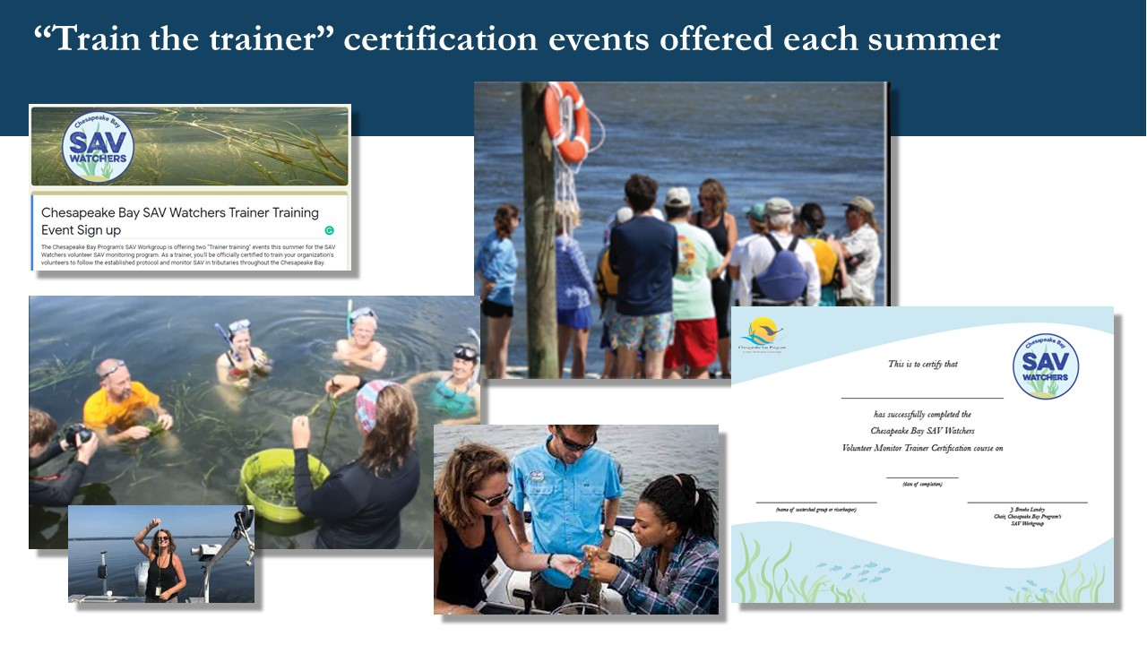
Chesapeake Bay SAV Watchers Program
SAV Watcher Trainer Certification Events in 2025:
Annapolis Maritime Musuem
Marshy Point Nature Center
St. Mary’s Watershed Association/SMCM
Virginia Commonwealth University/The Nature Center
VIMS, Others?
www.chesapeakebaysavwatchers.com OR https://www.chesapeakebay.net/what/programs/monitoring/sav-monitoring-program

Slide 7
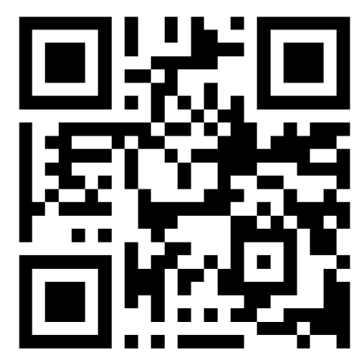
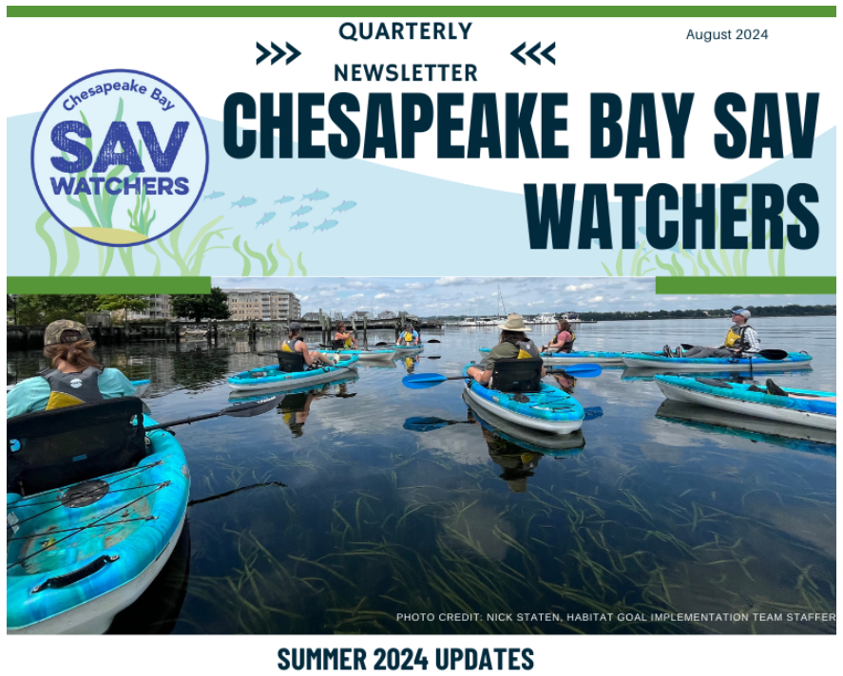
SAV Watchers Newsletter
Subscribe to our Newsletter here:
https://forms.gle/yYwkDPShvBjFCiby5
www.chesapeakebaysavwatchers.com OR https://www.chesapeakebay.net/what/programs/monitoring/sav-monitoring-program

Slide 8
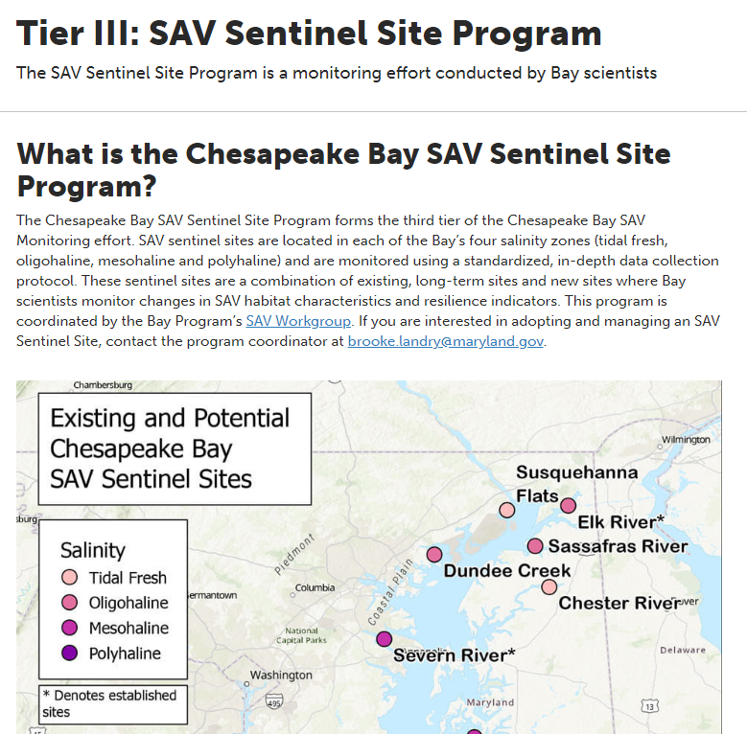
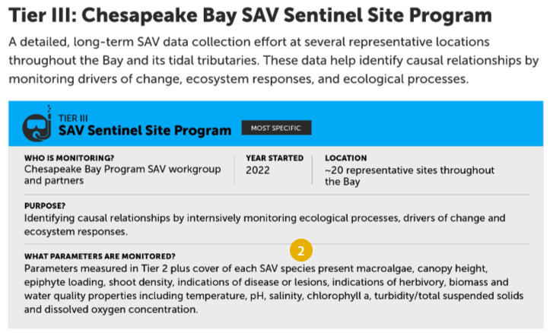
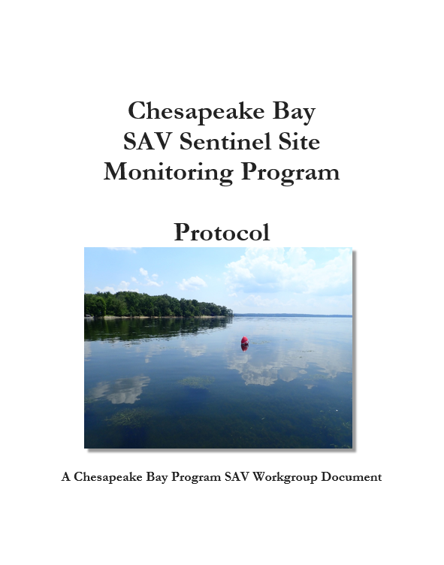
SAV Sentinel Site Program – continuing in 2025!
Sites that will be installed and monitored in 2025:
Severn River
Susquehanna Flats
Smith Island
Marshy Creek
Dundee Creek
St. Mary’s
VIMS sites
CB- NERR sites
https://www.chesapeakebay.net/what/programs/monitoring/sav-monitoring-program

Slide 9
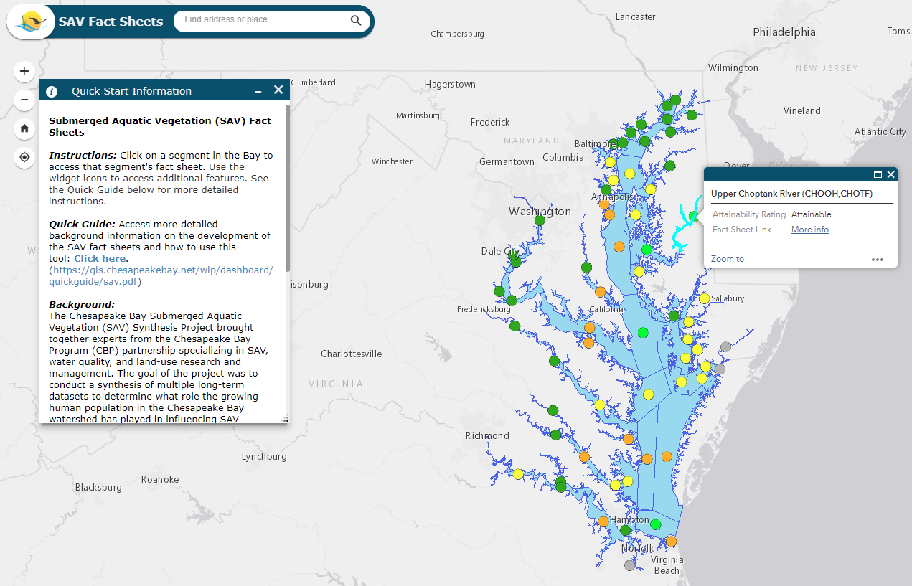
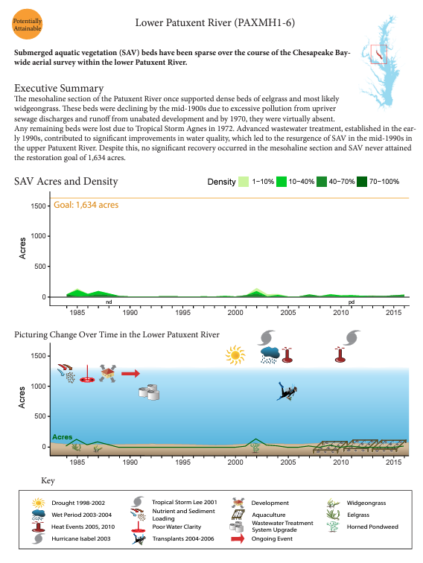
SAV Data Dashboard is getting updated!
Data Dashboard: https://gis.chesapeakebay.net/wdd

Slide 10
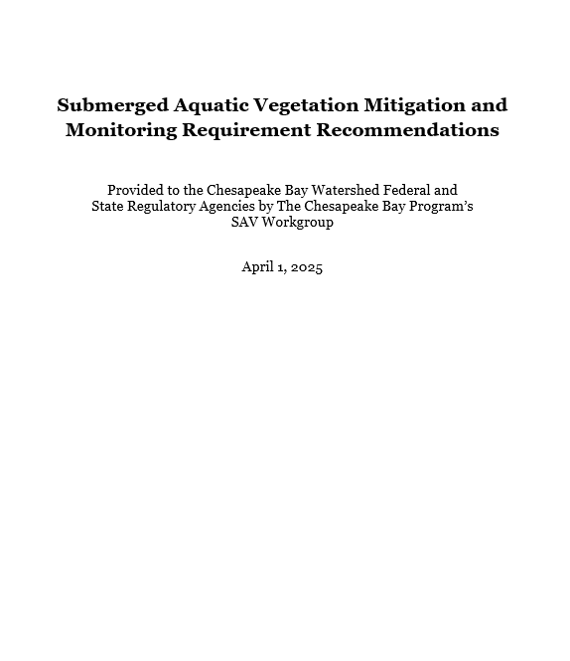
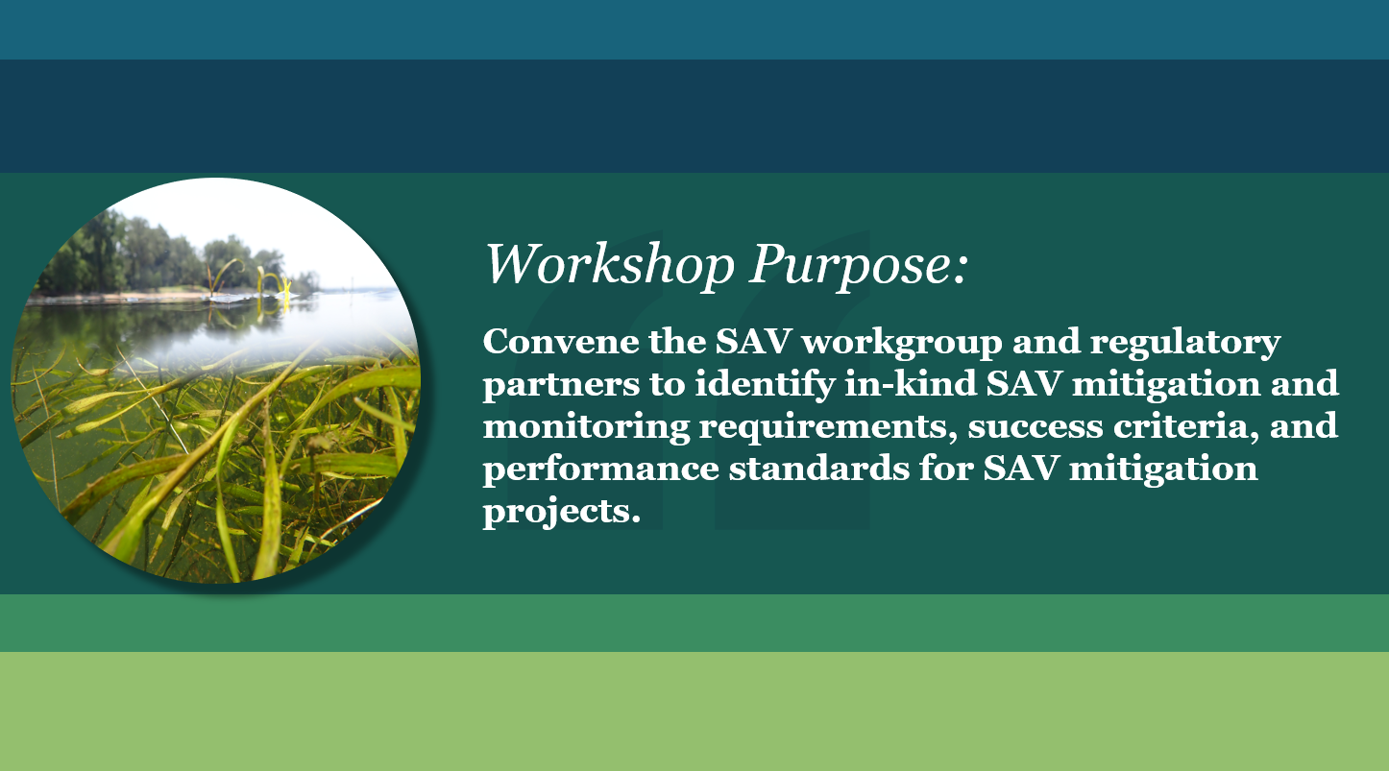
SAV Mitigation and Monitoring Workshop
Questions addressed:
1. What size impact should trigger SAV mitigation?
2. How do we determine if in-kind SAV mitigation is appropriate at that time?
Ie. If SAV is trending down in the area, should it be required, postponed?
3. What characteristics make for a suitable SAV mitigation project site?
4. How far away from the impact site is allowable for the mitigation site?
5. How far away from the mitigation site is allowable for a reference site?
6. What characteristics should a reference bed have?
7. How do you identify a donor bed?
8. Monitoring metrics and frequency?
9. How should mitigation projects be tracked and for how long, and who is responsible?
10. What should be required for long-term maintenance? Who is responsible?
11. How should we determine project success?
12. Should we require financial assurances?

Slide 11
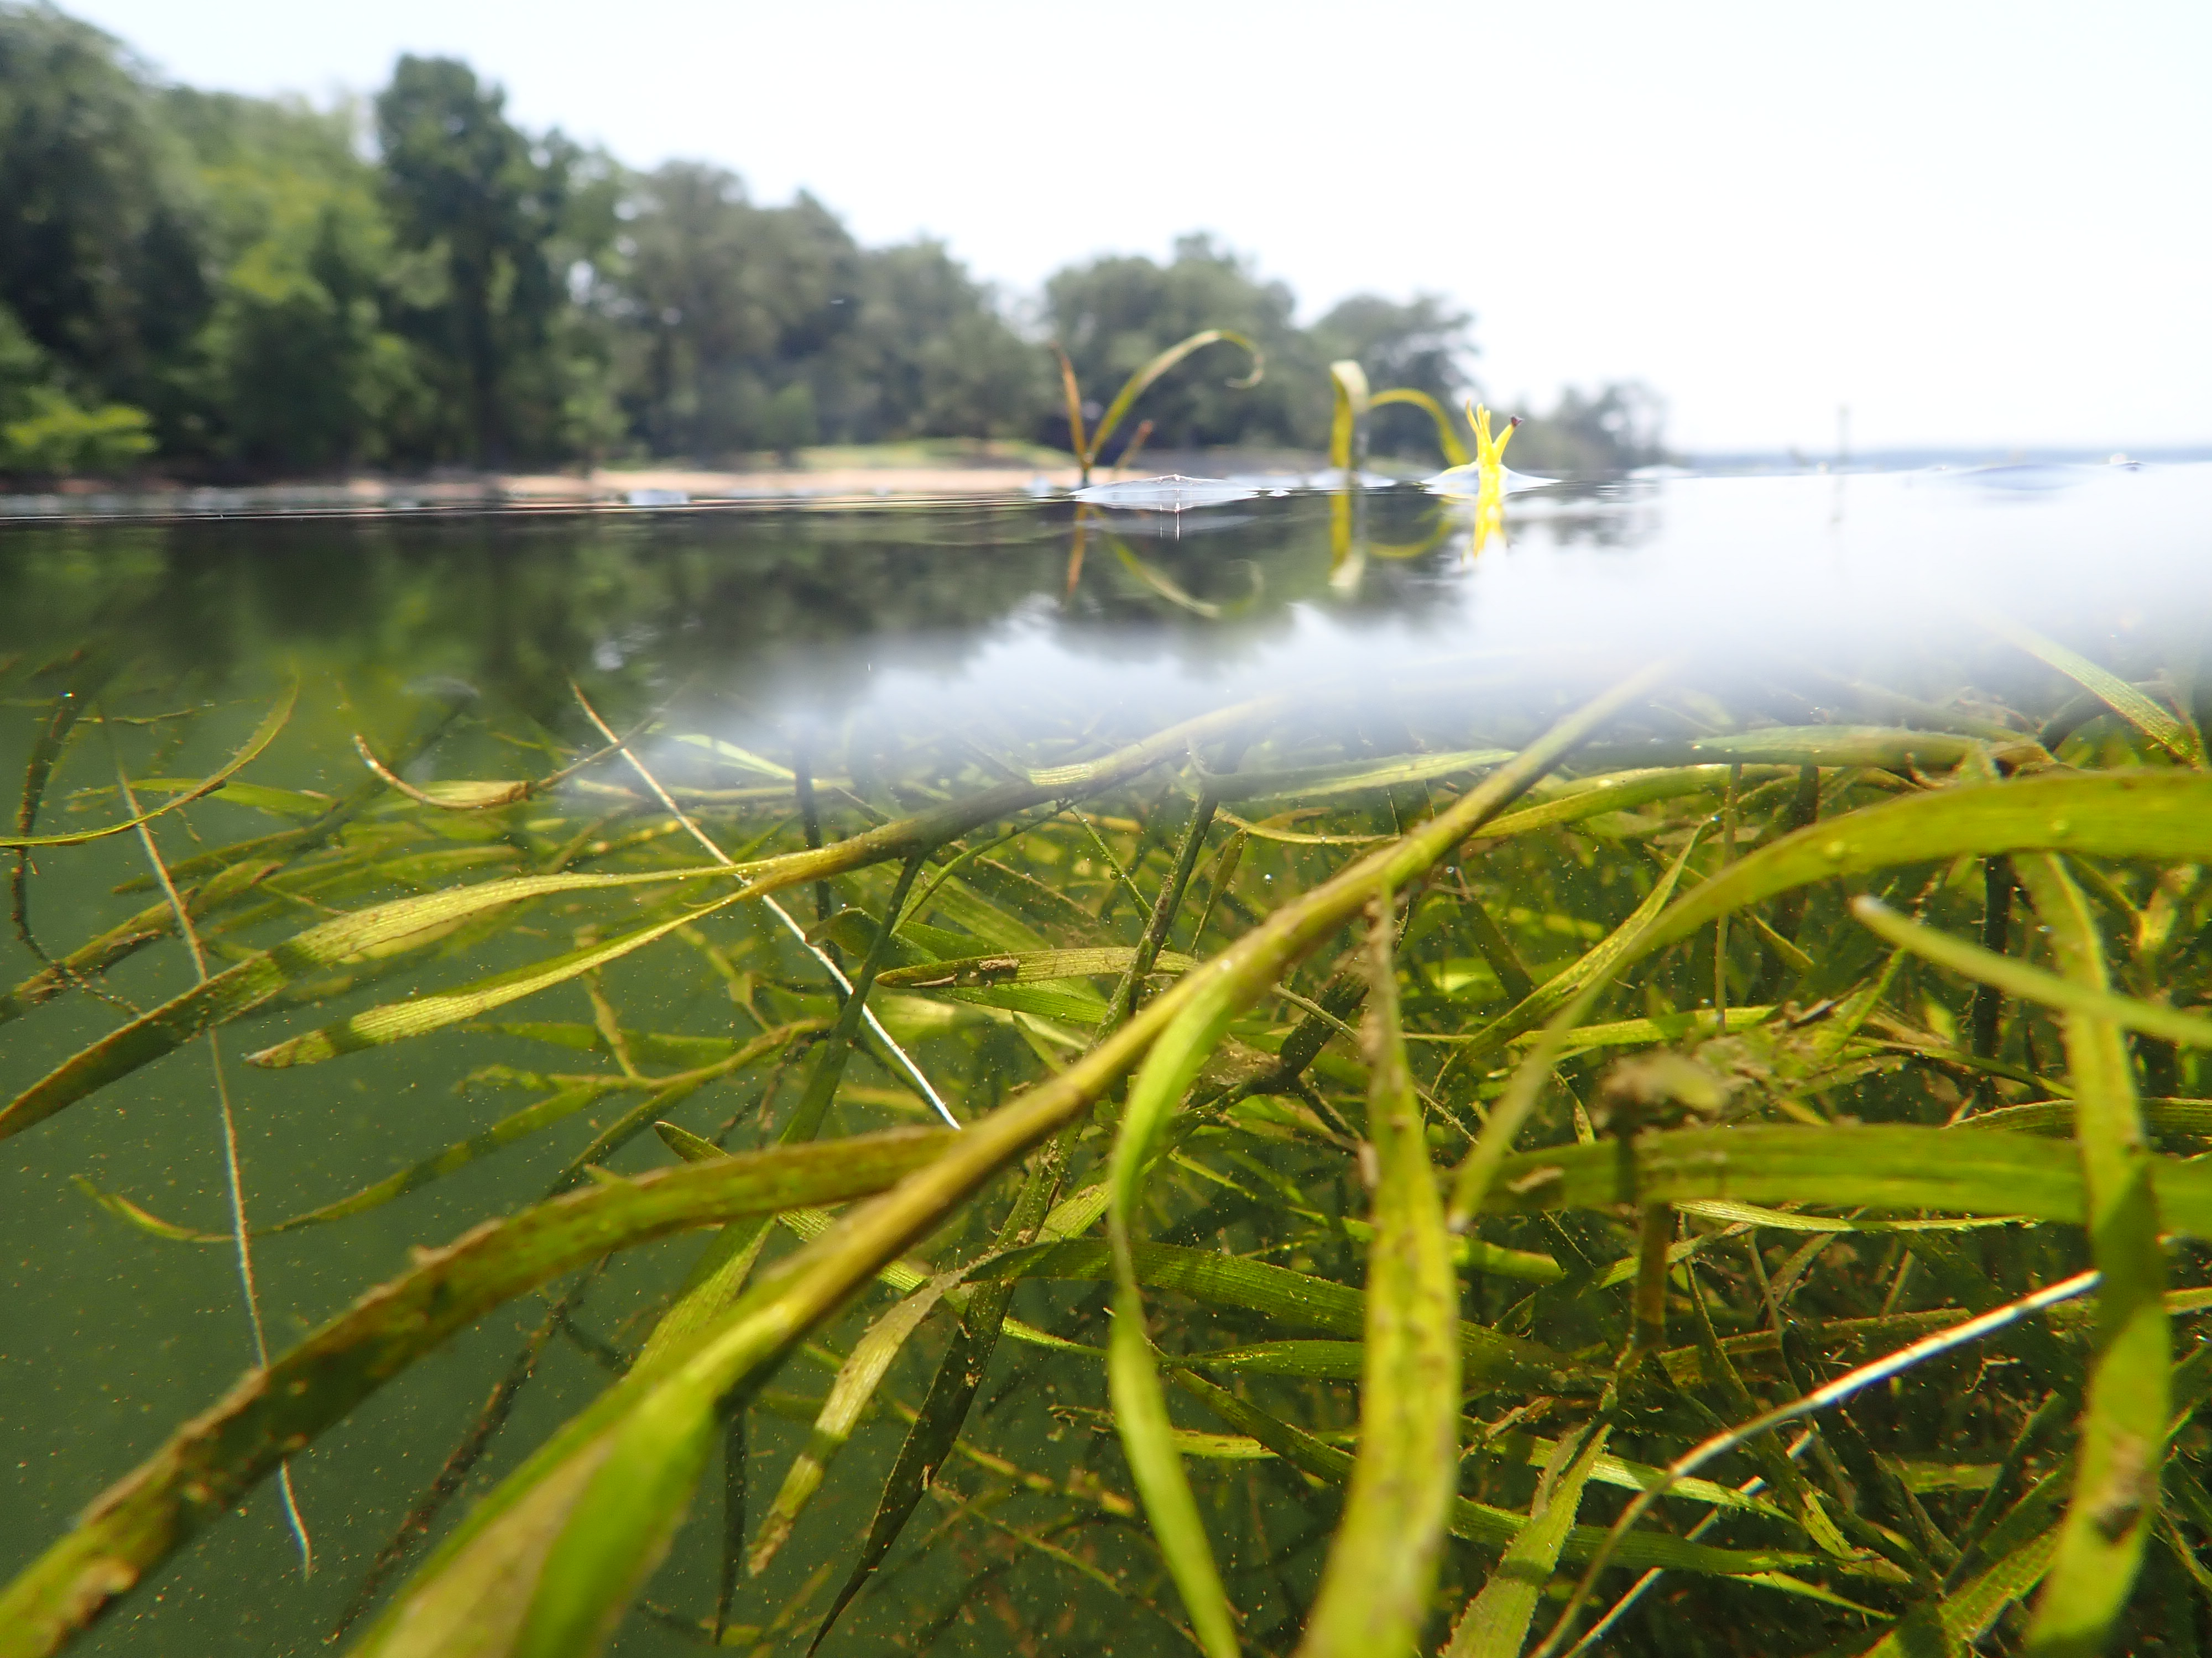
Through the Chesapeake Bay Watershed Agreement, the Chesapeake Bay Program has committed to…
Goal: Vital Habitats
Outcome:
Sustain and increase the habitat benefits of SAV in the Chesapeake Bay. Achieve and sustain the ultimate outcome of 185,000 acres of SAV Bay-wide necessary for a restored Bay. Progress toward this ultimate outcome will be measured against a target of 90,000 acres by 2017 and 130,000 acres by 2025.

Slide 12
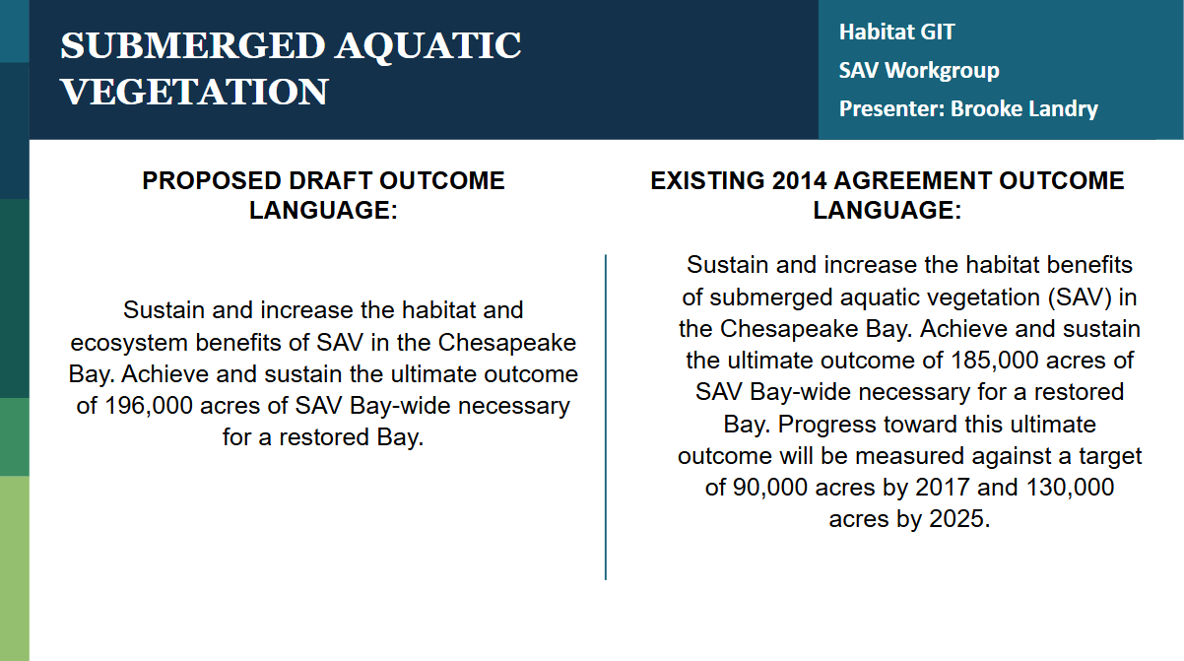

Slide 13
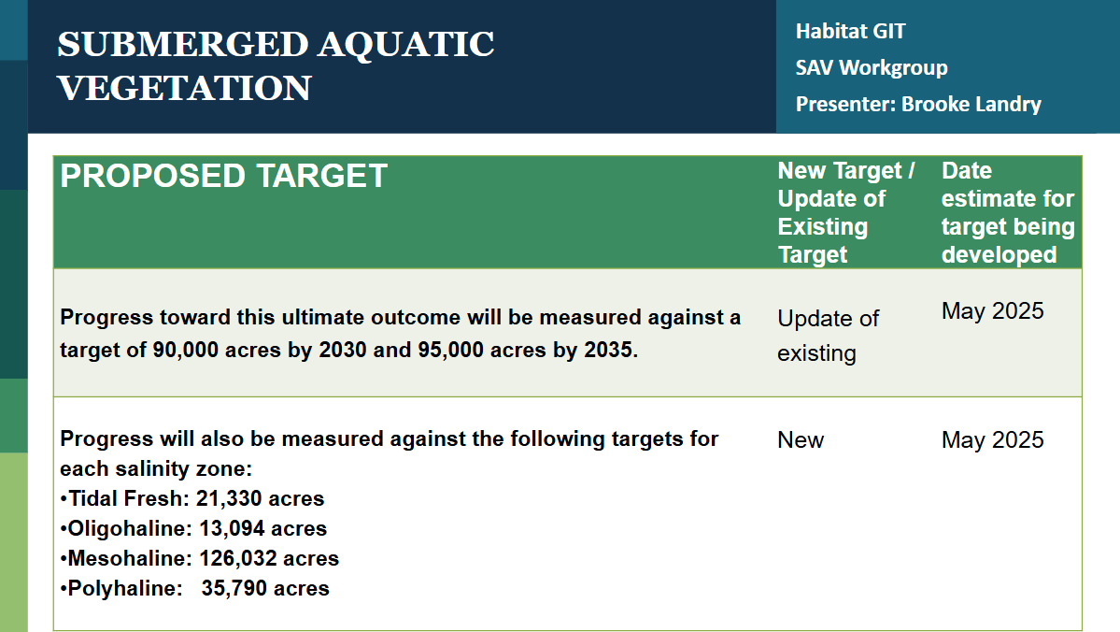

Slide 14
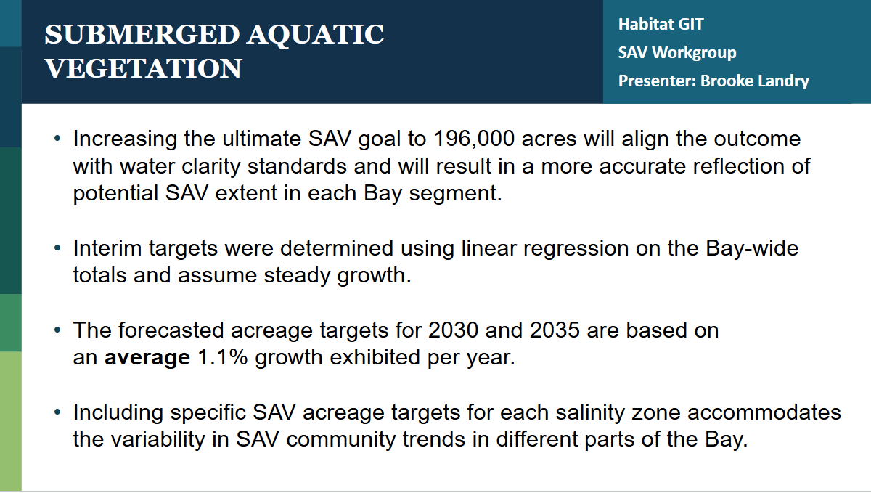

Slide 15
SAV Workgroup Winter 2025 QUARTERLY MEETING Chesapeake Bay Program
Questions?
Presentation template by SlidesCarnival.

