Slide 1
Sanitary Sewer Exfiltration Model Proposal
Joseph Delesantro, ORISE Fellow, CBPO, EPA
jdelesantro@chesapeakebay.net

Slide 2
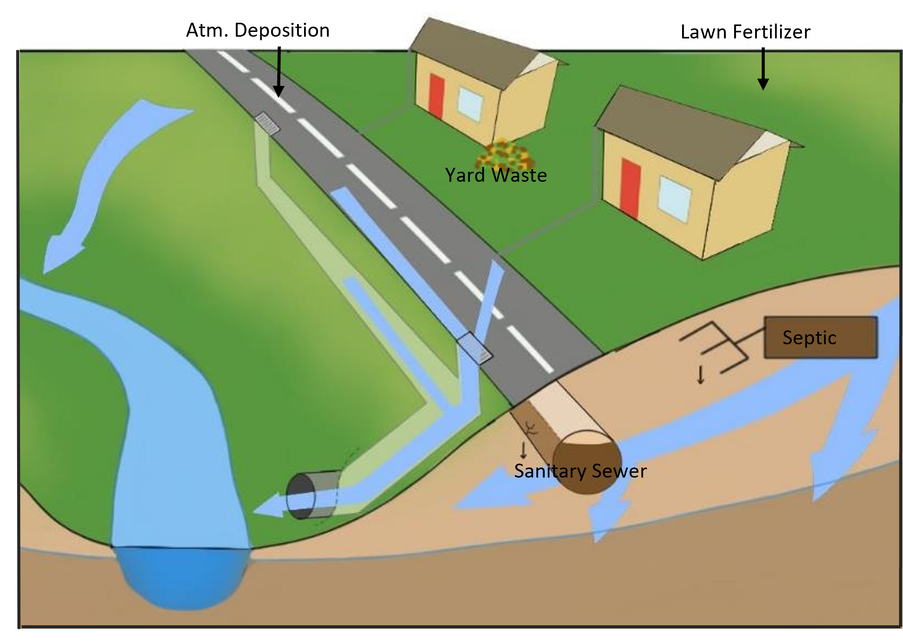
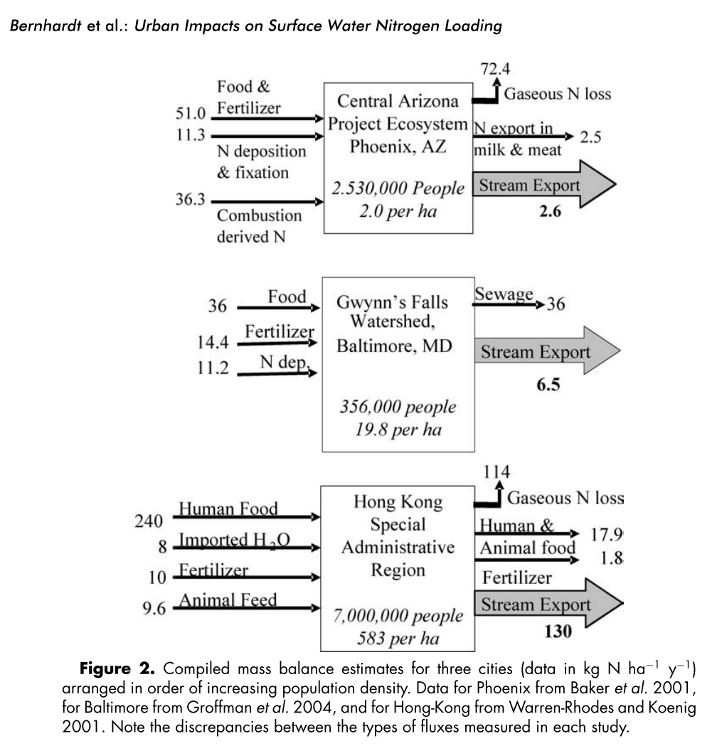
Humans convert food to wastewater
And we depend on sanitary infrastructure to contain and treat this nitrogen source
Bernhardt, E. S., Band, L. E., Walsh, C. J., & Berke, P. E. (2008). Understanding, managing, and minimizing urban impacts on surface water nitrogen loading. Annals of the New York Academy of Sciences, 1134, 61–96.
Baker, L. A., Hope, D., Xu, Y., Edmonds, J., & Lauver, L. (2001). Nitrogen balance for the Central Arizona-Phoenix (CAP) ecosystem. Ecosystems, 4(6), 582–602.
Groffman, P. M., Law, N. L., Belt, K. T., Band, L. E., & Fisher, G. T. (2004). Nitrogen Fluxes and Retention in Urban Watershed Ecosystems. Ecosystems, 7(4), 393–403.
Warren-Rhodes, K. & A. Koenig. (2001). Ecosystem ap- propriation by Hong Kong and its implications for sustainable development. Ecol. Econ. 39: 347–359.
Notes:
Food derived N is estimated to be the largest single input of N to urban watersheds and as such wastewater is the largest potential source of N. We depend on sanitary infrastructure to contain and treat this nitrogen source. But sewers leak.

Slide 3
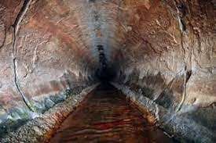
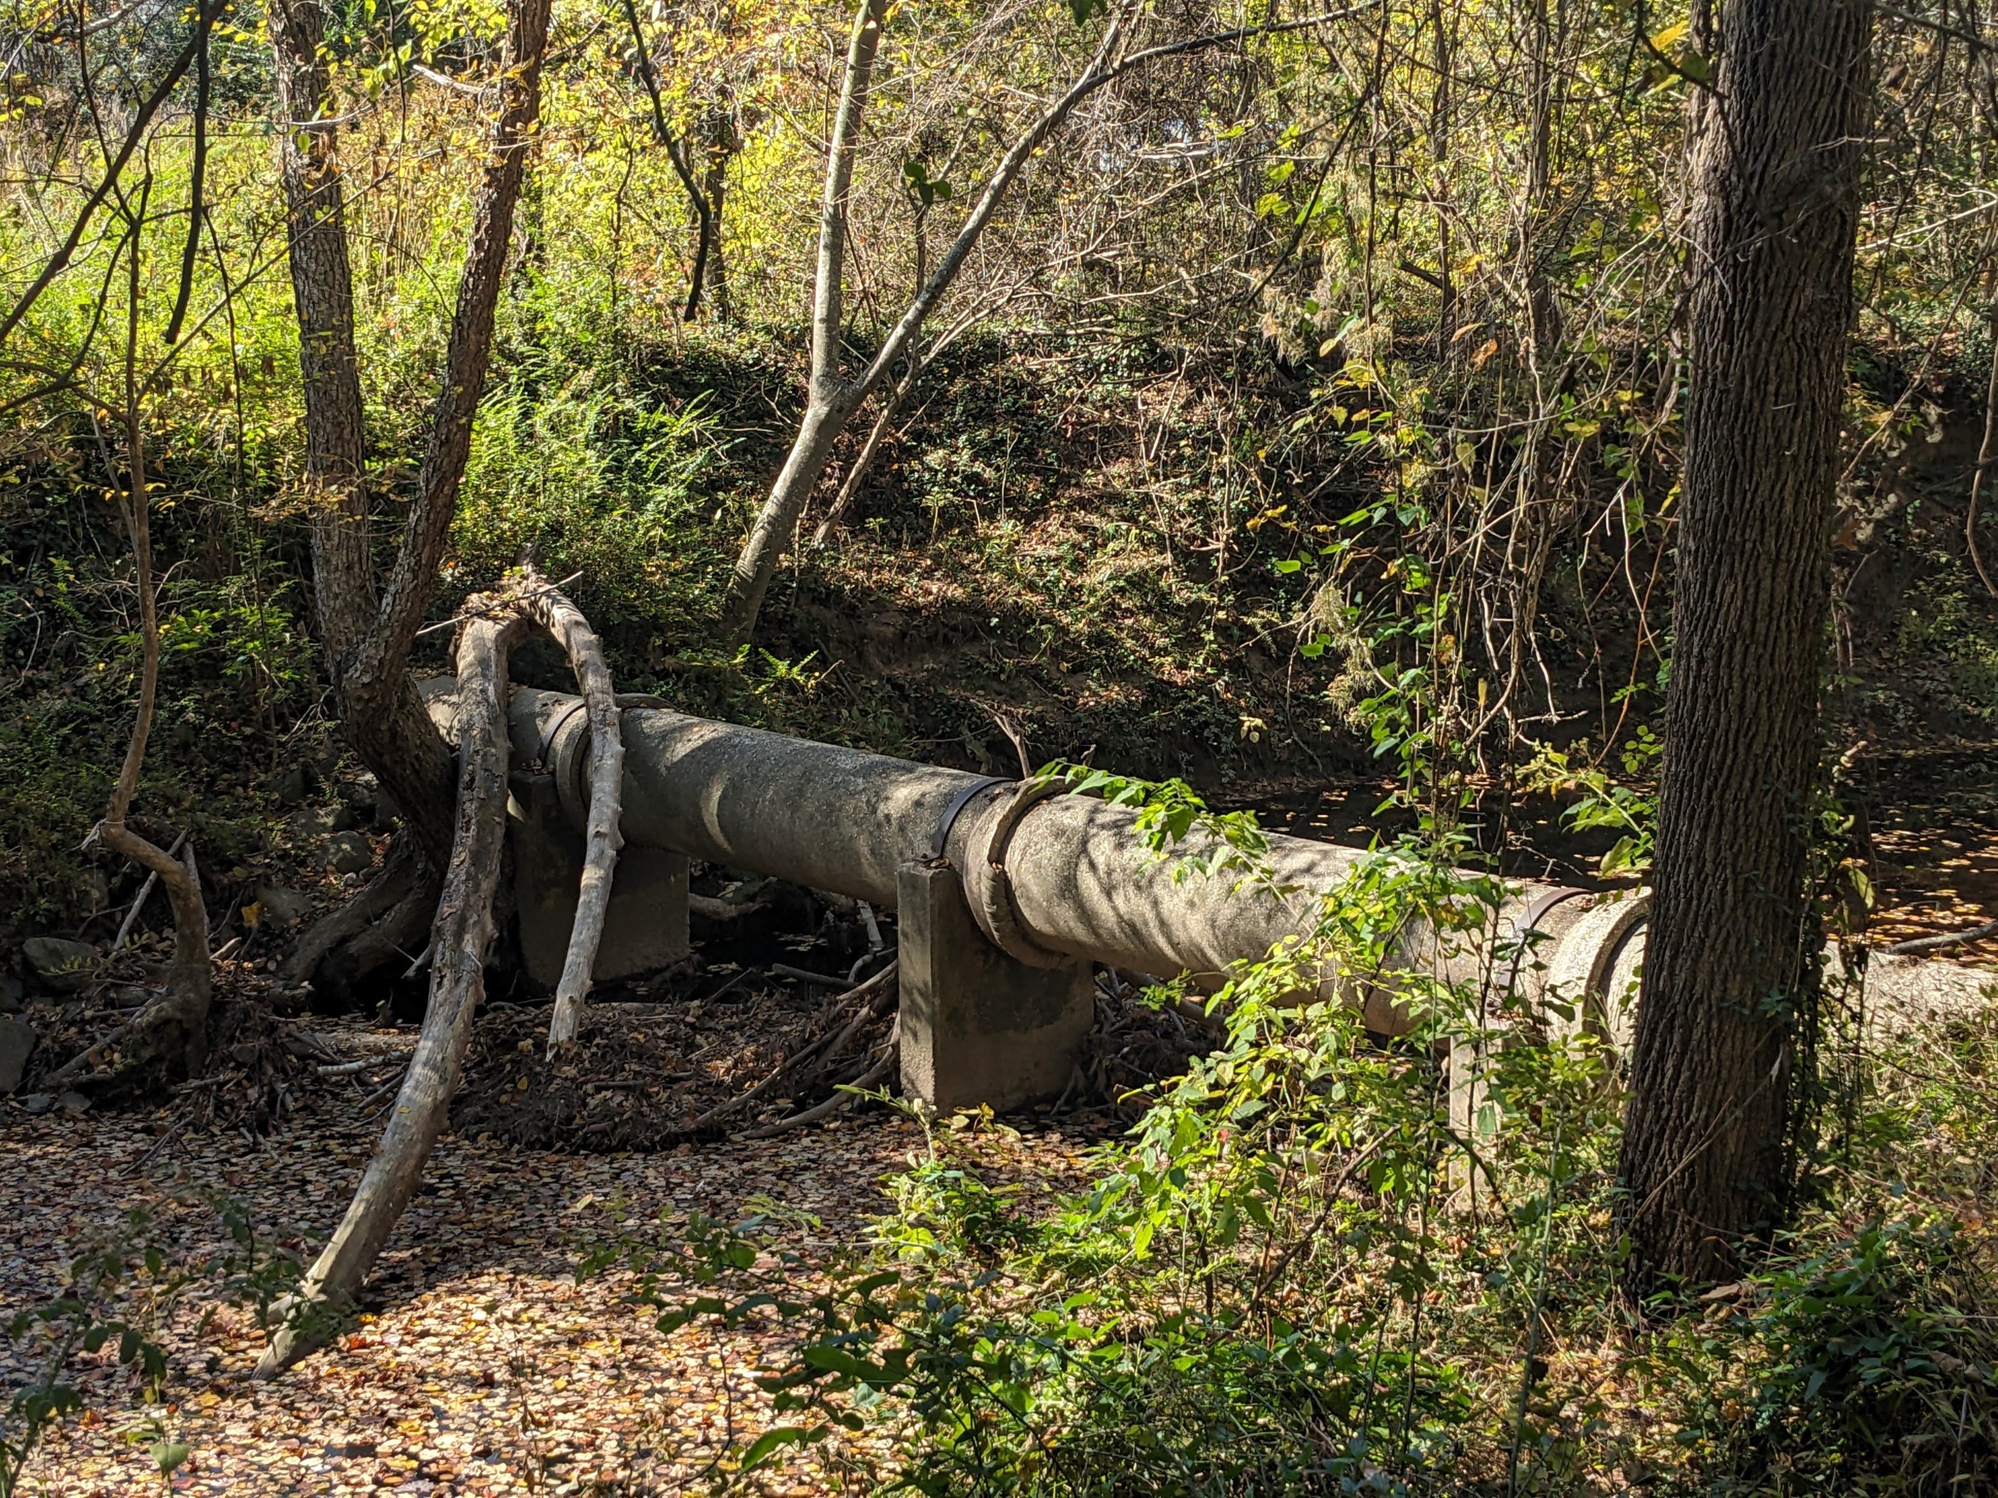
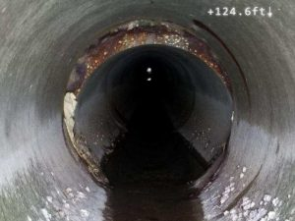
SCCWRP.org
“Sewer pipes are not designed to be watertight. Sewer design sets a standard for allowable leakage during construction, which averages 125 gallons per 400 feet of pipe, which is the standard distance between sewer manholes (ASTM, 2009), or about 1,650 gallons per mile of standard sewer pipe.”
Chesapeake Bay Program, (2014). “Final Expert Panel Report on Removal Rates for the Elimination of Discovered Nutrient Discharges from Grey Infrastructure”
Notes:
Here we have a couple examples of sewer defects… And because sewers are not designed to flow at high pressure, joints are not always designed to prevent inflow or outflow and sewers can leak without specific structural failures.

Slide 4
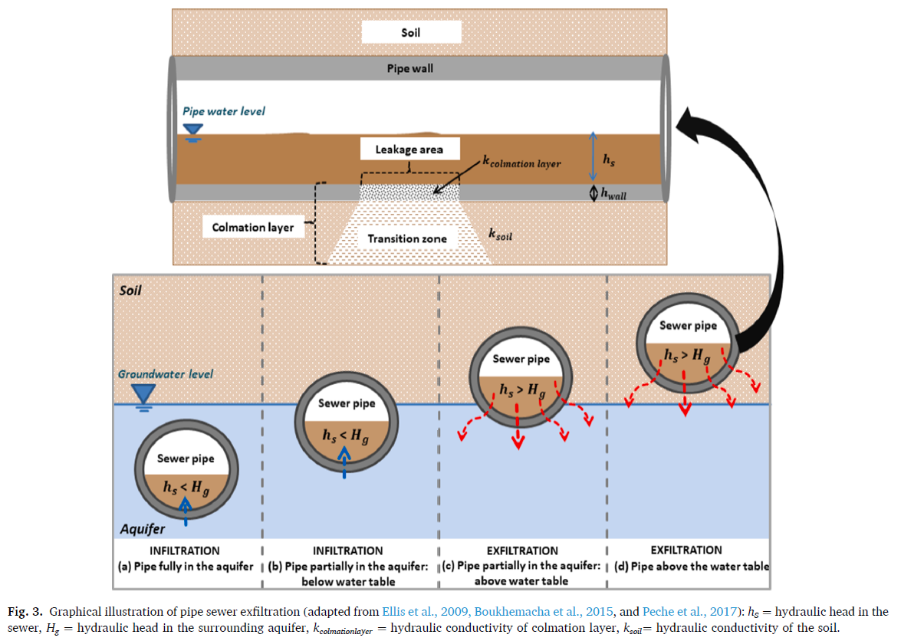
If it can infiltrate, it can exfiltrate.
Net system infiltration does not exclude areas of exfiltration
Segments may infiltrate in wet periods and exfiltrate in dry periods
Because WW nutrient concentrations are 2 orders or magnitude greater than background, small amounts of exfiltration can represent large loads
Nguyen, Hong Hanh, Aaron Peche, and Markus Venohr. "Modelling of sewer exfiltration to groundwater in urban wastewater systems: A critical review." Journal of Hydrology 596 (2021): 126130.

Slide 5
Why does this matter for the model?
Proper appropriation of loads
Improved targeting and crediting of management actions
Scenario analysis (E.g., remediation, pipe ageing, etc.)
This load is in the bay, the load is in the model, but it is currently misappropriated.

Slide 6
Potential impacts of SS Exfiltration in the CBW
Conservative estimated contribution to the CBW from literature:
  665,392 – 2,217,974 lb N/year
  0.23 - 0.76% of the total N load to the CB
  1.51 - 6.04% of the WW load to the CB
  3.28 - 10.93% of the urban load to the CB
  0.60% – 48.9% of the load from individual urbanized catchments to CBW**
  13 - 47.5% of the measured load from individual urbanized residential catchments in the NC Piedmont*
PRELIMINARY
Note: Values derived from the mean of studies or study regions (Delesantro et al., 2022; Nguyen and Venohr, 2021)
Assuming 30mg/l N in raw WW
Delesantro et al., 2022: Assuming NO₃⁻ proportion from WW ~ TN proportion from WW
*Assuming stormflow WW exfiltration loading from mean of Delesantro et al., (in review) urban catchments
and baseflow WW exfiltration from Delesantro et al., 2022
** using full range in exfiltration values reported from Nguyen and Venohr, 2021

Slide 7
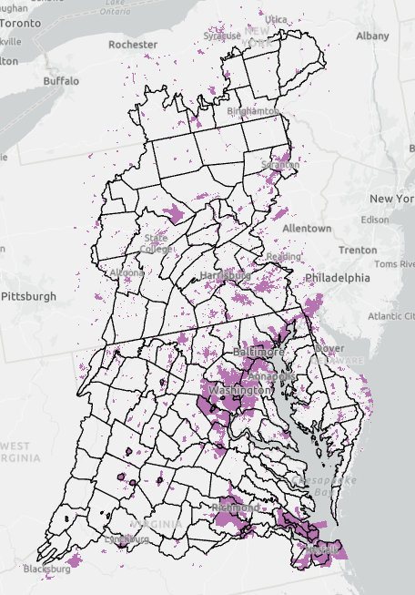
Potential modeling of sanitary sewer exfiltration
Option A
Use per unit area or per capita exfiltration estimates from the most relevant literature
Apply load to urban land use within service boundaries
Requires no additional data collection
Requires literature review and WG approval of exfiltration values

Slide 8
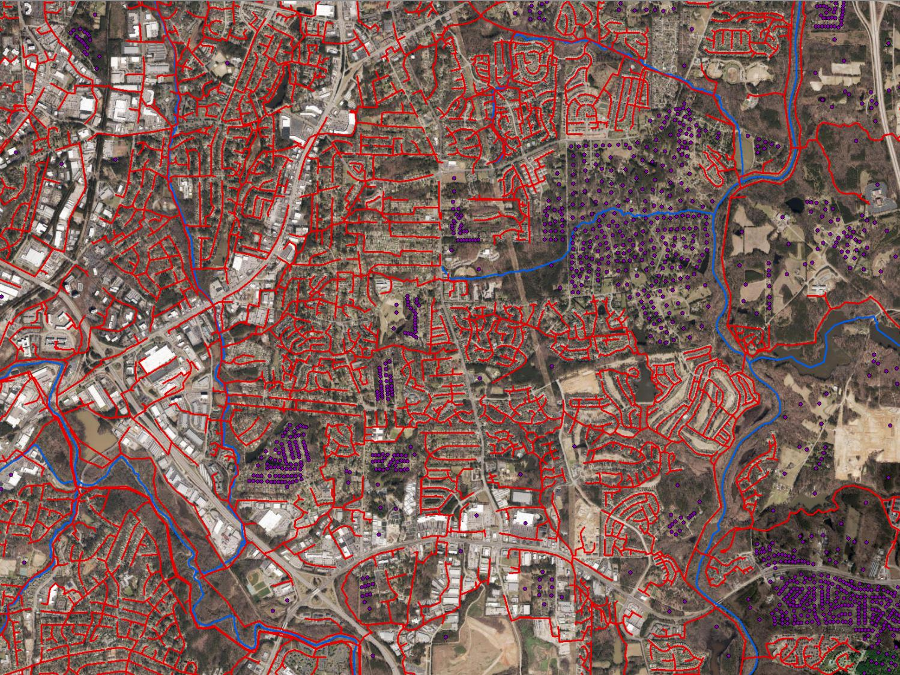
Potential modeling of sanitary sewer exfiltration
Option B
Use exfiltration per unit length of gravity pipe estimated from the literature at watershed or system scale
  These values generally have good agreement
Apply load to urban land use within service boundaries
Requires gravity pipe length from each utility
Requires literature review and WG approval of exfiltration values
Sanitary Sewer
Septic System

Slide 9
Potential modeling of sanitary sewer exfiltration
Option B
Load exfiltrated (N and P) within the service area
mass N and P/ year
Exfiltration per unit length of pipe
Vol/year/length
Length of pipe in the service area
Length
N and P per unit vol raw WW
mass N and P/Vol
Load can be evenly proportioned to developed LU within the service boundary
Or
Proportioned to model units based on the relationship between sewer length density and sewer served population density.
Derived from studies of system or network averages or solicited from utilities.

Slide 10
Potential modeling of sanitary sewer exfiltration
Option C
Model exfiltration as a function of pipe location, soils, groundwater depth, topography, and age.
Spatially and temporally (potentially) explicit
Requires detailed mapping and attribute data for sanitary sewer lines
Requires greater modeling effort
Requires literature review and WG approval of model parameters
Nguyen, Hong Hanh, Aaron Peche, and Markus Venohr. "Modelling of sewer exfiltration to groundwater in urban wastewater systems: A critical review." Journal of Hydrology 596 (2021): 126130.

Slide 11
Potential modeling of sanitary sewer exfiltration
Option D
A hybrid option where utilities or states opt for Option A, B, or C depending on the data they can provide and the level of detail they want accounted in exfiltration estimates.

Slide 12
Potential modeling of sanitary sewer exfiltration
Option E
No action

Slide 13
Crediting Sanitary Sewer Rehabilitation
Final Expert Panel Report on Removal Rates for the Elimination of Discovered Nutrient Discharges from Grey Infrastructure, N-6, pg. 57-59
“…requires before and after flow metering in the pipe to determine the change in sewage exfiltration as a direct function of the sewer repair, based on the decline in flow rate associated with the capital project. While it is allowable to use the sewage concentration default values, the credit is also subject to a discount factor.
Discount factors:
50% if project is within 150’ of stream or within 10 feet of a lower elevation storm drain pipe,
10% if project is greater than 150’ away from the stream or greater than 10’ feet from a lower elevation storm drain pipe to account for losses during groundwater migration
Walch, M., Brosh, M., Lilly, L., Tribo, J., Whitehurst, J., Brumbaugh, B., ... & Katchmark, W. (2014). Recommendations of the Expert Panel to Define Removal Rates for the Elimination of Discovered Nutrient Discharges from Grey Infrastructure FINAL PANEL REPORT.

Slide 14

Crediting Sanitary Sewer Rehabilitation
A possible whole system approach
Y
Y: 36% to 70% in the I/I literature. Requires additional investigation.
X: A small percentage of pipes may account for the vast majority of exfiltration.
T: How often should pipes be rehabilitated?
Values of T and the characteristics of the curve should reflect and prioritize targeted rehabilitation.
Percent exfiltration reduction
0
0
Percent length of pipe rehabilitated in last T years
X

Slide 15
End

