Slide 1
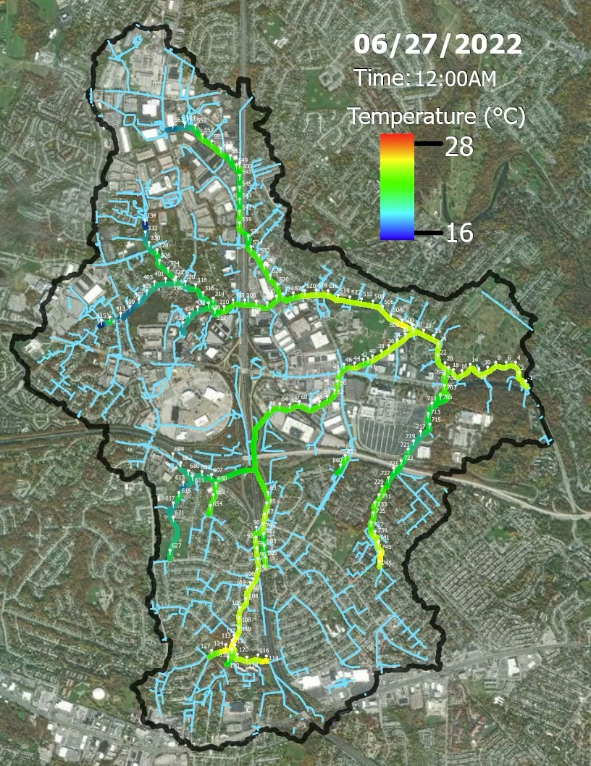
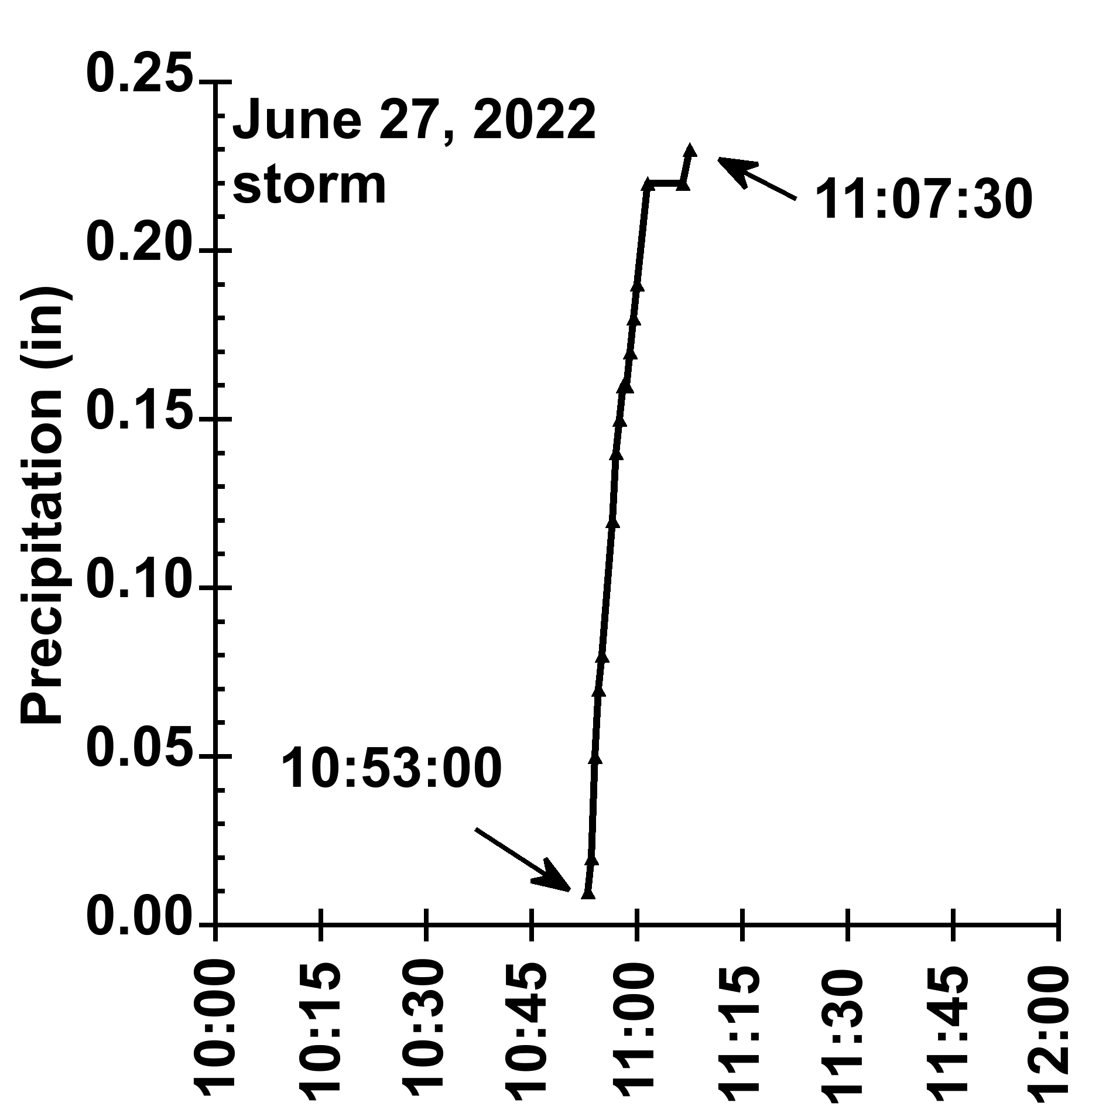
Example animation: June 27, 2022 storm
Stream
Slide from Pooled Monitoring forum; presentation available here

