Slide 1
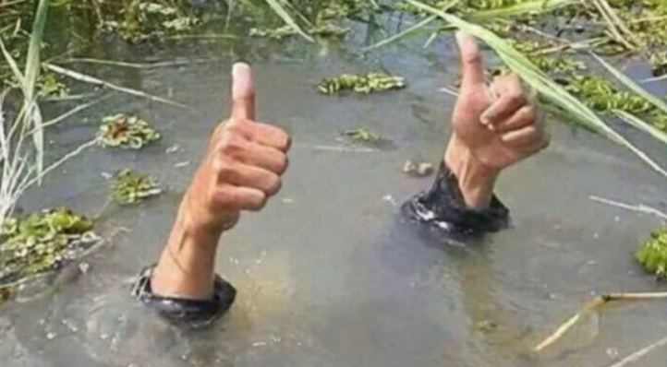
Wetlands Workgroup Update
April 29, 2025

Slide 2
Workgroup Structure
Wetlands WG Chair
Pam Mason, VIMS
Black Duck WG Chairs
Ben Lewis, DWR
Alicia Berlin, USGS
CBP Staff
Dede Lawal
Chris Guy
WWG Vice Chair
Tidal Team
Tess Danielson, DOEE
WWG Vice Chair
Nontidal Team
Nancy Schumm, City of Gaithersburg
Held joint Tidal and Nontidal team meetings in January and April
Separate team meetings and joint meeting mostly focused on Beyond 2025

Slide 3

Wetlands Outcome
Continually increase the capacity of wetlands to provide water quality and habitat benefits throughout the watershed. Create or reestablish 85,000 acres of tidal and non-tidal wetlands and enhance function of an additional 150,000 acres of degraded wetlands by 2025. These activities may occur in any land use (including urban), but primarily occur in agricultural or natural landscapes.

Slide 4
Proposed Beyond 2025 Wetlands Outcome
Restore, create, enhance and protect wetlands to support people and living resources, including waterbirds and fish, provide water quality, flood and erosion protection, recreation and cultural benefits.

Slide 5
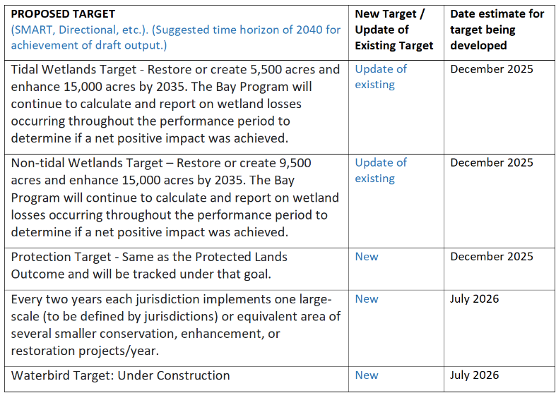
*Target language still under debate within workgroup

Slide 6
University of Michigan SEAS Report
Interviews and literature research to understand current perceptions of non-tidal wetlands, identify barriers to communication and participation in restoration projects, and develop a targeted strategy to better engage local stakeholders.
Join SET meeting May 6 to see their presentation or view their capstone presentation here (start at 1 hour, 2 min)
Final Report to be available to WG includes recommendations for non-tidal focused communication strategy
  Address negative misconceptions of wetlands
  Connect to the cultural identities of communities
  Build long-term relationships with communities

Slide 7
Terminology White Paper
Objective to define wetland terms to have shared understanding for use in CBP wetland outcome tracking and communications
Primary author Linh Nguyen, Intern from Franklin and Marshall College
Wetland best management practices were organized into creation, restoration, and enhancement categories for both tidal and non-tidal wetland types
Definitions of practices were synthesized from regional governmental and NGO sources
WWG Chairs reviewing final draft before releasing to workgroup in July

Slide 8
NWI Update- NFWF Small Grant
Bay Region National Wetlands Inventory is woefully outdated (most jurisdictions have data from the 60’s)
Funding request to update piedmont region of Maryland
Ducks unlimited partnering with City of Gaithersburg
Requesting WWG letter of support

Slide 9
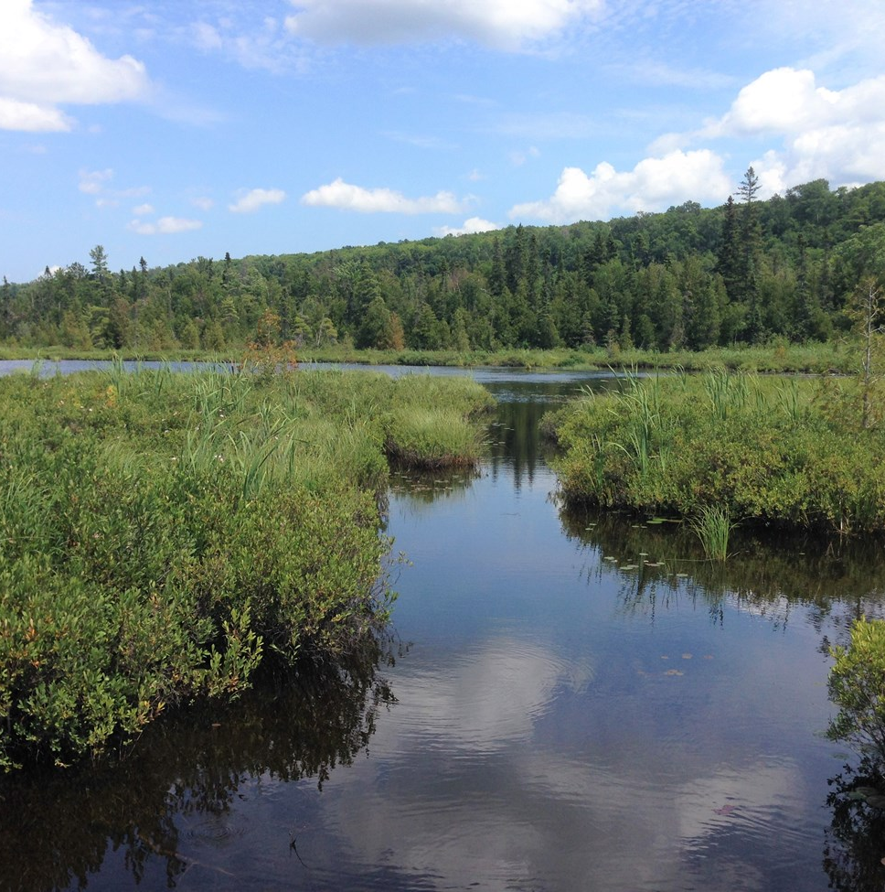
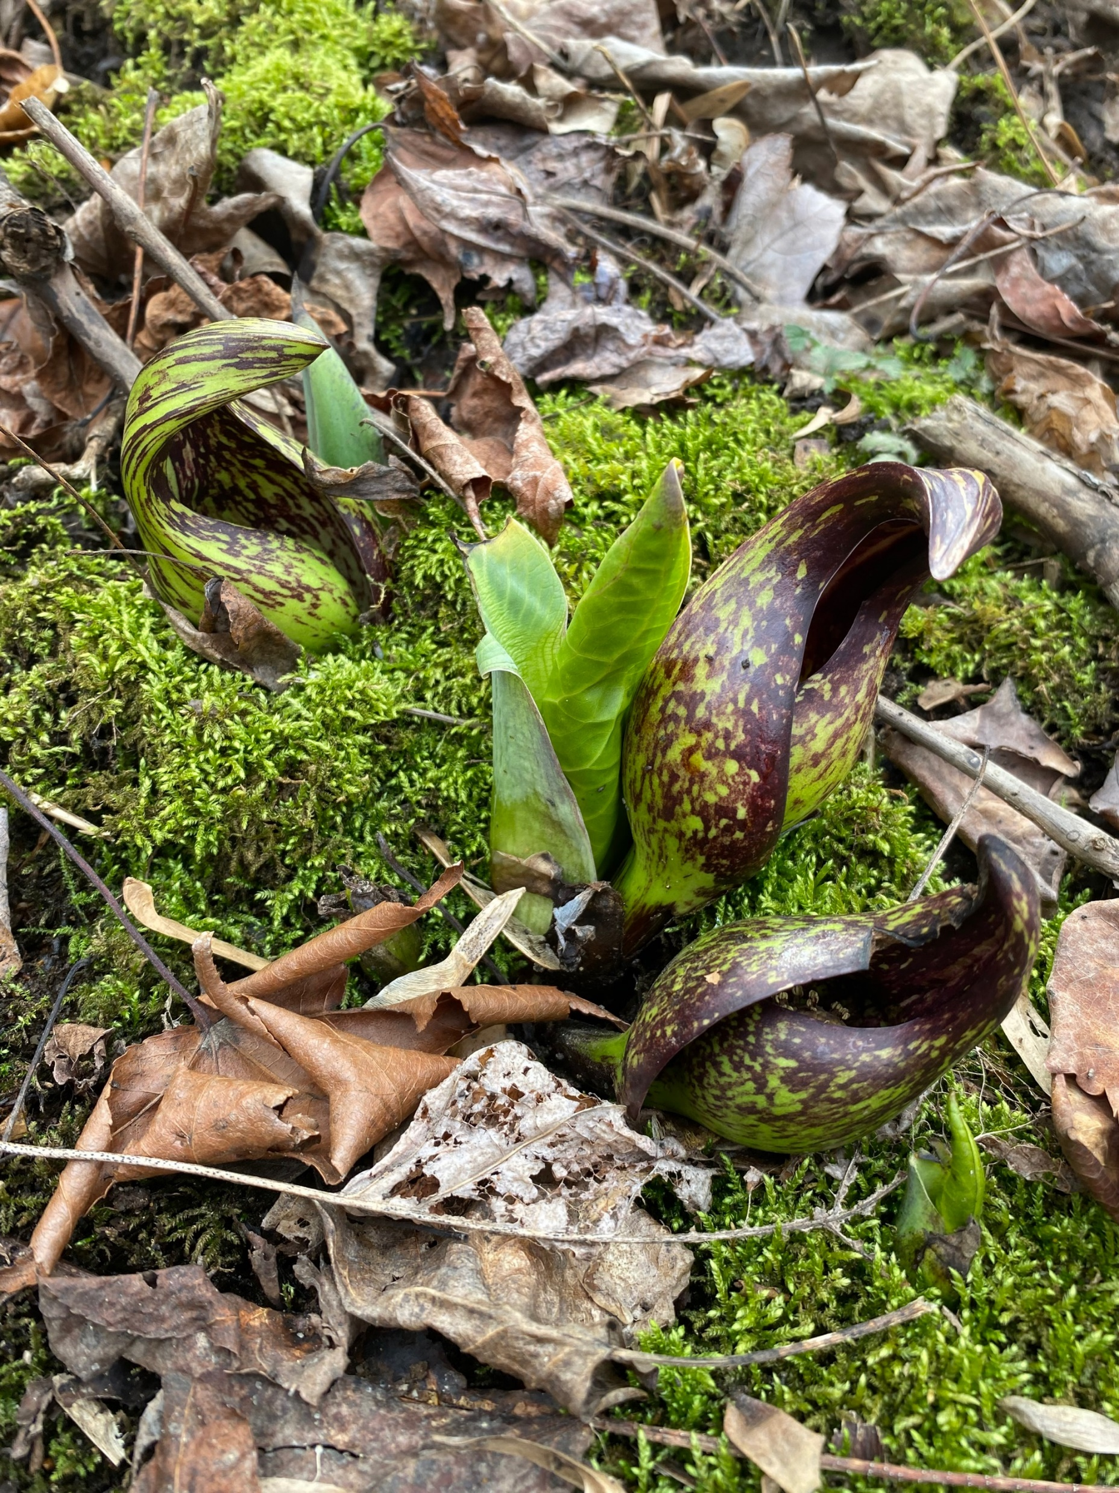
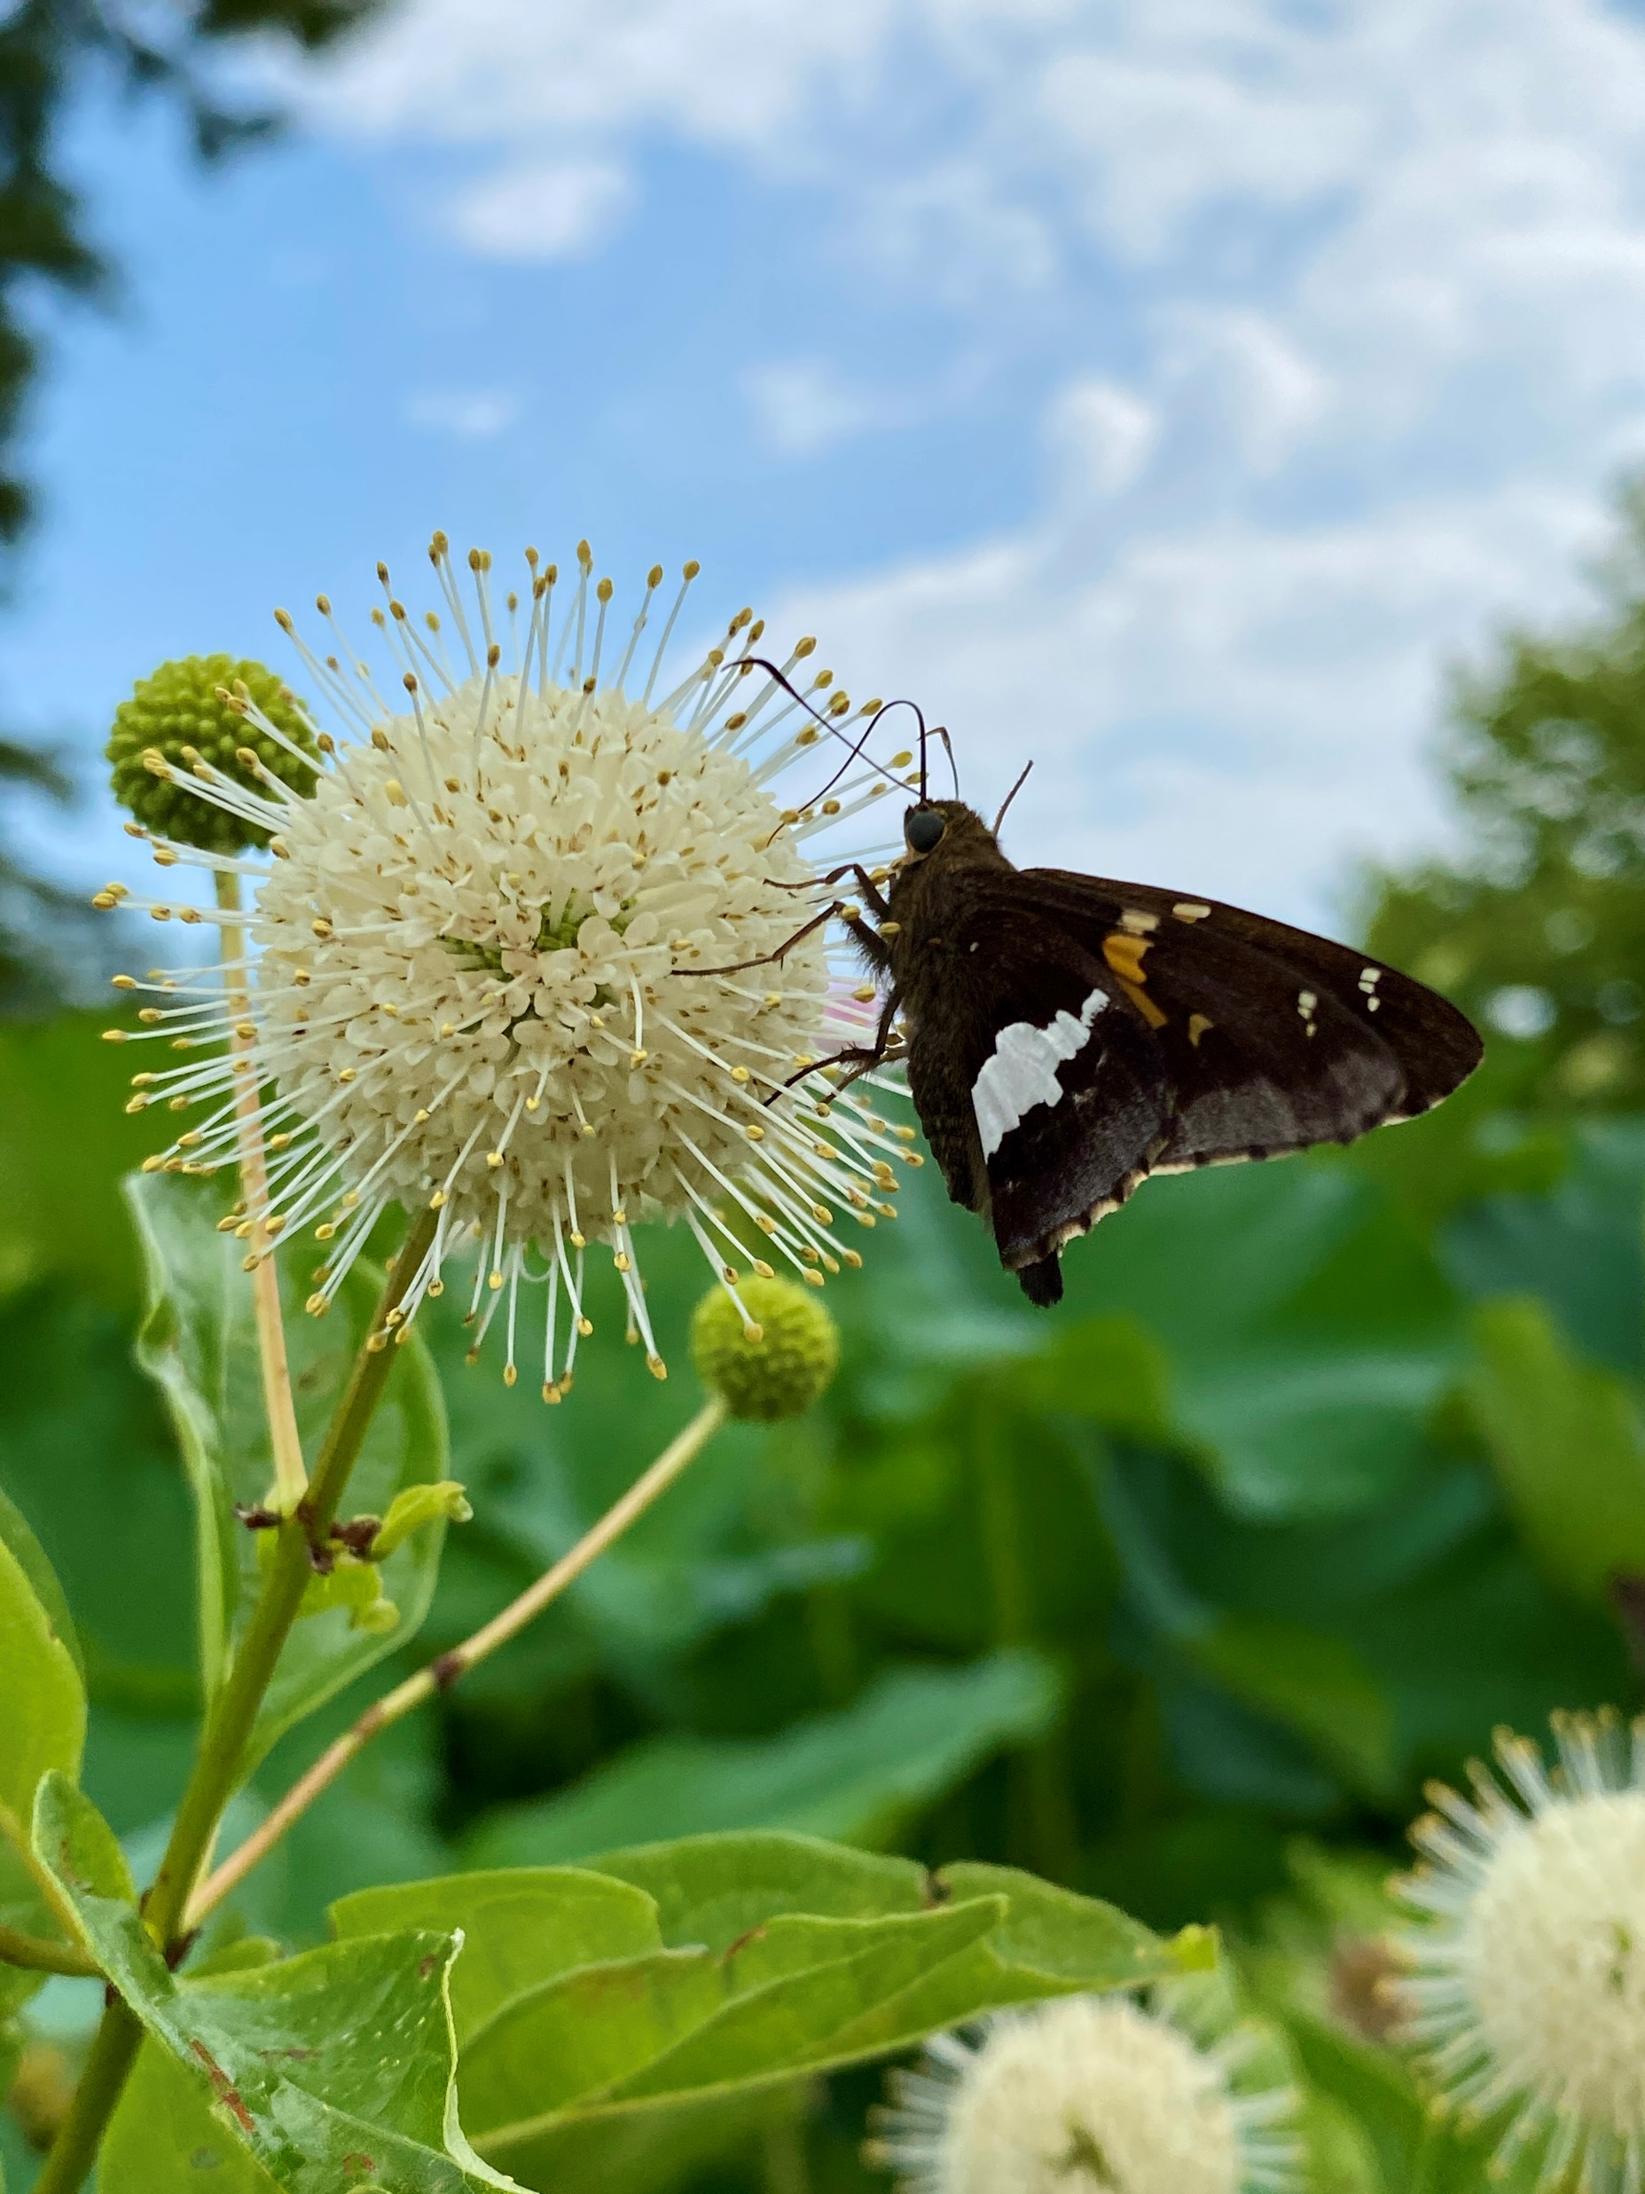
Questions?

