Slide 1
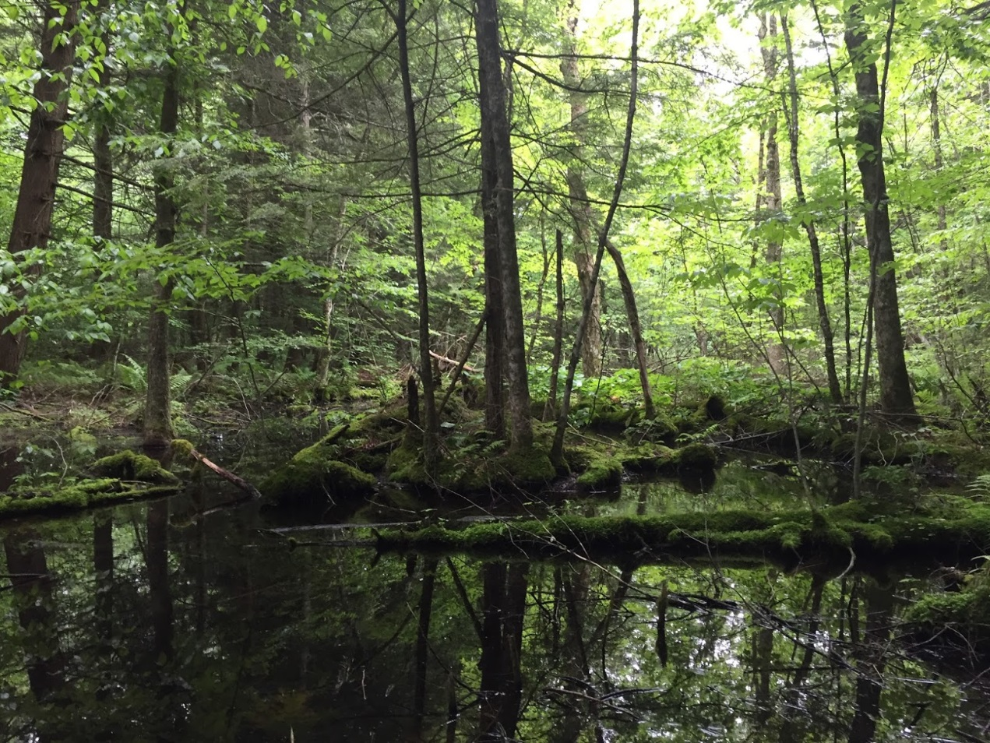
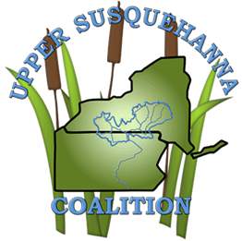
A Lidar-aided hydrogeologic modeling and object-based wetland mapping approach for Pennsylvania
Upper Susquehanna Coalition
&
University of Vermont Spatial Analysis Laboratory
Patrick A. Raney, Ph.D.
Wetland Scientist
Upper Susquehanna Coalition /
Tioga County SWCD
Owego, NY
paraney@u-s-c.org
October 27th, 2016
March 23, 2017

Slide 2
Setting the stage for CBP wetland mapping
NWI data produced between late 1970’s to mid 1980’s for much of the state of Pennsylvania
  NWI costly and time-consuming to update
  Advances in aerial imagery resolution since that time
    Terrain modeling techniques
    High-resolution elevation, landcover data
Desire to identify restoration areas to meet the TMDL
  We sought to merge two contrasting approaches to wetland identification
    Terrain Modeling & OBIA
      Both have their strengths – and weaknesses
      Merging to overcome limitations of each
      I’ll discuss Terrain Modeling
      Sean MacFaden will describe his and Jarlath O’Neil-Dunne’s work at UVM on OBIA in greater detail

Slide 3
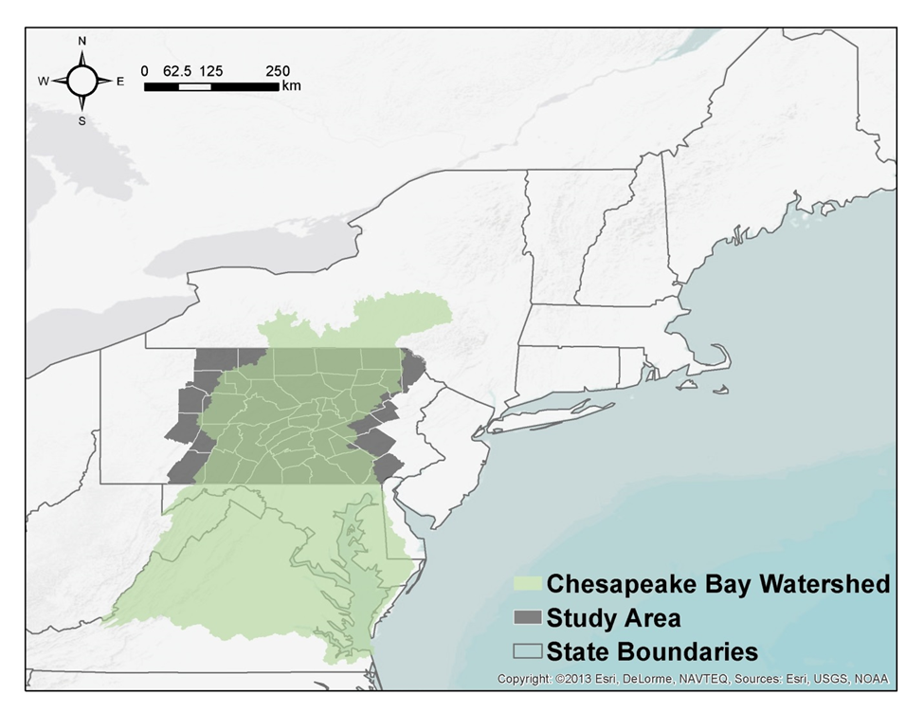

Slide 4
Wetlands mapping workflow
USC
UVM - USC
Climate
UVM
Wetlands Prediction
Reference Wetlands
Soils
Ches. Cons
Geology
Group
Topography
Wetland Categorization (Bay Program)
Land Cover
Object-Based Wetlands Mapping & Categorization
Review
Aerial Imagery
Wetland Dataset
Report

Slide 5
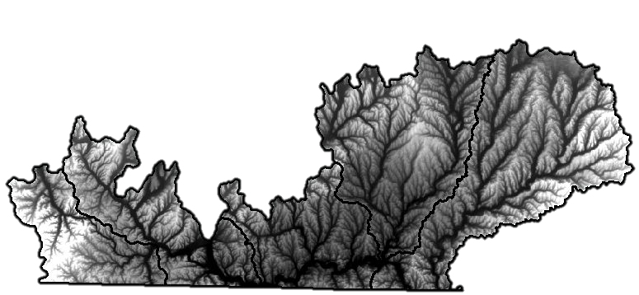
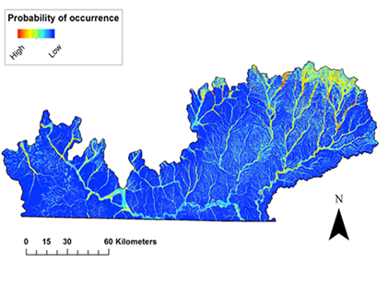
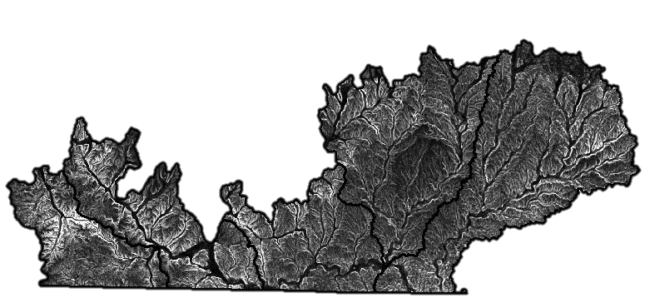
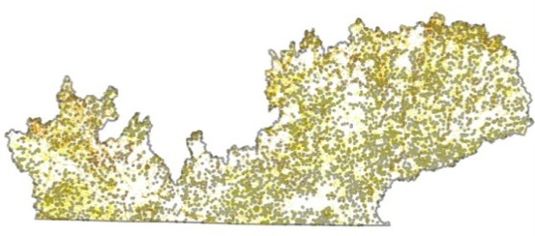
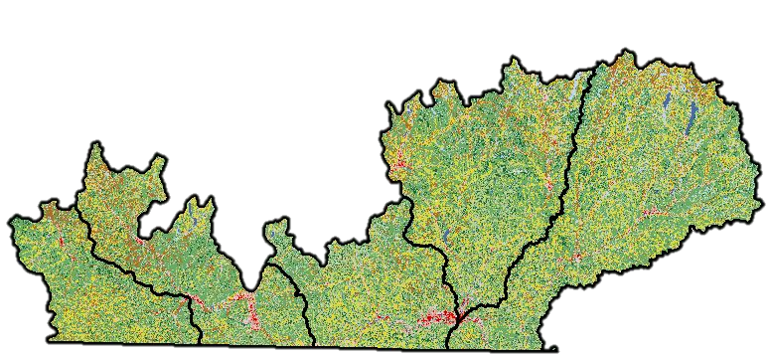
How wetland modeling works
Background Environmental Conditions
Terrain e.g., Elevation, Slope, CTI
Soils, Geology, Climate, Landcover
Presence [Absence]
Data:
Predicted
wetland
features
=
~
(Hunter et al. 2012)
* Note that there are many, many algorithms that can be used to model wetland distribution – they vary tremendously in their interpretability & the final accuracy they achieve – again strengths and weaknesses.

Slide 6
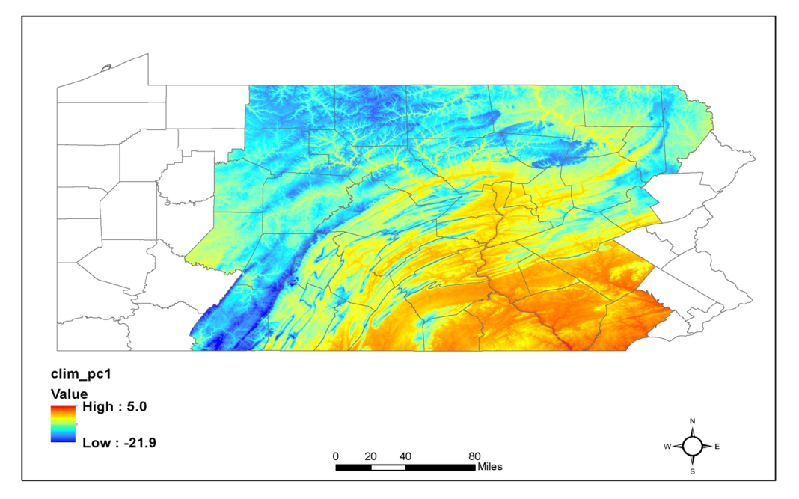
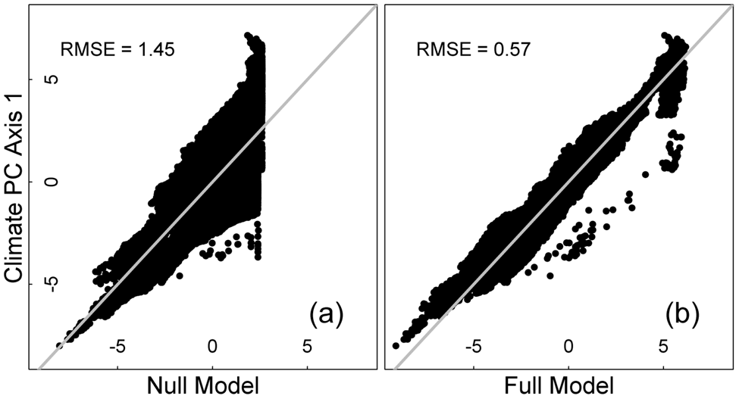
Climate Downscaling
From low 800m² resolution to target resolution (here 10m²)
Approach – produces similar results for PA (left), and NY (right)
Techniques set the stage for including climate-change projections into fine-scale OBIA wetland mapping approaches
R²=0.96

Slide 7
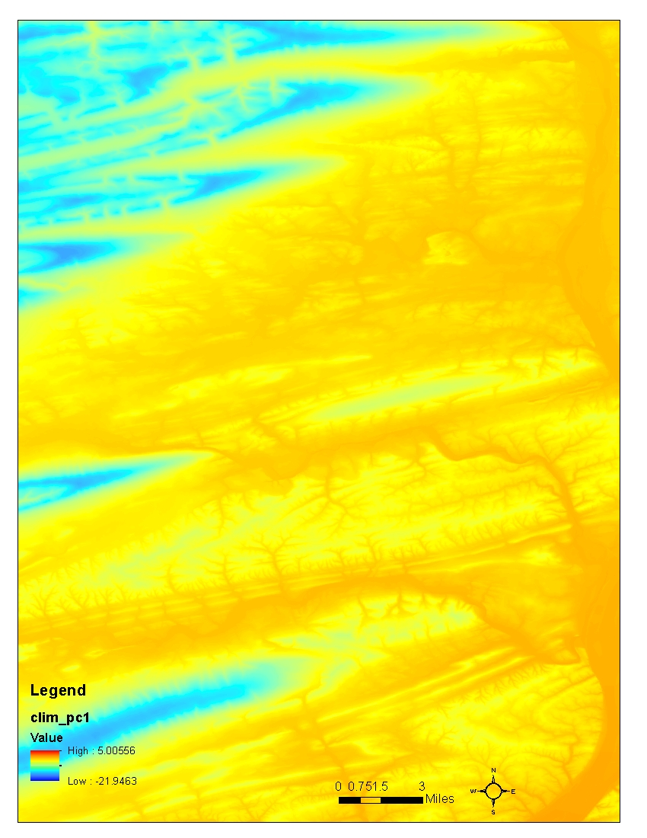
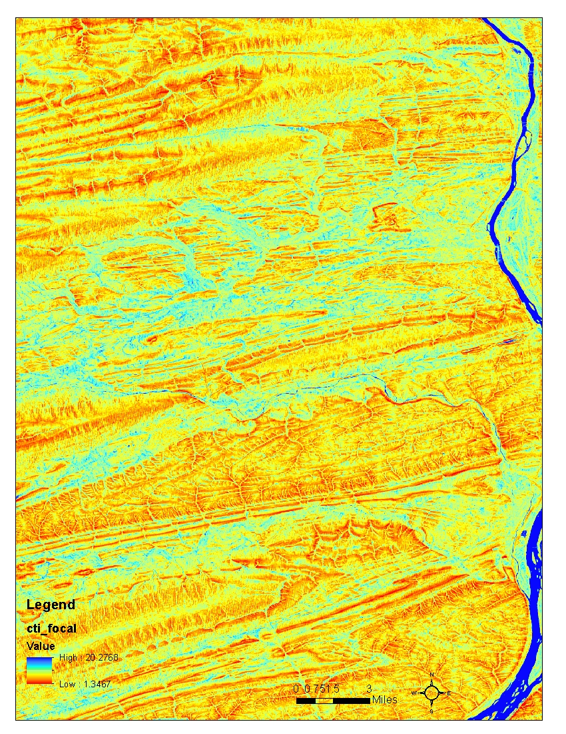
Examples of variables used in statistical modeling – showing edge of Susquehanna Main Stem
Climate variation
Wetness (CTI)
1:100,000
1:100,000

Slide 8
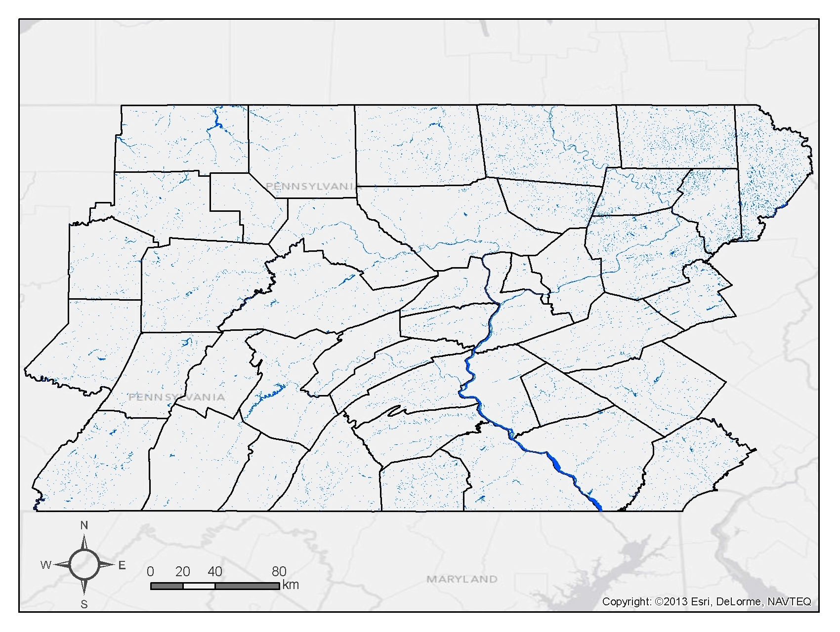
Existing National Wetlands Inventory

Slide 9
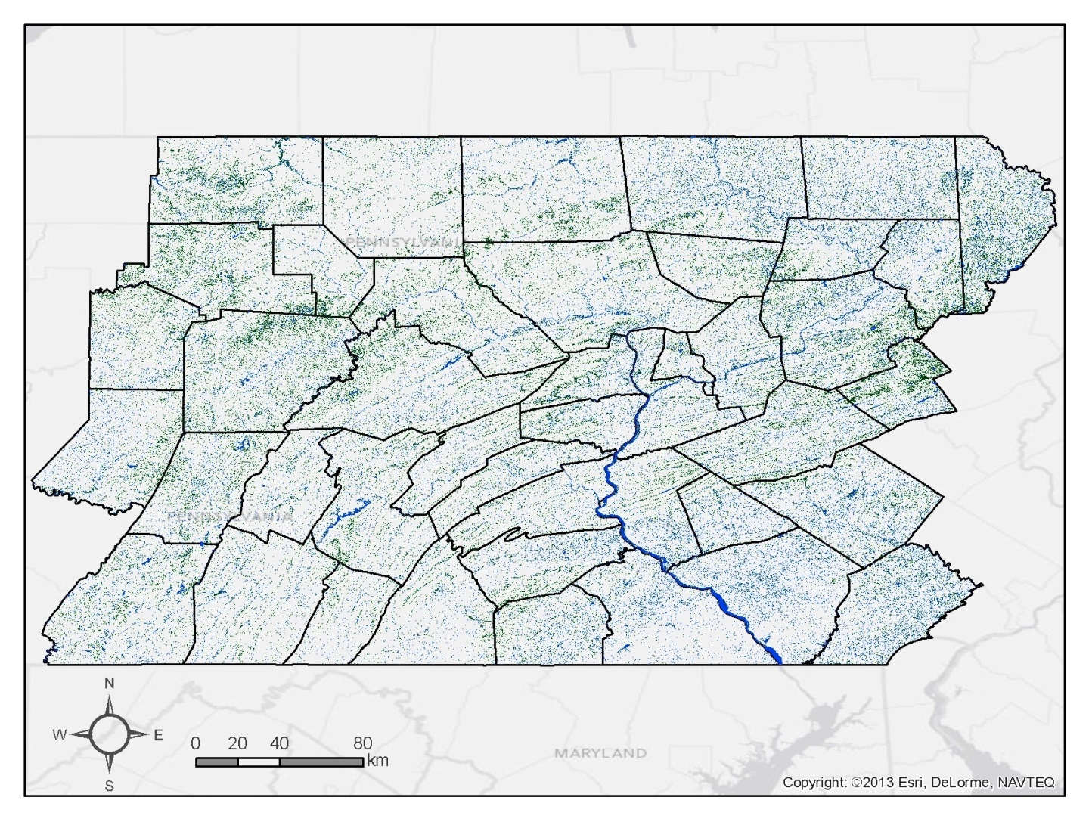
Statistical Model Output
PFO-PSS Validation: R²=0.86; AUC=0.99; n=350
PEM Validation: R²=0.85; AUC=0.99; n=295
PEM
PFO-PSS

Slide 10
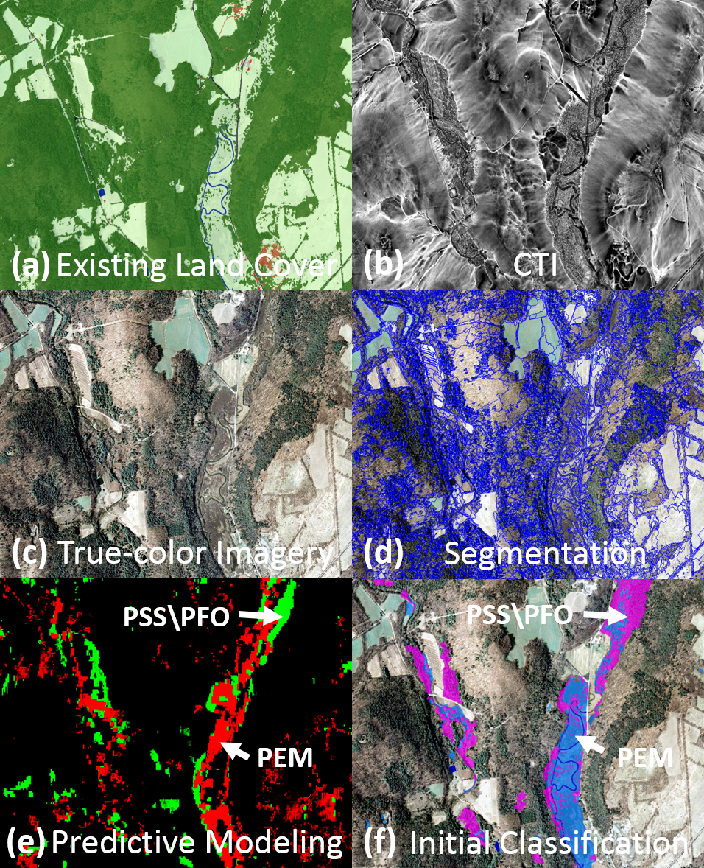
OBIA – UVM Spatial Analysis Lab

Slide 11
Let’s start with Statistical Model Output Again
PEM
PFO-PSS

Slide 12
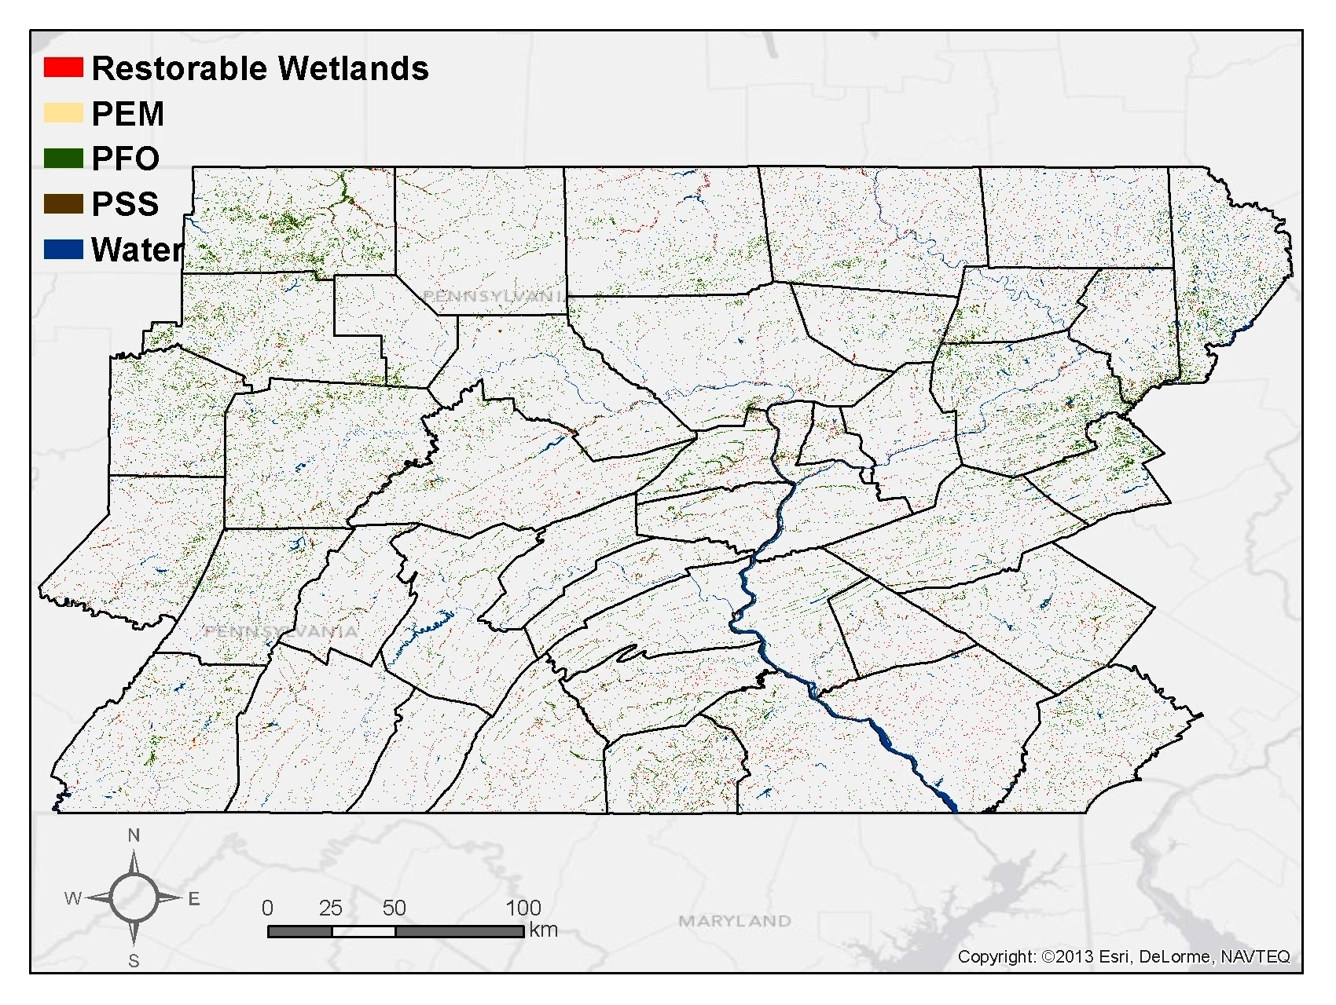

Slide 13
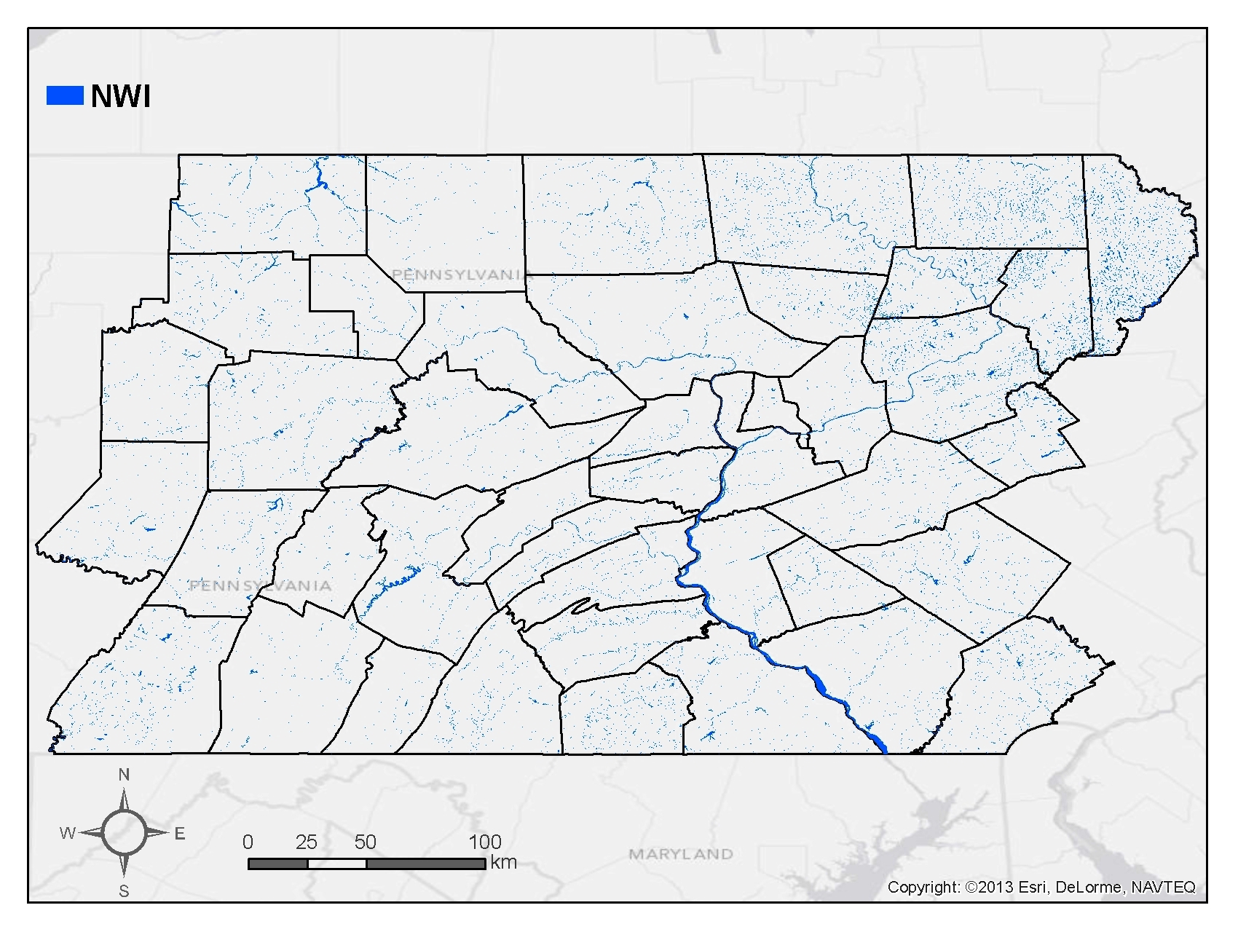

Slide 14
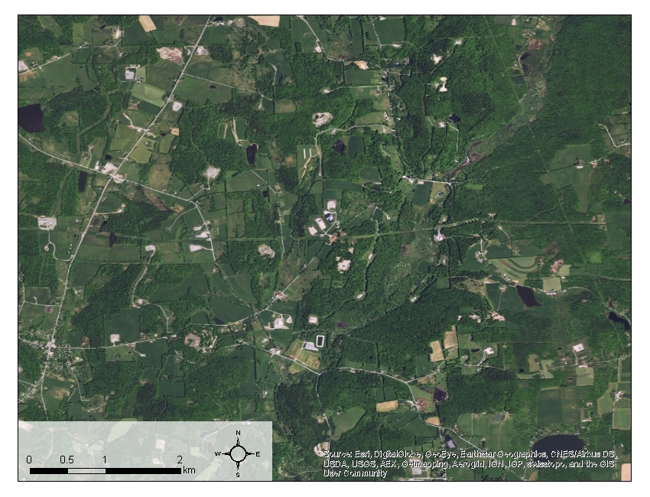

Slide 15
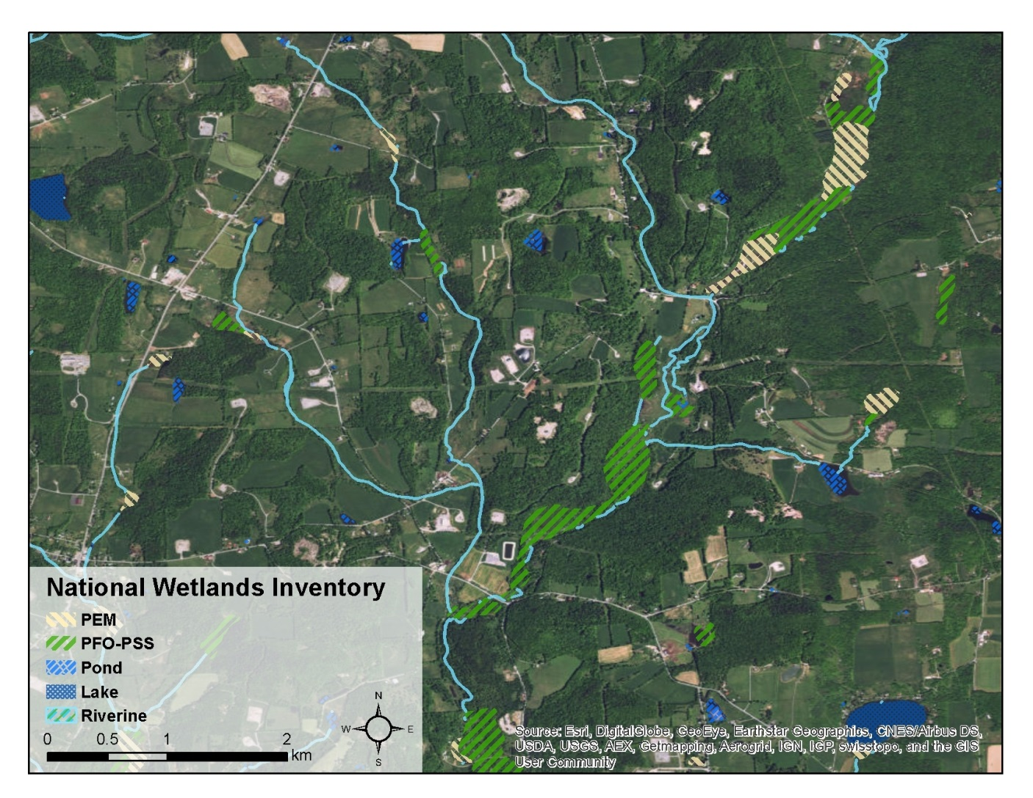

Slide 16
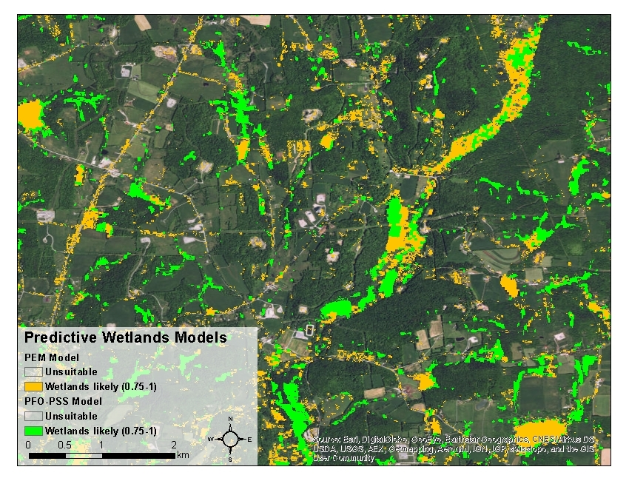
10m resolution statistical model output at 0.75 probability threshold

Slide 18
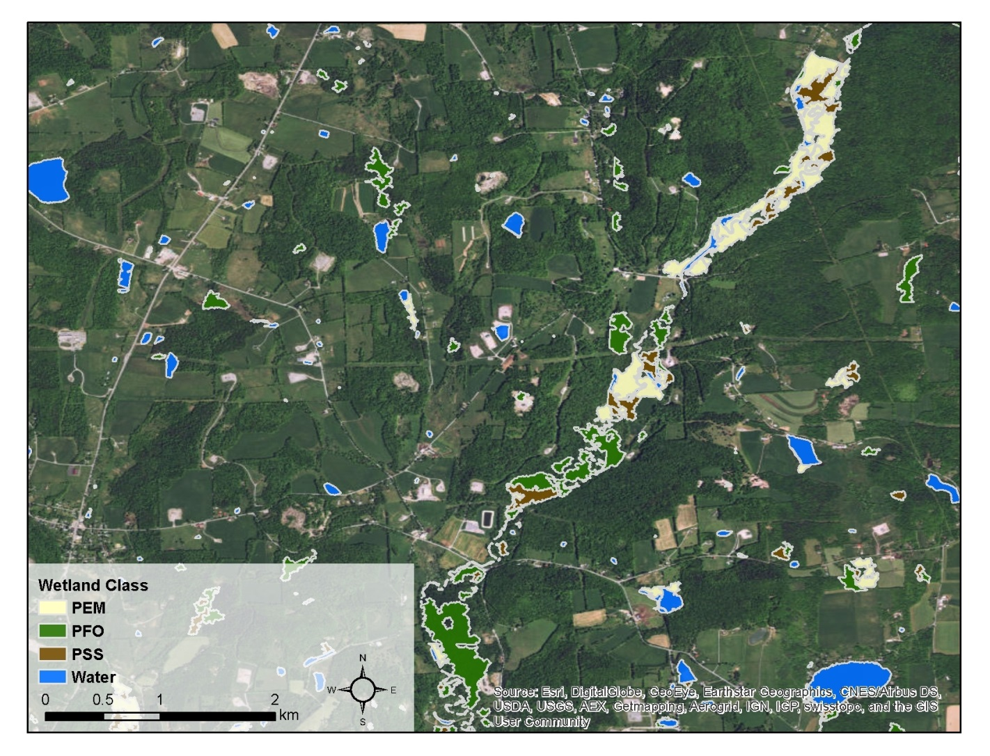
Lidar-aided hydrogeologic modeling and object-based wetlands mapping
96% correct classification rate on 219 validation wetlands

Slide 19
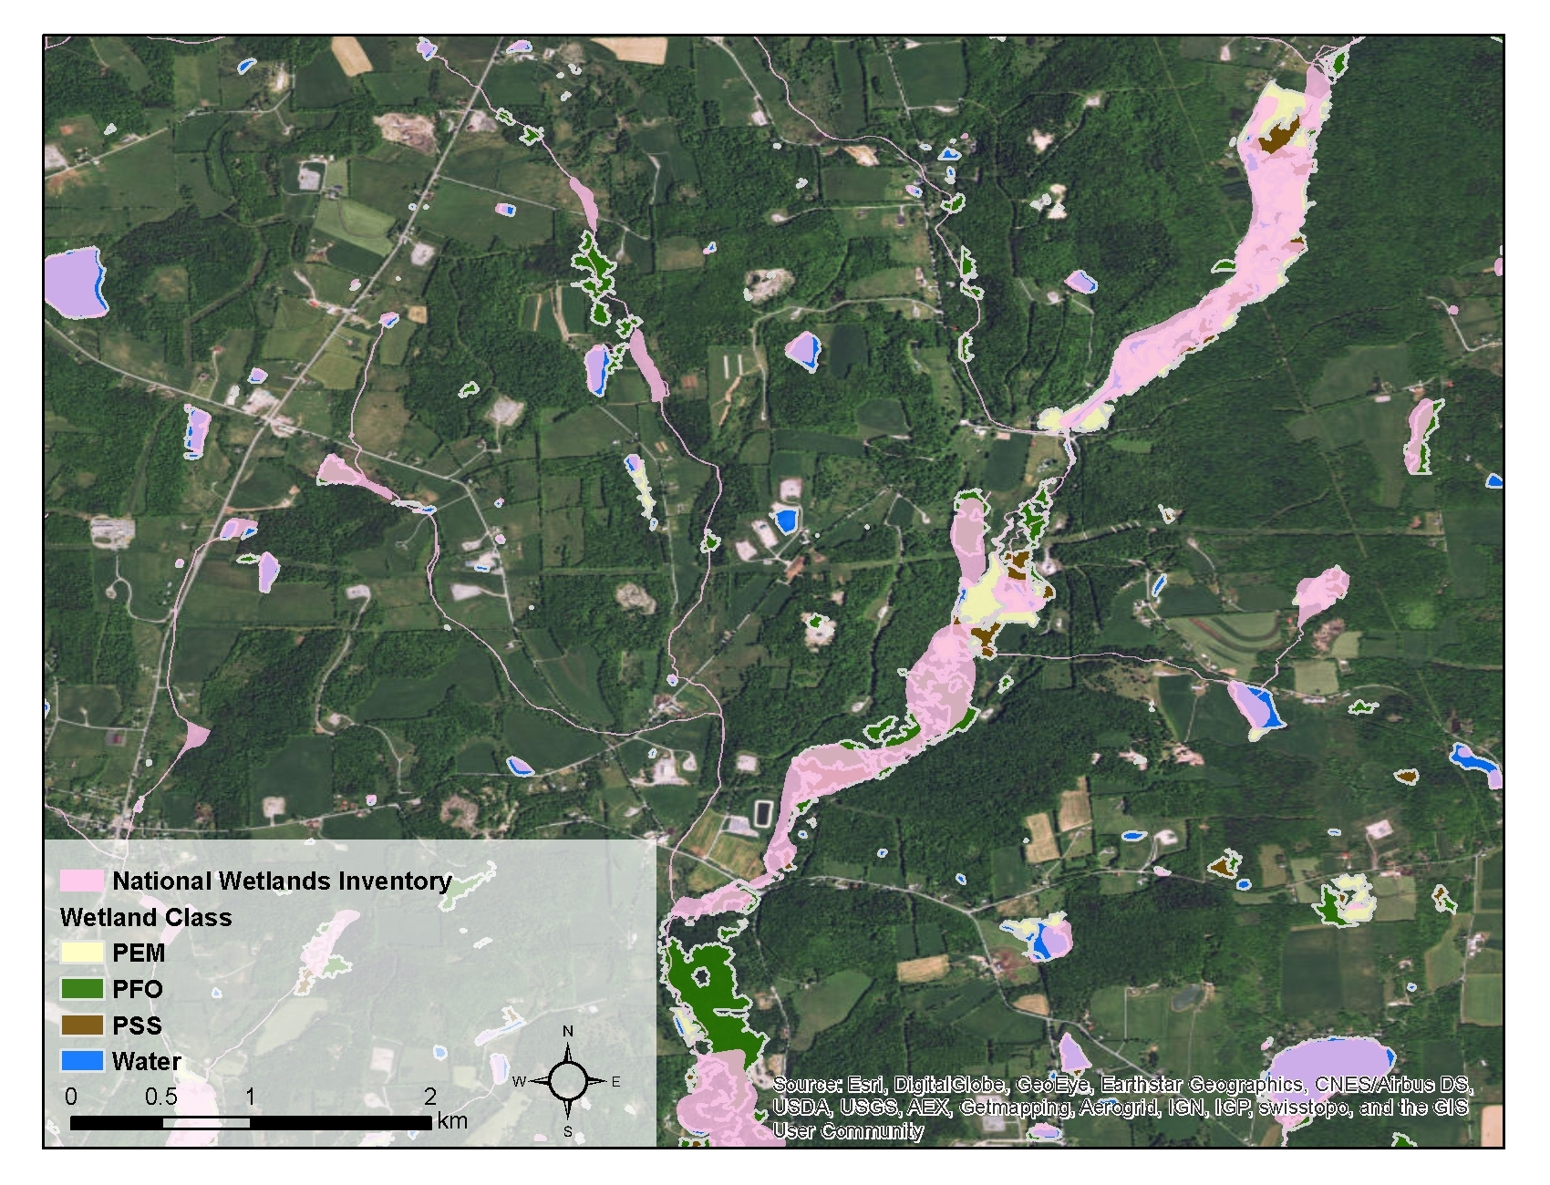
Lidar-aided hydrogeologic modeling and object-based wetlands mapping vs. National Wetlands Inventory

Slide 20
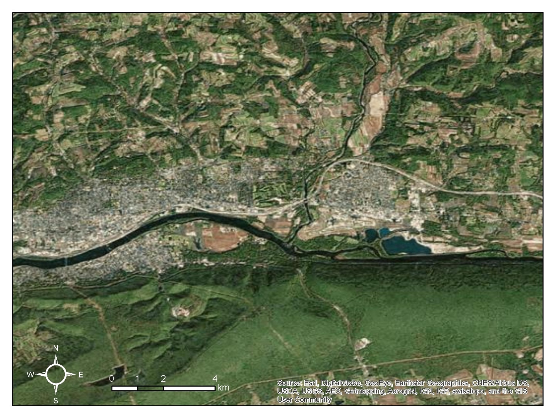

Slide 21
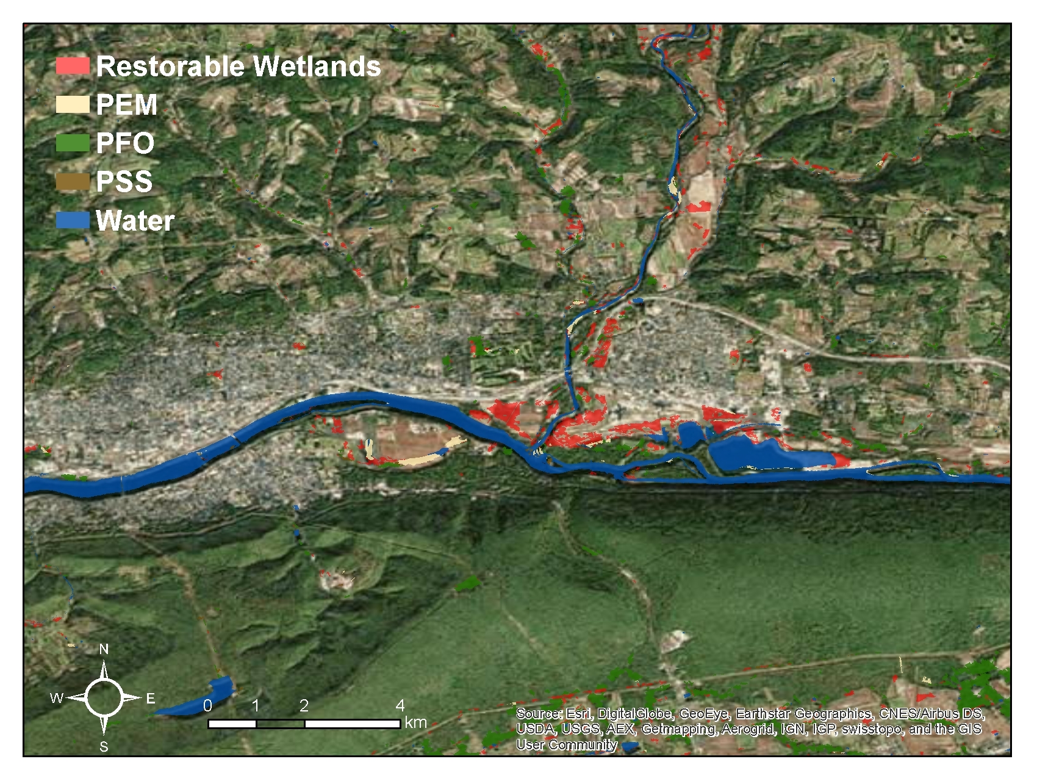

Slide 22
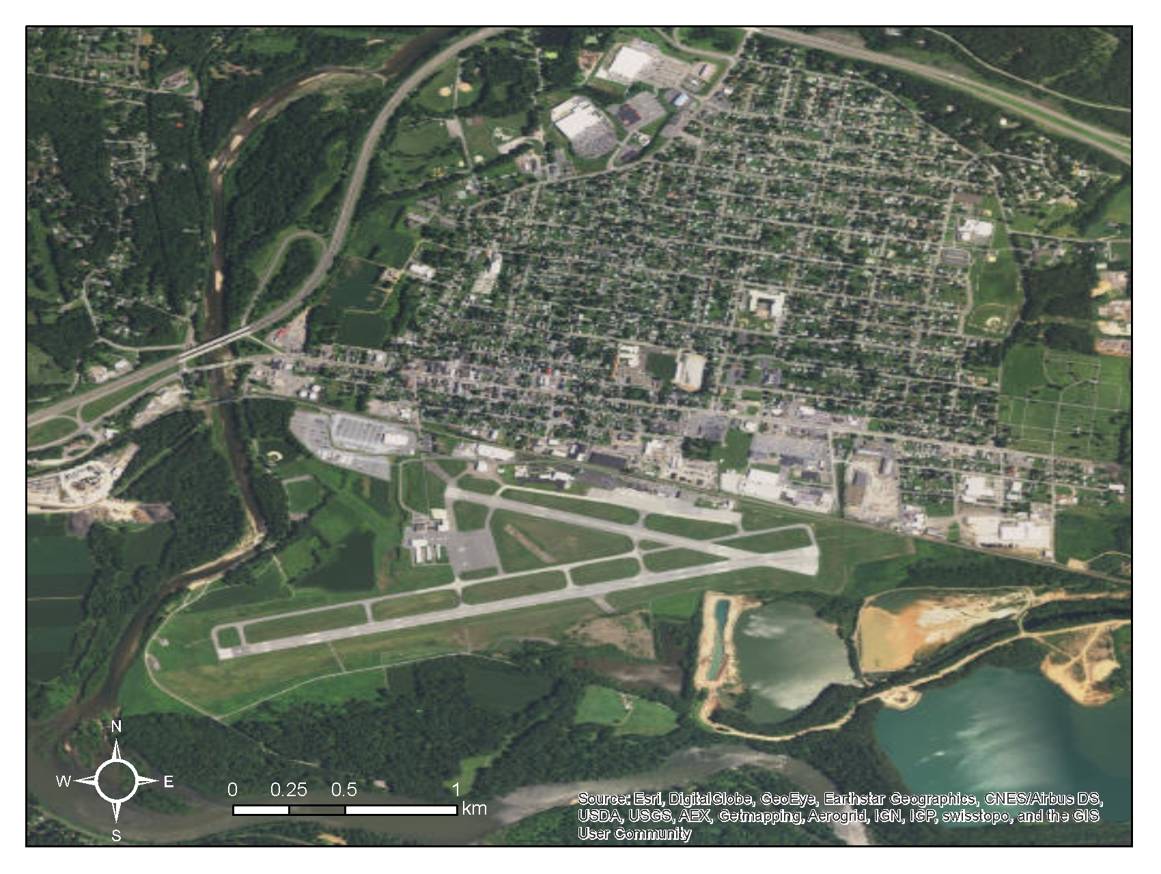
1:24,000

Slide 23
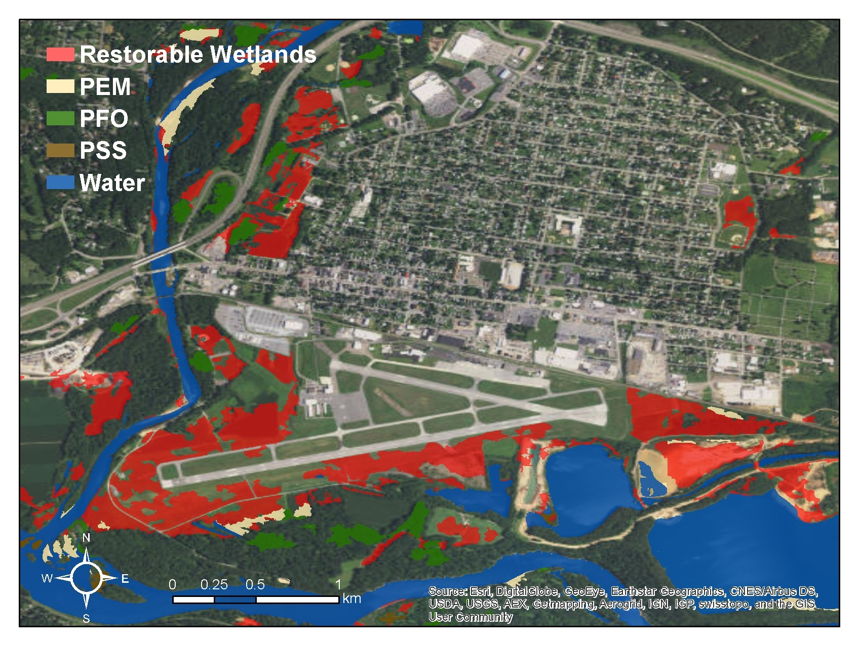
1:24,000

Slide 24
Thoughts on next steps for statistical modeling
Upgrading from 10 to 5m resolution
  20GB / variable, 20 variables…
Shift to alternate modeling algorithm(s)
  Maxent ; random forest
    Reduced commission rates vs. gam on NY data
      However response interpretability is reduced

