Slide 1


The Office of Sustainability develops and advocates for programs, policies and actions by government, citizens, businesses, and institutions that improve the long-term environmental, social, and economic viability of Baltimore City.

Slide 2

Baltimore Sustainability Plan
Cleanliness
Pollution Prevention
Resource Conservation
Greening
Transportation
Education & Awareness
Green Economy
29 Goals
131 Strategies

Slide 3
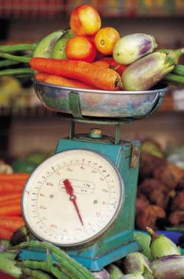
Greening Goal #2: Establish Baltimore as a leader in sustainable, local food systems
Strategy A: Increase the percentage of land under cultivation for agricultural purposes
Strategy B: Improve the quantity and quality of food available at food outlets
Strategy C: Increase demand for locally-produced, healthy foods by schools, institutions, super-markets and citizens
Strategy D: Develop an urban agriculture plan
Strategy E: Implement Baltimore Food Policy Task Force recommendations related to sustainability and food
Strategy F: Compile local and regional data on various components of the food system

Slide 4



Baltimore Food Policy Initiative
Goal: To increase access to healthy and affordable foods in Baltimore City food deserts.
Activities:
Mapping food needs
Working with vendors to stock healthy food
Promoting EBT at farmer’s markets
Healthy eating campaigns in City Schools
Learn more:
http://www.baltimorecity.gov/Government/
AgenciesDepartments/Planning/
BaltimoreFoodPolicyInitiative.aspx

Slide 5
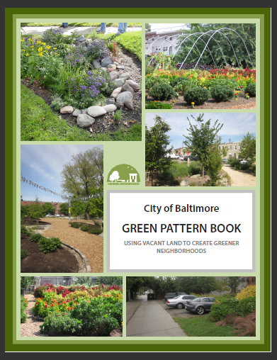
The Green Pattern Book is a tool to support the greening of vacant land by City agencies, NGOs, community-based organizations, and individual residents by creating a ‘common language’.
This document includes information on:
Visioning
Site selection
Guidelines
Resources

Slide 6
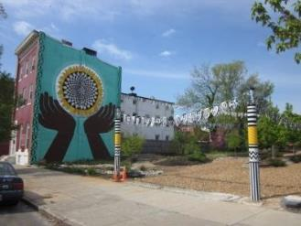
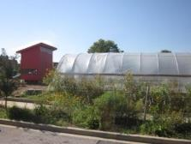
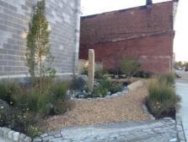
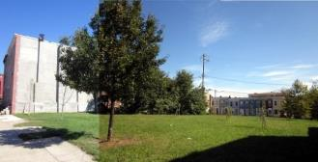
How Do We Grow a Green City?
Promoting eight different green “patterns” for re-using vacant land:
Clean and Green
Community Managed Open Space
Urban Agriculture
Green Parking
Stormwater Management
Urban Forests
Neighborhood Parks
Mixed Greens

Slide 7
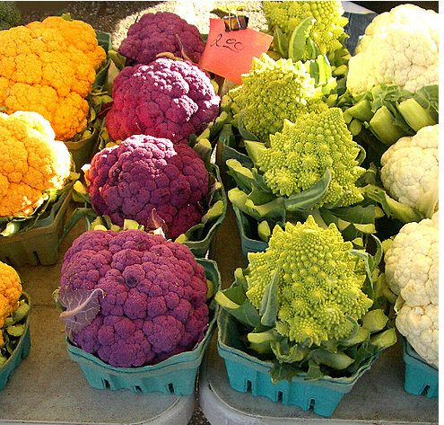
Homegrown Baltimore: Grow Local, Buy Local, Eat Local

Slide 8
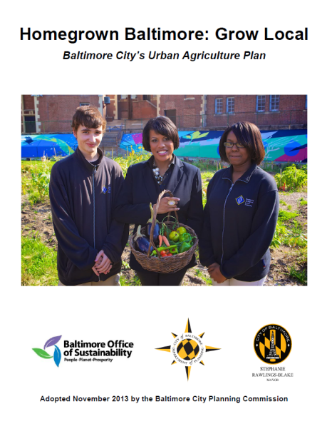
- Context
- Land Assessment
- Policy Context
- Current Activities
- 25 Major Recommendations: Land, Water, Soil, Capital, Support
- Buy Local, Eat Local
- Appendices of relevant city code
www.baltimoresustainability.org/homegrown-baltimore-grow-local

Slide 9
Zoning and Permitting
Community-managed open spaces and urban agriculture will be recognized uses under Baltimore’s new Zoning Code
CMOS: permitted in most districts
Urban agriculture: conditional in most districts
A straight-forward process for standards and community acceptance
Learn more: www.rewritebaltimore.org

Slide 10
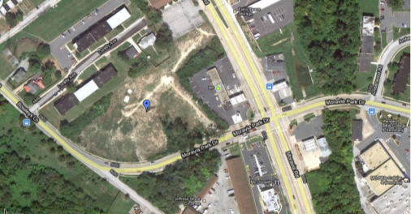
Land Assessment
Conditions sought:
Contiguous
One acre or larger
City-owned
Flat
Open to the sun
No short to mid term development plans
Approximately 35 acres identified – most need a lot of prep and outreach!

Slide 11
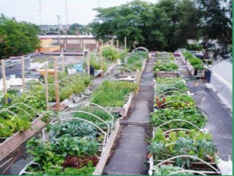
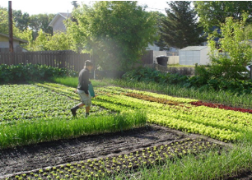
Pre-Qualification Application http://www.baltimoresustainability.org/homegrown-baltimore-grow-local
Minimum qualifications:
At least 1 year of experience
Sustainable management plan
Openness to community involvement
Financially sound proposal
Terms:
Rolling deadline to apply
5-year leases (with 2-year notice to vacate), terms based on farm type
$100/year
Funding available to help with initial capital costs

Slide 12
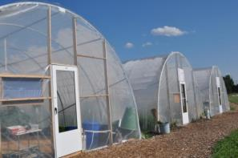
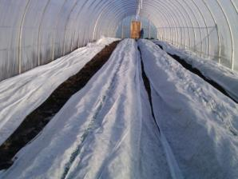
Results So Far
Received 12 responses so far, of which 6 have been qualified
First lease with Big City Farms and Strength to Love II for 1.5 acres in Sandtown-Winchester
Second lease with Real Food Farm for 1.5 acres in South Clifton Park
Third lease in progress for 1.5 acres in Johnston Square

Slide 13
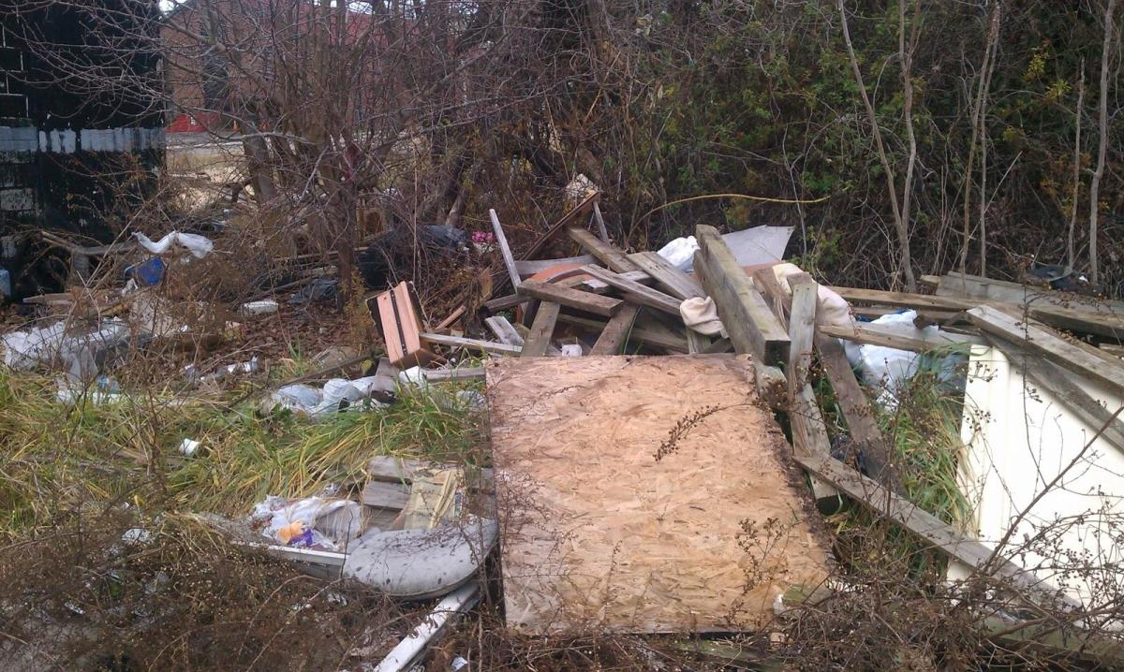

Slide 14
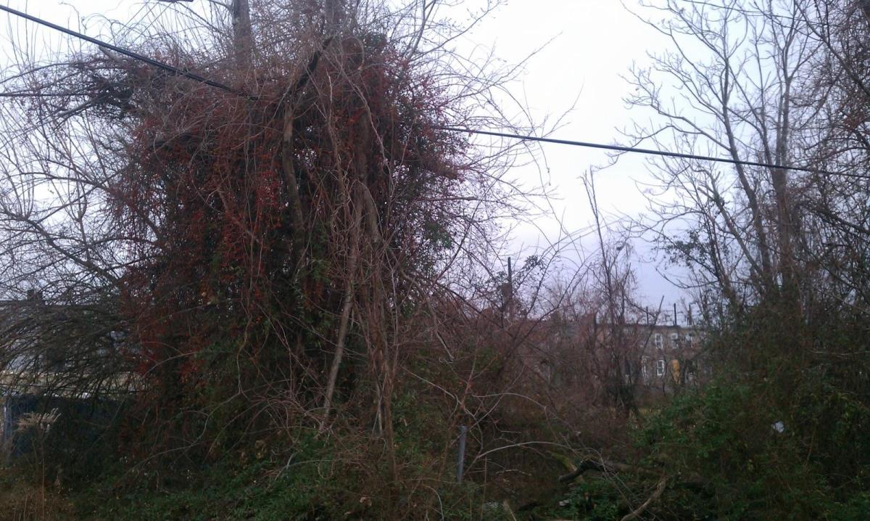

Slide 15
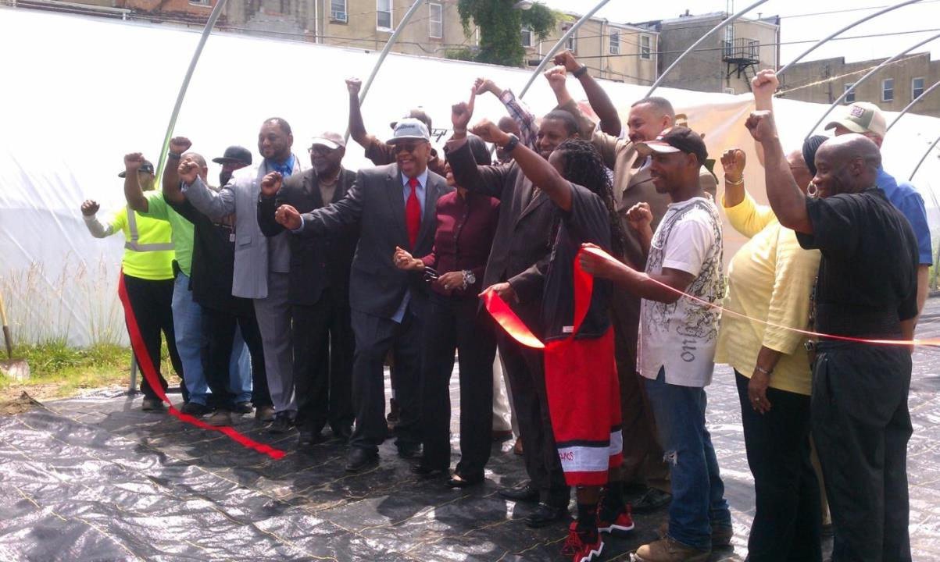

Slide 16
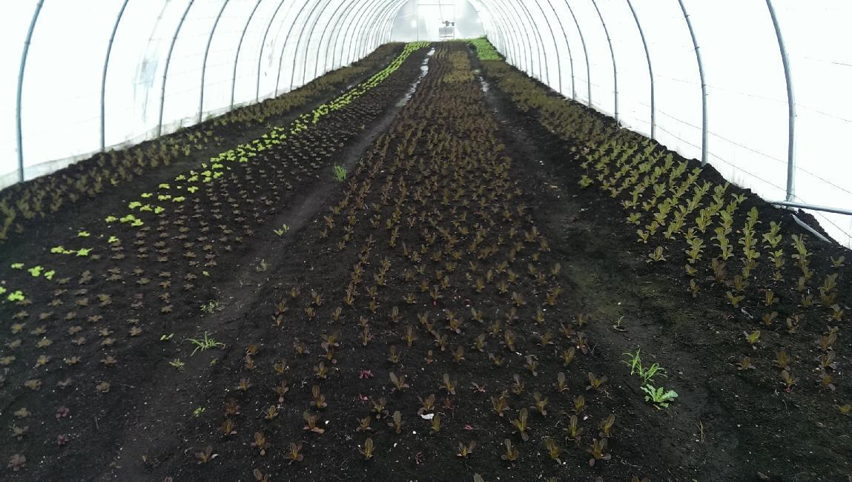

Slide 17
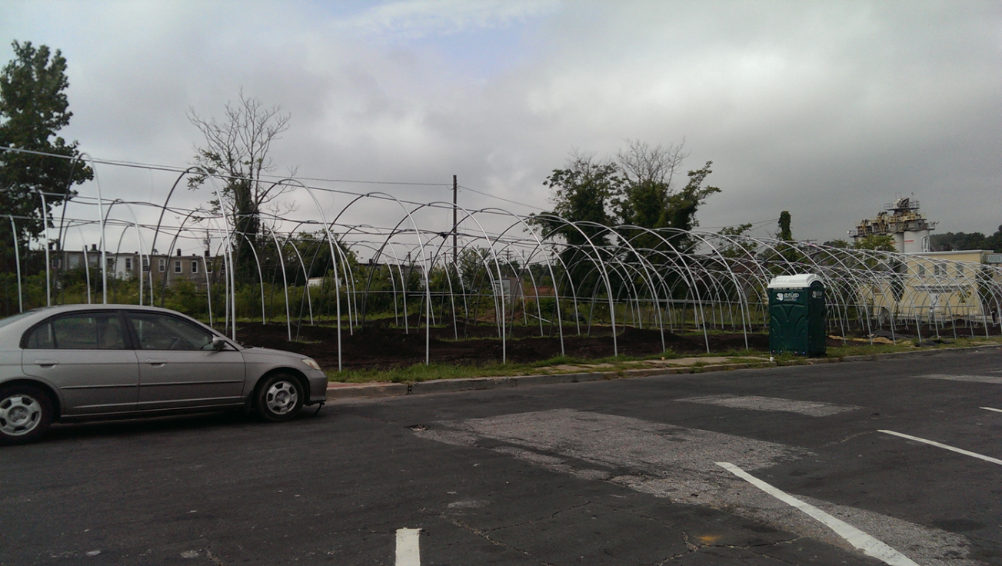

Slide 18
Animal Husbandry
4-10 chickens on most properties
Up to 50 chickens on farms and community gardens with an approved management plan
2 bee hives on most properties, scales up with land size, no upper limit
2-24 rabbits on most properties
2-6 dwarf, miniature, and pygmy goats on most properties

Slide 19
Stormwater Management
Approval required from Public Works if more than 5,000 square feet are being disturbed
Agriculture is generally not subjected to normal fees and timelines for approval
Mitigation/capture may still be required if new impervious surface is being created
Baltimore County Soil Conservation District provides support via water quality plans

Slide 20
Other policies
No permits required for hoop houses
Water access $120/year via Housing Department
Soil Safety Plans required for Use Permits
New urban agriculture tax credit for private land – 90% if it stays a farm for 5 years
Aquaculture allowed, regulated by the State
Rooftop gardens and farms allowed

