Slide 1

Achieving the Goal of Stewardship
2014 Chesapeake Watershed Agreement

Slide 2
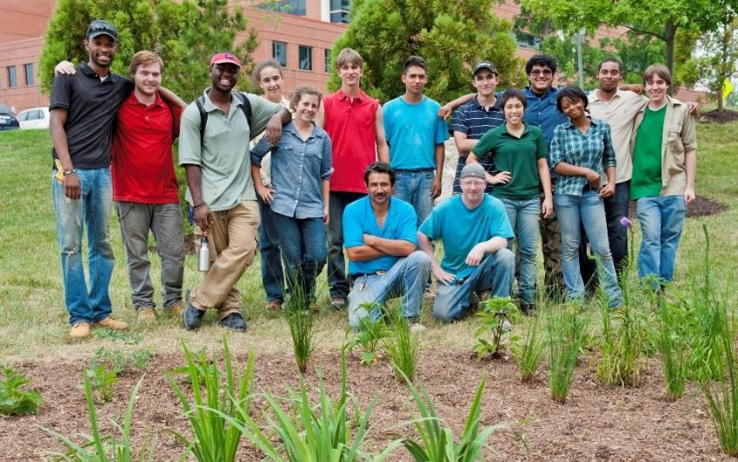
Citizen Stewardship Outcome
Increase the number and diversity of trained and mobilized citizen volunteers with the knowledge and skills needed to enhance the health of their local watersheds.

Slide 3

Why is this outcome important?
It is the people part of the new Bay Agreement
Restoration actions must be widespread-- a thousand cuts/a thousand solutions.
Local government needs support from its residents to act.
Many other outcomes and management strategies also rely on broad grass roots action.
This has not been a direct emphasis of the Chesapeake Bay Program in the past.

Slide 4
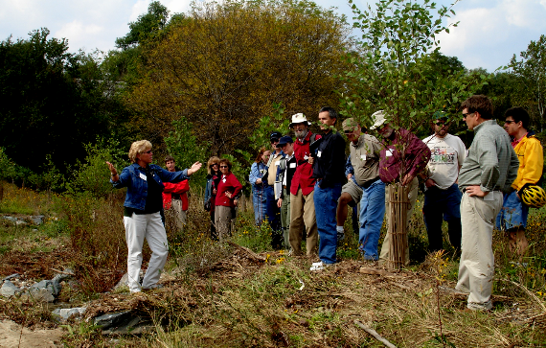
Citizen Stewardship – Key points
Increase the number and diversity of trained and mobilized citizen volunteers with the knowledge and skills needed to enhance the health of their local watersheds.
Citizen stewards
Building Local champions
Volunteer/Collective Action
Change Individual Behavior

Slide 5
Citizen Stewardship Framework
Increasing citizen actions for watershed health
Community Leaders/ Champions
Mobilize/Increase
Volunteerism/ Collective Community Action
Knowledge & skills
Individual Citizen Actions
and Behaviors
Increasingly Environmentally Literate Population (Elit Goal)

Slide 6
















Examples
Community Leaders Taking Action
Community Conservation Projects by Volunteers
Changing Behavior/Adopting BMPs
Notes:
EXAMPLES

Slide 7
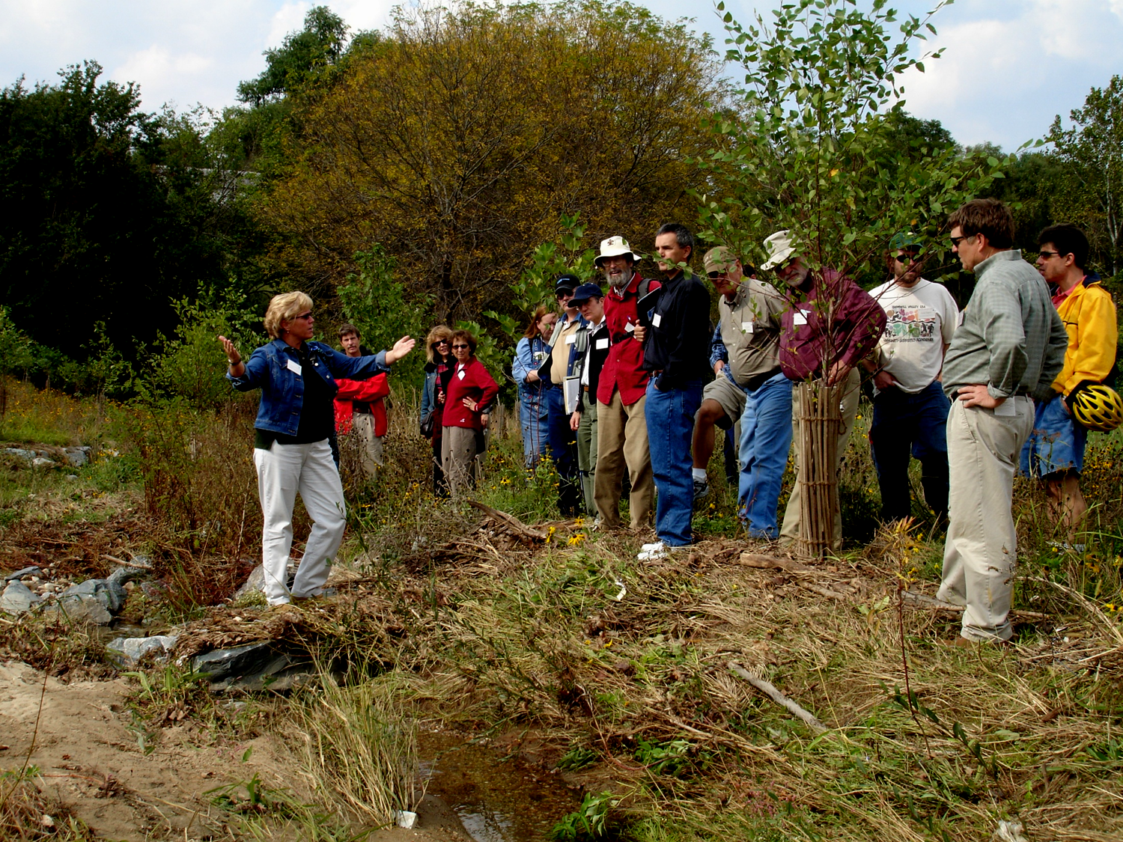
Leveraging Impact
We need strategies to develop and mobilize more watershed leaders that can expand participation in community-based programs, and champion efforts to change behavior and foster personal actions.

Slide 8
Factors Influencing Success
External Factors
  Lack of social norms to encourage scaled up adoption of behaviors
  Lack of access, use and broad level appreciation of natural resources
Capacity Factors
    Inability to reach ALL to inform, raise awareness link with actions
    Lack knowledge and use of marketing strategies to encourage behavior adoption
    Lack organization and program capacity to engage volunteers/build leaders

Slide 9
Management Approaches/Actions
Identify methods to measure impact
Provide Training and Technical Assistance
Share best practices and successful models
Increase investment/capacity

Slide 10
Management Approaches/Actions
Group Work – develop recommended actions to address factors influencing
by federal agencies
by states
by the Chesapeake Bay Program
by NGOs (broadly applicable)

Slide 11

Why Measure Progress?
  Collect and share data useful to practitioners to informing program design and improvements
  Predict/quantify the water quality and other values of stewardship programs and citizen actions.
  Increase/maintain support for investments in citizen stewardship.

Slide 12
How do we Measure Progress?
Community Leaders/ Champions
Mobilize/ Increase
Stewardship Index
Tracking Data?
Volunteerism/ Collective Community Action
Tracking Data?
Knowledge & skills
Individual Citizen Actions
and Behaviors
Behavior Index, Tracking Data?
Increasingly Environmentally Literate Population (Elit Goal)
ELIT Tool

Slide 13

Next Steps
Revise and complete DRAFT Management Strategy
  March 1, 2015
Begin Development of Stewardship Index
  February, 2015 – December, 2015
Public review of DRAFT Management Strategy
  March 15 – April, 2015
Finalize Management Strategy, draft work plans by June, 2015
What is our management structure moving forward?

