Slide 1
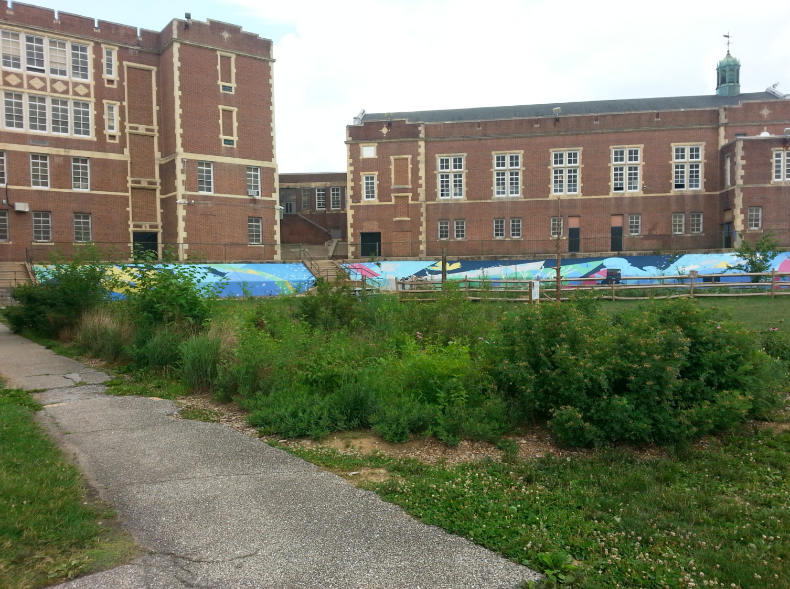

Addressing Stormwater Pollution in Baltimore
Blue Water Baltimore’s
Approach
Notes:
Innovative programs, not necessarily projects

Slide 2
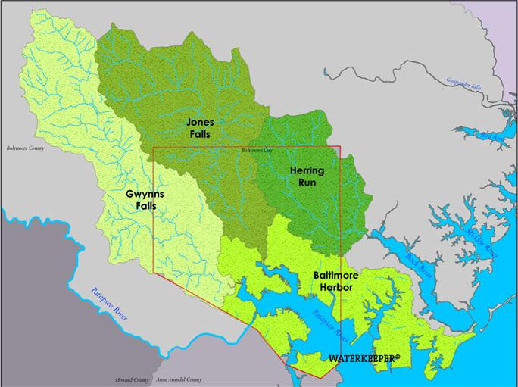

Baltimore’s Watersheds
194 square miles
1 million residents
Stats
Map

Slide 3
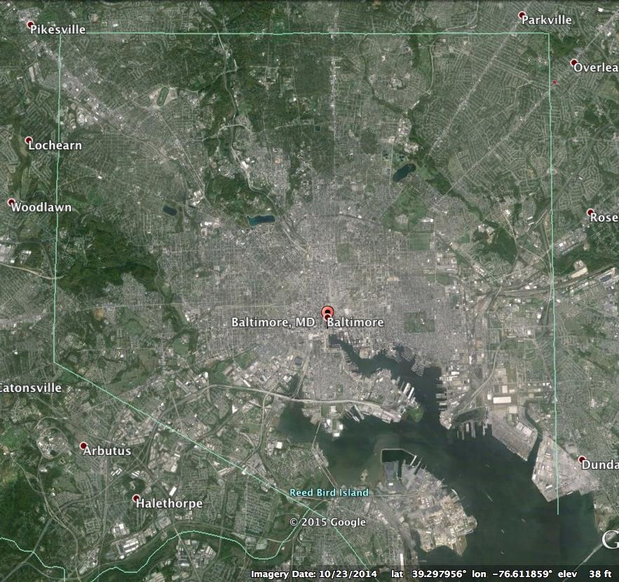
Notes:
92 sq mi
45% impervious
27% tree canopy, with numerous inner city neighborhoods closer to 10%
2000 mi. of roads
450 mi. of alleys
1,146 mi. of storm drain pipes
14,000 vacant lots

Slide 4
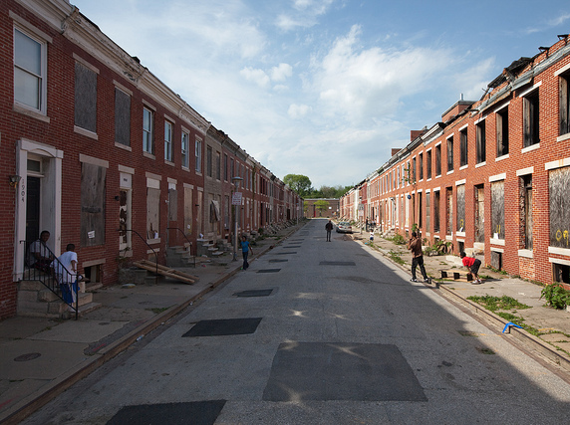
Notes:
622k residents, almost 20% below poverty line
Many residents know little about the natural environment and have far more immediate concerns

Slide 5
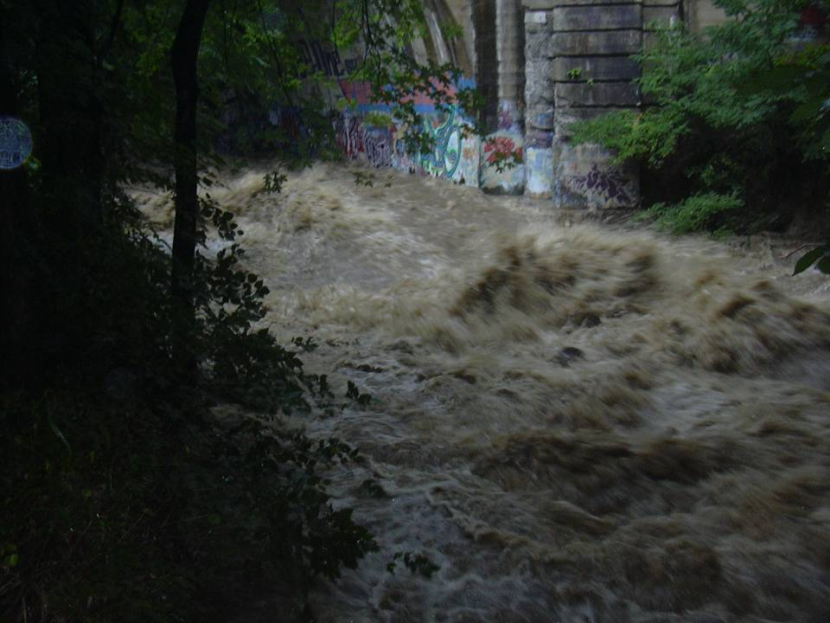
Notes:
Stormwater is not what causes pollution. It’s poor stormwater management.
-sewage overflows
-trash, oils, sediment
-erosion (volume)
-heat

Slide 6
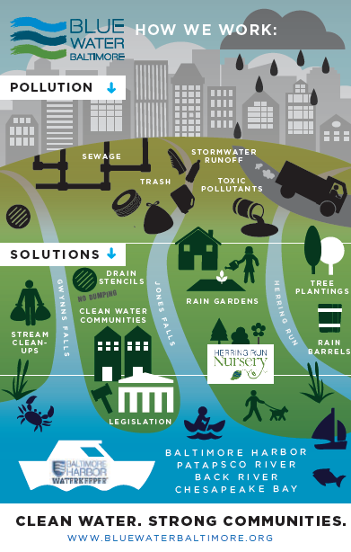
Water Quality Monitoring
Pollution 101 Training
Pollution Response
Education and Outreach
Ecoliteracy Programming
Stream Cleanups
Advocacy
Legislation
Legal Action
Local Policy Change
Green Infrastructure
Developing Relationships
Water Audits
Project Management
Collaborating with Partners
Herring Run Nursery

Slide 7

Jessie Hillman
jhillman@bluewaterbaltimore.org
410-254-1577 x 114
www.bluewaterbaltimore.org

