Slide 1
Achieving the Goal of Stewardship
2014 Chesapeake Watershed Agreement

Slide 2

The Stewardship Goal
“Increase the number and diversity of local citizen stewards and local governments that actively support and carry out conservation and restoration activities that achieve healthy local streams, rivers and a vibrant Chesapeake Bay.”

Slide 3
the Bay Agreement recognized …
That long term success depends on the support and action that arises from local citizens and local conservation groups.
Local government leaders must have the capacity and tools to address watershed issues and the support to implement policies and incentives that support restoration efforts.
The base of the environmental movement and its leadership must be more diverse and inclusive.

Slide 4
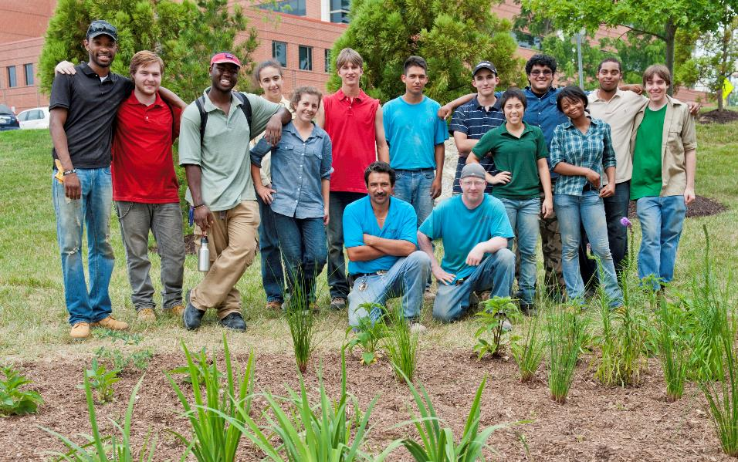
Citizen Stewardship
Increase the number and diversity of trained and mobilized citizen volunteers with the knowledge and skills needed to enhance the health of their local watersheds.

Slide 5
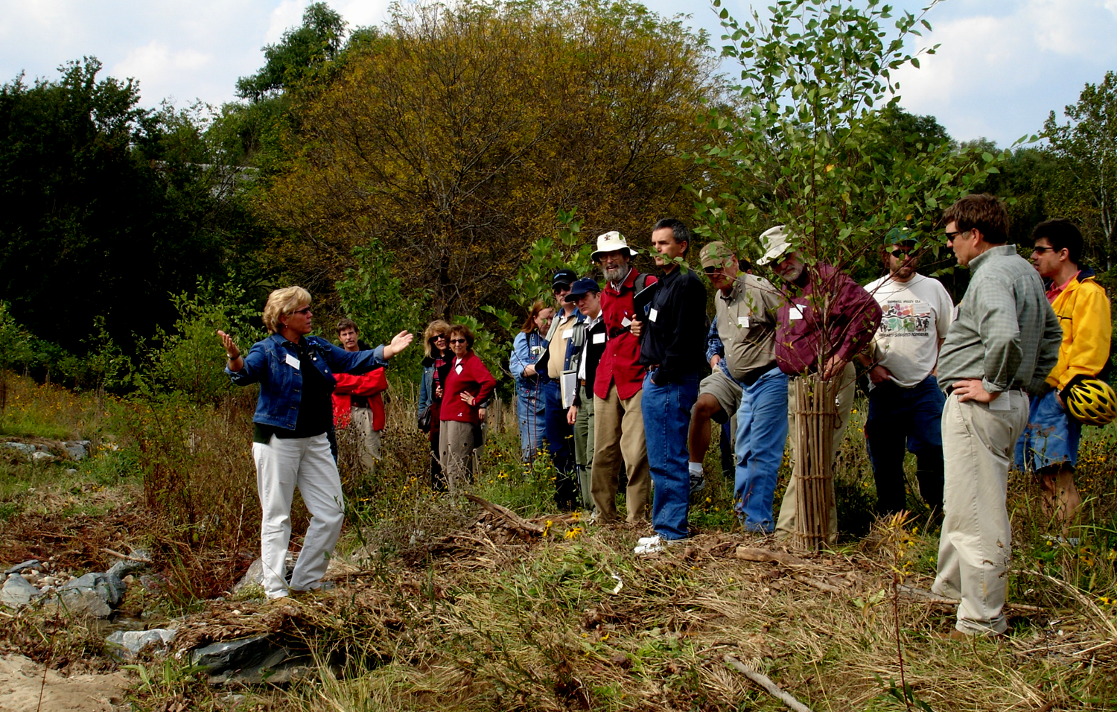
Citizen Stewardship
Increase the number and diversity of trained and mobilized citizen volunteers with the knowledge and skills needed to enhance the health of their local watersheds.
Citizen stewards
Individual Behavior change
Volunteers/Collective Action
Local champions

Slide 6
Moving from Personal Action
to Citizen Leadership
Individual Citizen Actions
and Behaviors
Volunteerism/ Collective
Community Action
Citizen Leaders/ Champions
Increasing level of engagement

Slide 7
Discussion
What does success look like? Who are the citizen stewards within this framework? Who is missing?
What are examples of successful actions taking place at each of these levels of citizen stewardship?
What types of actions, programs, or tools would be most effective at increasing the # and success of stewards at each level?

Slide 8
Metrics
We can measure many things, but why?
  General awareness – how tuned in are citizens to CBP issues and strategies?
  Effectiveness of programs and approaches (i.e. behavior change)?
  Predict/quantify the value of citizen actions
  Increase or maintain support for investments in local outreach and engagement.

Slide 9
Next Steps
Produce scope of work for metrics – CBT- Dec
First Strategy Draft - what we know –Background, baseline, barriers, 2- year potential actions - Jan
Committee to remain involved in review and input
Solicit actions from states/federal agencies
Recognize many existing efforts – Where can the CBP add value?
Potential Actions:
  Metrics
  Gaps – Replication of success
  Case Studies – play out how to enhance citizen connection in a focused area and issue

