Slide 1

Achieving the Goal of Stewardship
2014 Chesapeake Watershed Agreement
Albert Todd, Director
Alliance for the Chesapeake Bay

Slide 2

What is the Stewardship Goal?
“Increase the number and diversity of local citizen stewards and local governments that actively support and carry out conservation and restoration activities that achieve healthy local streams, rivers and a vibrant Chesapeake Bay.”

Slide 3
the new Bay Agreement recognized …
Citizen Stewardship -That long term success depends on the support and action that arises from local citizens and local conservation groups.
Local Leadership - Local government leaders must have the capacity and tools to address watershed issues and the support to implement policies and incentives that support restoration efforts.
Diversity - The base of the environmental movement and its leadership must be more diverse and inclusive.

Slide 4
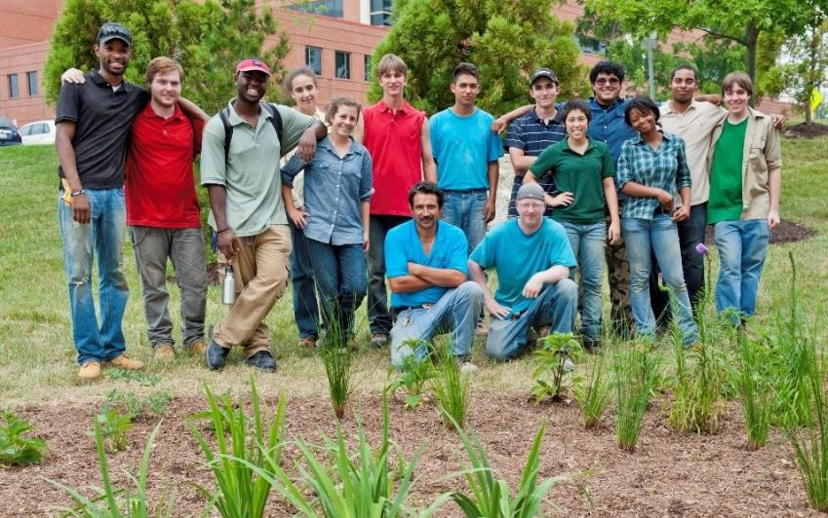
Citizen Stewardship Outcome
Increase the number and diversity of trained and mobilized citizen volunteers with the knowledge and skills needed to enhance the health of their local watersheds.

Slide 5

Why is this outcome important?
It is the People part of the new Bay Agreement
Restoration actions must be widespread-- the thousand cuts/solutions
Local government needs citizen support to act.
Motivating broad grass roots action is essential for many management strategies
This is a new/non-traditional emphasis for the Chesapeake Bay Program

Slide 6
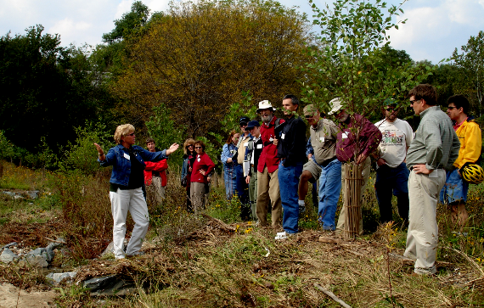
Citizen Stewardship – Key points
Increase the number and diversity of trained and mobilized citizen volunteers with the knowledge and skills needed to enhance the health of their local watersheds.
Citizen stewards
Change Individual Behavior
Volunteer/Collective Action
Become Local champions

Slide 7
Citizen Stewardship Framework
Moving Personal Action to Citizen Leadership
Individual Citizen Actions
and Behaviors
Volunteerism/ Collective
Community Action
Mobilize/Increase
Citizen Leaders/ Champions
Increasing
level of engagement

Slide 8





Changing Behavior
Do it yourself online center
Stormwater.allianceforthebay.org
Volunteerism
Citizen and Watershed Groups engage in local stream cleanups
Community Leaders
River Wise Congregations -Creating Church Leaders

Slide 9
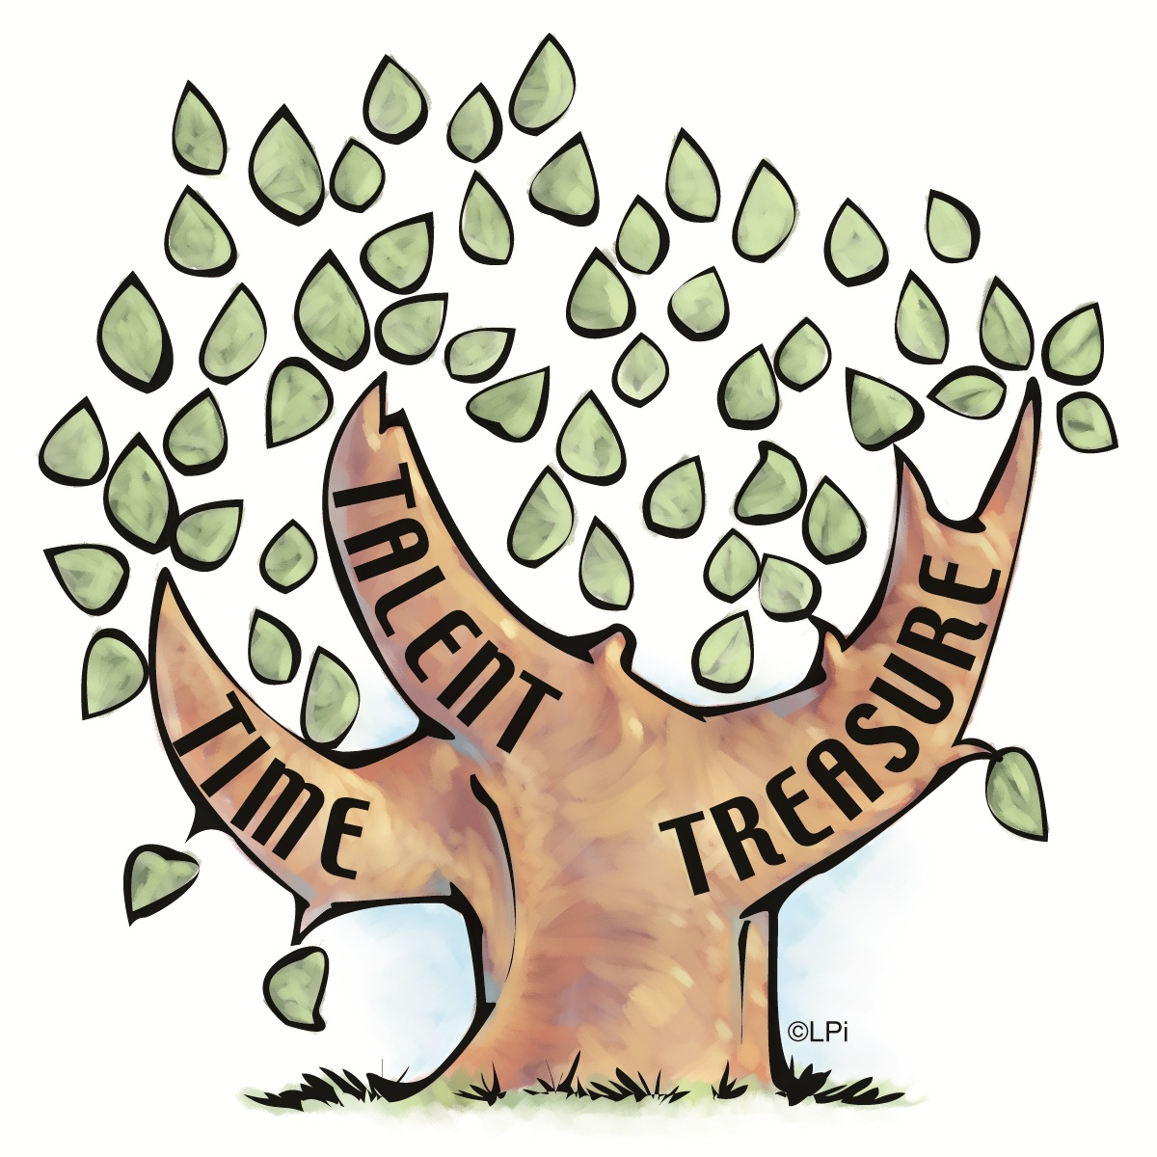
Strategy Questions
What are citizen stewards? Who is missing?
What does success look like? How is it measured?
What successful actions are taking place at each of these levels of citizen stewardship? What are the barriers to expanding?
What types of actions, programs, or tools would be most effective at increasing the # and success of stewards at each level?
Who can add value? (CBP, States, Federal agencies, local governments, local groups, business) How?

Slide 10

Why Metrics?
  Measure general awareness – how tuned in are citizens to CBP issues and strategies?
  How effective are our programs/approaches (i.e. creating behavior change)?
  Can we predict/quantify the value of citizen actions ?
  Increase/maintain support for investments in local outreach and engagement.
We can measure many things but will it add value?

Slide 11
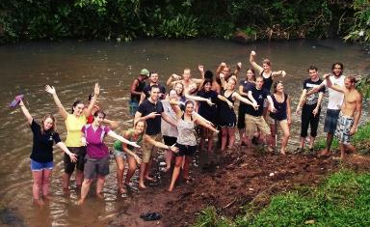
Who is involved?
Jurisdictions - District of Columbia, Maryland, Pennsylvania, Virginia, West Virginia, Chesapeake Bay Commission and the Federal Government .
Non-Profits – Over 600 environmental or community-based groups in the watershed environment nearly all of which engage in some form of citizen outreach and engagement.
Local Governments – Independent action as well as partnerships with NGOs. Public education, incentives for BMPs,etc.
Churches – Partner with NGOs on tree planting, rain gardens, stormwater, advocacy.
Businesses - Employee engagement/community investment
Schools – Clubs/Student community service

Slide 12
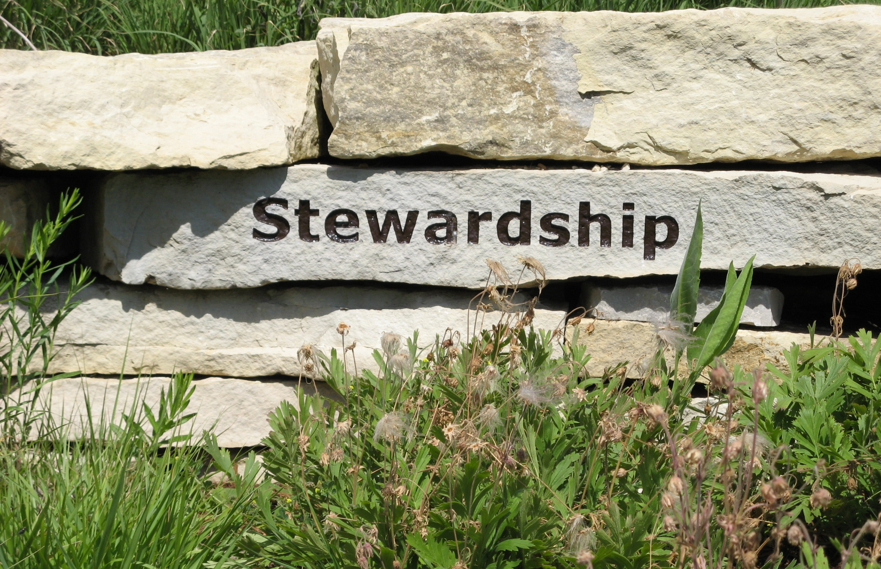
Complexity
Extremely broad constituency – How to reach?
Many groups – Many individual agendas
Many successful and ongoing efforts
Loose affiliations with Chesapeake Bay Program
Little knowledge of agreement, management strategies and their implications
Need for common messages/approach vs. need for tailored outreach.
Where can the CBP add value?

Slide 13
Timeline
November 18 kick-off Meeting – attended by over 25 NGOs with State and CBP representatives.
December 2 – RFP issued for two projects
  Metrics Framework Development – Options
  Database of Outreach Programs, tools, resources, and results
December 9 – Conference call with signatory representatives
December 12 – 1st draft /outline of management strategy
January-March – Committee to host meetings (in each state) to solicit feedback and input to first draft strategy

