Slide 1
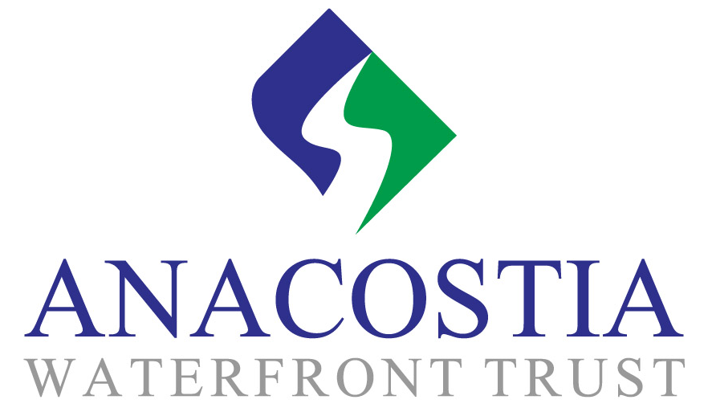
Helping To Create An Active, World-class Public Waterfront For All People
Citizens Advisory Committee
February 17, 2016

Slide 2
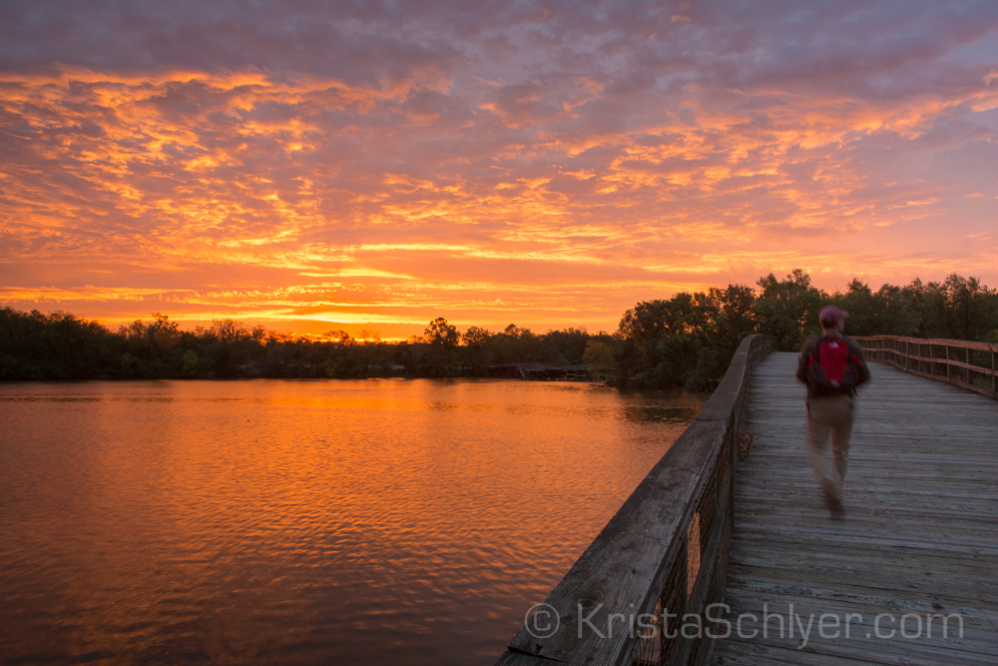
Background
Anacostia Waterfront Trust began as a Summit Fund of Washington-supported project of the Federal City Council
The Summit Fund approached former DC Mayor Anthony Williamsto inquire if his organization would be willing to design and implement an Anacostia project.

Slide 3
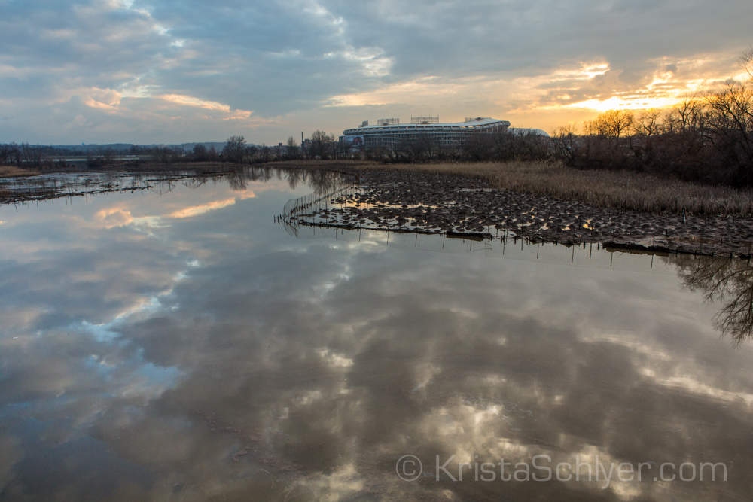
Vision
The Anacostia Waterfront Trust is driven by a clear and comprehensive vision of a transformed Anacostia corridor – the water, the public lands, and the adjacent communities from the Maryland border to the Potomac.
A transformed waterfront will be a wonderful, active, multi-purpose civic space that unites the two sides of the city and helps people on the east side to stay and prosper.

Slide 4
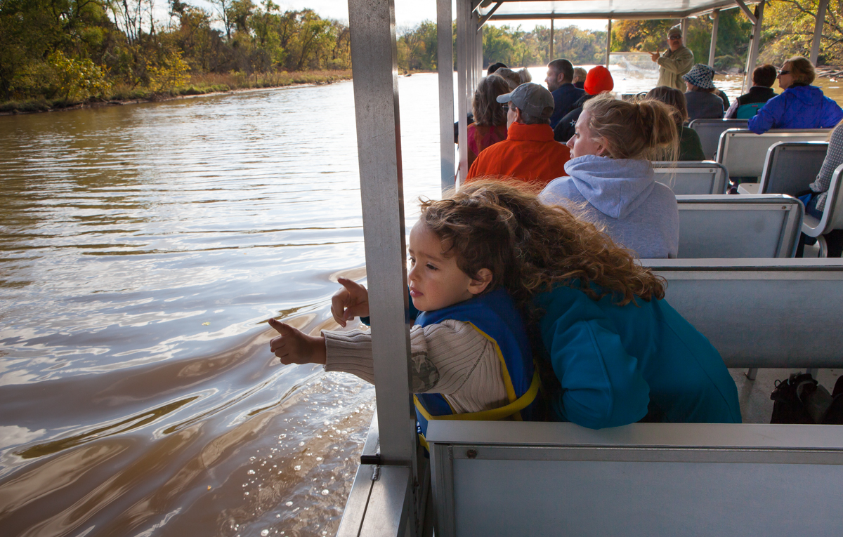

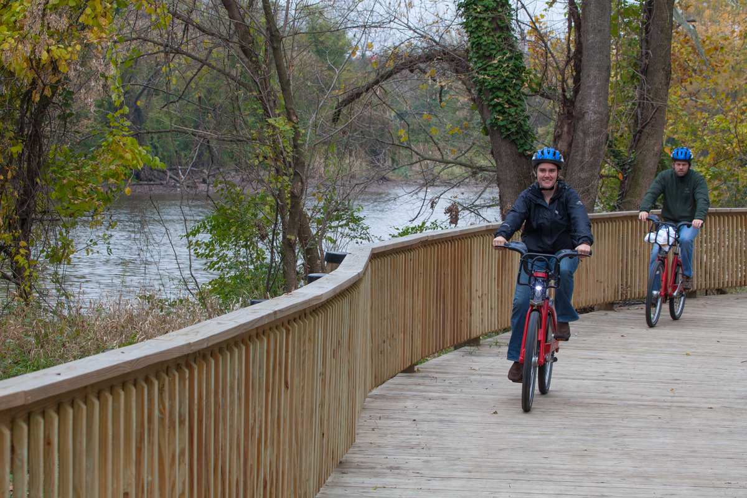
The Trust’s Three Focus Areas
Community
River
Park

Slide 5
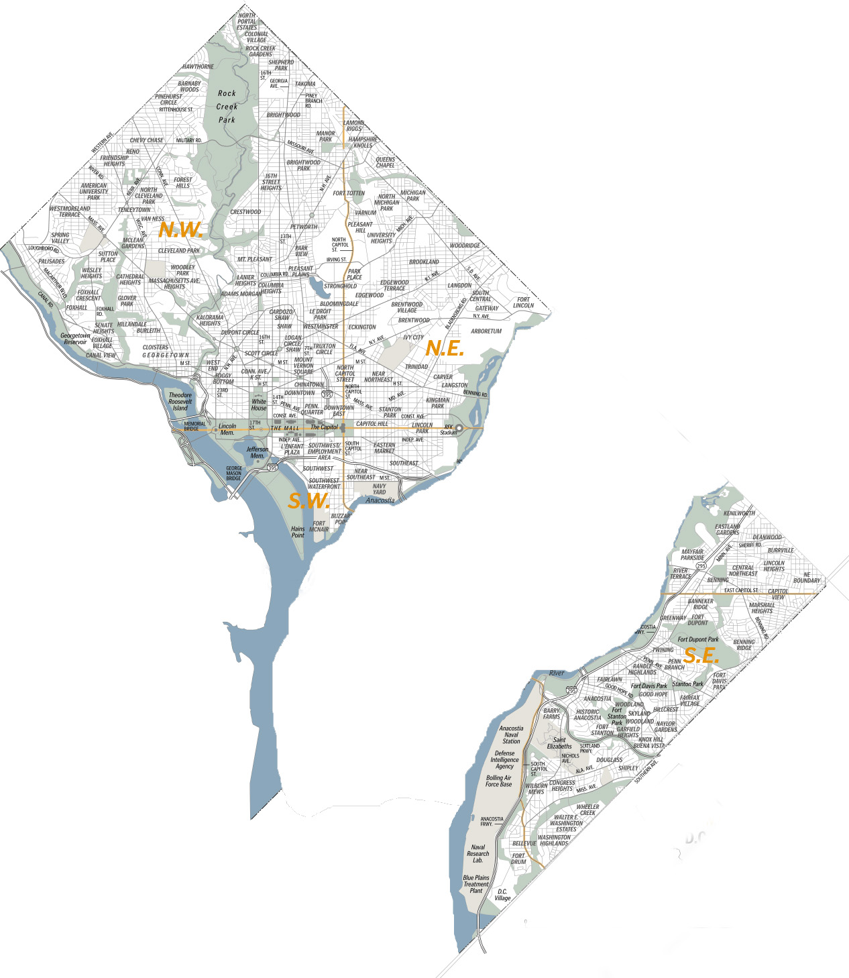
DC has always been divided by the Anacostia

Slide 6
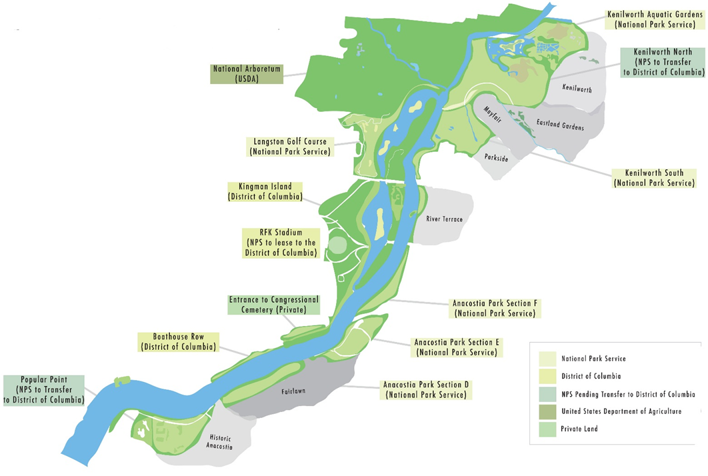
DC’s Anacostia River Corridor

Slide 7
Programs
The Trust
Strategic planning and coordination
Advocacy
Water
RainPay*
Water quality master plan
United for a Healthy Anacostia River
Land
Creating the waterfront vision
Communities
Exemplary Communities
Anacostia Park and Community Collaborative*

Slide 8
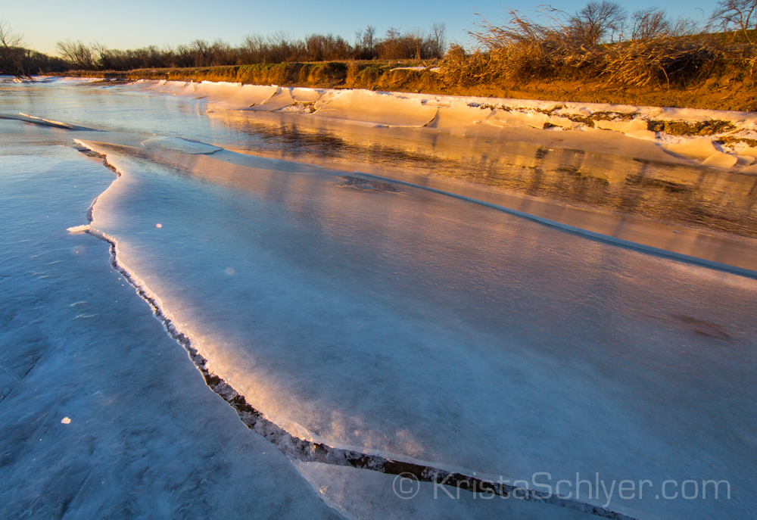
Anacostia Park and
Community Collaborative
Anacostia Business Improvement District
Anacostia Coordinating Council
Anacostia Waterfront Trust
DC Appleseed Center
DC Promise Neighborhood Initiative
East River Family Strengthening Collaborative
Friends of Kenilworth Aquatic Gardens
Georgetown University Policy Lab
Groundwork Anacostia River DC
Institute for Public Health Innovation
National Progressive Baptist Convention
The Urban Institute
Ward 7 Business Partnership

Slide 9
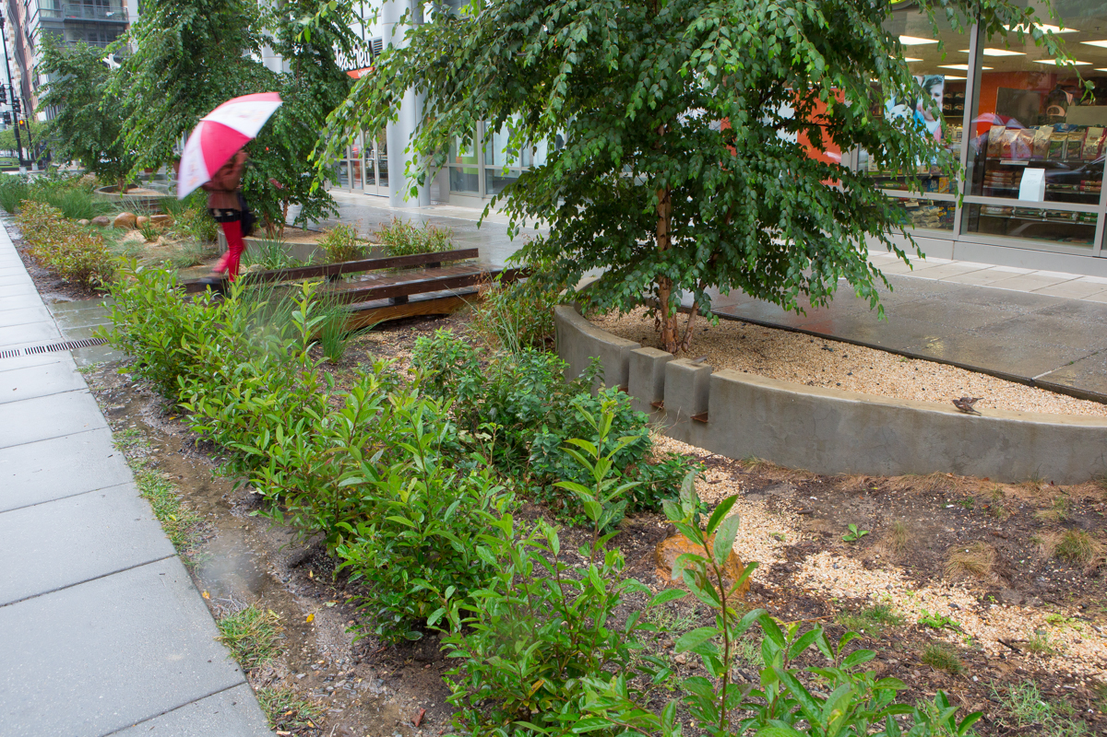
Leverages DC’s Stormwater Retention Credit Trading moving DC’s regulatory obligation to capture stormwater to the places where it does the most good for the Anacostia

Slide 10
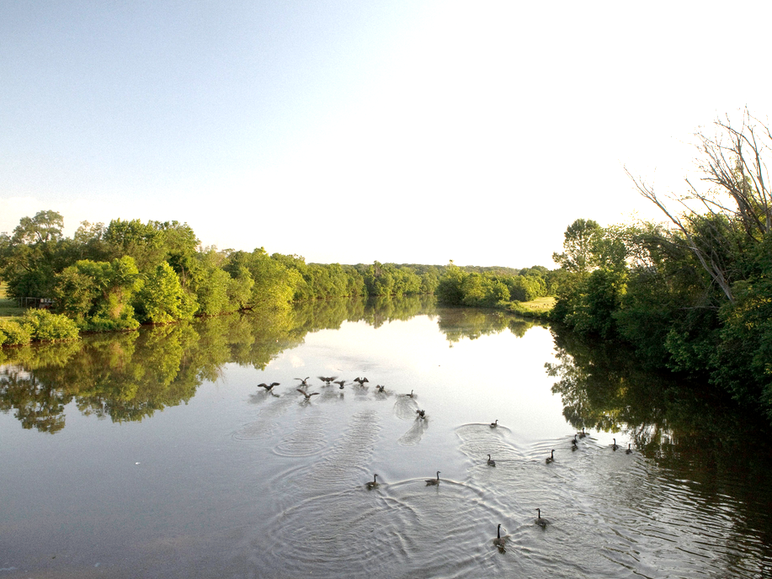
The District of Columbia has created a first-in-the-world Stormwater Retention Credit Trading program.
©Becky Harlan

Slide 11
The idea for the SRC program is…
Require development projects to install stormwater retention
but
Provide flexibility by allowing “offsite” retention through participation in a private market for stormwater retention

Slide 12
DC Stormwater Requirements
Development projects
over 5,000 sf
Renovation projects for which:
Cost exceeds 50% pre-project value
Combined footprint of structures & land disturb ≥ 5,000 sf.
Retain first
1.2” of rainfall
Retain first
0.8” of rainfall

Slide 13
Options to meet regulations
Install 100% of retention requirement onsite | Install at least 50% onsite & go offsite for the rest by:
 | A. | Purchasing Stormwater Retention Credits
 | B. | Building stormwater retention on another property
 | C. | Paying “in-Lieu Fee” $3.57 / gallon
OR
Notes:
These regulatory requirements form the foundation of Stormwater Retention Credit trading program.
Regulated projects have options to meet the new stormwater regulations. Firstly they must
In order to lower the overall cost to developers and building owners and maximize the ecological and social value of stormwater retention investments, the new DC regulations allow up to 50% of the retention requirement to be achieved “off-site” on another DC property, through participation in the new Stormwater Retention Credit (SRC) trading system, or, alternatively, by paying a per-gallon “in-lieu” fee (currently set at $3.57/gallon) to the government. Utilizing off-site retention is an ongoing obligation that can be met on a yearly or multi-year basis.
Off-Site Retention Vol. (OSRv) is ongoing obligation. ➢ Both SRCs & ILF achieve 1 gal. of OSRv for 1 year. ➢ Clock starts on 1-yr. lifespan when used for OSRv. ➢ SRCs can be banked indefinitely. ➢ Use of SRCs generally not limited by watershed. ➢ Maintenance failure at SRC-generating site does not invalidate SRCs purchased from that site.

Slide 14
What is a Stormwater Retention Credit
(SRC)?
1 SRC
1 gallon of retention for 1 year
from a voluntary stormwater project

Slide 15
The SRC trading program
has great potential
but there are
barriers to entering market

Slide 16
Additionally, the SRC market is not maximizing environmental benefit

Slide 17
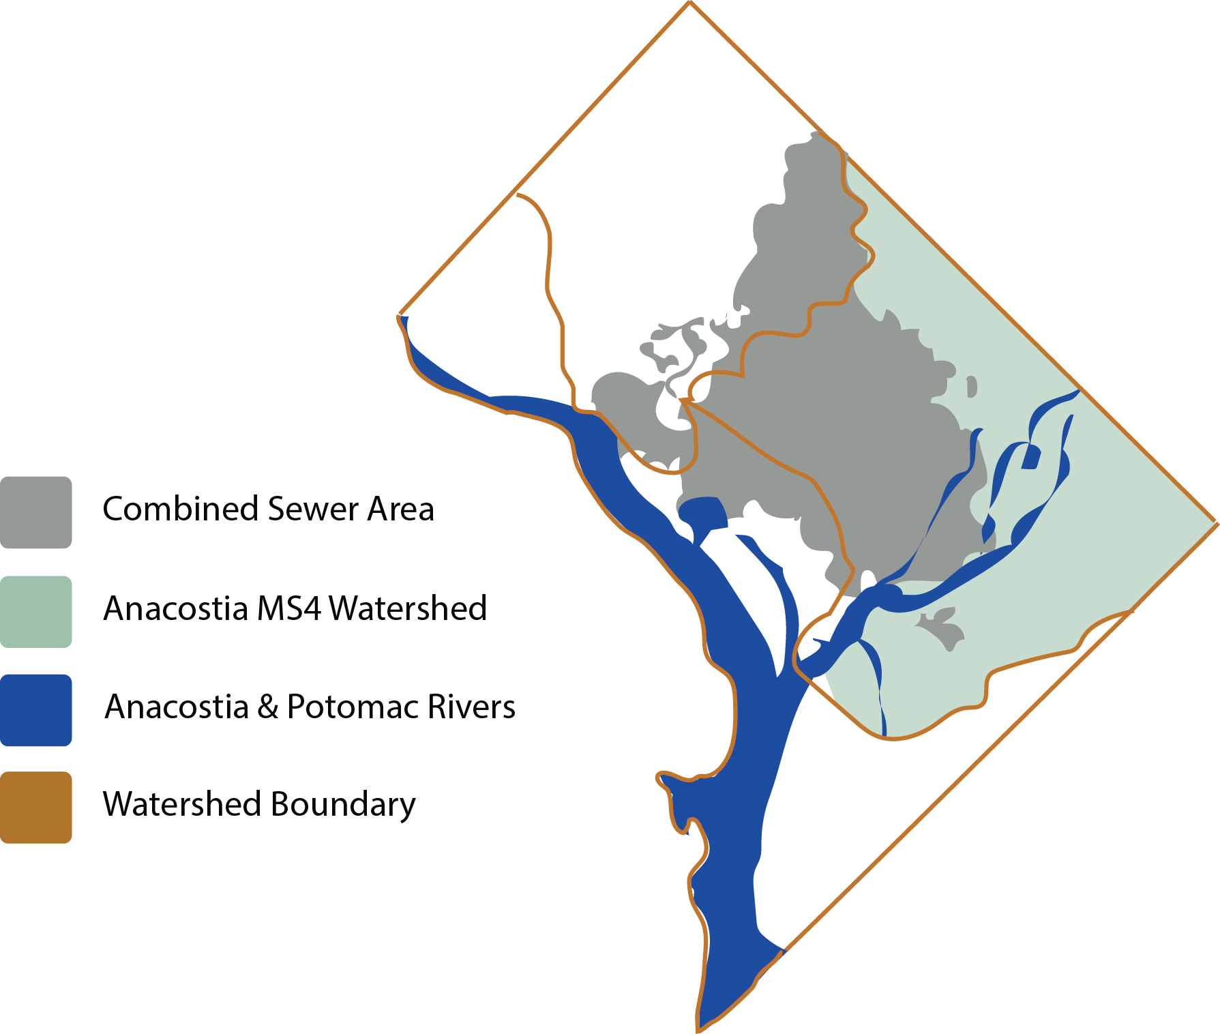
Not all stormwater is equal
Stormwater projects in the Anacostia Municipal Separate Storm Sewer System (MS4) have the greatest impact on improving water quality
Notes:
RainPay is a program to move DC’s regulatory obligation to capture stormwater to the places where it does the most good for the Anacostia

Slide 18
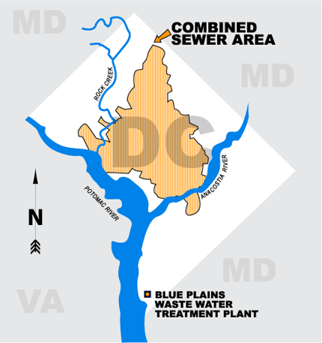
DC’s Combined Sewer and MS4

Slide 19
Degrees of Environmental Impact
Low pollution, high erosion (Rooftops draining to small streams) | High pollution, high erosion (Pavement draining to small streams)
Low pollution, low erosion (Rooftops draining to a river or CSS area until overflow occurs) | High pollution, low erosion (Pavement sheeting to a river, or CSS area until overflow occurs)
EROSION SCALE
POLLUTION SCALE

Slide 20
An intermediary such as RainPay can help
overcome barriers to participation
ensure environmental impact

Slide 21
RainPay Gardens
Partner with landowners
to produce credits where they
do the most good for the Anacostia
RainPay Credits
Pre-sell blocks of credits to
regulated entities at a
negotiated price

Slide 22
RAINPAY Gardens | Lease land in Anacostia Watershed | Design, permit & build green stormwater project | Certify project for stormwater credits | Maintain stormwater project
RAINPAY Credits | Determine # of credits, length of agreement and price | Sign contract for timely provision of credits | DC approves credits & Certificate of Occupancy | RainPay handles long-term stormwater obligation
Transfer credits

Slide 23
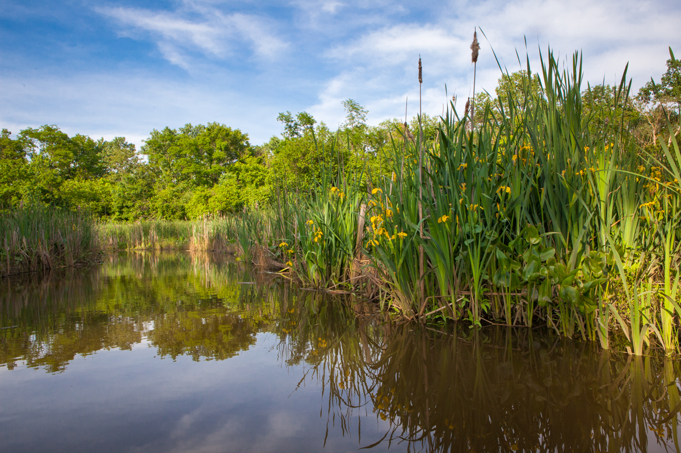
Anacostia Waterfront Trust
1156 15th Street NW Suite 600
Washington, DC 20005
Doug Siglin, Executive Director
(202) 223-4560
dsiglin@anacostiatrust.org
Chris Karakul
(202) 223-3222
ckarakul@federalcitycouncil.org
www.AnacostiaTrust.org
www.Rainpay.org

