Slide 1
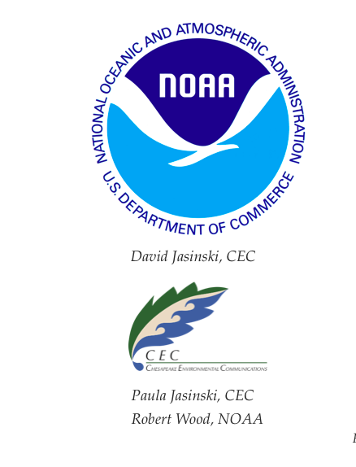
Chesapeake Bay Ecosystem Atlas

Slide 2
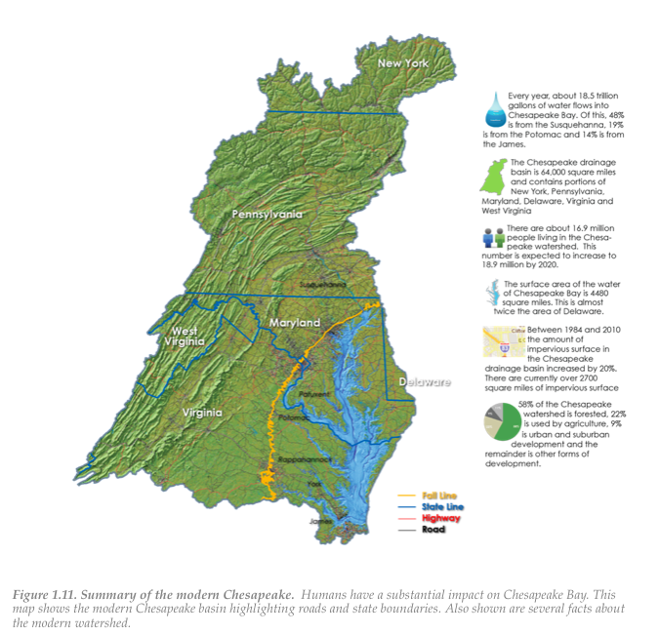
What is it?
A reference guide to the ecology of Chesapeake Bay developed with NOAA
Target audiences are middle & high school students, graduate students, managers, and engaged public
Chapters on Basin Basics, Flow and WQ, Plankton, Food Web, and Climate Change (in dev)
Teacher’s Edition includes curriculum guides

Slide 3


Why an eBook?
Immersive
Engaging
Web enabled
Paper is out – Electrons are in
Inexpensive to update

Slide 4
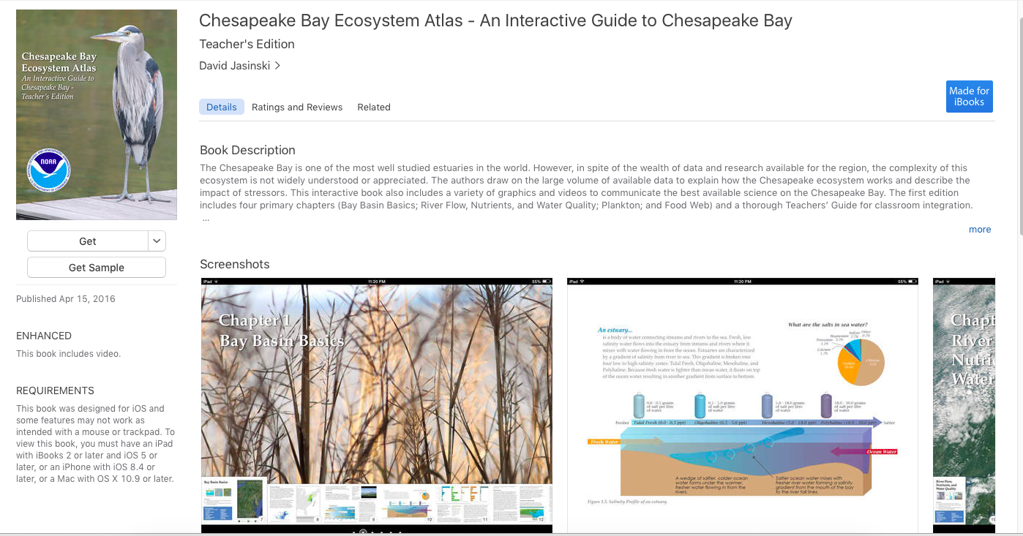
How do you get it?
Free download from iTunes bookstore for all Mac platforms
Other tablet versions expected

Slide 5
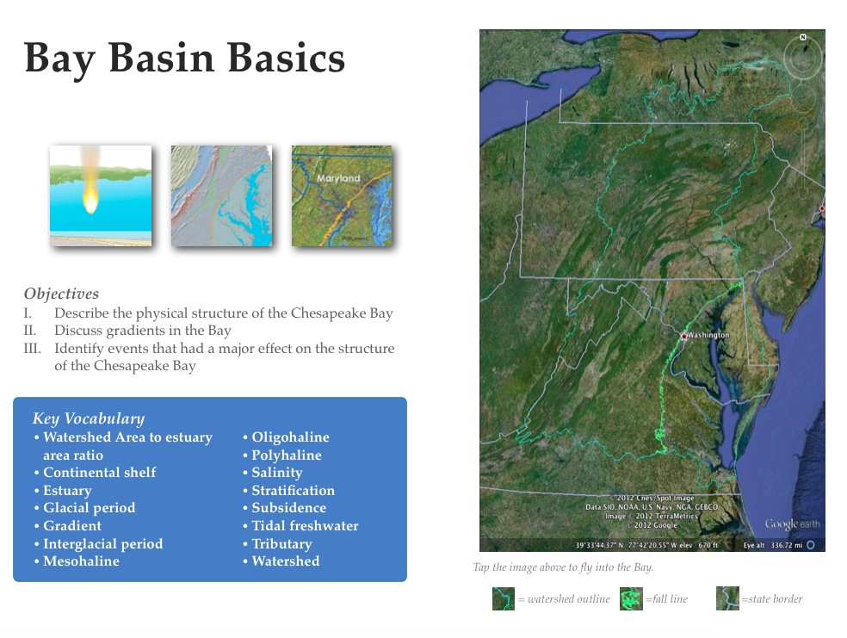
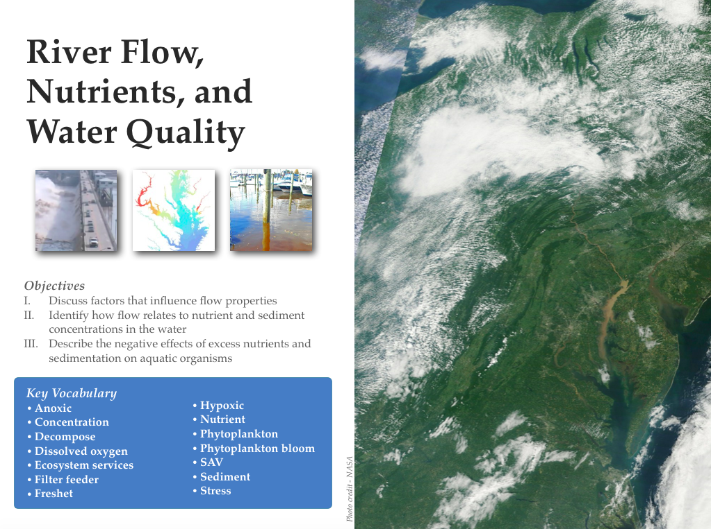
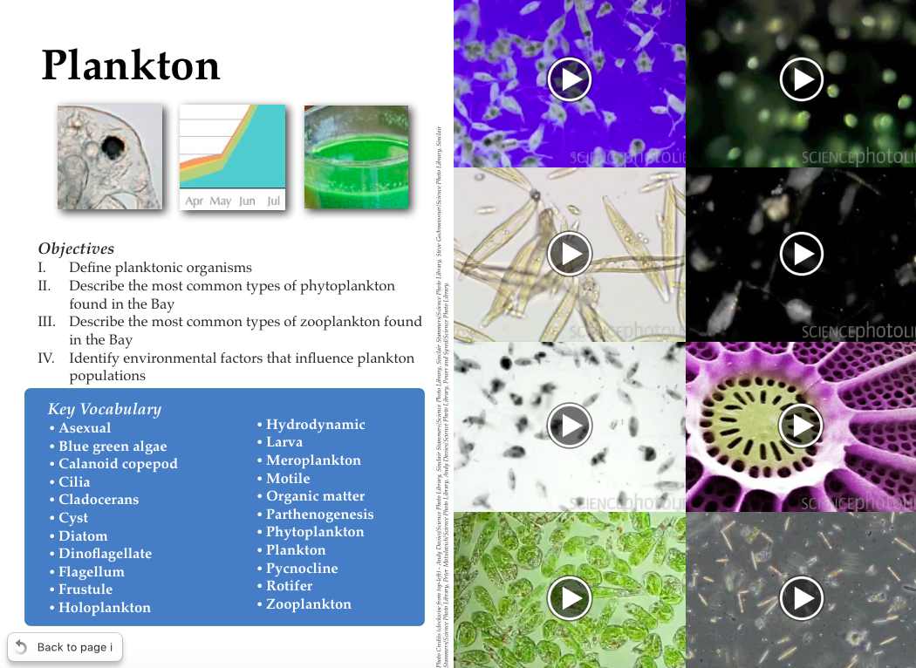
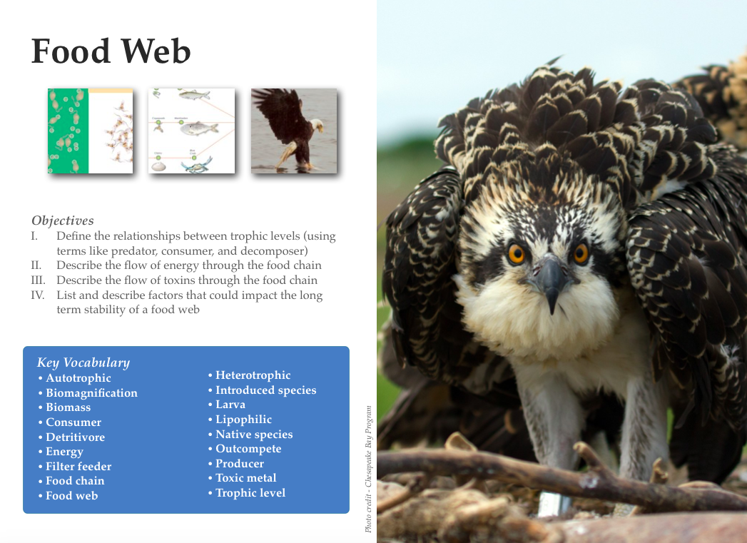

Slide 6
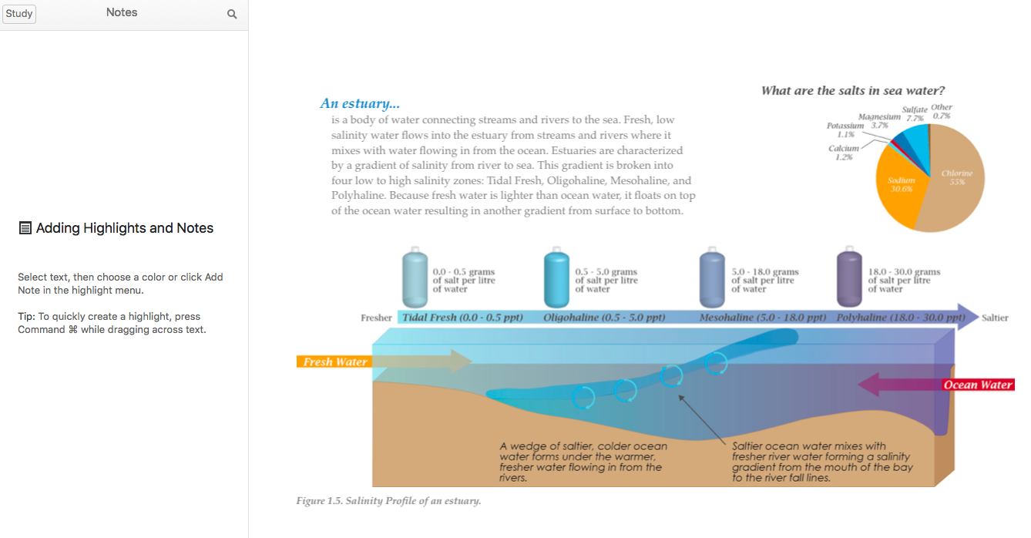
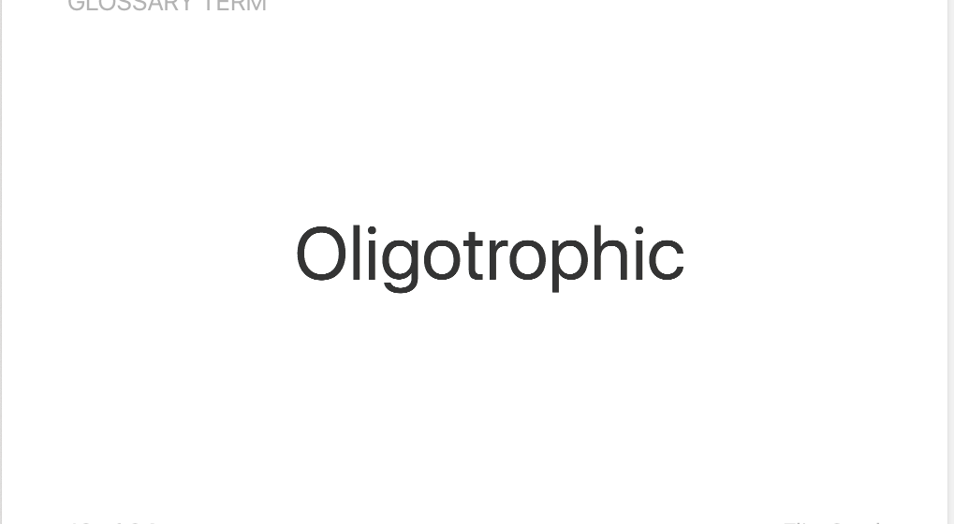
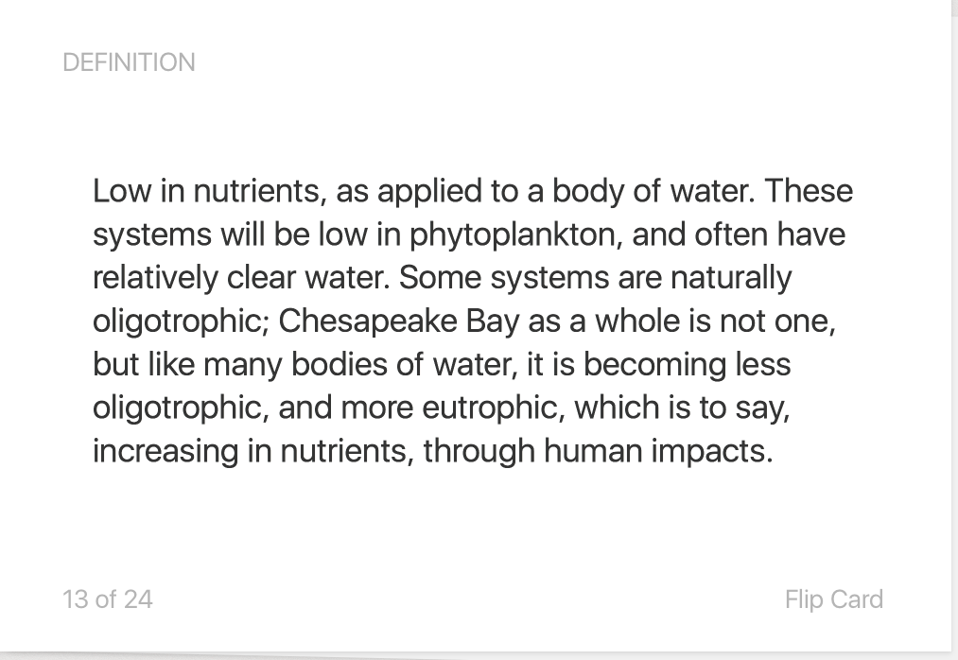
Study Guides
Oligotrophic

Slide 7
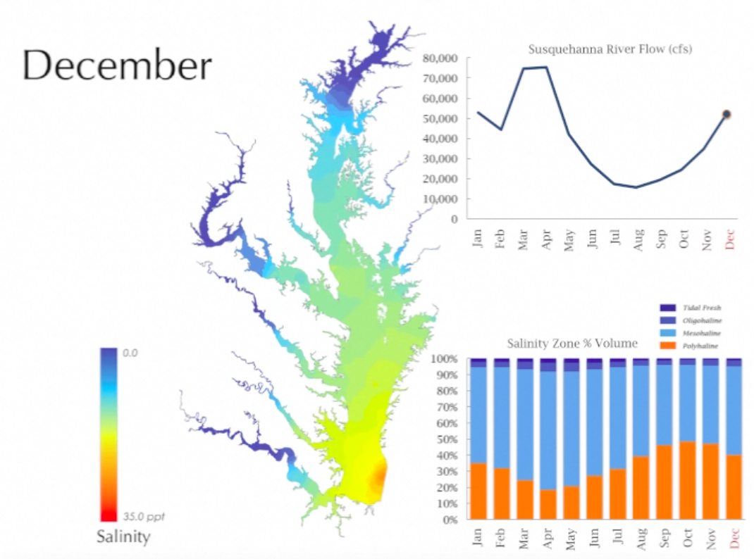

Slide 8
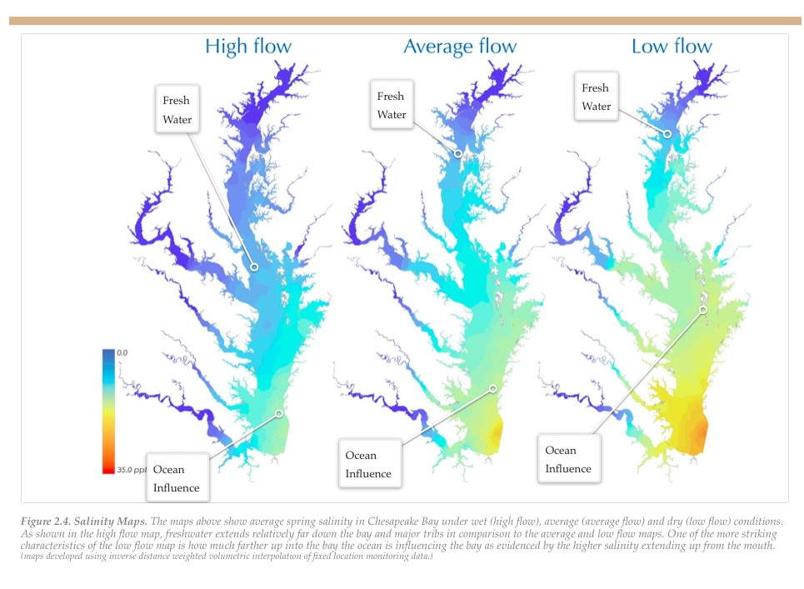

Slide 9
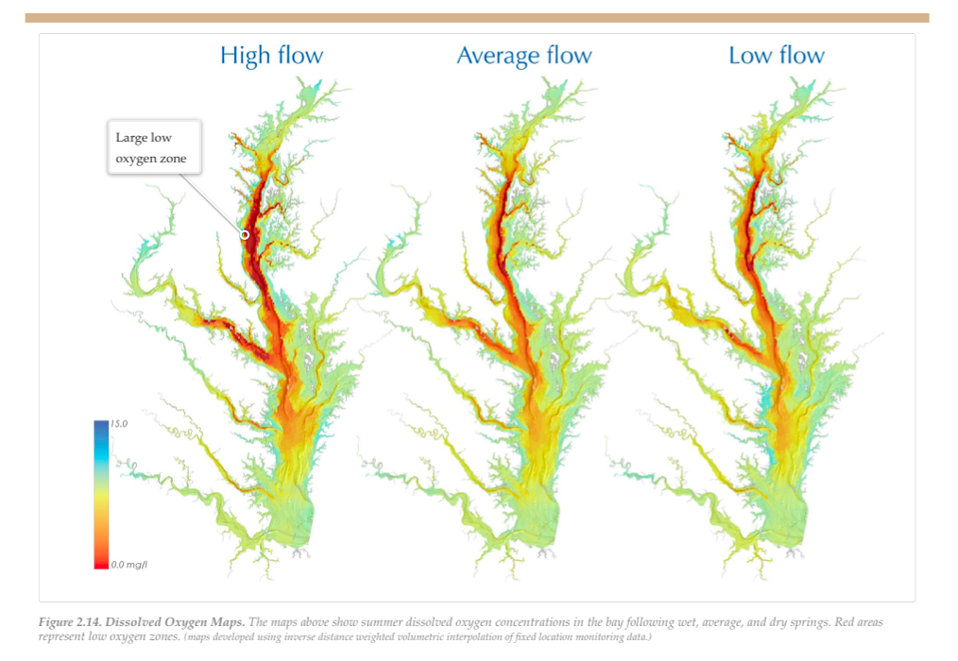

Slide 10
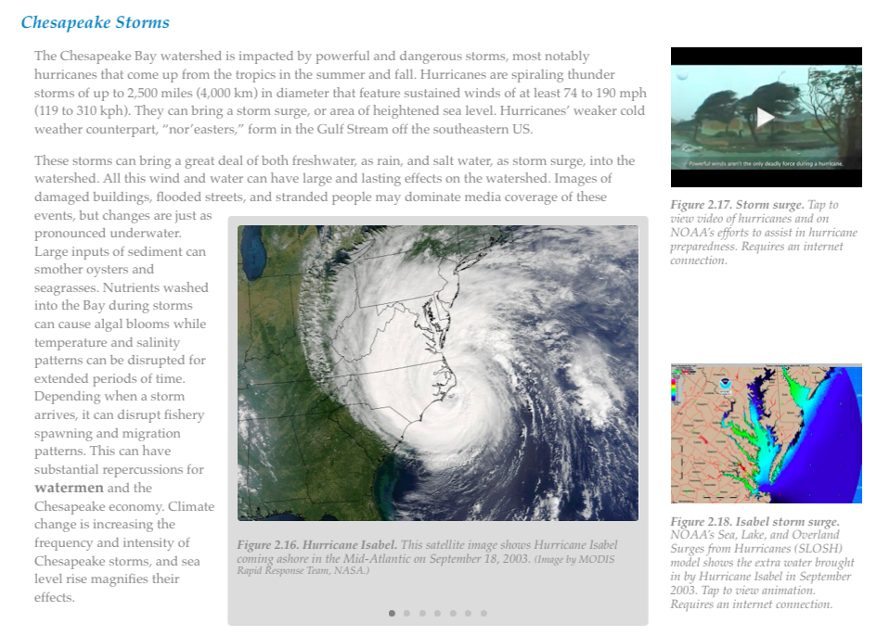

Slide 11
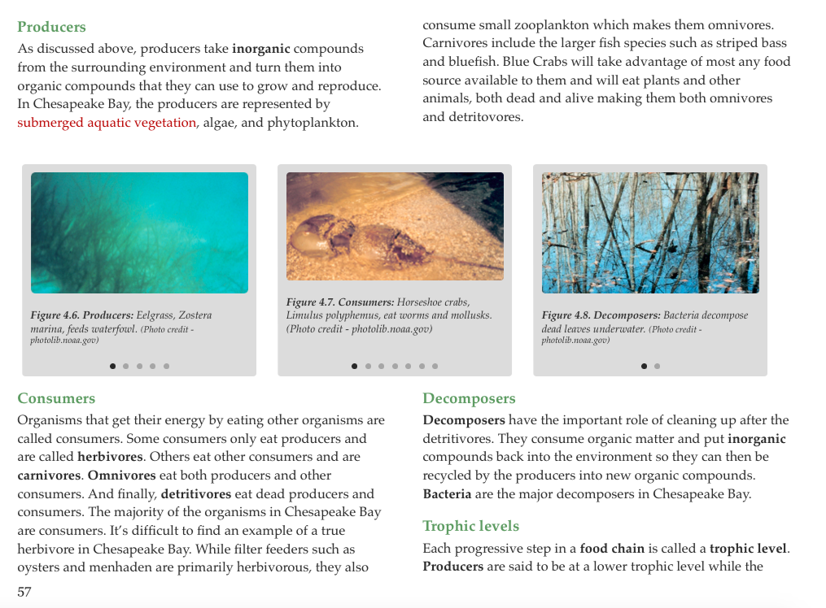

Slide 12
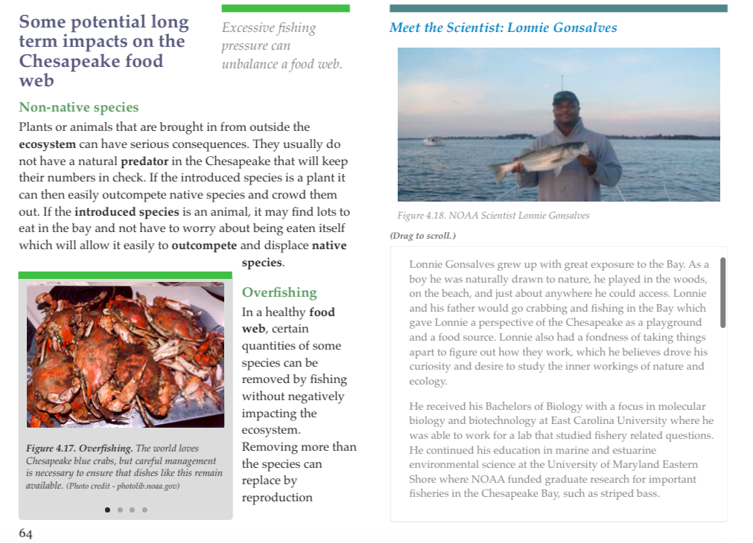

Slide 13
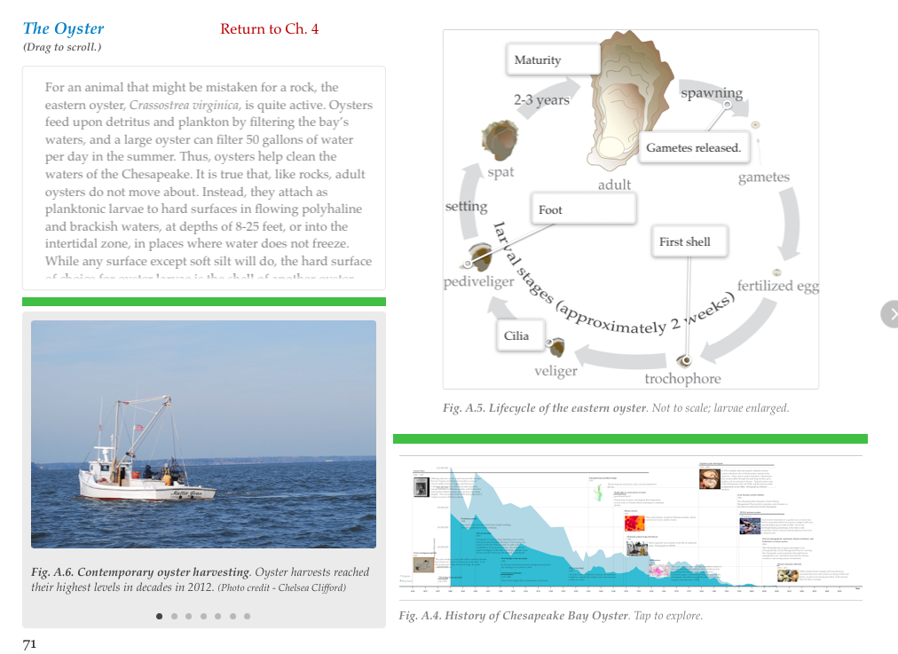

Slide 14
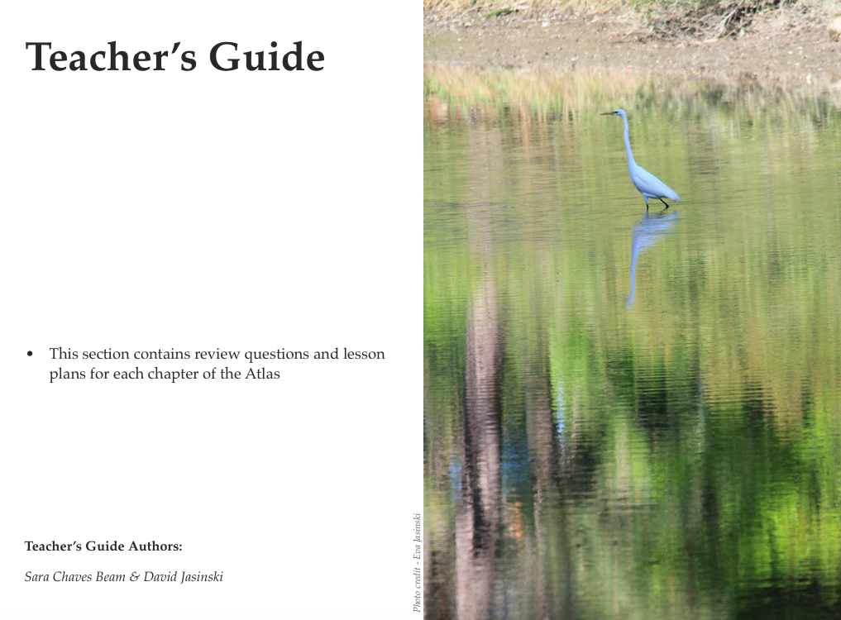

Slide 15
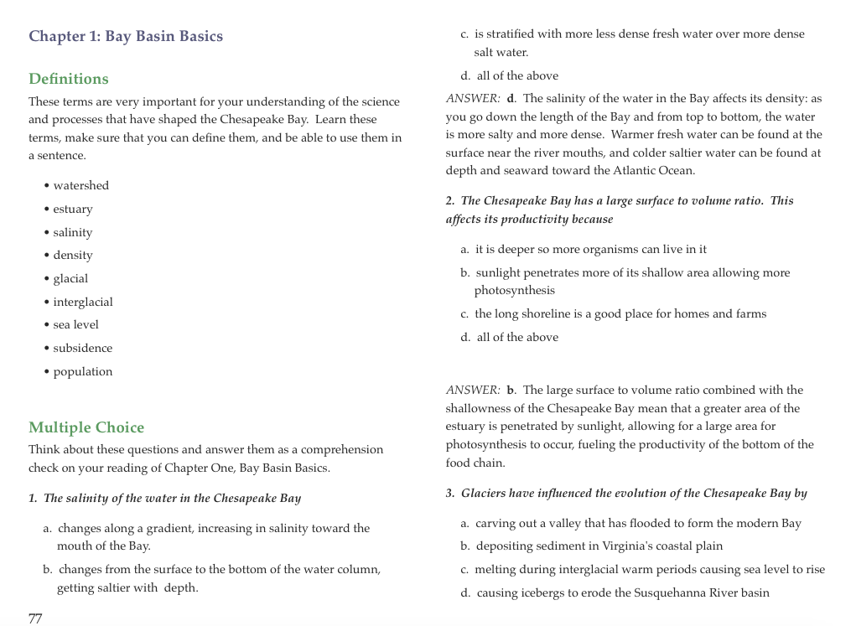

Slide 16
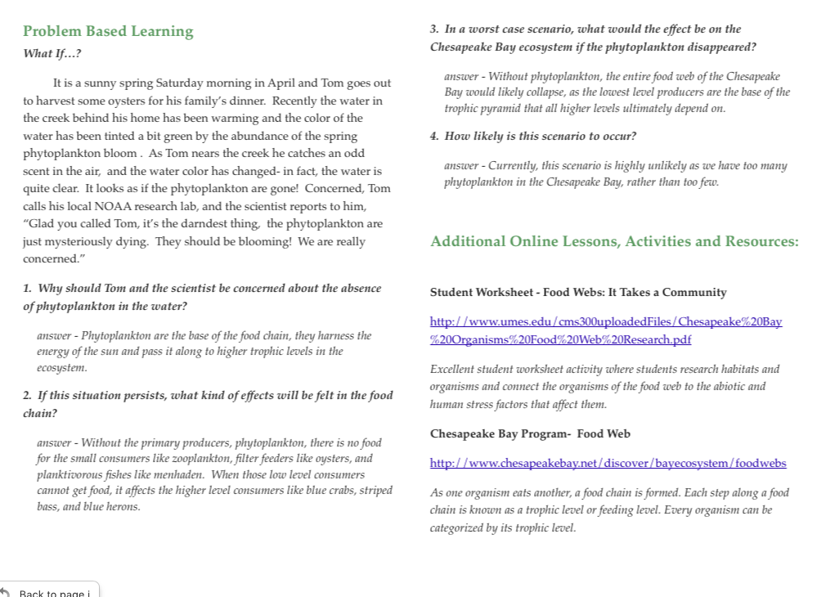

Slide 17
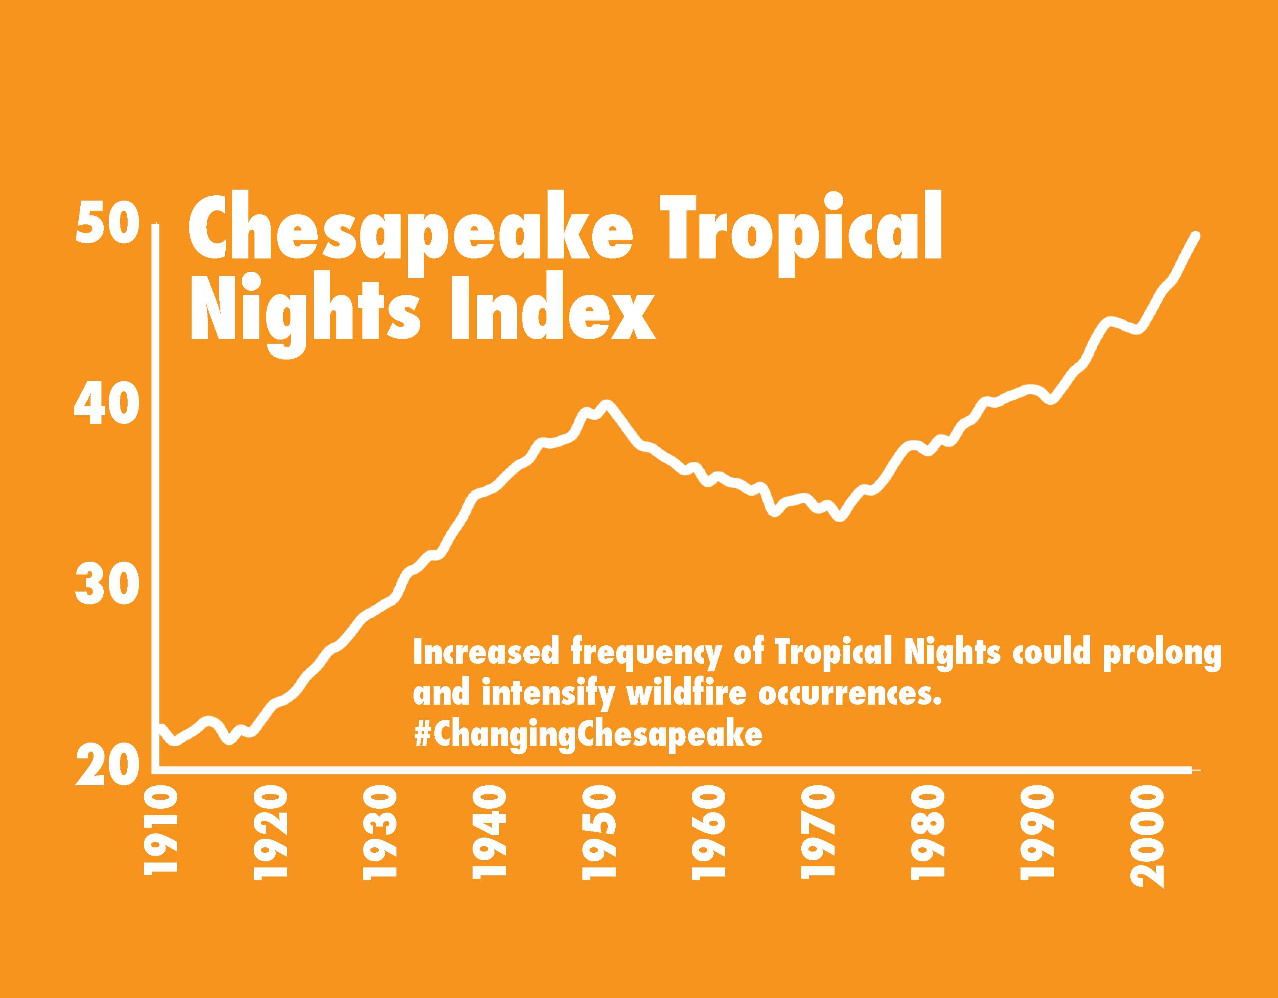
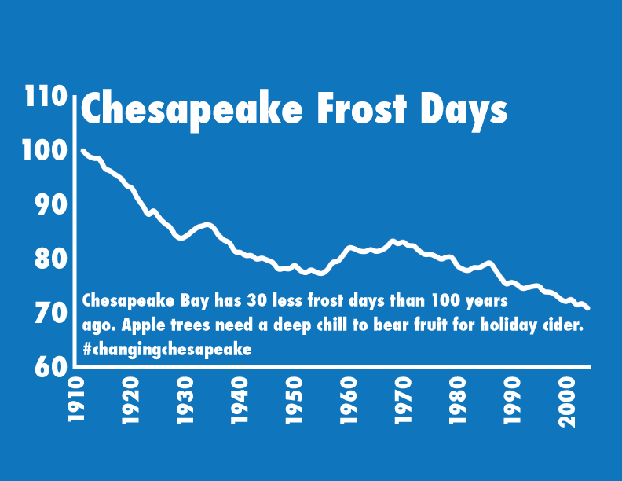
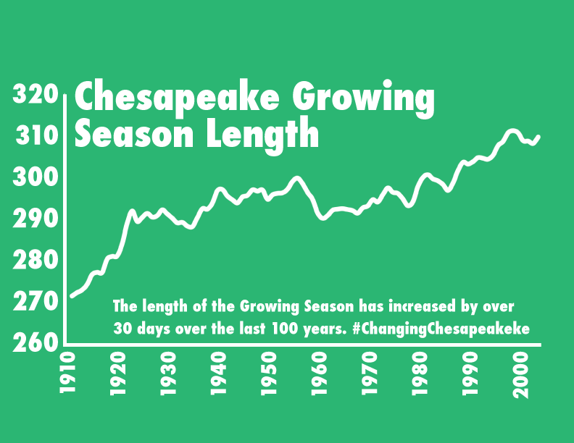
What’s Next
Finalizing climate change chapter
Creating cross-platform edition
Including live data links
Web portal

