Slide 1
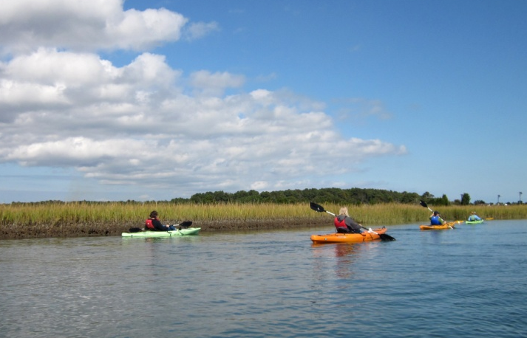

The Bay’s Health & Future: How it’s doing and What’s Next
The New Chesapeake Watershed Agreement:
Affirming Our Commitment &
Charting the Next Course
Nicholas DiPasquale, Director
Chesapeake Bay Program
Environmental Protection Agency

Slide 2
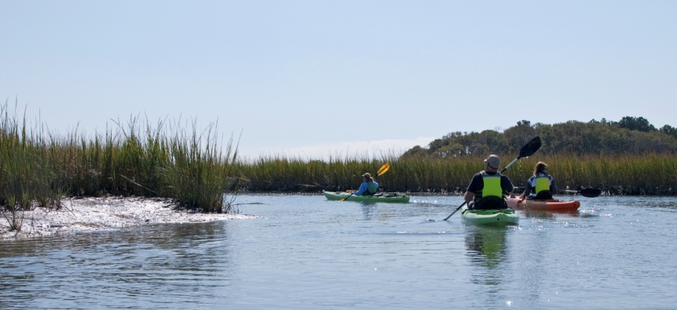
How did we get here?
2009 – Federal Executive Order was issued
2010 – CBP Agreement - Chesapeake 2000 (C2K) – Commitments largely met, expired or outdated.
2010 – FLC and CBP’s Top Leadership called for coordinating/integrating goals, outcomes, actions of the CBP with those in the EO Strategy
2011 - CBP EC and FLC-D agreed to a 3-year, 4 stage discussion and process
Stage 1: Use Goal Implementation Teams to Set Direction (2011)
Stage 2: Develop Negotiation Protocols (2012)
Stage 3: Negotiate New Agreement (2013)
Stage 4: Implement New Agreement (2013-2025)
Notes:
Top Leaders are:
Executive Council (EC)
Federal Leadership Committee
Stage 1: Goal Teams, which focus on specific Bay issues/areas such as Fisheries or Habitats, revisited and revised their goals for the future of CBP’s work
Stage 2: Established how we were going to go about getting to a new agreement
Since state reps were also hard at work on writing their WIP’s, we decided to hold off on this until the WIP process was complete
Stage 3: We are in it now. Goal for new agreement to be signed by EC at fall meeting 2013
Stage 4: Getting it done!

Slide 3
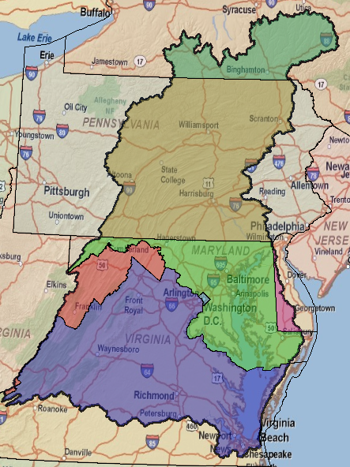
Why A New Partnership Agreement ?
The Next Generation Agreement:
Renews commitments & sets new goals
Provides opportunity for full participation by the headwater states
Updates science, governance and management techniques – ie: climate change, adaptive management
Improves coordination, integration & collaboration among the partners
Harmonizes the EO and TMDL with the Partnership agreement and governance structures
Notes:
1) Re-commmittment
Everyone’s participation is critical to achieving the shared goal of clean waters in the Bay and throughout the watershed.
And in every relationship – esp. one as complex as CBP – there’s value in taking time to re-examine how things are working and where you need to improve in order to move forward.
C2K Goals/outcomes largely expired – need a new guiding plan w/ solid goals
Chesapeake 2025 is our roadmap for the near future
Opportunity to change our way of doing business
2) Current agreement based on current science
CBP is a unique, regional partnership focusing on the continuous pursuit of the best scientific understanding of the Chesapeake Bay ecosystem.
Just as our science and circumstances (and ecosystems) change – CBP needs to adapt its goals and outcomes to better reflect what we know today.
3) Improved inclusion/collaboration
Chesapeake 2025 brings together federal agencies, Bay states & DC to work in a more integrated and collaborative fashion for benefit of Bay restoration
Better integration of EO, TMDL & CBP goals
Makes our efforts more transparent and accountable
A balanced, collaborative effort to get us to a balanced ecosystem that can support both natural resources and people’s quality of life

Slide 4
Framework being considered
ALL goals, outcomes and strategies derived from the CBP Goal Teams –
issue experts & stakeholders from across the jurisdictions / watershed.
CBP’s Executive Council (EC)
to “agree” on
overarching GOALS &
initial OUTCOMES for the partnership
(This is the content of the new Watershed agreement)
GOAL
OUTCOME
OUTCOME
CBP’s Principals’ Staff Committee (PSC) to track OUTCOMES ,
ensuring they are measureable & achievable; adapting as needed
OUTCOME
Mngmt
Strategy
Mngmt
Strategy
CBP’s Management Board (MB) to manage and track the STRATEGIES, adapting them as necessary over time for success
Mngmt
Strategy
Resource managers and decision makers will be guided by the strategies while retaining some flexibility to implement the practices that make the most sense for their region.
Notes:
New Watershed Agreement will include the overarching GOALS & initial OUTCOMES
Management strategies will be called for in the new watershed agreement – but not be drafted or finalized
There will be plenty of time for input on the development of these strategies

Slide 5
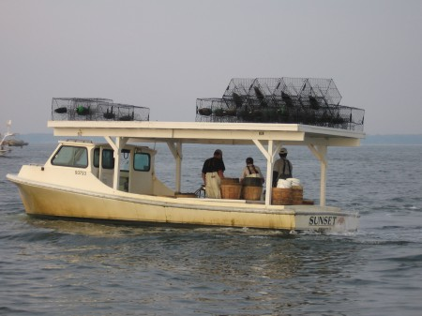
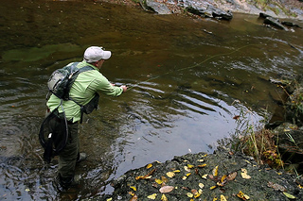
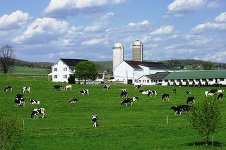
What will it do?
Simplify
  Clearer goals and more well defined outcomes than previous agreements
Be more flexible
  Use of adaptive management to adjust to changing conditions and circumstances
Improved transparency, tracking & accountability
  Partners set priorities & commit resources through management strategies
Notes:
Simplification
Goals are more clear (simpler) than those of C2K – therefore more understandable, measureable
Focus will be on higher priority goals and outcomes
Flexibility
Resource managers in each jurisdiction will be able to adapt their management strategies to better support their goals
This is not an “opt out” – it’s a sensible solution to the diverse ways that jurisdictions manage the equally diverse resources they have
Accountability
Annual reviews of partner management strategies and clear, simple goals on high priority issues will make it easier to track how efforts are going

Slide 6
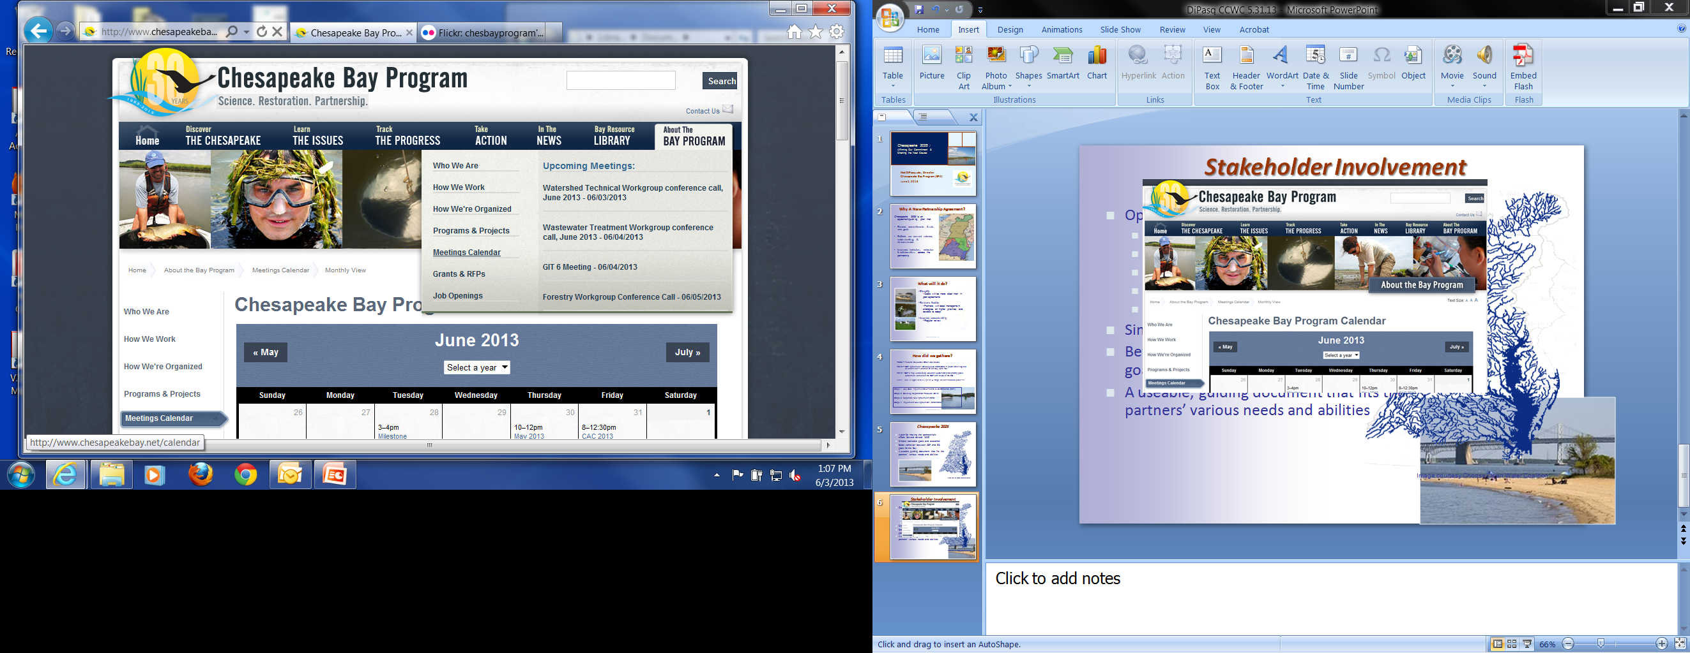
Stakeholder Involvement
CBP partner meetings are always OPEN
  Management Board – 6/13, 10am-noon
  Principals’ Staff Com - 6/27, 10am-3pm
  Management Board – 7/11, 10am-3pm**
  Management Board – 8/8, 10am-noon
  Principals’ Staff Com - TBD
  Management Board – 9/12, 10am-3pm
** 7/11 MB Mtg
Two hours set aside for stakeholder input

Slide 7
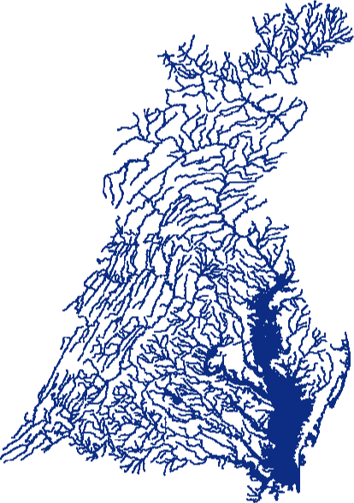
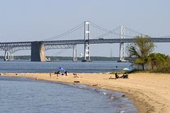
New Watershed Agreement in summary
A plan for moving the partnership’s collaborative efforts into the future
Simpler, trackable goals and outcomes
Updated science as a basis
Better cohesion between CBP and EO goals for the Bay
A useable, guiding document that fits the partners’ various needs and abilities
Image courtesy Choose Clean Water Coalition

