Slide 1
Chesapeake Bay Program Decision Framework Implementation

Slide 2
CBP reasons for implementing the decision framework
Adaptive management
Application of the logic necessary to enable adaptive management
Accountability
full documentation of CBP activities:
what
why
how
time-bound expectations

Slide 3
CBP Decision Framework
goals – clear articulation
factors affecting attainment
current efforts and gaps
strategies – detailed and justified
monitoring – outputs and outcomes
assessment – evaluate progress toward time-bound goals
manage adaptively – short-term or long-term adjustments

Slide 5
DF Implementation Outcomes
GIT/workgroup
significant effort to implement
operational clarity
transparency and accountability
CBP management
identifying coordination opportunities
clarifying decision points
Future program design
framing management issues and partner roles

Slide 6
GIT/Workgroup Benefits
goal articulation
clearer understanding of intent
transparency/accountability
factor analysis
practicality of goals
identification of “missed” factors
effort/gap analysis
coordination opportunities within CBP

Slide 7
GIT/Workgroup Benefits
strategy development
enhanced internal and external coordination
focused scope of activities
monitoring
improved design for performance assessment
coordination opportunities within CBP
performance assessment
changed posture for future evaluations
enhanced alternatives analysis
manage adaptively

Slide 8
CBP Management Benefits
consistent and comprehensive documentation of program activities
identification of coordination needs & opportunities across GITs
strategy links
monitoring coordination
clarification of CBP decision points

Slide 9
CBP decision points
GIT level
strategy development
strategy performance assessment and revision
Program management level
cross goal/strategy coordination
program resource allocation needs/priorities
DF implementation effectiveness
Program direction level
CBP scope and structure

Slide 10
DF Implementation Outcomes
GIT/workgroup
significant effort to implement
operational clarity
transparency and accountability
CBP management
identifying coordination opportunities
clarifying decision points
Future program design
framing management issues and partner roles

Slide 11
Framing Future Program Design
Review/synthesis of current goals
EC approved goals and commitments
presently there are 27 goals identified by GITs
Program structure
decision framework implementation is highlighting the essential distinctions between
GIT purview and abilities
partnership/program purview and abilities
individual partners or stakeholders interests and actions

Slide 12
Framing Future Program Design
Program evaluation
What assessments are needed to monitor and manage the program?
At what levels do assessments need to occur?
individual intervention assessments (outputs)
goal attainment evaluations (outcomes)
program performance (effectiveness)
Characteristics of any future agreement
Should the agreement be based on:
explicit environmental outcomes
partnership structure
governance/decision process

Slide 13
Cross Goal Team Collaboration

Slide 14
How do strategies and actions of one GIT influence or affect the actions and outcomes of another GIT?
Decision Framework provides a common nomenclature for inter-GIT communication and collaboration
In many cases geography is the common currency for inter-GIT communication and collaboration

Slide 15
GIT Decision Framework Coordination
Water Quality GIT
TMDL Goal
Decision Framework
Sustainable Fisheries GIT
Oyster Tributary
Restoration Framework
Protect and Restore
Habitats GIT
Decision Framework(s)
Articulate Program Goal
Articulate Program Goal
Articulate Program Goal
Factors Influencing Goal Attainment
Factors Influencing Goal Attainment
Factors Influencing Goal Attainment
Current Management Efforts
Current Management Efforts
Current Management Efforts
Develop Management Strategy
Develop Management Strategy
Develop Management Strategy
Develop
Monitoring Program
Develop
Monitoring Program
Develop
Monitoring Program
Assess Performance
Assess Performance
Assess Performance

Slide 16
GIT Decision Framework Coordination
Water Quality GIT
TMDL Goal
Decision Framework
Sustainable Fisheries GIT
Oyster Tributary
Restoration Framework
Protect and Restore
Habitats GIT
Decision Framework(s)
Articulate Program Goal
Articulate Program Goal
Articulate Program Goal
Factors Influencing Goal Attainment
Factors Influencing Goal Attainment
Factors Influencing Goal Attainment
Current Management Efforts
Current Management Efforts
Current Management Efforts
Water
Quality
Standards
Attainment
Healthy
Habitats
Protected or
Restored
Develop Management Strategy
Develop Management Strategy
Develop Management Strategy
Develop
Monitoring Program
Develop
Monitoring Program
Develop
Monitoring Program
Assess Performance
Assess Performance
Assess Performance

Slide 17
GIT Decision Framework Coordination
Water Quality GIT
TMDL Goal
Decision Framework
Sustainable Fisheries GIT
Oyster Tributary
Restoration Framework
Protect and Restore
Habitat GIT
Decision Framework(s)
Articulate Program Goal
Articulate Program Goal
Articulate Program Goal
Factors Influencing Goal Attainment
Coordination
of
Management
Strategies
Factors Influencing Goal Attainment
Factors Influencing Goal Attainment
Coordination
of
Management
Strategies
Current Management Efforts
Current Management Efforts
Current Management Efforts
Develop Management Strategy
Develop Management Strategy
Develop Management Strategy
Develop
Monitoring Program
Develop
Monitoring Program
Develop
Monitoring Program
Assess Performance
Assess Performance
Assess Performance

Slide 18
Next MB meeting: Demonstration of how the MB can use the framework to improve goal attainment by facilitating cross-goal coordination
Focus: Sustainable Fisheries; Oyster Tributary Restoration (or simply living resources)
Identify criteria for oyster restoration
Identify gaps in GIT 1 controls (water quality standard attainment, protected/restored habitat, land use, etc.
How can other GITs help achieve goals?

Slide 19
Oysters Goal: Restore native habitat and populations in 20 tributaries out of 35-40 candidate tributaries by 2025.
Tributaries selected for restoration - based on numerous criteria, including: amount of area suitable for restoration, historic data, depth of beds, bottom type, salinity, benthic habitat, etc.

Slide 20
The framework helps us look across GITs for factors affecting a particular goal, but how would/should we align our restoration and protection strategies to achieve multiple ecological benefits?
One approach is to begin with an assessment of various geographic priorities and strategies already in place and evaluate how well they complement each other (or not)
ChesapeakeStat will help guide and visualize the process

Slide 21
Types of Questions That Can Be Explored Geographically
What is the water quality like in a particular tributary of interest?
Are the trends in DO improving or getting worse?
Is the area of interest in a high nutrient loading segment?
What do the WIPs say about plans for nutrient reduction for the tributary targeted for oyster restoration?
Will the priority funding areas for pollution reduction activities benefit those areas targeted for oyster restoration?
Is the area vulnerable to population growth and are there lands targeted for protection?

Slide 22
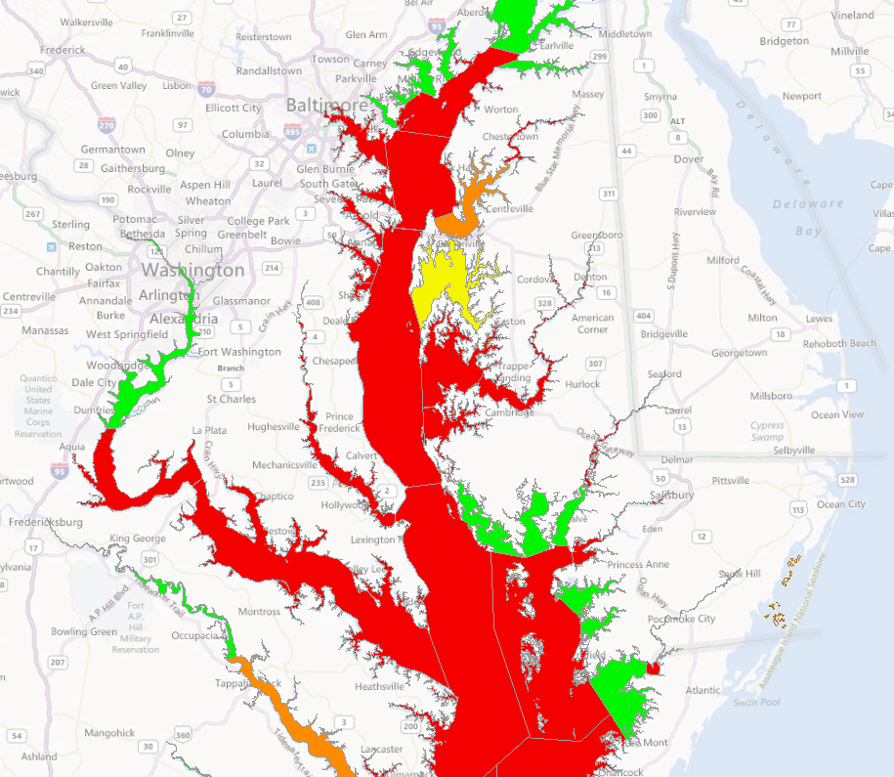
Criteria outside GIT 1 Purview
We know from the Decision Framework that one of the major obstacles or factors affecting Goal attainment, is poor water quality.
Segments meeting WQ standards that support living resources can help identify/narrow those tributaries with potential for restoration

Slide 23
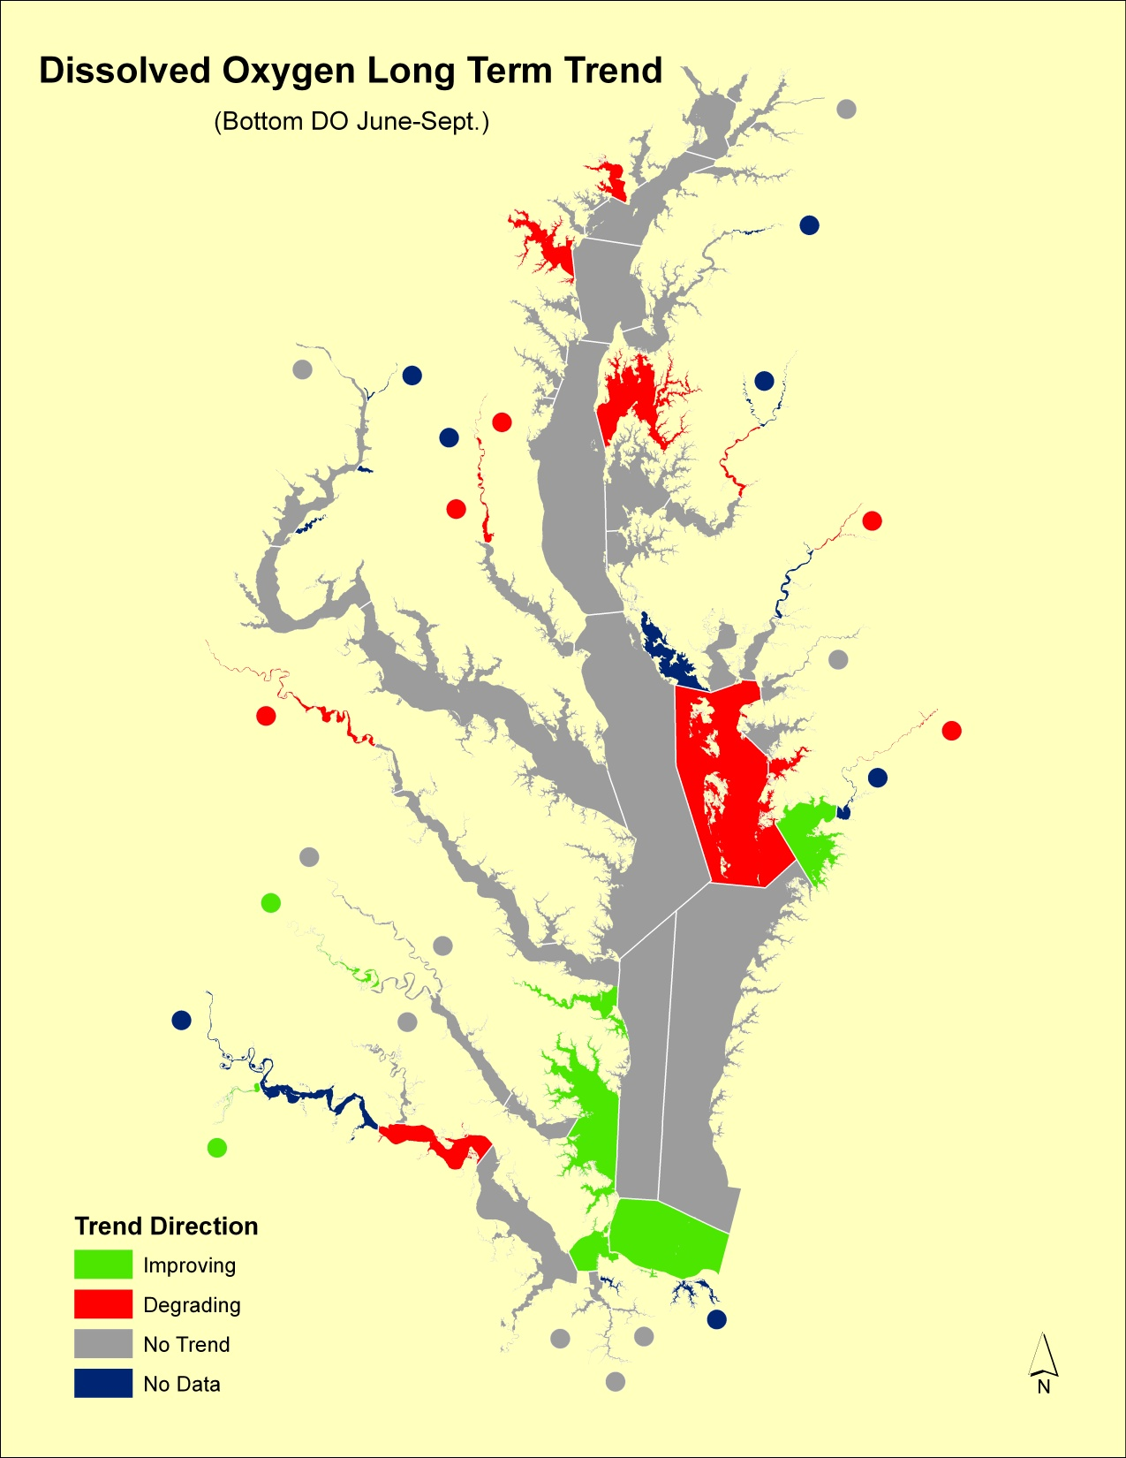
Long-term trends for DO is another factor we might want to consider when making multi-year restoration investments
In other words, are we selecting tributaries where water quality is getting better or worse?

Slide 24
So What?

Slide 25
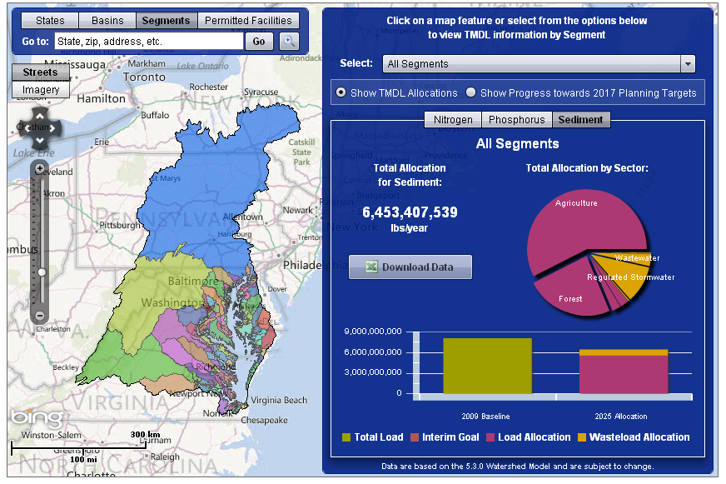
One place to start is the TMDL and the pollutant load allocations already in place; and their implications for various sectors and partner programs aimed at addressing the pollution diet
The Bay Tracking and Accounting System in ChesapeakeStat provides a graphic summary of the geographic implications of the TMDL

Slide 26
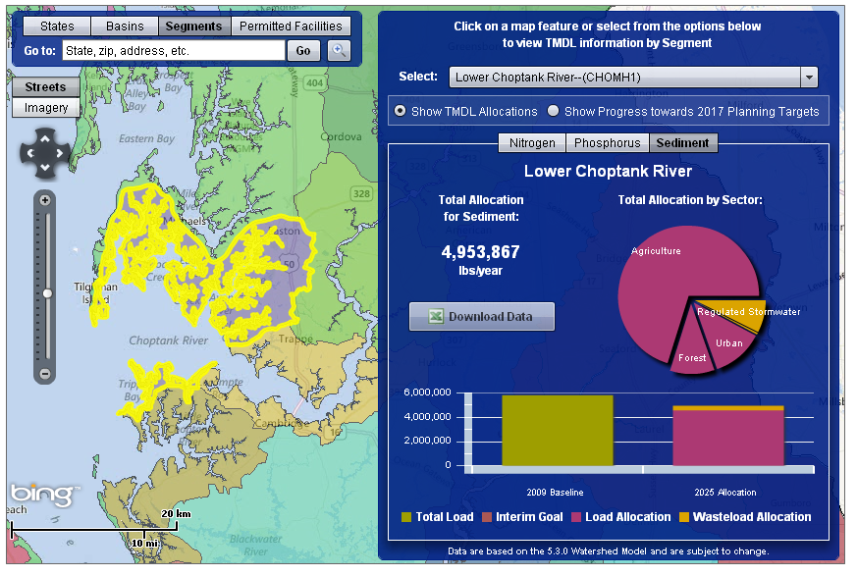
Focus on a candidate restoration area… Talbot County as example.
A quick look at the TMDL tracking tool in ChesapeakeStat shows that agriculture is the predominant source sector contributing to poor water quality in the Lower Choptank segment

Slide 27
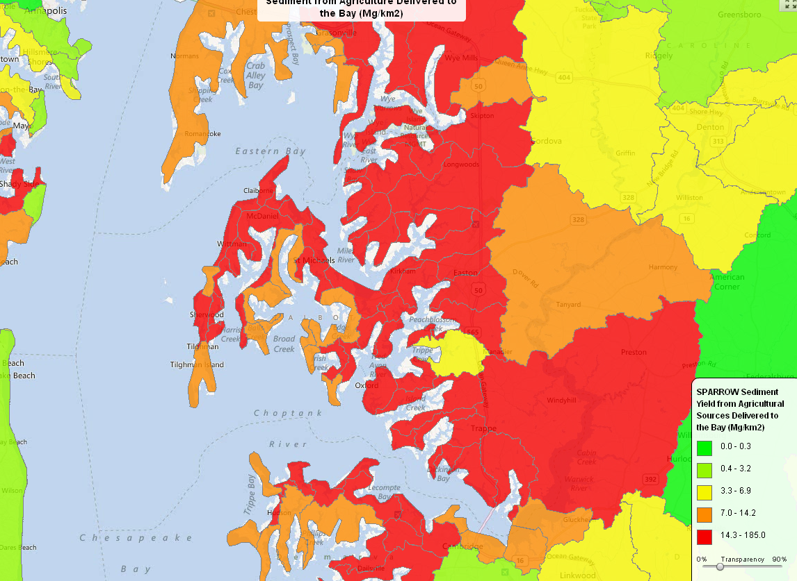
Diving into source sectors…
Other data sources help explain specific contributions to poor water
Example – USGS’ SPARROW models break out nutrient and sediment loads by source sector
This can help to point out particularly problematic or high loading areas (or more suitable areas).

Slide 28
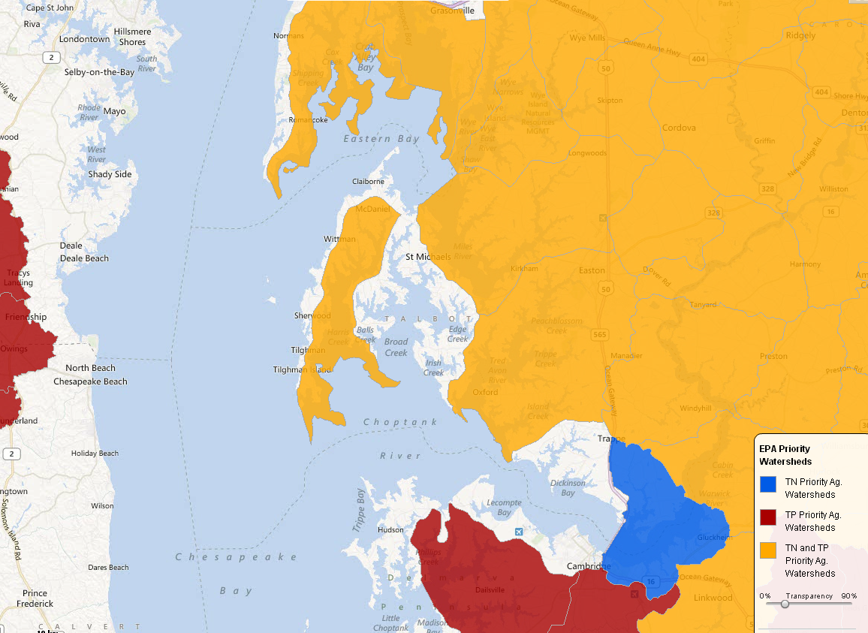
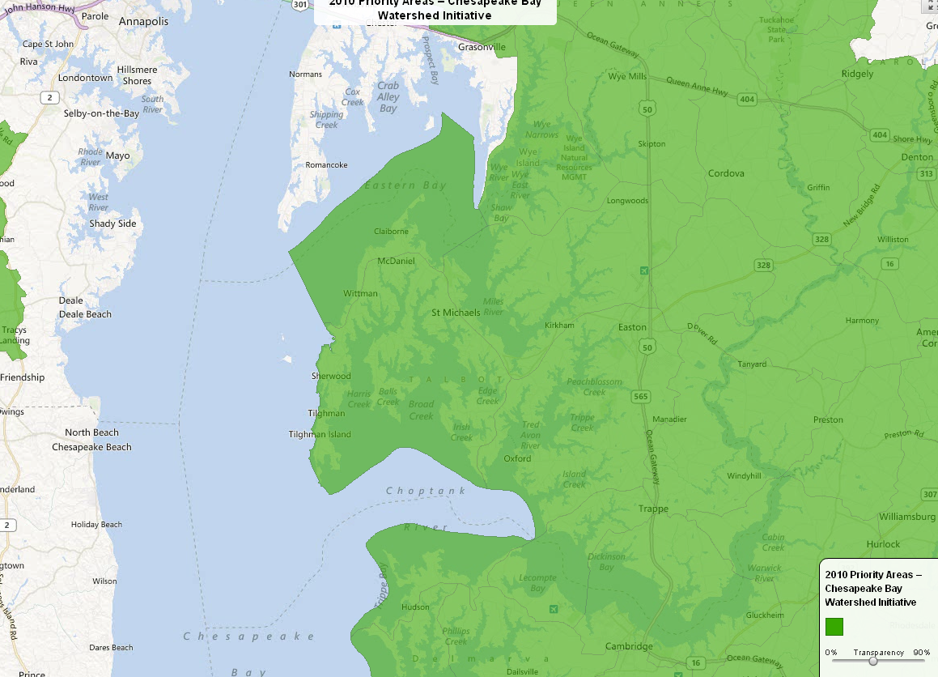
Priority Watersheds
Geographic priorities help compliment or contrast with potentially important tributaries for restoration
Can be used to inform:
implementation of agricultural BMPs (using the new SPARROW model)
various funding mechanisms
- NFWF grant prioritization
- NRCS established priorities in the CB Watershed Initiative for farm bill funding

Slide 29
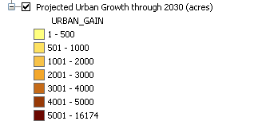
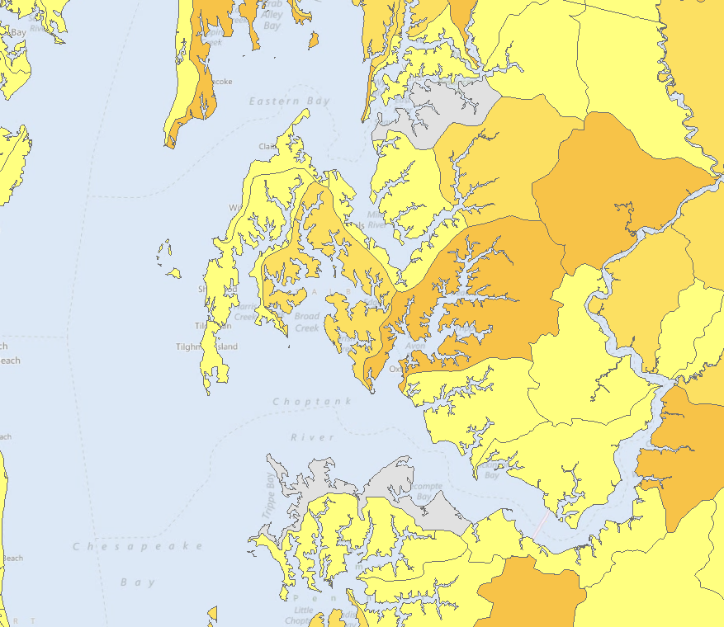
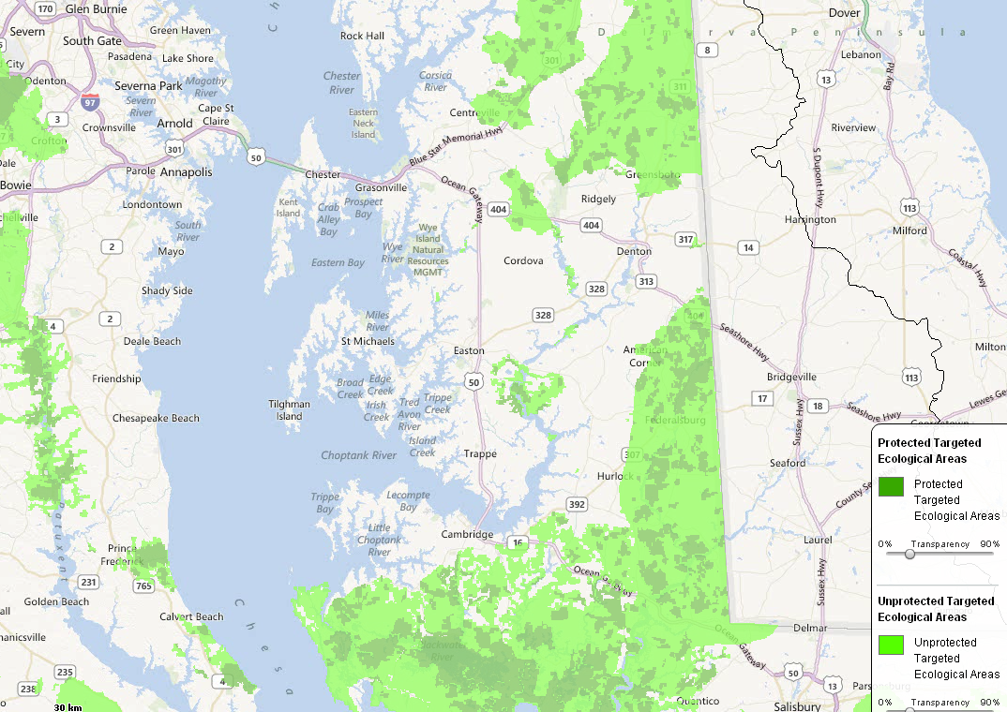
Land Use Changes
Visualize realities of the changing landscape
Population projections
Loss of forest and farmland
Urbanization
…and their effects:
N, P & S loads
viability of terrestrial and aquatic habitats
Maryland’s targeted terrestrial ecological areas and the degree of protection, GITs 1 and 2 may find tributaries that are priorities to multiple partners

Slide 30
These are examples of looking at the candidate tributaries through a regional lens to identify opportunities for collaboration and integrated planning across multiple GITs
When planning on a tributary by tributary basis, additional “project level” information could come into play, or local monitoring information.
Using these regional screens as a starting point, the Oyster team could bring other GITs into tributary specific planning for habitat restoration planning and management strategy development.

