Slide 1
Fisheries Goal Team (GIT 1)
Management Board presentation 9/2/2012
Peyton Robertson, Chair
Thomas O’Connell, Vice Chair
Bruce Vogt, Coordinator

Slide 2
Fisheries GIT Goals
What?
Overarching Goals
Improve interjurisdictional management of fisheries resources that move across political and administrative jurisdictions.
Improve the connection between science and management to ensure decision making leads to productive and sustainable fisheries.
Promote coalition building, information sharing, and appropriate coordination of management decisions that can feed into broader fisheries commissions and councils (e.g., Atlantic States Marine Fisheries Commission and the Mid Atlantic Fishery Management Council ).
Workgroup Goals
Blue Crabs: Maintain sustainable blue crab interim rebuilding target of 200 million adults (1+ years old) in 2011 and develop a new population target for 2012 through 2025.
Oysters: Restore native oyster habitat and populations in 20 tributaries out of 35 to 40 candidate tributaries by 2025.
Invasive Catfish: Reduce the spread of invasive catfish and mitigate their negative impacts on native species.

Slide 3
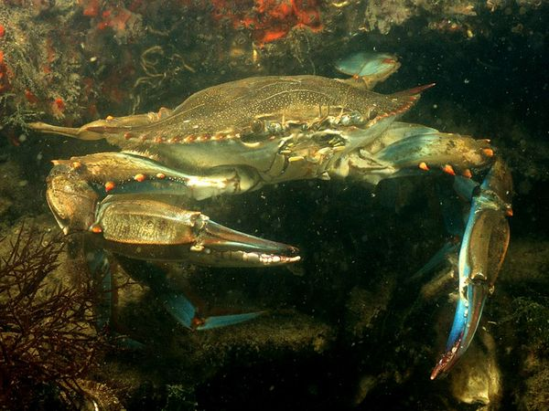
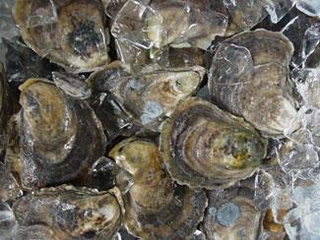
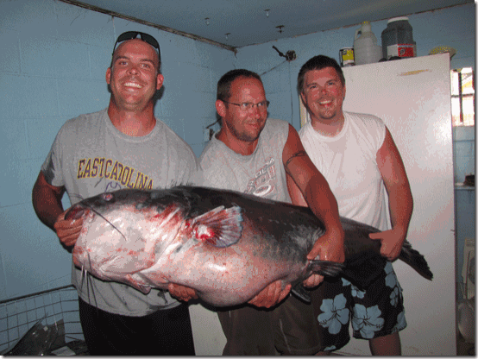
Fisheries GIT Goals
Why?
The Fisheries GIT believes these goals are of top priority in order to recover and sustain fisheries resources within the Chesapeake Bay.
Most goals originated from Executive Order 13508
Overarching Goals:
More timely science to lead decision making
Regular discussion on priority fishery issues raises awareness and improves cross-jurisdictional decisions
Blue Crabs:
Maintaining a sustainable population for commercial and recreational fisheries with ample supply for consumption and perpetuation of the stock
Oysters:
Shift to large scale, targeted (place based) restoration approaches
Habitat benefits for other fisheries
Invasive Catfish:
Invasive species have the potential to harm native species and disrupt ecosystem balance

Slide 4
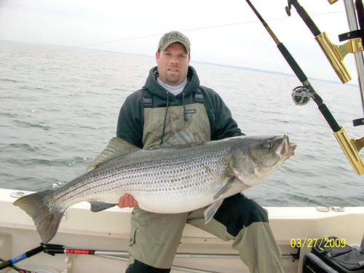
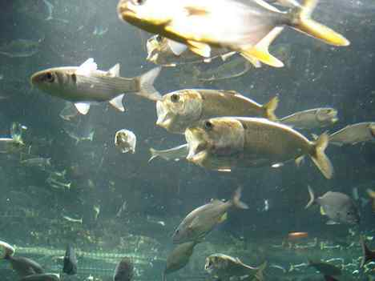
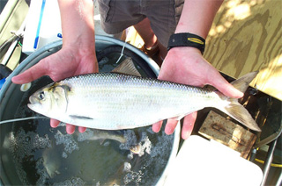
Fisheries GIT Goals
Who?
Who the GIT is working with:
Chesapeake Bay Stock Assessment Committee (scientists, academics, managers)
Oyster Metrics Team (scientists, academics, state, federal)
Oyster MD and VA Interjurisdictional Workgroups (state, federal, NGOs)
Invasive Catfish Taskforce (scientists, academics, state, federal)
Key Stakeholders:
Commercial and Recreational Fishermen
Jurisdictional Managers (MD DNR, VMRC, PRFC, DC DOE, ASMFC)
General Public (fisheries resources = the “people’s” resources)
Restoration & Conservation Interests
Through our membership and workgroups, these stakeholders are involved in the science and decision making processes of the Fisheries GIT.

Slide 5
Habitat Goal Team (GIT 2)
Management Board presentation 9/2/2012
Jeff Horan, Chair
Jennifer Greiner, Coordinator

Slide 6
Habitat GIT Goals
Restore a network of land and water habitats to support priority species and to afford other public benefits
Wetlands: Restore 30,000 and enhance 150,000 acres of tidal and non-tidal wetlands by 2025 (restore 4,000 and enhance 20,000 acres every 2 years)
Black Duck – wintering population of 100,000 birds by 2025 (“wetland habitat adequate to support”)
Fish passage: Open 1,000 additional steam miles for fish passage by 2025 (64 mi/yr)
American shad, river herring, eel – Monitor populations at 50% of new projects
Stream Health: Provide expert guidance on stream restoration techniques, funding, and priority restoration projects that benefit water quality and aquatic habitat
Brook Trout – Improve 58 sub-watersheds by 2025 (Work with STAR taskgroup to translate outcome to “catchments” and “patches” to better target restoration)
Submerged Aquatic Vegetation: Coverage of 185,000 acres for restored Bay
Meet water clarity criteria in areas and at depths designated for SAV use
Plant or seed 20 acres of SAV each year to enhance understanding of site selection, recruitment, and habitat suitability

Slide 7
Habitat GIT Rationale
These are important because…
Wetlands provide wintering habitat for waterfowl, nursery habitat for fish and shellfish, remove nutrients/sediment from overland flow, absorb flood waters, and buffer shoreline communities from tidal storm surge
Fish passage structures allow commercially and recreationally valuable fish to migrate to their historic spawning grounds, facilitating their recovery
Healthy streams provide habitat for recreationally important species such as brook trout, and have stable banks that are less likely to erode
SAV is nursery area for crabs and oysters and oxygenates the Bay’s water
Where is the goal derived?
Goal and top 3 outcomes derived from Strategy for Conserving and Restoring the Chesapeake Bay Watershed (Executive Order 13508)
SAV target is from SAV Strategy and based on historic acreage
Brook trout and black duck outcomes based on Joint Venture science

Slide 8
Habitat GIT Collaborators
Member Organizations:
Close Collaboration With:
STAC, STAR
Fisheries GIT
Watersheds GIT
Water Quality GIT
Comm Team
Pennsylvania FBC
Virginia DGIF
Maryland DNR and MDE
Delaware DNREC
West Virginia DNR
New York DEP
University of MD
Ducks Unlimited
Eastern Brook Trout Joint Venture
Atlantic Coast Joint Venture
Upper Susquehanna Coalition
Chesapeake Bay Trust
National Fish & Wildlife Foundation
FWS
USGS
NRCS
USACE
NOAA
EPA
USFS
NPS
Need involvement from:
Agricultural landowners
Local governments
District of Columbia

Slide 9
Water Quality Goal Team (GIT 3)
Management Board presentation 9/2/2012
Larry Merrill, Chair
Russ Baxter, Vice Chair
Katherine Antos, Coordinator

Slide 10
Water Quality GIT Goals
Have all practices in place by 2025 that are necessary to reduce nitrogen, phosphorus, and sediment to levels that will contribute to meeting water quality standards in the tidal waters of the Chesapeake Bay for DO, SAV/clarity, and chlorophyll-a.
Practices will be in place by 2017 that would achieve 60% of the necessary pollutant reductions compared to 2009.
Restoration of water quality is vital to achieving conditions that support living resources and protect human health.

Slide 11
WQGIT Goal Basis and Support
Multiple Chesapeake Bay Agreements, most recently Chesapeake 2000
In 2009, Executive Council called for practices in place by 2025
Similar goal in Executive Order 13508 and Bay TMDL
WQGIT Workgroup Support:
Source Sector Workgroups (Agriculture, Urban Stormwater, Wastewater, Forestry) – Analyze information and provide recommendations to support better understanding and accelerated implementation of practices to reduce nitrogen, phosphorus and sediment.
Additional WQGIT Workgroups – Provide information and recommendations on two-year milestone development, evaluation and communication; technical issues relating to BMPs; development and impacts of trading and offset programs; estimates and future projections of land use and land cover.

Slide 12
WQGIT Partner Engagement
Diverse partnership composed of:
• Federal, state, and local agencies
• River basin commissions and non-profit organizations
• Industry groups
• Academic institutions
• Other interested parties
• Over 25 agencies/organizations regularly participate
Collaborative pollution reduction efforts are imperative:
• Actions in one jurisdiction directly impact water quality in another.
• Water quality is vital to achieving conditions that support living resources and protect human health.

Slide 13
Healthy Watersheds Goal Team (GIT 4)
Management Board presentation 9/2/2012
Mark Bryer, Chair
Richard Hall, Vice Chair
Mike Fritz, Coordinator

Slide 14
Healthy Watersheds GIT
What?
Maintain Healthy Watersheds GIT
Maintain local watersheds at optimal health across a range of landscape contexts

Slide 15
Healthy Watersheds GIT
Why?
Importance
Restoration efforts can’t succeed without protection of what is currently healthy
Watershed health protection is significantly more cost-effective than restoration
Local watershed health is meaningful to local interests throughout the Bay watershed
Origins
E.O. 13508 Strategy: Stream Restoration Desired Outcome: 70 percent of sampled streams rate fair, good or excellent
Chesapeake 2000: “Preserve, protect and restore those habitats and natural areas that are vital to the survival and diversity of the living resources of the Bay and its rivers.”

Slide 16
Healthy Watersheds GIT
Who?
Who will my GIT work with to accomplish this goal?
State environment and natural resources staff
Conservation NGOs (TNC, CBF, AFT)
STAR, other GITs
EPA HQ Healthy Watershed Initiative
Who are the stakeholders?
The partner jurisdictions
Local governments and local watershed organizations
Which stakeholders/partners need to be involved to meet goal? Are they currently represented on the GIT?
See first list above, all of whom are represented on the GIT

Slide 17
Stewardship Goal Team (GIT 5)
Management Board presentation 9/2/2012
John Maounis, Chair
Kristin Saunders, Vice Chair
Amy Handen, Coordinator

Slide 18
Stewardship GIT
GOALS:
Conserve landscapes and increase access to the Bay and rivers to allow all to enjoy the natural and cultural resources of the watershed. Increase the number of citizen stewards who support and carryout local conservation and restoration.

Slide 19
Stewardship GIT
Conserve Landscapes: Conserve landscapes treasured by citizens to maintain water quality and habitat; sustain working forests, farms and maritime communities; and conserve lands of cultural, indigenous and community value.
Importance
Protecting these special places provides a suite of related benefits including ecological, cultural, historic, and recreation benefits.
Chesapeake’s most treasured landscapes add billions of dollars to the region’s economy
Many Chesapeake landscapes with great ecological, historical, and cultural importance are vulnerable to the effects of land development and climate change
Origin
E.O. 13508 Strategy: Conserve landscapes treasured by citizens to maintain water quality and habitat; sustain working forests, farms and maritime communities; and conserve lands of cultural, indigenous and community value.
Chesapeake 2000: Strengthen programs for land acquisition and preservation within each state that are supported by funding and target the most valued lands for protection. Permanently preserve from development 20 percent of the land area in the watershed by 2010.
Who
Partners: Federal and state environment and natural resources staff, conservation NGOs and Land Trusts
Stakeholders: Citizens, partner jurisdictions, Land Trusts and NGOs.
Additional partners needed: All partners needed are currently represented.

Slide 20
Stewardship GIT
Expand Public Access: Expand public access to the Bay and its tributaries through existing and new local, state and federal parks, refuges, reserves, trails and partner sites.
Importance
Currently, public access to the Bay and its rivers falls short of public demand.
Public access to the Bay and its tributaries enriches our communities. Outdoor recreation encourages physical health, human connectivity, and spiritual renewal. Time spent close to the land and water creates a sense of place that motivates more people to become personal stewards of our natural and cultural resources—and citizen advocacy is critical to the ultimate success of restoration efforts underway across the region.
Origins
E.O. 13508 Strategy: Expand public access to the Bay and its tributaries through existing and new local, state and federal parks, refuges, reserves, trails and partner sites.
Chesapeake 2000: Expand public access by 30%. Install 30 new gateway sites by 2003, and increase water trails by 500 miles by 2005.
Who
Partners: Federal and state environment and natural resources staff, conservation NGOs
Stakeholders: Citizens, recreation and sport organizations, partner jurisdictions and NGOs.
Additional partners needed: All partners needed are currently represented.

Slide 21
Stewardship GIT
Expand Chesapeake Conservation Corps: Expand Chesapeake Conservation Corps workforces.
Importance
Conservation Corps programs provide opportunities for diverse youth to work and volunteer in the outdoors, develop technical, life, leadership and employment skills, receive mentorship, and participate in recreational activities that promote physical, mental, and social well-being.
Youth in Chesapeake Conservation Corps programs complete conservation and restoration projects in priority watersheds, work on infrastructure and maintenance projects on public lands, participate in environmental, historical, and cultural education and interpretation programs, and much more.
Origin
E.O. 13508 Strategy: Expand Chesapeake conservation corps workforces.
Who
Partners: Conservation and youth-related NGOs, federal and state environment and natural resources staff
Stakeholders: Youth, mentors, natural resource and land management agencies, citizens, partner jurisdictions and NGOs.
Additional partners needed: All partners needed are currently represented.

Slide 22
Stewardship GIT
Ensure Environmentally Literate Students: Ensure that elementary and secondary students in the Mid-Atlantic Region graduate environmentally literate with the tools they need to make informed choices to protect and restore local environments and the Chesapeake Bay.
Importance
The health of our environment is dependent upon the actions of every citizen and will soon rest in the hands of our youngest citizens.
Environmental education is critical to developing the next generation of citizen stewards who possess the critical thinking skills needed to assess scientifically credible information related to the environment, the ability to communicate what they have learned in a meaningful way, and the ability to make informed and responsible decisions regarding the environment.
Origin
E.O. 13508 Strategy: Develop a Chesapeake Bay Elementary and Secondary Environmental Literacy Strategy that expands upon the meaningful watershed educational experience objective.
Chesapeake 2000: 5.1.4: Beginning with the class of 2005, provide a meaningful Bay or stream outdoor experience for every student in the watershed before graduation.
Who
Partners: Federal, regional, state, and/or local representation from natural resource agencies, departments of education, colleges/universities, and non-governmental organizations (including NAAEE affiliates)
Stakeholders: Youth, educators, education agencies, natural resource agencies, families, and NGOs.
Additional partners needed: PA Department of Education, WV Department of Education, WV Natural Resource Agency, WV College/University, DC College/University

Slide 23
Enhancing Partnering, Leadership, and Management Goal Team (GIT 6)
Management Board presentation 9/2/2012
Mike Foreman, Chair
Carin Bisland, Vice Chair
Greg Allen, Coordinator

Slide 24
Enhance Partnering, Leadership and Management
What?
Continuously improve governance and management to ensure Program effectiveness, efficiency, accountability and partner participation:
Effectively implement adaptive management across the program
Effective and efficient governance of the Program

Slide 25
Enhance Partnering, Leadership and Management
Why?
Assist the Management Board and its members with CBP coordination and operation needs
Essential function as determined by external evaluators: GAO and FLC (EO 13508 Strategy; Accountability)
Provide leadership on key issues: alignment, adaptive management, accountability and progress reports, cross-GIT colaboration, and governance based on fair and open processes

Slide 26
Enhance Partnering, Leadership and Management
Who?
Cross-program support role and function necessitates working with many stakeholders represented by the membership of MB and GITs
GIT representation currently made up of Jurisdictions, EPA, DoD, Advisory Committee Liaisons, and the Bay Commission
Close collaboration with STAR supports adaptive management through monitoring data collected

Slide 27
Scientific, Technical Assessment and Reporting (STAR) – Roles and Goals.
Management Board presentation 9/2/2012
Bill Dennison UMCES Chair
Mark Bennett USGS Vice Chair
Peter Tango USGS Coordinator

Slide 28
Scientific, Technical Assessment and Reporting - STAR Goals
What?
STAR provides coordination among the modeling, monitoring, indicator, and information management activities needed by the GITs
STAR works with CBP science partners to synthesize information for cross-cutting CBP products
STAR Facilitates science partnerships to develop increased capacity to serve the priority science needs of the GITs

Slide 29
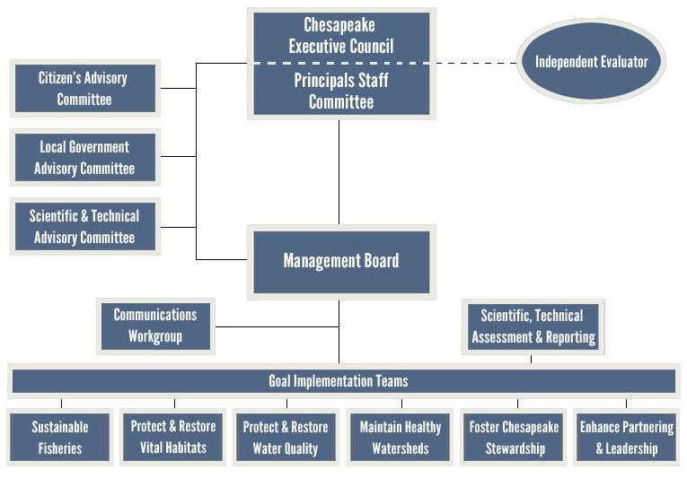
Scientific, Technical Assessment and Reporting - STAR Goals
Scientific, Technical Assessment and Reporting Workgroups and Task Groups
Analytical Methods and Quality Workgroup
Indicators Workgroup
Modeling Workgroup
Non-tidal Water Quality Workgroup
Tidal Monitoring and Analysis Workgroup
Toxic Contaminants Action Team

Slide 30
Scientific, Technical Assessment and Reporting - STAR Goals
Why?
Assist GITs in prioritizing the types and locations of management actions
Increase monitoring partnerships
Facilitate the explanation of factors affecting ecosystem change and the effect of management practices needed for assessment and adaptive management
Provided access, share, and coordination of key data and information
Communicating results of key findings (working with the CBP communications office)

Slide 31
Scientific, Technical Assessment and Reporting - STAR Goals
Who?
Act as liaison to federal/state/academia/Non-governmental organizations (NGOs) to identify opportunities to address science needs of the GITs.
Evolve the STAR workgroups to address major research needs
Increase interaction with Scientific and Technical Advisory Committee (STAC)

Slide 32
Thank you.
Questions?

