Slide 1
Social Science Action Team: Incorporating Social Science into the Chesapeake Bay Program Partnership
Chesapeake Bay Program Partnership
Management Board Meeting
May 9, 2012
Annapolis, MD

Slide 2
Main Discussion Points for Today
Overview of Purpose & Scope, including Mission Statement and Membership
Proposed Short- and Long-Term Actions
Approval to create Social Science Action Team

Slide 3
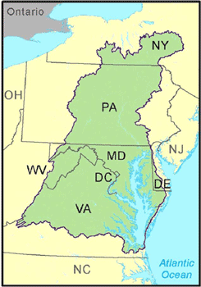
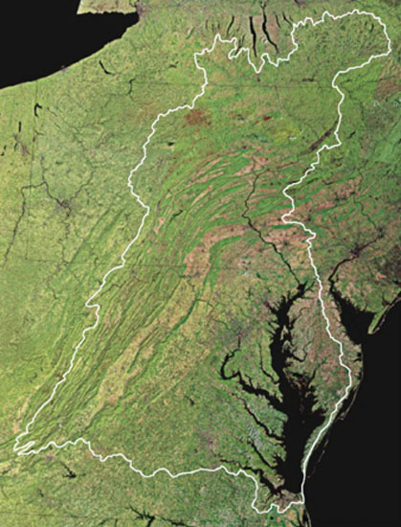
Purpose of Action Team
Increase awareness of the social science disciplines
Demonstrate value of social science to Bay Program Partnership
Build off previous social science analyses - there’s already a lot happening in the watershed!

Slide 4
Purpose of Action Team
Bridge the gap between natural and social sciences
Integrate social science methods and research into the Bay Program’s priorities and decision making framework

Slide 5
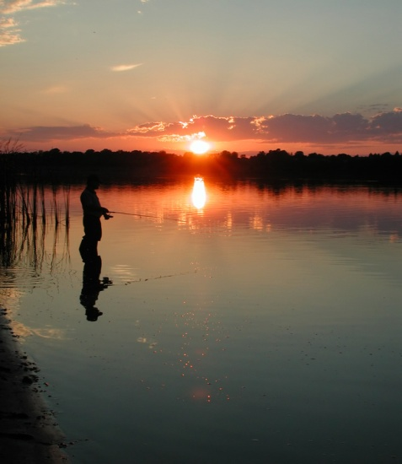


Proposed Mission Statement
To identify, evaluate, and develop opportunities for applying social science methods and research findings into the Chesapeake Bay Program Partnership.

Slide 6
Scope & Duration of Action Team
8-10 Social Scientists representing the:
Bay Jurisdictions
Chesapeake Bay Program Office
One year term
Utilizing an Adaptive Management Approach
Action Team to conduct self study throughout this period to identify key successes and areas for improvement
Based on self study, reevaluate key objectives and determine next steps at end of one-year period
Report back to Management Board on findings and recommendations for possible transition to more permanent inclusion in Bay Program structure

Slide 7
Across the Watershed: Research Needs*
Behavior-change research
What drives decision-making; enhancing community engagement; understand local values and knowledge
Economic research
Cost-benefits and cost-effectiveness estimates
Research on the cultural landscape
Measuring (conflicting) expectations; social dynamics influencing community values
Research to address communication barriers
Develop indicators to measure “success”; multiple definitions of “success”
Research to understand institutional change
Dynamics of political environment and its impact on community

Slide 8
Constraints to Integrating Social Science*
Lack of access to tools and research
Lack of self-promotion and knowledge of how to use social science tools and access experts
Institutional constraints
Current thinking too traditional; first programs to be cut
Barriers of scale
How to allow for bottom-up community involvement in restoration
Communication
Competing language by managers and social scientists

Slide 9
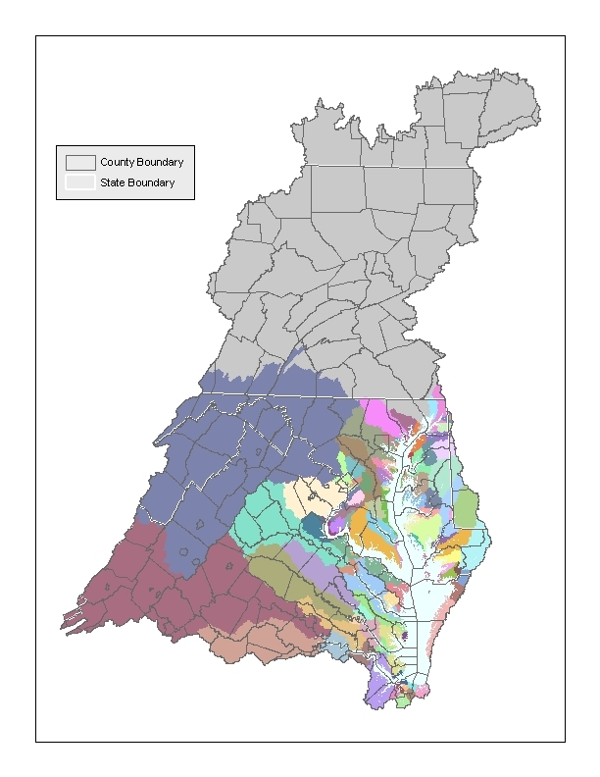
Proposed Actions
Develop Workplan
Articulate priorities, actions, desired outcomes
Identify overarching social science themes
Assess social science needs in GITs
Opportunities that benefit from tech assistance, and link with social science expertise

Slide 10
Proposed Actions
Identify high profile case studies that demonstrate value of social science
Particularly, applied research in Chesapeake Bay that could assist with water quality improvements, habitat restoration, fisheries management, etc.
Facilitate social science speaker series
Connects research with Bay Program priorities
Explore opportunities to access/acquire additional funding for implementing social science recommendations

Slide 11
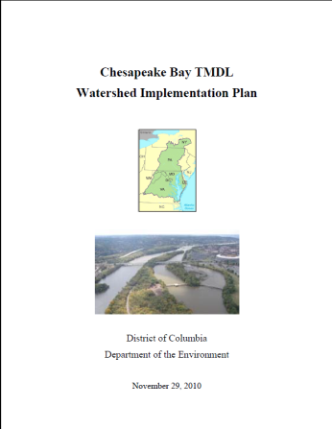
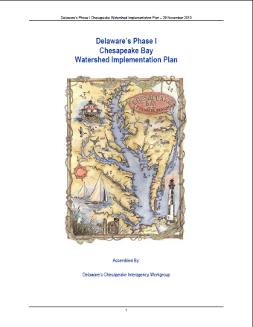
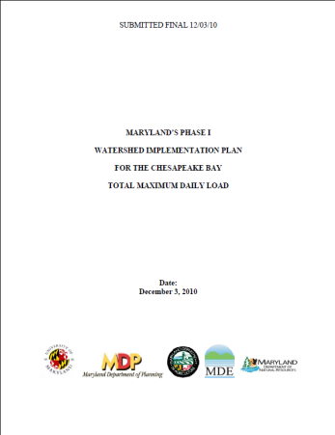
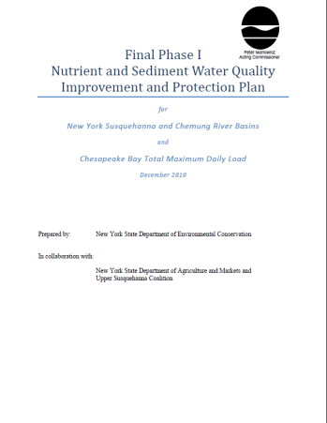
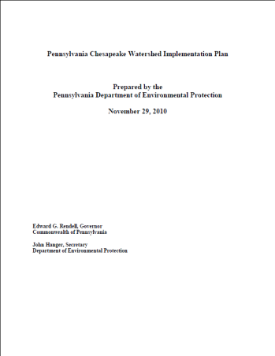
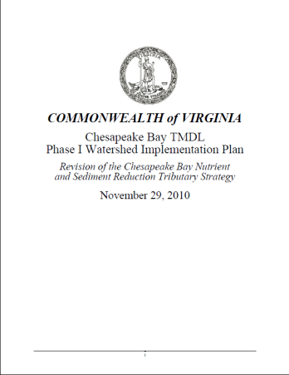
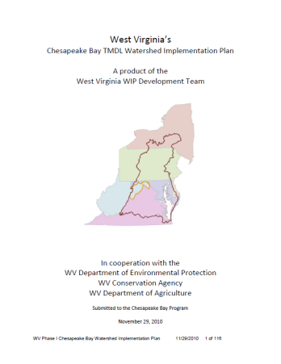
Longer Term Actions (Post-Year One)
Synthesize existing and ongoing social science research and how it could be applied to Bay Program
Effectively utilizing social science methods and principles
Initiate social science research effort in priority watersheds
Develop social science online resource directory

Slide 12
Thank you!
Questions?
Lucinda Power
410-267-5722; power.lucinda@epa.gov
Dr. Michael Paolisso
301-405-1433; mpaoliss@umd.edu

