Slide 1

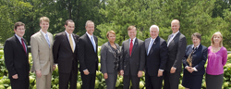
2012 Chesapeake Executive Council “Step By Step, Stream by Stream: Restoring our Waters
Management Board update 6/13/12 Margaret Enloe, CBP Communications
EC Planning Team Chair

Slide 2
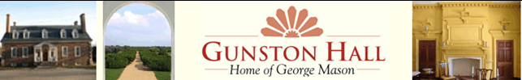
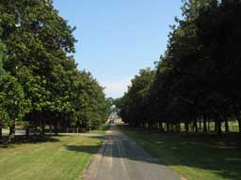
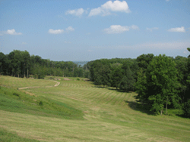
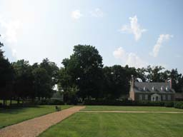
Logistics
Location & Date
Gunston Hall Plantation
Lorton, VA
Monday, July 9
http://www.gunstonhall.org/visit/index.html
Notes:
Sites Visited
VA - River Farm/Nat’l Horticultural Society
VA – Gunston Hall & Plantation
VA – Hollin Hall (& Unitarian Fellowship)
VA – Geo. Washington Masonic Memorial
DC - Aquatic Resources Education Center
Others not visited:
DC – City-Wide Conf Center (not available)
DC - Reagan Int’l Trade Center (too $$)
VA – Mt Vernon (backup, have done EC there 2ce)

Slide 3
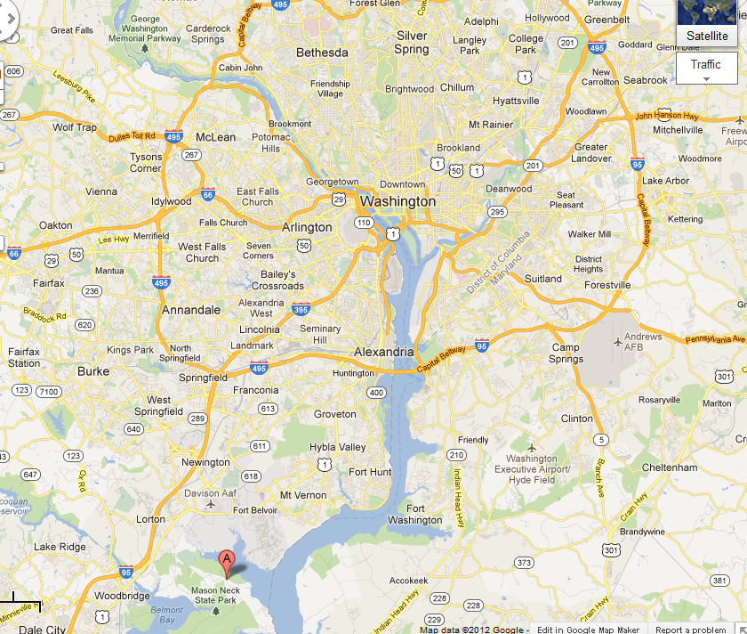
Gunston Hall

Slide 4
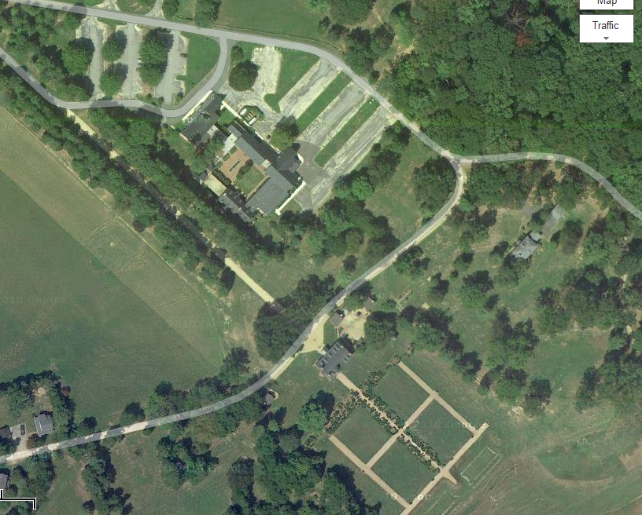
Parking
Visitors Center
Ann Mason Room
Historic Mansion

Slide 5
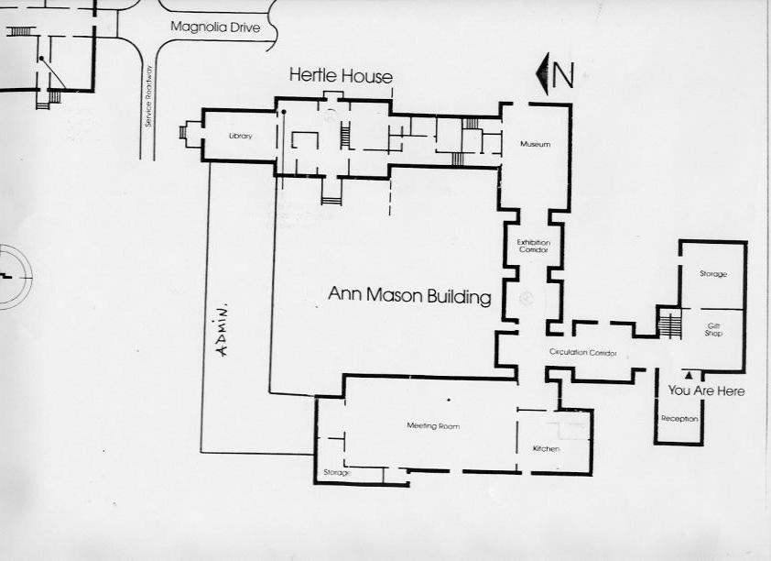
Floorplan
Tree
Gunston Hall (manor house)
Pvt Lunch
COURTYARD
Visitor Center Entrance
Morning Session Anne Mason Room

Slide 6
Executive Council Meeting
EC Members or Reps. Attending
EPA Lisa Jackson, Administrator, EPA / EC Chair
CBC Emmet W. Hanger, Jr., Senator
MD Martin O’Malley, Governor
DC Vincent Gray, Mayor
PA Michael Krancer, Secretary, DEP
VA Doug Domenech, Secretary, Natural Res.
DE Collin O’Mara, DNREC
WV Teresa Koon, DEP
NY Jim Tierney, DEC (expected)
USDA Kathleen Merrigan, USDA, Deputy Secretary

Slide 7

Gunston Hall & Plantation
Historic venue & grounds
On Potomac River (tho’ it’s distant)
Large meeting room w/ podium, a/v and ample seating
Pvt lunch space w/ access to private courtyard (if needed)
Reasonable price
Good parking
Several good photo opp locations
Eager to host us

Slide 8
Agenda – At-A-Glance
EC 2012
10:15-30 EC Members arrive
10:30-12:35 Morning Session – PUBLIC
12:35-2:00 Lunch - PRIVATE
(Concurrent for others: lunch, historic activities on site)
2:15 – 3:15 Press Conference

Slide 9
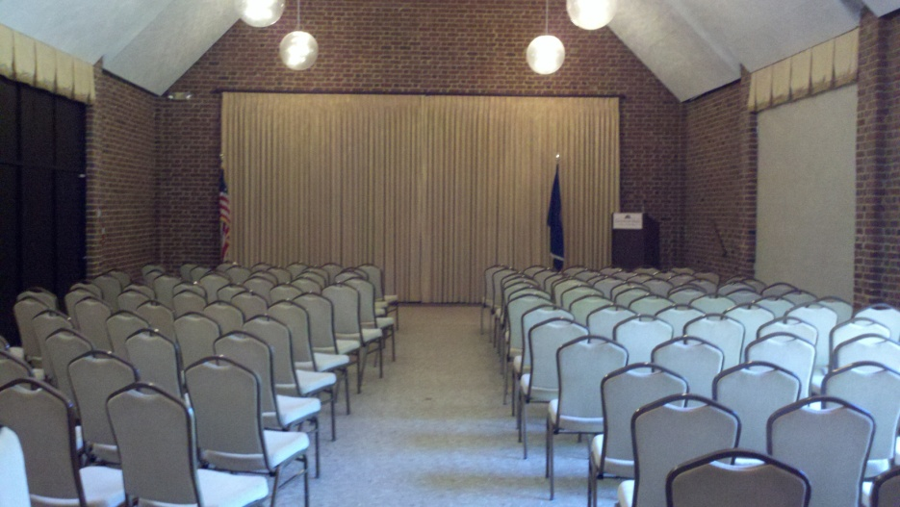
Agenda – Annotated
10:15-10:30 EC members arriving
10:30-12:35 Morning Session – PUBLIC
10:30-10:40 Welcome, Agenda, Overview – EC Chair
10:40-11:50 Program Updates – CBP Director/Advisory Comm. Chairs
(10:40) State of Program: Program overview (5 min); Restoration Indic. (10min) Report on Deliverables from 2011 EC Meeting (5 min); Milestones (15 min)
(11:15) Discussion: EC and Nick DiPasquale
(11:30-12) CAC, STAC, LGAG briefings (10 min ea.)
(12:15) Discussion: EC and Advisory Committees (15 mins)
12:15-12:35 Lightening Talks
Notes:
W’shed groups? fr PA, MD, VA, DC

Slide 10
Morning Session
Morning Session (10:30am-12:35pm)
Ann Mason Room
(EC Members plus 1)
Projector Screen
MORNING SESSION
Checklist:
Laptop
Internet
Projector
Projector Screen
EC Table that sits 16
16 EC chairs
Public seating for 80
80 public chairs
8ft table (x3)
9 mics (3/table table)
Table linens
Nameplates
Gavel/strike plate
WV
VA
USDA
CBC
PA
CBP Dir.
8 ft
table
8 ft
table
+1’s
chairs
DE
MD
EPA
DC
NY
Jeff C.
+1’s
chairs
8 ft
table
8 ft
table
AV Table
8ft table
CAC LGAC STAC
40 Chairs
Reserved for GIT Chairs
34 Chairs
Aisle

Slide 11
Lightening Talks
Goal:
To set a tone of optimism about implementation happening across w’shed
To provide positive, constructive examples of watershed-specific restoration related to the lunch discussion topics.
Time: 12:15-12:35 (4 quick talks at 5 mins ea.)
 | Watershed Highlighted | Topic Highlighted | (Tent) Speakers | Possible Topical focus:
PA | TBD – Planning Team Members still discussing specifics |  |  | Agriculture Fisheries Stormwater Wetlands Partnerships Engagement Land Conservat. Access Other?
MD
VA
DC
Notes:
W’shed groups? fr PA, MD, VA, DC

Slide 12
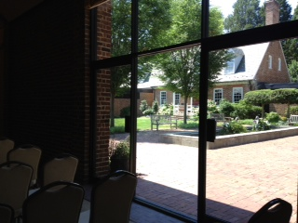
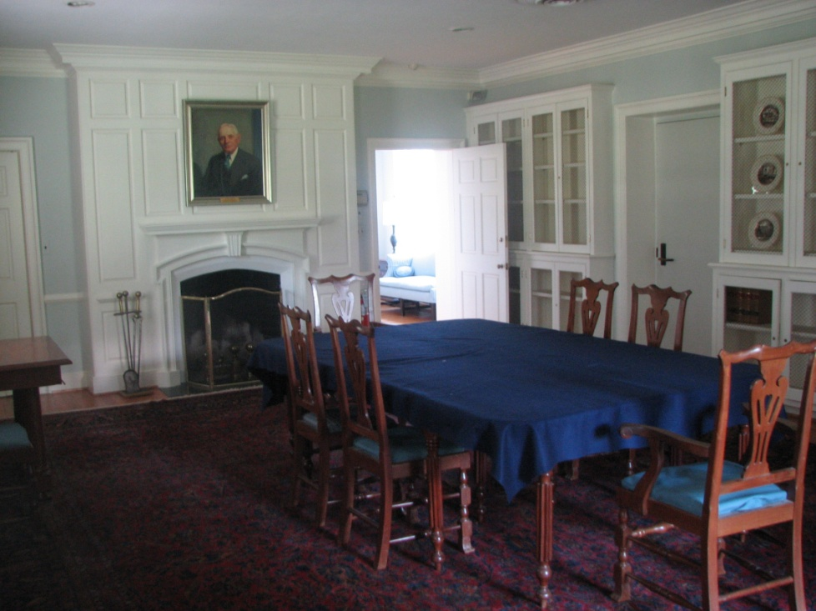
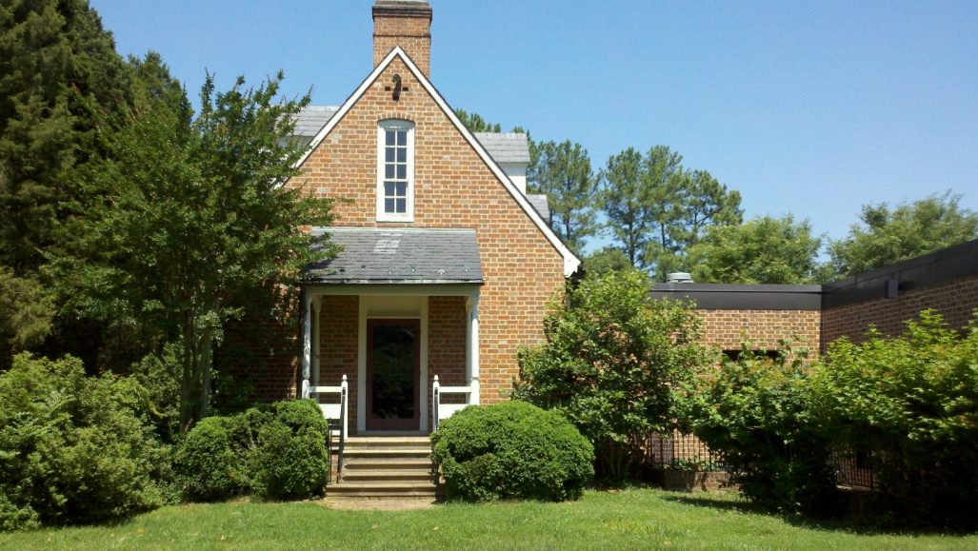
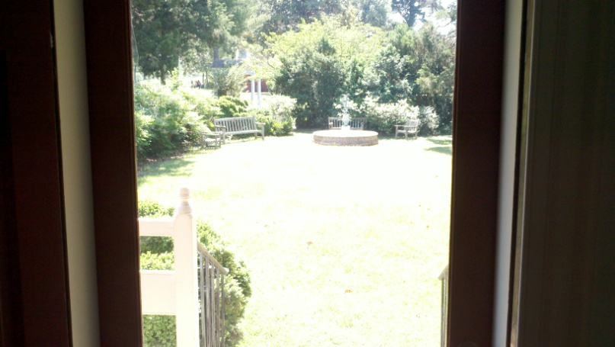
Private Lunch
12:35-2:00 Lunch
12:35 Walk to/transition to lunch
12:45-1:40 Suggested Discussion Topics (20 min ea.)
1. Attracting and collectively supporting targeted, public funding to Bay
2. Attracting private capital to Bay - Creating a “restoration economy”
3. Trading
1:40 -2 Business
4. Nomination & vote on new EC Chair
5. Briefing on Theme & Press Event
2-2:10 Transition to Press Conference

Slide 13
Private Lunch – sample arrangement
Lunch (12:35pm – 2pm)
Hertle Library
Seating for 21
(EC Members plus 1)
CBP Staff
Table (3)
Exit to
Courtyard
DE Sec DE Ag. Sec USDA Deputy USDA +1
NY
DC +1
DC Mayor
MD Gov
MD +1
WV
CBC +1
CBC Sen.
PA
PA +1
Buffet
Lunch
Menu
TBD
EC Table
2x 8ft tables – food/beverages
EPA EPA EPA – Jackson VA VA +1
Entry
from HALLWAY
TO KITCHEN

Slide 14
Press Conference
2:15 – 3:15
2:15 Welcome - Gunston Hall Acting Director, Mark Whatford
2:20 Administrator Jackson remarks
2:30 Governor O’Malley remarks
2:40 Senator Hanger remarks
2:50 Mayor Gray remarks
3-3:15 Media Q&A and buffer time

Slide 15
News Conference 2:15pm – 3:15pm
Ann Mason Meeting Room or Outdoors under shade tree
(Open to the Public)
Flags
Seating for 5 w/linens
and water
2 – mics
DE USDA CBC PA EPA
Podium w/mic &
Speaker
CBPO Logo
&
MULT BOX
Seating for 5 w/linens
And water
2 – mics
VA MD DC NY WV
40 Chairs
40 Chairs
Aisle
Press
EC MEMBERS ENTER FROM THIS DIRECTION

Slide 16
Press Conference
TENTATIVE Messages
Implementation / Lightening talks (positive news)
Two year milestones: The new, successful blueprint for the future
Announcement of new EC Chair
Pending: Still in discussion by Planning Team et al.
Announcement of Local Gov’t Capacity Building Initiative (NFWF) Awardees
Selected local governments will receive technical assistance (valued at up to $150,000) to overcome specific challenges that they identify as barriers to improving water quality. In addition to technical assistance, a portion of funding may be used to support implementation of a demonstration project associated with the technical assistance they receive. Applicants chosen by 3rd week June.

Slide 17
Communications
DEADLINES/DUE DATES
Wed. June 20 | Media materials to partners for review and approval
Fri. June 22 | EC Memb/rep bios submitted by COB – wilke.tim@chesapeakebay.net
Mon. June 25 | All Security contacts to Lori Mackey – mackey.lori@epa.gov
Tues. June 26 | Partner comments / approval of media materials APROVAL DUE
Wed. June 27 / Mon. July 2 | Early notice to Media / Formal Media Advisory
Mon. July 2 | Briefing of EC Chair
Thurs – July 5 | CBP Bay Brief distributed with EC details / Media Materials finalized
Mon a.m. – July 9 | Deadline for media to confirm attendance
Event day | EC Meeting & Press Event
Notes on Handling of Media:
Media will be invited to the afternoon’s activities– Restoration event & Press Conference only --- Start time: TBD
Media will be able to attend the Executive Council’s morning briefing if this is public
Media check-in: Required. There will be a check-in table at a convenient location TBD.
Press Conference: Media should use the microphone when asking questions and identify themselves and their news organization during the news conference.
Interviews with EC members: Requests to interview specific EC members will be referred to the partner’s communications lead – Margaret Enloe - and take place after the news conference concludes. Time: TBD

