Slide 1
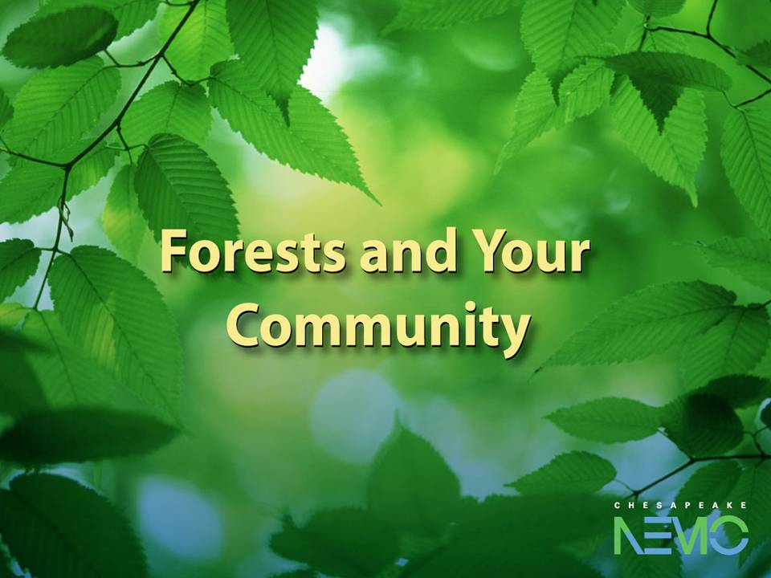
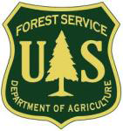

Chesapeake's Future Forests:
Crafting a Forest Restoration Strategy for the Bay Watershed
Partners

Slide 2
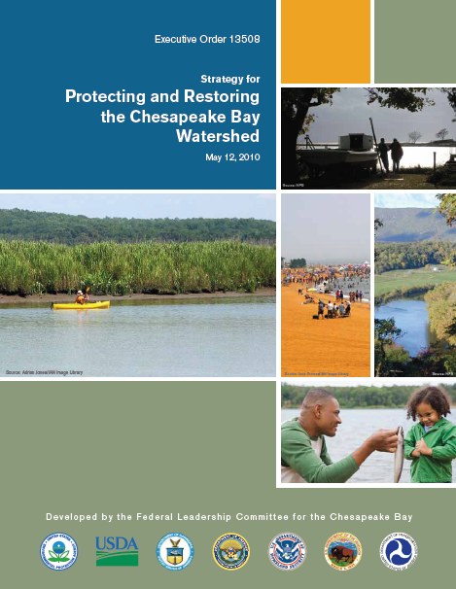
Goal: Recover Habitat
“By 2012, USDA will work with Dept. of Interior and other entities to develop a Chesapeake Bay watershed strategy to maximize forest restoration in priority areas… ”
Priority areas =
Urban, green infrastructure, wildlife habitat, mine lands, brownfields, agroforestry
Notes:
Why we are here today…set the context for this strategy and get the involvement of a wide array of partners in developing this strategy over the next 6 months

Slide 3
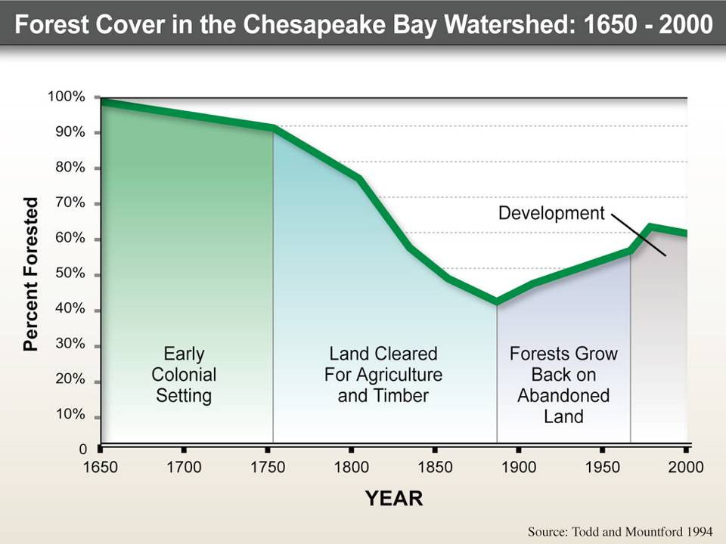
2009:55%
Notes:
Then we look at the graph over time – first we notice how forested the watershed used to be, but then we see how resilient they are. We already gained a lot back; now we’re declining and we have a lot of impacts to the watershed coming from the non-forested land; --a rate of loss of 100 acres a day. Now the watershed is at 55% forest cover. The difference is that this is a permanent loss of forest ; (Next slide) SPRAWL
We can actually chart the change in forest cover over 350 years. Many people don’t recognize that the low point in forest cover was actually late in the 19th century. We have more forests today, but there is a worrisome trend in the past 25 years.

Slide 4
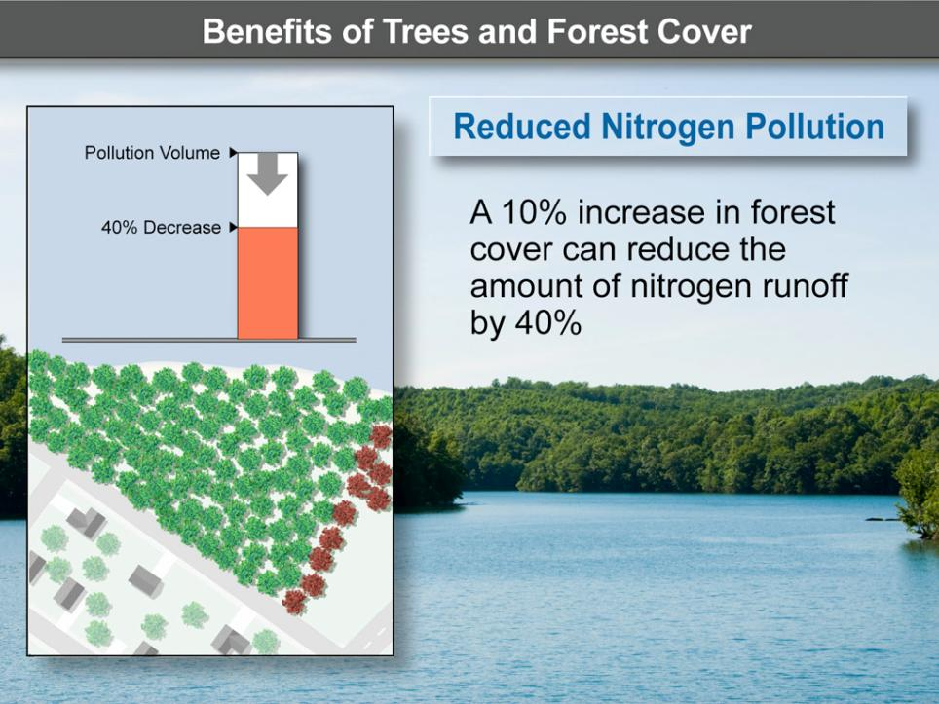
Chesapeake NEMO
Notes:
A 10% increase in forest cover can reduce the amount of nitrogen runoff by 40%.

Slide 5

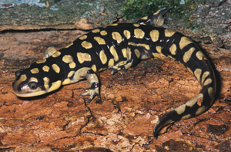
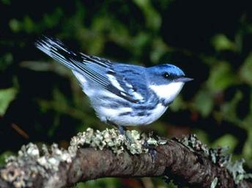
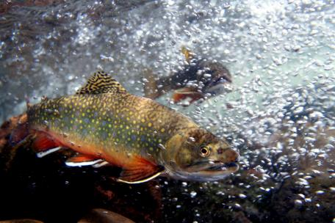
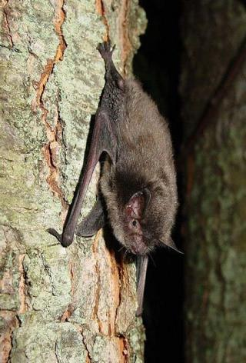
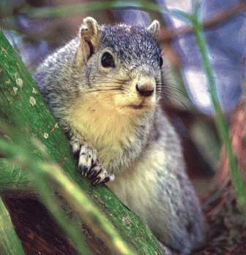
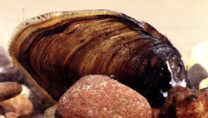
Notes:
Priority Areas: Core Wildlife Habitat

Slide 6
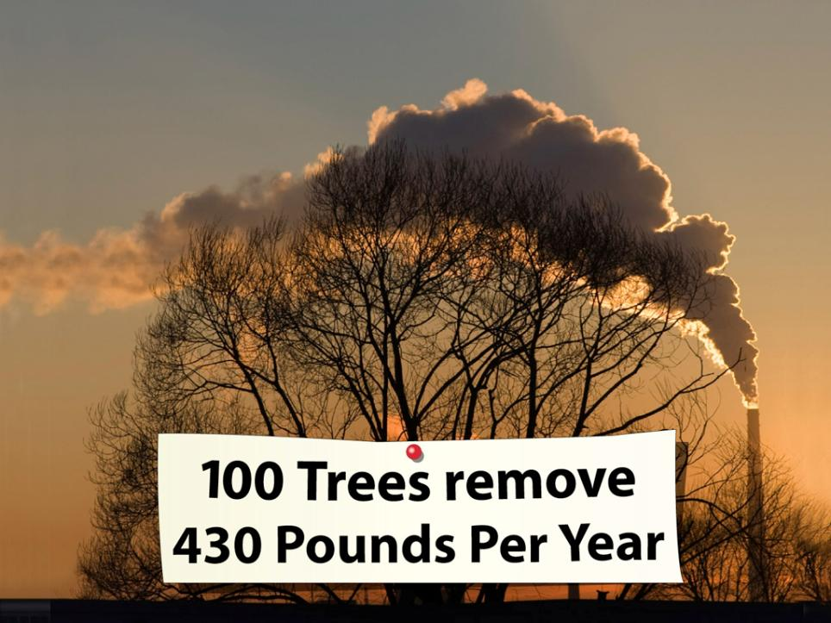
Chesapeake NEMO
Notes:
Forests are also beneficial to air quality – they absorb pollutants and fine particulate matter and offer shade which helps reduce temperatures.
100 trees can remove 430 pounds of pollutants (like ozone and particulates) per year.

Slide 7
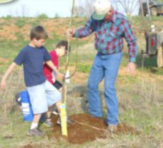
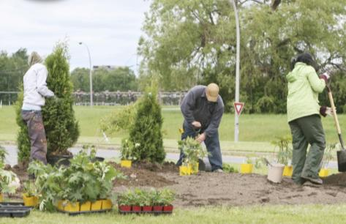
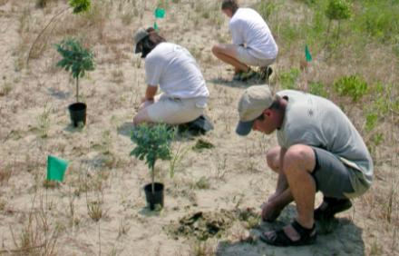
Why a Forest Restoration Strategy for the Chesapeake Bay watershed?
Building on successes
Responding to new opportunities
Focusing on priority areas

Slide 8
General Outline for Each:
Five Priority Areas
  Wildlife Habitat
  Mine Lands
  Agroforestry
  Urban & Community Trees
  Contaminated Sites
        Why is this a priority for forest restoration?
        Where are these areas on the landscape?
        How – what programs and tools are available to help?
        What actions are needed to promote forest restoration in these areas? (will help guide Forestry Workgroup and partner priorities)

Slide 9
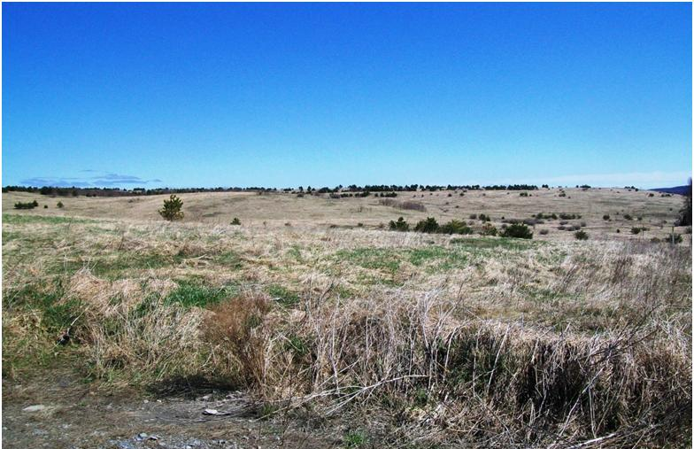
MINE LANDS
Coal mine lands exist in high value Appalachian forest habitat, headwaters of Chesapeake Bay
Post SMCRA reclamation has been predominantly grass, with high soil compaction and limited regeneration of trees
Opportunities on different types of sites: Abandoned Mine Lands, historic permitted/post SMCRA, active mining sites
Note: Not recommending reforestation of ALL mine lands – some provide important grassland habitat, or ag production

Slide 10
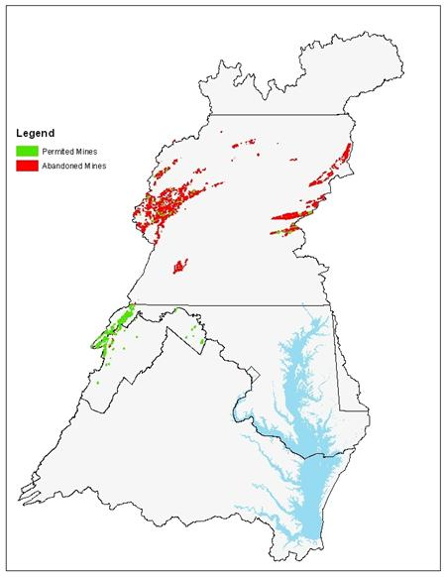
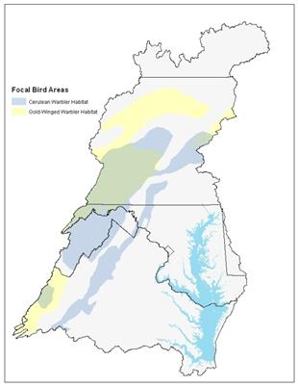
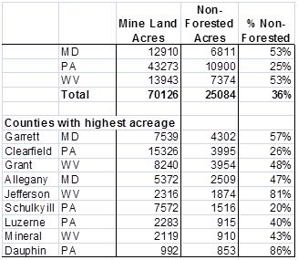
MINE LANDS

Slide 11
MINE LANDS - HOW
Appalachian Regional Reforestation Initiative (ARRI) – provides strong science, technical guidance, and partnership strategies for reforesting mine lands
Possible Funding Sources –
  Fed/state cost share (EQIP, WHIP, etc)
  EPA Brownfields, 319 grants; OSM Abandoned Mine Lands
  Private – foundations, utility companies seeking carbon credits
Critical role of watershed/community groups to identify reforestation sites, seek grants, and plant trees (e.g. OSM VISTA Appalachian Coal Country Teams)

Slide 12
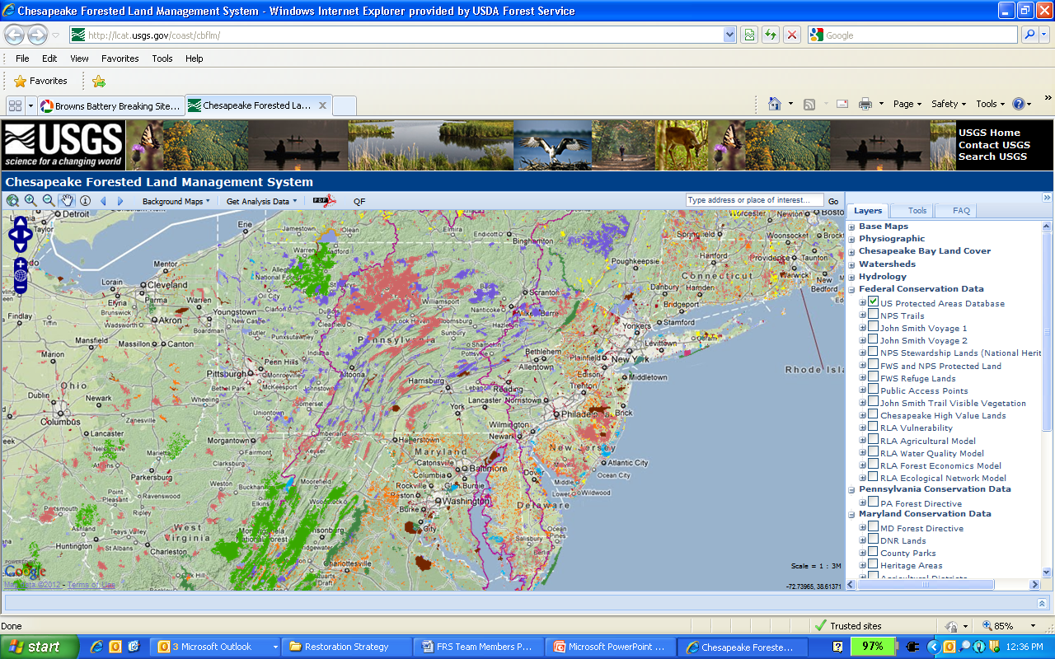
Integrating Across Priorities
COAST Forest Mapping tool (USGS) will be revised with Strategy GIS layers

Slide 13
Next Steps
Incorporate comments from public and CBP
Issue Final Document
Develop set of FY2013 actions to be pursued with partners
Complete the companion Working Lands Conservation Strategy
QUESTIONS..? IDEAS..?

