Slide 1
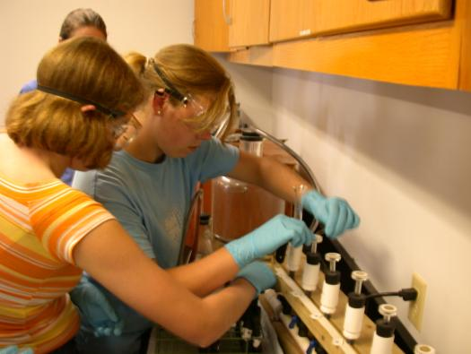
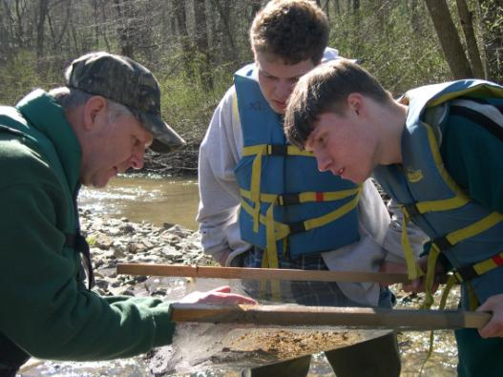
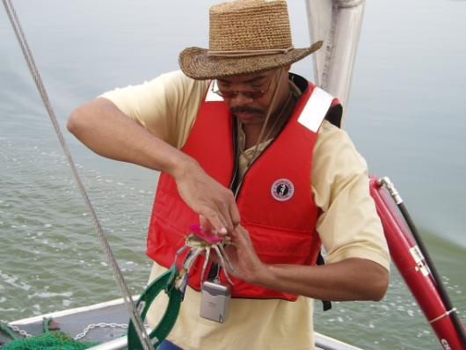
CHESAPEAKE BAY EXECUTIVE ORDER ENVIRONMENTAL LITERACY STRATEGY Summary overview SHANNON SPRAGUE & Ann Regn Co-cHAIRs, CBP EDUCATION WORKGROUP Fostering stewardship Goal Team
CBP Management Board Presentation August 2, 2012

Slide 2
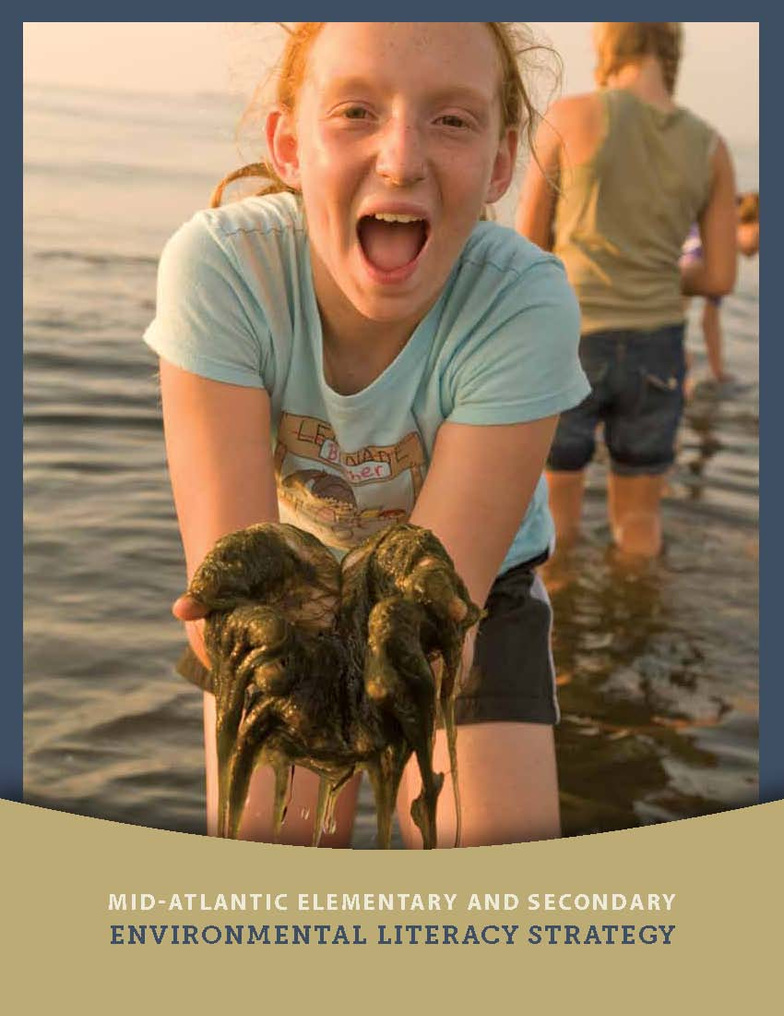
Overview
Requested Action:
Recommend the Mid Atlantic Environmental Literacy Strategy to the Principal Staff Committee for adoption
Presentation Outline:
History of K-12 Collaboration
Overview of Strategy and related partner efforts
Current projects supporting Strategy

Slide 3
Environmental Issues are Complex and Distributed
“In the coming decades, the public will more frequently be called upon to understand complex environmental issues, assess risk, evaluate proposed environmental plans and understand how individual decisions affect the environment at local and global scales. Creating a scientifically informed citizenry requires a concerted, systematic approach to environmental education.”
National Science Foundation (2003)

Slide 4
Long History of K-12 Collaboration
1998:
Directive 98-1 Signed by Governors
2005:
Multi-State MWEE Tracking Begins
2012:
Envi Literacy Strategy Released
2000:
MWEE Keystone Commitment Adopted
2010:
Executive Order Plan Calls for Education
2002: NOAA B-WET Created
Directive 98-1:
Departments of Education become active partners in CBP
Interagency education group required in each jurisdiction

Slide 5
Long History of K-12 Collaboration
1998:
Directive 98-1 Signed by Governors
2005:
Multi-State MWEE Tracking Begins
2012:
Envi Literacy Strategy Released
2000:
MWEE Keystone Commitment Adopted
2010:
Executive Order Plan Calls for Education
2002: NOAA B-WET Created
MWEE Commitment:
Provide every student in the watershed with a meaningful watershed educational experience prior to graduation
Research or inquiry based outdoor experience fully integrated with curriculum that includes preparation, action, and reflection
Identified as one of ten “keystone commitments” essential for long term success

Slide 6
Long History of K-12 Collaboration
1998:
Directive 98-1 Signed by Governors
2005:
Multi-State MWEE Tracking Begins
2012:
Envi Literacy Strategy Released
2000:
MWEE Keystone Commitment Adopted
2010:
Executive Order Plan Calls for Education
2002: NOAA B-WET Created
NOAA B-WET:
Until NOAA B-WET, the MWEE was an unfunded mandate
Historic funding levels between $1.2M and $3.5M annually
To further advance MWEE goal, NOAA took on federal leadership role in the Education Workgroup

Slide 7
Long History of K-12 Collaboration
1998:
Directive 98-1 Signed by Governors
2005:
Multi-State MWEE Tracking Begins
2012:
Envi Literacy Strategy Released
2000:
MWEE Keystone Commitment Adopted
2010:
Executive Order Plan Calls for Education
2002: NOAA B-WET Created
MWEE Tracking:
States began reporting progress towards MWEE goal at 2005 Summit
Self-report survey instrument completed by school divisions

Slide 8
Long History of K-12 Collaboration
1998:
Directive 98-1 Signed by Governors
2005:
Multi-State MWEE Tracking Begins
2012:
Envi Literacy Strategy Released
2000:
MWEE Keystone Commitment Adopted
2010:
Executive Order Plan Calls for Education
2002: NOAA B-WET Created
Executive Order Plan:
Executive Order signed in 2009 by President Obama – did not include stewardship element
Implementation Strategy released in 2010 included stewardship in response to public comment

Slide 9





Long History of K-12 Collaboration
1998:
Directive 98-1 Signed by Governors
2005:
Multi-State MWEE Tracking Begins
2012:
Envi Literacy Strategy Released
2000:
MWEE Keystone Commitment Adopted
2010:
Executive Order Plan Calls for Education
2002: NOAA B-WET Created
Environmental Literacy Strategy:
Significantly expands federal support for state environmental literacy efforts in the context of the Chesapeake Bay Program
Better coordinates and applies federal resources, including partners not represented in broader Bay program

Slide 10
Education Workgroup Structure & Membership
Advisory Group
Fedl Agency Nat’l Offices: NOAA, FWS, NPS, EPA, ED, USFS, NASA, NSF, USDA, Energy, USGS, etc. Nat’l Nonprofits CBP GITs
Executive
Committee
State, Co-Chair – Ann Regn, VA DEQ
Federal, Co-Chair – Shannon Sprague, NOAA
PA – Jack Farster
USFWS – Karen Mullin
WV – TBD
DC – Grace Manubay
DE – Ashley Peebles
EPA – Larry Brown
CRC Staff – Sarah Brzezinski
MD – Britt Slattery
NOAA – Kevin Schabow
USFS – Barbara McGuinness/Susan Cox
VA – Eric Rhodes
CBT – Jamie Baxter
Confirmed Member
To Be Determined
State Delegations (C2K Commitment)
Delaware | District of Columbia | Maryland | Pennsylvania | Virginia | West Virginia
Tonyea Mead DE DOE | James Rountree DCPS | Gary Hedges MSDE | PA DOE | Eric Rhoades VA DOE | WV DOE | Depts of Education
Matt Ritter DNREC | Grace Manubay DDOE | Britt Slattery MD DNR | Jack Farster PA DCNR | Ann Regn VA DEQ | WV DEP | Natural Resource Agencies
Chris Petrone DE Sea Grant | University | Drew Ferrier Hood College | Ann Faulds PA Sea Grant | Tamara Willis Mary Baldwin College | University | College or University
Ashley Peebles DAEE | Ariel Trahan DCEEC | Laura Collard MAEOE | Ruth Roperti PAEE | Barbara Young VRUEC | Frank Rogers WVEEA | NAAEE State Affiliates
Jennifer Holmes | Rebecca Davis Trihn Doan | Libby Campbell | TBD | Suzie Gilley Bill Portlock Daria Blom Lisa Deaton | Kevin Stitzinger Mountain Institute | At Large
Federal/Regional
Federal Agencies See Executive Committee for more federal reps NOAA – Bart Merrick NPS – Abbi Wicklein-Bayne
Non-Profits CBT – Kacey Wetzel CBF – Tom Ackerman CBF – Don Baugh MAMEA – David Christopher Nat Geo – Elena Takaki NCLI – Sarah Bodor NWF – Kim Martinez
LEA Reps AACPS – Steve Barry

Slide 11
Working Together Makes Us Stronger
State Literacy Plans
Shared Vision for Education Workgroup
Shared Goals & Outcomes for Education Workgroup
Federal Strategies & Commitments
Regional Strategies & Commitments
Shared MWEE Metrics
Notes:
The Chesapeake Bay Program has had an active Education Workgroup since 1998. I have the priviledge of serving as that group’s co-chair along with a state co-chair, Ann Regn of the VA Dept of Environmental Quality. This long-standing partnership has enabled the community to recognize the importance of a fully coordinated approach to environmental education. As was mentioned previously, the states have or are developing environmental literacy plans based on their individual needs and priorities, but informed by our long-term commitments including one for comprehensive outdoor education for every student. The state affiliates of the North American Association for Environmental Education (who incidentally created the guidance for developing state literacy plans) represent non-profit and other partners who are actively working to increase environmental education in their states. These affiliates helped to create the goals and objectives outlined in the federal EL strategy along with the federal partners, and are developing their own strategies and commitments to advance the shared objectives. We have also agreed to adopt the same or complementary metrics to ensure we are working in a common direction.

Slide 12
Mid Atlantic EL Strategy
Called for in Executive Order 13508 Strategy
Details specific federal strategies to support the shared Goals and Outcomes
Establishes shared Goals and Outcomes for federal, regional, and state partners of Education Workgroup
Completed in partnership with state reps, affiliates of the NAAEE, and other nongovernmental partners
Being implemented by the CBP Education Workgroup.

Slide 13
Mid Atlantic EL Strategy - Development
March 2011: Kick-Off meeting with federal/state agencies and non-profit partners
Summer/Fall 2011:
Expand federal partnerships
Inventory Federal Programs
Create federal commitments in support of shared goals/outcomes
November 2011: Released for Public Comment
May 2012: Final draft released

Slide 14
Mid Atlantic EL Strategy - Goals
Goal 1: Every student in the region graduates with the knowledge and skills to make informed environmental decisions
Goal 2: All educators in the region responsible for instruction about or in the environment have access to sustained professional development opportunities, tools, and resources that support their efforts to provide students with high-quality environmental education
Goal 3: Every school in the region maintains its buildings, grounds, and operations to support positive environmental and human health outcomes
Goal 4: The education community in the region functions in a unified manner and coordinates with key national, regional, and state programs to represent the full suite of information and opportunities available for PK-12 audiences

Slide 15
NAAEE Mid-Atlantic Affiliate Strategy
Federal strategy catalyzed new era of non-profit collaboration
MAEOE, VRUEC, DCEEC, PAEE, WVEEA, and DAEE
Shared strategy finalized Summer 2012; monthly meetings
Focused largely on improvement of program development and implementation:
Outdoor Student Programs
Teacher Professional Development (and certification requirements)
School Greening Projects

Slide 16
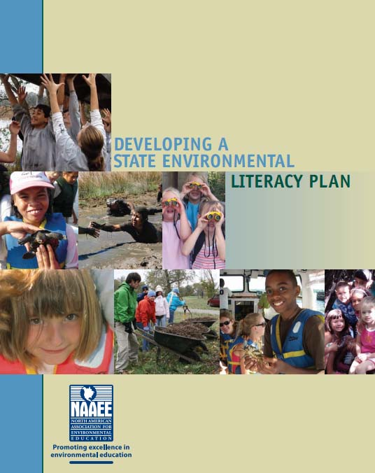
State Environmental Literacy Plans
47 states have or are developing Environmental Literacy Plan
NAAEE issued guidance document in 2008
State Status
Maryland: est. April 2009
District of Columbia: Submitted to DC Council June 2012
Pennsylvania: coming July 2012
Delaware: coming Oct 1, 2012
Virginia: Currently updating EE Business Plan
West Virginia: In early development

Slide 17
Implementing the Strategy
Revised MWEE Metric in development
STAC “Best Practices” Workshop: August 27-28
Draft metrics: Spring 2013
Pilot: 2013/2014 Academic Year
Capacity Building Mini Grants
EPA grant to Chesapeake Bay Trust to support affiliate priorities
Ongoing conversations with NASA, NSF, US ED, and DOI America’s Great Outdoors about collaborative projects in the region

Slide 18
Why You Should Recommend Adoption
Advances MWEE keystone commitment
Acknowledges robust partnership effort of key state, federal, and non-governmental partners
Endorses the call for widespread federal support to help CBP efforts
Does not commit partners to specific actions, rather provides vision and guidance on Workgroup priorities

Slide 19
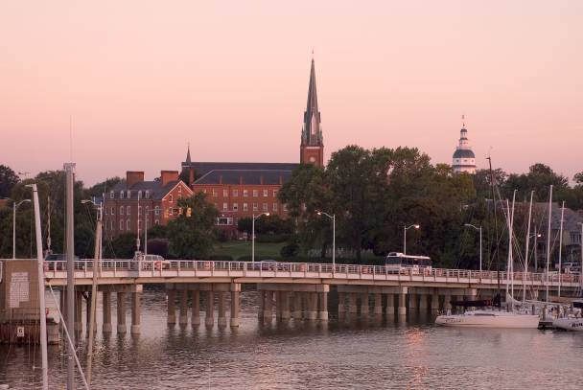
Contact Information
Shannon Sprague Environmental Literacy Manager 410-267-5664 shannon.sprague@noaa.gov

