Slide 1
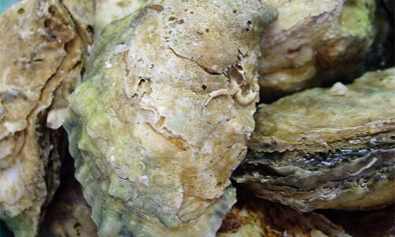


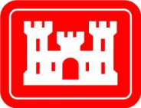
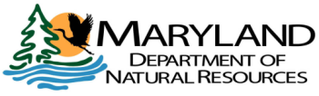
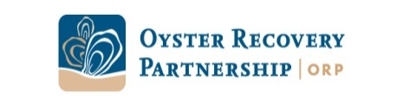
Moving the Dial on the
Bay-wide Oyster Restoration Goal
Peyton Robertson, NOAA
February 2013
Notes:
NOAA and our federal and state partners are fully committed to oyster restoration in the Bay.

Slide 2
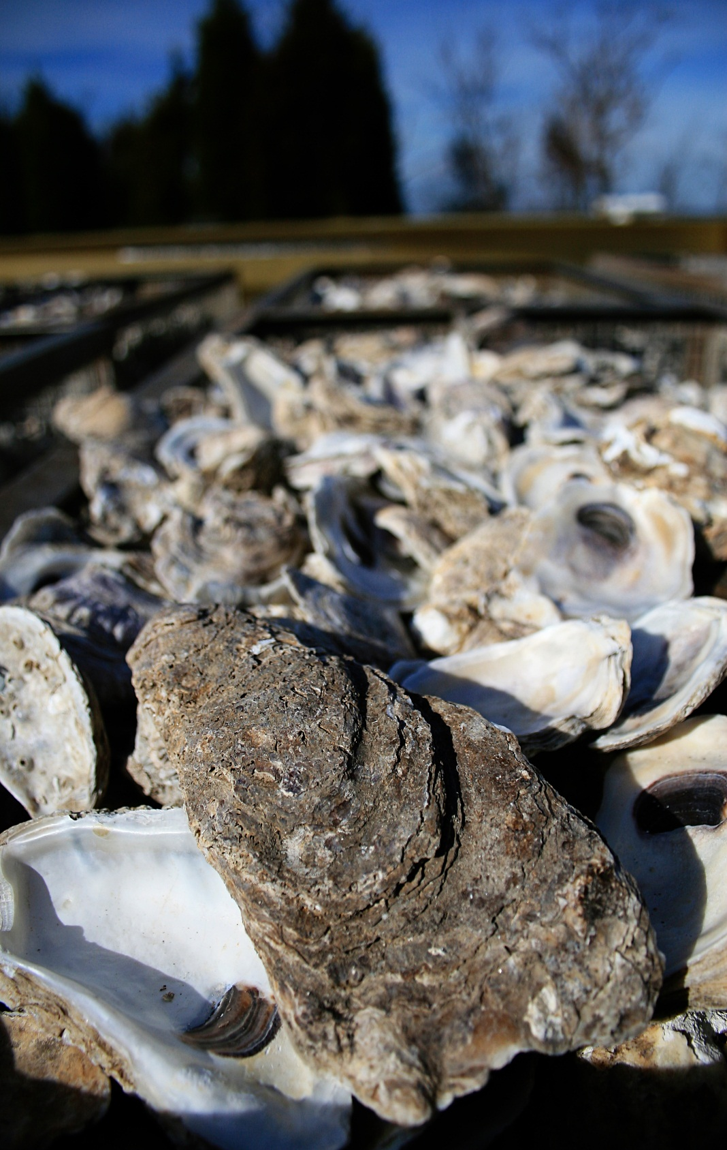
Overview
Goal:
Restore oyster populations in 20 tributaries by 2025
Oyster Metrics:
Developed Bay-wide, consensus definition of ‘restored reef’ and ‘restored tributary’
Tributary Selection:
MD & VA Oyster Restoration Interagency Workgroups
Notes:
Metrics Partners:
NOAA, Army Corps, MD Dept Natural Resources, VA Marine Resources Commission, Oyster Recovery Partnership, Univ of MD, VA Institute of Marine Science; + 17 consulting scientists

Slide 3
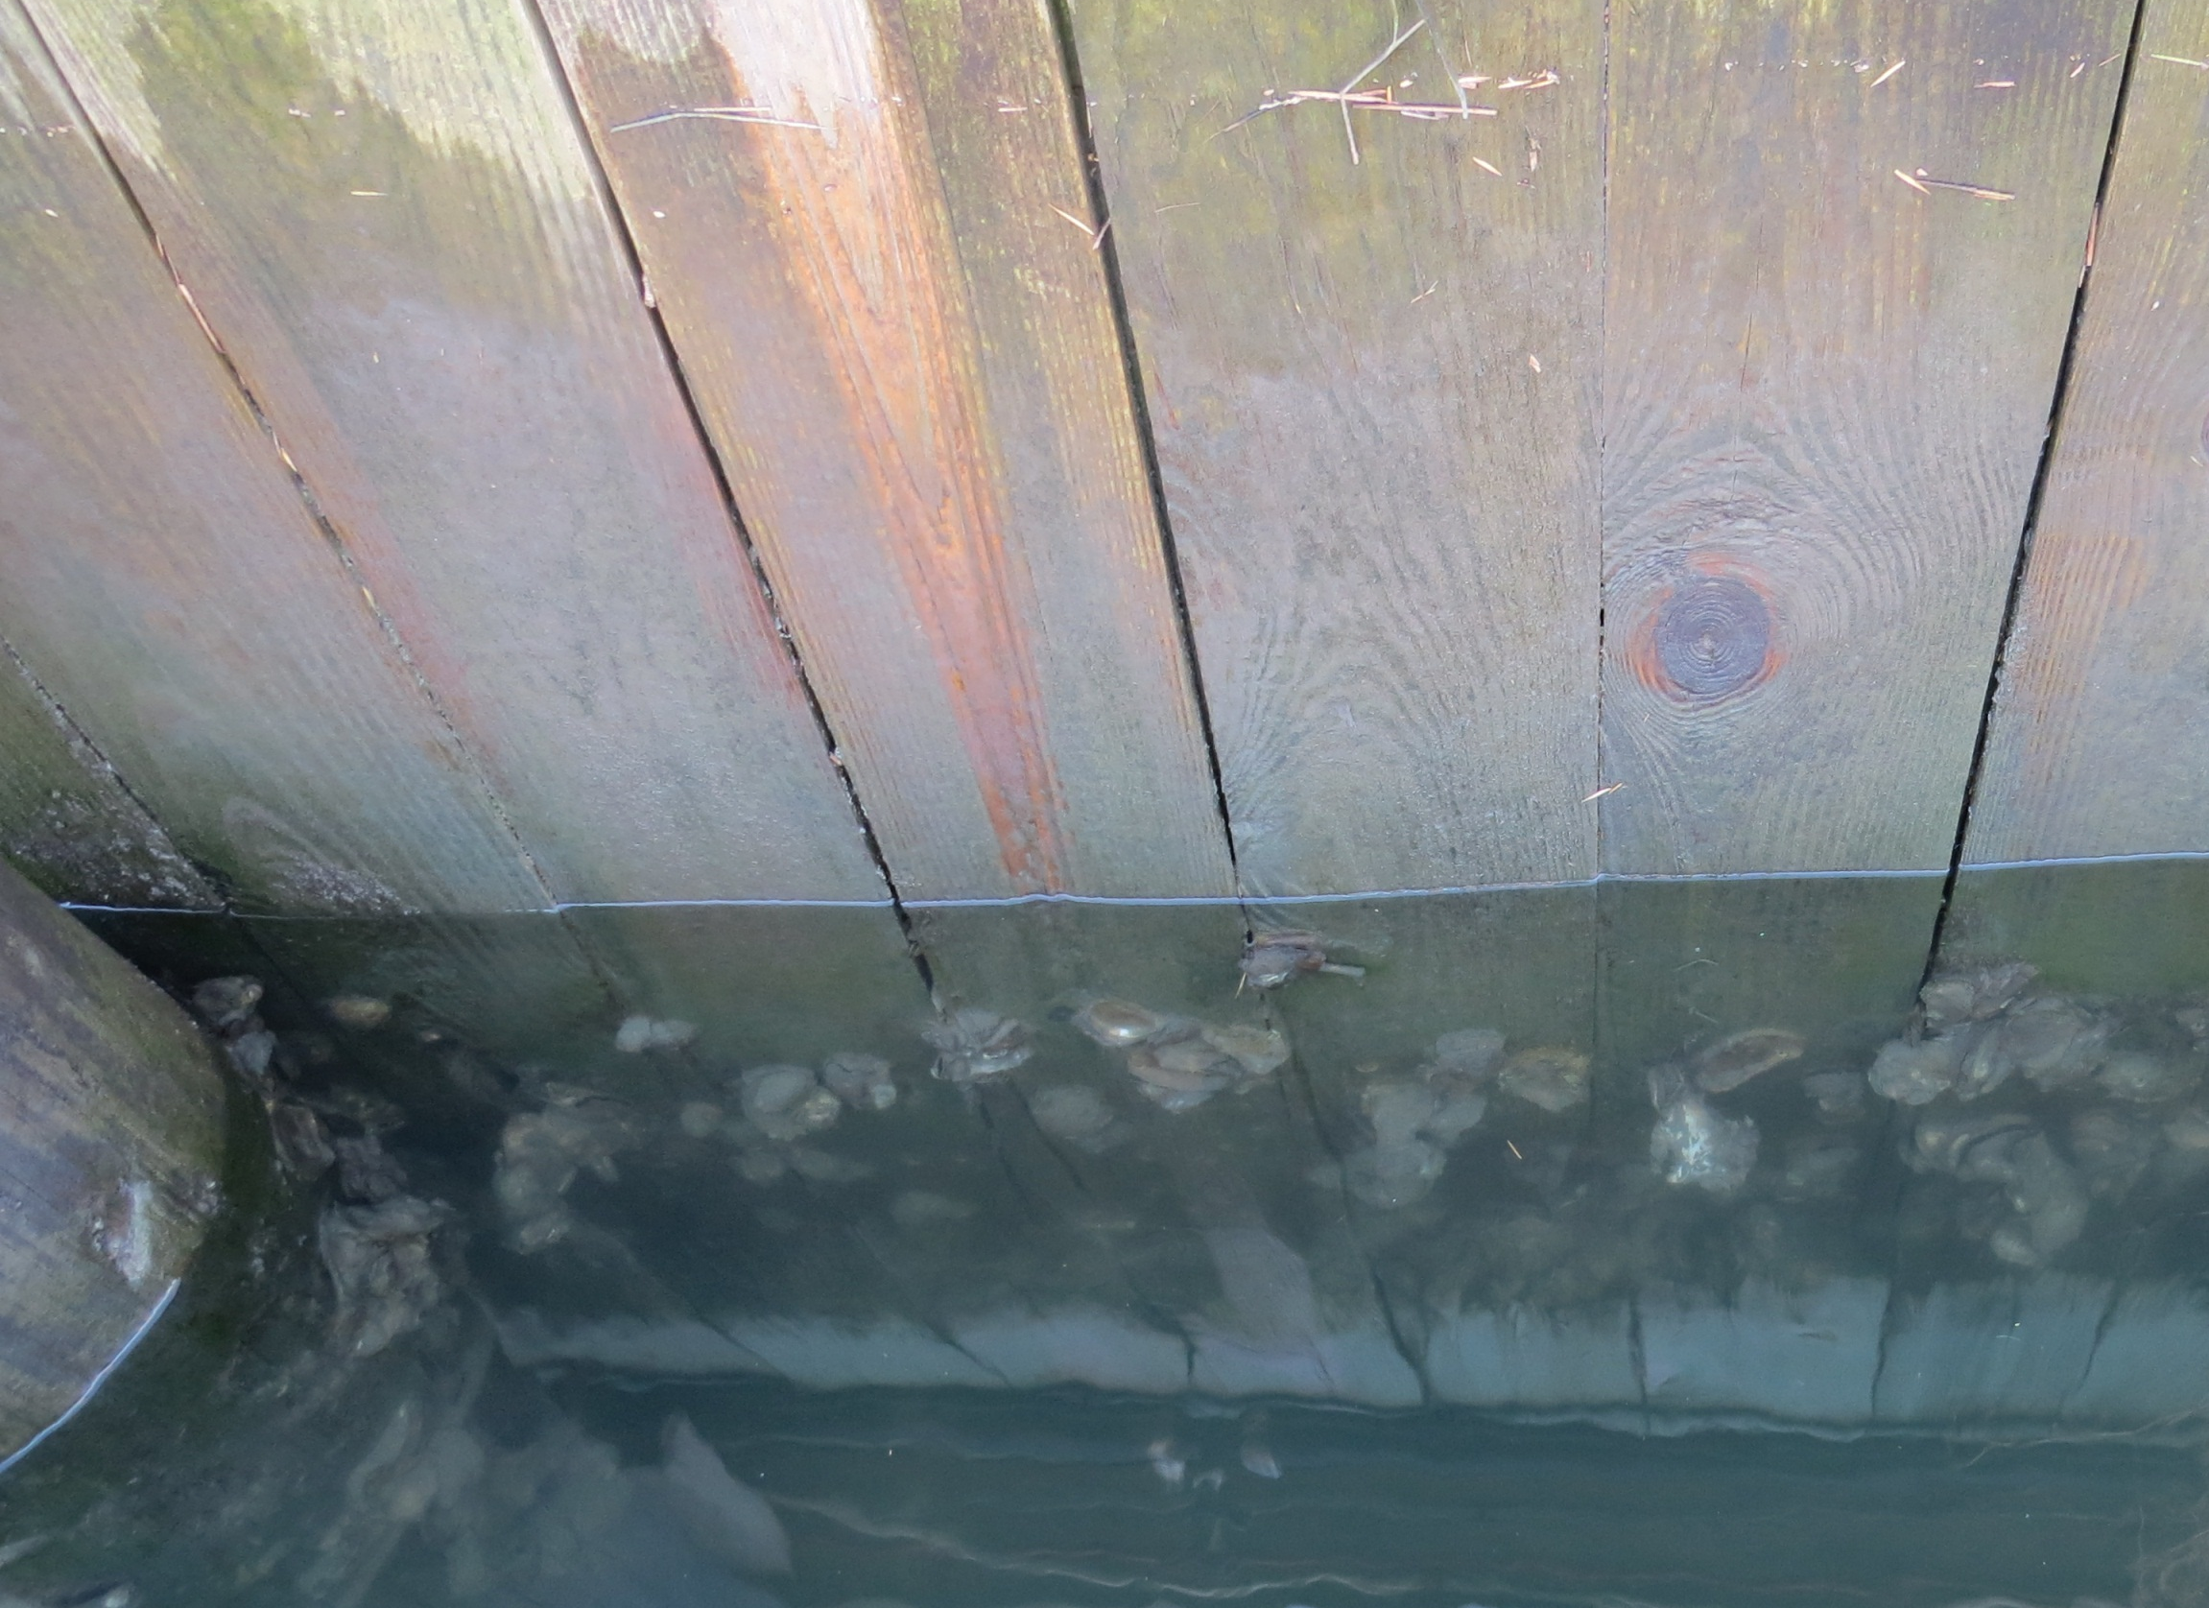
Chesapeake Bay Program Sustainable Fisheries
Goal Implementation Team
MD Interagency Oyster Restoration Workgroup
(NOAA; Army Corps -Baltimore; MD Dept. Natural Resources; ORP)
VA Interagency Oyster Restoration Workgroup (NOAA; Army Corps-Norfolk; VA Marine Resources Comm.)
MD Oyster Restoration Partners
VA Oyster Restoration Partners
Oyster Metrics Team
(NOAA, Army Corps DNR,VMRC, ORP)

Slide 4
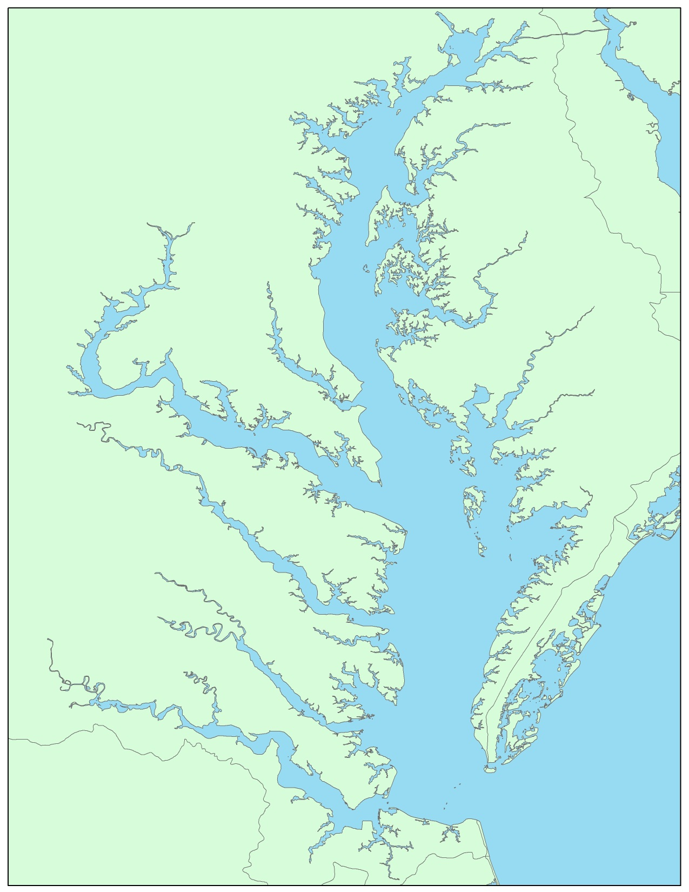
Maryland
Harris Creek
Workgroup:
NOAA, Army Corps Baltimore, MD Dept Natural Resources, and Oyster Recovery Partnership
13 Consulting Scientists
Little Choptank
Tributary Selection:
Harris Creek (#1)
Little Choptank River (#2)
Develop Tributary Plans:
Harris Creek
Little Choptank River

Slide 5

Harris Creek:
Tributary Plan Process
Define restoration goal:
target acreage = 300-600 acres
Conduct pre-restoration oyster population surveys
Develop a draft map summarizing major datasets
Conduct public open house
Develop a draft tributary plan
Send draft to the Coast Guard
Send draft to consulting scientists for review
Complete tributary plan (living document)
Obtain permit clearance, as needed
Implement/ continue seeding and substrate activities
Monitor project performance and adaptively manage

Slide 6
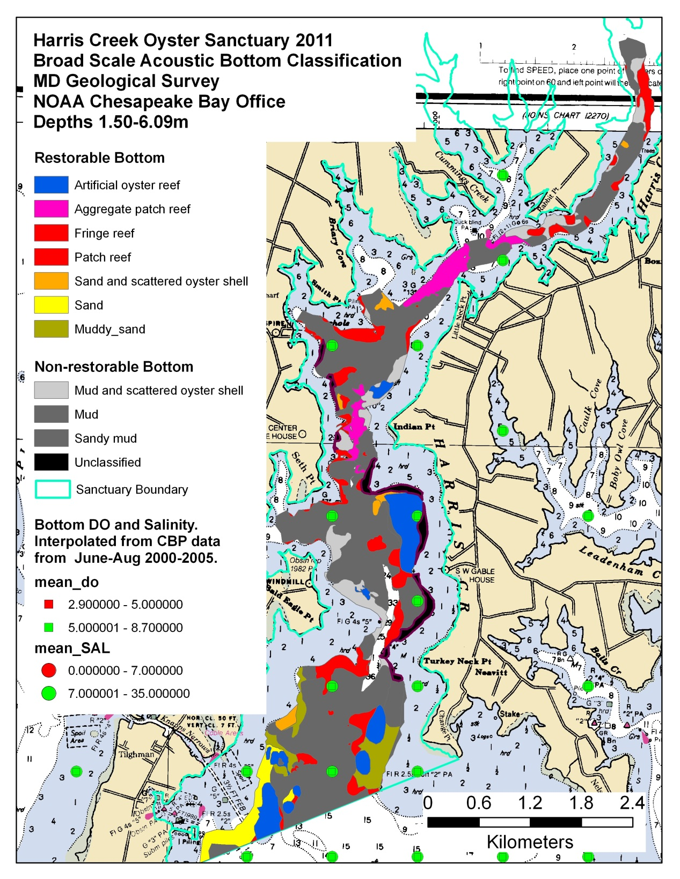
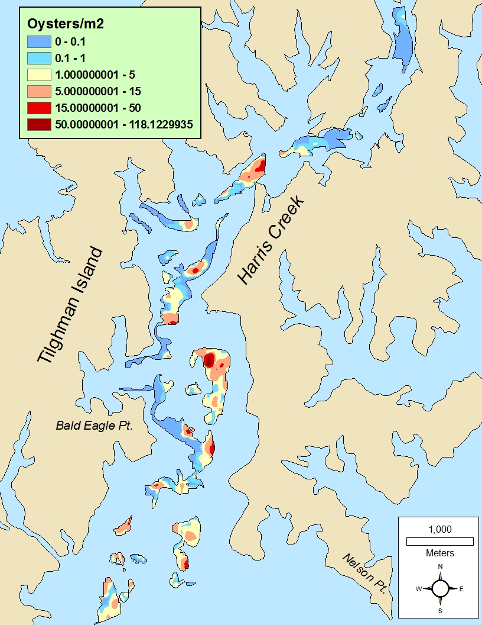
Restorable
Bottom
Analysis
Population Survey

Slide 7
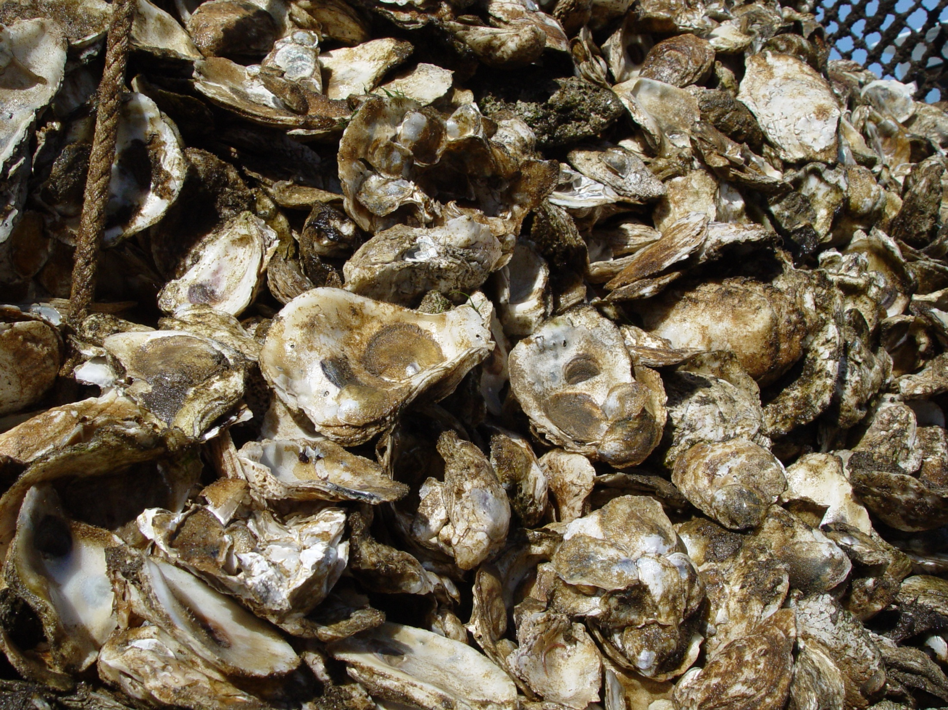
Harris Creek Tributary Plan
Acres: 377
Substrate: 350,000 cubic yards
Seed: 2 billion
Estimated cost: $31 million
Permit issues:
  MD DNR: needs permit modification to construct reefs that will allow 5 ft clearance (current permit specifies 8 ft); modification under review
  Army Corps: needs NEPA modification to construct reefs that will allow 5 ft clearance (current NEPA is 8 ft clearance); under review.

Slide 8
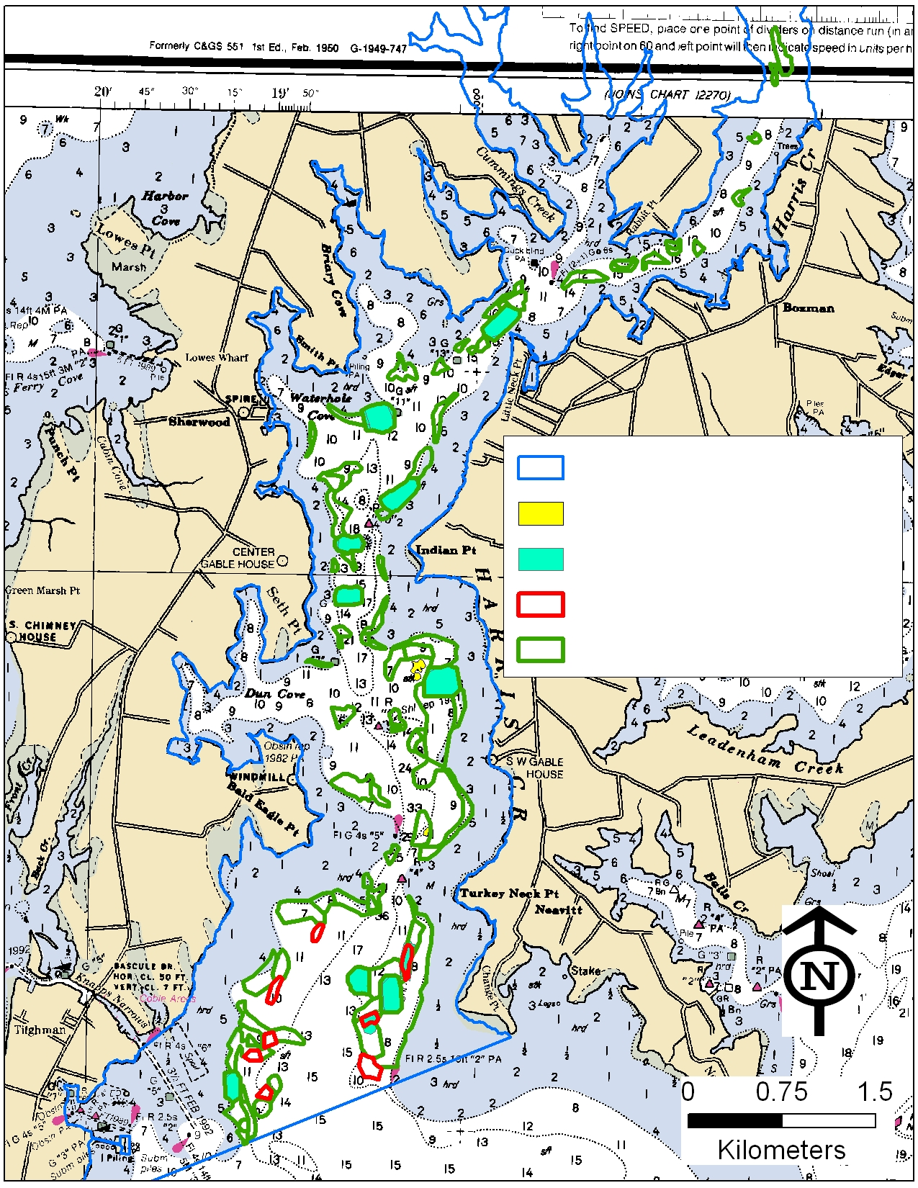
Harris Creek:
Restoration Progress
2012:
22 acres new reef constructed (Army Corps)
97 acres seeded (Oyster Recovery Partnership, in partnership with Univ. of MD, with funding from NOAA and DNR)
Sanctuary Boundary
Meets ‘restored’ goal (3)
2012: seeded (97)
2012: constructed (22)
377 acres targeted
2013 (planned):
34 acres to be constructed (Army Corps)
97 acres to be planted (Oyster Recovery Partnership, with funding from NOAA and DNR)
DNR: $7 m to spend on substrate and seed; in water in 2013

Slide 9
Harris Creek:
Restoration Progress, cont’d
Good News:
Natural spat set on Harris Creek in 2012
DNR & NOAA are funding population assessments to see if some reefs need less seed than anticipated due to natural set
Sanctuary Boundary
Meets ‘restored’ goal (3)
Up Next:
Little Choptank
2012: seeded (97)
2012: constructed (22)
377 acres targeted
Summary:
Approx 1/3 of the way toward the 300 acre minimum goal
End of 2013: likely to be 2/3 of the way there

Slide 10
Virginia
Tributary Selection:
Lynnhaven River
Lafayette River
Elizabeth: Western Branch
Elizabeth: Eastern Branch
Lafayette
Elizabeth:
Western Branch
Lynnhaven
Elizabeth:
Eastern Branch

Slide 11
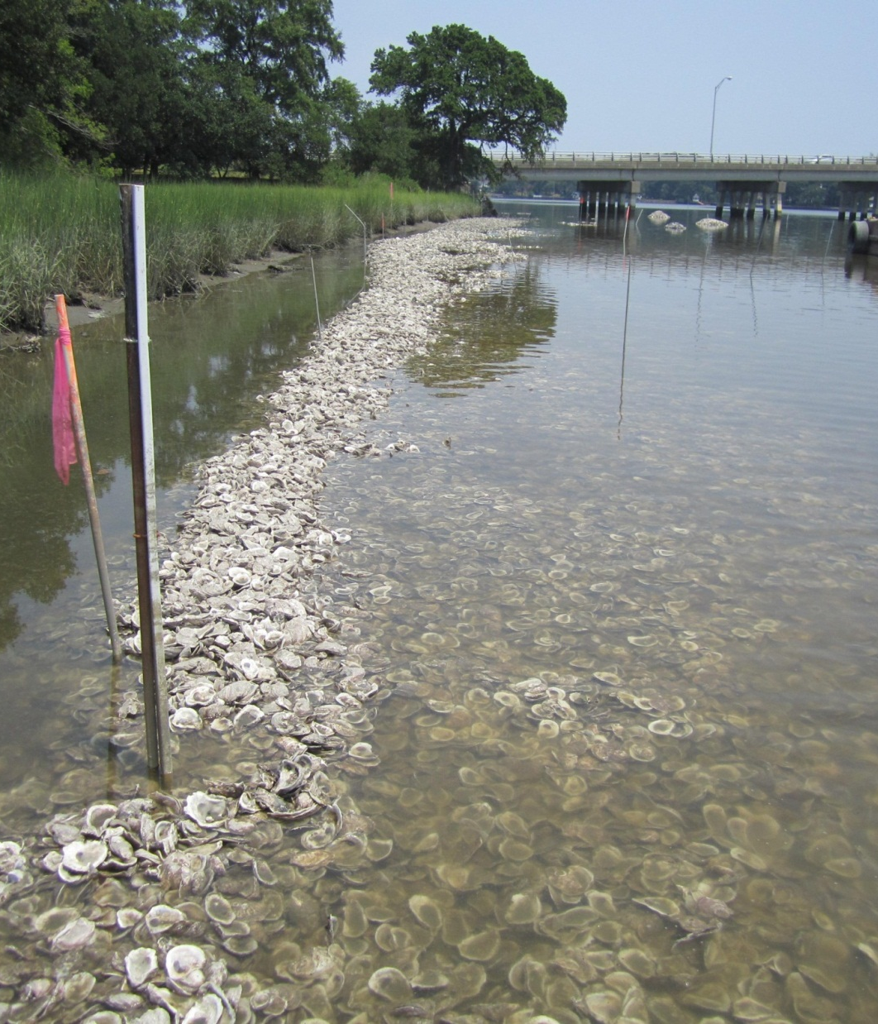
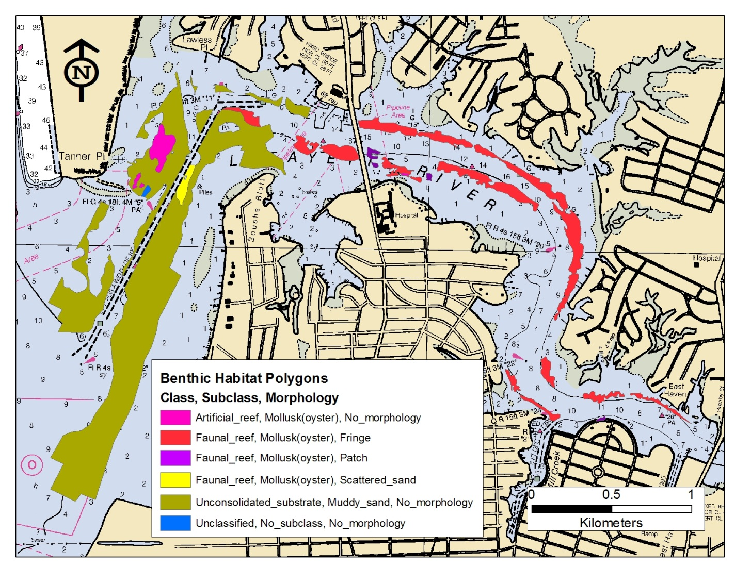
Lafayette River:
NOAA conducted acoustic mapping and ground-truthing surveys of the benthic habitat of the lower 1/3 of the river to inform future restoration work.
NOAA funded CBF (reef balls and oyster seed) and Elizabeth River Project (reef construction) to do restoration work in 2012 and 2013
Plan to continue as funding allows

Slide 12
Virginia
Analysis of prior restoration (Army Corps)
Great Wicomico
Lynnhaven
Great Wicomico
Lynnhaven
Notes:
-analysis not yet complete, but it looks like neither trib currently meets the Oyster Metrics definition of a ‘restored trib’.

Slide 13
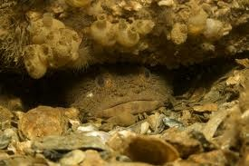
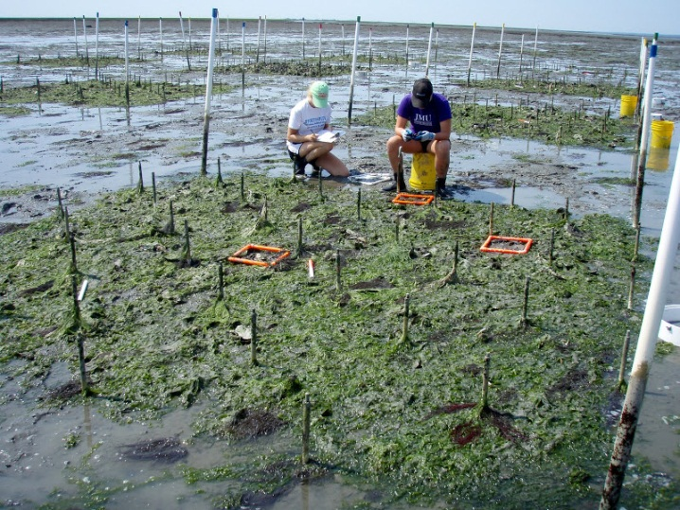
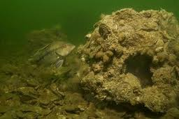
Ecosystem Services Project
Fisheries Production
Denitrification

Slide 14
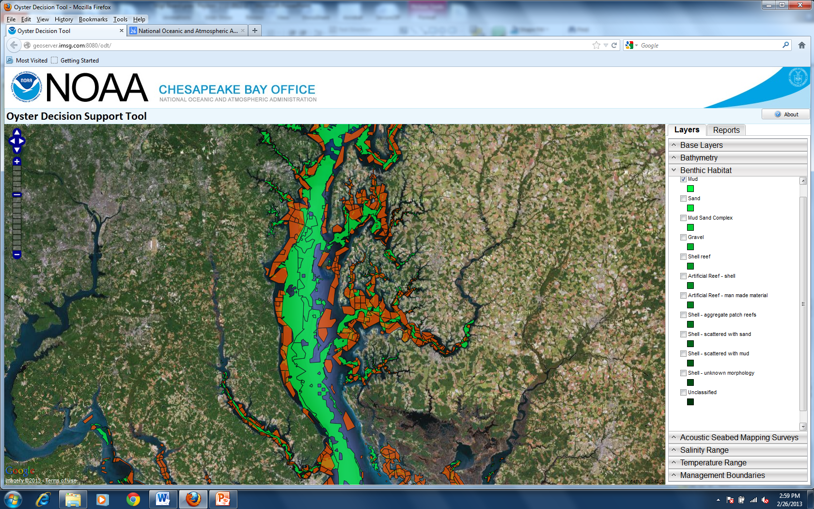
Oyster Decision Support Tool
Notes:
Track restoration progress
Provide access to monitoring data
Research and analyze trends/correlations

Slide 15
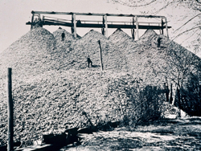
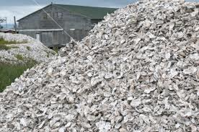
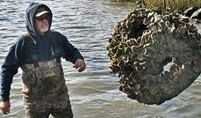
Challenges
Funding
Limited Shell
Permitting

Slide 16
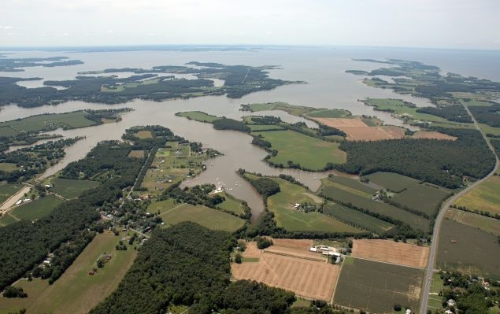
What can the
Management Board do?
Show the Bay Partnership can make a measurable difference in a place
  Endorse Harris Creek as a focus area for GIT collaboration
Pursue funding strategies to accelerate oyster restoration efforts
Notes:
Water quality improvements
Habitat conservation & restoration
Public engagement and education
Economic opportunities

