Slide 1
Progress on Reducing Nutrient and Sediment Pollution
Carin Bisland, EPA
Principals’ Staff Committee
5/14/12

Slide 2
EC Presentation of Pollution Reduction Progress
Five Sets of Documents
Backgrounder - tying all progress together
2009-2011 Milestones Progress (2-Pagers)
2011 Reducing Pollution Indicators Summary
2012-2013 Milestones (2-Pagers)
Nutrient and Sediment Trends
One Powerpoint

Slide 3
1. Backgrounder
Performance metrics first established in 1987 with the long term goal of 40% nutrient reduction by 2010.
EC directed partnership to develop short term 2 year milestones in 2008.
NAS reviewed the concept of 2 year milestones.
Midway through 2009-11 milestones, the TMDL was developed
  New Baseline, planning targets, tracking and accounting system

Slide 4
Backgrounder Continued
For the 2012 EC meeting
What can we say to answer the ultimate question – are we making appropriate progress in meeting the tidal water quality standards for DO, Clarity, and chlorophyll a?
  practices put in place during the original 2009-11 milestone period against the practices planned in 2008 to meet the milestones
  2011 progress (first year of the TMDL) – Are we generally on a straight line trajectory to meet our targets in 2017?
  2012-13 Milestones and 2017 planning targets – do they keep the jurisdictions on a trajectory to meet the 2017 target or is there reasonable assurance that the programs they are putting in place now will get them on track to meet the 2017 targets?

Slide 5
In Addition - Monitoring
20 + year record and new monitoring programs to determine whether the actions on the ground are reducing pollutants in the adjacent rivers.
  Progress on meeting water quality standards for DO, clarity, chlorophyll a

Slide 6




Diet Analogy

Slide 7
2. 2009-2011 Milestones
2-Pagers for each individual jurisdictions.
Progress is based on rates of implementation, not on pollution load reductions.
Progress is compared with expected BMP implementation from original factsheets where applicable.
Data for implementation of practices from input deck information where possible.
Jurisdictions and CBPO are finalizing factsheets now.

Slide 8
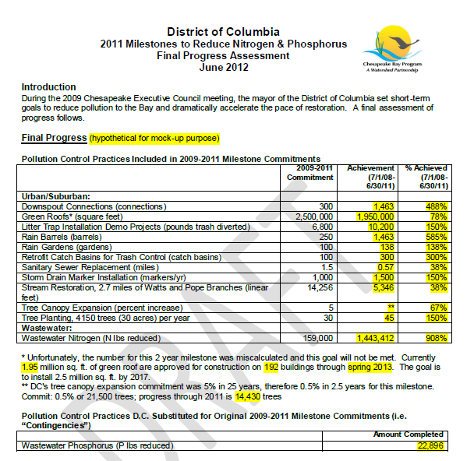
2. 2009-2011 Milestones

Slide 9
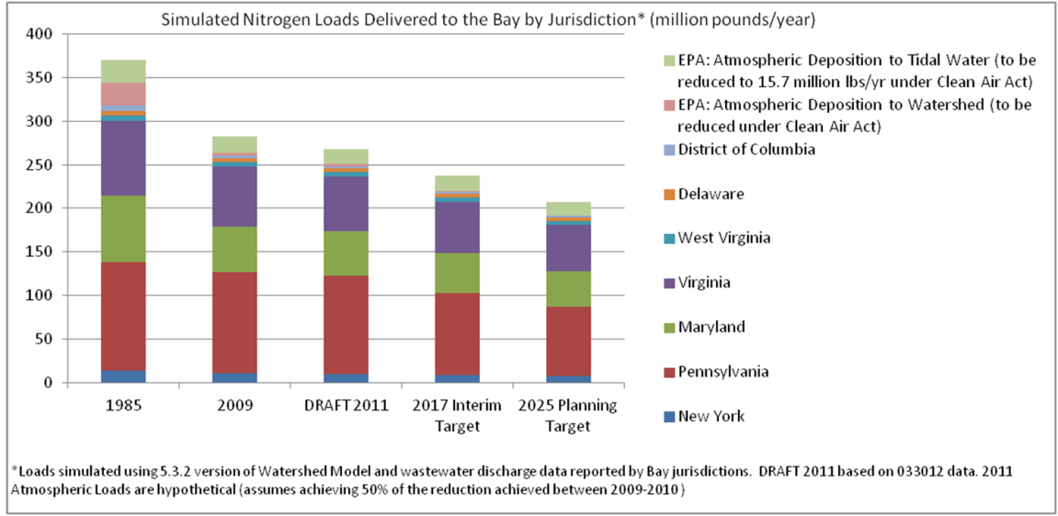
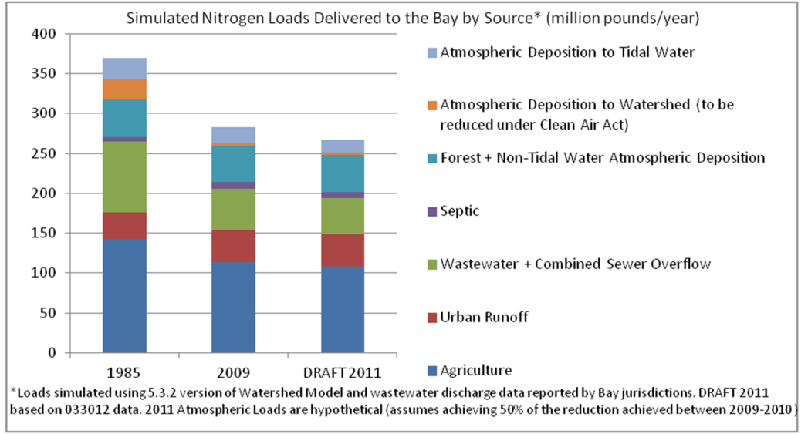
3. 2011 Progress Run
For N, P, and sediment
By Jurisdiction
By Sector
Notes:
Note that the executive summary indicator is just watershed wide.
The jurisdiction and sector specific stuff is only online

Slide 10
4. 2012-13 Milestones
2-Pagers for each individual jurisdiction.
General Narrative
Highlights of programmatic and BMP actions.
Expected load reductions from those actions as stacked bars for N, P, and Sediment
Jurisdictions and CBPO are finalizing factsheets this week for the PSC meeting

Slide 11
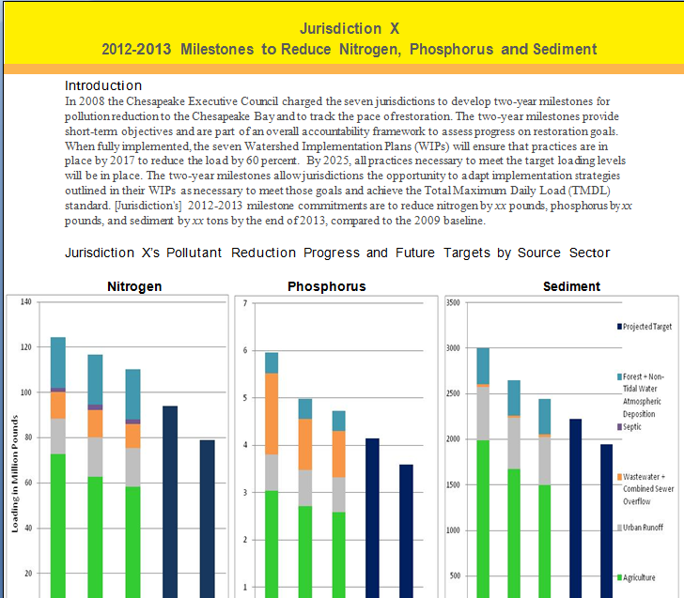
4. 2012-13 Milestones

Slide 12
5. Nutrient and Sediment Trends
Part of proposed integrated approach to better assess and communicate progress toward attainment of water-quality standards (more detail in next presentation)
Provided for two periods, long-term changes (1985-2010) and over 10 years (2001-2010)
Uses the CBP nontidal monitoring network to show changes

Slide 13
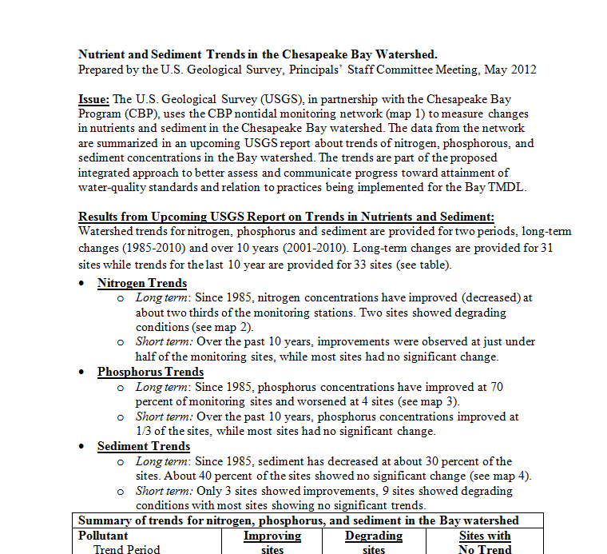
5. Nutrient and Sediment Trends

Slide 14
Presentation Mock-up
2011 Progress (Draft) in Relation to 2009 Baseline, 2013 Milestone (Draft), 2017 Interim Target and 2025 Planning Target

Slide 15
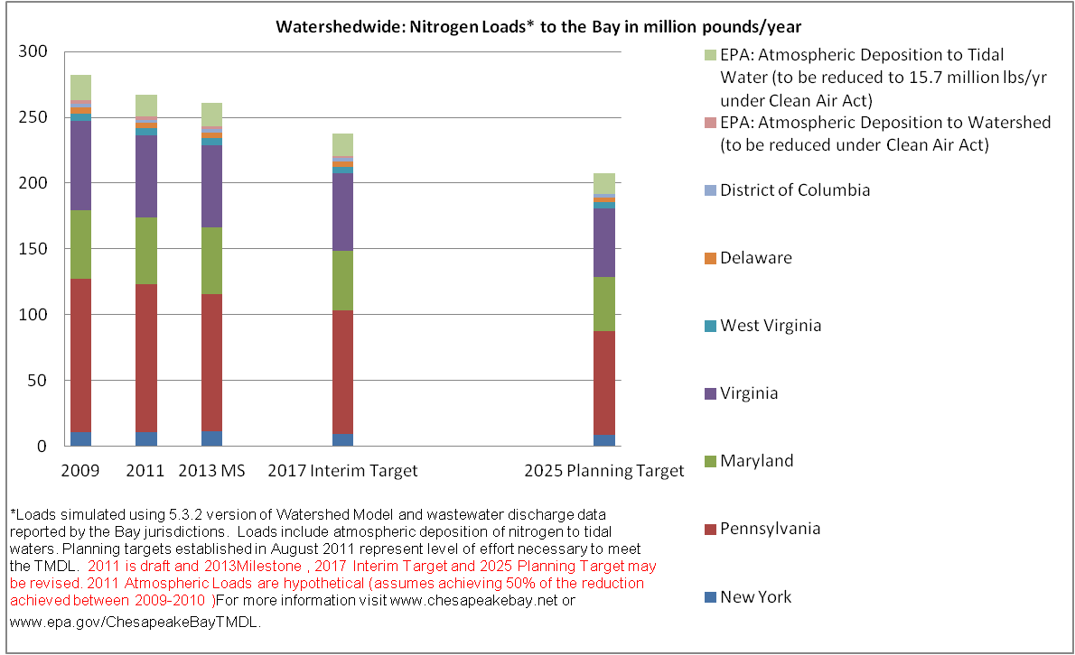
Option 1
Notes:
Nitrogen Loads to Bay, millions of pounds, simulated using CBP phase 5.3.2 Watershed Model (2009N051811AA_CDF; 2011 Progress N033012 AA_CFD). "AA_CFD" refers to the scenarios run using "Allocation Air" and "Constant Delivery Factors.
2011 Atmospheric Loads are hypothetical (assumes achieving 50% of the reduction achieved between 2009-2010 ).
2013 MS are based on 020212 "2013 Final Milestones" for jurisdictions. Based on straightline trajectory to 2017 for EPA At Dep loads
2025 Planning Targets, established 8/1/11, are for development of Phase II Watershed Implementation Plans
2017 targets are calculated as follows: 2017=2009Load-0.6*(2009Load-2025load)
Atmospheric deposition simulated using the Chesapeake Bay Airshed Model (a combination of a regression model of wet deposition and a continental-scale air quality model of North America called the CMAQ for estimates of dry deposition).
Atmospheric deposition to the watershed that is EPA's responsibility to reduce under the Clean Air Act is calculated by subtracting the totals of the 2009N051811AA_CDF and 2011 Progress N033012 AA_CFD scenarios from the; 2009N051811_CDF and 2011Progress N033012_CDF scenarios

Slide 16
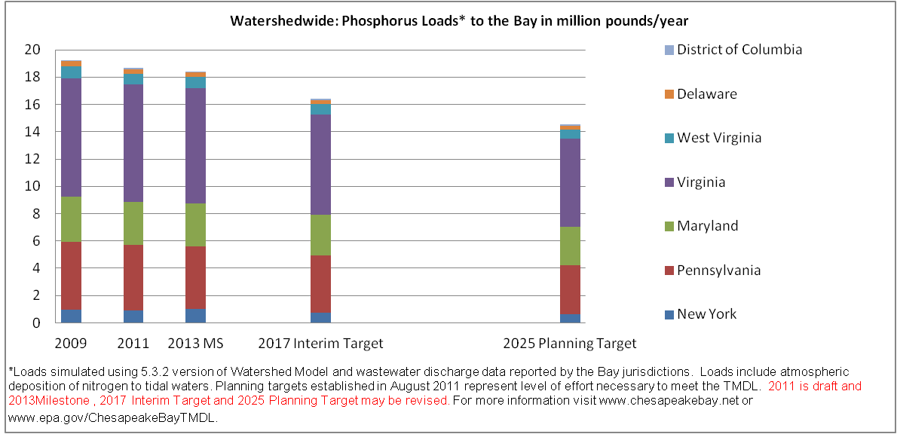
Notes:
Nitrogen Loads to Bay, millions of pounds, simulated using CBP phase 5.3.2 Watershed Model (2009N051811AA_CDF; 2011 Progress N033012 AA_CFD). "AA_CFD" refers to the scenarios run using "Allocation Air" and "Constant Delivery Factors.
2011 Atmospheric Loads are hypothetical (assumes achieving 50% of the reduction achieved between 2009-2010 ).
2013 MS are based on 020212 "2013 Final Milestones" for jurisdictions. Based on straightline trajectory to 2017 for EPA At Dep loads
2025 Planning Targets, established 8/1/11, are for development of Phase II Watershed Implementation Plans
2017 targets are calculated as follows: 2017=2009Load-0.6*(2009Load-2025load)
Atmospheric deposition simulated using the Chesapeake Bay Airshed Model (a combination of a regression model of wet deposition and a continental-scale air quality model of North America called the CMAQ for estimates of dry deposition).
Atmospheric deposition to the watershed that is EPA's responsibility to reduce under the Clean Air Act is calculated by subtracting the totals of the 2009N051811AA_CDF and 2011 Progress N033012 AA_CFD scenarios from the; 2009N051811_CDF and 2011Progress N033012_CDF scenarios

Slide 17
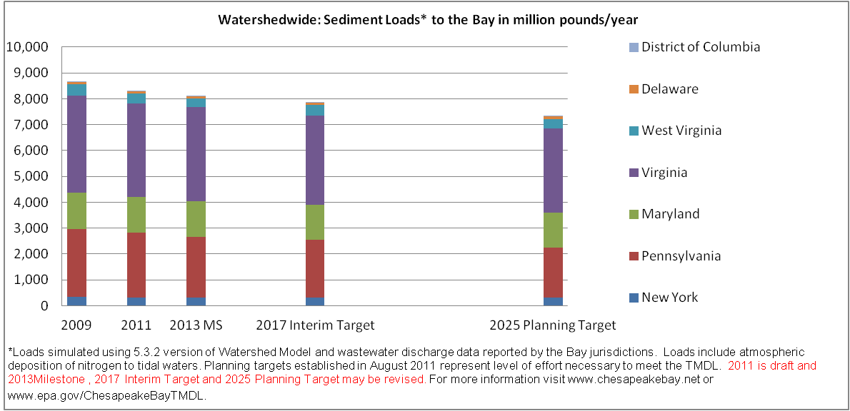
Notes:
Nitrogen Loads to Bay, millions of pounds, simulated using CBP phase 5.3.2 Watershed Model (2009N051811AA_CDF; 2011 Progress N033012 AA_CFD). "AA_CFD" refers to the scenarios run using "Allocation Air" and "Constant Delivery Factors.
2011 Atmospheric Loads are hypothetical (assumes achieving 50% of the reduction achieved between 2009-2010 ).
2013 MS are based on 020212 "2013 Final Milestones" for jurisdictions. Based on straightline trajectory to 2017 for EPA At Dep loads
2025 Planning Targets, established 8/1/11, are for development of Phase II Watershed Implementation Plans
2017 targets are calculated as follows: 2017=2009Load-0.6*(2009Load-2025load)
Atmospheric deposition simulated using the Chesapeake Bay Airshed Model (a combination of a regression model of wet deposition and a continental-scale air quality model of North America called the CMAQ for estimates of dry deposition).
Atmospheric deposition to the watershed that is EPA's responsibility to reduce under the Clean Air Act is calculated by subtracting the totals of the 2009N051811AA_CDF and 2011 Progress N033012 AA_CFD scenarios from the; 2009N051811_CDF and 2011Progress N033012_CDF scenarios

Slide 18
Watershed-wide progress
Include key “highlights” (to be ID’d by the jurisdictions in the 2009-2011 MS factsheets) of accomplishments
Identify key highlights of actions that are expected to be taken in 2012-13 (to be ID’d by the jurisdictions in the 2012-13 MS factsheets)

Slide 19
Monitoring Results and Opportunities
Could include:
Long term and short term non-tidal trends in N, P
Tidal Monitoring results for 2011 for Water Clarity, DO
New nontidal monitoring to improve understanding of water quality changes based on actions taken

