Slide 1
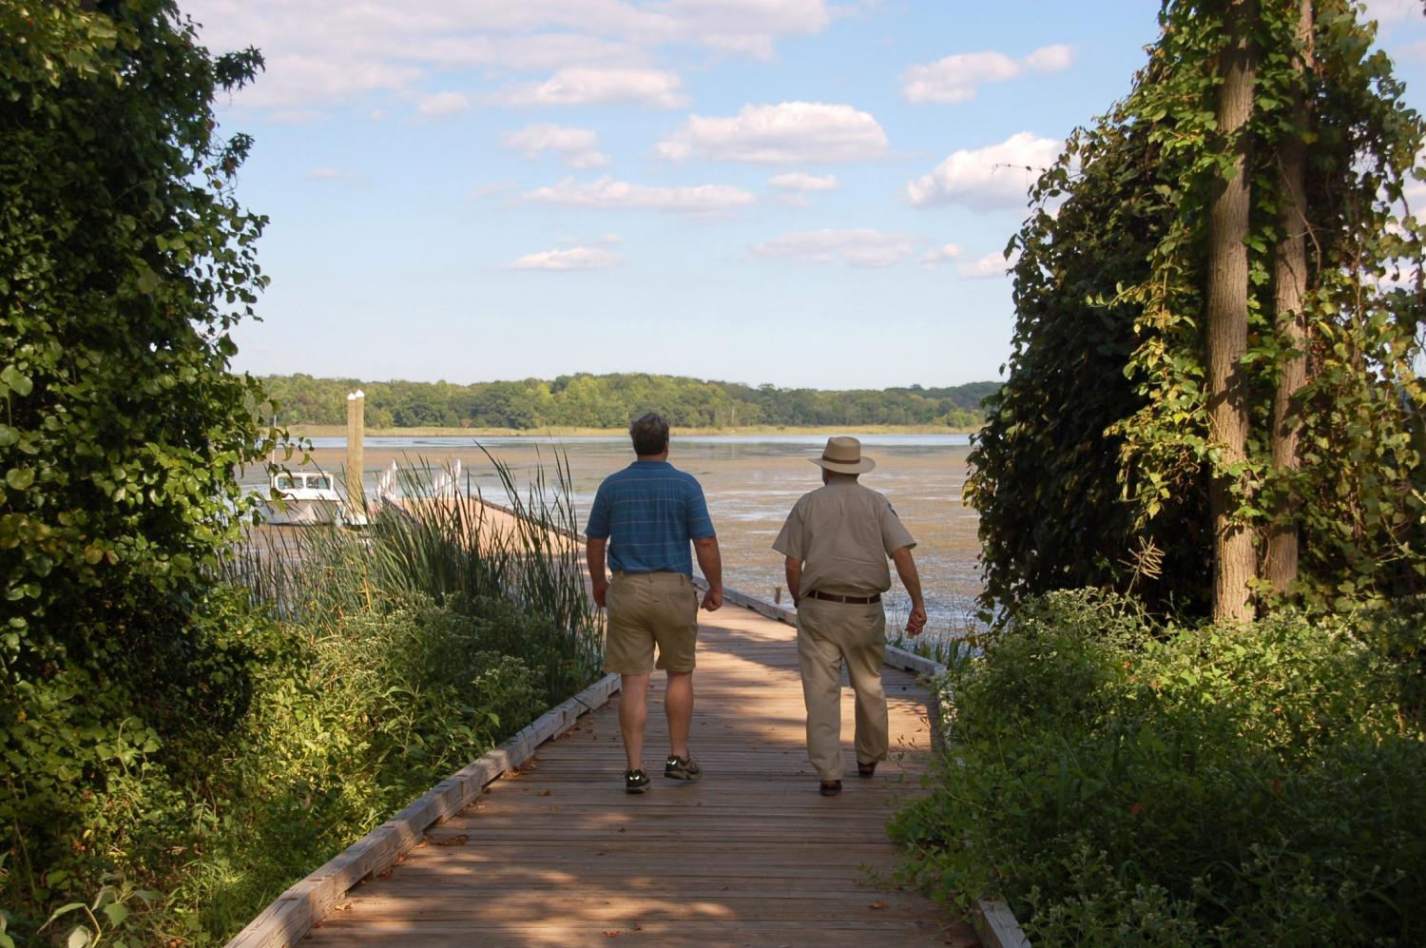
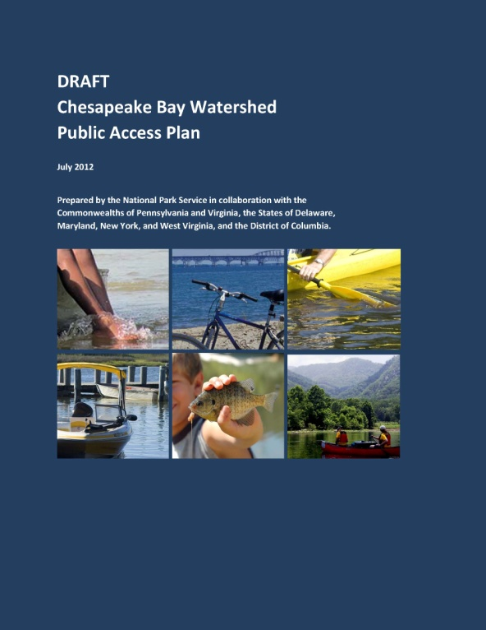
Chesapeake Bay Watershed
Public Access Plan

Slide 2
Public Access Plan
The Strategy for Protecting and Restoring the Chesapeake Bay Watershed was released in May 2010, in response to Executive Order 13508 (Chesapeake Bay Protection and Restoration) issued by President Obama.
It includes a key goal to increase public access to the Bay and its tributaries by adding 300 new public access sites by 2025.

Slide 3
Public Access Action Team
John Davy, National Park Service – Chesapeake Bay Office
Andy Fitch, National Park Service – Chesapeake Bay Office
Heather Bennett, National Park Service – Chesapeake Bay Office
Sarah Brzezinski, Chesapeake Research Consortium
Andrea Almond, Virginia Department of Conservation and Recreation
Tom Ford, Pennsylvania Department of Conservation and Natural Resources
Lisa Gutierrez, Maryland Department of Natural Resources
Larry Hart, Virginia Department of Game and Inland Fisheries
Mark Hohengasser, New York State Parks
Jackie Kramer, Pennsylvania Fish and Boat Commission
Michael Krumrine, Delaware Department of Natural Resources and
Environmental Control
Susan Moerschel, Delaware Department of Natural Resources and
Environmental Control
Danette Poole, Virginia Department of Conservation and Recreation
Bret Preston, West Virginia Division of Natural Resources
Tammy Stidham, National Park Service – National Capital Region
Emily Wilson, Maryland Department of Natural Resources

Slide 4
Public Access Plan
To develop plan to accomplish this task the Public Access Action Team needed to:
Define Study Area
Develop Definition of Public Access
Inventory Existing Sites
Identify Potential New Sites

Slide 5
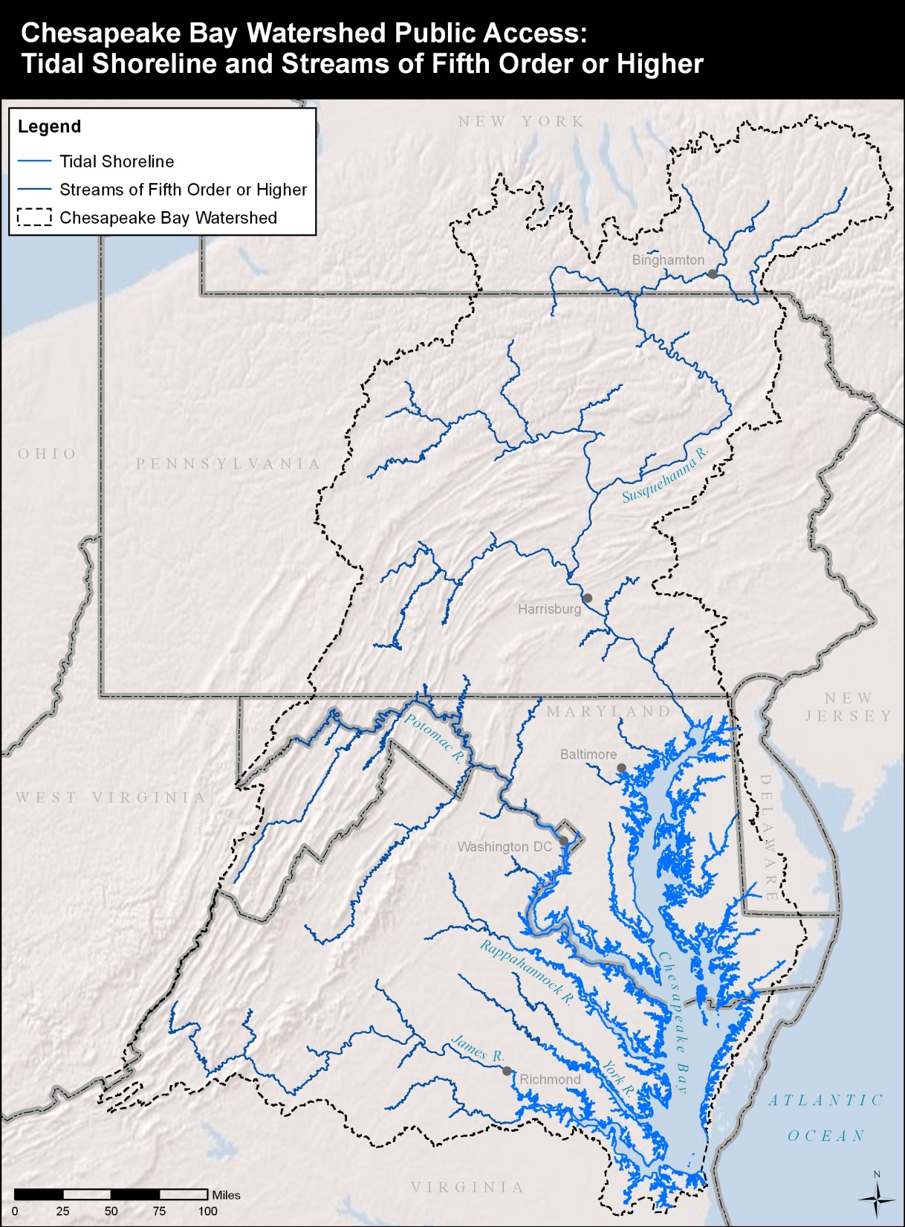
Study Area:
All tidal streams and bays
Streams classified as “fifth-order” and higher
Smaller than fifth-order when part of a water trail or contribute to its development.

Slide 6
Public Access Plan
Definition:
Public access sites are locations owned and managed by a public entity (or a nonprofit organization in an agreement with a public entity) for the purposes of providing:
Boat-related access: boat ramps, car-top boat launches, soft launches (supporting paddle craft, motor, and/or sail boats).
Swimming access: designated areas appropriate for swimming
6

Slide 7
Public Access Plan
Definition (cont.):
Fishing access: piers, bank fishing facilities or easements, and parking adjacent to the water
Viewing access for water, wildlife, and shoreline areas: nature trails, hiking or biking trails, waterfront access trails, boardwalks, and observation decks located at or leading directly to the water’s edge.
7

Slide 8
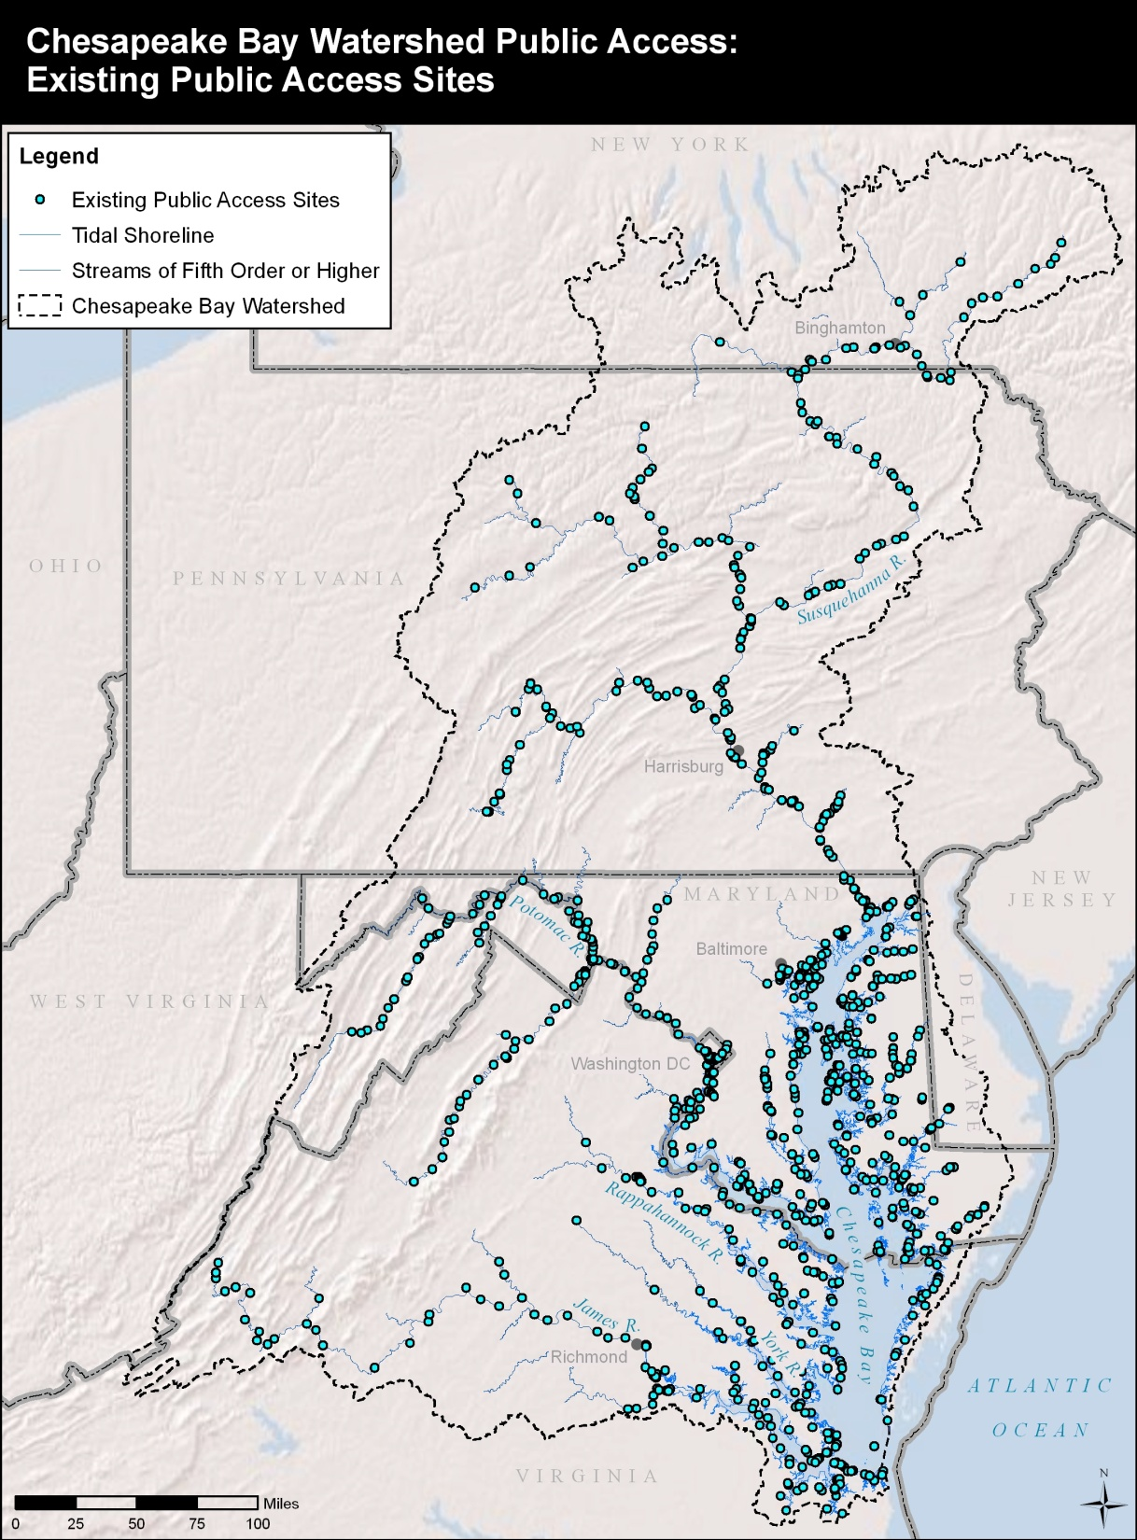
Inventory Process:
Review existing data
Public workshops
On-line public mapping tool
Results:
1,144 existing sites
sites average 15 miles apart
Less than half provide boat access

Slide 9
Public Access Plan
Potential New Site Identification:
Planning team reviewed existing planning documents
Members of the public identified hundreds of additional desired sites at workshops and on-line.
Team reviewed and refined the list of sites for this plan
9

Slide 10
Public Access Plan
Results of Process:
316 specific potential new sites identified
  Over half are on publicly owned land.
  Boat launches are the most frequently suggested access type for these sites (47% of the total sites).
10

Slide 11
Potential New Sites Continued:
A high demand for new public access sites is frequently concentrated in and around urban areas.
A large number potential sites are along existing water trails or national historic trails, which can bring strong community and local support for developing needed sites.
Members of the paddling public frequently expressed a desire for small primitive campsites, picnic areas, and restrooms at appropriate locations along water trails.

Slide 12
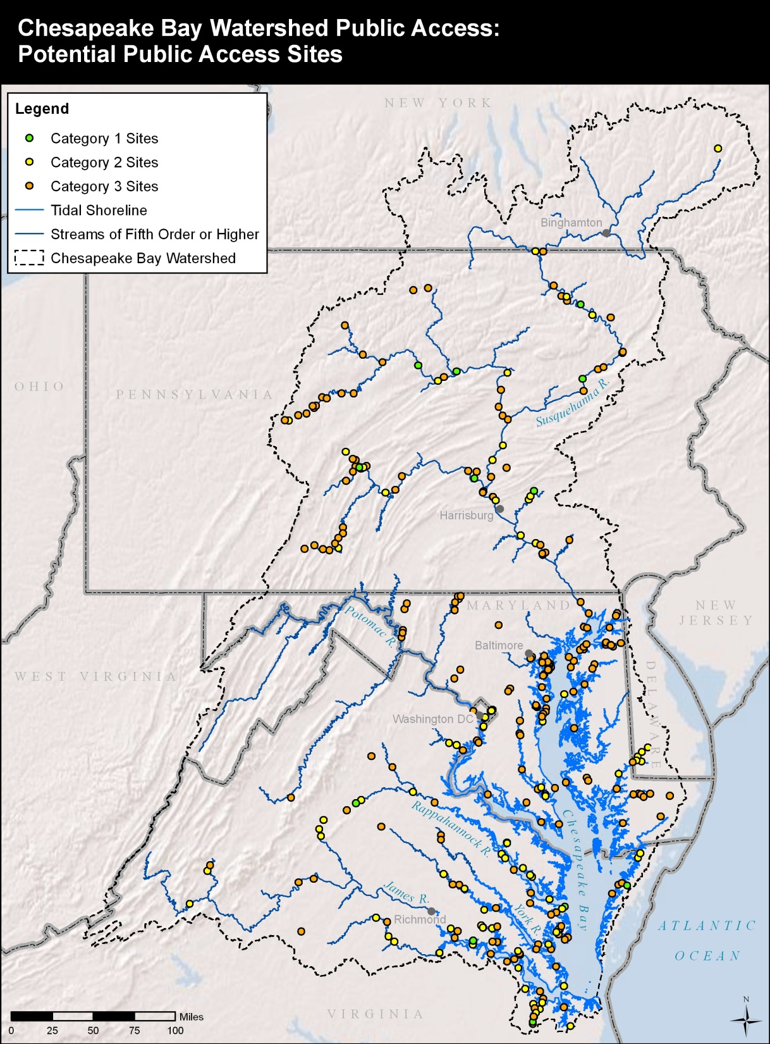

Slide 13
Public Access Plan
Key Actions From Plan:
Make funding for public access a priority
Do more assessment and design for potential access sites
Fill strategic gaps along the trails
Work with private sector funders
Incorporate potential public access sites in key state and local plans
13

Slide 14
Public Access Plan
Key Actions From Plan:
Further examine urban issues and needs
Hydro Power relicensing as way to expand access
Explore options for railroad crossing liability
Establish MOUs with DOTs
Explore potential for additional access on public lands
Further address accessibility issues
Build opportunities for citizen stewardship
14

Slide 15
Public Access Plan
Relationship to Land Conservation & Bay Watershed Protection:
People generally care for what they love
Most of the potential public access sites are along designated trails, have public support
Evocative settings are a key component of trails, conserved lands protect these settings and may provide public access.
Public access is a good reason to protect land, it provides direct public use benefit.
15

Slide 16
Public Access Plan
Bottom Line:
There is a high need for additional public access. This plan provides guidance and support for development of new access sites. Thus when land use planning or land conservation is being considered along the Bay and its tributaries appropriate public access should always be evaluated as part of the potential use mix.
16

