Slide 1
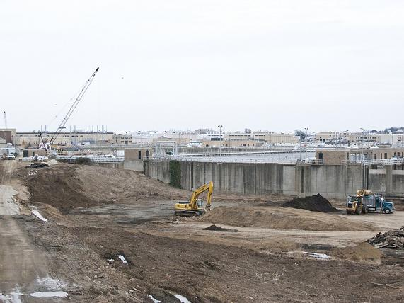
Proposal for a Supplemental Wastewater Indicator
Katherine Antos, Water Quality Team Leader
Water Quality Goal Implementation Team Coordinator
U.S. EPA Chesapeake Bay Program Office
Chesapeake Bay Program Management Board
May 9, 2012

Slide 2
Background
Maryland suggested alternative wastewater indicator since wastewater data in current Reducing Pollution Indicators are affected by annual weather variations but other loads are not
Discussed with the Wastewater Treatment Workgroup, Water Quality Goal Implementation Team, and Management Board between October 2011 and April 2012
Guiding principles:
Maintain current Reducing Pollution Indicator based on wastewater monitoring data
Add supplemental indicator to clearly communicate on-the-ground efforts
Minimize reporting burden to the jurisdictions

Slide 3
Proposed Supplemental Indicator
On April 9, WQGIT approved the following indicator pending review of the indicator results:
“The number and/or percentage of significant wastewater facilities with nutrient treatment technology operational and installed that will attain the wasteload allocation at the permitted flow. Indicator data to also include facilities that achieve permit limits through trading/offset programs.”
Indicator would be based on whether permit limits for significant facilities have reached their effective date
April 30: WQGIT and WWTWG approved sharing the following options with the Management Board
New York abstained

Slide 4
Option 1:

Slide 5
Option 2:

Slide 6
Features
Data based on same reporting period as Reducing Pollution Indicator
Will show same years as Reducing Pollution Indicator
Executive summary will focus on watershed-wide progress. State-specific progress available online
In the future, could consider incorporating numbers or percents based on design flow

Slide 7
Decisions Requested
Do you approve the adoption of a supplemental indicator that tracks significant wastewater facilities that that are meeting Bay TMDL WLAs?
If yes, would you prefer that this indicator report the number of significant facilities or the percent of significant facilities?

