Slide 1
Request to Revise the Executive Order Brook Trout Outcome to Align with State Restoration Efforts
Jeff Horan, Habitat GIT Chair
Doug Stang, EBTJV Steering Committee Chair

Slide 2
Objectives
Inform the Management Board of the rationale for a revised Brook Trout Outcome that is
  Correct scale
  Cost effective
  Detects meaningful change
Seek guidance on the process for advancing the revised Brook Trout Outcome

Slide 3
Brook Trout Outcome
2010 EO Strategy: Restore 58 sub-watersheds from ‘reduced’ (10-50% habitat loss) to ‘healthy’ (less than 10% habitat loss) classification by 2025.
  Crafted with input from Habitat GIT and EBTJV
February 24, 2012 the EBTJV recommended the outcome be revised to reflect new science conducted at finer catchment-scale
- Sub-watersheds are HUC 6, catchments are finer scale

Slide 4
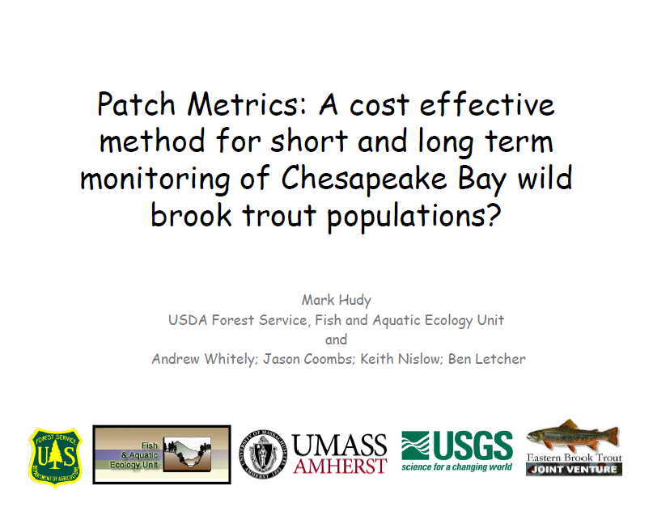

Slide 5
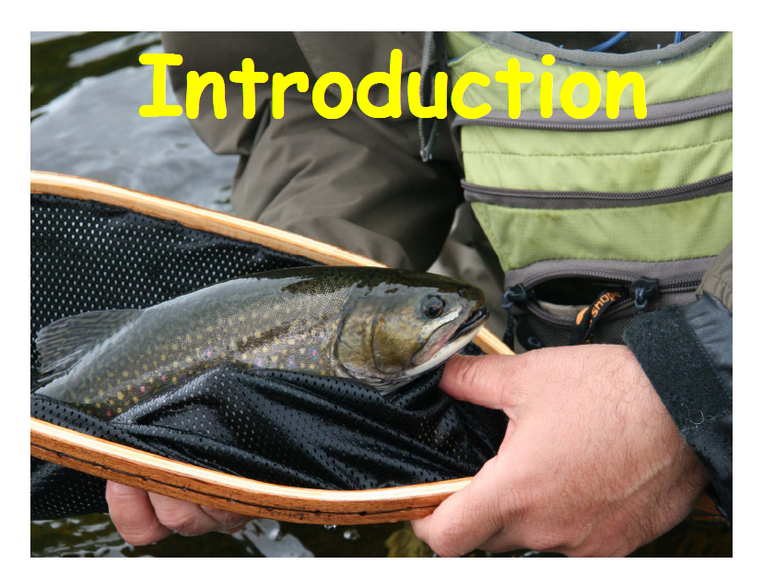

Slide 6
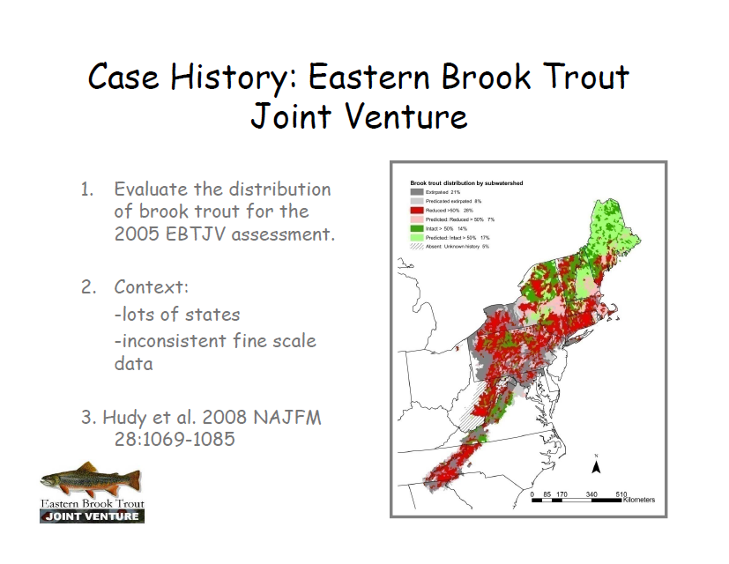

Slide 7
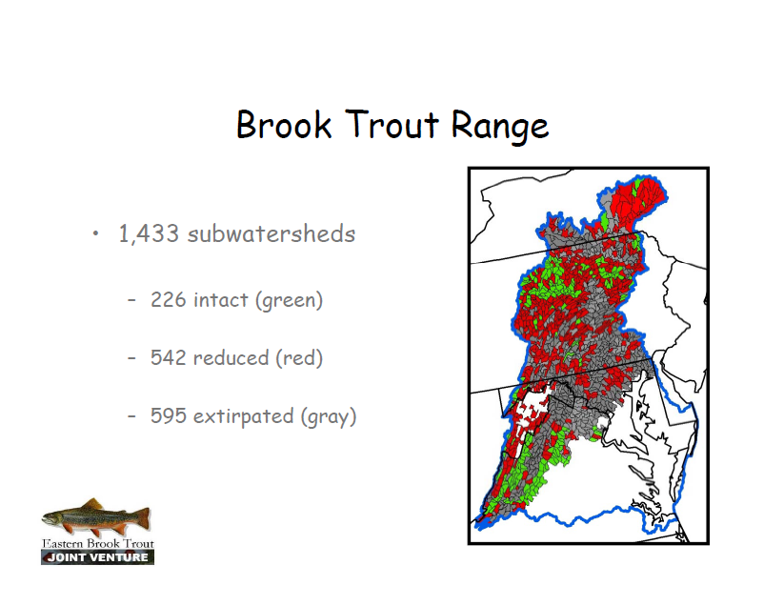

Slide 8
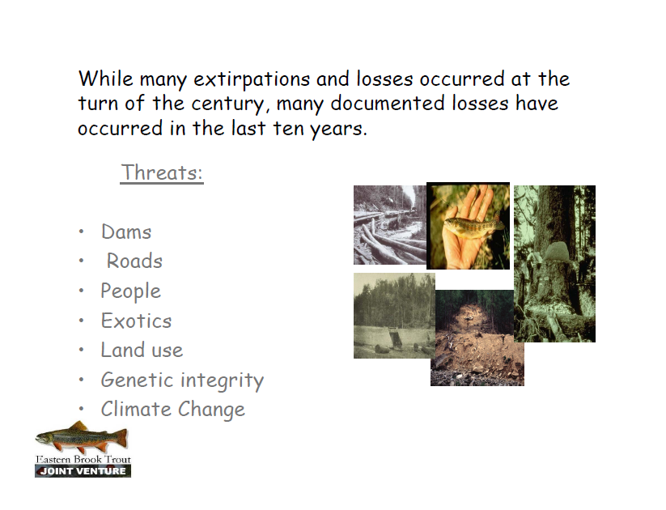

Slide 9
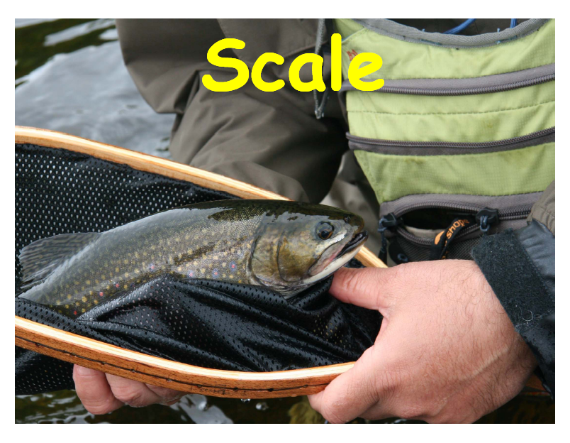

Slide 10
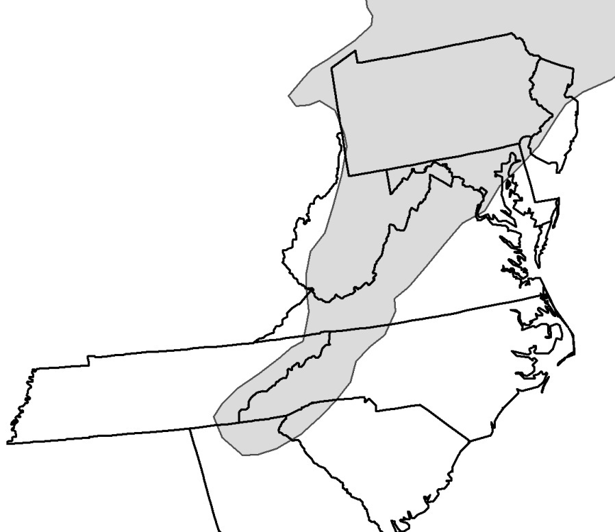
Assessment Scales
Sub-basins (4th HUC; 8 digit)
53 (avg size= 254,172 ha)
Watersheds (5th HUC;
10 digit)
690 (avg size = 41,201 ha)
Subwatersheds (6th HUC;
12 digit)
3,079 (avg size = 8,879 ha)
Catchments (14 digit ?)
124,688 (avg size = 237 ha)

Slide 11
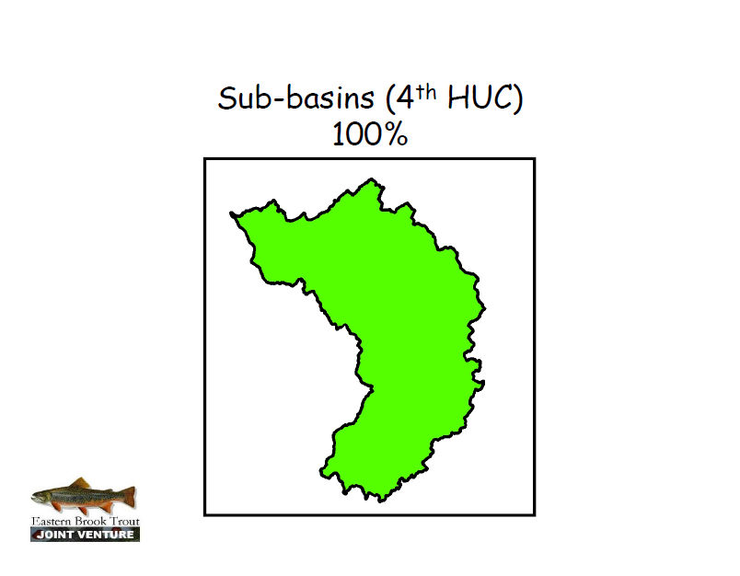

Slide 12
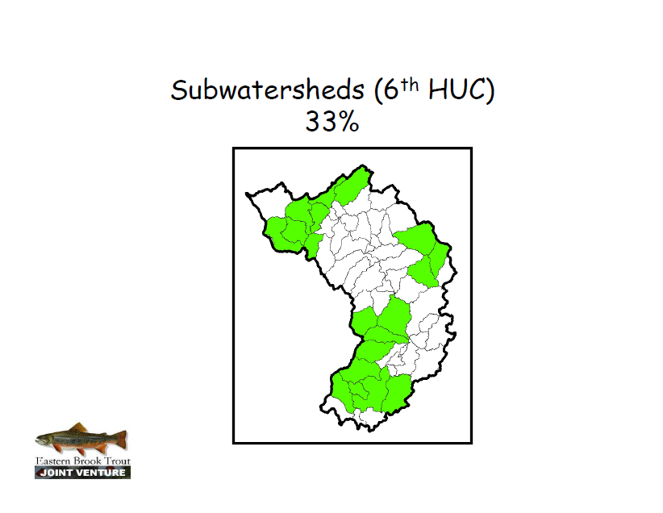

Slide 13
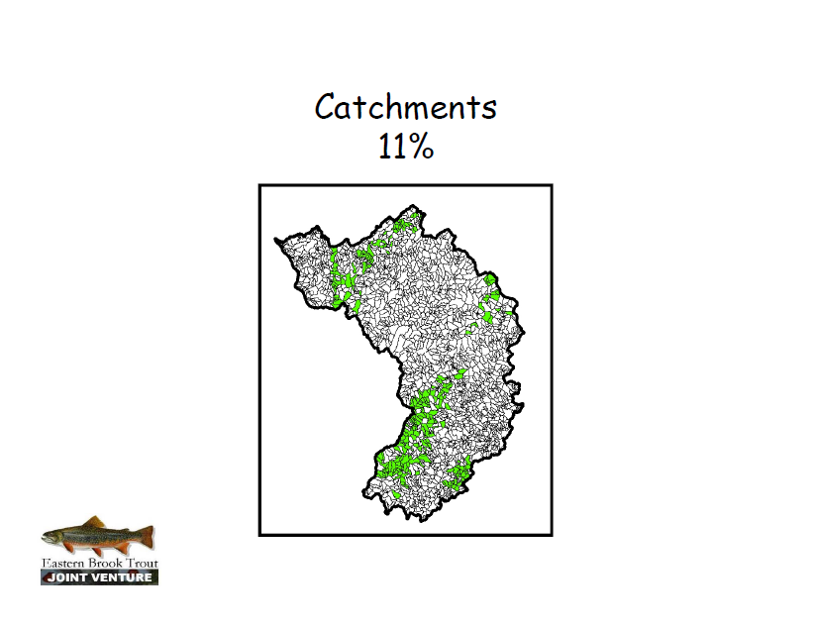

Slide 14
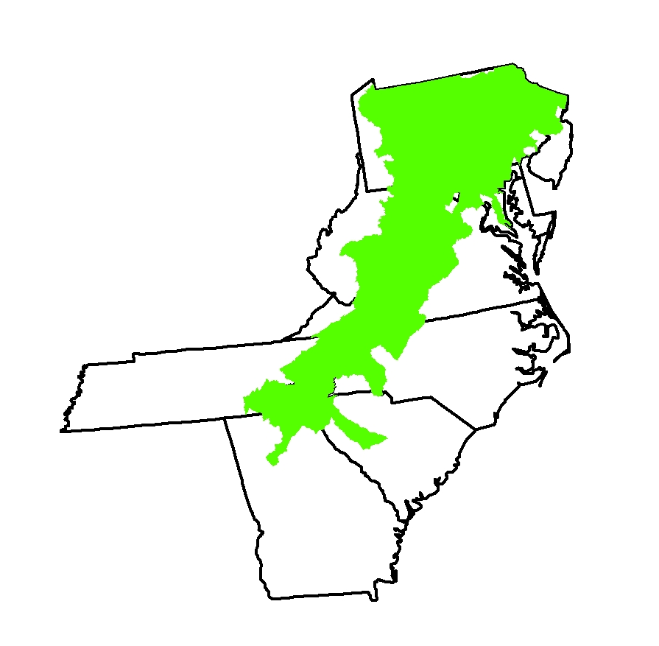
Brook Trout Distribution: Sub-basin (4th HUC)
88% of 85 sub-basins
“Brook trout are well distributed throughout their native range”.

Slide 15
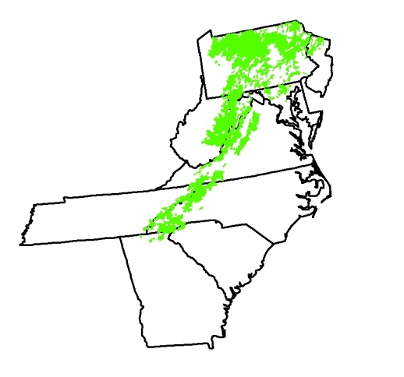
Brook Trout Distribution: Watershed (5th HUC)
72% of 690 watersheds
“There have been some losses of brook trout but they are still found in approximately 75% of their range”.

Slide 16
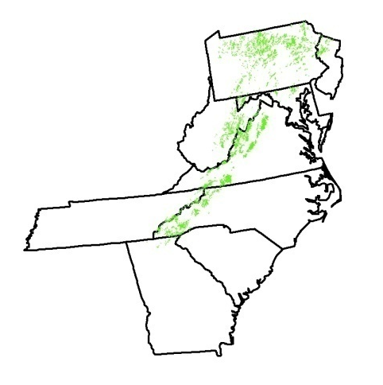
Brook Trout Distribution: Subwatershed (6th HUC)
47 % of 3,079 subwatersheds
“Brook trout have been extirpated from over half of their historic subwatersheds”.

Slide 17
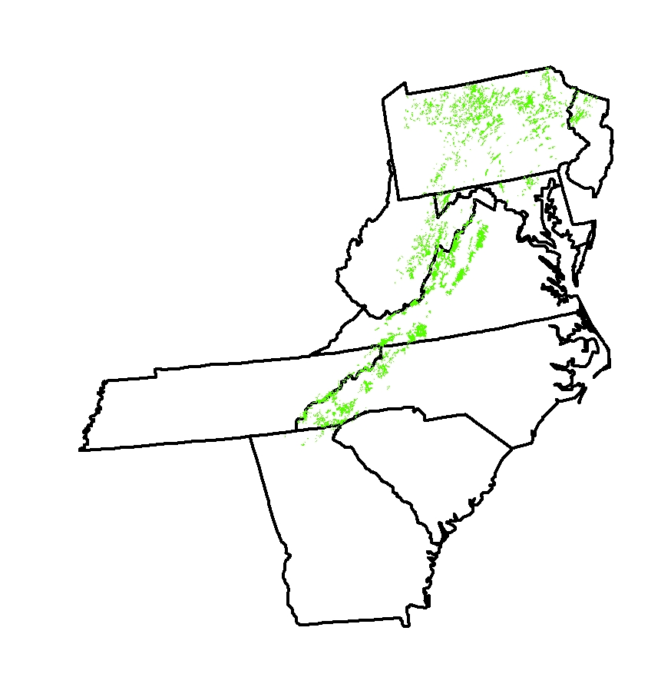
Brook Trout Distribution: Catchments
11 % of 124,688
catchments
“Brook trout do not occupy 90% of their historic catchments”

Slide 18
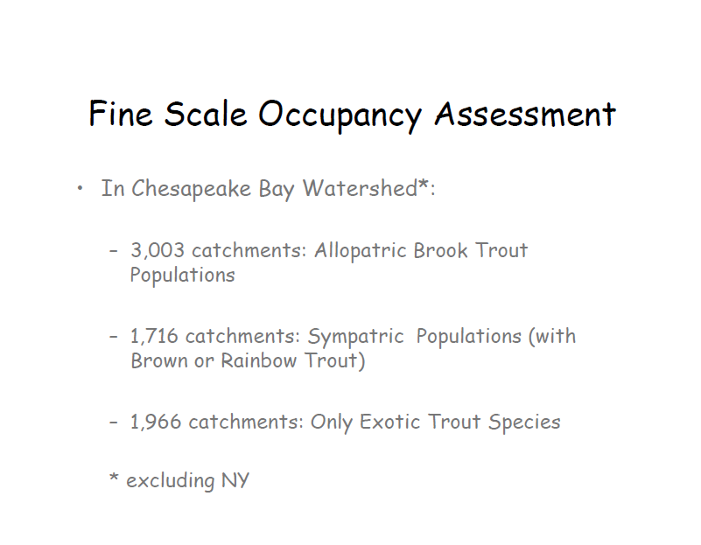

Slide 19
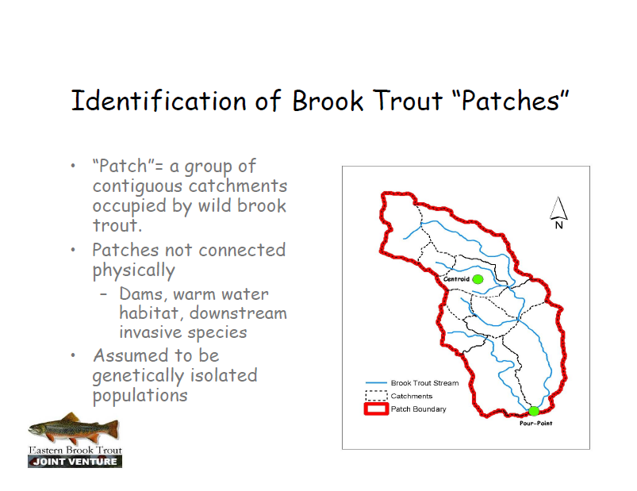

Slide 20
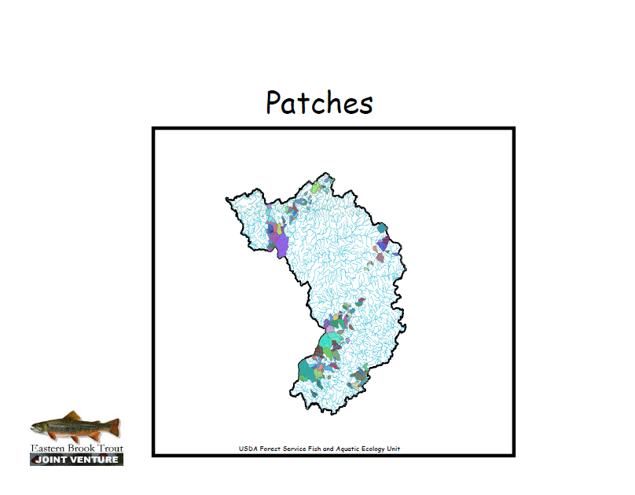

Slide 21
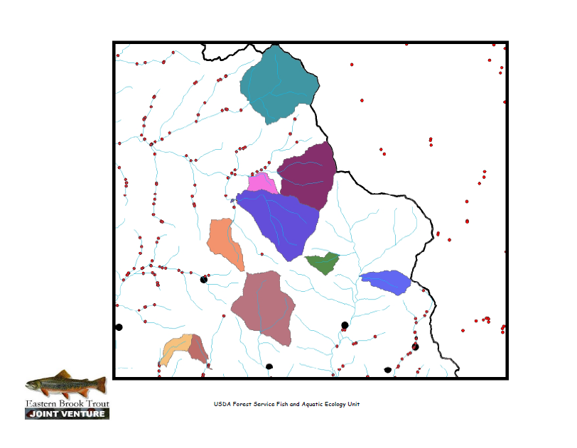

Slide 22
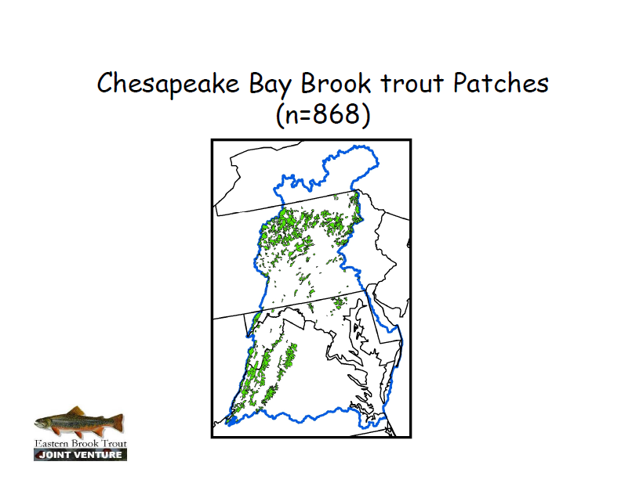

Slide 23
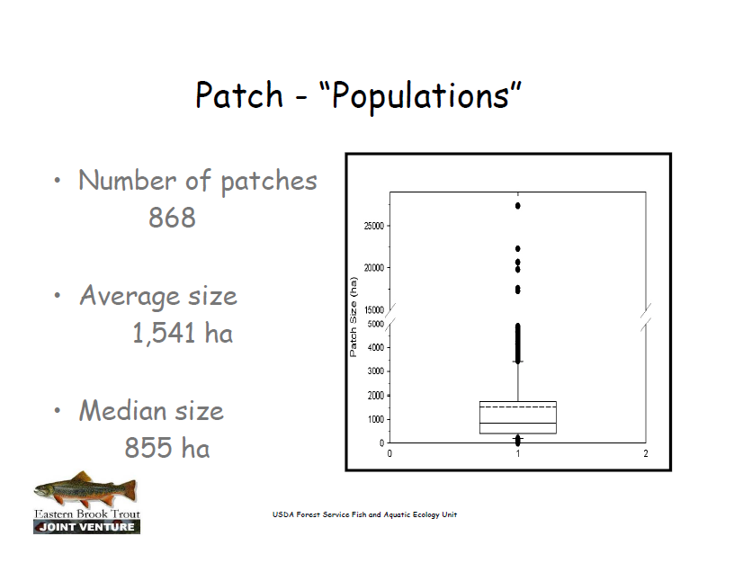

Slide 24
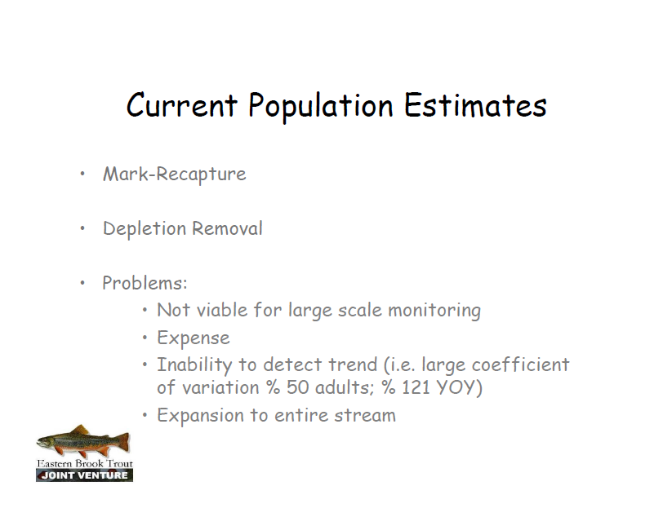

Slide 25
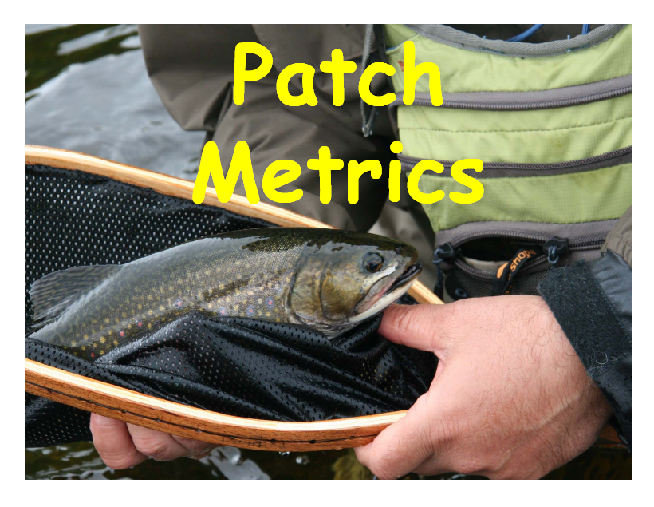

Slide 26
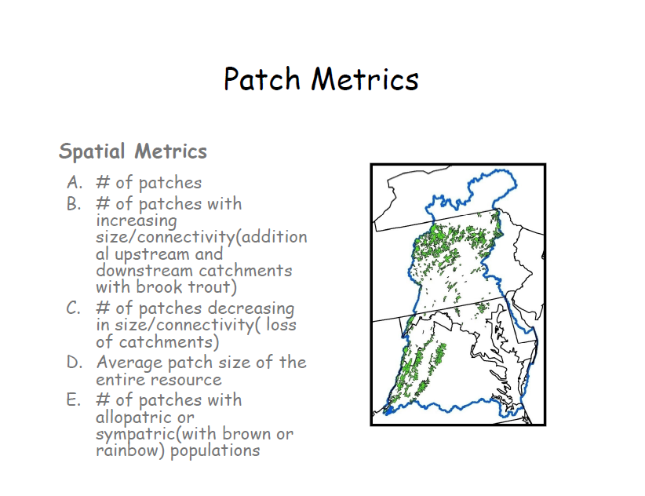

Slide 27
Questions?

