Slide 1

Providing businesses with a forum where they can make their voices heard, share best practices, facilitate volunteer opportunities for employees...

Slide 2
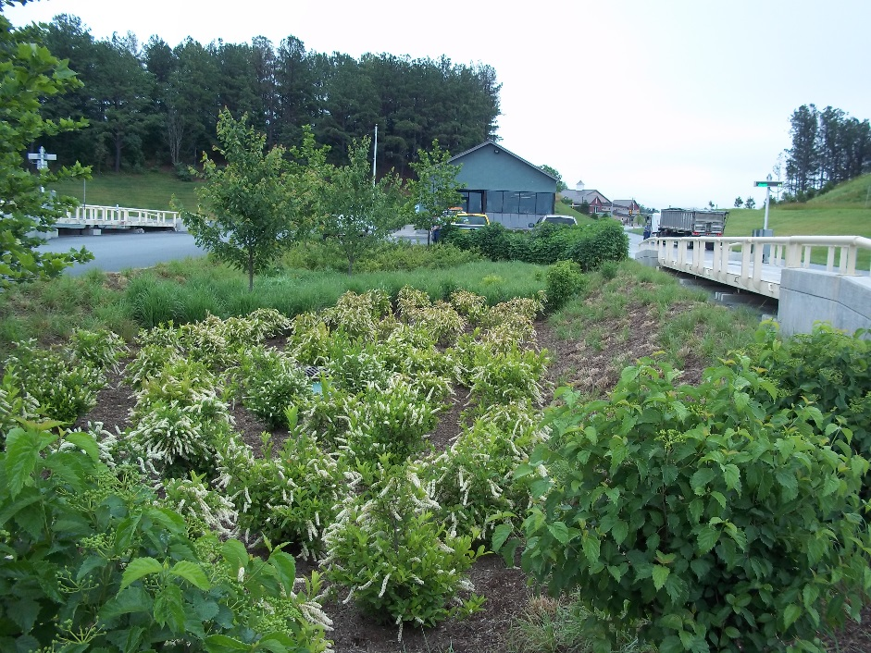
By Business, For Business
Recognize Business Innovation and Achievement
Link Sustainability and Chesapeake Bay Goals
Harness the Power of Employee Engagement
Business-Based Steering Committee
Build a Collaborative Network
Share Information
Luck Companies
Notes:
To build this, this is what businesses thought useful. Held several business forums, businesses suggest we focus on these bullets, as per the forums. This is what businesses want to see in B4B

Slide 3
Mission Statement
The Businesses for the Bay (B4B) program encourages businesses within the
Chesapeake Bay watershed to take voluntary and measurable actions to support protection and restoration of the Chesapeake Bay
and help the public understand the valuable role of the business community in sustaining the health of the Chesapeake Bay and its watershed.

Slide 4
Reasons to Join the B4B Membership Association
Be part of a network of business leaders
Associate with the trusted Alliance for the Chesapeake Bay
Connect with local NGOs, governments, & watershed groups
Take voluntary and measurable actions
Share lessons learned, success stories, and best practices
Enhance business social responsibility
Participate in professional development opportunities
Build recognition
Engage employees
Accomplish environmental sustainability goals

Slide 5
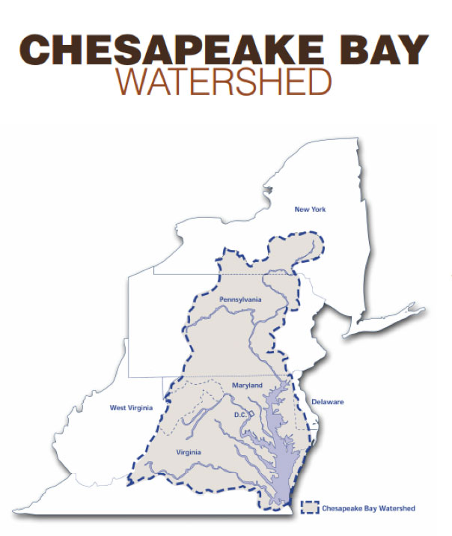
An association of businesses working towards a common goal: Who should join?
Businesses
Throughout the Watershed
All sizes
All sectors
With or without sustainability goals
Employee interest a plus
Notes:
B4B is envisioned as a business association of businesses working towards a common goal, so like other associations you’d be a member

Slide 6
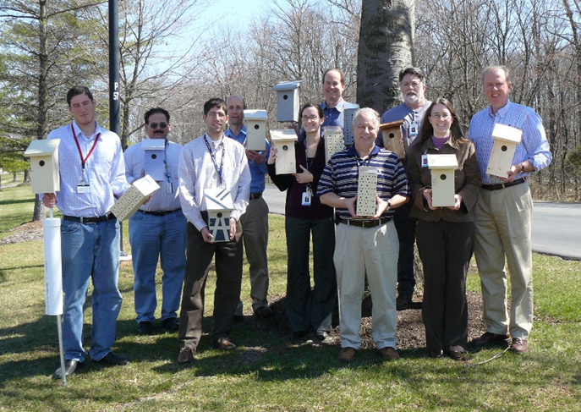
Ways to Join Businesses for the Bay
Be a Member
Be a Sponsor
Be a Networking Partner
Lockheed Martin
Notes:
Some companies, such as Luck Companies, are a Member and a Sponsor!

Slide 7
B4B Membership Requirements
Member must be a business
In compliance, or working towards compliance, with all applicable environmental regulations and requirements
B4B Actions voluntarily go above and beyond requirements
Pledge to actively participate and encourage employees to volunteer
Commit to at least one Action tied to the Chesapeake Bay Watershed Agreement
Membership application
Membership fee

Slide 8
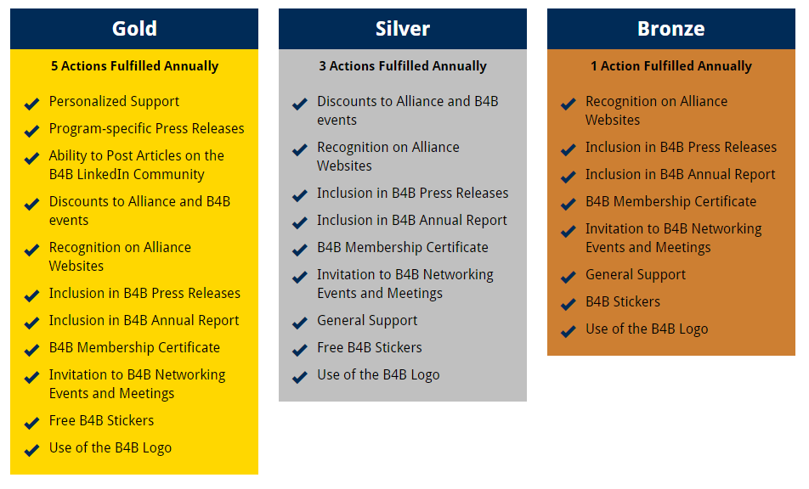
B4B Membership Levels & Benefits
B4B Membership Levels are Action-Based

Slide 9
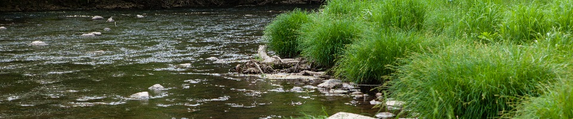
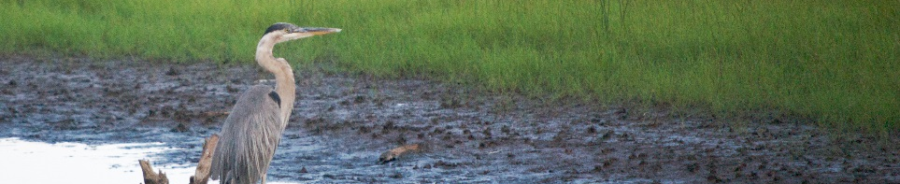
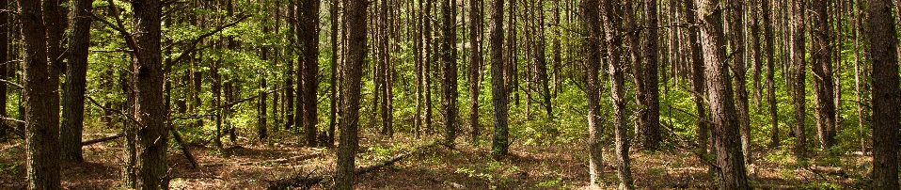
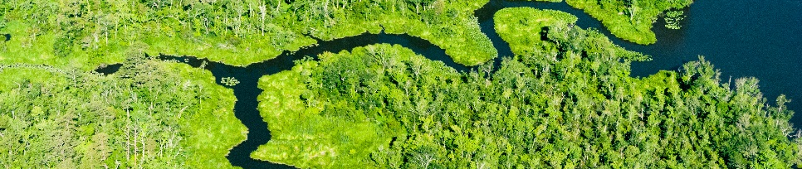
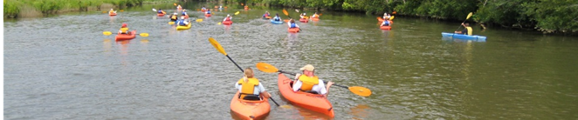
Example Actions to Achieve Vision
of an environmentally and economically sustainable Chesapeake Bay watershed
Decrease impervious surfaces
Keep trash out of waterways
Maintain streambanks and shorelines
Clean Water
Install or maintain wildlife habitat structures
Plant native trees
Control non-native, invasive species
Abundant Life (Fisheries and Habitats)
Protect wildlife corridors
Protect land in a voluntary conservation easement
Acquire new land, with the purpose of conservation
Conserved Lands
Manage and protect cold, clean streams
Conduct a Flood Vulnerability Analysis
Climate Change Resiliency
Create or sustain a "green team"
Provide environmental education opportunities
Participate in Project Clean Stream
Engaged Communities
Photos Courtesy of Chesapeake Bay Program
Notes:
Some actions are eligible to be counted by the states under the Watershed Agreement. We hope to facilitate that linkage.

Slide 10












Businesses for the Bay Founding Members (68 Actions)
AKRF, Inc. - Maryland Office
Dancing Grass Designs
Earth & Water Group
EcoLogix Group
ECS Mid-Atlantic, LLC
InClime Solutions
LandStudies, Inc.
Lockheed Martin - Manassas
Luck Companies - Corporate Campus
Octoraro Native Plant Nursery, Inc.
Perdue Farms
Science Systems and Applications, Inc. Smithfield Foods
Stormwater Maintenance & Consulting

Slide 11
Annual B4B Membership Fees
1-50 employees: $200
51-100 employees: $500
101-1000 employees: $1,000
>1001 employees: $2,000
Bundle Discount*: $5,000
*For businesses with multiple facilities in the watershed

Slide 12
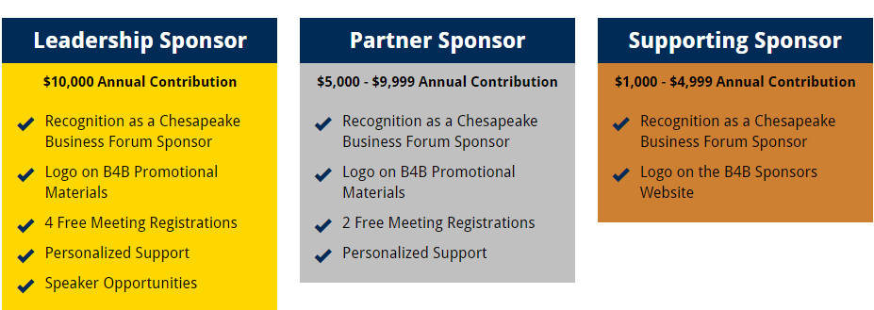
B4B Sponsorship Levels & Benefits
Annual Contribution in Addition to or Instead of Membership

Slide 13
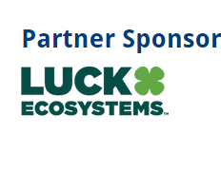

Many thanks to Luck Ecosystems and Chesapeake Center for Excellence
2016 Businesses for the Bay Sponsors!

Slide 14


B4B Networking Partners
Includes governmental and non-profit organizations
Participate in Businesses for the Bay events
Network with businesses and each other
Raise awareness
FREE
Picture Your logo Here!

Slide 15
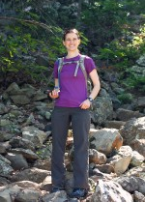

Contact Info
Corinne Stephens
Alliance for the Chesapeake Bay
Business Partnerships Manager
cstephens@allianceforthebay.org
http://businesses.allianceforthebay.org
Join our LinkedIn Group: https://www.linkedin.com/groups/8433450
Notes:
Everyone is invited to join our LinkedIn group!

