Slide 1
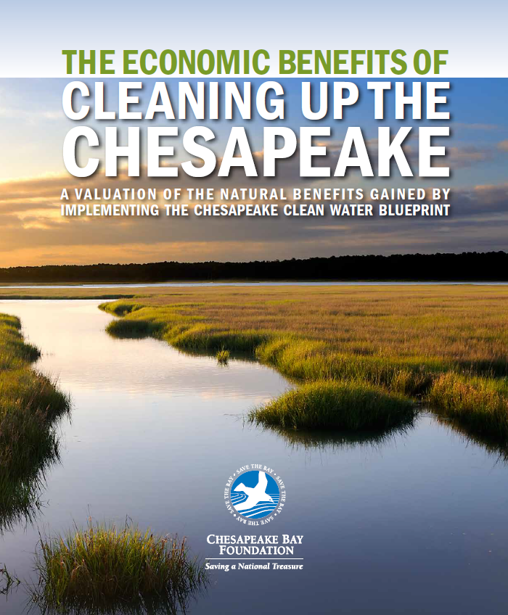

“The region’s environmental and economic health will improve when we fully implement the Blueprint. The cleanup plan was designed with the understanding that all people and communities in the watershed can contribute to making the Bay cleaner, and that everyone will benefit when pollution is reduced. Our analysis confirms this.”
Dr. Spencer Phillips,
lead author
Title Text for Slide
The Economic Report
Notes:
These are general validator quotes. This would be a great spot to insert a quote from one of your state-specific validators. Review the validator quotes circulated to staff to find one that works well for your audience…

Slide 2

Outline
What are ecosystem services?
What types of ecosystem services does the Bay and its watershed provide?
How will the Chesapeake Clean Water Blueprint affect them?
Study approach
Study results

Slide 3
“Ecosystem Services”
Our lands, waters, and associated plants and animals provide natural benefits that economists call ecosystem services. These benefits include production of goods such as food and timber; life-supporting processes such as water and air purification and flood protection; and life-enhancing assets such as beautiful places to recreate and live.

Slide 4
We chose 8 “ecosystem services” that are most likely to be affected by the Blueprint:
- Aesthetic value
- Air pollution treatment
- Climate stability
- Food production
- Recreation
- Waste treatment
- Water supply
- Water regulation

Slide 5

Examples of natural benefits by land use
Agriculture
Aesthetic value, food production
Air pollution treatment, water supply
Recreation, food production
Climate stability, waste treatment
Water regulation
Water regulation, waste treatment
Recreation
Forests (including buffers)
Open Water
Urban Open (parks, etc.)
Urban (impervious)
Wetland
Other
Ecosystem Services
Notes:
You might wonder- how are these categories really providing values- well here are some examples: on the water side- the blueprint will use natural systems to clean water which will mean less filtering by our treatment facilities. We will have less flooding damage, increased tourism and fishing, improved soil health will lead to drought resistance and thus more food production, trees in urban areas leads to reduce heat island effects in cities- they also reduce asthma cases and finally people enjoy living in pristine areas which would lead to an increase in property values.

Slide 6
How does the Blueprint lead to increased value?
Waste Treatment
Reduced treatment facility costs, (less to filter)
Water Supply
Water regulation
Reduced flood damage
Recreation
More eco-tourism, fishing trips, hiking
Food Production
Improved soil health (drought resistance), More fish and shellfish
Climate Stability
Reduced energy costs due to moderated urban temperatures
Air Pollution Trt
Reduction in asthma cases and other public health benefits
Aesthetics
Increased property values
Examples
Notes:
You might wonder- how are these categories really providing values- well here are some examples: on the water side- the blueprint will use natural systems to clean water which will mean less filtering by our treatment facilities. We will have less flooding damage, increased tourism and fishing, improved soil health will lead to drought resistance and thus more food production, trees in urban areas leads to reduce heat island effects in cities- they also reduce asthma cases and finally people enjoy living in pristine areas which would lead to an increase in property values.

Slide 7
Three Scenarios
  The present-day dollar value of natural benefits for the watershed (based on 2009 pre-Blueprint)
  The dollar value of the same services post-Blueprint
  Estimate of what we lose if we don’t fully implement the Blueprint (“Business as usual”)

Slide 8
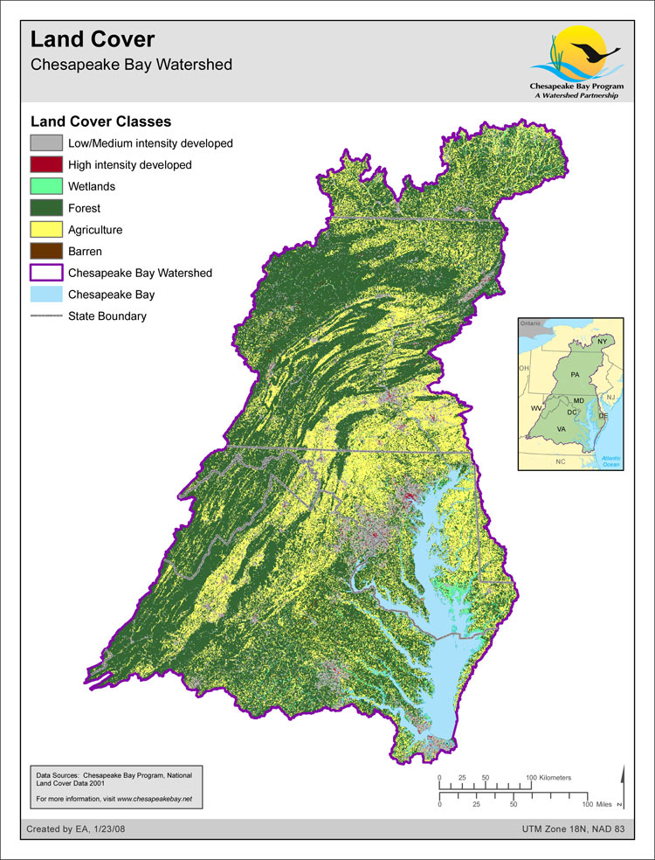
Approach
Worked with CBP staff to acquire fine scale land use information for entire watershed for the three scenarios

Slide 9
Approach
Implementation of Blueprint will have 2 primary effects:
Changes in acres of the various habitats e.g., increases in higher value habitats like forests
2. Improved condition of existing habitats and their services (e.g., increased Bay DO results in more food production, reduced nitrogen pollution means healthier wetlands that can better reduce flooding)

Slide 10
 | Baseline (2009) | Blueprint | Business as Usual
Tidal Segments (Health Indicator, 0-1 scale) | 0.709 | 1.000 | 0.709
Open Water (Acres) | 2,902,290 | 2,902,290 | 2,902,290
Non-Tidal Segments (Health Indicator, 0-1 scale) | 0.533 | 0.606 | 0.494
Agriculture (Acres) | 9,115,604 | 8,508,590 | 8,937,770
Forest (Acres) | 26,087,310 | 26,146,565 | 25,599,783
Open Water (Acres) | 418,638 | 418,638 | 418,638
Urban Open (Acres) | 1,827,581 | 2,138,186 | 2,157,705
Urban Other (Acres) | 3,272,272 | 3,519,108 | 3,627,798
Wetland (Acres) | 245,895 | 238,374 | 232,321
Other (Acres) | 130,960 | 128,794 | 124,252

Slide 11
Approach
Baseline Scenario
2009 land use
Adjust values of current condition (Baseline) based on a measure of human impact and degradation (“Index of Wildness”, Tidal DO).

Slide 12
Blueprint Scenario
2025 Projected land use w/Blueprint
“Upstream” improvement in habitat based on expected pollution reductions in sediment, nitrogen, and phosphorus
Tidal water improvement based on expected improvements in dissolved oxygen

Slide 13
BAU Scenario
2025 Projected landuse – no Blueprint
“Upstream” degradation in habitat based on expected pollution increases in sediment, nitrogen, and phosphorus in 2025 according to CBP projections
Tidal water dissolved oxygen assumed to be the same as 2009

Slide 14
Ecosystem Service Value (ESV)
Land use adjusted for quality (acre⁻¹) x
Ecosystem Service Value_{(land use type)}
($ acre⁻¹ year⁻¹)
=
Economic value ($ year⁻¹)
Total Value
Notes:
You might wonder- how are these categories really providing values- well here are some examples: on the water side- the blueprint will use natural systems to clean water which will mean less filtering by our treatment facilities. We will have less flooding damage, increased tourism and fishing, improved soil health will lead to drought resistance and thus more food production, trees in urban areas leads to reduce heat island effects in cities- they also reduce asthma cases and finally people enjoy living in pristine areas which would lead to an increase in property values.

Slide 15
Present-day Benefits
$107 billion annually –
spread across entire watershed

Slide 16
“Business as Usual”
  Without Blueprint: benefits decline to $101.5 billion annually – a loss of $5.6B
Notes:
The “Business as Usual” scenario includes many prescribed practices that were already underway as of 2014 and will continue to be implemented, including upgrading sewage treatment plants and reducing some urban and suburban polluted runoff.

Slide 17
Post-Blueprint
$22 billion in annual benefits
Notes:
The study looks only at benefits, not costs. But for the report’s release, , we have used Trib Strategy estimates to place the cost of the Blueprint at roughly $5B/year. That means the added benefits of the Blueprint (from our study) would outweigh the costs by 4:1.

Slide 18
 | Baseline | Blueprint |  |  | Business-as-Usual
Jurisdiction | Value (millions of 2013$) | Value (millions of 2013$) | Change from Baseline |  | Value (millions of 2013$) | Change from Baseline
Virginia | 41,195 | 49,540 | 8,346 |  | 38,006 | -3,189
Pennsylvania | 32,637 | 38,828 | 6,191 |  | 30,810 | -1,827
Maryland | 15,892 | 20,449 | 4,557 |  | 15,209 | -683
New York | 10,361 | 12,276 | 1,915 |  | 10,363 | 1.5
West Virginia | 6,330 | 7,668 | 1,338 |  | 6,458 | 128
Delaware | 735 | 941 | 206 |  | 659 | -76
District of Columbia | 25 | 29 | 3.8 |  | 27 | 1.2
Total | $107,176 | $129,732 | $ 22,556 |  | $101,531 | - $5,645

Slide 19

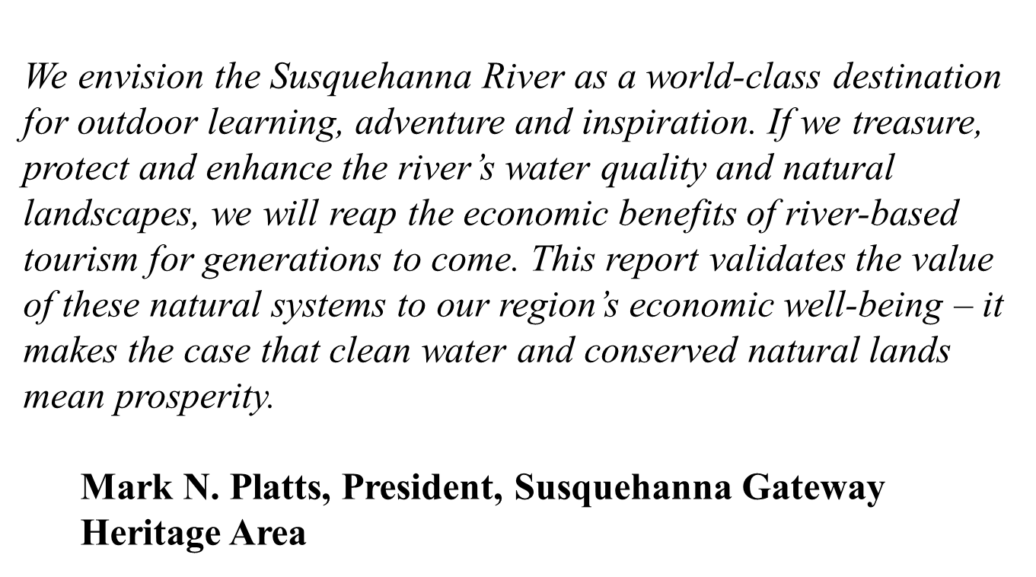
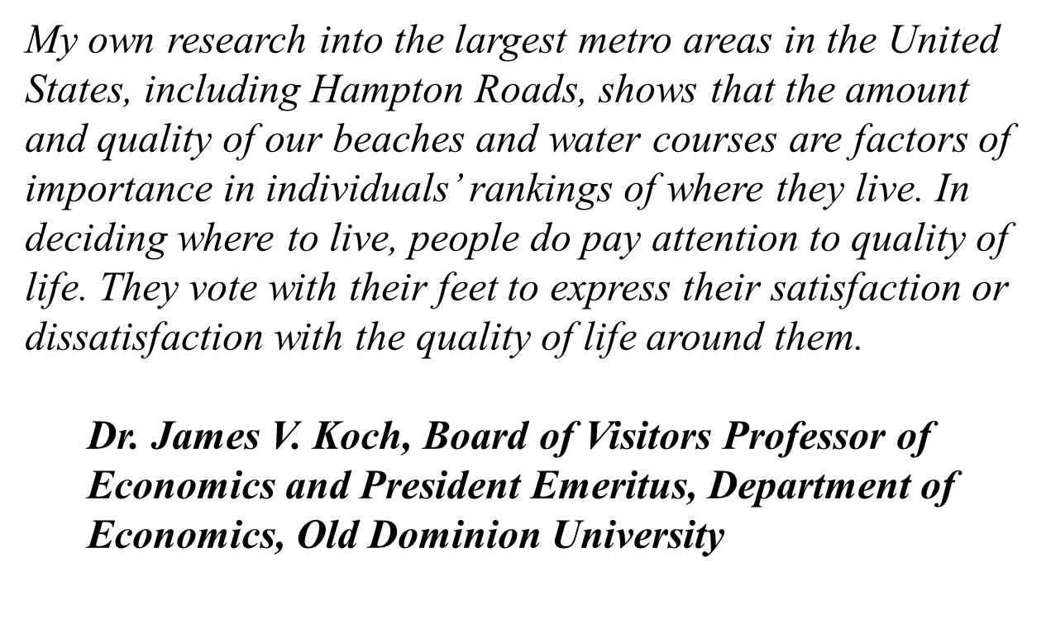
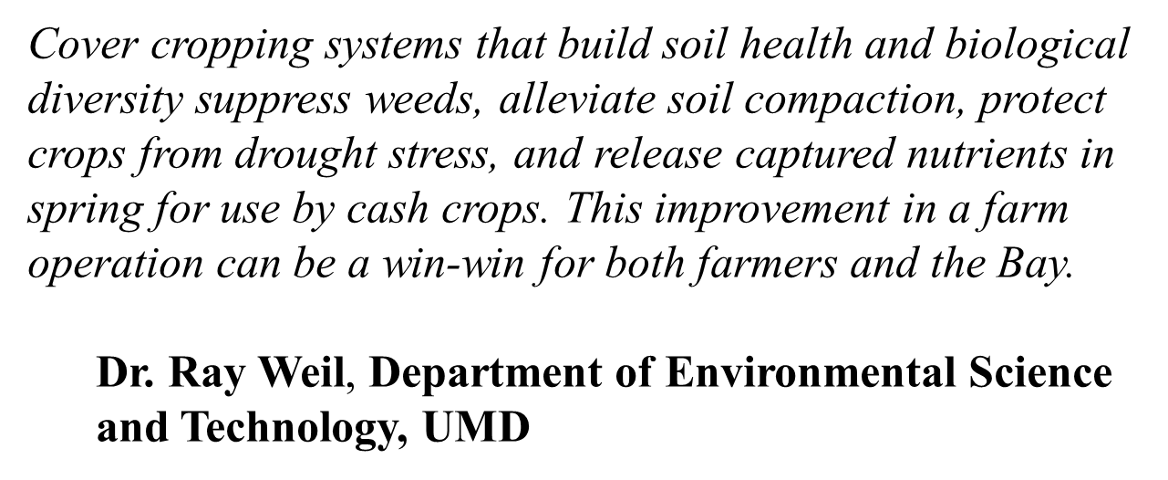
Notes:
The study looks only at benefits, not costs. But for the report’s release, , we have used Trib Strategy estimates to place the cost of the Blueprint at roughly $5B/year. That means the added benefits of the Blueprint (from our study) would outweigh the costs by 4:1.

Slide 20
Takeaways
  Watershed-wide benefits
  Benefits 4x the cost

Slide 21
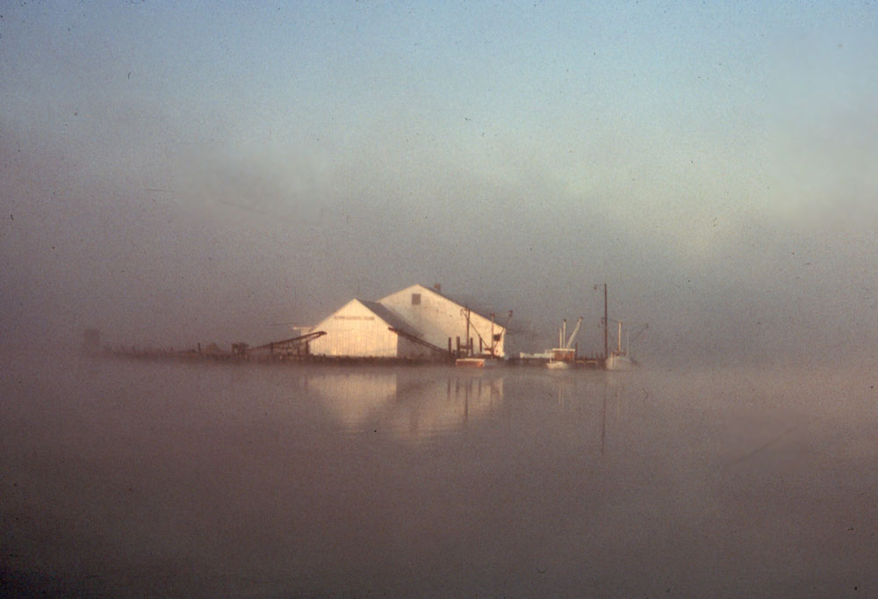
THANK YOU
QUESTIONS?
The End
Notes:
A pollution cap, or Total Maximum Daily Load (TMDL), would set a maximum amount of nitrogen, phosphorus, and sediment pollution that a healthy Bay can tolerate.
There are a great many clean water laws on the books. EPA and its partner state governments need to enforce these laws already on the books and create new laws and regulations with clearly defined pollution-reduction criteria and standards.
With the current financial crisis facing the nation, it is even more important that dollars spent on clean water be done in a manner that yields the greatest pollution reductions.
Another opportunity lies with the economic stimulus package. The stimulus package can bring new life to the economy as well as the Bay and its rivers by providing money for sewage treatment plant upgrades through the federal Clean Water State Revolving Fund, and by making sure all highway projects include runoff pollution control systems.

Slide 22
 | Baseline | Blueprint |  |  | Business-as-Usual
Land Use | ESV (millions of 2013$) | ESV (millions of 2013$) | Change from Baseline (%) | Difference from BAU (%) | ESV (millions of 2013$) | Change from Baseline (%)
Agriculture | 12,258 | 13,434 | 10% | 23% | 10,949 | -11%
Forest | 73,960 | 86,406 | 17% | 24% | 69,639 | -6%
Open Water | 16,721 | 24,301 | 45% | 47% | 16,549 | -1%
Urban Open | 3,403 | 4,706 | 38% | 26% | 3,727 | 10%
Urban Other | 11 | 14 | 26% | 18% | 12 | 7%
Wetland | 356 | 364 | 2% | 34% | 270 | -24%
Other | 467 | 508 | 9% | 32% | 386 | -17%
Total | $107,176 | $129,732 | 21% | 28% | $101,531 | -5%

