Slide 1

Black Duck Action Team Update
Habitat Goal Team Meeting – Spring 2020
Ben Lewis, VA DGIF
Black Duck Action Team Lead

Slide 2
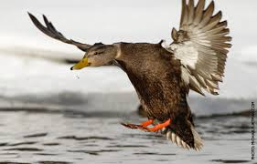
Through the Chesapeake Bay Watershed Agreement, the Chesapeake Bay Program has committed to…
Outcome: By 2025, restore, enhance, and preserve wetland habitats that support a wintering population of 100,000 black ducks, a species representative of the health of the tidal marshes across the watershed. Refine population targets through 2025 based on best available science.

Slide 3
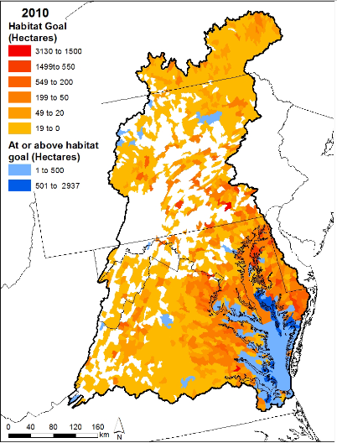
2014 Baseline
Habitat Based Outcome
  Where were we in 2014?
DU and ACJV
            Available acres per HUC broken down by wetland type
            Energy Supply x Habitat Capability Index
          Total # of acres of available black duck habitat 566,477 acres

Slide 4
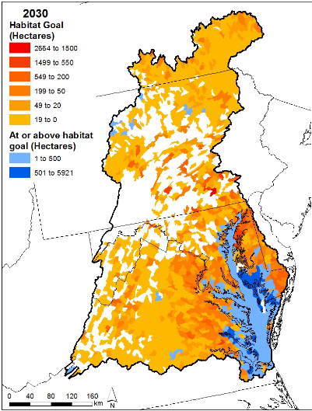
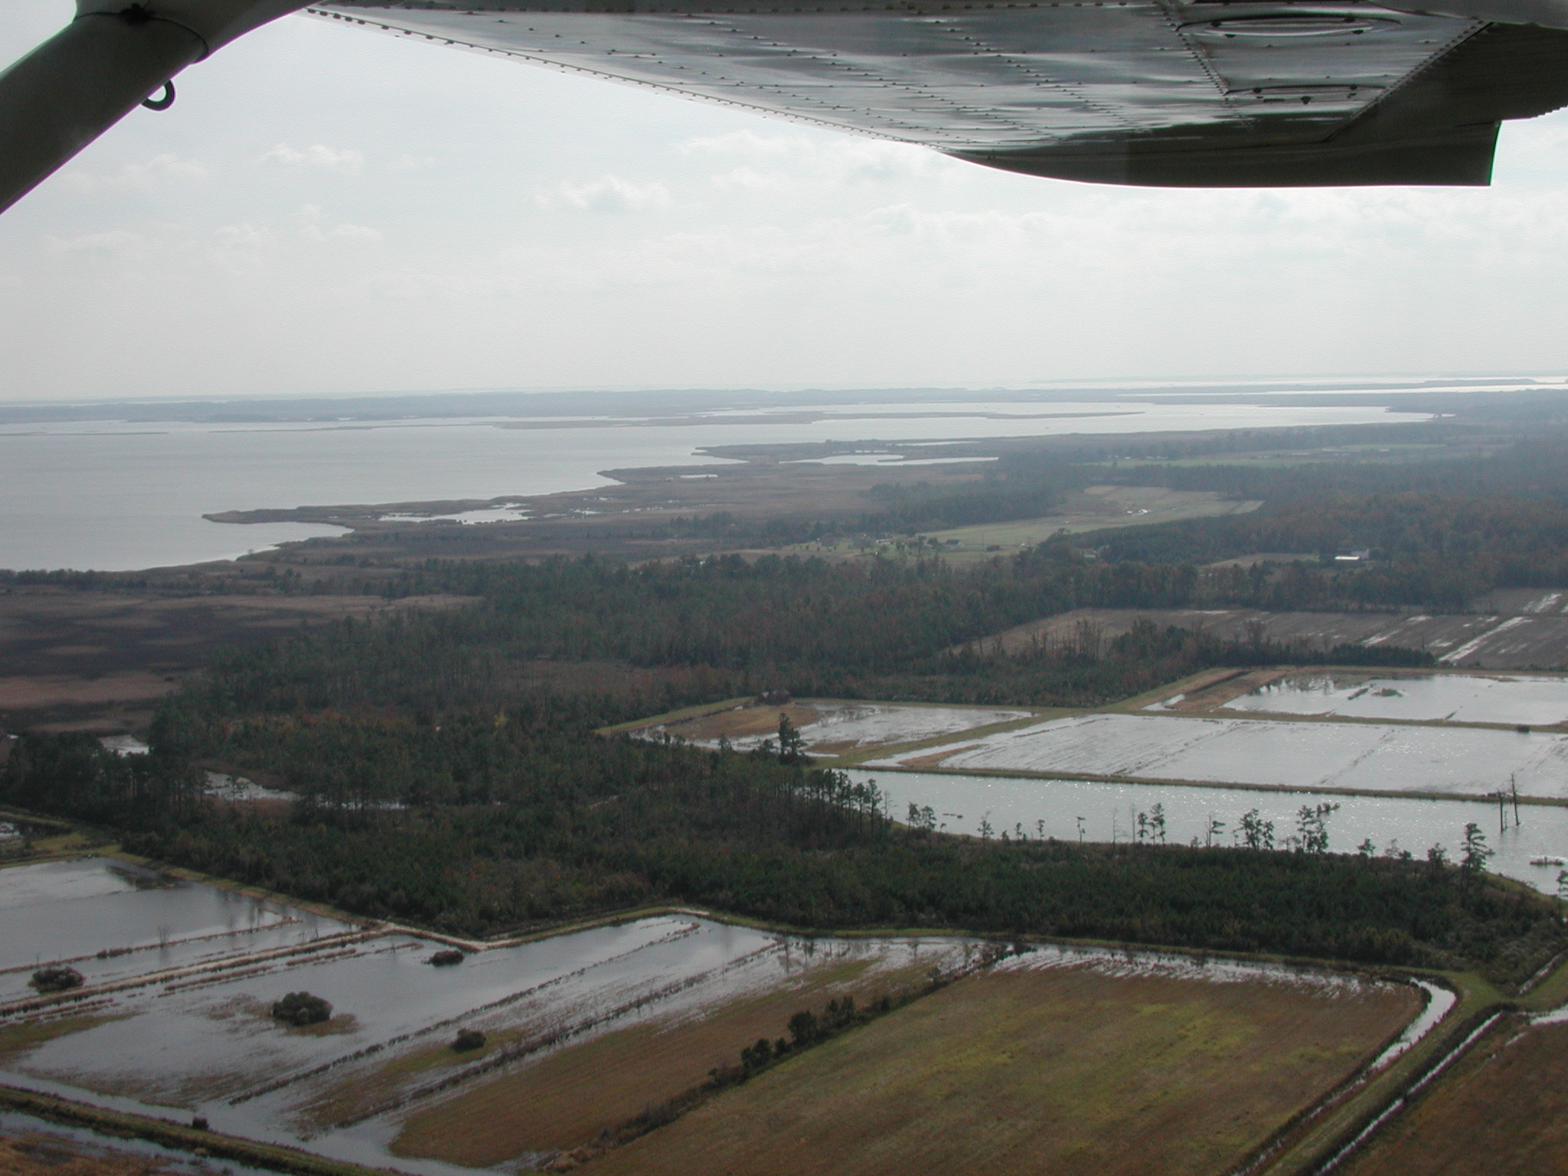
2025 Restoration Goal
Black Duck Decision Support Tool
  Estimate how much habitat restoration
  and enhancement is needed to meet
  outcome
  Additional restoration of 151,272 acres of
  black duck habitat

Slide 5
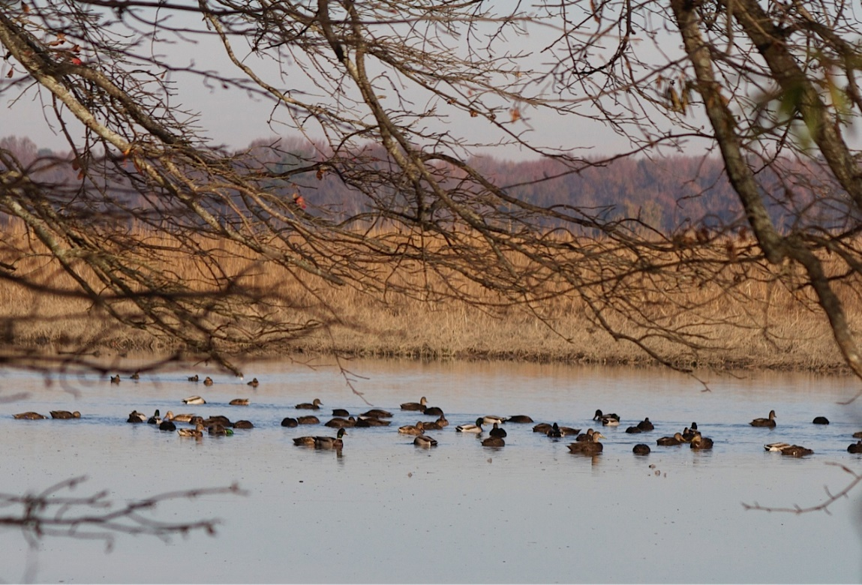
Updates to the Black Duck DST
Ducks Unlimited redoing the Decision Support Tool
  Concern with how the Habitat Capability Index is applied
  Improved NWI wetland layer
    More accurate energy supply
    data and would change the
    results from the DST
  Evolving Model

Slide 6






2025 Restoration Goal
Challenges – tracking progress towards the goal
  How far we have come and how far we need to go
  Challenge for other GIT’s as well
Data call to partners

Slide 7
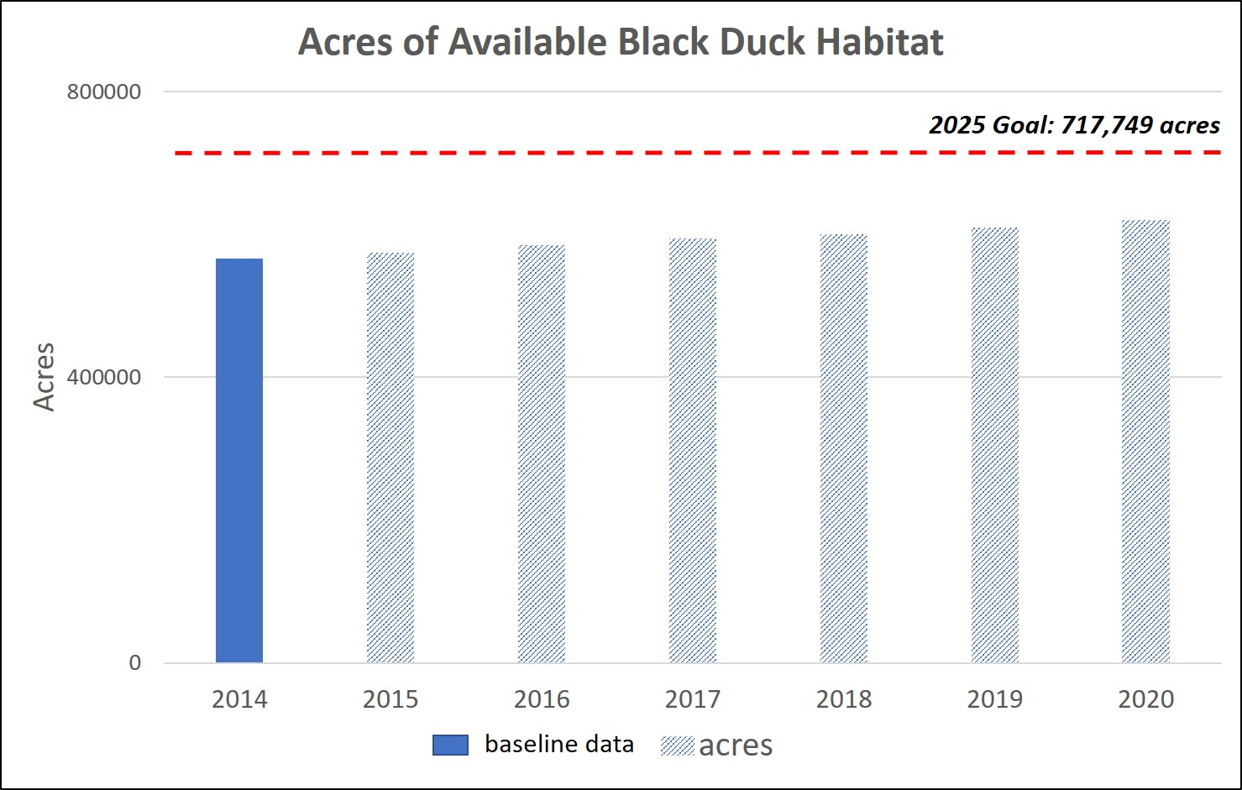
2025 Restoration Goal

Slide 8
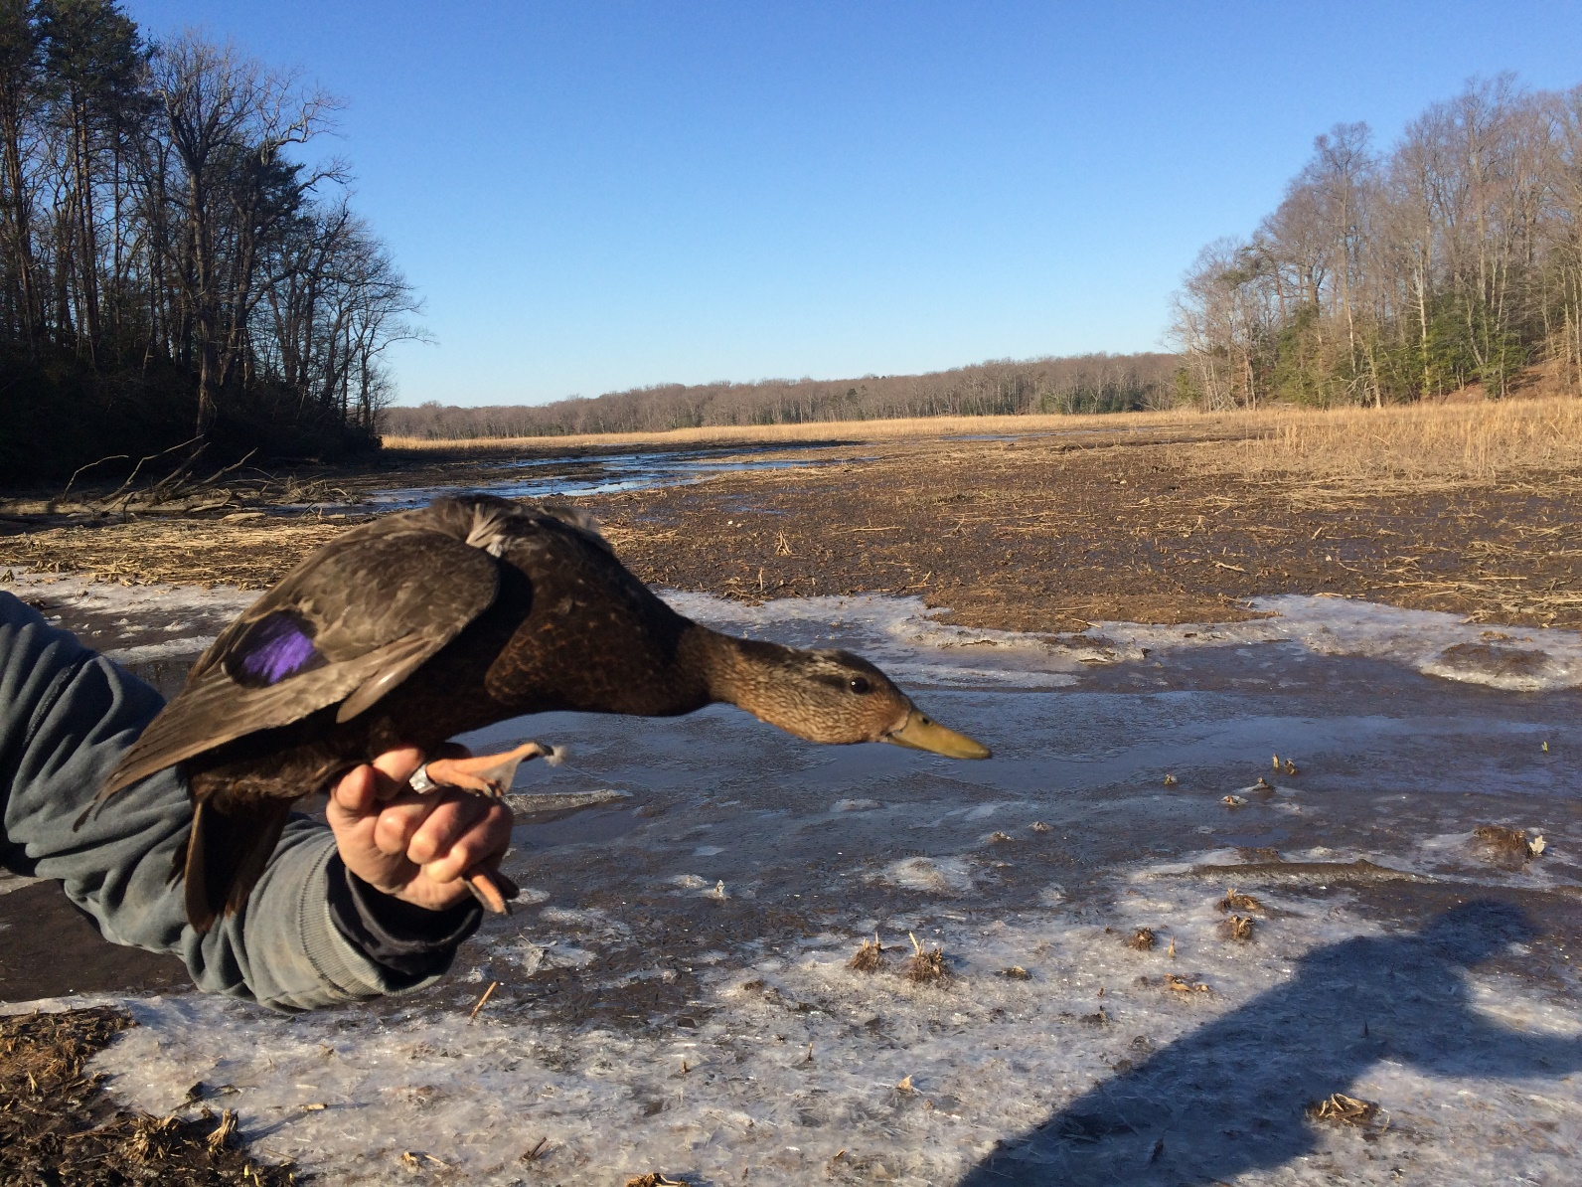
Questions?
Notes:
[time for discussion at the end of the presentation, before the next outcome presentation]

