Slide 1
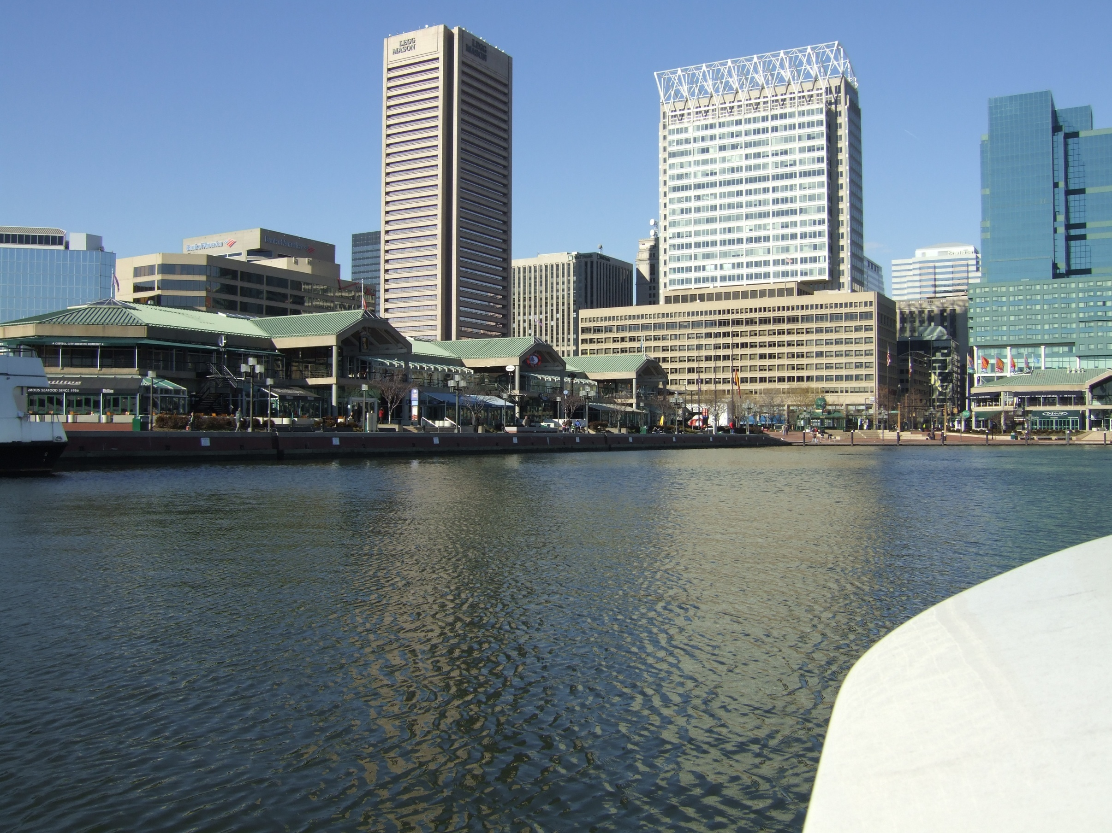
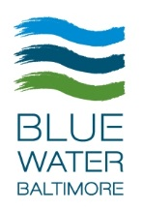
Citizens Advisory Committee Meeting to the Chesapeake Executive Council
January 22, 2017
Angela Haren
Director of Advocacy & Baltimore Harbor Waterkeeper
aharen@bluewaterbaltimore.org
Notes:
Blue Water Baltimore’s mission is to restore the quality of Baltimore’s rivers, streams and Harbor to foster a healthy environment, a strong economy, and thriving communities.

Slide 2
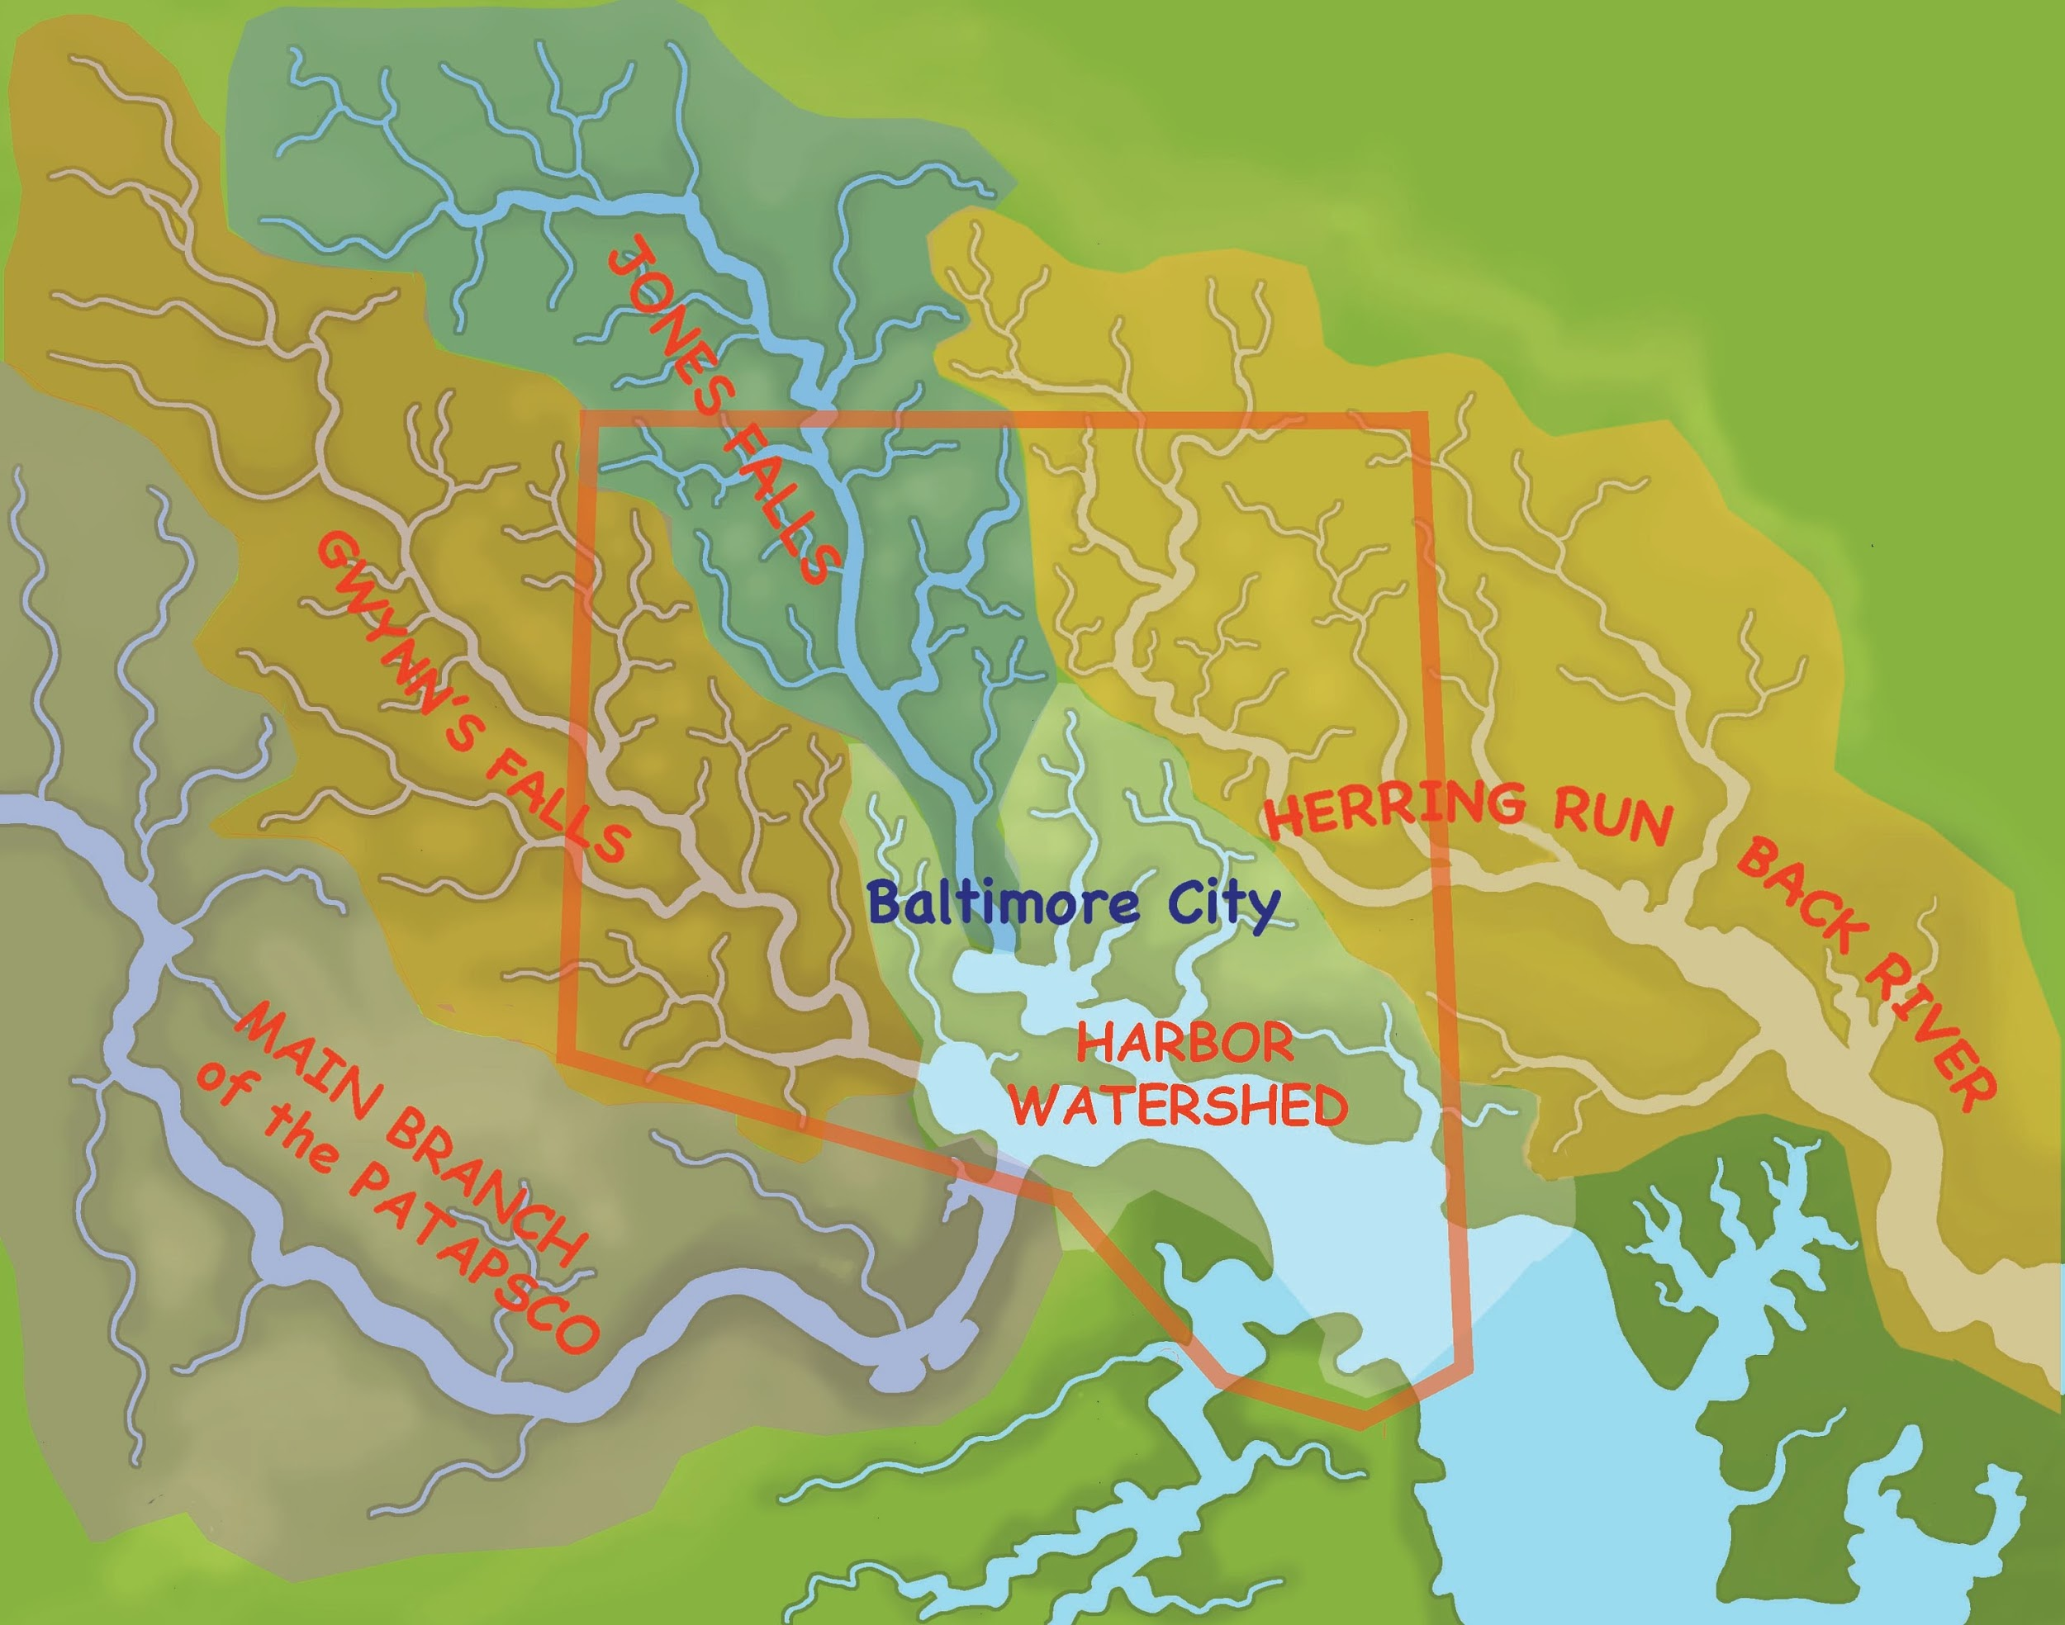
Tributaries to the Patapsco River

Slide 3
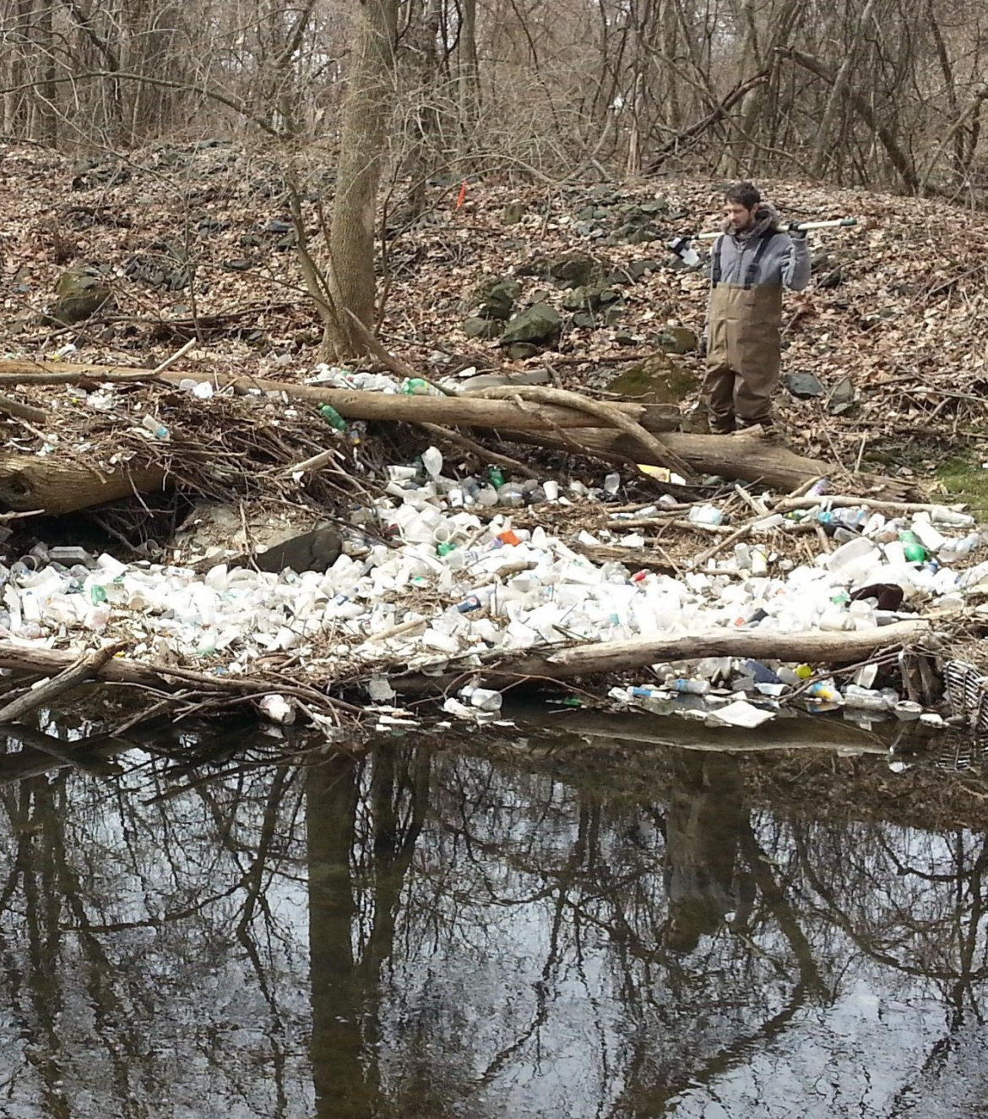
Pollution Sources
Industrial pollution
Past and present
Stormwater Runoff
High levels of sediment and related contaminates
Nutrients
Fertilizer and pet waste
Sewage Spills
Chronic, high levels of sewage through storm drain system
Trash
Neighborhood streets, alleys and parking

Slide 4
What’s in the Water?
Waterways within the Patapsco watershed are impaired for:
Chlordane
Chlorides
Chromium
Copper
Cyanide
Fecal Bacteria (Enterococcus)
Lead
Nickel
PCBs
Sulfates
Total Nitrogen
Total Phosphorus
Total Suspended Solids
Trash
Zinc
Source: Maryland Department of the Environment

Slide 5
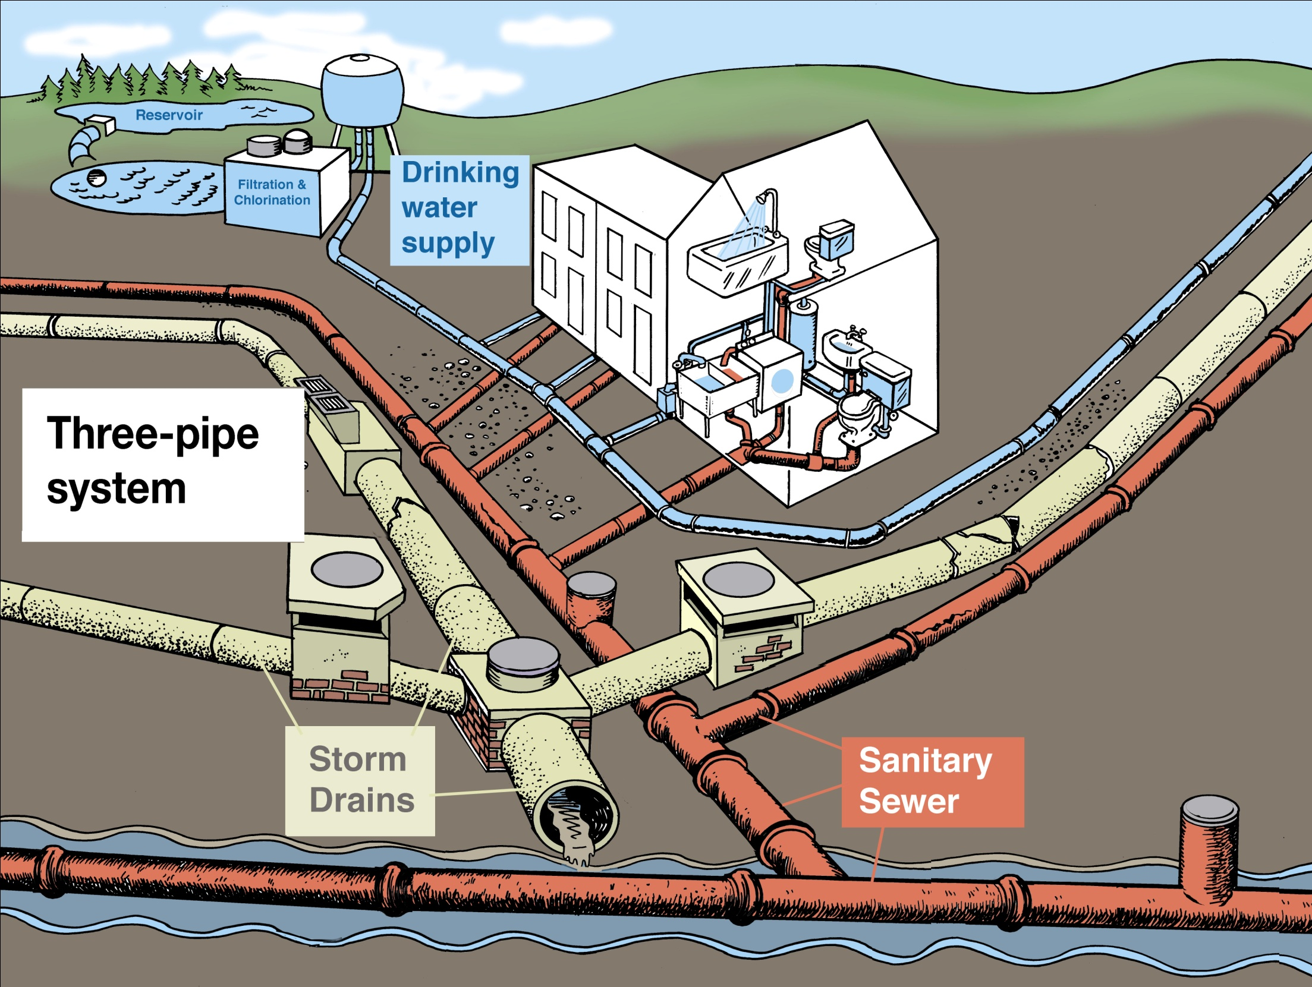
Property of
Blue Water Baltimore

Slide 6
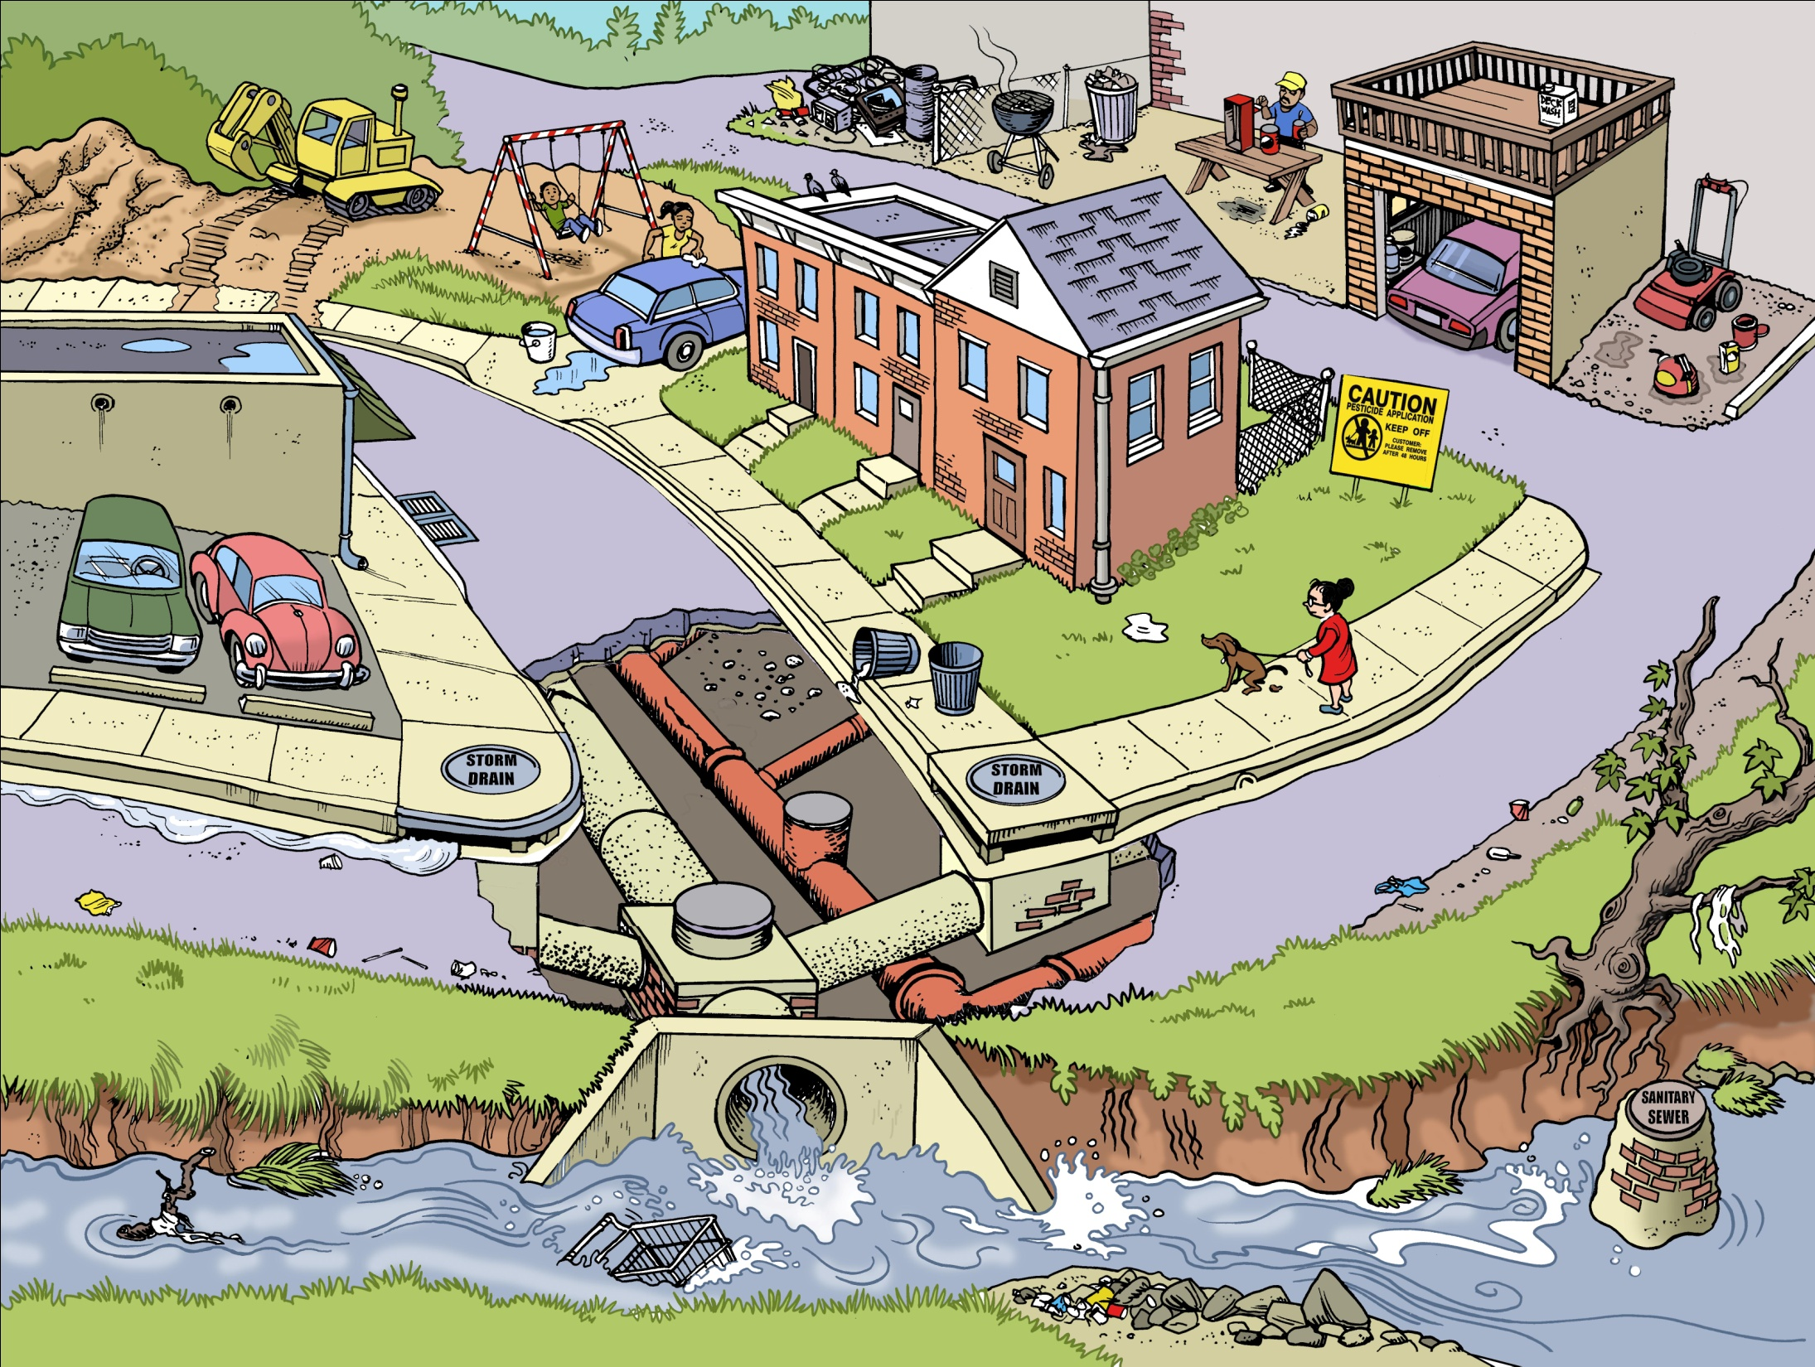
Below the streets of Baltimore
Property of
Blue Water Baltimore

Slide 7
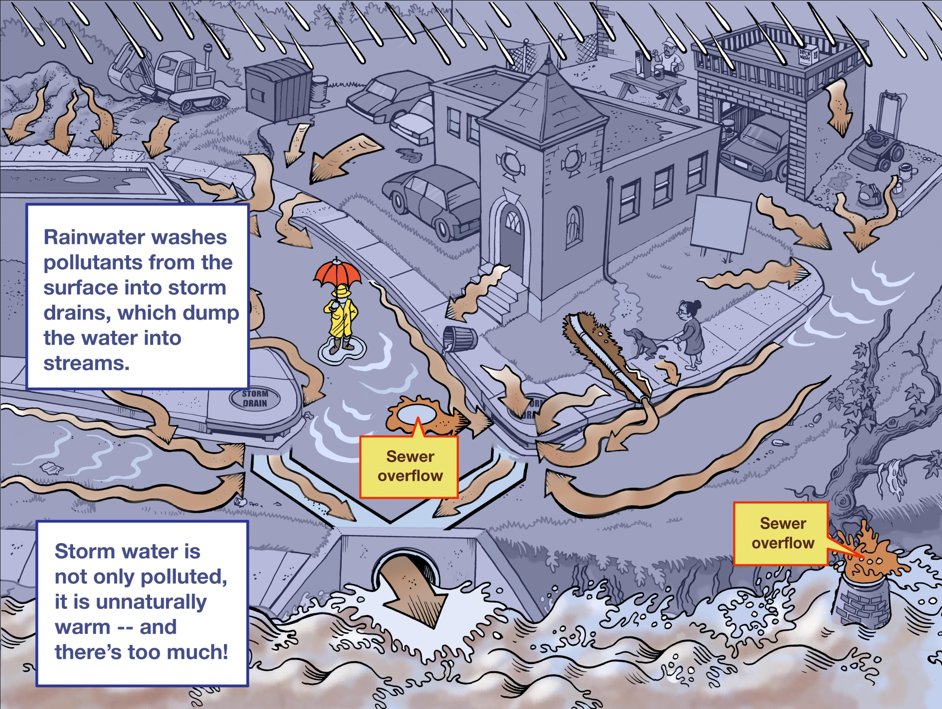
Property of
Blue Water Baltimore
Notes:
When it rains

Slide 8
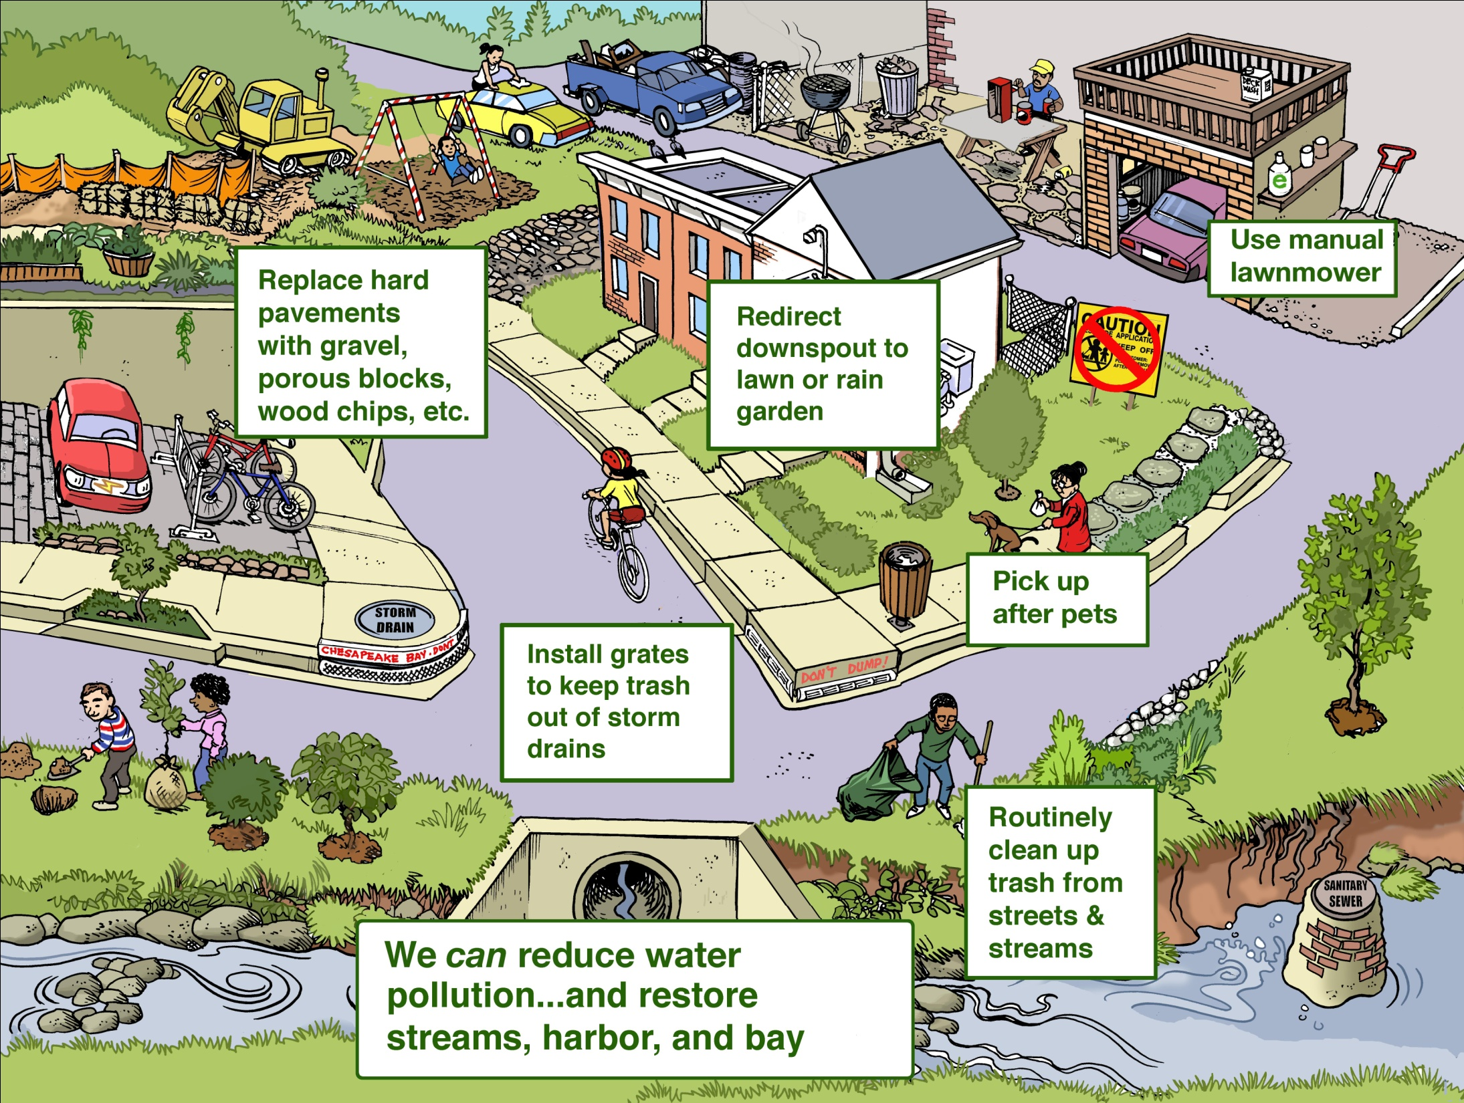

Slide 9
Overview of Programs
Baltimore Harbor Waterkeeper
Water quality monitoring
Advocacy: legal, regulatory, legislative
Citizen outreach and education
Restoration
Urban forestry
Stormwater management

Slide 10
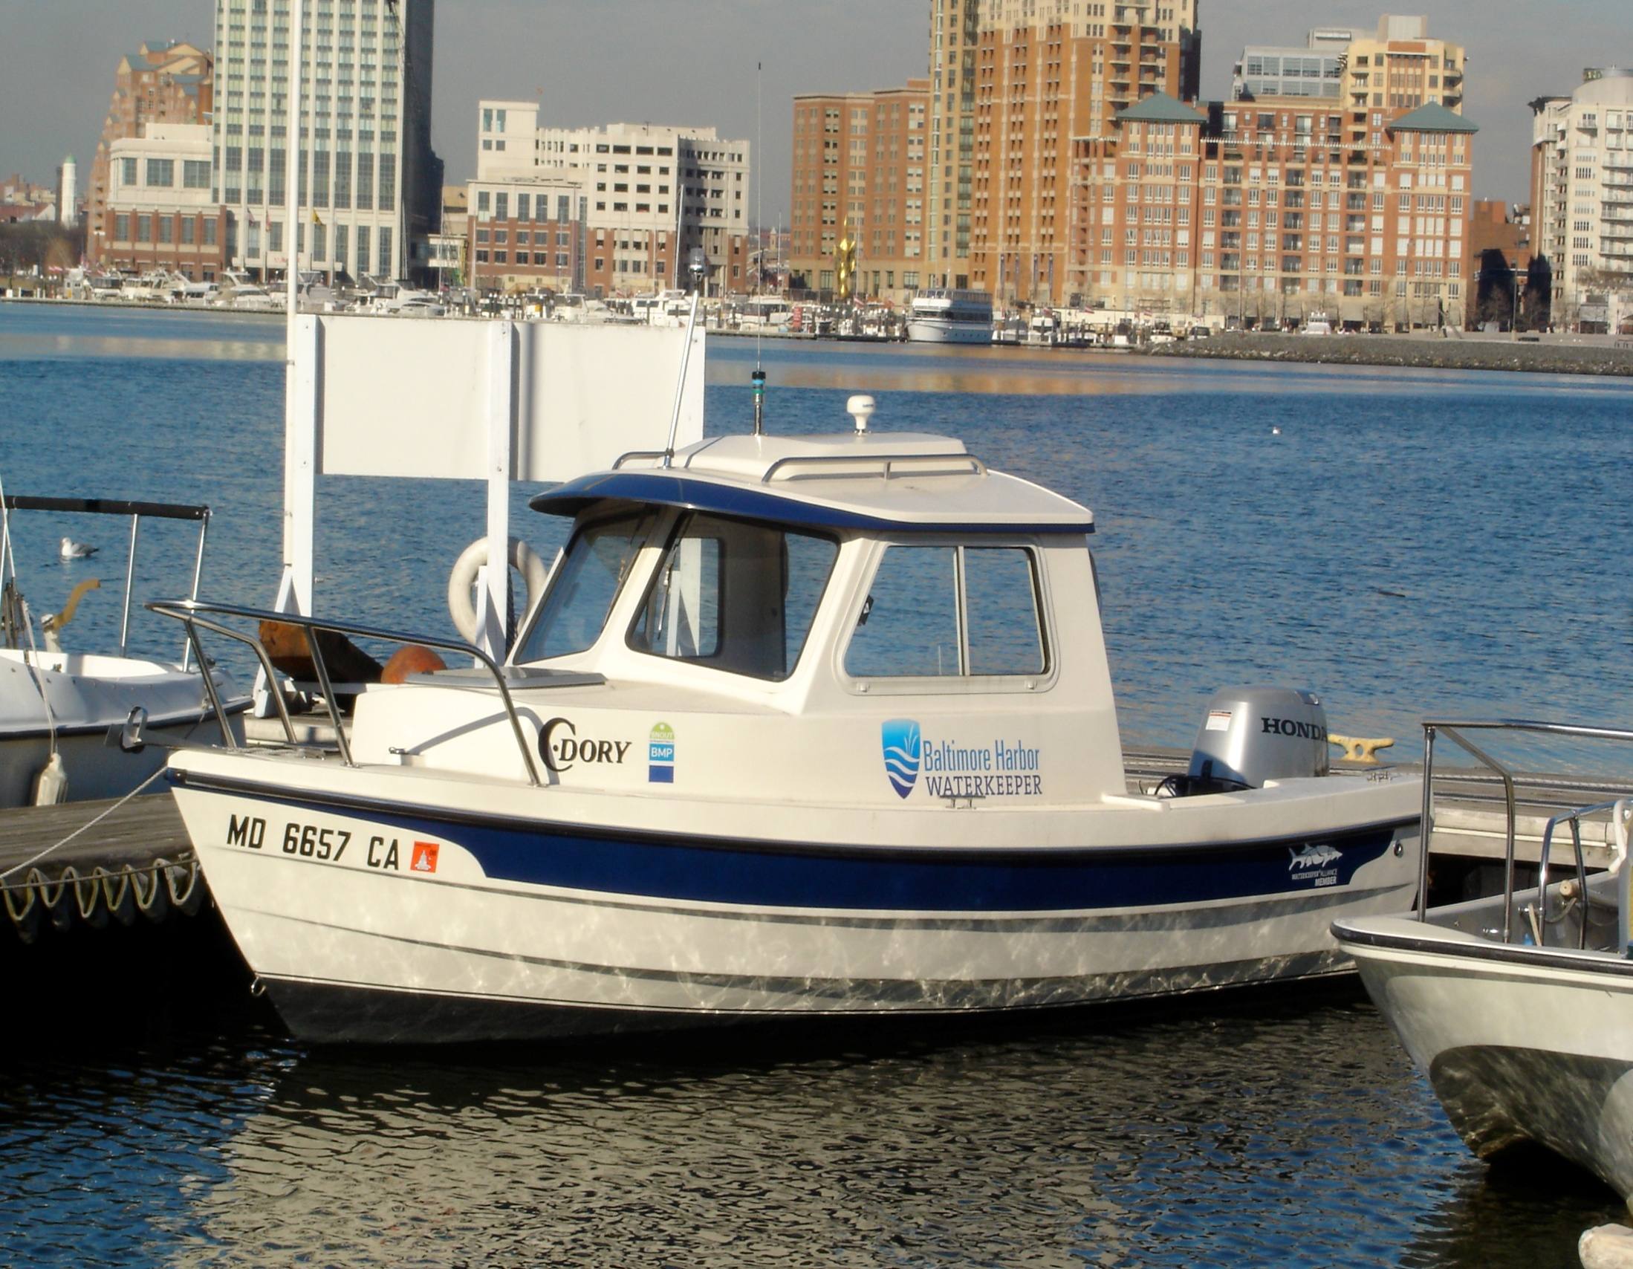
Baltimore Harbor Waterkeeper
Uses science and the law to enforce against polluters and
ensure that government is doing its job
Water quality monitoring
Pollution reporting & citizen involvement
Legal & policy advocacy
Community outreach

Slide 11
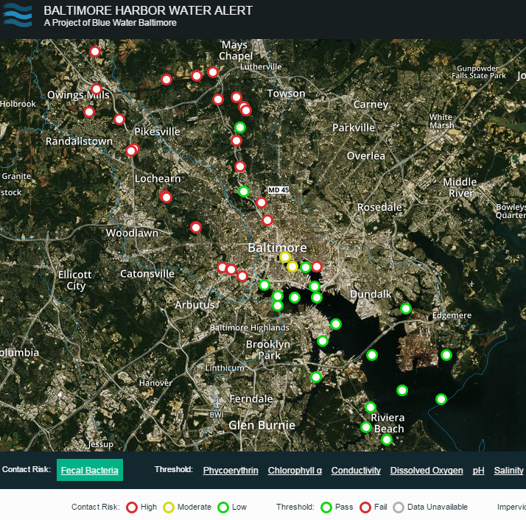

Slide 12
Priority Issues
Sewage
- 484 reported sewage overflows in Baltimore City in 2016
Trash
- SB186/HB229-Polystyrene Phase-Out
Stormwater
Toxics

Slide 13
Questions?
Angela Haren
Director of Advocacy & Baltimore Harbor Waterkeeper
aharen@bluewaterbaltimore.org
410-254-1577 ext. 112
Harbor Alert: http://www.harboralert.org

