Slide 1

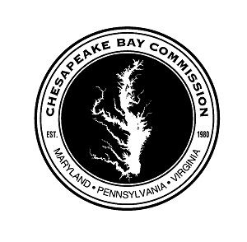
BOOTS ON THE GROUND
Improving Technical Assistance for Farmers
A REPORT OF THE CHESAPEAKE BAY COMMISSION
NOVEMBER 2017
Ann Pesiri Swanson
CBC Executive Director
Citizens Advisory Committee
Mary 24, 2018

Slide 2
Who am I and what is the Chesapeake Bay Commission?

Slide 3
The Chesapeake Bay Restoration
A History of Key Events
1960s
1960s-70s Visible decline in Bay resources
1976-1982 EPA conducts 5-year Bay study
1980 Chesapeake Bay Commission established
1983 First Bay Agreement - Bay Program created
1987 Second Bay Agreement – WQ Goals: 40% reduction
1992 Amendments to Agreement – Tributary Strategies
2000 Third Bay Agreement – Water Quality Focus
2008 Acknowledged Regulatory Approach (TMDL) needed
2010 Chesapeake Bay TMDL established
2014 Fourth Bay Agreement – Verification & Accountability
2017 60% of the practices in place to deliver clean water
2025 TMDL to be achieved – 100% of practices
2025
Notes:
In the late 1970’s, U.S. Senator Charles “Mac” Mathias (R-Md.) sponsored a congressionally funded, $27 million, five-year study to analyze the Bay’s rapid loss of wildlife and aquatic life.
By the end of 1982, EPA and the states of the Bay watershed were completing the study, known as the Chesapeake Bay Research Program, that identified excess nutrient pollution as the main source of the Bay's degradation. These initial research findings led to the formation of the Chesapeake Bay Program as the means to restore the Bay.
As the Chesapeake Bay Research Program was reaching completion, the attention of all parties turned to a central question:
“What would governments do to protect and restore the Bay and how would they manage that process?”
EPA was drafting, with input from the states, its final recommendations based on the Bay Research Program, at which point the Federal investment would be complete. It became clear to the states that to remain coordinated and supported by the Federal government, the EPA needed to remain involved and an ongoing, managed partnership needed to be formed.
The first Chesapeake Bay Agreement was signed on December 9, 1983 to launch this coordinated governance process to address the Bay’s pollution problems.
The Bay Commission sponsored the conference.

Slide 4
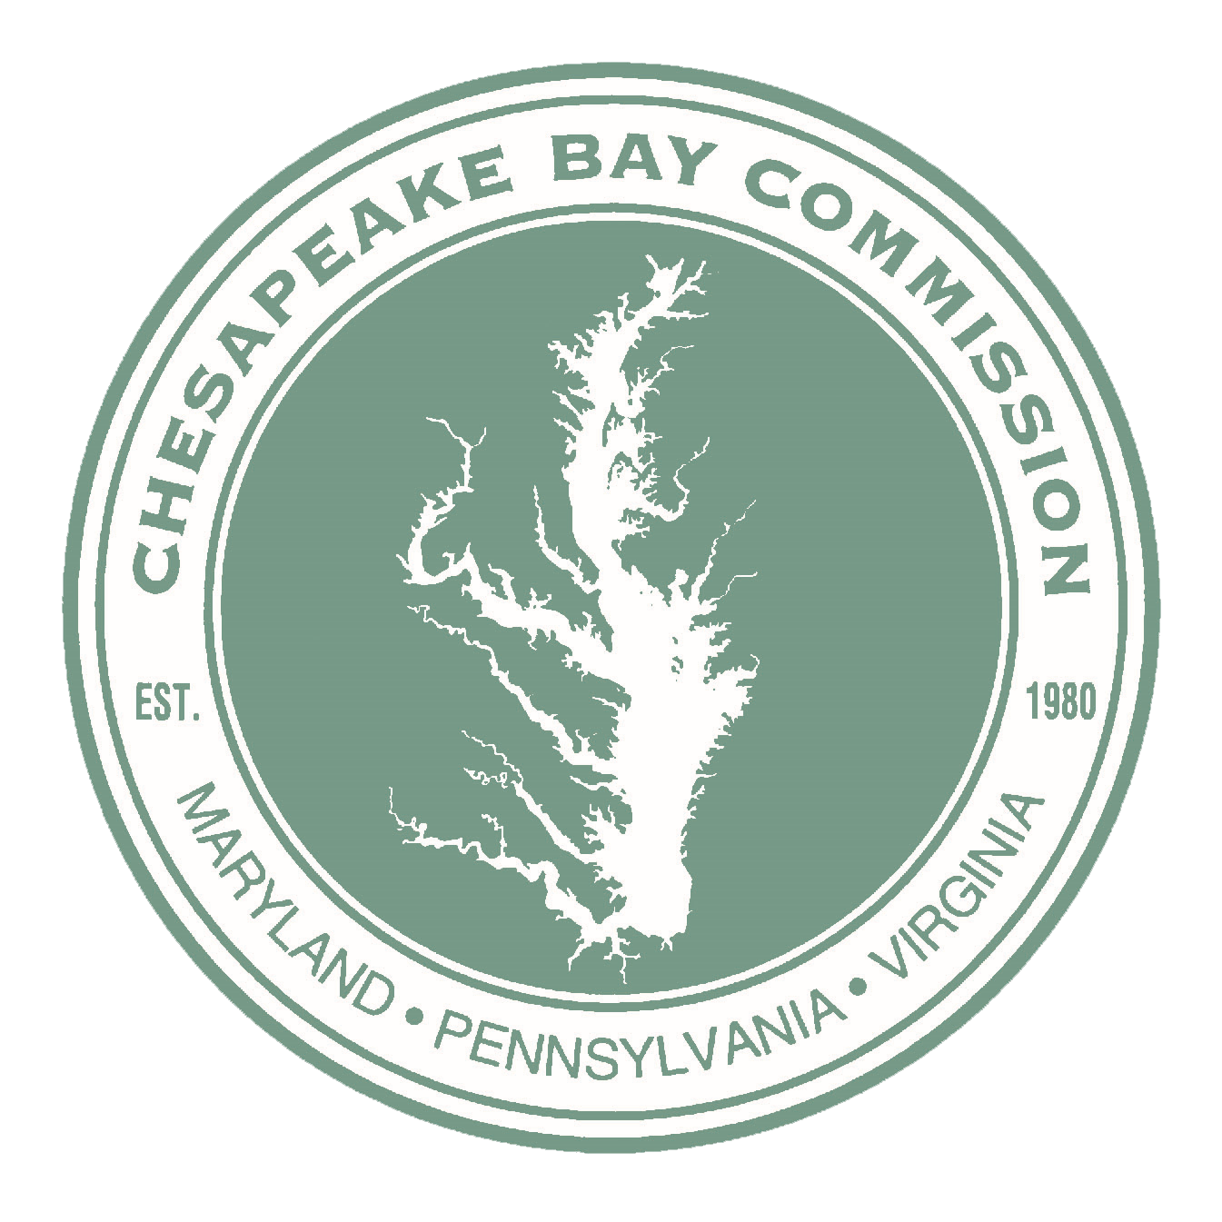
Chesapeake Bay Commission
Established by State Law
Tri-State Legislative Commission
(Pennsylvania, Maryland & Virginia)
7-Member State Delegations (21 members total)
2 Senators
3 House of Representatives
1 Administration (Cabinet-level)
1 Citizen
Notes:
Identify critical environmental needs, evaluate public concerns and ensure state and federal actions to sustain the living resources of the Bay.

Slide 5

What Were the Creators Thinking?
Created in 1977-1980
Focused on legislative coordination
Interstate policy analysis
Intrastate interaction
Advisor at federal, state and local level.
Policy Maker/Mediator
Policy for the Bay

Slide 6
The Chesapeake Bay Restoration
A History of Key Events
1960s
1960s-70s Visible decline in Bay resources
1976-1982 EPA conducts 5-year Bay study
1980 Chesapeake Bay Commission established
1983 First Bay Agreement - Bay Program created
1987 Second Bay Agreement – WQ Goals: 40% reduction
1992 Amendments to Agreement – Tributary Strategies
2000 Third Bay Agreement – Water Quality Focus
2008 Acknowledged Regulatory Approach (TMDL) needed
2010 Chesapeake Bay TMDL established
2014 Fourth Bay Agreement – Verification & Accountability
2017 60% of the practices in place to deliver clean water
2025 TMDL to be achieved – 100% of practices
2025
Notes:
In the late 1970’s, U.S. Senator Charles “Mac” Mathias (R-Md.) sponsored a congressionally funded, $27 million, five-year study to analyze the Bay’s rapid loss of wildlife and aquatic life.
By the end of 1982, EPA and the states of the Bay watershed were completing the study, known as the Chesapeake Bay Research Program, that identified excess nutrient pollution as the main source of the Bay's degradation. These initial research findings led to the formation of the Chesapeake Bay Program as the means to restore the Bay.
As the Chesapeake Bay Research Program was reaching completion, the attention of all parties turned to a central question:
“What would governments do to protect and restore the Bay and how would they manage that process?”
EPA was drafting, with input from the states, its final recommendations based on the Bay Research Program, at which point the Federal investment would be complete. It became clear to the states that to remain coordinated and supported by the Federal government, the EPA needed to remain involved and an ongoing, managed partnership needed to be formed.
The first Chesapeake Bay Agreement was signed on December 9, 1983 to launch this coordinated governance process to address the Bay’s pollution problems.
The Bay Commission sponsored the conference.

Slide 7

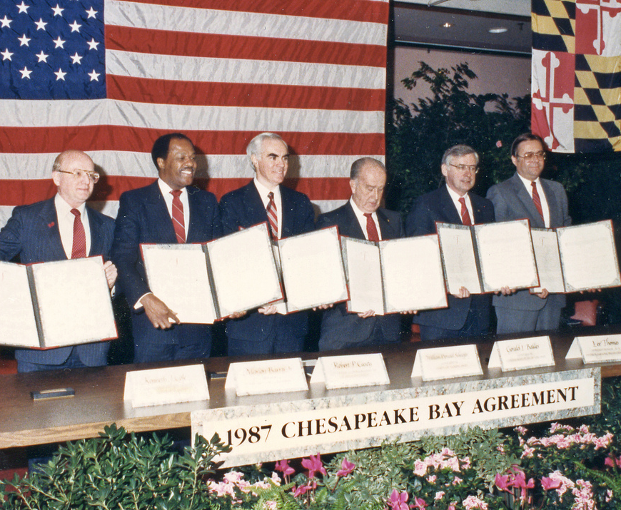
Since the Chesapeake Bay Program’s start in 1983, its partners have used written, signed agreements to guide the restoration of the nation’s largest estuary.

Slide 8
The Chesapeake Bay Restoration
A History of Key Events
1960s
1960s-70s Visible decline in Bay resources
1976-1982 EPA conducts 5-year Bay study
1980 Chesapeake Bay Commission established
1983 First Bay Agreement - Bay Program created
1987 Second Bay Agreement – WQ Goals: 40% reduction
1992 Amendments to Agreement – Tributary Strategies
2000 Third Bay Agreement – Water Quality Focus
2008 Acknowledged Regulatory Approach (TMDL) needed
2010 Chesapeake Bay TMDL established
2014 Fourth Bay Agreement – Verification & Accountability
2017 60% of the practices in place to deliver clean water
2025 TMDL to be achieved – 100% of practices
2025
Notes:
In the late 1970’s, U.S. Senator Charles “Mac” Mathias (R-Md.) sponsored a congressionally funded, $27 million, five-year study to analyze the Bay’s rapid loss of wildlife and aquatic life.
By the end of 1982, EPA and the states of the Bay watershed were completing the study, known as the Chesapeake Bay Research Program, that identified excess nutrient pollution as the main source of the Bay's degradation. These initial research findings led to the formation of the Chesapeake Bay Program as the means to restore the Bay.
As the Chesapeake Bay Research Program was reaching completion, the attention of all parties turned to a central question:
“What would governments do to protect and restore the Bay and how would they manage that process?”
EPA was drafting, with input from the states, its final recommendations based on the Bay Research Program, at which point the Federal investment would be complete. It became clear to the states that to remain coordinated and supported by the Federal government, the EPA needed to remain involved and an ongoing, managed partnership needed to be formed.
The first Chesapeake Bay Agreement was signed on December 9, 1983 to launch this coordinated governance process to address the Bay’s pollution problems.
The Bay Commission sponsored the conference.

Slide 9
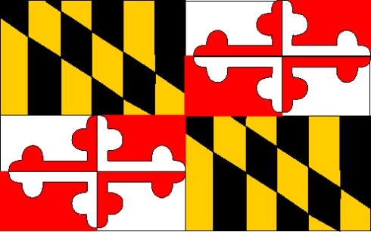
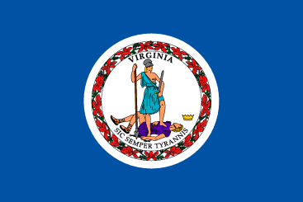
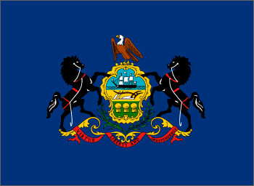
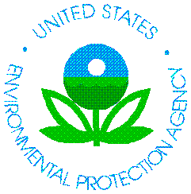
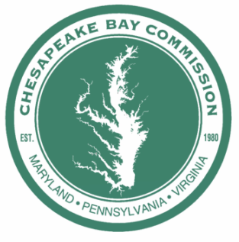



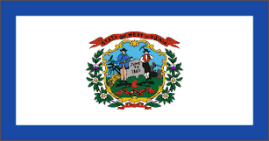
Chesapeake Bay Program
Governor of MD
Governor of VA
Governor of PA
EPA Administrator
Chair of Chesapeake Bay Commission
Governor of NY
Mayor of DC
Governor of DE
Governor of WV
Notes:
In 2014- with the adoption of a the 4th Bay Agreement, the original members of the Chesapeake Executive Council- the Governors of MD, PA, VA, the Mayor of the District of Columbia, The Administrator of the U.S. Environmental Protection Agency (EPA), The Chair of the Chesapeake Bay Commission, were joined by the Governors of WVA, N.Y. and Del,
The Bay Agreement guides the voluntary actions of the states and federal government and drives the science and investments in restoration.
COMPREHENSIVE VIEW: While the TMDL focuses only on water quality and reducing nitrogen, phosphorus and sediment, Bay restoration also relies on the partners to take action to restore the crab, oyster and rockfish populations, bay grasses, and habitat, and to address toxics, land use, public access, environmental education, diversity, and climate change. We need to address all these aspects to achieve a restored Bay.
The Chesapeake Bay Program and partnership is one of the most advanced restoration program world wide and there is wide recognition for our rich history of science, restoration and policy.

Slide 10
The Chesapeake Bay Commission makes intentional, strategic policy decisions
…Technical Assistance

Slide 11
Chesapeake Bay Watershed Nitrogen Reductions
2015-2025
1985
2015
2025
M lb.
(144 M kg.)
242 M lb.
(110 M kg.)
192 M lb.
(87 M kg.)
*Chesapeake Bay Program Partnership, Based on the jurisdictions’ Phase II WIPs.
Notes:
How did we get here:
In May 2016, the Chesapeake Bay Commission held a meeting (Bethesda, MD) on the TMDL, the progress underway and what opportunities there were for improvements in the Farm Bill.
Speakers, including USDA Under Secretary Ann Mills, PA Ag Secretary Russell Redding, DCR’ s Daryl Glover (Director of the Soil and Water Conservation Division), and Farmer Bobby Whitescarver helped us to focus in on opportunities – on farms, in the Farm Bill and at the state level.
There was a constant message that more TA was needed.
1985-2015: Where did the Nitrogen come from?
59% Wastewater
39% Agriculture
2% Forest
2015-2025: Where will the Nitrogen come from?
71% agriculture
24% Urban Stormwater
5% Septic Systems

Slide 12
Chesapeake Bay Watershed Phosphorus Reductions
2015-2025
1985
2015
2025
15.4 M lb.
(7 M kg.)
14.5 M lb.
(6.6 M kg.)
25.6 M lb.
(11.7 M kg.)
*Chesapeake Bay Program Partnership, Based on the jurisdictions’ Phase II WIPs.
Notes:
1985-2015: Where did the Phosphorus come from?
73% Wastewater
24% Agriculture
2% Urban Stormwater
1% Forest
2015-2025: Where will the Nitrogen come from?
64% agriculture
36% Urban Stormwater

Slide 13
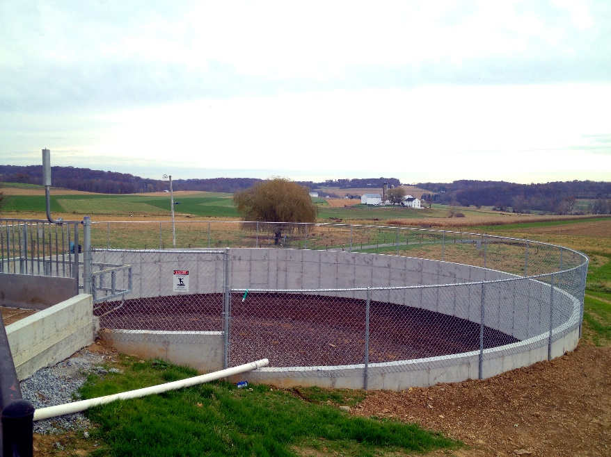
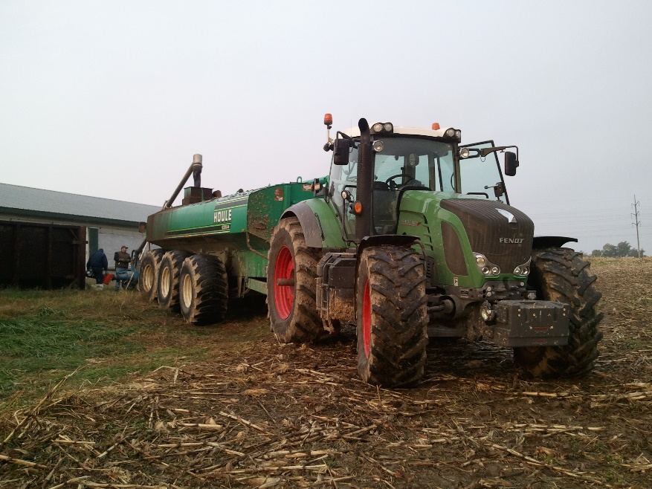
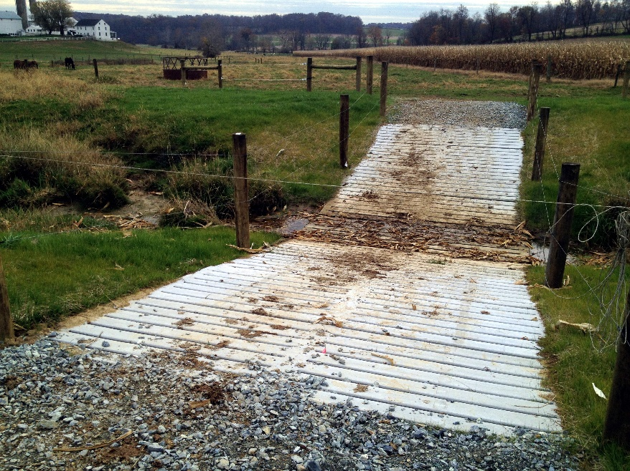
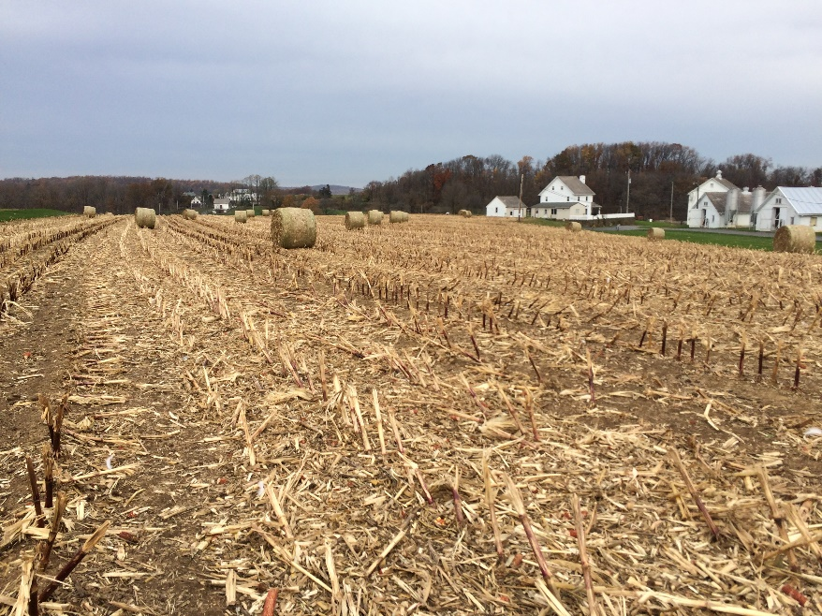
Reductions are achieved through PRACTICES . . .
EXAMPLES INCLUDE:
Cover crops
Conservation tillage
Nutrient management techniques
Stream fencing
Rotational grazing
Buffers
In-field livestock watering stations
Manure storage facilities
Precision feeding
Notes:
What we quickly learned is that many of the most common practices that are central to the WIP implementation require TA.
But the TA comes only after a practice is signed up for.
What happens if the Farmer is not yet familiar with the practice – but should be?

Slide 14
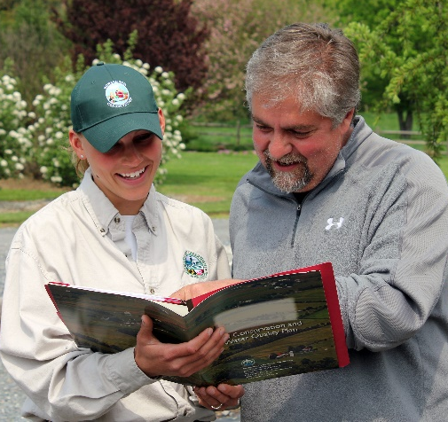

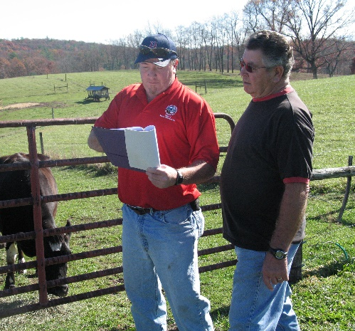
Agricultural Conservation Is Dependent Upon Adequate Funding and TECHNICAL ASSISTANCE
CBC 2017
TA REPORT
1. What is technical assistance, who provides it, and how does it work?
2. How is it funded?
3. What do we need to do to ensure availability and effectively delivery?
Notes:
The Commission members wanted to know more.
How do farmer’s access readily available, effective and professional technical assistance? Is it sufficient given our expectation that farmers will be full partners in delivering Clean Water.

Slide 15
CBC’s Technical Assistance Expert Team
Kristen Saacke Blunk, National Fish and Wildlife Foundation
Russ Brinsfield, Private Consultant
Matt Ehrhart, Stroud Water Research Center
Fred Fiscus, Pennsylvania Department of Environmental Resources
Katie Frazier, Virginia Agribusiness Council
Tim Garcia, Natural Resources Conservation Service
Darryl Glover, Virginia Department of Conservation and Recreation
Terron Hillsman, Natural Resources Conservation Service
Roy A. Hoagland, HOPE Impacts, LLC
Peter Hughes, Red Barn Consulting
Matthew Johnston, University of Maryland
John Lipman, Lipman Development Strategies
Lara Lutz, Writing/Editorial Consultant
Louise Lawrence, Maryland Department of Agriculture
Beth McGee, Chesapeake Bay Foundation
Connie Musgrove, Private Consultant
Royden Powell, Private Consultant
Jake Reilly, National Fish and Wildlife Foundation
Kelly Shenk, Environmental Protection Agency
Jeff Swinehart, Lancaster Farmland Trust
Christopher Thompson, Lancaster County Conservation District
Lindsay Thompson, Delaware-Maryland Agribusiness Association
Kendall Tyree, Virginia Association of Soil and Water Conservation Districts
Bobby Whitescarver, Whitescarver Natural Resources Management, LLC
Tim Woodward, Tellus Agronomics
Dana York, Green Earth Connection
Notes:
[Page 24
Purpose of this slide is to describe the process for developing the report and recommendations. Leaving this slide up during this description allows the members to view the depth and breadth of expertise involved with report.]
Our Process:
CBC staff reached out to technical assistance experts from local, state and federal governments; private for-profit companies; nonprofit conservation organizations; and the agriculture sector.
We solicited their input, guidance and critical review throughout the process.
First educated ourselves on their roles and the workings of their agencies/processes. We asked for their review of feedback on section one of the report (what is TA? And who provides it?)
We reached out to Virginia, Pennsylvania, and Maryland for the data you see on funding for TA.
Finally, we gathered a group of TA experts in Annapolis to discuss solutions – we disciplined ourselves to focus on solutions, rather than rehashing problems.
This panel reviewed the final draft report and series of recommendations – changes were made throughout to incorporate their input.

Slide 16
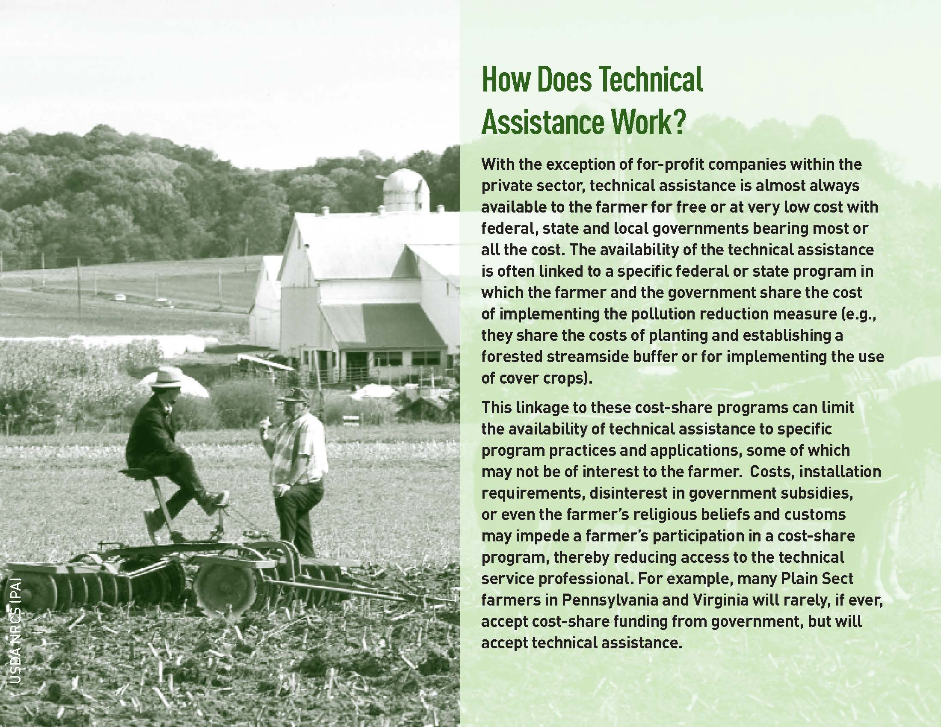
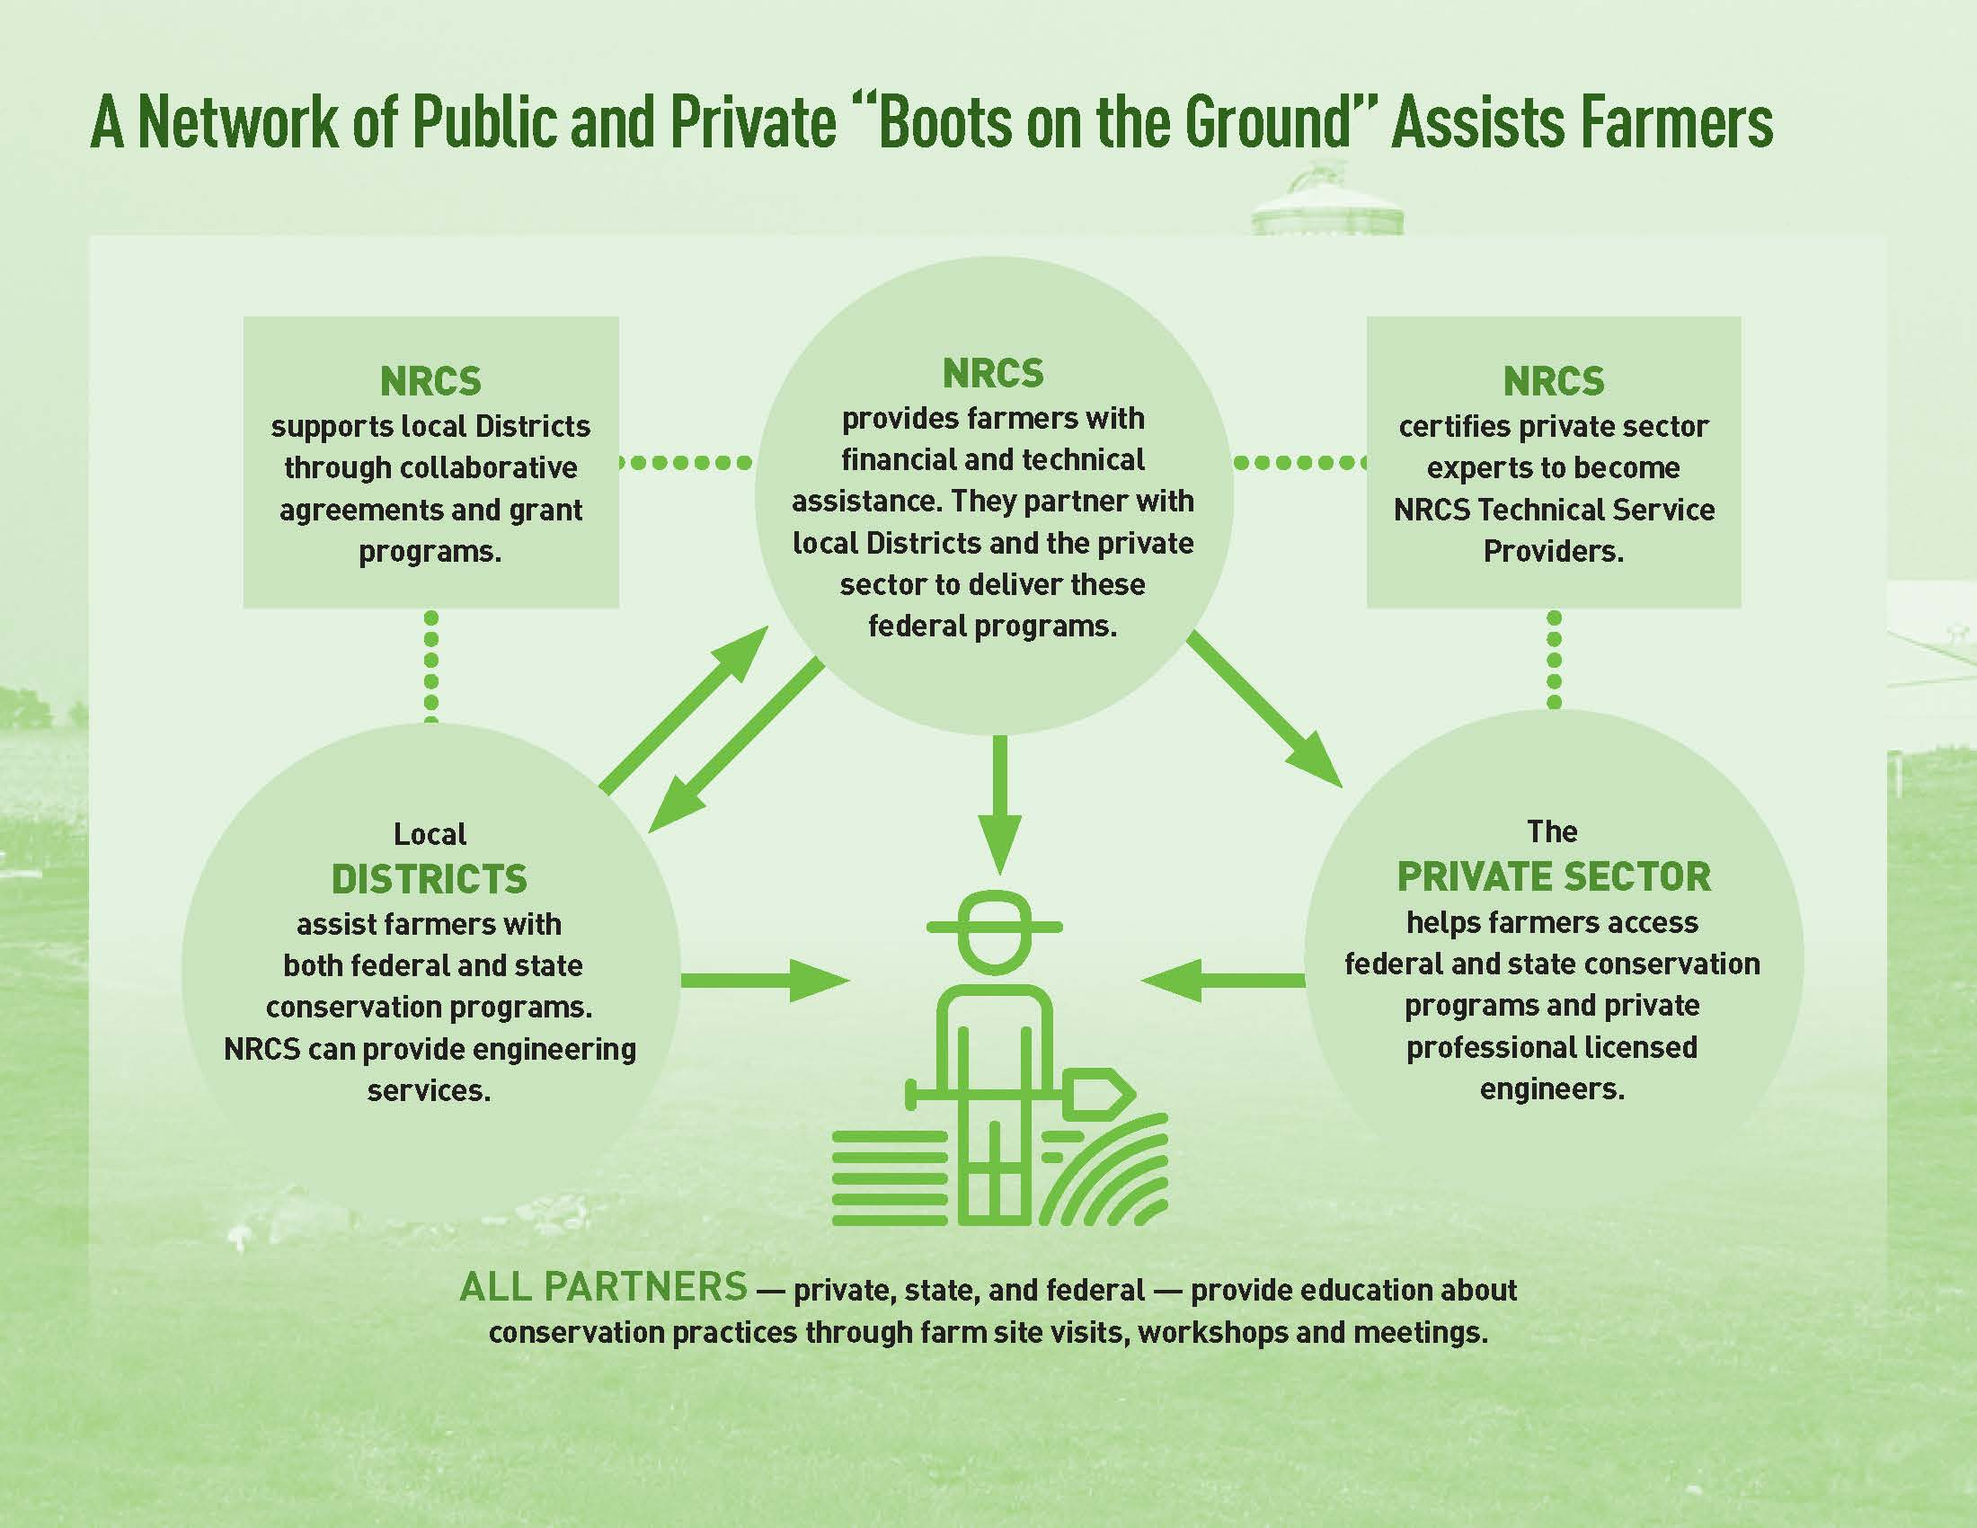
Notes:
Page 14
It also attempts to describe, in readable and understandable terms, WHO delivers TA.
This diagram lays out in a simple format the public and private agencies providing technical assistance to the region’s farmers.
Technical assistance is offered by a myriad of agencies, yet NRCS and your local Districts offer the lion’s share.
The Chart on Page 9 shows, all totaled in just our 3 states there are 137 Conservation Districts, 99 of which are wholly or partially in the watershed.
3-5 staff per district covering anywhere from 22,000 (MD), to 24,000 (VA) to 78,000 acres per TA provider.
Technical assistance providers develop a relationship of trust with the farmer. They work at the individual farm level to assess and determine the specific recommendations for an individual field or farm. This is critical as one size does not fit all.
The definition of Technical Assistance must be broadened. Currently, the “term” is too narrowly defined.
"Technical assistance is a service provided by an agricultural conservation professional to a farmer. The service provided is education, advice and oversight of the planning, programs and practices available to the farmer to reduce and manage agricultural pollution, while at the same time helping the farmer meet the management and business objectives that guide his or her operation. The service may include, for example: educating a farmer about available pollution reduction ‘cost-share’ programs; advising a farmer on ‘whole-farm’ conservation planning; or sharing engineering expertise on the implementation of farm-specific pollution reduction practices. Technical assistance often incorporates services related to programs and practices that provide the farmer with benefits beyond those of pollution reduction. These practices and programs may provide other benefits to air quality or wildlife habitat, for example, which are independent of, or in addition to, water pollution reduction outcomes. Services often also include valuable follow-up. This includes implementation assistance and guidance on maintaining and updating plans and practices"

Slide 17
How is Technical Assistance Funded?
State Funding for Technical Assistance
Fiscal Year | Pennsylvania* | Maryland | Virginia
2009 | 5.7 | 8.0 | 1.0
2010 | 5.6 | 7.9 | 1.6
2011 | 6.0 | 8.0 | 1.2
2012 | 6.8 | 8.5 | 1.2
2013 | 7.1 | 9.6 | 2.8
2014 | 7.1 | 9.5 | 1.2
2015 | 7.1 | 8.1 | 2.8
2016 | 6.9 | 8.8 | 2.8
2017 | Not avail. | 9.7 | 7.4
2018 | Not avail. | Not avail. | 2.2
*In millions.
Notes:
Pages 16-19
Pennsylvania: Conservation Districts in Pennsylvania are funded through a number of statutory directives and budget allocations. There are no dedicated funds.
Maryland: Funding also comes through the annual budget as well as the Water Quality Improvement Act which legislatively mandates annual funding sufficient to employ 110 technical assistance positions.
Virginia: The commonwealth also supports Districts through the annual budget with funding from the Water Quality Improvement Act and a land recordation fee. Virginia statute directs 8 percent of cost-share dollars to technical assistance.
Bottomline: For the most part, funding has been stable – but this is in the face of growing cost share dollar availability for practices and mounting demands under the TMDL.
WWTP have been upgraded – remember the chart I showed you at the start. To close the gap to 2025, farms will be relied on to capture 64% of the phosphorus and 71% of the nitrogen.
This translates to anywhere frim 28% (MD) to 135% (PA) increase in acres of agriculture best management practices

Slide 18
How is Technical Assistance Funded?
NRCS Funding for Technical Assistance
Fiscal Year | Pennsylvania* | Maryland | Virginia
2005 | 29 | 17.3 | 26.4
2006 | 27.5 | 17.1 | 26
2007 | 26.9 | 13.5 | 22.3
2008 | 28 | 15.5 | 24.9
2009 | 29.9 | 15.2 | 24.9
2010 | 35.7 | 18.9 | 29.6
2011 | 34.5 | 18.2 | 27.6
2012 | 31 | 14.5 | 25.8
2013 | 31 | 12.7 | 22
2014 | 32.7 | 14.5 | 24.8
2015 | 21.9 | 15.2 | 25
*In millions.
Notes:
NRCS technical assistance is funded through Congressional appropriations.
The federal Farm Bill provides authorization for technical assistance (TA) dollars linked to cost share programs and for the conservation technical assistance (CTA) program.
These figures combine total funding for NRCS TA and CTA in our 3 states.
RCPP has also funded TA – but funding has decreased from $42 million annually to $9 million annually.

Slide 19
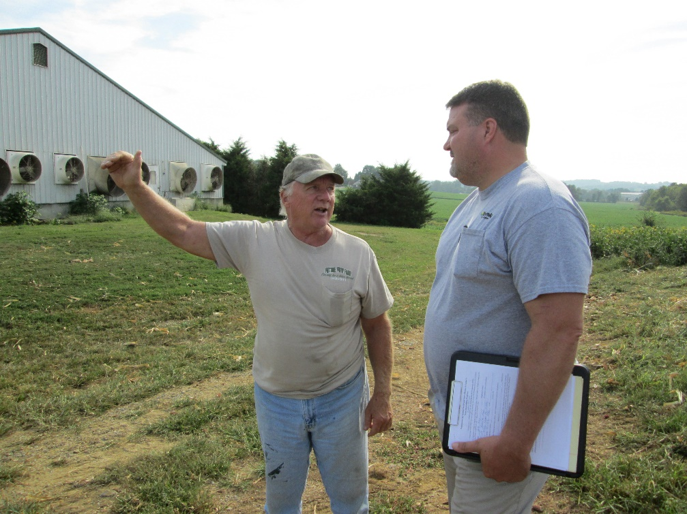
RECOMMENDATIONS 1. Create a robust network of private sector & non-profit providers of technical assistance.
Make training and certification more streamlined and accessible
Allow private providers full certification authority
Remove NRCS’ inherent internal competition, while increasing NRCS staffing levels
Establish quantifiable numeric NRCS goals for out-sourcing TA to the private sector
Notes:
Part III of the report, beginning on page 19 lays out our recommendations.
The current levels of TA available to famers is insufficient to achieve the agricultural pollution reduction goals under the Chesapeake Bay TMDL.
As with all pollution reduction efforts, the reductions must come from the combined effort of government, NGO and the private sector.
However, our research showed that there are quite a few obstacles in the way of robust private sector involvement.
Rather than diminish the role of publicly provided TA, the expansion of private TA can help relieve some of the burdens placed upon NRCS and allow them to do what they do best – planning, the development of science-based practice standards and technical assistance training.

Slide 20
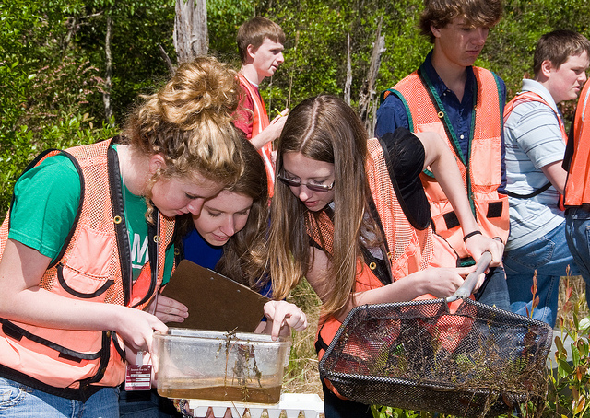
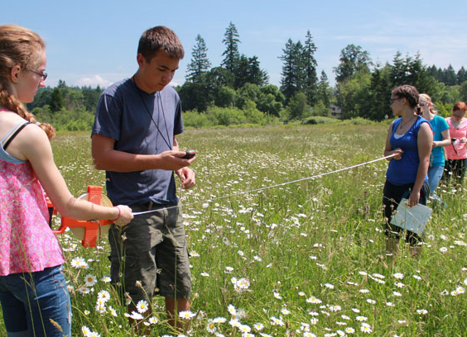
RECOMMENDATIONS 2. Enhance the job climate for governmental professionals providing technical assistance.
Develop a tuition loan assistance program
Develop a two-year certification program for high school graduates, with post-graduate apprenticeship
Provide access to training centered on innovative technologies
Notes:
Like the private for-profit and non-profit sector, there is also a need to create more favorable employment conditions for publicly employed conservation professionals.
Given the importance of the one-on-one relationship between farmer and provider, the need for a provider’s continuous training and education, and the need to keep these governmental professionals in their jobs cannot be overstated.
TUITION: There exists in the teaching and legal fields programs that allow for educational loan forgiveness in exchange for public service commitment for a number of years. Could a similar program apply for TA?
CERTIFICATE PROGRAMS: Working with the farm community takes a certain skill set, one that many believe is best achieved by growing up and working on a farm. However, new, young conservation professionals are increasingly coming from urban backgrounds or generic environmental science (sometimes even liberal arts). The creation of a two-year certificate would allow high school graduates to enter the field absent a four-year degree (and its debt), but with training better tailored to the job of an agricultural conservation advisor.
TRAINING: The 2025 TMDL goals are ambitious, and put much of the pollution reduction on the backs of farmers. Agricultural TA must keep pace with emerging technologies, particularly those that advance water quality goals. Government programs should place a priority on ongoing education, ensuring that they have access, receive encouragement, and have sufficient time to pursue continuing education.

Slide 21
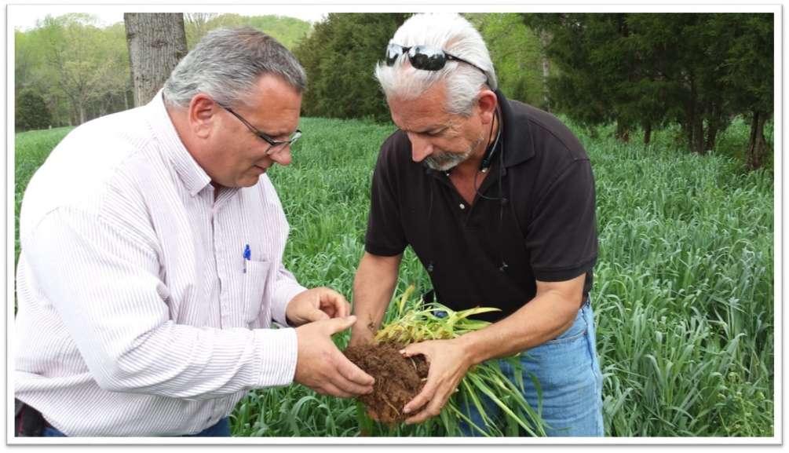
RECOMMENDATIONS 3. Provide stable and predictable levels of funding for technical assistance, including funds independent of cost-share programs.
state and federal levels
Independent of and supplemental to cost-share programs
Geographic targeting
Consider Farm Bill state block grants (e.g. CWA section 319)
Notes:
Funding for TA varies widely at both the state and federal level.
This variability undermines the consistent delivery of TA, creating insecurity in the predictability of available assistance. Such unpredictability reduces the likelihood of a farm considering the implementation of a new, and often unfamiliar practices.
BLOCK GRANTS: States administrations are more likely to understand the receptivity of the farmers and where and how the delivery of additional technical assistance would be met with success.
Federal Block grants to the states could help with this strategic delivery. Section 319 of the Clean Water Act provides a model. With federal oversight and state implementation, 319 supports the states efforts for a wide range of nonpoint source pollution management efforts (TA, technology transfer, monitoring, and more). A parallel program in the Farm Bill could establish a sustained baseline level of funds for TA. However, this will not happen without voices of support coming from every corner.
A 2011 EPA study looking at 319 anticipated this concept by acknowledging the need for “the development and implementation of statewide nitrogen and phosphorus pollution frameworks.” The report recommended the development of programs requiring implementation of practices to reduce this pollution from agricultural sources.
Such implementation cannot happen without Technical Assistance.

Slide 22
What’s happening now?

Slide 23
THE 2018 FARM BILL CBC Recommendations to Improve Technical Assistance
Critical Role of NRCS in providing TA
Long-Term Funding for Annual Practices with TA
Block Grants to States to support financial assistance, TA and edge of field monitoring.
Enhance RCPP
Modernize CREP
Notes:
RCPP
Authorizes the advance of TA funding to eligible partners
Requires the available TA amount to be published at the time of project selection
Limits agency costs for TA to those necessary to carry out the objectives of the partnership agreement.
Requires NRCS feedback throughout the application process
Allows grant funding to go directly to a partner organization.
CREP
Allows partner TA to count as match
Allows number and size of parcels to be considered when estimating TA need
Encourages partnership with NGOs for TA

Slide 24
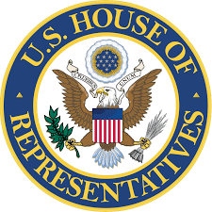
AMENDMENT TO H.R. 2, AS REPORTED OFFERED BY MR. BANKS OF INDIANA
At the end of subtitle F of title XI, add the following:
SEC. 11613. WATERS OF THE UNITED STATES RULE.
The final rule issued by the Administrator of the Environmental Protection Agency and the Secretary of the Army entitled ‘‘Clean Water Rule: Definition of ‘Waters of the United States’ ’’, published on June 29, 2015 (80 Fed. Reg. 37054), is repealed, and any regulation or policy revised under, or otherwise affected as a result of, that rule shall be applied as if that rule had not been issued.
◊
Notes:
the U.S. House of Representatives is debating and voting on amendments to the Farm Bill (H.R. 2). One amendment, offered by Congressman Bank (IN) and others, would repeal the 2015 Clean Water Rule.
This amendment would eliminate the safeguards under the Clean Water Rule for the waters that feed the drinking water of 117 million Americans and protect small streams and other waters that serve as habitat for wildlife, reduce flooding risk, and naturally filter pollution.
The Banks amendment would undermine the entire rulemaking process by disregarding the public input submitted in opposition to attempts to roll back the Clean Water Rule.
The proposed amendment uses the Farm Bill as a means to help the administration and industry with their reckless and unpopular effort to roll back clean water safeguards.
Appears there are the votes to pass it. Opportunity lies in the Senate.

Slide 25

State Action Pennsylvania
Ag Plan Reimbursement
$1.5M available for nutrient management and erosion & sedimentation plan-writing
PSU Ag Stewardship & Conservation Certificate
Will jumpstart planning skills and in-field experience
Thaddeus Stevens College of Technology
12 wk. conservation planning course under development
Notes:
Plan Reimbursement Program is part of Gov. Wolf’s 2016 commitment to provide additional state resources toward the Chesapeake Bay.
Plan costs range from $500-$1500, so 800-2200 plans could be funded.
Application deadline was April 1, 2018, and program was fully-subscribed.
The TA training certificates are outgrowths of the PA in the Balance Conference, which identified TA as one of four core initiatives.
The PSU certificate is under the Environmental Resource Management program
11-14 credits, including an internship or independent study to provide hands-on field experience
Announced in May 2017
1st student to enroll is doing their internship at Lancaster CD this summer
Thaddeus Stevens is in Lancaster
Program is still under development

Slide 26
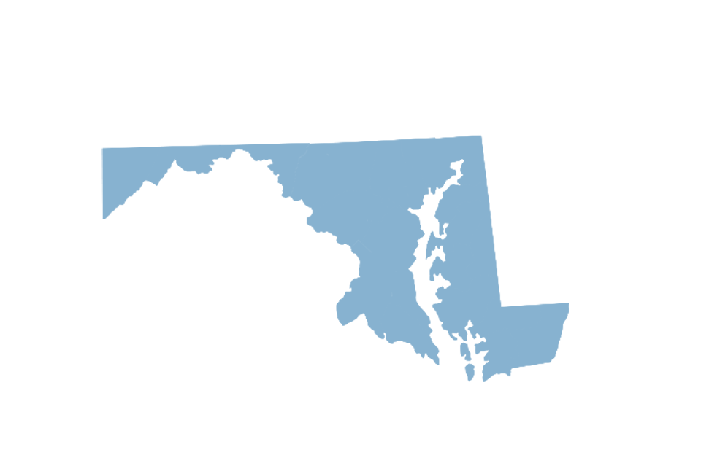
State Action Maryland
Targeting Expanded TA in Conservation Districts
Using funds to hire one planner and two technicians in Talbot, St. Mary’s and Dorchester counties for FY 2019. Committed to continuing effort in FY 2020.
Shorerivers Partnership
Collaborating with Shorerivers to leverage state funding to pilot new drainage management program on Eastern Shore.
Uses funding from National Fish and Wildlife Foundation, state and private sources.
Link outside engineering expertise with Soil Conservation District staff.
Green Light to Fill 8 Vacant State TA Positions
Notes:
Maryland Department and Agriculture and the Soil Conservation Districts are partnering with the National Association of Conservation Districts to leverage state funding for TA. NACD has received a national grant from NRCS to enhance TA nation-wide. Maryland is using state funding as match to hire three additional TA employees in three districts. Additionally, the State has had to commit to continuing these employees through 2020 as part of the grant.
MDA is collaborating with the new Shorerivers organization to leverage state funding for TA with a National Fish and Wildlife Foundation grant received by Shorerivers. They are working together to pilot new methods for drainage management on Eastern Shore farms. Initiative links SCD staff with outside engineering firms, to help grown the size of the TA “tool-box”.
MDA has received approval from the Department of Budget and Mangement to 8 vacant positions in SCD field offices. Hiring freezes at both the state and federal level have slowed pace of TA.

Slide 27
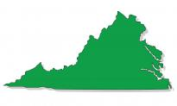
State Action Virginia
Three budget amendments introduced; one remaining
Would increase and stabilize TA funding using increased revenue from existing marine fuel sales tax
Virginia Environmental Endowment
James River Water Quality Improvement Program prioritizes Improved Technical Assistance to Accelerate Implementation of Agricultural Pollution Reduction Practices
Notes:
Budget amendments introduced by Sen. Hanger (co-chair of Senate Finance)
The general fund amendment would have established an annual funding base of $35M while the second half of the recordation fee would have increased the dedicated funding by $10 million. The remaining amendment will increase the base funding going to the Water Quality Improvement fund reserve by $2.5m.
Senate Finance is currently in negotiations on Medicaid Expansion and will hopefully release its budget proposal in the next couple of weeks.
The use of grant funds for technical assistance staff is a new concept that CBC has been discussing with Joe Maroon at VEE and it has been included as a funding priority for their $15 million James River Water Quality Improvement Program.

Slide 28
State Action Maryland
Partnership with Nat’l Assoc. of Conservation Districts
Leveraging state technical assistance funding through collaboration with NACD, recipient of a federal grant from NRCS to enhance TA nation-wide.
Using funds to hire one planner and two technicians in Talbot, St. Mary’s and Dorchester counties for FY 2019. Committed to continuing effort in FY 2020.
Shorerivers Partnership
Collaborating with Shorerivers to leverage state funding to pilot new drainage management program on Eastern Shore.
Uses funding from National Fish and Wildlife Foundation, state and private sources.
Link outside engineering expertise with Soil Conservation District staff.
Green Light to Fill 8 Vacant State TA Positions
Notes:
Maryland Department and Agriculture and the Soil Conservation Districts are partnering with the National Association of Conservation Districts to leverage state funding for TA. NACD has received a national grant from NRCS to enhance TA nation-wide. Maryland is using state funding as match to hire three additional TA employees in three districts. Additionally, the State has had to commit to continuing these employees through 2020 as part of the grant.
MDA is collaborating with the new Shorerivers organization to leverage state funding for TA with a National Fish and Wildlife Foundation grant received by Shorerivers. They are working together to pilot new methods for drainage management on Eastern Shore farms. Initiative links SCD staff with outside engineering firms, to help grown the size of the TA “tool-box”.
MDA has received approval from the Department of Budget and Mangement to 8 vacant positions in SCD field offices. Hiring freezes at both the state and federal level have slowed pace of TA.

Slide 29
Chesapeake Bay Program Technical Assistance
Agricultural Technical Assistance Directive or Resolution
Executive Council Planning Committee stage
In part, to highlight “non-point” emphasis of Phase 3 WIPs.
Parallel document being considered related to stormwater.
Includes Commission-suggested Action Items
Assess TA capacity to deliver ag sector load reductions.
Identify strategies (and timelines) to ensure needed capacity exists.
Enhance TA job climate per Commission report.
Commit to stable and predictable funding.
Support changes to Farm Bill that promote Bay restoration.

Slide 30
Questions?
Ideas?
Opportunities?
Notes:
Are there any questions?
I again urge you to read the full report – if you have not already – and help us to spread the word at the state and federal level.

