Slide 1
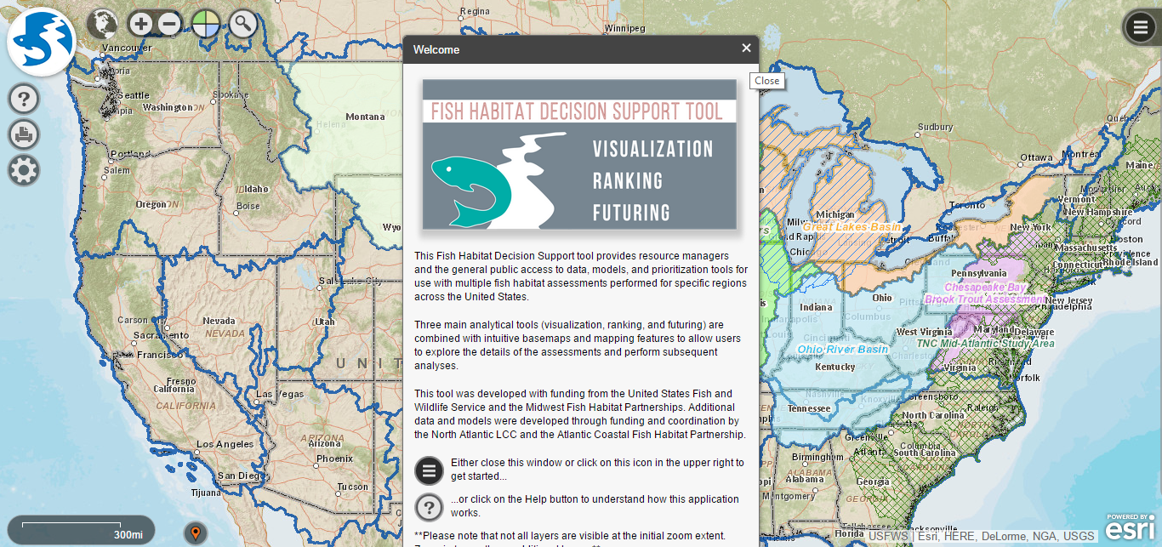
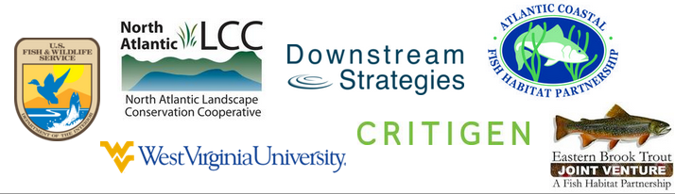
Fish Habitat Decision Support Tool
www.FishHabitatTool.org

Slide 2
Overview
Brief overview of the assessments
Demonstration of landing website and general layout of the tool
Demonstration of visualization tool
Demonstration of ranking tool
Demonstration of futuring tool
Questions

Slide 3
Project Overview
Timeline
2008 – Midwest Fish Habitat Partnerships
2009 - Great Plains FHP
2012 - North Atlantic LCC
Assessment Process
Landscape characteristics used to predict aquatic characteristics (statistical models)
“Post-modeling” indices of stress and habitat quality
Tool development
Originally ArcGIS Desktop
Midwest FHPs secured funding for web version

Slide 4
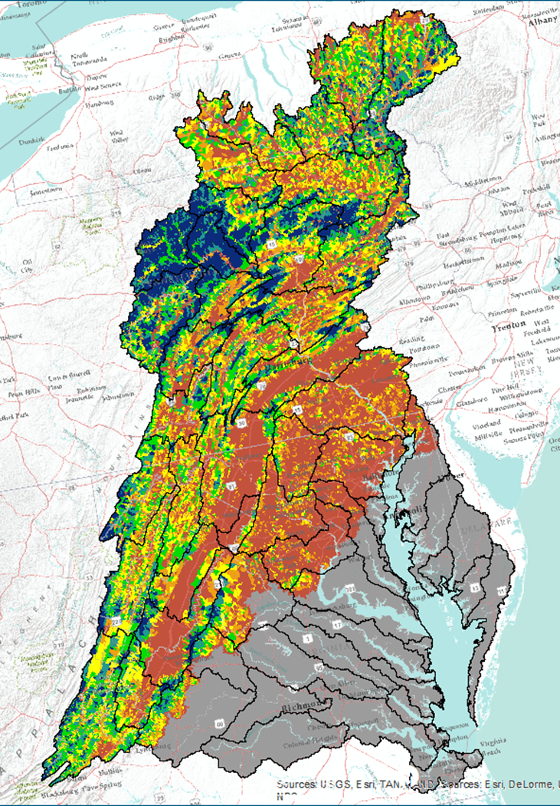
Chesapeake Bay Brook Trout Assessment
Statistical details
Strong model
Key factors:
Natural
Predicted July stream temperature
Slope
Precipitation
Stressors
Impervious surface cover
Agriculture
Mining
Post-modeling Indices
Stress
Natural habitat quality
Climate change vulnerability

Slide 5
Chesapeake Bay Brook Trout Assessment
Limitations
Invasive species data
Barriers
Springs/Groundwater
Acid Precipitation
Local variability
Habitat complexity
Water quality

Slide 6
Disclaimers
Modeling is complete
Tool is still being refined
95% complete

Slide 7
Webtool Utility
Data repository
(30-100+ attributes for 1.2 million catchments)
Downloadable GIS data
Visualization of data and model results
Ranking algorithm
User-defined weighting of metrics
Priority establishment
Future scenario modeling
User defined landscape modifications
Visualize change in brook trout occupancy

Slide 8
Landing Page
www.FishHabitatTool.org
Tutorial Videos
Reports/Data Information

