Slide 1

Brook Trout Outcome
Quarterly Progress Meeting - May 2017
Stephen Faulkner, USGS
Brook Trout Action Team Coordinator
Notes:
Thank Paige

Slide 2
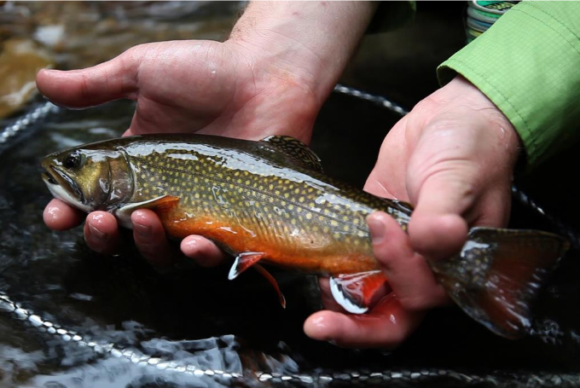
Through the Chesapeake Bay Watershed Agreement, the Chesapeake Bay Program has committed to…
Goal: Brook Trout Outcome
Outcome: Restore and sustain naturally reproducing Brook Trout populations in Chesapeake Bay headwater streams, with an eight percent increase in occupied habitat by 2025.

Slide 3
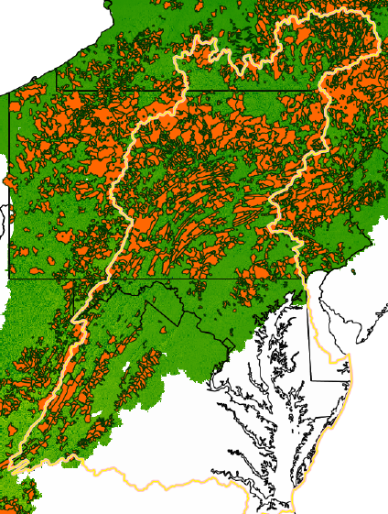
Occupied Habitat:
Baseline: EBTJV 2015 assessment estimated 13,500 sq. km of allopatric (Brook Trout only) occupied habitat baywide.
Outcome target: Increase by 1,100 sq. km for a total of 14,600 sq km by 2025.
Notes:
The estimates are based on th 2015 EBTJV assessment

Slide 4

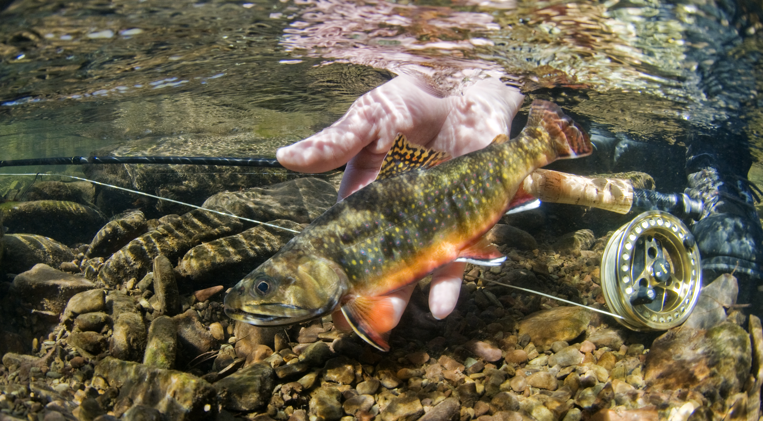
What We Want
Incentives for Team Members to be more engaged and invested in the Outcome.
Pathways for communication/
outreach with key decision-makers/planners to increase awareness/opportunities
Support for cross-GIT collaboration, monitoring programs
Notes:
Coordinate reps performance plans with BTAT workplans to better align; financial support for workshops
For example, engage planners/DOT on culvert replacement projects to use fish-friendly culverts, connect BT patches
For example, ensuring monitoring is fully supported, make it explicit restoration project objectives

Slide 5
Setting the Stage: What are our assumptions?
1
Notes:
[section header, no action required] The section that follows should provide some brief historical context for the Bay Program’s work toward this outcome. Add slides as needed while being mindful of the time you have.

Slide 6
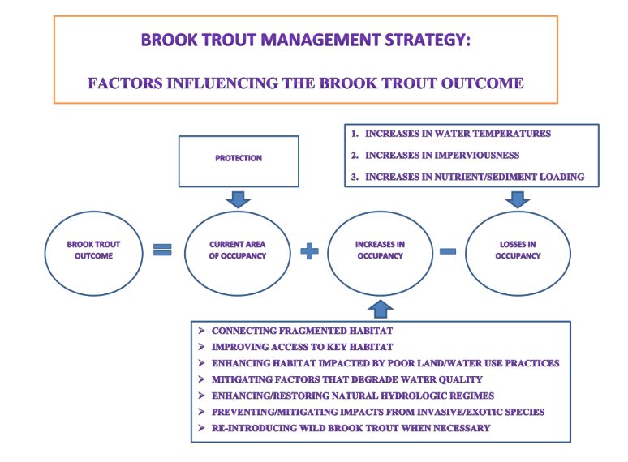
Logic Behind Our Outcome
Following the Decision Framework
Notes:
INSTRUCTIONS: Describe the factors, efforts & gaps, and management approaches that are relevant to your ask or key takeaway. You could use the analysis and insight gained from your logic table to consider questions like,
What are my critical factors originally identified in the Management Strategy?
What did I originally identify in the Management Strategy as gaps in existing programs that addressed those factors?
What were the management approaches I chose for my strategy and workplan to address those gaps?
REMEMBER: Prioritize the information you want to present based on your story, ask, or key takeaway.

Slide 7
Logic Behind Our Outcome
Following the Decision Framework:
Factors
Current Efforts and Gaps
Management Approaches
Scientific/Technical Understanding
Partner Participation
Agency Engagement
Driver/stressor impacts
Climate/Land Use
Temperature
Sediment
Invasives/exotics
Monitoring support
Landowner participation
Identify/communicate priority (best) areas
Emerging stressors/restoration priorities
Refine/apply decision support tools (DST)
Continue/expand monitoring
Notes:
Monitoring support – both existing populations and restoration projects, resources needed to adequately address
Identify/communicate priority areas – both conservation, where stressors are the lowest, and restoration

Slide 8
Progress: Are we doing what we said we would do?
2

Slide 9
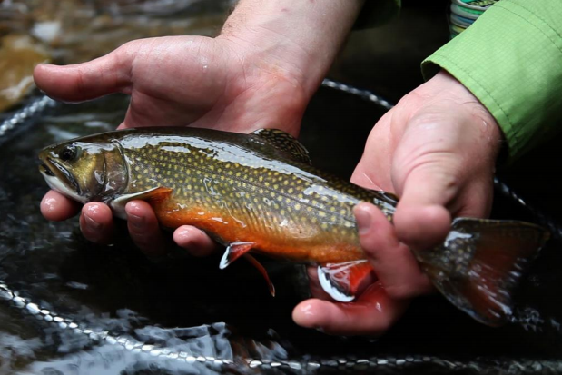
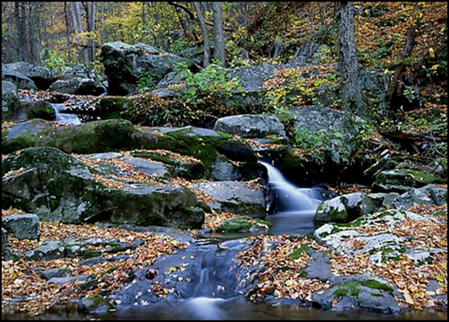
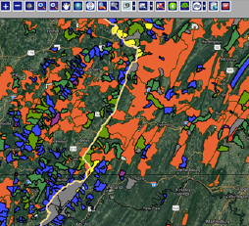
What is our progress?
9/13 action items completed
Identified “Best of the Best” Brook Trout patches for conservation/ restoration
Supporting Restoration Work
Trout Unlimited –
Cacapon, Shenandoah,
James
Multi-partner (State, County, NGO’s) –
Upper Gunpowder
Updated CB Brook Trout occupancy model in Upper Susquehanna River Basin
Coordinating with partners - spatially explicit DST
Notes:
I would add Federal to the UGR project partner list

Slide 10
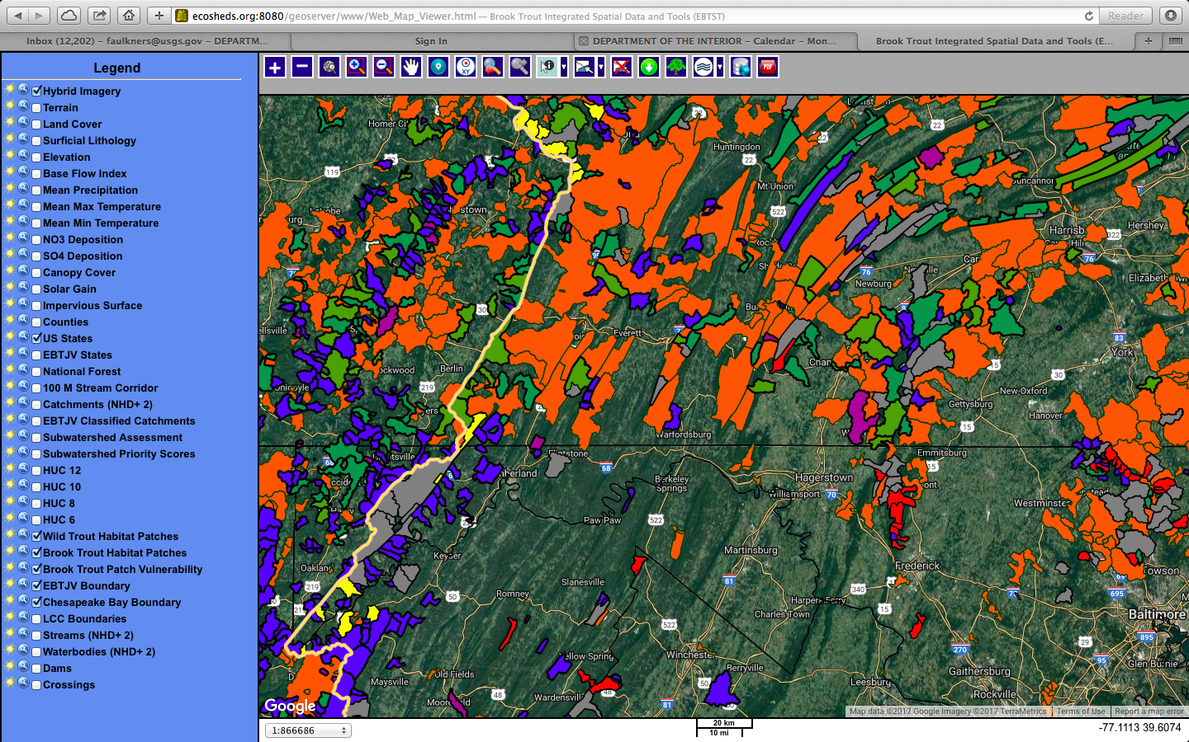
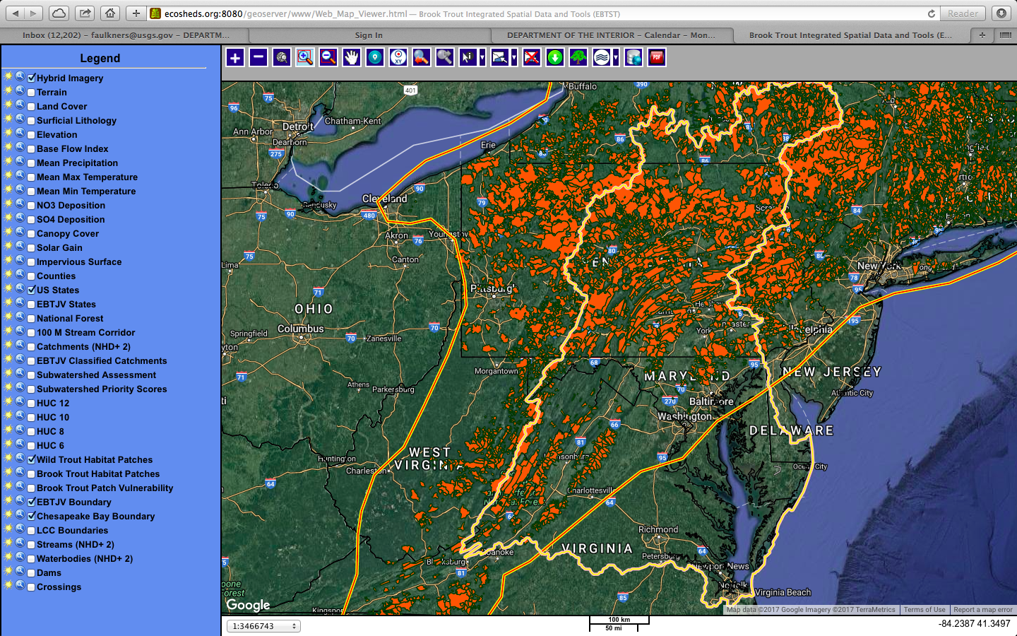
Are we on track?
Notes:
Map of all BT patches, but need to drill down to ID allopatric, vulnerable patches. Needs UOG update.
Talking Points:
Discussion Question 1 (continued)
What is your anticipated deadline? What is your anticipated trajectory?
What actual progress has been made thus far?
What could explain any existing gap(s) between your actual progress and anticipated trajectory?

Slide 11
Are we on track?
14,600
(target)
1,100 km² newly occupied habitat
Occupied habitat (km² )
No annual presence/absence indicator
???
13,500
(baseline)
2015
2017
2025
Time
Notes:
Map of all BT patches, but need to drill down to ID allopatric, vulnerable patches. Needs UOG update.
Talking Points:
Discussion Question 1 (continued)
What is your anticipated deadline? What is your anticipated trajectory?
What actual progress has been made thus far?
What could explain any existing gap(s) between your actual progress and anticipated trajectory?

Slide 12
Analysis
Discussion Question 2: Which actions were most critical in progress thus far?
Greater coordination and consensus among conservation partners
Integrating the best available science into DST, restoration decisions, monitoring
Identifying and prioritizing “best of the best” areas within each state for both conservation and restoration
Notes:
INSTRUCTIONS: consider these questions and include those that are most relevant to your outcome.

Slide 13
Analysis
Discussion Question 3: Which management actions will be the most critical to your progress in the future? Why?
Coordination between DST and on-the-ground practitioners, projects
Identifying key decision-makers at state/local levels to educate/engage
Monitoring restoration progress/success
Cross-GIT goal coordination
Strong engagement, participation among the partners
Notes:
INSTRUCTIONS: consider these questions and include those that are most relevant to your outcome.

Slide 14
Challenges: Are our actions having the expected effect?
3
Notes:
[section header, no action required] This second section provides the BUT part of the AND, BUT, THEREFORE story structure. This section provides an opportunity to talk about your challenges, based on your analysis using the logic table and the discussion questions in the SRS Quarterly Meeting Guide.

Slide 15
Challenges
Limited ability to control stressors
Insufficient resources for partner engagement/monitoring
Limited understanding/access to DST’s
Majority of restoration opportunities are on private property
Restoration opportunities not equal among States

Slide 16
Adaptations: How should we adapt?
4
Notes:
[section header, no action required] This second section provides the THEREFORE part of the AND, BUT, THEREFORE story structure. This section provides an opportunity to talk about your adaptations and next steps, based on your analysis using the logic table and the discussion questions in the SRS Quarterly Meeting Guide.

Slide 17
Based on what we’ve learned, we plan to…
Improve coordination with partners and local agencies to tie their projects with our Outcome target and CBP priorities
Develop a priority list of streams to re-introduce and restore brook trout to create naturally reproducing populations
Developing a template for communicating “best of best”
areas for conservation/restoration efforts
Work with partners to revise work plan to address
Challenges including cross-GIT collaboration

Slide 18










Agreement Goals and Outcomes
Sustainable Fisheries
Vital Habitats Goal
Blue Crab Abundance
Blue Crab Management
Oyster
Forage Fish
Fish Habitat
Wetlands
Black Duck
Stream Health
Brook Trout
Fish Passage
Submerged Aquatic Vegetation (SAV)
Forest Buffer
Tree Canopy
Water Quality Goal
Toxic Contaminants Goal
2017 Watershed Implementation Plans (WIP)
2025 WIP
Water Quality Standards Attainment and Monitoring
Toxic Contaminants Research Toxic Contaminants Policy and Prevention
Healthy Watersheds Goal
Stewardship Goal
Healthy Waters
Citizen Stewardship
Local Leadership
Diversity
Land Conservation Goal
Public Access Goal
Protected Lands
Land Use Methods and
Metrics Development
Land Use Options Evaluation
Public Access Site Development
Environmental Literacy Goal
Climate Resiliency Goal
Student
Sustainable Schools
Environmental Literacy Planning
Monitoring and Assessment
Adaptation Outcome
Notes:
BT Outcome linked in some way to all of the other Goals; need better coordination with those management plans.

Slide 19
What We Want
Incentives for Team Members to be more engaged and invested in the Outcome.
Pathways for communication/
outreach with key decision-makers/planners to increase awareness/opportunities
Support for cross-GIT collaboration, monitoring programs
Notes:
Coordinate reps performance plans with BTAT workplans to better align; financial support for workshops
For example, engage planners/DOT on culvert replacement projects to use fish-friendly culverts, connect BT patches
For example, ensuring monitoring is fully supported, make it explicit restoration project objectives

Slide 20
Discussion
Notes:
[time for discussion at the end of the presentation, before the next outcome presentation]

