Slide 1
2016 – 17 Bay Barometer

Slide 2
What is it?

Slide 3

Annual report on watershed health and restoration.
Retrospective summary of previously published indicators.

Slide 4
What does it look like?

Slide 5
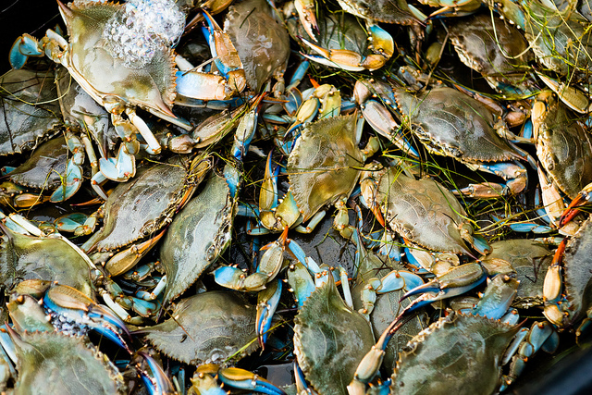
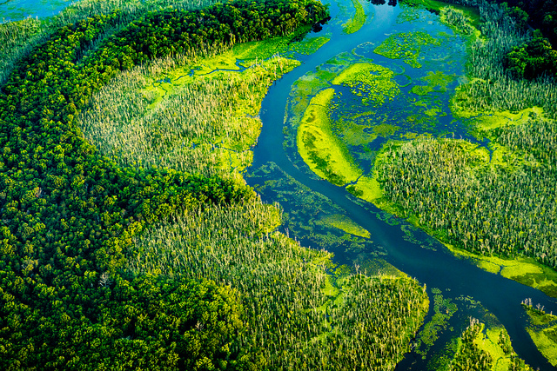

A picture is worth a thousand words
Aligned to themes of Watershed Agreement.
Comprehensive coverage of 20 indicators.
Where indicators not available, or have not been recently updated, outcomes addressed with highlights from past year.

Slide 6
Who is the audience?

Slide 7

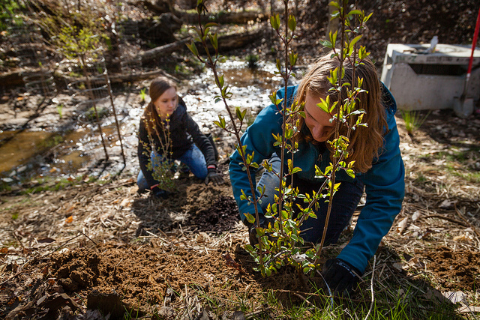
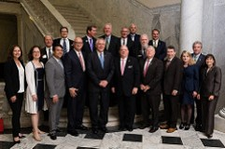
Use charts to explain your ideas
Audiences
Gray
White
Black

Slide 8
New in 2017

Slide 9
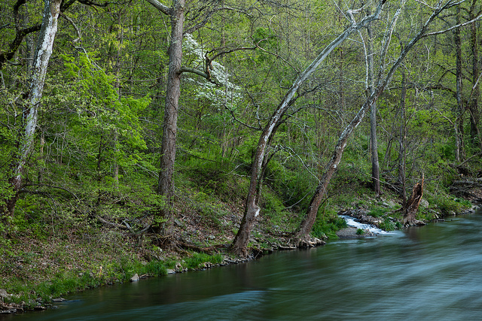
Environmental Literacy & Planning
Student MWEEs
Citizen Stewardship

Slide 10
What are we seeing?

Slide 11
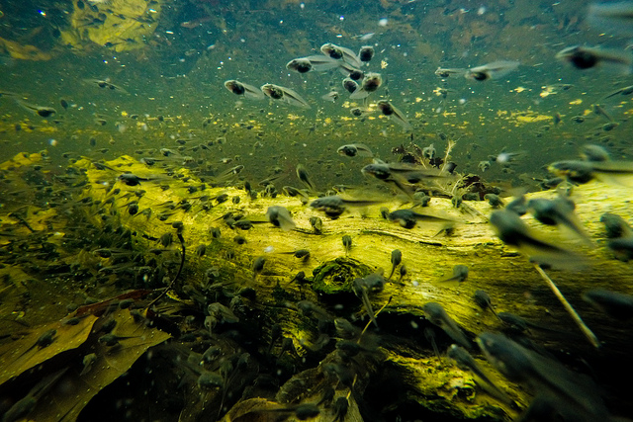
POSTIVE TRENDS ACROSS THE BOARD

Slide 12
You can also split your content
Positive Trends
Water Quality Standards Achieved
Public Access
SAV
Estimated Pollution Reduced
Fish Passage
Blue Crab Abundance

Slide 13
254 million
1,126
130
Female blue crabs observed in 2017
Additional miles opened to fish passage from 2012 – 2016.
Access sites opened to the public from 2010 – 2016.

Slide 14
97,668
40 percent
9 percent
Acres of underwater grassess mapped in 2016
Of the Chesapeake Bay and tidal tributaries met water quality standards in 2014 – 2016.
Of nitrogen loads lowered by pollution controls from 2009 – 2016.

Slide 15
In two or three columns
News Stories
Climate Resiliency
Healthy Watersheds
Protected Lands
Forest Buffers
Forage Fish
Toxics Contaminants Research
Local Leadership
Blue Crab Management
Wetlands
Brook Trout
Land Use Metrics & Metrics Development
Diversity
Land Use Options Evaluation
Tree Canopy
Black Duck
Fish Habitat
Stream Health

Slide 16
Media Release

Slide 17
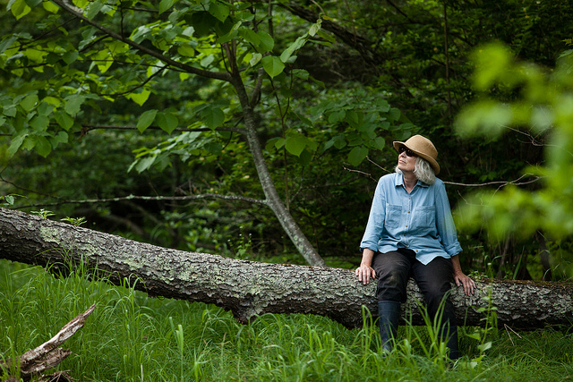
Press Release: January 4, 2018
Quotes from:
- Governor Larry Hogan
- Jim Edward, Acting CBP Director
- John Arway, Executive Director, PA Fish and Boat Commission
- Brooke Landry, Chair, SAV Workgroup

Slide 18

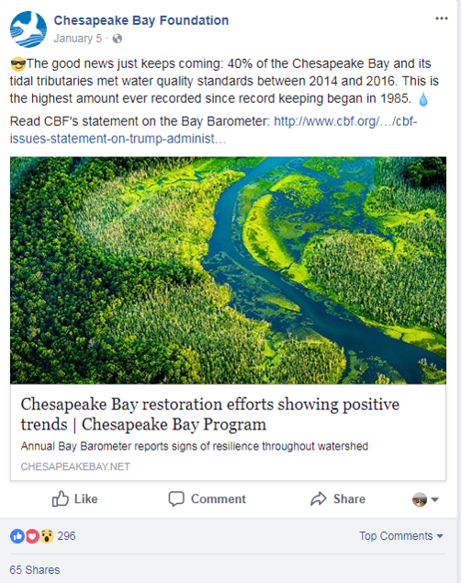

Media Engagement
Facebook: reached 20,532 people (liked 319 times, shared 88 times)
Twitter: 6,913 impressions (retweeted 20 times)
Press: Capital Gazette, WBAL-NBC, WITF-FM, Public News Service, Daily Press, E & E News, The Daily Times

Slide 19
Lessons Learned

Slide 20
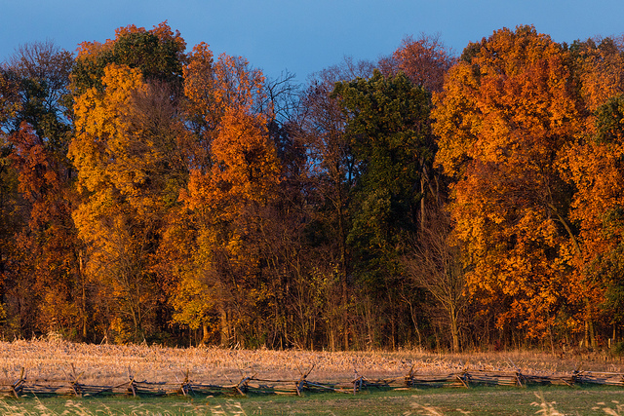
State-specific fact sheets
State-specific facts for social media
Always have a back-up plan!

Slide 21
Thanks!
ANY QUESTIONS?
Rachel Felver
CBP Communications Director
Alliance for the Chesapeake Bay
rfelver@chesapeakebay.net

