Slide 1

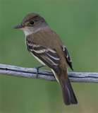
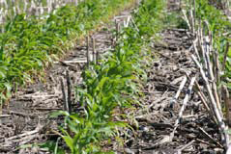
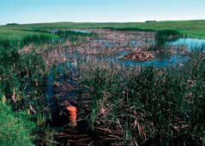

USDA Natural Resources Conservation Service (NRCS)
Priorities, Programs and Services in the Chesapeake Bay Watershed
Citizens Advisory Committee, February 20, 2019
Barry Frantz
USDA Natural Resources Conservation Service

Slide 2
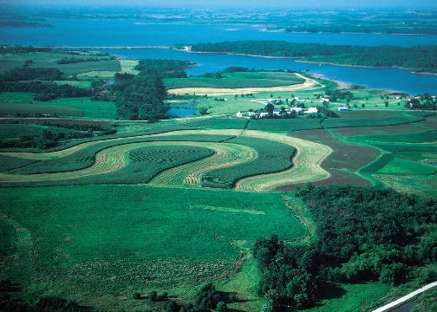
NRCS Perspective: Private Lands Conservation
There are about 87,000 privately operated farms in the Chesapeake Bay watershed.
Farmers make decisions every day that impact their financial and environmental sustainability.
Landowners voluntarily work with NRCS to make better decisions.
Local leadership and partners are critical to success
Notes:
NRCS works primarily, but not only, on private lands. We also work in partnerships with other federal, state, local agencies and private organizations.

Slide 3
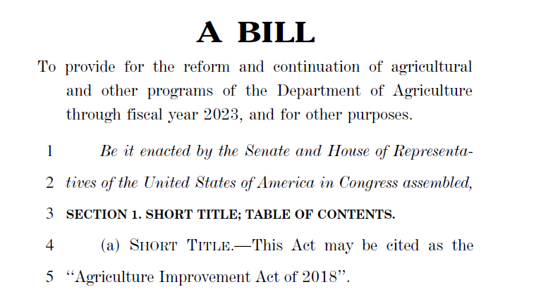
NRCS National Priorities – 2018 Farm Bill
Notes:
The 2018 Farm Bill demonstrates strong congressional support for private lands conservation., and is the major source of NRCS funding to help farmers and landowners implement conservation practices and protect agricultural and rural lands.

Slide 4
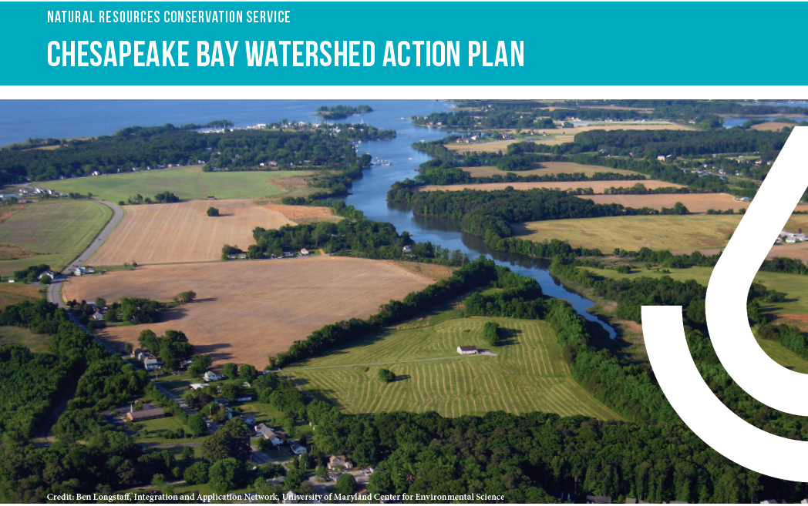
NRCS Chesapeake Bay Watershed Priorities
Notes:
NRCS’s Chesapeake Bay Action Plan identifies three natural resource priorities; three public engagement priorities; and three science, technology and partnership priorities.

Slide 5
NRCS Chesapeake Bay Natural Resource Priorities
Help farmers and landowners plan and implement practices to:
Improve Water Quality
Improve Soil Health
Restore and improve fish and wildlife habitat

Slide 6
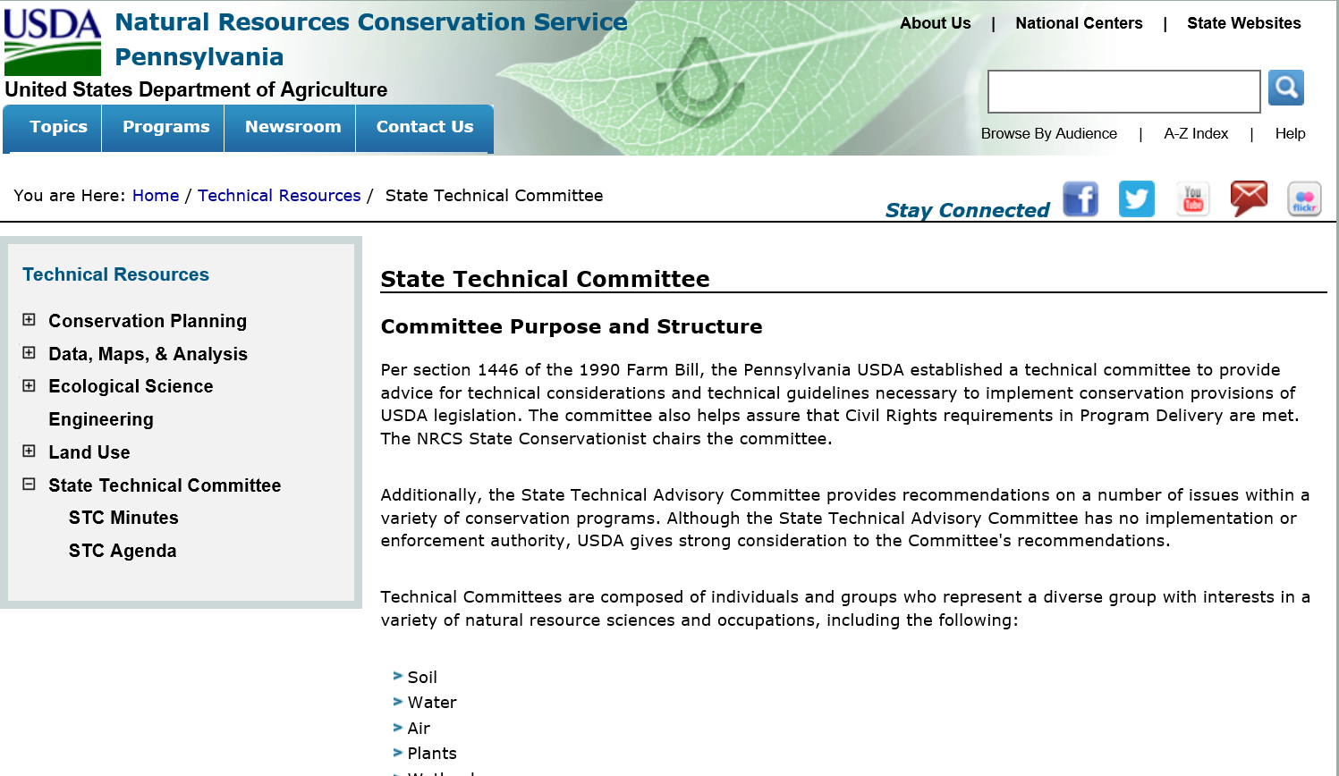
Public Engagement Opportunity: State Technical Committees and Local Working Groups
Notes:
State Technical Committees and Local Working Groups provide the public with an opportunity to learn about and provide comments on NRCS conservation programs, practices and priorities.

Slide 7
NRCS Programs and Tools
Conservation Technical Assistance
Conservation planning assistance
Conservation Programs
Agricultural Management Assistance
Conservation Stewardship Program CSP
Environmental Quality Incentives Program EQIP
Easement Programs
Agricultural Conservation Easement Program ACEP
Agricultural Land
Wetland Restoration
Healthy Forest Reserve Program
Regional Conservation Partnership Program RCPP
Conservation Practices
Conservation Practice Enhancements
Conservation Easements
Other conservation measures
Notes:
NRCS provides conservation planning assistance and financial assistance to individual land users. We start with a conservation plan and as customers determine what their priorities are, we can help then apply for financial assistance to help implement their plans.
RCPP provides a way for non federal partners to develop cooperative projects using eligible activities available under the covered conservation programs

Slide 8
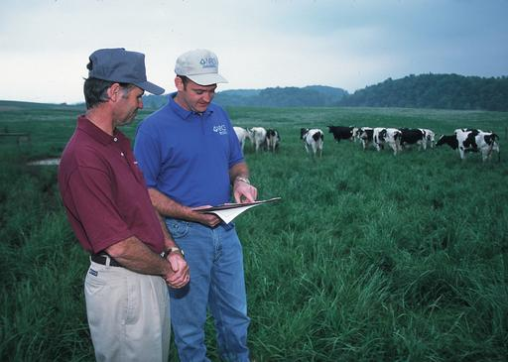
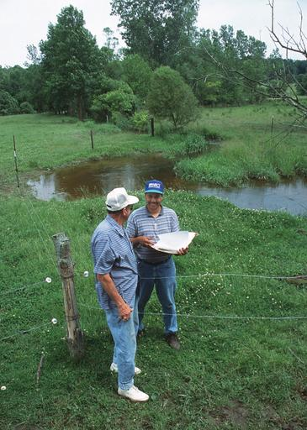
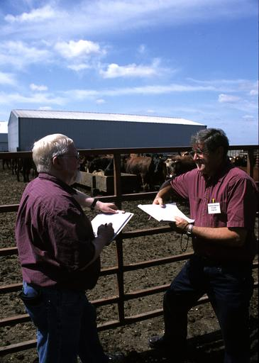
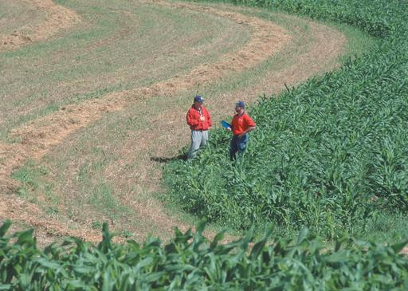
Conservation Technical Assistance

Slide 9
Conservation Technical Assistance
NRCS provides science-based planning and implementation assistance to farmers and landowners.
Not a Farm Bill program
Delivered in cooperation with county conservation districts
Other partners are commonly involved!
Notes:
NRCS also provides Technical Assistance to landowners participating in FSA’s Conservation Reserve Program and Conservation Reserve Enhancement Program (CREP).
In the Chesapeake Bay Watershed, there is a high demand for NRCS Conservation Technical Assistance

Slide 10
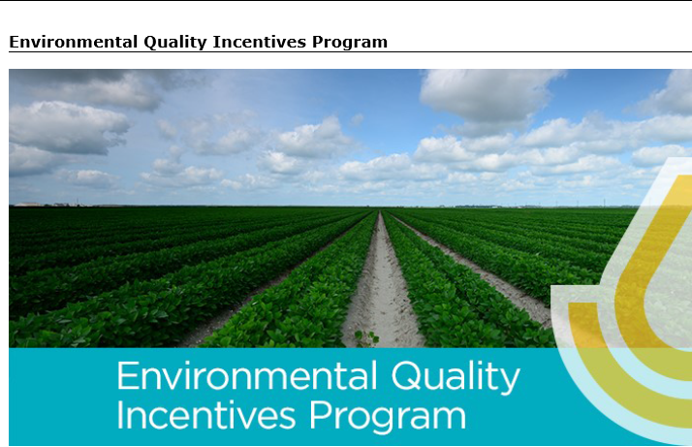
Notes:
EQIP is the primary farm bill conservation program providing funding for implementation of conservation practices.

Slide 11
Examples of Chesapeake Bay States EQIP Fund Pool Options
On-Farm Energy
Beginning or Socially Disadvantaged Farmers
Livestock /AFO-CAFO
Stream Corridor Mgt
Forestland
Cropland
Air Quality
Pasture & Grazing
Organic Farming
National Water Quality Initiative
American Black Duck
Bog Turtle
Golden-winged warbler
Oyster restoration
High tunnels
Conservation Activity Plans

Slide 12
Examples of Practices Funded by EQIP
Waste Storage Facility
High Tunnel
Cover Crop
Residue Mgt/No-till
Grassed Waterway
Prescribed Grazing
Forage and Biomass Planting
Stream Crossing
Heavy Use Area Protection
Nutrient Mgt
Feed Mgt
Denitrifying Bioreactor
Terrace
Tree/Shrub Establishment
Forest Stand Improvement
Watering Facility
Wildlife Habitat Mgt

Slide 13
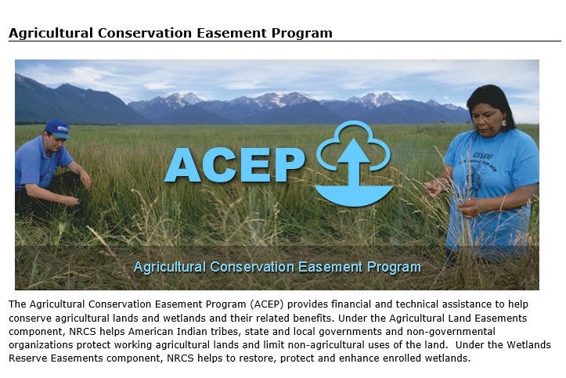
Notes:
ACEP is the primary farm bill conservation program that funds voluntary placement of conservation easements on agricultural lands, and for restoration and protection of wetlands.

Slide 14
ACEP Options
Agricultural Conservation Easements
Requires a non federal partner
Generally, Pays up to 50% of fair market value
Perpetual easement, or maximum allowed by state law
Wetland Restoration Easements
NRCS handles all aspects of easement acquisition
Must include a restorable wetland
Permanent or 30 year easements; 30 year contract option for Tribes

Slide 15
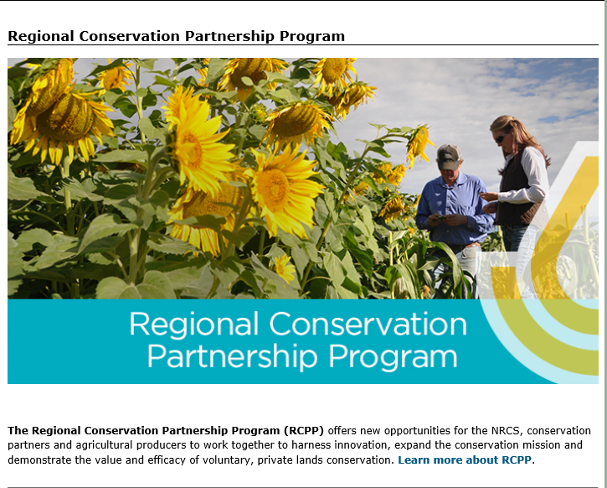

Slide 16
Regional Conservation Partnership Program
Provides entities with opportunity to access NRCS Farm Bill program authorities through a unique partnership.
Encourage innovative, locally driven projects.
Increases investment through partner contributions to achieve defined results.
Reaches out to new participants for NRCS programs.

Slide 17


Slide 18
Voluntary Private Lands Conservation and Customer Privacy
Farmers trust they can work in private with NRCS to solve critical natural resource problems.
Farm Bill statute prohibits USDA from releasing customer’s conservation plan and practice data.
NRCS can release aggregated data, or customers can release their own data.
Notes:
Section 1619 in the 2008 Farm Bill is the most commonly referenced law related to what information USDA can release.

Slide 19
Partner Program Opportunities
National Fish & Wildlife Foundation
Chesapeake Bay Watershed
Conservation Partners Program
Innovative Nutrient and Sediment Reduction
Notes:
NFWF can fund both Technical Assistance and Financial Assistance (practice cost-sharing) projects. Priorities for each year’s grants are identified in the funding announcement.

Slide 20


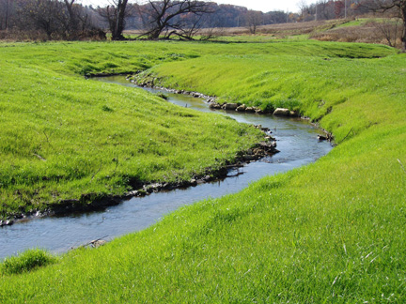
The U.S. Department of Agriculture (USDA) prohibits discrimination against its customers. If you believe you experienced discrimination when obtaining services from USDA, participating in a USDA program, or participating in a program that receives financial assistance from USDA, you may file a complaint with USDA. Information about how to file a discrimination complaint is available from the Office of the Assistant Secretary for Civil Rights.
USDA prohibits discrimination in all its programs and activities on the basis of race, color, national origin, age, disability, and where applicable, sex (including gender identity and expression), marital status, familial status, parental status, religion, sexual orientation, political beliefs, genetic information, reprisal, or because all or part of an individual’s income is derived from any public assistance program. (Not all prohibited bases apply to all programs.)
To file a complaint of discrimination, complete, sign and mail a program discrimination complaint form, available at any USDA office location or online at www.ascr.usda.gov, or write to:
USDA Office of the Assistant Secretary for Civil Rights 1400 Independence Avenue, S.W. Washington, D.C. 20250-9410
Or call toll free at (866) 632-9992 (voice) to obtain additional information, the appropriate office or to request documents. Individuals who are deaf, hard of hearing or have speech disabilities may contact USDA through the Federal Relay service at (800) 877-8339 or (800) 845-6136 (in Spanish). USDA is an equal opportunity provider, employer and lender.
Persons with disabilities who require alternative means for communication of program information (e.g., Braille, large print, audiotape, etc.) should contact USDA's TARGET Center at (202) 720-2600 (voice and TDD).

