Slide 1
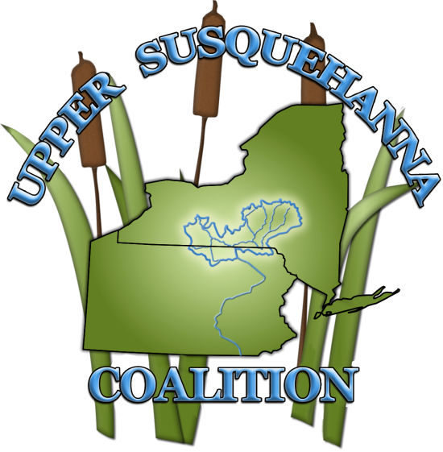
Upper Susquehanna Coalition
Mike Lovegreen
USC Stream Team Leader
Citizen’s Advisory Committee – February 20, 2020

Slide 2
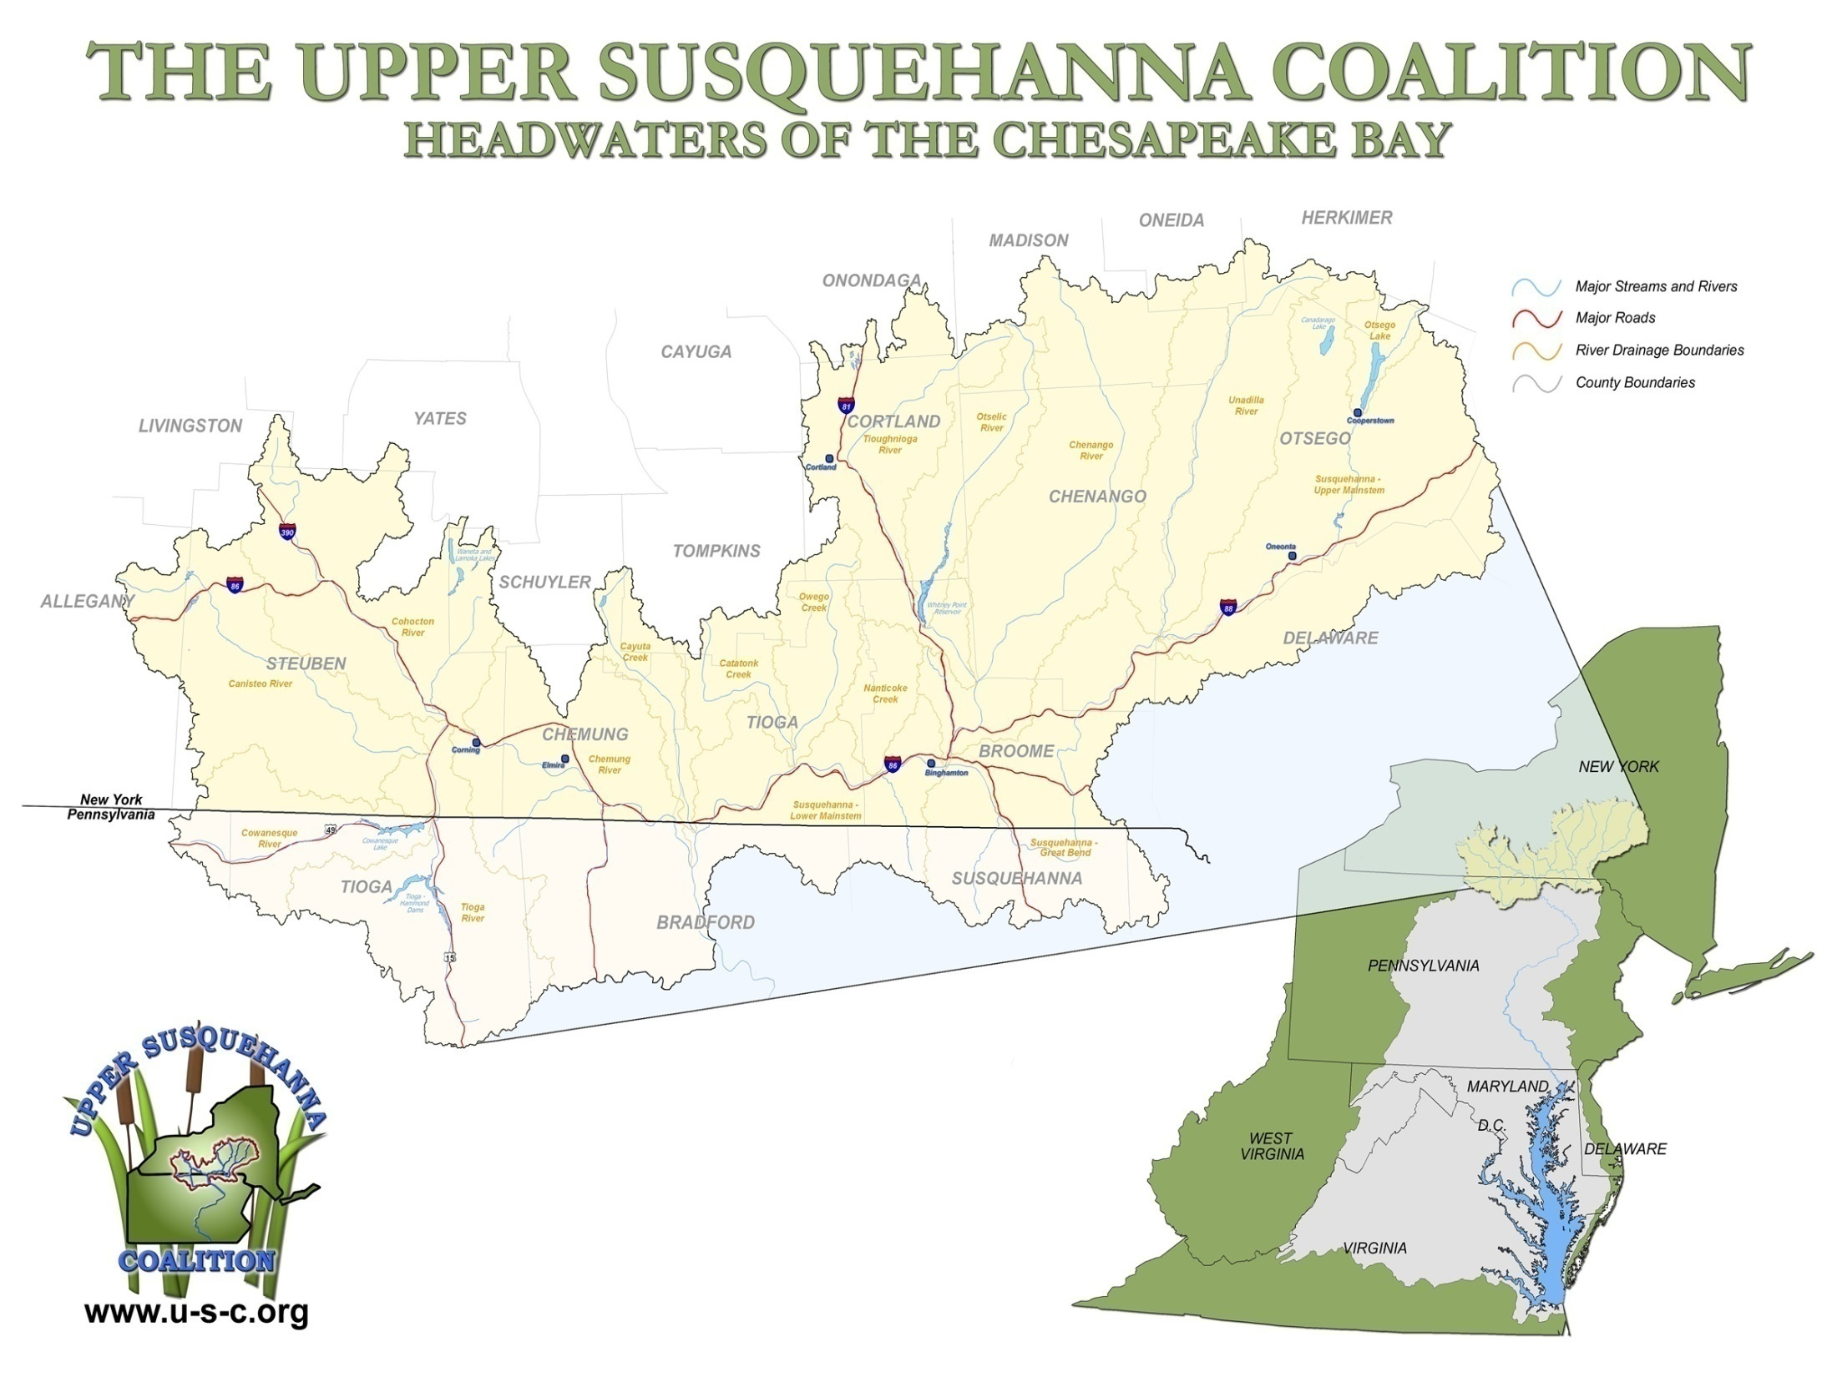

Coalition of 21 Soil and Water Conservation Districts
17 counties in NY, 4 in PA
7,500 square miles
Headwaters of the Chesapeake Bay
USC implements nonpoint source projects to address watershed issues

Slide 3
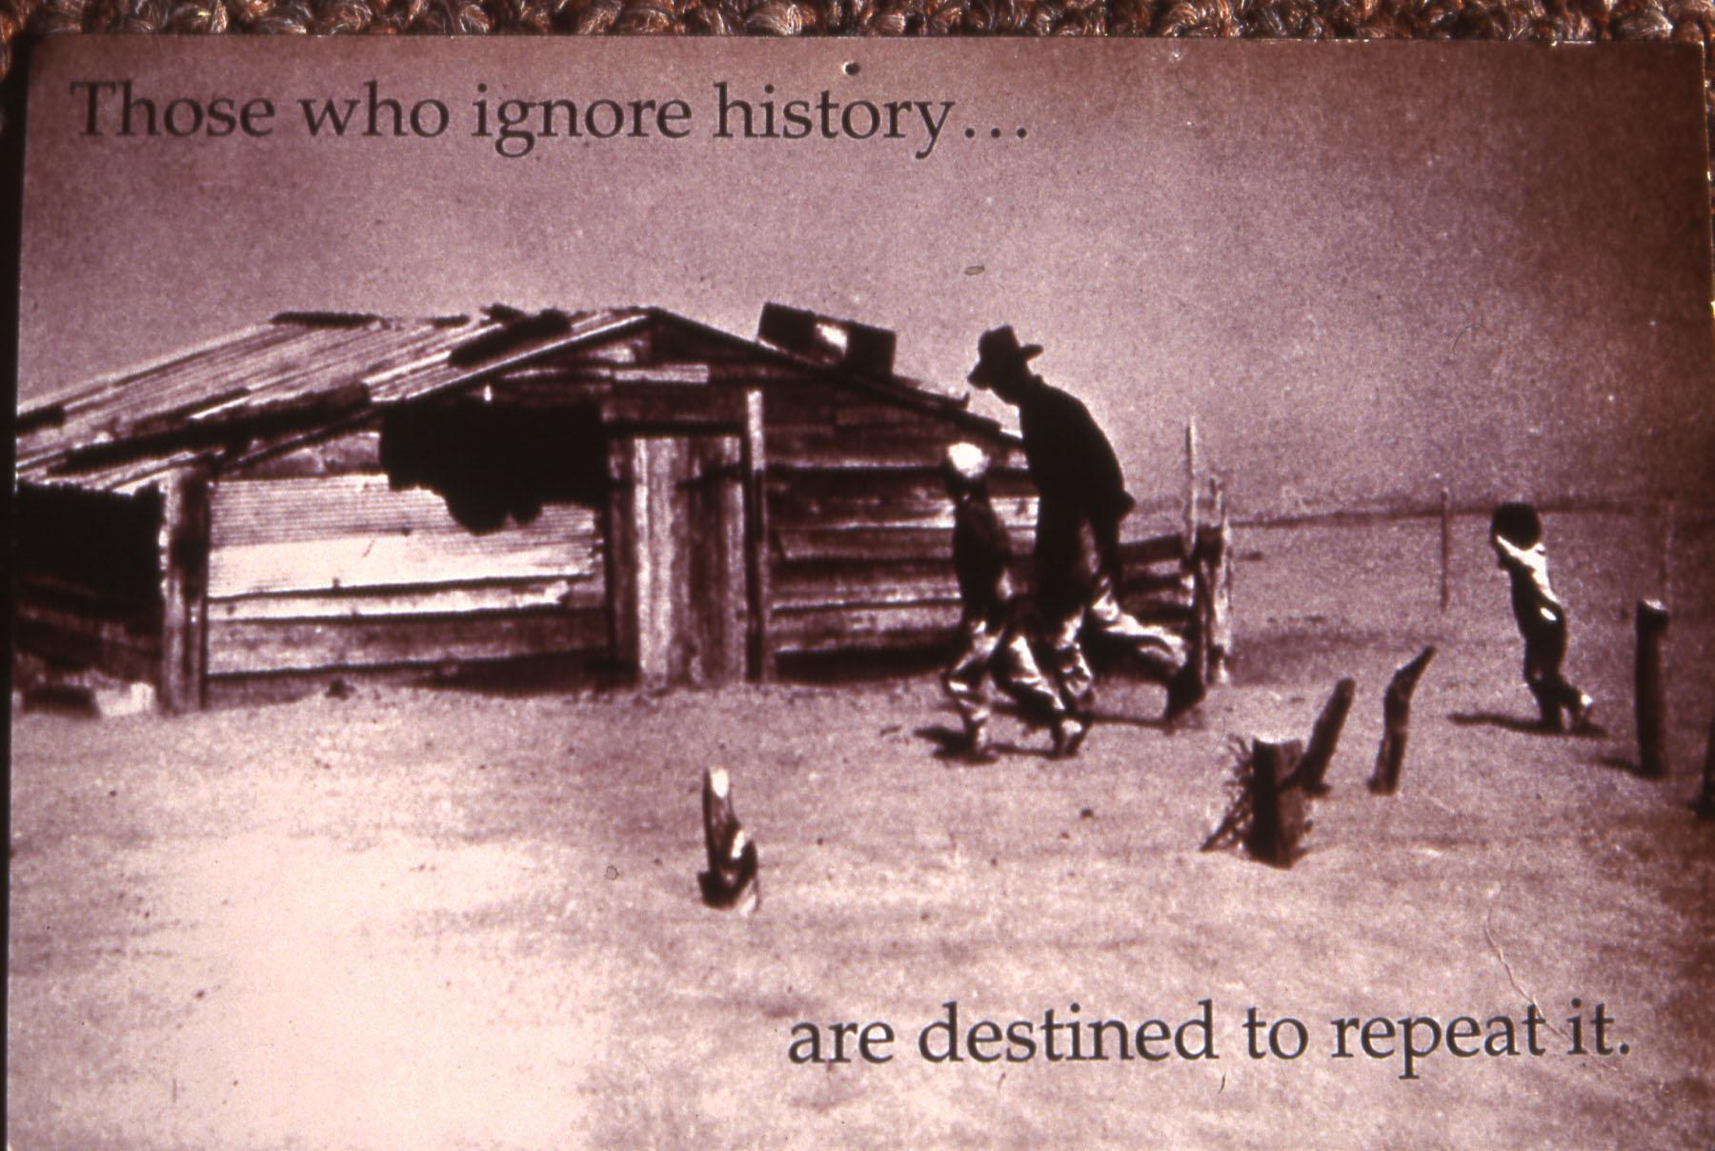
THE BEGINNINGS

Slide 4
THE BEGINNINGS
1930 “Dust Bowl”
“Soil Erosion Service”
Demonstration of BMPs
Need for Local Buy-In
Standard State Soil Conservation District Law
Unique:
“Community-Based,” “Locally Led,” “Grassroots”
Defined, by law, as political subdivisions of State Government

Slide 5
One of the best, and certainly the most promising, of the devices yet invented by man for dealing democratically and effectively with the maladjustments in land use, as well as for carrying forward positive programs of desirable conservation, and for maintaining the work, is the soil conservation district Hugh Hammond Bennett

Slide 6
Conservation District Law – District Powers
New York
Pennsylvania
Conduct surveys, investigations and research
Employ the personnel necessary
Carry out preventative & control measures on any lands … with written consent ...
Cooperate or enter into agreements with, and to furnish financial aid to any agency
… to acquire by purchase, exchange, lease, gift, grant, bequest, devise or otherwise, any property
Make available … material or equipment
Assist and advise county and municipal governments
Accept … any authority delegated
Conduct surveys, investigations and research
Employ the personnel necessary
Carry out preventative & control measures on any lands … with written consent ...
Cooperate or enter into agreements with, and to furnish financial aid to any agency
… to acquire by purchase, exchange, lease, gift, grant, bequest, devise or otherwise, any property
Make available … material or equipment
Assist and advise county and municipal governments
Accept … any authority delegated

Slide 7
Conservation District Law – District Powers
New York
Pennsylvania
Sue and to be sued … to make and execute contracts …
… may require contributions in money, services, materials or otherwise ...
Accept contributions
Sponsor projects
Enter public or private property
To construct, improve, and maintain such structures …
To develop and update comprehensive plans for the conservation of soil and water resources,
Sue and to be sued … to make and execute contracts …
… may require contributions in money, services, materials or otherwise ...
Accept contributions
Sponsor projects
Enter public or private property
Establish a program of assistance to environmental advisory councils

Slide 8
District Compliance Roles
New York
Pennsylvania
Direct Assistance to Landowners for “compliance assistance”
CAFO field assistance with DEC inspections as landowner “ombudsman”
Education and Information
Participation in AEM – Agricultural Environmental Management – as gateway to funding for farmers
Direct Assistance to Landowners for “compliance assistance”
CAFO field assistance with DEP inspections as landowner “ombudsman”
Education and Information
Multiple State Program delegations opportunities for district participation
Education/Information Enforcement
Chapter 102 – Erosion Control
Chapter 105 – Stream Regulation
Nutrient Management Law
USC PA Counties elected non-compliance

Slide 9
Authority to Create USC
NY - The authority to make this Understanding is found under NY Soil and Water Conservation Districts Law (As Amended Through the Laws of 2004- as of November 17, 2004), AN ACT establishing the State Soil and Water Conservation Committee, and creating Soil and Water Conservation Districts, constituting chapter nine-b of the consolidated laws: § 10. Cooperation between districts - The directors of any two or more districts organized under the provisions of this chapter may cooperate with one another in the exercise of any or all powers conferred in this chapter.
PA - The authority to make this Understanding is also found under PA Conservation District Law, Act of May 15, 1945, P. L. 217, (As Amended April 30, 1986, Act. No 39): Section 10. Cooperation between Districts. – The directors of any two or more districts organized under the provisions of this act may cooperate with one another in the exercise of any or all powers conferred in this act and upon approval of the county governing bodies and the State Conservation Commission, may create official special purpose or watershed organizations to solve specific problems of a multi-county or multi-state nature.

Slide 10

History of the USC
Long History of inter-state cooperation amongst Districts
Common needs, geography, weather, soils, etc.
Initial meeting with EPA – Bill Matuszeski and Glenn Eugster
CBP desire for “whole watershed” approach + strong local desire to participate
Section 319 Funding through PA (Bradford CD)
USC established in 1992 as a network of county natural resource professionals
Water Quality Coordinating Committees (NY), CBP Committees (PA)
Developed strategies, partnerships, programs and projects to protect the headwaters of the Susquehanna River and Chesapeake Bay Watersheds.
Worked under a signed MOU as authorized by District Law(s)
EPA direct funding to USC for implementation
Focus on Non-Point Source Projects
3 Standing Committees:
Executive, Education and Planning/Implementation
Notes:
Before talking about Agriculture, CB and the USC and our involvement I thought I would take a step back and give you a little history on the USC.
The USC was formed by water quality professionals recognizing the importance of regional watershed issues and similar work that we do
Members of Local WQCC: local health dept., planning, highway, cooperative extension and EMC, SWCD etc

Slide 11
History of the USC
In 2006, the USC transitioned to a coalition of Soil and Water Conservation Districts (SWCDs) / Conservation Districts (CDs) utilizing District Law
19 SWCDs (16 in NY and 3 in PA)
Cover 99% of the headwaters of the Susquehanna River
3 Focus Areas:
Stream Corridor Rehabilitation
Wetland Restoration
Environmentally and Economically Sustainable Agriculture
Newly Developed Program area directly related to CB goals and needs: BUFFERS
Notes:
IN 2006 the USC recognized that we needed more “standing” from the state and federal perspective and a better ability to enter into contracts and agreements with state and federal partners, we had a Cornell Law class review our needs, function and provide to us guidance of how we should move forward. It was decided that since many of the main players of the organization were SWCD’s that we look at District Law, that allows us to enter into contractual relationships with other District’s.
Under a new signed MOU, Tioga County SWCD became the administrative entity for the USC and is responsible for all contractual and legal obligations of the USC, but what can not be forgotten is that the USC is a Coalition of 19 SWCDs whose breadth reaches into PA and covers the headwaters of the Chesapeake Bay.
Our 3 main goals of the USC are flood attenuation, nutrient reduction and Habitat Enhancement these goals translate into 3 focus areas of the USC:
A newly developed “focus area” for the USC is our buffer program, however buffers cross over all 3 of our focus areas.

Slide 12
USC
Vision: A well functioning Susquehanna River Headwaters in harmony with itself and the entire Chesapeake Bay Watershed.
Mission: To protect and improve water quality and natural resources in the Upper Susquehanna River Basin with the involvement of citizens and agencies through planning, education, coordination, funding, project implementation and advocating for our water resources.
Notes:
The USC works to reduce nutrients that get into our local waters and the bay
We focus on non-point source pollution, which basically means pollution that doesn’t come out of a pipe.
It comes from runoff from Ag land, stormwater, or groundwater.
What the SWCD mainly do is work with agriculture to reduce nutrients coming off farms,
there is no sewage treatment plant for the cows, and there are specific practices that can help a farm reduce nutrients to local waters.

Slide 13
Watershed Approach
Utilize Multiple Barrier Approach for planning and implementation of restoration projects on a watershed basis.
Address the issue at the source, across the landscape, within the stream corridor as well as programmatically
Notes:
Programmatically (regulations, training and protection)

Slide 14
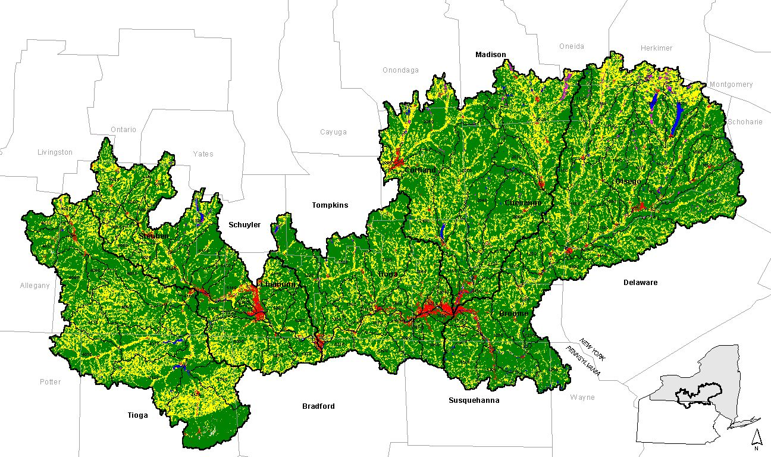
Land Use in the Susquehanna River Basin
69% forest
23% agriculture
3% urban/suburban
4% open water/wetlands
Notes:
NY makes up about 10% of the land area of the watershed and delivers about 6% of the nutrient and sediment load
NY portion of the watershed is 69% forested, 23 % agriculture, 3 % urban/suburban, 4% open water/wetlands.
New York drains 7,500 square miles ; 13,000 miles of roads and 17 000 miles of stream.
While most of the rest of the watershed in PA, VA, are experiencing land use changes in the form of urbanization and forest loss due to population growth,
NY we see populations dropping, forested land increasing when farms are abandoned.
In the southern areas of the watershed a farm is sold for development. Here, usually a farm is sold to another farmer, or left to grow back into forest.

Slide 15
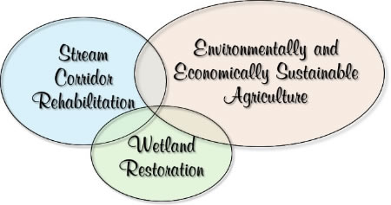
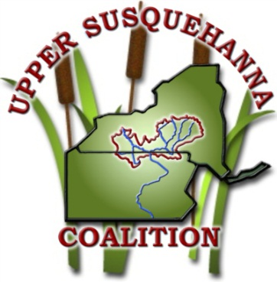
Upper Susquehanna Coalition Focus Areas
USC Approach to Focus Areas
Wetland Team
Stream Team
Ag Team
Concept of teams is to build capacity within USC and our partners to address nonpoint source issues within our identified focus areas
Notes:
Focus areas
The USC utilizes the multiple barrier approach (MBA) on a watershed basis and focus our efforts on 3 key areas.
other areas the USC is involved in which include: but at this time not as in depth as the identified 3.
Stormwater issues (water quality and quantity issues) Erosion and sediment control trainings and Stormwater plan review, MS4 assistance
Natural Gas (environmental scoping and planning, involvement in restoration and monitoring of well pads and pipelines, involvement in County level advisory boards.
WQ monitoring (individual districts and university involvement)
Building capacity at the county level has proven to be key to quality restoration, rehabilitation and sustainability in these focus areas..
So how do we accomplish this???? Through a Team approach

Slide 16
Keys to Success
Partnerships – Local, Regional, State, Federal
Coordination at a regional level
SWCD’s Relationships and reputations at the local level
Flexible funding
Prioritizing work based on local needs
Regional Delivery
Team Development that provides local support and expertise
USC
Upper Susquehanna Coalition
Notes:
Identify Partners
The USC’s foundation for its success in achieving the goals and accomplishments that it has is based on the unique relationship developed between its member soil and water conservation districts (SWCD’s) and it turn the individual members’ relationships with their federal, state and local partners and landowners.

Slide 17
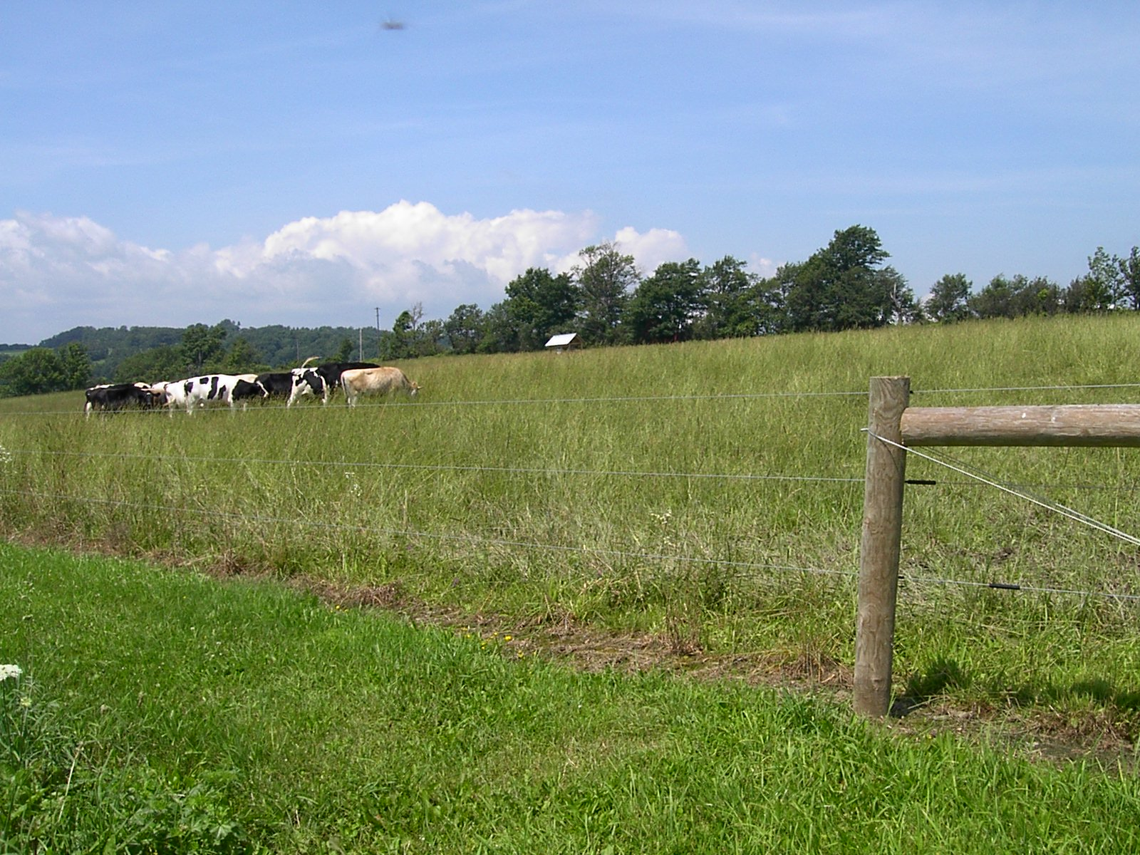
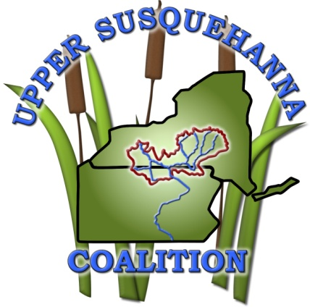
USC Ag Team
Agriculture Team
Goal: Provide a consistent, quality controlled process that builds USC and partners capacity to address agricultural environmental issues and economic sustainability on farms.

Slide 18
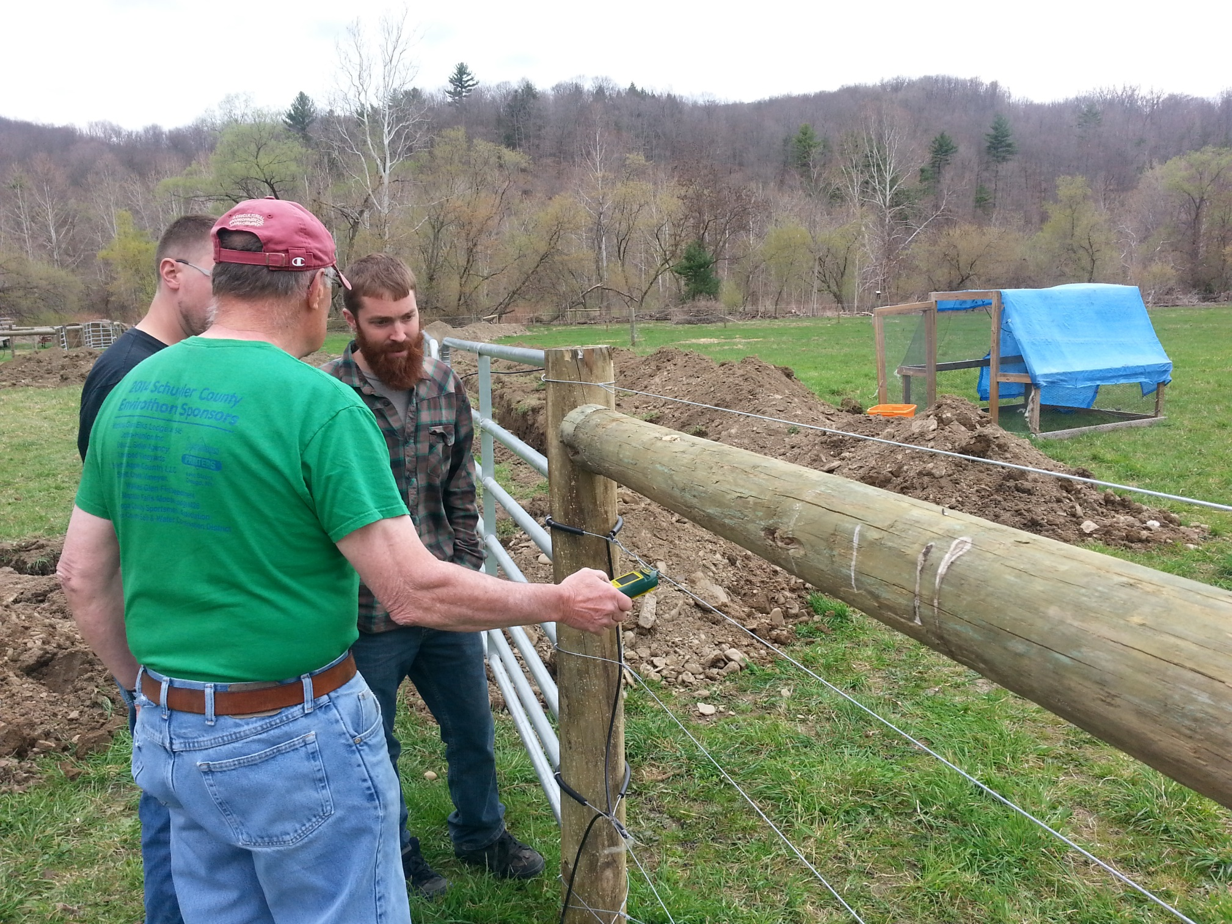
USC Ag Team
Approach: Fund, Build, Design and Implement as well as Verify, Collect and Report Ag BMP Implementation Data
AEM
Training
Data Management and QA/QC
Specialists
Equipment
Collaboration

Slide 19
Regional Agricultural Challenges
Chesapeake Bay Goals as defined in the NY WIP
Agricultural Economy
Physical Locations of Farms
Financial Assistance
Programmatic Constraints (full implementation of CNMP for all EQIP projects deters farm sign ups)
Capacity – technically skilled individuals (including engineers)
Regulations
Climate – Long cold, wet winters

Slide 20
NFWF – USC Integrated Approach to Nutrient Management
October 1, 2015 – October 31, 2018
$317,520.00 Total Grant Amount
10,611.9 acres NEW Nutrient Management Plans (4,397 acres in 2018)
21,855.5 acres UPDATED Nutrient Management Plans (9,048 acres in 2018)
60 farms – Precision Feed Management Matrix
1,950 Soil Tests
97 Manure Analysis
1,019.7 acres of Cover Crops Implemented
7 Counties participated

Slide 21
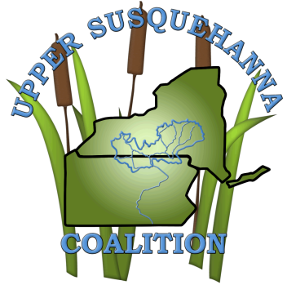
USC Riparian Buffer Program
Work with partners to match buffer funding for implementation of other farm practices, ex. grazing, nutrient management, fencing etc.;
Assists with buffer planning and implementation;
Helps coordinate DEC’s Trees for Tribs program in the Upper Susquehanna Watershed;
Collects data and tracks buffer implementation; and
Education and outreach

Slide 22
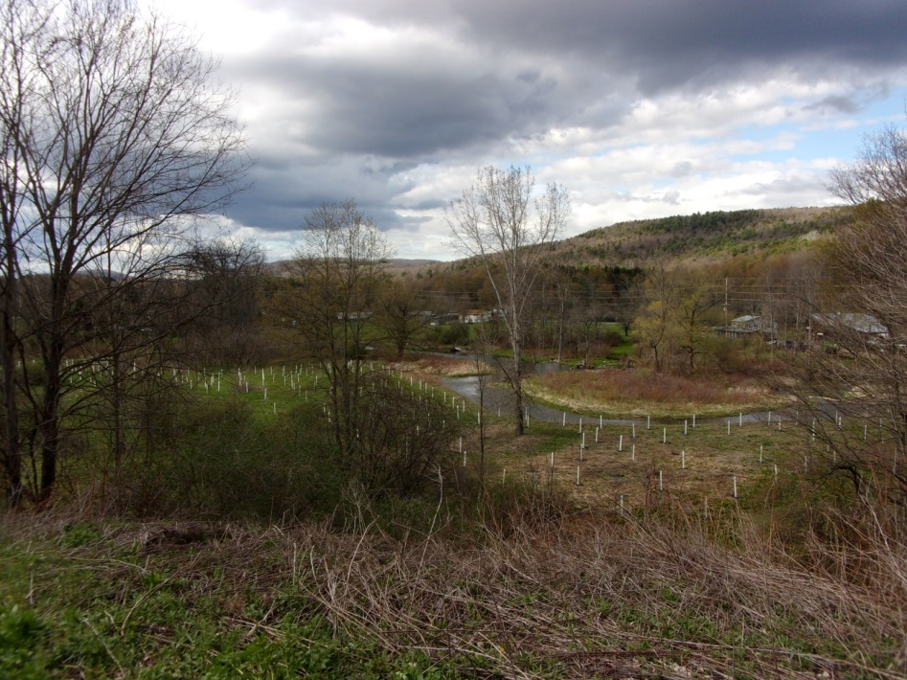
Regional Riparian Buffer Challenges
Understanding and Recognizing the Values of Buffers
Appropriate Compensation for replacement of current land uses with Buffers
Cooperation and Coordination of All Partners in Implementation of Buffers
Reducing the Complication of Programs and Incentives

Slide 23
Goals
Implement new buffers;
Monitor effectiveness of implemented buffers
Ex: Determine if CREP buffers are even still there; and
Track buffer implementation progress.

Slide 24
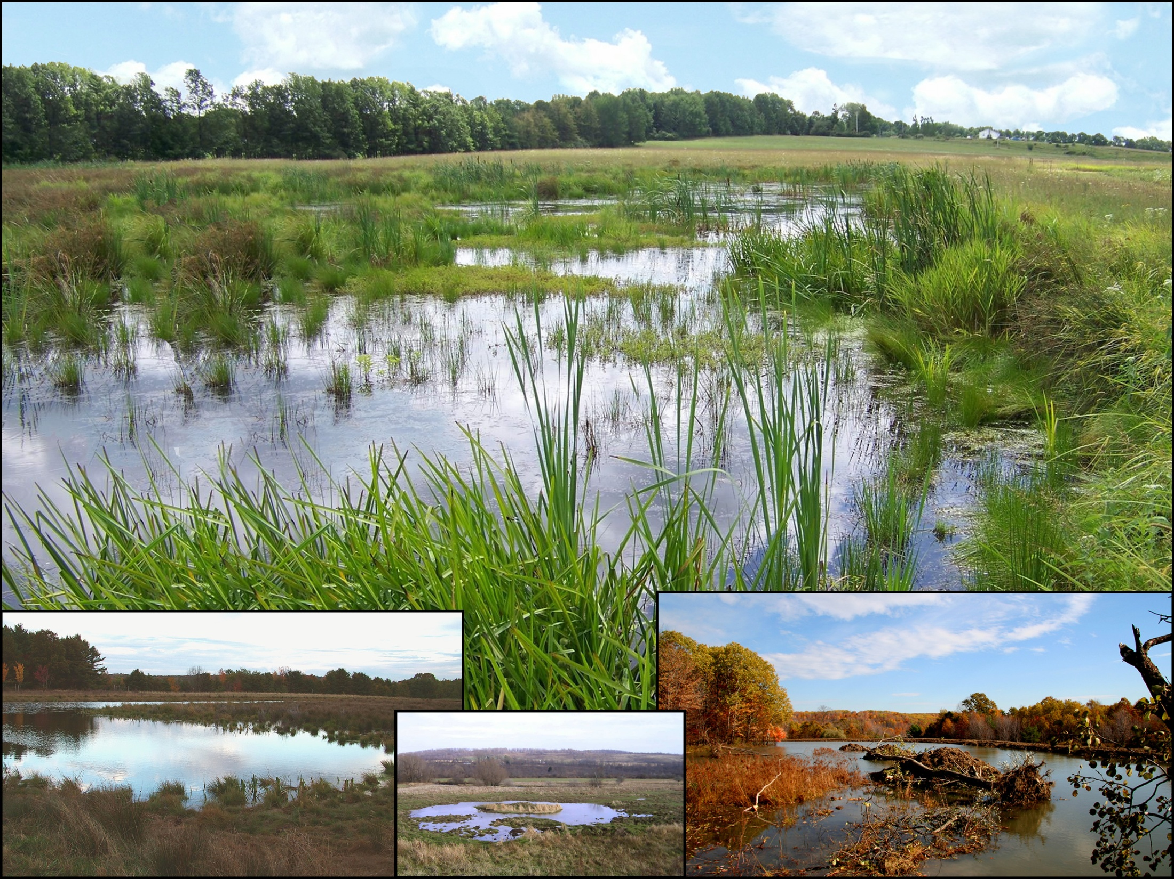
Upper Susquehanna Coalition (USC)
Wetland Team
Goal: Establish, Restore, Enhance and Conserve Wetlands
Approach: Build, Design, Restore and Fund
Notes:
By developing an approach that is both Vertically and Horizontally integrated we have a team that designs, builds and restores wetlands.

Slide 25
What does the USC Wetland Team do?
Wetland
research
Wetland Site Evaluation
Wetland Mitigation
Wetland permitting
USC
Wetland Plant Propagation
Wetland monitoring
Wetland
Wetland design
Protection
Wetland
delineation
Wetland education
Wetland
Wetland tracking
maintenance
Wetland database management
Wetland watershed planning
Wetland Construction
Wetland
modeling
in short – Wetland Everything

Slide 26
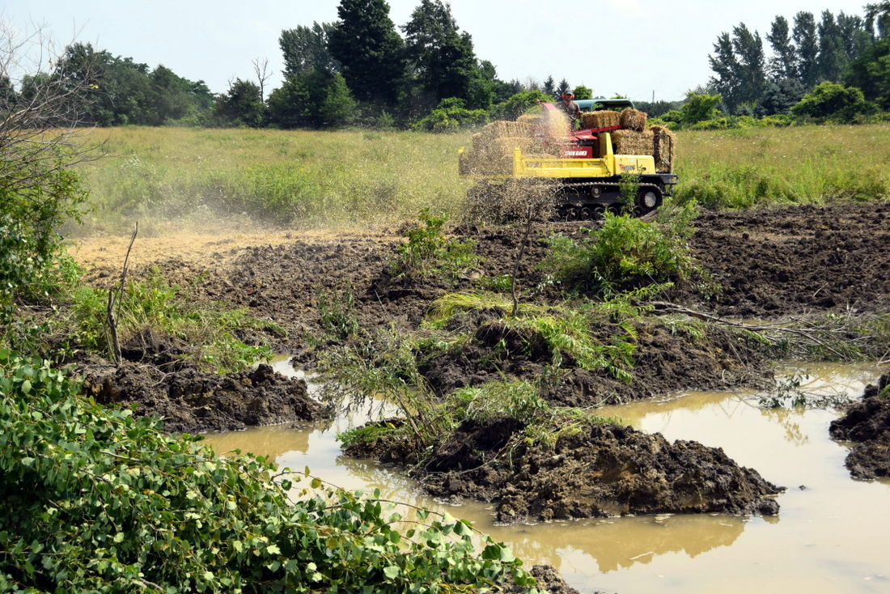
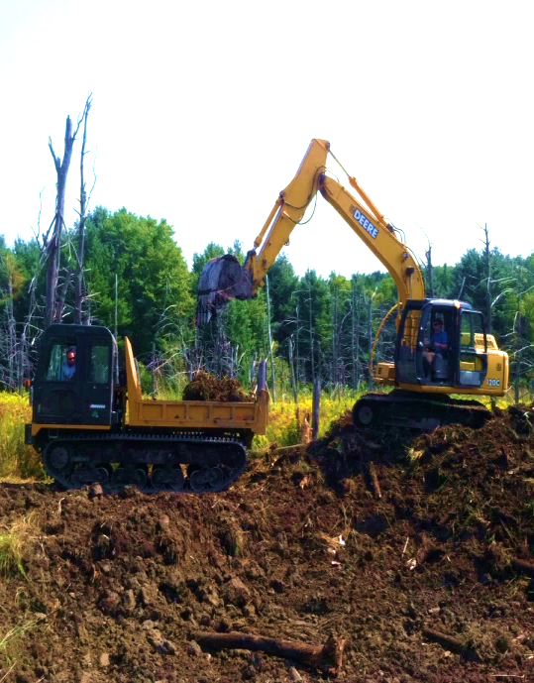
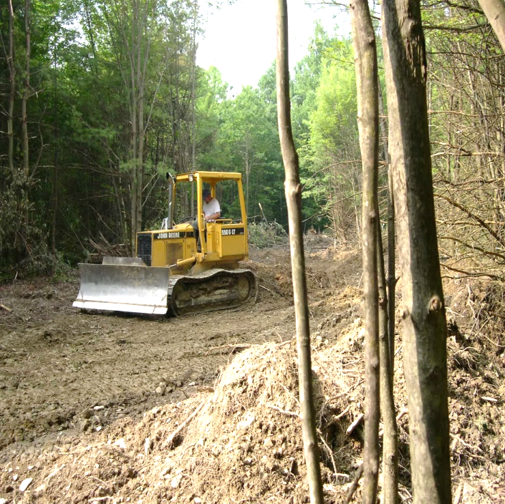
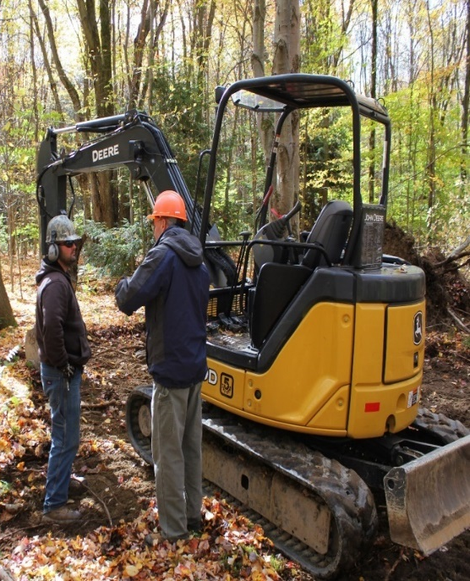
USC Wetland Team Current Assets
JD 550 bulldozer
JD 120 excavator
JD 75 excavator
JD 50 excavator
Kubota Skid Steer
Yanmar crawler carrier
Morooka crawler carrier
Mulcher Head for excavator

Slide 27
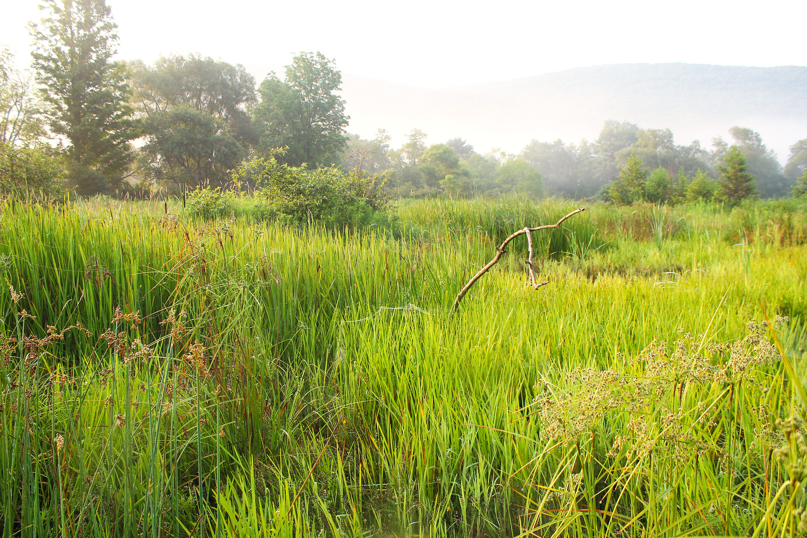
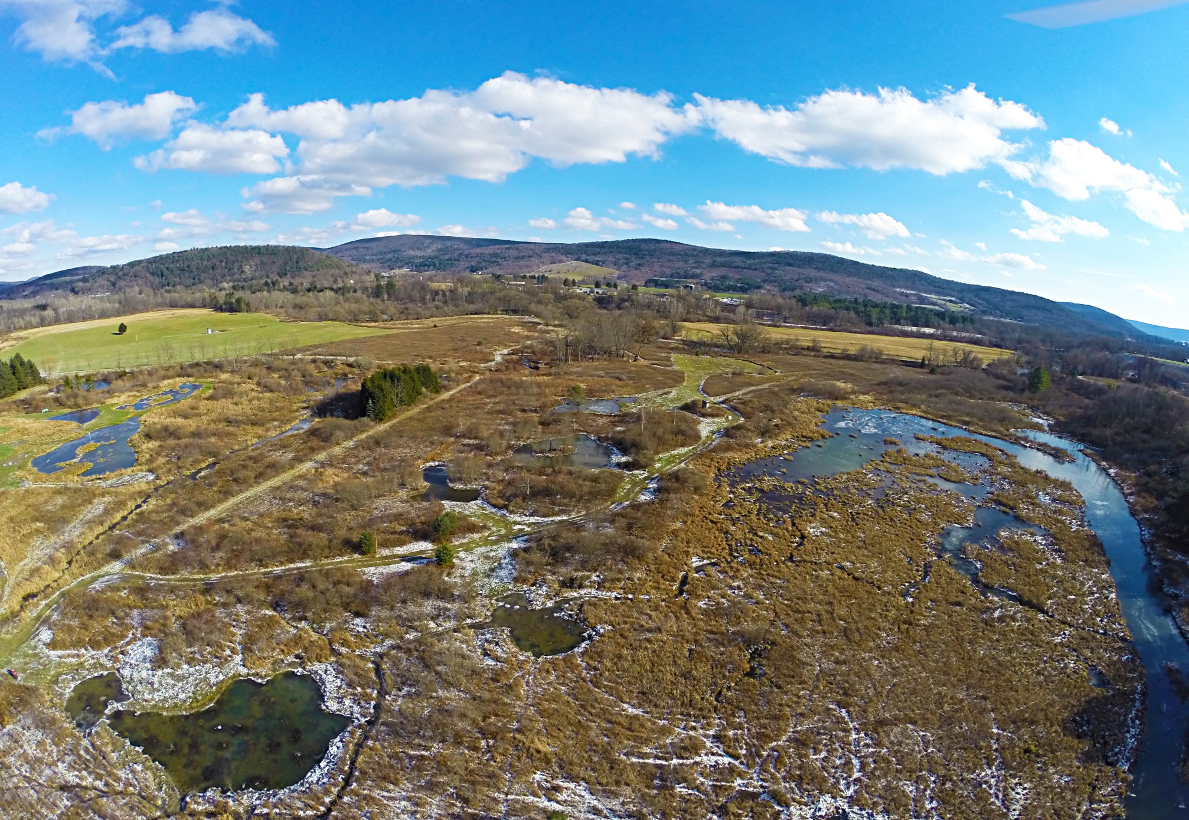
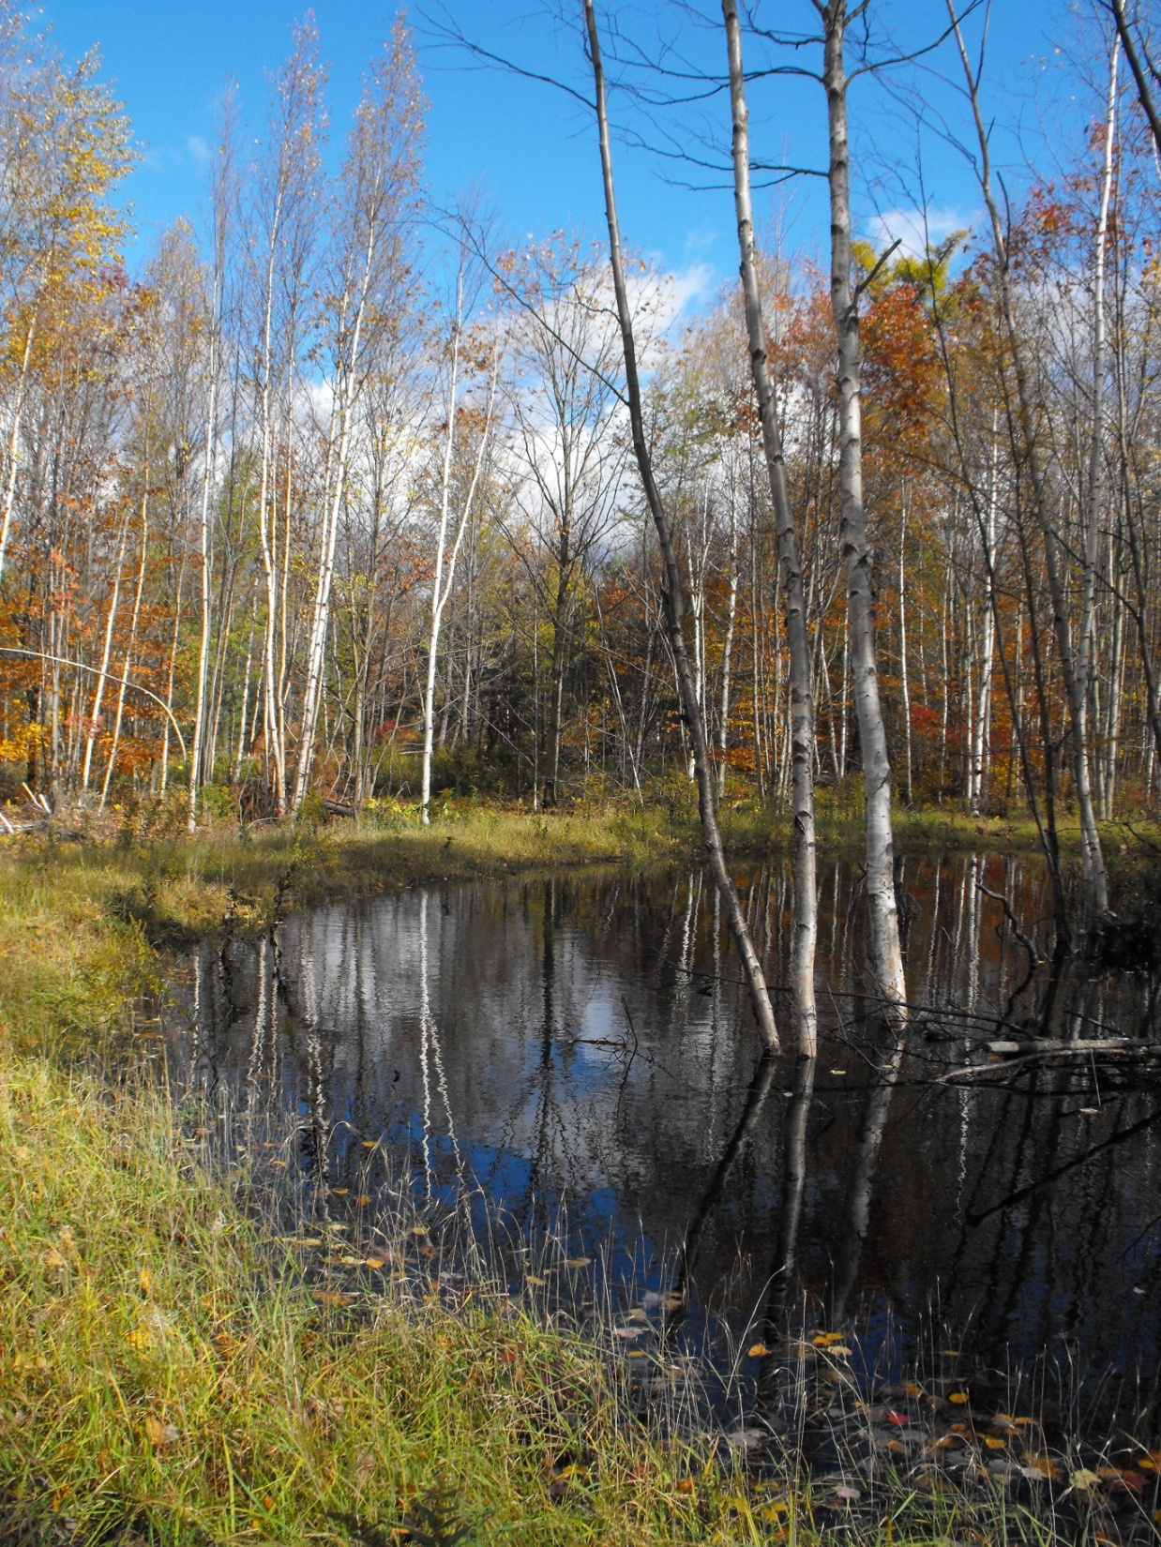
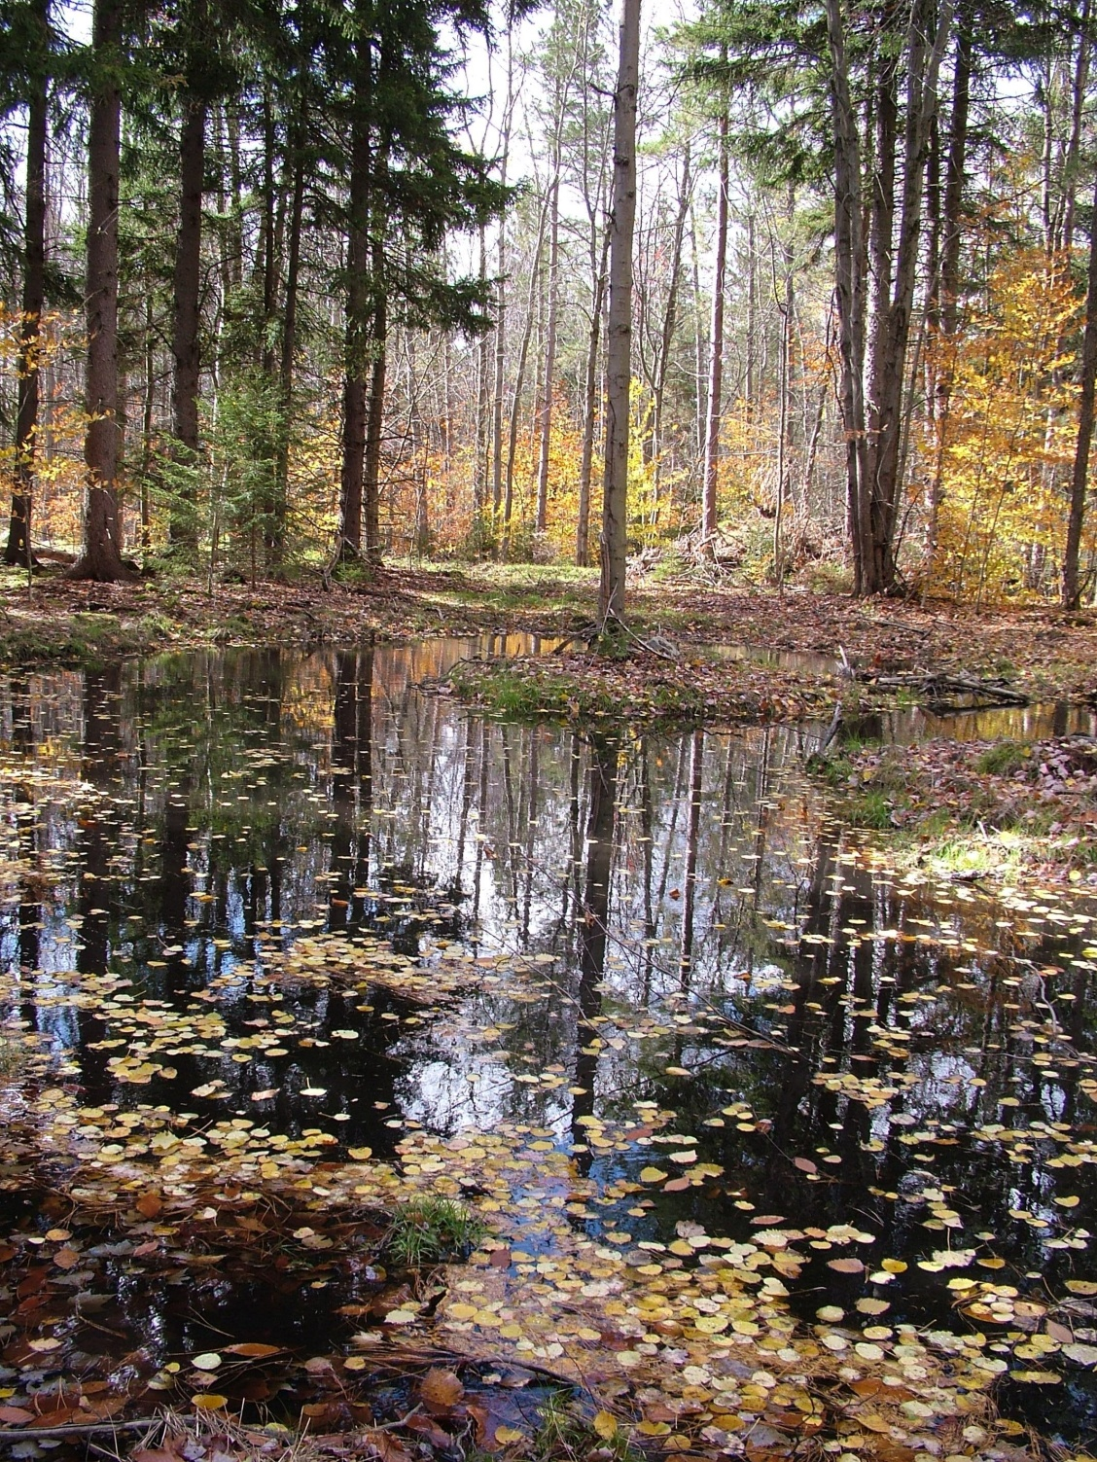
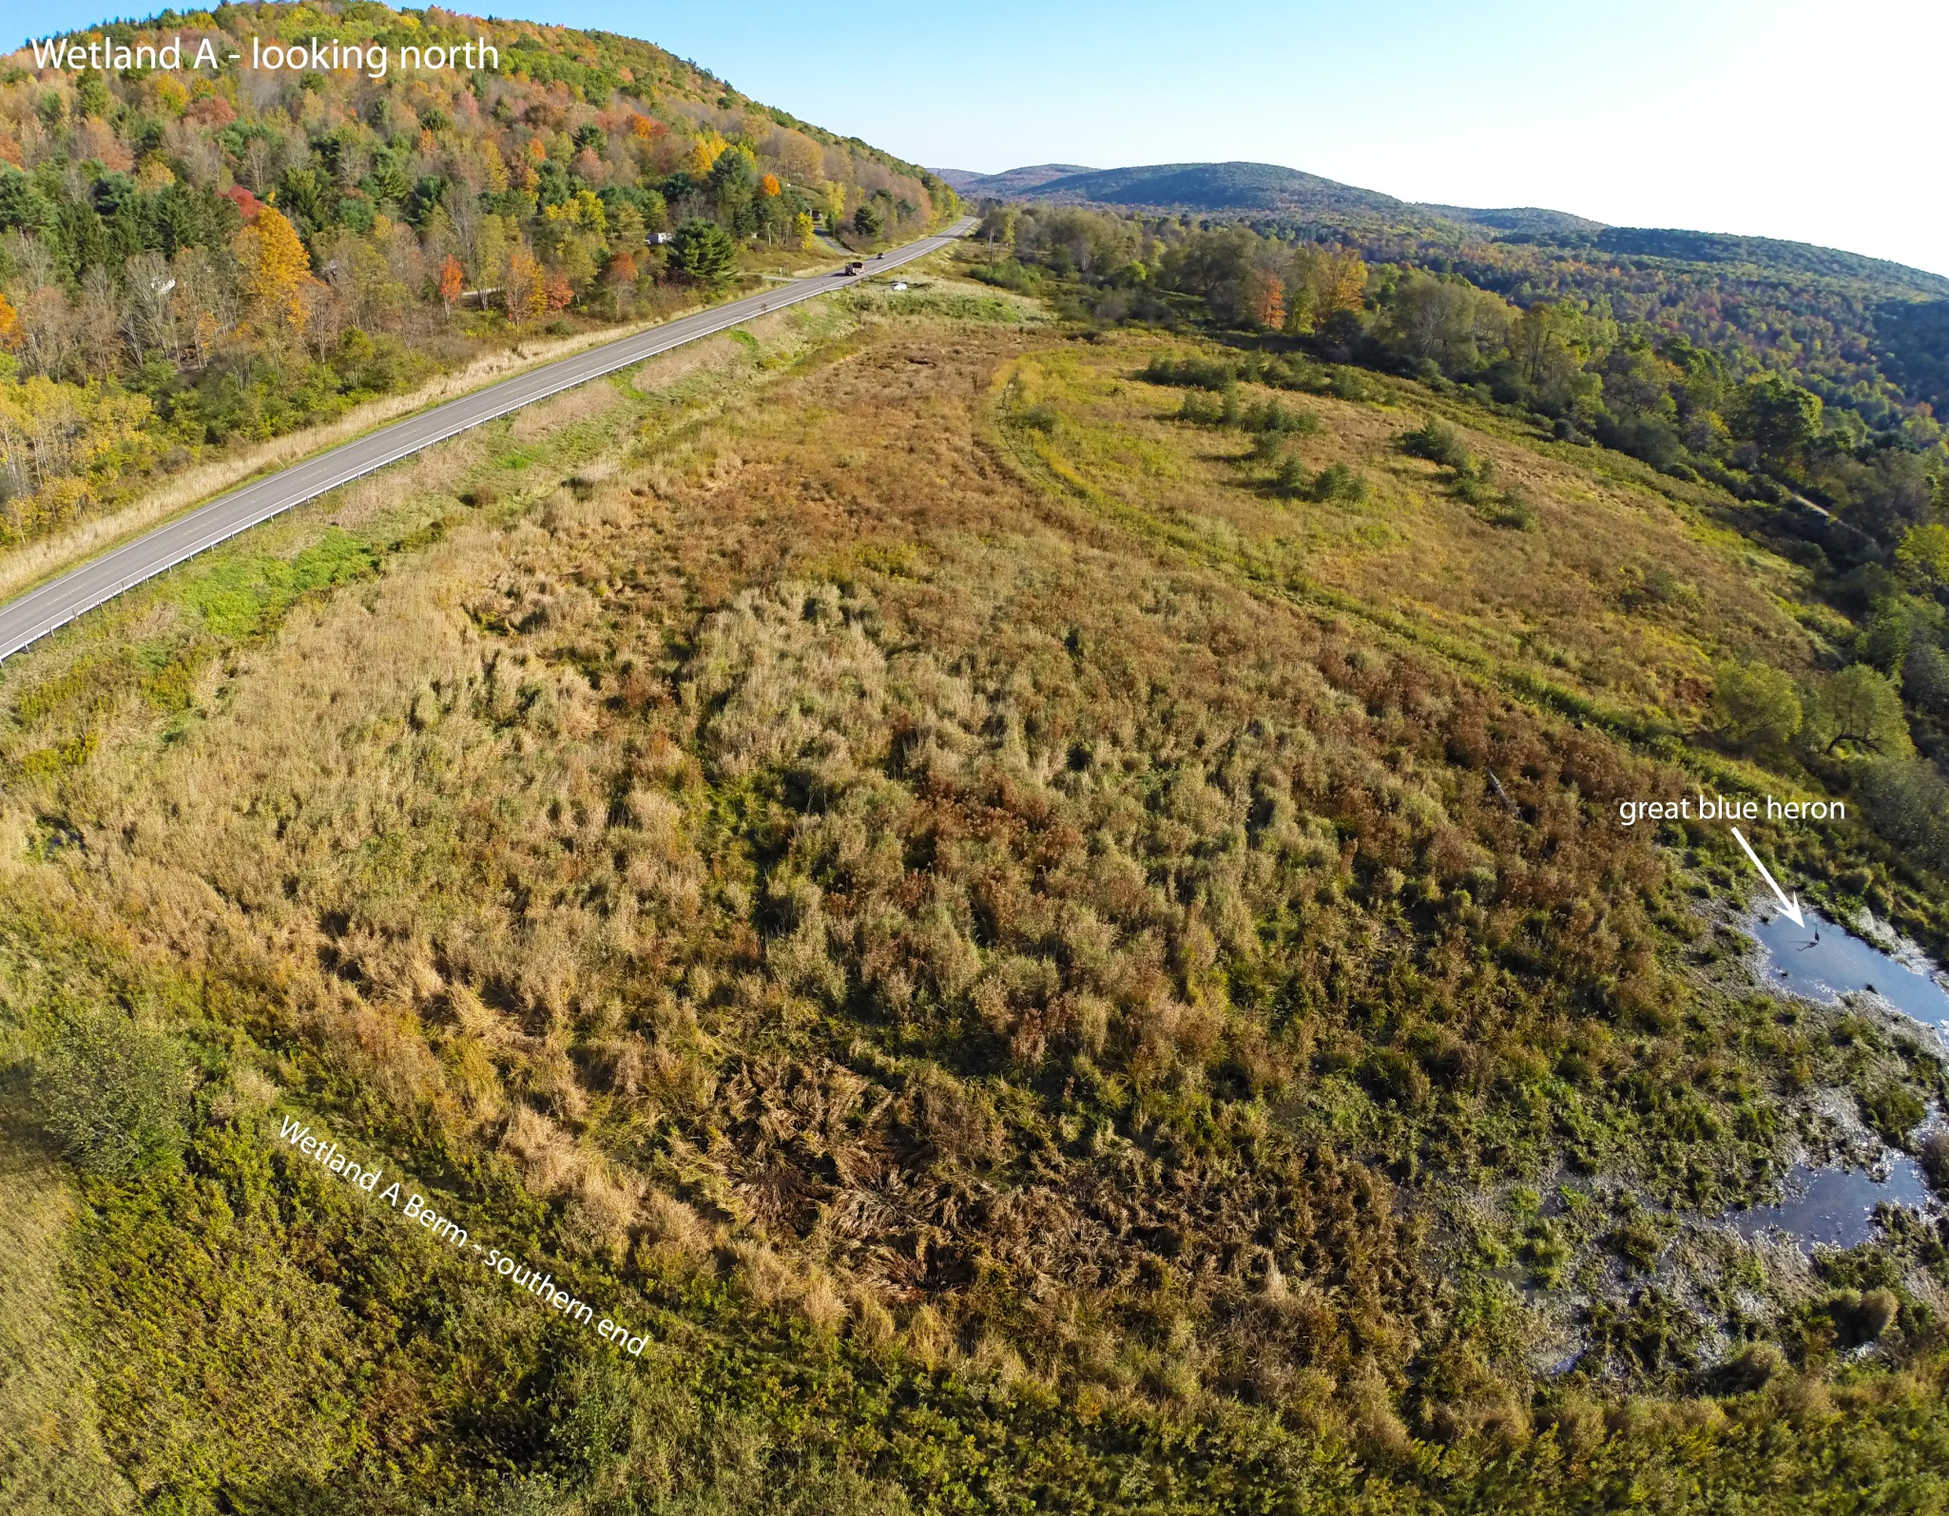
RESTORATION
Wetland Team
USC

Slide 28
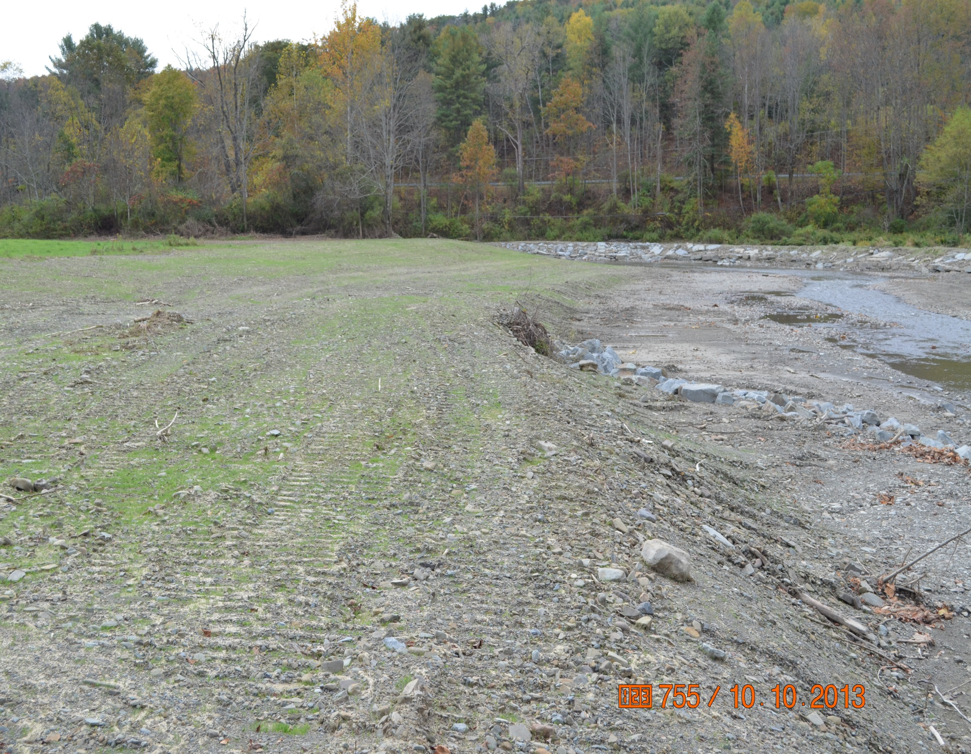
Upper Susquehanna Coalition (USC)
Stream Team
Goal: have a consistent, quality controlled process that builds USC and partners capacity to address stream issues.
Approach: Background Reports, Watershed Analysis (Including Triage Reports), Design Reports, Implementation and Training
Notes:
Stream Team leader, Mike Lovegreen is here today and will be available during the open house session for more specific questions.

Slide 29
Stream Corridors – A Major Resource Issue for Upper Susquehanna Basin
Flooding
Channel Instability
Significant Bank Erosion
Loss Habitat
Threat to communities, infrastructure, homes, farmland

Slide 30
Regional Challenges in Addressing Stream (and Agricultural) Resources
Steep topography – flashy hydrology
Shallow hillside soils – fragipan restrictions
Tight Valleys concentrating floodplains with transportation, development and farming
Historic impacts on stream morphology disrupting stream corridor functions
Climate - Intense – localized storm systems
Culture

Slide 31
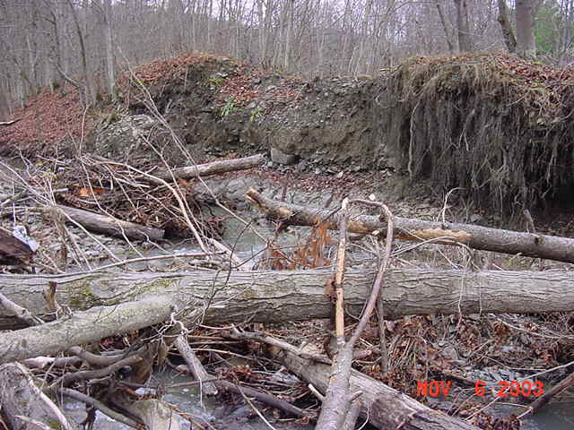
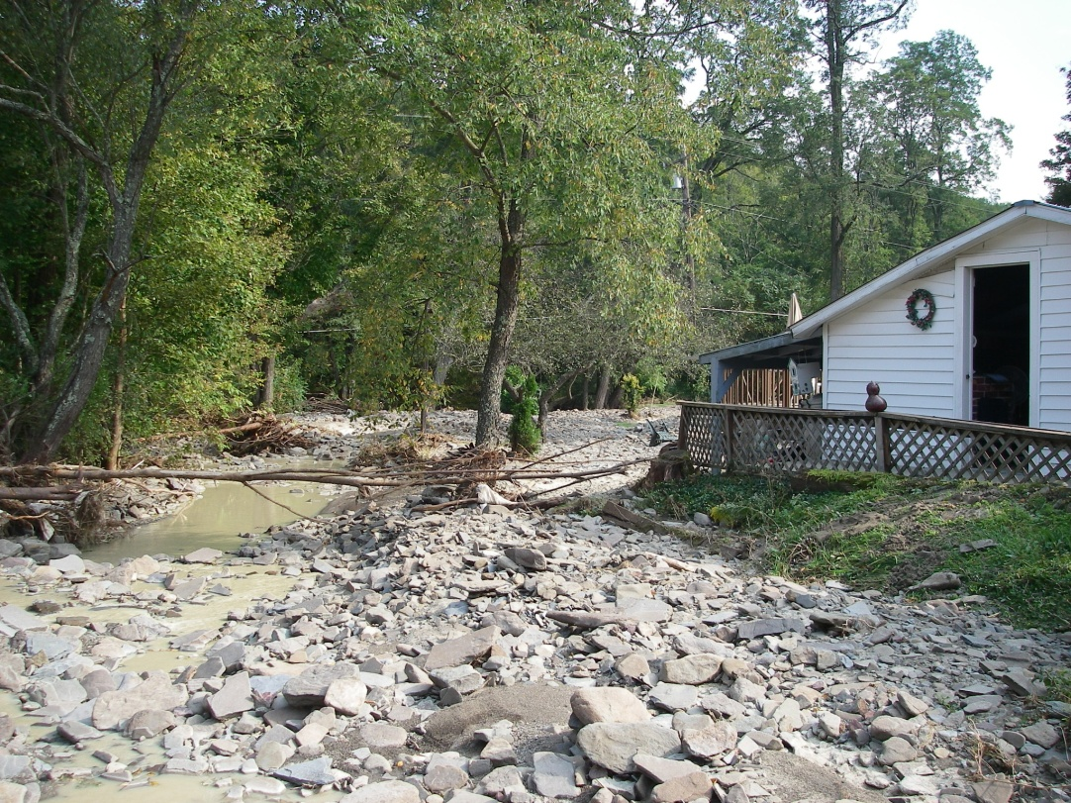
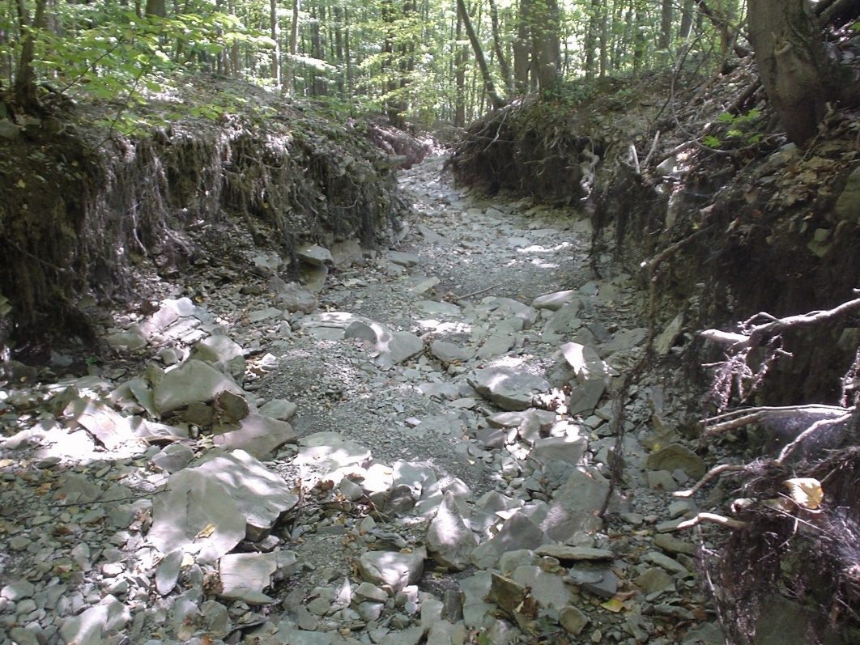
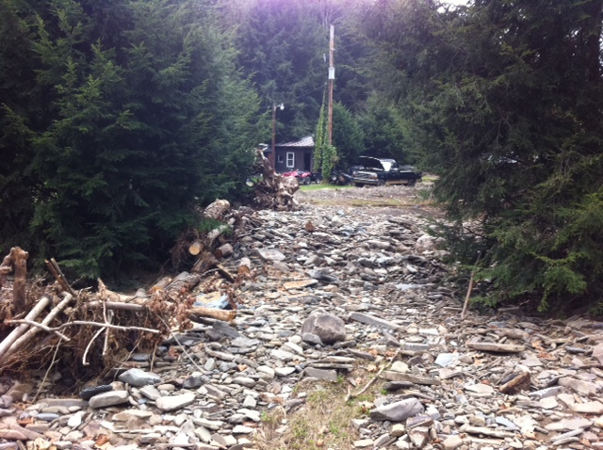

Slide 32
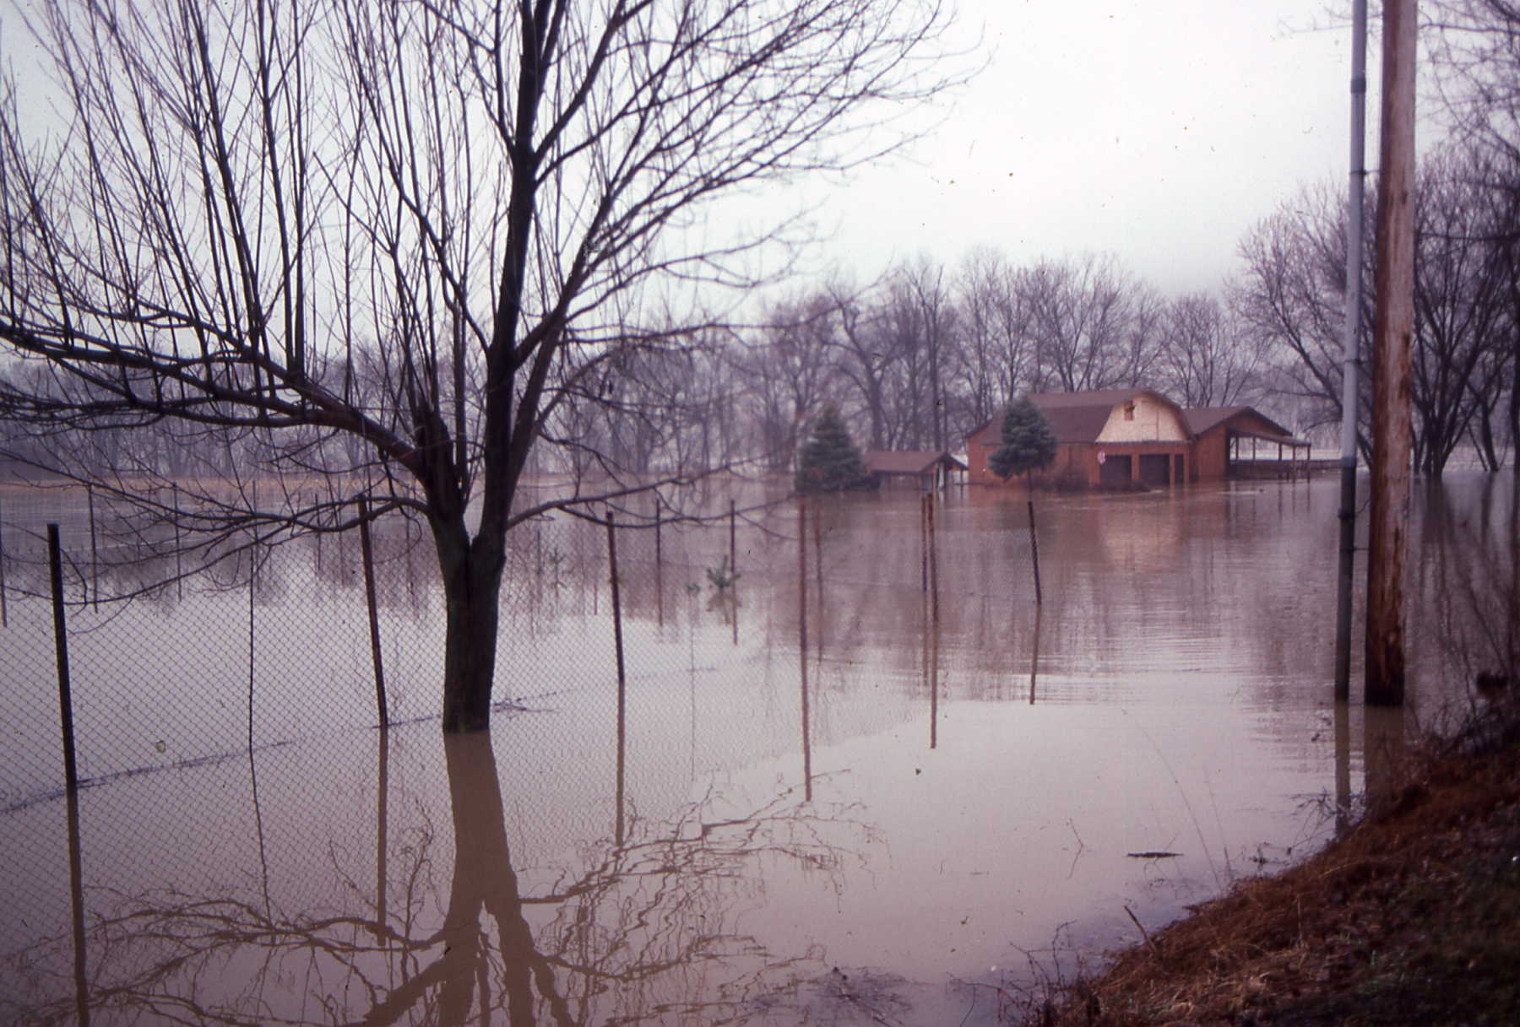
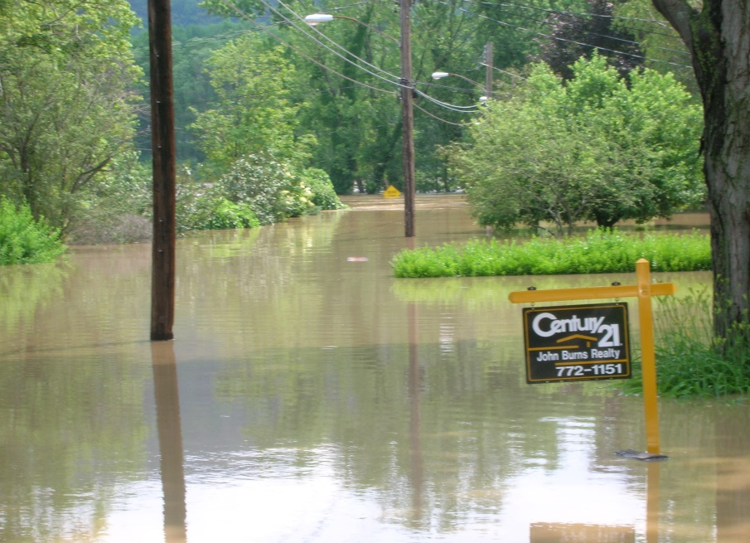
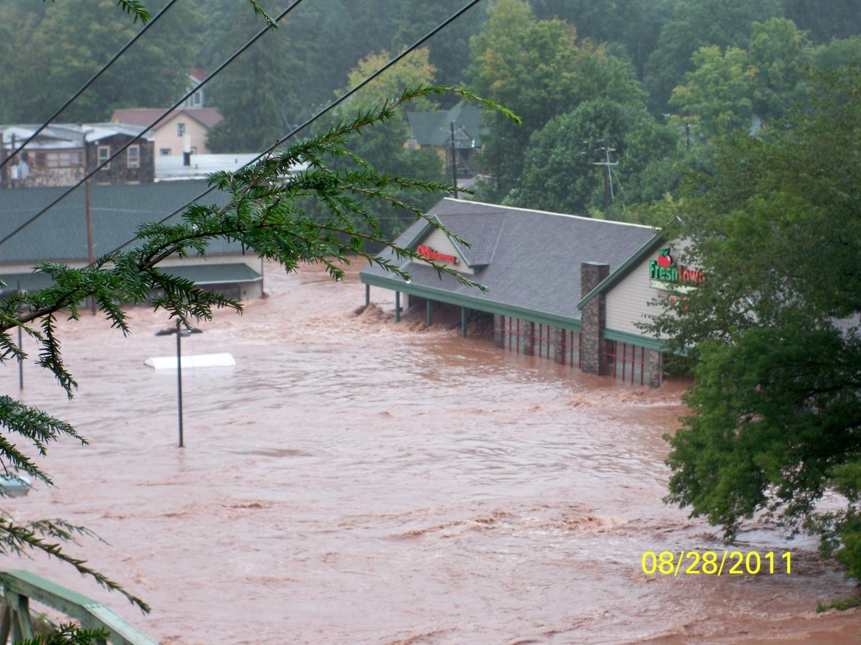
Notes:
Town was severely damaged where floodplain development occured

Slide 33

TYPES OF STREAM PROJECTS
Stream Corridor Assessment Guide
Planning protocols for climatic resiliency in stream corridor management on farms
North Atlantic Aquatic Connectivity Collaborative (NAACC) – culvert assessment
Municipal ESI Trainings
NFWF - I-4 Program – Local Capacity Building
USC Member Assistance
INTEGRATION
IMPLEMENTATION
INVESTIGATION
INFORMATION

Slide 34
Upper Susquehanna Coalition Looking Forward
Continue to look for additional funding sources to support focus areas
New Ideas, programs, partners
How can partner assist with watershed efforts?
Notes:
Current and active NFWF grant for stream corridor rehabilitation was funded for $750K. Projects are underway.

Slide 35

2019 Funding Opportunities & Projects
DEC – USC Cover Crop Implementation Project
Additional guidance on what we can count for cover crops will be coming out with further announcements a little later in the year.
NFWF – Regional Delivery (USC Water Quality Program)
Majority of funding is allocated, but may have a small amount of funding left for some projects.
Continuing the program for future funding opportunities?
NRCS – Regional Conservation Partnership Program
Round 2 – Grazing Practices
Deadline for Applications and Plans is January 18th
BMP Data Entry & Verification

Slide 36
2019 Funding Opportunities & Projects
NRCS CTA CRP
Funding support for CREP planning, estimates, buffer planting plans, status reviews
DEC’s Trees for Tributaries Program
Great for small landowners, volunteer-sized projects, generally smaller sized projects.
NFWF Buffer Establishment
Funding for buffer stewards to monitor and maintain buffers as well as implement projects
DEC Buffer Protection
Buffer restoration on permanently protected lands. Funding to hire professional tree planters
DEC WQIP Expanding Wetland Restoration
Funding to support wetland creation and restoration on private and public lands
DEC WQIP Berm and Wetland Program
Berm removal funding and wetland creation in state forests
DEC WQIP ESI Expanded
Funding for ESI trainings and other practice installation

Slide 39
DEC Program Updates
•Cover crop contract amendment
•USC Capacity Contract amendment
▪Additional funding for: verification, pilot road ditch demonstration projects/outreach, Trees for Tribs coordination, pilot cost-share program for Ag NPS, database upgrades
•DEC-DAM-USC Buffer Program
▪CREP incentives, CREP re-enrollment activities, assessment, planning, implementation (new sites), evaluation of existing buffers, management activities, new non-CREP incentive for cropland buffers
•Optimization for WWT facilities, permit modifications
•New DEC BMP database
•Round 2 Nonpoint Source Planning Grant
•Regional Planning Board assistance with BMP tracking and reporting
•WIP assistance funding application

Slide 40
Philosophy
Implementation
Support soft practices in the watershed
Ag: Grazing, nutrient management planning, buffers, streams, precision feed management, cover cropping, etc
Streams: ESI, stream rehabilitation, berm removal
Wetlands: wetland restoration and protection
Don’t compete with funding for SWCD’s for structural work
Constantly looking for opportunities to fund local needs
Teams help to build capacity within Districts and provide support if there isn’t capacity there
FILL GAPS (technically and financially)
USC
Upper Susquehanna Coalition
Notes:
The philosophy behind our team approach is that our teams are to be recognized as a source of quality, value driven technical assistance.
Provide technical and financial support to local SWCDs.
Building capacity means:
Consistent approach
Quality assurance
Technical capacity
Training
Funding –moves thru USC to SWCD members and ultimately to conservation on the ground!
USC utilizes the combined knowledge, skills, expertise, equipment and other resources of all its members and partners to address local and regional needs

Slide 41
KEY POINTS
USC based on legal authority (CD Law) with extensive powers to plan & deliver conservation
USC encompasses extensive network of partners from local level – regional level – State level – Federal level
USC recognized as effective integrator of local needs and implementation based on realistic capacity expectations
USC presents an extremely flexible delivery system of resource assistance in terms of both funding and technical assistance at all partner levels
USC an effective method for increasing capacity at all levels – local to Federal
“The sum of the collective efforts exceeds the sum of the individual efforts”

Slide 42
USC utilizes the combined knowledge, skills, expertise, equipment and other resources of all its members and partners to address regional needs

Slide 43
Questions
Mike Lovegreen
USC Stream Team Leader
Tioga County SWCD
183 Corporate Drive
Owego, NY 13827
Email: mike.Lovegreen@u-s-c.org
Phone: 607-346-2718

