Slide 1

Challenges… and Some Success
Sally Claggett, CBP USFS Coordinator

Slide 2
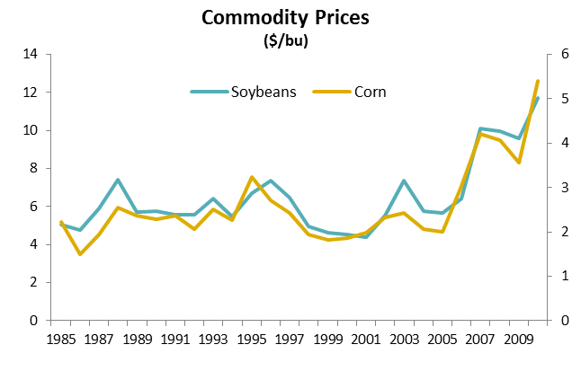

Slide 3

RFB Verification in a Nutshell
Baseline
Survival
Contract Expiration (re-enrollment)

Slide 4

The challenge of quantifying existing buffers
Verifying Baseline
GIS accuracy : stream layer must match exactly to land cover data
Need good resolution to pick up narrow buffers.

Slide 5
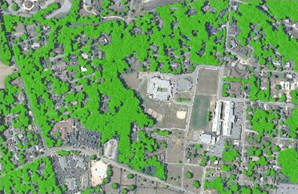
New Tools will help…
Verifying Baseline
Land Image Analyst and other software
Designed for use by localities
Can use high resolution
Trees are detected by satellite

Slide 6
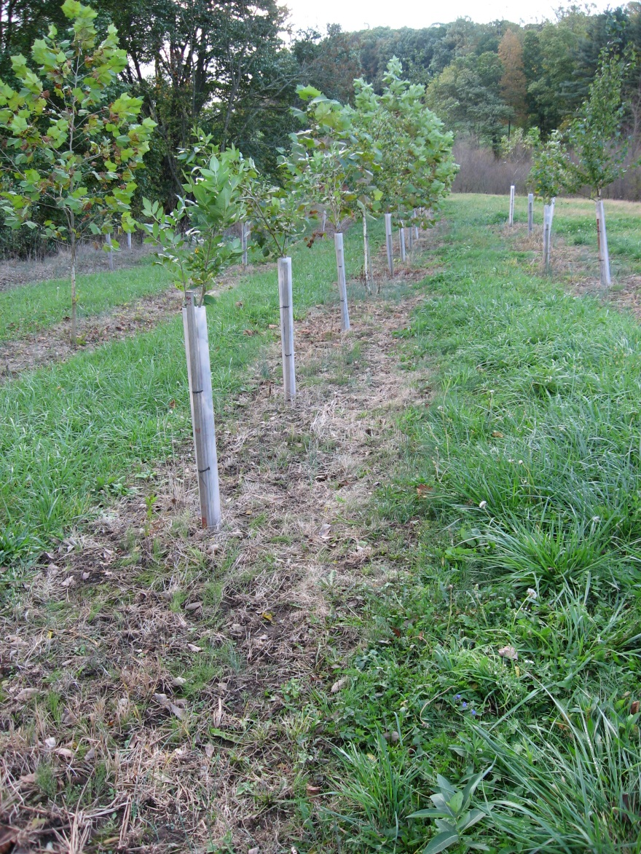
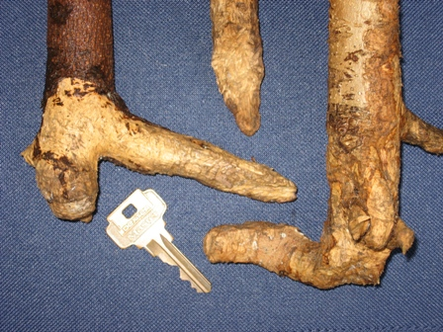
Survival/maintenance
1x herbicide inadequate
Heavy grass competition
Often damage by voles
Deer damage with 4’ shelters could be high
Maintenance by landowners was lacking
Some contractors don’t care
Notes:
Early PA CREP killed lots of trees and had many failed projects. This has been a barrier to wider adoption of the practice.

Slide 7
PA CREP Partners make changes…
Survival/Maintenance
Partners requested:
Extend “establishment period” from 3 to 5 years
Cost-share for 2x/yr herb. applic’s for up to 5 yrs
FSA in DC authorized first in nation (2007) options:
4 yr establishment period
4 herbicide applics over 4 years (50% cost share)
PA DEP agreed to other 50% cost-share
Notes:
So around 2005, PA CREP sought FSA approval to cost share post-planting care including herbicide applications.
Result in 2006: first in nation CREP with cost share for post-planting care, particularly the herbicide use

Slide 8
Outreach/technical assistance
Needs recognized
Creative funding from various partners (states, feds, grants)
Extra money, but not enough assistance (boots-on-the-ground)
CBWI-- 2 miles of forest buffer (2008-2011)

Slide 9
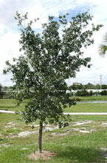
Formulas for Success…
State and outside money leveraging farm bill funding to get forest buffers on the ground:
increased technical assistance
bonus payments
vouchers to landowners
improved survival (with TA)

Slide 10

Future of CREP -- ??
Verifying Baseline
New Farm Bill
No CREP from September 30, 2012 to May 15, 2013.
VA DCR has draft policy creating serious concern about CREP funding for FY14

