Slide 1
Conowingo Dam Update
Presented to the Citizens Advisory Committee
D. Lee Currey
Co-Chair CBP Modeling Workgroup
Acting Director, Water Management Administration
Maryland Department of the Environment
February 23, 2017

Slide 2
Topics for Today
Background
State of the science
The implications and policy options for the MPA and Phase III WIP
Update on Maryland water quality certification for Conowingo Dam relicensing

Slide 3
Background

Slide 4
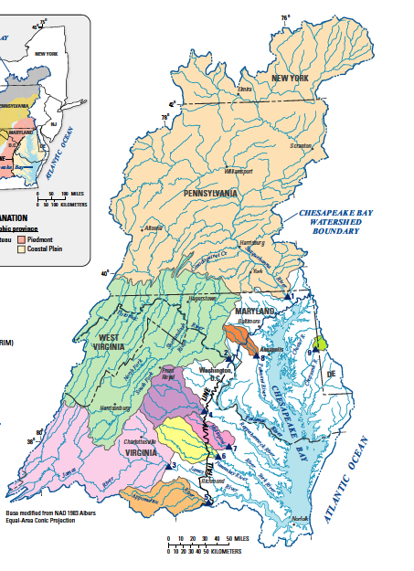
Susquehanna River Has a Major Influence on Chesapeake Bay Water Quality
Susquehanna watershed
43% of Chesapeake Bay watershed
47% of freshwater flow into the Bay
41% of nitrogen loads to the Bay
25% of phosphorus loads to the Bay
27% of sediment loads to the Bay
Influences Bay water quality well
into Virginia’s portion of the Bay
Potomac watershed
Source: Linker (2014)
Notes:
The Susquehanna River contributes almost one-half of the freshwater inflows into the Chesapeake estuary and over 40% of the nitrogen.
Almost half of the nitrogen load to the Bay is from the Susquehanna
Much less of the phosphorus load is from the Susquehanna river, but that is changing
These numbers do not inform the amount of nitrogen and phosphorus that influence the growth of algae
The second largest contributor of nutrients is the Potomac Basin

Slide 5
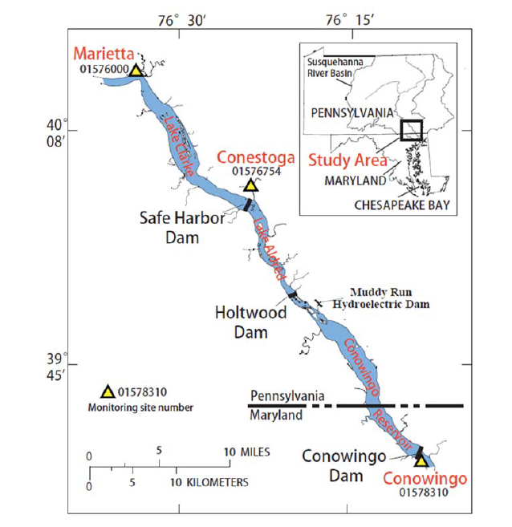
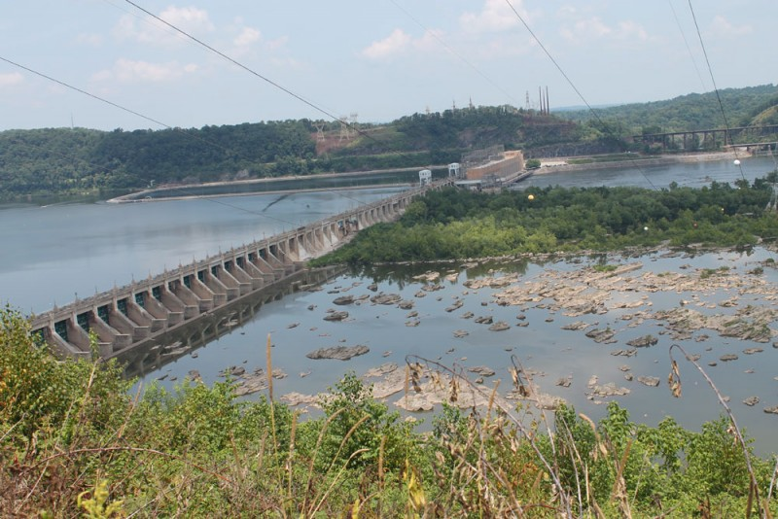
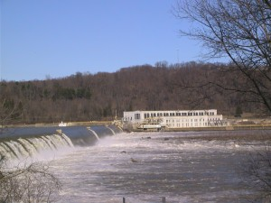
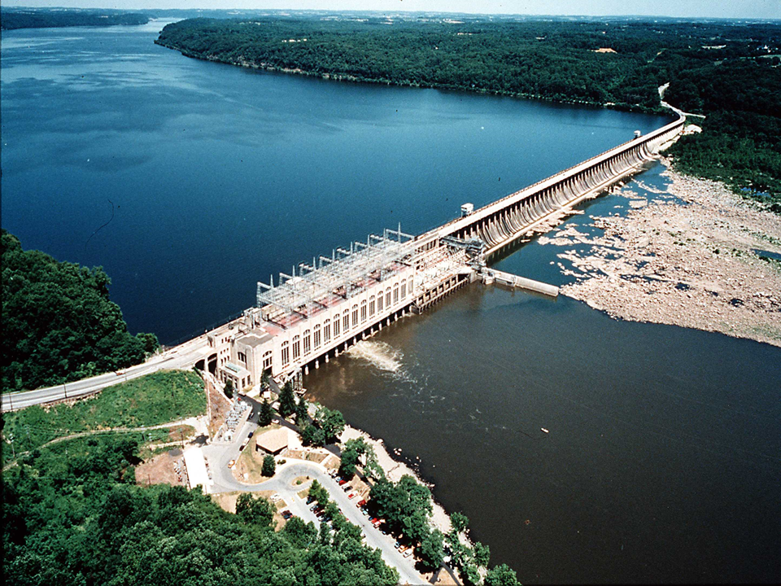
Lower Susquehanna River Reservoirs
Sources: Langland, USGS, Bay Journal, Lower Susquehanna River Keeper

Slide 6
History of the Lower Susquehanna River Reservoirs: 1900-2020
1900
1910 – Holtwood Dam constructed
1920
1920 – Holtwood Dam reaches equilibrium
1928 – Conowingo Dam constructed
1931 – Safe Harbor Dam constructed
1940
1950 – Safe Harbor Dam reaches equilibrium
1960
1960s – Historical lowest flows in Susquehanna
1972 – Tropical Storm Agnes
1980
1979 – Systematic water quality monitoring begins on
the Susquehanna River at Conowingo Dam
1996 – “Big Melt” flood event
2000
2001 – SRBC convenes “Susquehanna Sediment Task Force” Symposium; publishes report
2010 – Chesapeake Bay TMDL established
2012 – Hirsch 2012 scientific paper publishes clear evidence for Conowingo Reservoir at or near dynamic equilibrium
2015 – Lower Susquehanna River Watershed Assessment
2020
2017 – Bay TMDL Midpoint Assessment
Source: Langland, USGS, Personal Communication

Slide 7
Chesapeake Bay TMDL and the Conowingo Dam
The 2010 Chesapeake Bay TMDL said…
“EPA’s intention is to assume the current trapping capacity will continue through the planning horizon for the TMDL (through 2025). The Conowingo Reservoir is anticipated to reach a steady state in 15 – 30 years, depending on future loading rates, scour events and trapping efficiency.”
“Under these assumptions, the waste load allocations (WLA) and load allocations (LA) would be based on the current conditions at the dam.”
Source: Appendix T. Sediments behind the Susquehanna Dams Technical Documentation: Assessment of the Susquehanna River Reservoir Trapping Capacity and the Potential Effect on the Chesapeake Bay (U.S. EPA 2010)

Slide 8
State of the Science

Slide 9
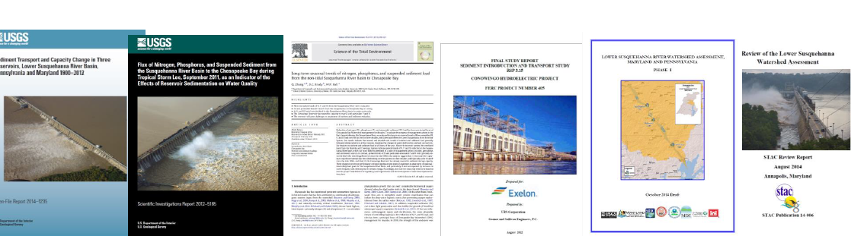
Significant New Monitoring And Research Since 2011 Indicate Conditions have Changed
U.S. Geological Survey (USGS) (2012, 2014, 2015)
U.S. Army Corps of Engineers (2015)
Johns Hopkins University (2013, 2015, 2016)
CBP Scientific and Technical Advisory Committee (2014, 2016)
Enhanced Monitoring and Modeling funded by Exelon and conducted by Gomez and Sullivan, University of Maryland and USGS (2014-2016)

Slide 10
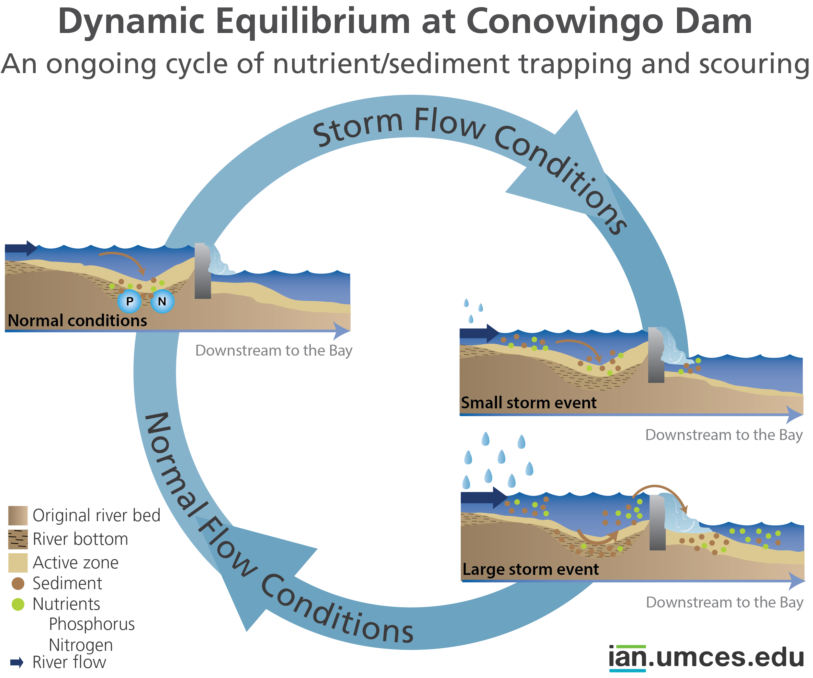
Characteristic of Reservoirs
Fate and Transport of Material
Dynamic Equilibrium is when, over many years, the input is equal to the output
Notes:
The balance occurs over a period of time, currently many years, that is determined by
(1) the frequency and magnitude of scour events,
(2) the overall rate at which sediment enters the reservoir,
(3) the state of the underlying reservoir bathymetry, and
(4) longer-term processes of change with regard to the spatial distribution of coarse and fine sediments in the reservoir bed. The bed-coarsening and bathymetric effects continue to occur at a much slower rate and in this regard the system is still far from true equilibrium.
Overall, and in the absence of intervention, the quantity and nature of sediments and nutrients reaching the Chesapeake Bay are likely to obtain long-term average values that more closely resemble those at the LSRRS influent than in the first sixty years of reservoir operation, with important implications regarding the impacts of the Susquehanna watershed loads on Bay water quality.
Despite the “dynamic equilibrium” condition, the slow on-going changes in the bed are likely to continue to alter the timing and amounts of sediment and nutrient loads for some time to come, offering additional challenges to modeling and management.
10

Slide 11
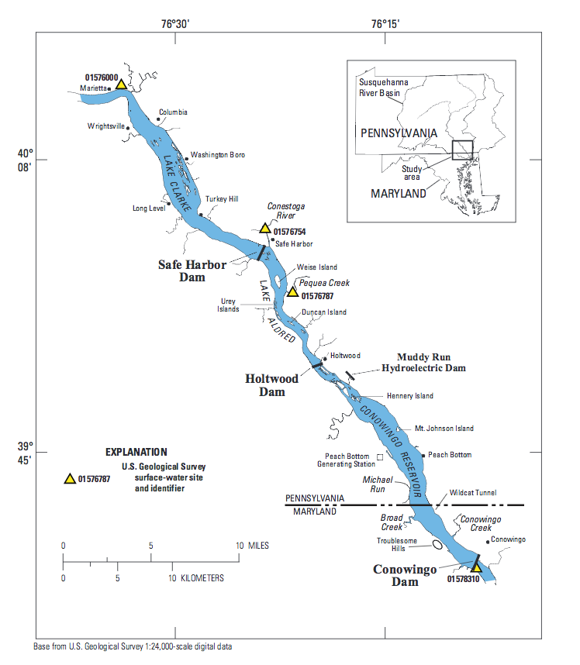
Nutrient and Sediment Loading Trends into and Out of the Reservoir System (1985 to 2014)
Long-Term Monitoring Trends
Monitoring Station Name | Total Nitrogen |  | Total Phosphorus |  | Sediment
Susquehanna at Marietta
Conestoga River
Pequea Creek | * |  | * |  | *
Susquehanna at Conowingo
Source: USGS Trend Results published to internet in 2016
* WQ data record not long enough for establishing trends
- improving
- degrading

Slide 12
Nutrient and Sediment Loading Trends into and Out of the Reservoir System (2005 to 2014)
Recent Monitoring Trends
Monitoring Station Name | Total Nitrogen |  | Total Phosphorus |  | Sediment
Susquehanna at Marietta
Conestoga River
Pequea Creek |  |  |  |  | ?
Susquehanna at Conowingo |  | ? |  |  |  | ?
Source: USGS Trend Results published to internet in 2016
? Indicates that trend analysis was inconclusive
- improving
- degrading

Slide 13
Nitrogen Loads Into, Trapped Within and Exiting the Reservoir System: 1990s-2010s
Early 1990’s, about 20% of N trapped
~170
~30
~140
Loads Into Reservoir System
Long term improving trend
Early 2000’s, about 10% of N trapped
Loads Out of Reservoir System - Conowingo long term improving trend
~160
~20
~140
Early 2010’s, Approaching no net trapping
~130
~0
~130
Source: Data from USGS (2016), http://cbrim.er.usgs.gov/loads_query.html
loads are approximate and in units of million lbs/year using estimates for 1992, 2002, and 2012
Notes:
The inputs have decreased by 40 million lbs and the outputs have decreased by 10 million lbs
Most of the nitrogen is dissolved and does not settle out.

Slide 14
Phosphorus Loads Into, Trapped Within and Exiting the Reservoir System: 1990s-2010s
Early 1990’s, about 50% of P trapped
~10
~5
~5
Loads Into Reservoir System
Long term improving trend
Loads Out of Reservoir System - Conowingo Long term degrading trend
Early 2000’s, about 40% of P trapped
~11
~5
~6
Early 2010’s, Approaching no net trapping
~8
~0
~8
Source: Data from USGS (2016), http://cbrim.er.usgs.gov/loads_query.html
loads are approximate and in units of million lbs/year using estimates for 1992, 2002, and 2012
Notes:
The sediment trapping efficiency is decreasing and has gone from 70-75% to 40-45%.
The reservoir system has stored 2% of N, 31% P and 27% of Sed between 1987 -2014.
Conostoga is just like marietta.
If PA meets it’s load targets in
PA has more influence and should be doing more.

Slide 15
Sediment Loads Into, Trapped Within and Exiting the Reservoir System: 1990s-2010s
Early 1990’s, about 60% of Sed trapped
~7
~4
~3
Loads Out of Reservoir System - Conowingo Long term degrading trend
Loads Into Reservoir System
Long term improving trend
Early 2000’s, about 40% of Sed trapped
~8
~3
~5
Early 2010’s, approaching no net Sed trapping
~6
~0
~6
Source: Data from USGS (2016), http://cbrim.er.usgs.gov/loads_query.html
loads are approximate and in units of billion lbs/year using estimates for 1992, 2002, and 2012
Notes:
The sediment trapping efficiency is decreasing and has gone from 70-75% to 40-45%.
The reservoir system has stored 2% of N, 31% P and 27% of Sed between 1987 -2014.

Slide 16
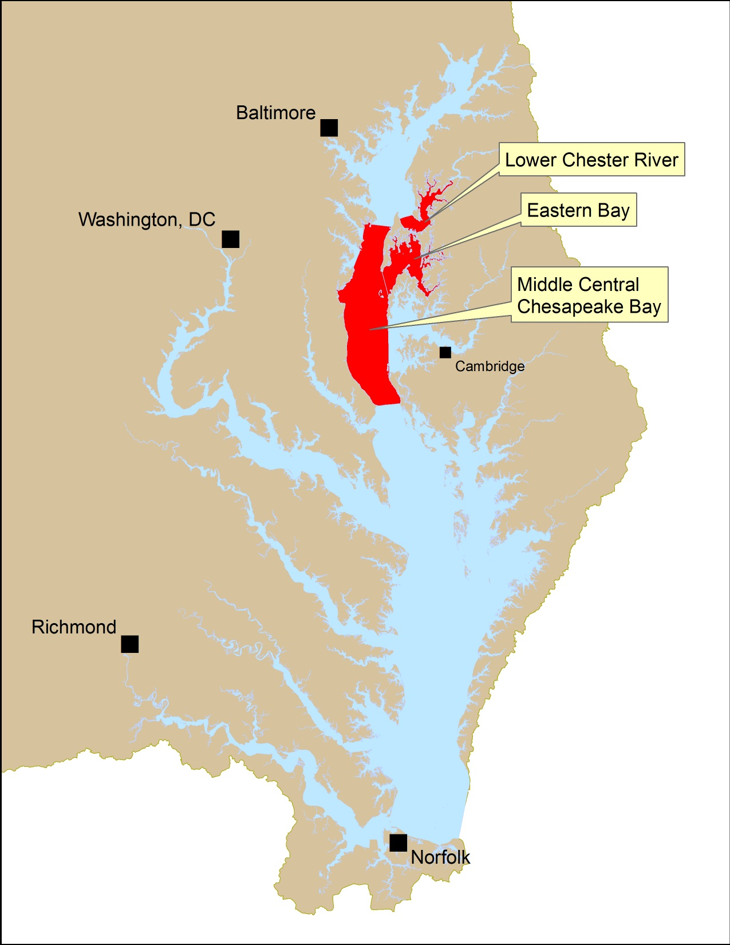
Impact of Changed Conowingo Reservoir Conditions on Chesapeake bay Water Quality
Chesapeake Bay Water Quality with Watershed Implementation Plans Fully Achieved and
Dams in Dynamic Equilibrium
Estimates of about 1 - 3% additional water quality DO standards non-attainment in 3 segments
Source: Linker et al. (2016), LSRWA (2015)
Notes:
2010 estimate conditions were about 23% main Bay.
Already accounted for natural attainment
Bay TMDL address flows that occur about 90% of the time and does not consider extreme events
But, the Lower Susquehanna River Watershed Assessment study indicates that with the WIP’s fully achieved by 2025 and the Dam at the new state of dynamic equilibrium, DO levels necessary to protect aquatic life in the Bay’s deeper northern waters will still not be sufficient in 3 of the 92 Chesapeake Bay segments due to excess nutrients caused by the increased scour frequency of sediments and nutrients from the Conowingo Reservoir. The 3 Bay segments not meeting their dissolved oxygen uses are: the CB4 mainstem below the Bay Bridge, Eastern Bay, and lower portions of Chester River.

Slide 17
Take Away Science Messages
Conditions are different and the net reservoir trapping ability is near zero.
The loss of net trapping has an impact on how upstream pollution management practices will translate into downstream impacts on water quality.
Loss of net trapping ability has an effect on outputs of TN, TP, and SS, but the effect is greatest on SS and least on TN.
The fate and transport of the scoured material is important and new information is available for factoring in the influence of particulate nutrients on Bay WQ
The key issue is not just scour during flood events, but is rather the net trapping over the entire range of hydrologic conditions

Slide 18
The implications and policy options for the MPA and Phase III WIP

Slide 19
Framing the Policy Questions
Who is responsible for additional load reductions?
Susquehanna watershed only
Susquehanna watershed + Maryland and Virginia
All Chesapeake Bay watershed jurisdictions
How will responsibility assigned?
Allocation equity rules used in the Bay TMDL
Most cost effective practices and locations
When will the additional reductions be required to be met?
Allocate additional loads into Phase III Planning Targets and address by 2025
Allocate additional loads into Phase III Planning Targets, but establish timeframe beyond 2025 to address Conowingo infill loads
Quantify impacts due to Conowingo infill but allocate and address necessary load reductions post-2025
Source: December 2016 PSC Meeting

Slide 20
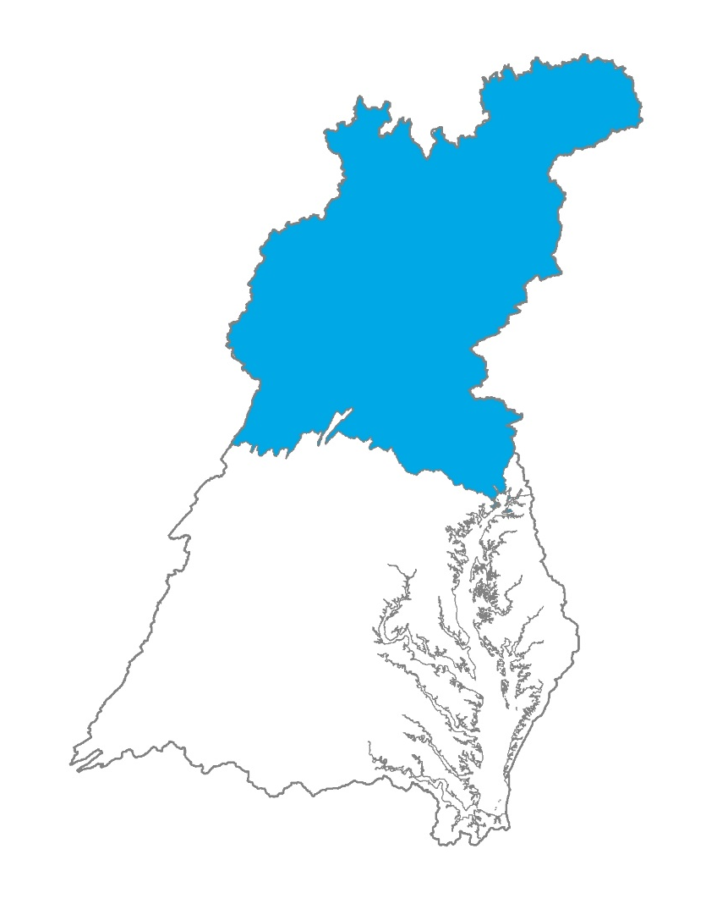
Susquehanna Watershed Only
Potential Range of Percent Increase in Phosphorus Load Above Each
Jurisdiction’s Phase II WIP Load
NY: 10 - 21
PA: 12 - 25
MD: 1 - 1
VA: 0 - 0
DE: 0 - 0
DC: 0 - 0
WV: 0 - 0
Source: December 2016 PSC Meeting, results are preliminary

Slide 21
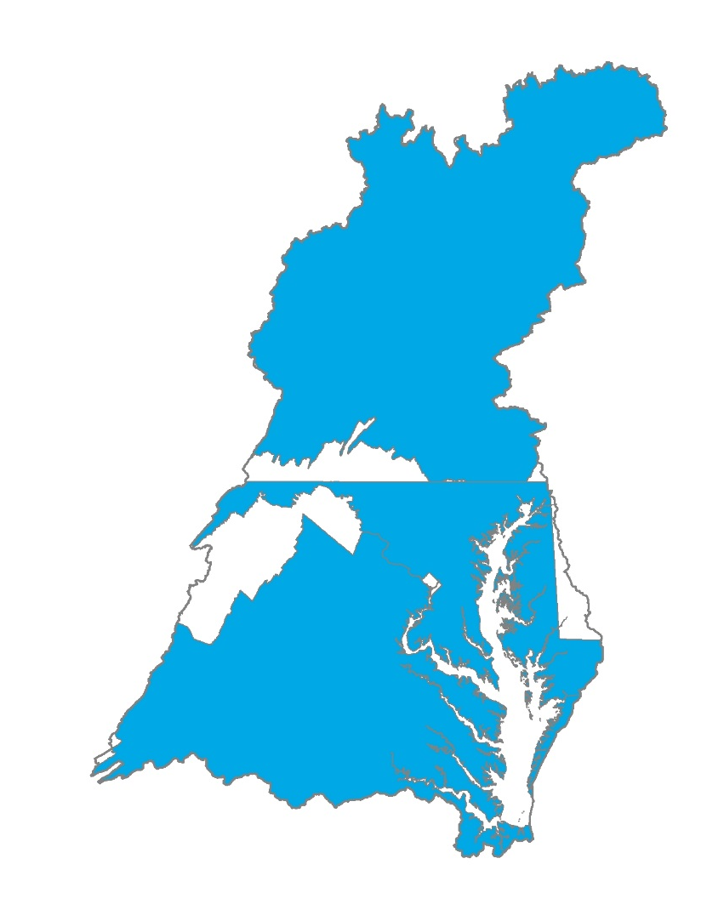
Susquehanna Watershed + Maryland & Virginia
Potential Range of Percent Increase in Phosphorus Load Above Each
Jurisdiction’s Phase II WIP Load
NY: 6 - 11
PA: 7 - 14
MD: 7 - 16
VA: 4 - 9
DE: 0 - 0
DC: 0 - 0
WV: 0 - 0
Source: December 2016 PSC Meeting , results are preliminary

Slide 22
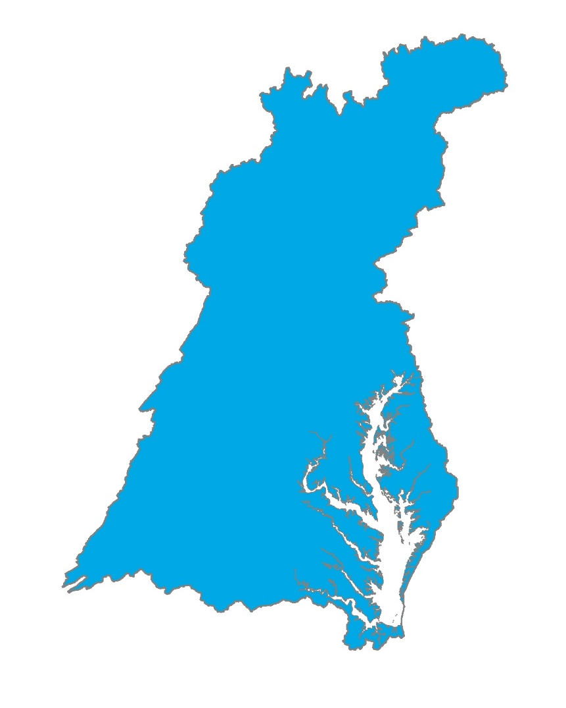
All Chesapeake Bay Watershed Jurisdictions
Potential Range of Percent Increase in Phosphorus Load Above Each
Jurisdiction’s Phase II WIP Load
NY: 5 - 10
PA: 7 - 14
MD: 6 - 14
VA: 4 - 8
DE: 9 - 20
DC: 1 - 3
WV: 5 - 11
Source: December 2016 PSC Meeting , results are preliminary

Slide 23
Timeline for 2017 Midpoint Assessment Decisions
December 2016: Framework for determining which jurisdictions will be responsible for addressing the additional nutrient and sediment loads resulting from infill of the Conowingo Reservoir
May 2017: Determine how much additional nutrient and sediment loads must be addressed resulting from infill of the Conowingo Reservoir and decide upon allocation rules
June 2017: Draft Phase III WIP planning targets fully reflect best understanding of additional loads from infill of the Conowingo Reservoir
December 2017: Final Phase III WIP planning targets fully reflect best understanding of additional loads from infill of the Conowingo Reservoir
Source: December 2016 PSC Meeting
Notes:
Dates reflect PSC approval dates – WQGIT and MB recommendations will be made in preceding months

Slide 24
Phase III WIP Solutions to Address Increased Loads
Additional upstream implementation
Increase reservoir capacity
More downstream implementation

Slide 25
Update on Maryland water quality certification for Conowingo Dam relicensing

Slide 26
Water Quality Certification
Clean Water Act §401 provide states with a tool to protect water quality
Applies to all federal permits and licenses involving a discharge to waters of the U.S. including adjacent jurisdictional wetlands.
Central feature is the ability to grant, grant with conditions, deny or waive certification
Granting certification, with or without conditions, allows the federal permit or license to be issued
Denying certification prohibits the federal permit or license from being issued
Decisions based upon EPA approved water quality standards and guidelines; and other appropriate requirements of state law

Slide 27
Conowingo Relicensing
In January of 2014 Exelon submitted an application for WQC
In November of 2014, MDE issued a Public Notice of the application and announced that “the Department intends to deny the application due to insufficient information provided by the applicant regarding the impacts of the activity on State water quality standards and limitations”.
In December 2014, Exelon withdrew their application and agreed to provide up to $3.5 million for coordinated study to address information gaps to be completed by 2016/17
Currently monitoring and modeling is being included in Bay Partnership modeling tools and undergoing review in preparation for MPA and WQC decisions

Slide 28
Summary
Susquehanna River has a significant influence on the Bay
Conditions in the Conowingo Reservoir are different than assumed in the Chesapeake Bay TMDL
All studies suggest that additional reductions in nutrients and sediments are needed to meet water quality goals
Current science describing the change in trapping and fate/transport is being incorporated into CBP modeling tools
Assigning both the additional reductions and the date at which they are to be achieved will occur within the PSC
Multiple implementation solutions are being, and will continue to be, explored to address impacts resulting from changed conditions

