Slide 1

Amen! Reaching Beyond the Choir
Jodi Rose, Executive Director

Slide 2
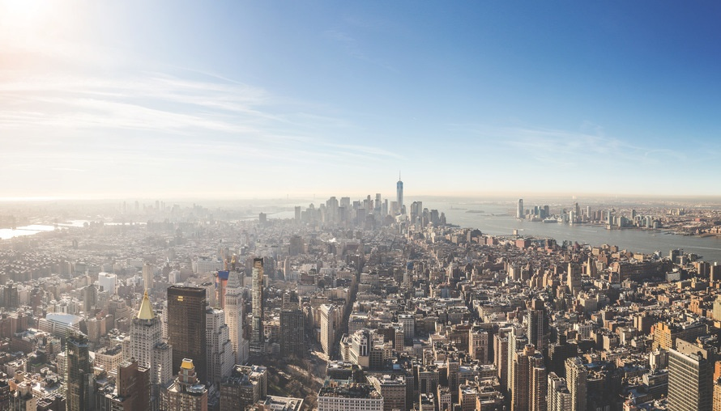
Wendell Berry
Wendell Berry
The Futility of Global Thinking, 1989
"The question that must be addressed is not how to care for the planet, but how to care for each of the planet's millions of humans and natural neighborhoods, each of its millions of small pieces and parcels of land...”
Notes:
How we handle our own individual properties is critical…we are part of a big puzzle, but we each must do our part. Don’t feel overwhelmed that the problem is too big. We MUST do our part.

Slide 3
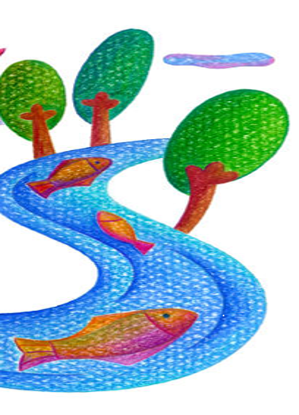
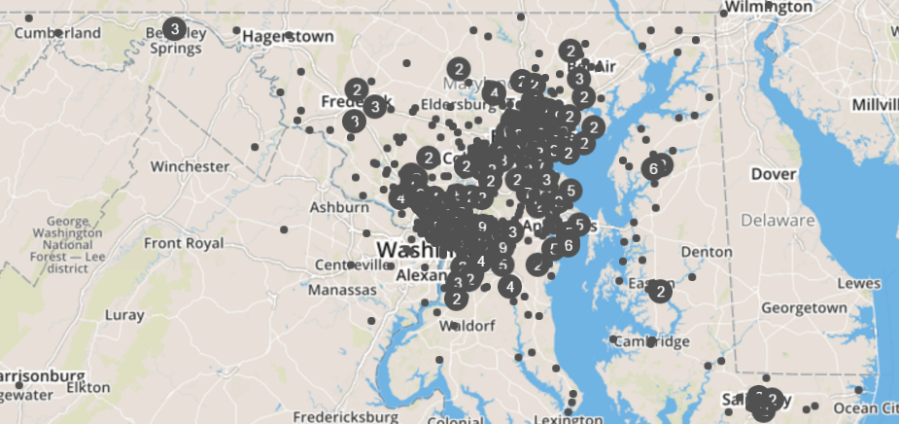
The Good News!
Worked with 200+ congregations in the past 3 years
Planted over 13,000 trees and installed dozens of rain gardens
Projects will treat over 2+ M sf of impervious surfaces
Thousands of people are learning about “watersheds”
Denominational leaders speaking out in support of watershed priorities at the Maryland statehouse (ex: fracking ban)
Maryland Black Caucus and black pastors meeting March 1st to discuss Environmental Justice and Food Deserts

Slide 4
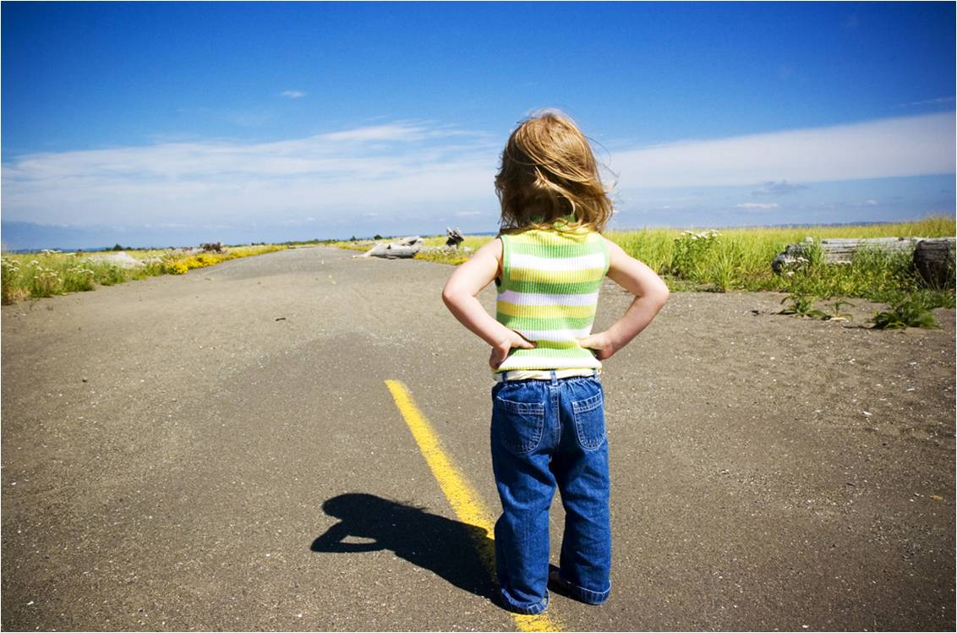
So, how does this work?
Congregations offer route for social diffusion
Receptive audience - their religious teachings align with being good stewards of natural resources (can depend on key leadership)
They need capacity help ($$, technical support, issue prioritization)
We broker capacity support in exchange for new hearts and minds
Ongoing relationships between congregations and local NGOs
IPC is not member-based

Slide 5
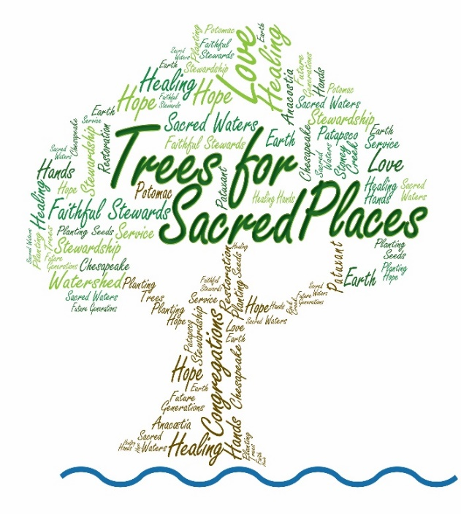



Trees for Sacred Places
Positive Outcomes:
Every planting coupled with environmental/spiritual knowledge building
13,000+ trees planted at faith-owned property = 1.3 Bgal rainwater intercepted, ~320 tons/yr CO2 sequestered
80+ congregations engaged = 5,000+ impressions
Lutheran DE-MD Synod – 500 trees for the Reformation
Ownership of the trees – 95% survival rate
Challenges:
# Trees not conducive for some settings
Funding emphasis on measurable outcomes

Slide 6


Successful Urban Initiative: Blue Water Congregations
IPC, Blue Water Baltimore – planning/implementation support from start to finish
Blue Water Baltimore performs a “Water Audit” on their site
IPC facilitates Visioning with their leadership team to decide on projects
Grant-writing support for their projects – about 50% success rate
96 Congregations engaged, 71 Water Audits
24 Visioning sessions
200K sf impervious surfaces treated
27K sf rain gardens installed
1.2K gal rainwater harvested

Slide 7
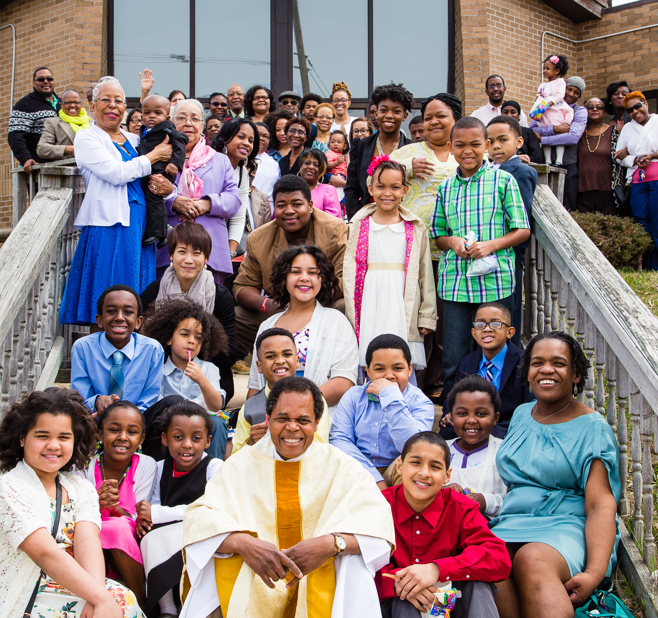
Holy Covenant Church 5657 The Alameda, Baltimore
Bernadine Coates – motivated and inspired, needed capacity support
Church – 23K sf impervious surface, Annual Runoff = 630K gallons
Treatment – 6,713 sf treated with 2 rain gardens
Design Grant – $18,680
Implementation Grant – $54,094
Feb. 5, 2015 to Fall 2017 – 2.5 years
Why is this success?
Wouldn’t have happened without our program
Community of color
Repeating actions (Legislative Summit)

Slide 8
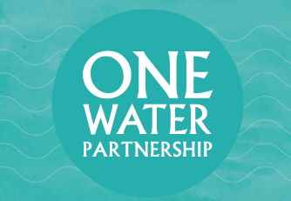
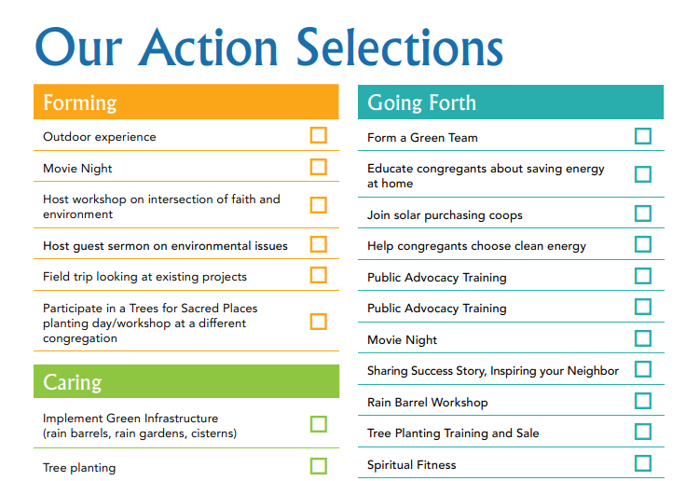
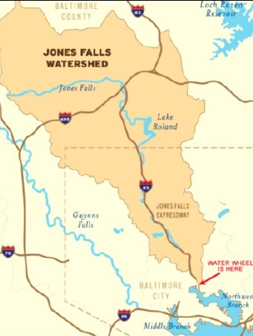
Evolution of Thinking: One Water Partnership
No one-size-fits-all
Surround congregations with partners – “personal trainers”
Teach people to love and cherish their own sub-watershed
Connect people to others in their sub-watershed community
Notes:
Work with 30 congregations over 2 years
15 will…
Form green committees
Sign a covenant with each other
Install 1 project on their grounds
Pick 3 other projects from a Menu of Actions

Slide 9
How is IPC Funded?
2017 Budget ~$350,000

Slide 10

How to Partner with IPC?
IPC as a Recruiter
Hire IPC to help you recruit congregations for your programs
Co-conceptualize programs where IPC’s role is funded
Help us with GIS capabilities to know where large church properties are
IPC as an Educator
Partner with IPC to bring the faith-based message to your audience
get around church/state separation this way
IPC as an Advisor
Behind-the-scenes advisor on program development
Help train your staff on religious/cultural sensitivity
IPC as Pipeline Builder
Help us reach more people – exposure, e-shares
Capacity-building so we can draw in more audiences

